Slide 1
Looking for support with developing your primary care workforce?
The HETV Workforce Development Tutors can help

Slide 2
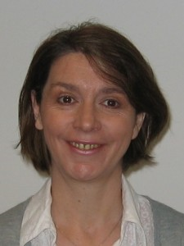
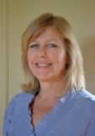
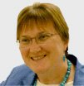
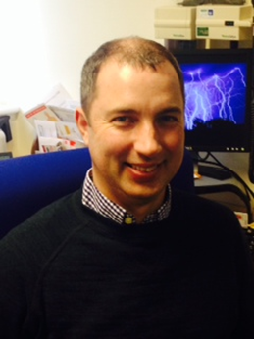
Who are we;
Maggie Woods
Ann Howard
Sue Lacey-Bryant
Michael Mullholland

Slide 3
What do we do? We….
work with practices and CCGs to understand and identify their workforce education and development needs as they transform primary care
signpost them to excellent education and development opportunities
provide checklists to help choose continuing education providers
share best practice and innovations across HETV
can connect you to other colleagues and resources

Slide 4
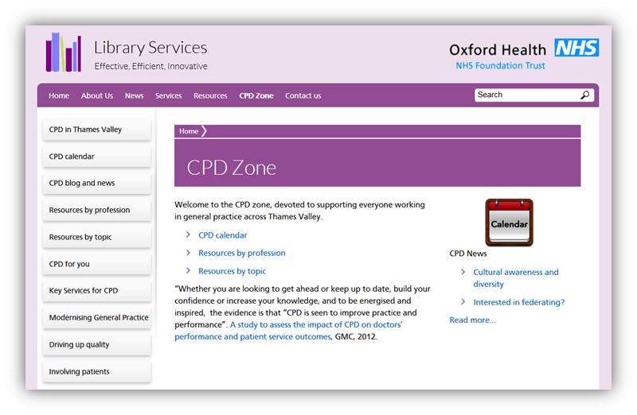
The go to place for primary care….

Slide 5
http://www.oxfordhealth.nhs.uk/library/cpd-zone/
For resources that support the continuous development of the primary care workforce go to the CPD zone at :
It contains……
Calendar of upcoming CPD events for general practice
Blog, News for primary care, and more
Link to CPD resources by Topic
Link to CPD resources by profession
Connect to people and organisations
Find out about best practice
Share information about new roles and ways of working

Slide 6
Contact us;
Berkshire : Maggie Woods
Maggie.Woods@tvwleadershipacademy.nhs.uk
Milton Keynes: Ann Howard
AnnDr.Howard@miltonkeynes.nhs.uk
Buckinghamshire : Sue Lacey-Bryant
Sue.LaceyBryant@thamesvalley.hee.nhs.
Oxfordshire : Michael Mullholland
michael.mulholland@nhs.net

