Slide 1
Workforce Performance Report
February 2016
Mike McEnaney
Director of Finance

Slide 2
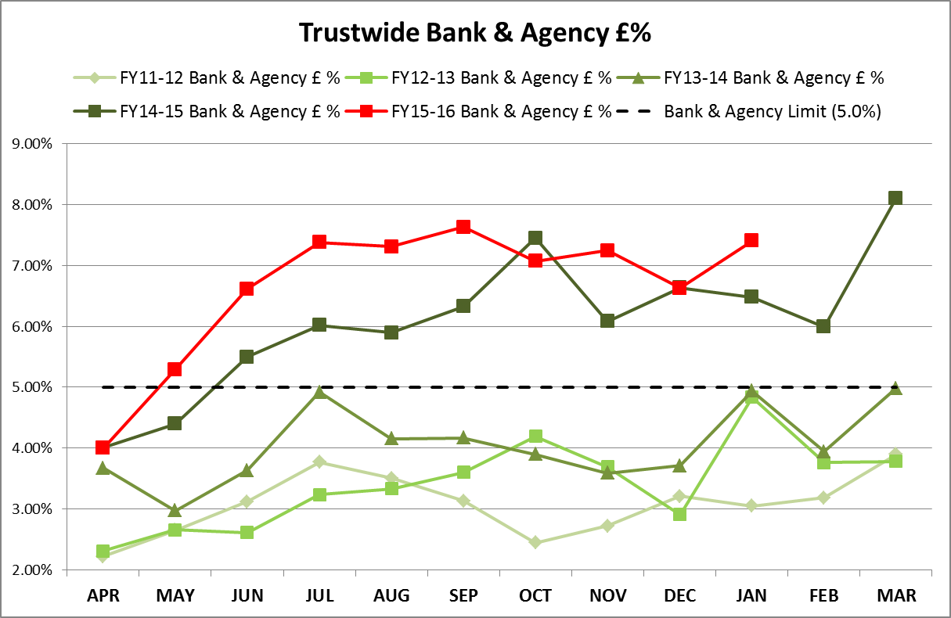
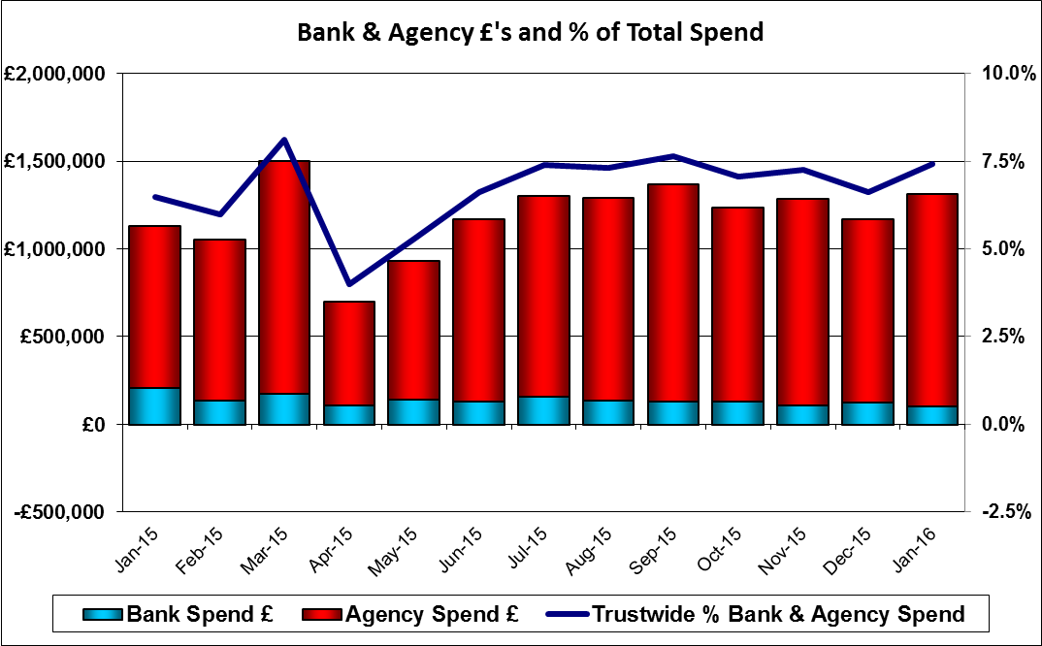
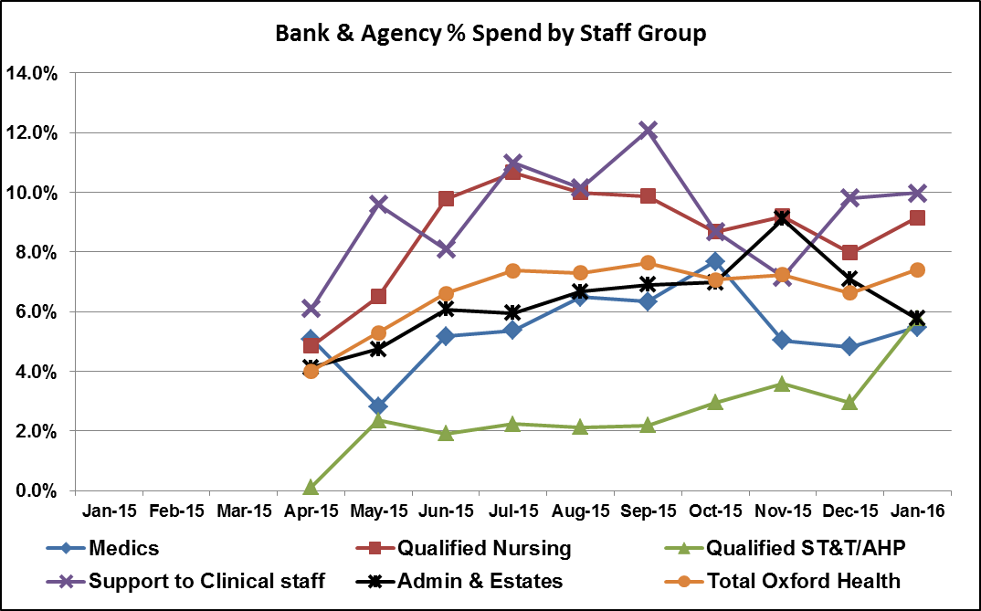
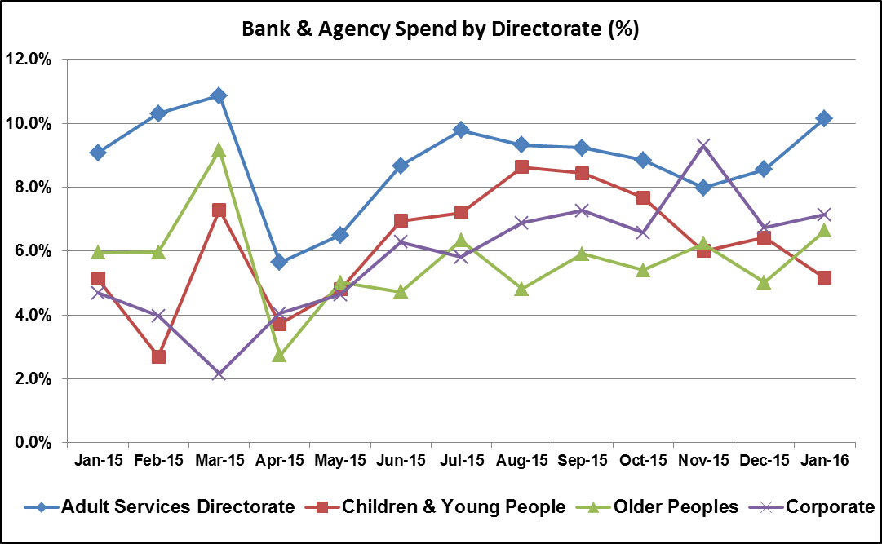
Agency spend increased by 17% between December 2015 (£1,041,345) and January 2016 (£1,213,601). The increase has been driven primarily by spend in MSK Physiotherapy, Kingfisher Ward, Oxon Assessment & Treatment teams and Winter Pressures, with the top 10 units (by month-on-month increase) generating an additional £267,328 in Agency spend alone. However, the MSK Physiotherapy spend is for staff on two projects covering (i) Reduced Waiting Lists and (ii) Fast Track Access – both initiatives are being externally funded.
Bank & Agency Spend
Target: 5.00%
This Month: 7.41%
Last Month: 6.63%
Last Year: 6.48%

Slide 3
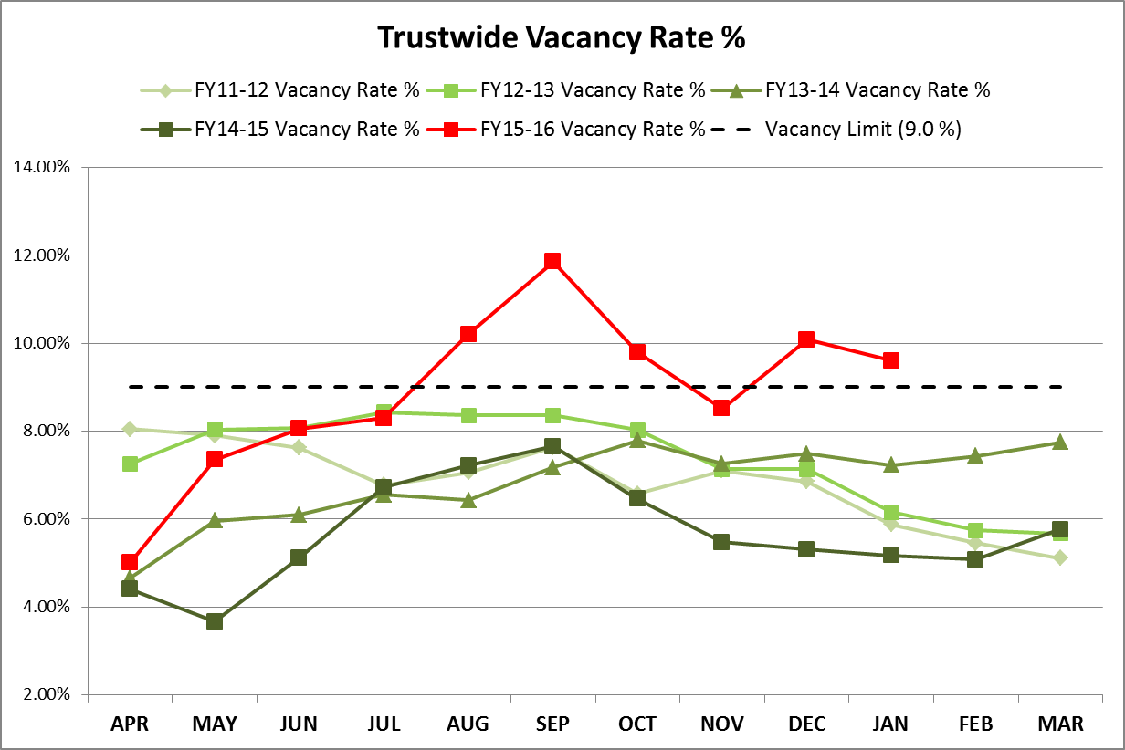
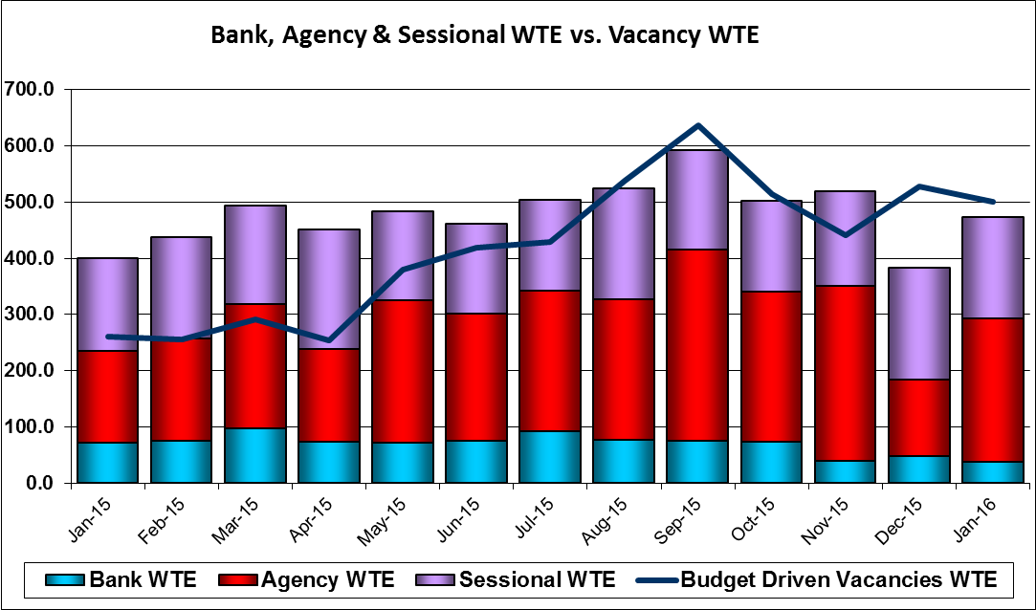
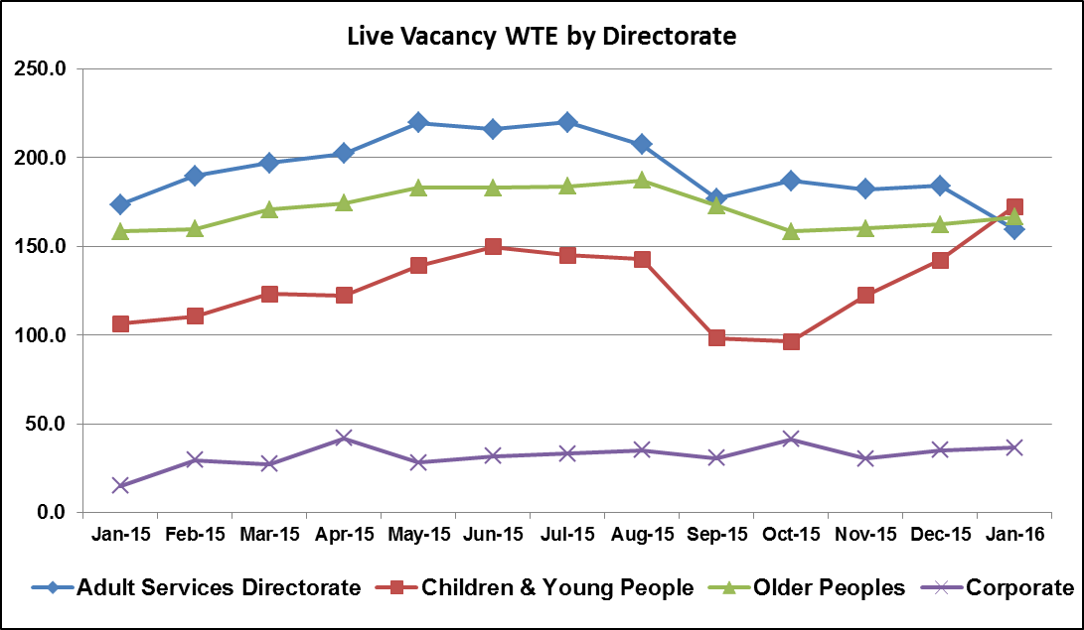
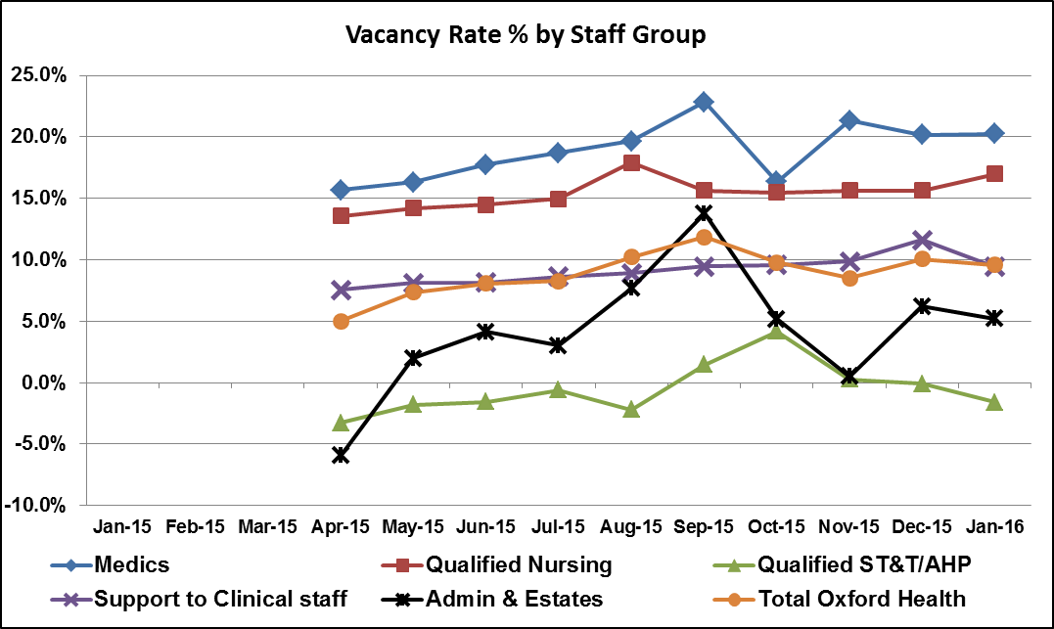
Vacancy
After the increase in December, the vacancy rate has dropped to 9.6% in January to bring the rate close to the Trust target. Without the new round of recruitment activity in the Children & Young People’s Directorate for Student Health Visitors and Student School Nurses it is likely that the Trust would have achieved its target of 9.0%.
Target: 9.00%
This Month: 9.6%
Last Month: 10.08%
Last Year: 5.17%

Slide 4
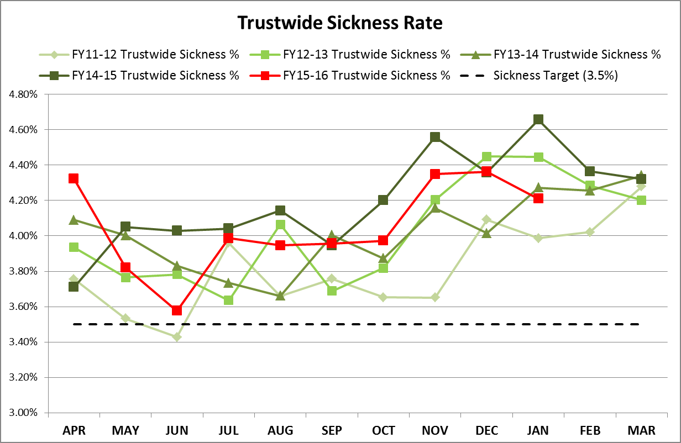
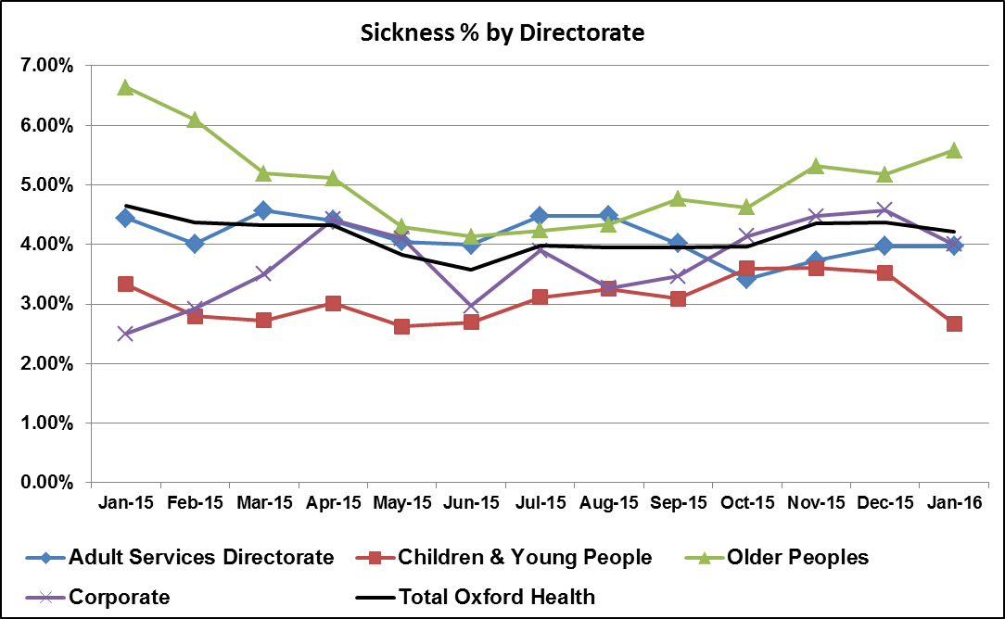
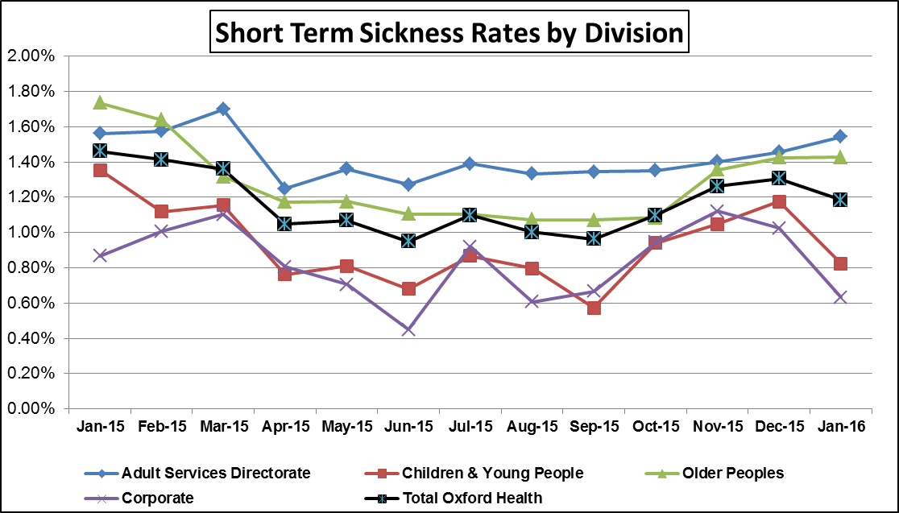
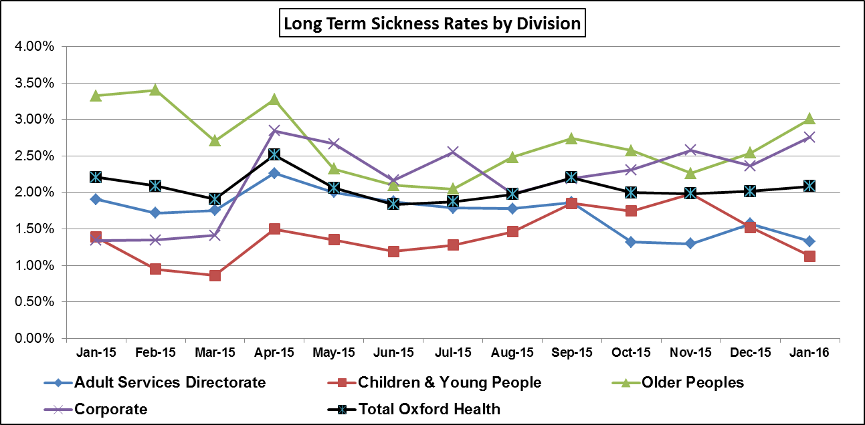
The Trust Sickness Absence rate remains above the Trust target. The seasonal trend is consistent showing an increase through the winter months and the 4.36% rate in December 15 is the same as last year. However, January has seen a notable decline to stand at 4.21% compared to a December figure of 4.36%. This decline results from a mild winter and combined HR and management pressure to reduce periods of short term sickness.
Sickness
Target: 3.50%
This Month: 4.21%
Last Month: 4.36%
Last Year: %

Slide 5
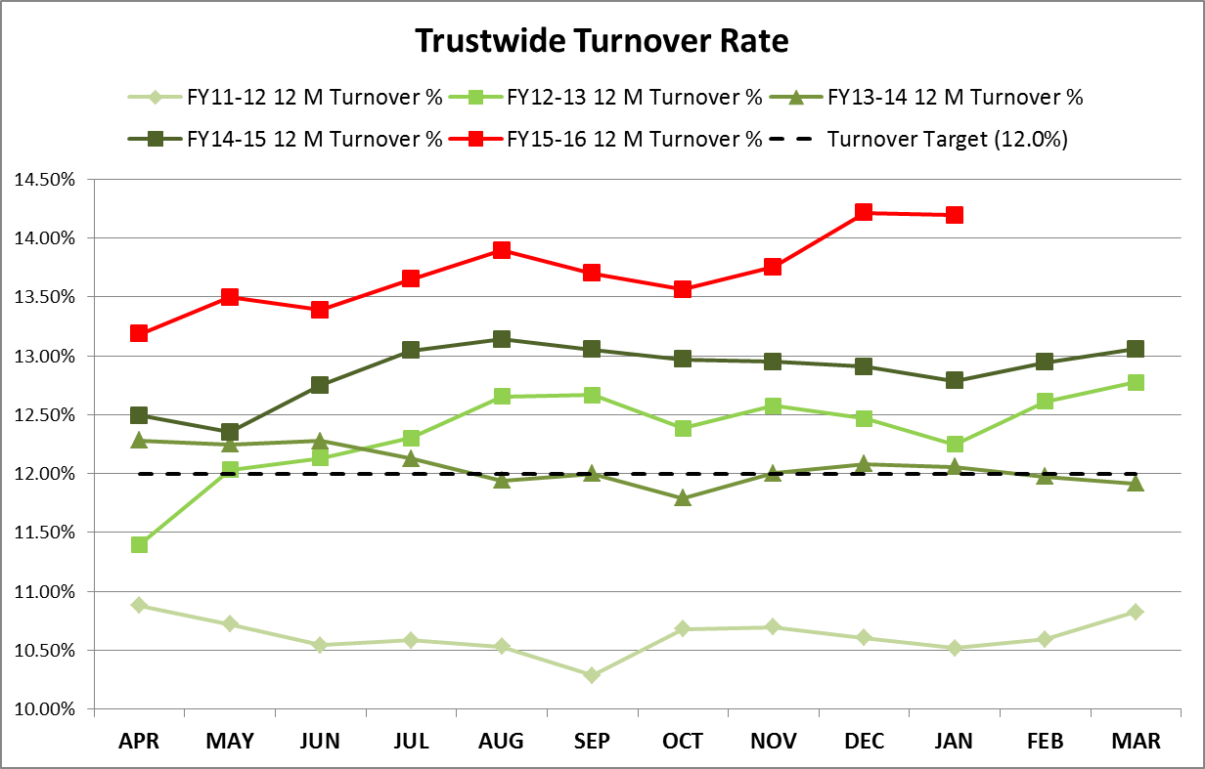
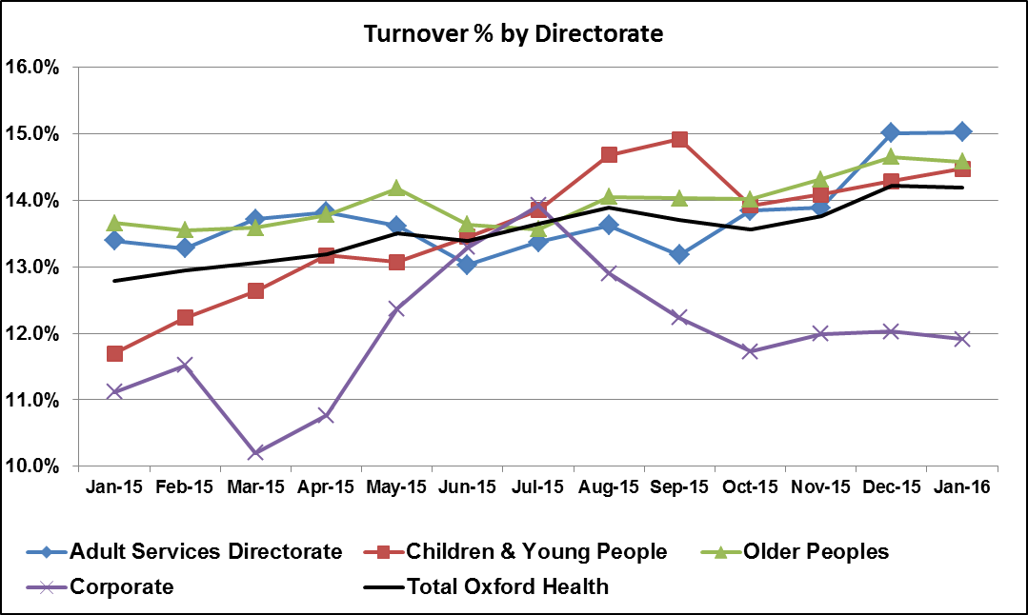
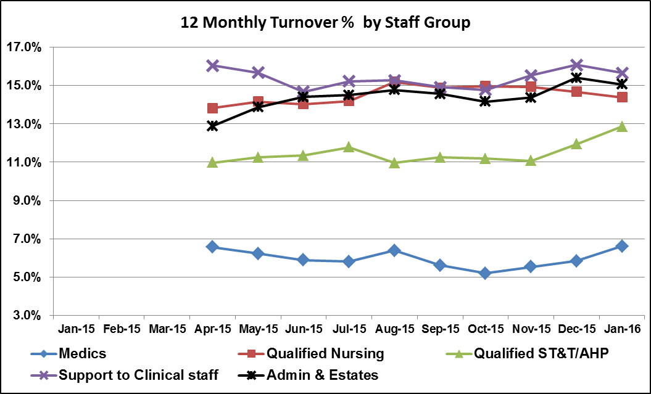
After a steady increase over the last few months, the Turnover rate has leveled off at 14.22% in December and 14.20% in January. In January, Adult Services (15.03%) had the highest rate followed by Older Peoples Directorate (14.58%) and Children & Young People (14.47%). The high rate of Turnover will prolong the high requirement for agency staff and continue to challenge recruitment in a difficult labour market.
Turnover
Target: 12.00%
This Month: 14.20%
Last Month: 14.22%
Last Year: 12.79%

Slide 6
Appendix

Slide 7
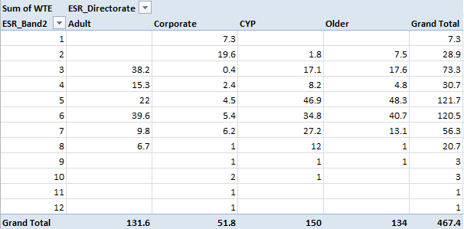
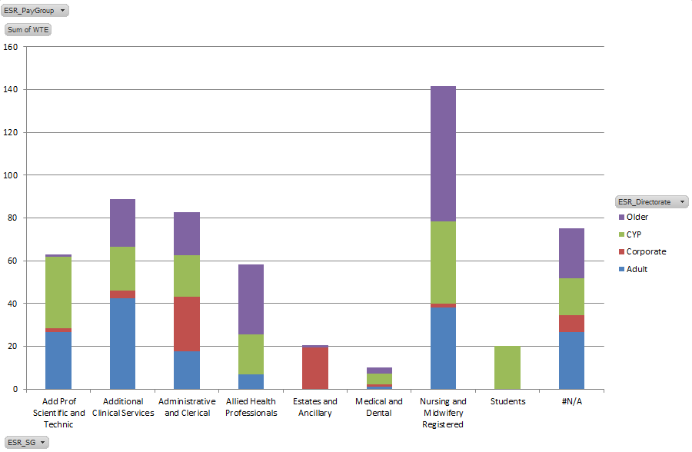
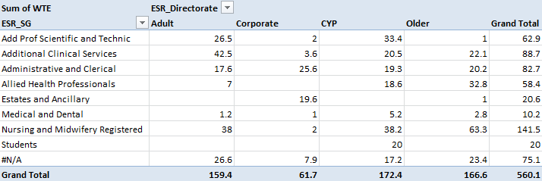
Vacancy – Staff Group by Directorate

