Slide 1
Workforce Performance Report
May 2016
Mike McEnaney
Director of Finance

Slide 2
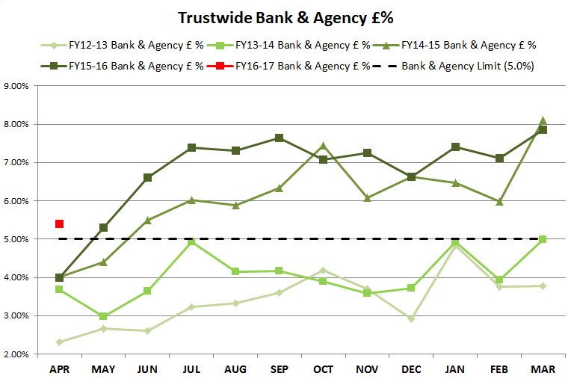
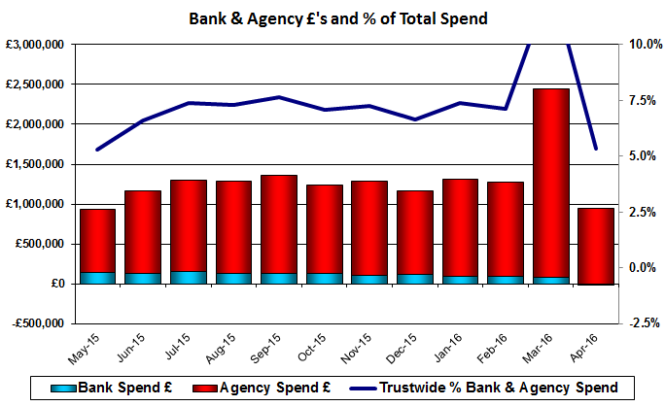
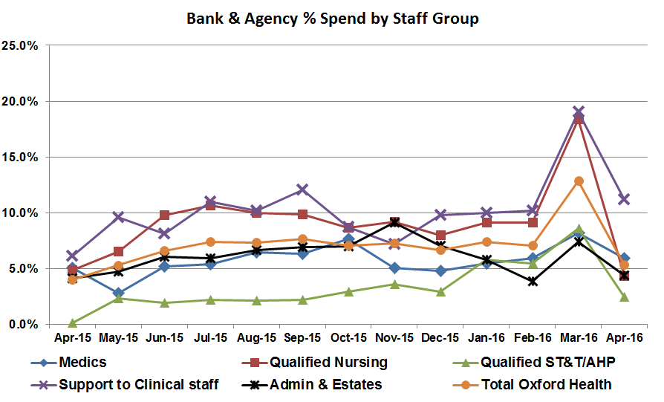
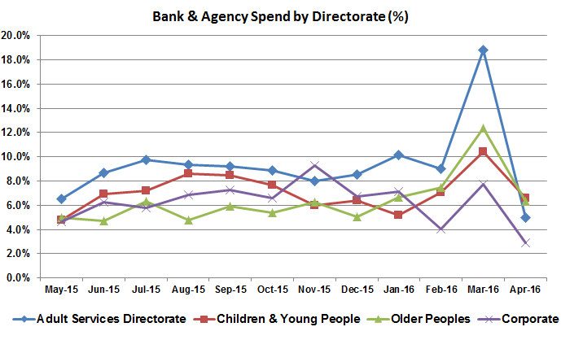
Bank and Agency Spend has decreased in April to 5.35% from the adjusted spike of 7.85% in March. Whilst a significant decline, it leaves the Bank and Agency Spend above target at the start of the new Financial Year when, in all previous years, it had started below target at 4% in Financial Year 15-16 and Financial Year 14-15.
Sessional spend has increased from 2.4% in March to 4.2% in April.
Bank & Agency Spend
Target: 5.00%
This Month: 5.35%
Last Month: 7.85%
Last Year: 4.00%

Slide 3
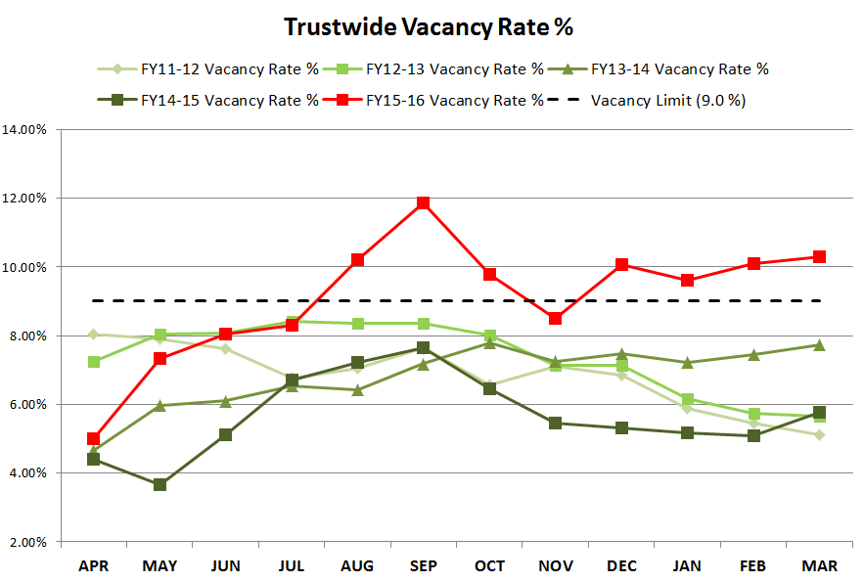
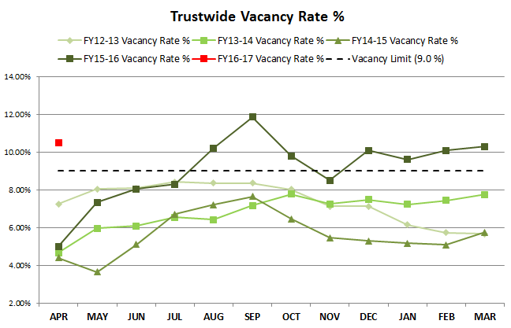
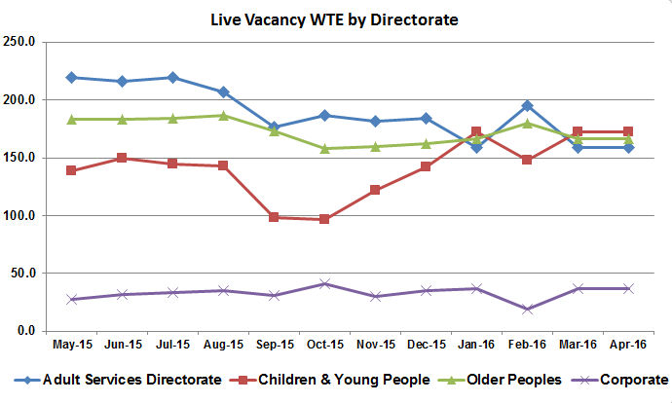
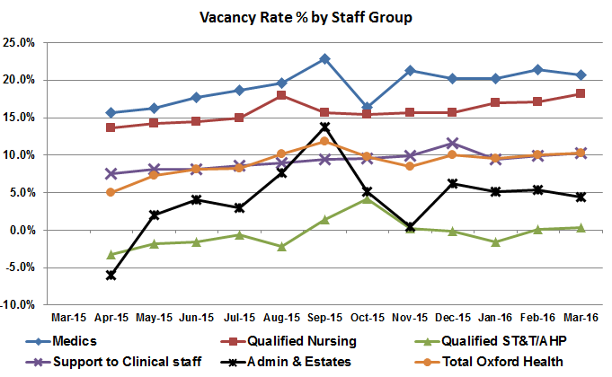
Vacancy
The Vacancy rate has increased slightly to 10.48% in April from 10.30% in March. The Recruitment team are working closely with managers to fill vacancies especially in difficult to recruit-to-areas such as Staff Nursing and Healthcare Assistants for the Highfield and Senior Mental Health Practitioners within the Community Teams and Thames House and Community Psychiatric Nurses for both Oxford City and Chiltern Adult Mental Health Teams.
Target: 9.00%
This Month: 10.48%
Last Month: 10.30%
Last Year: 5.01%

Slide 4
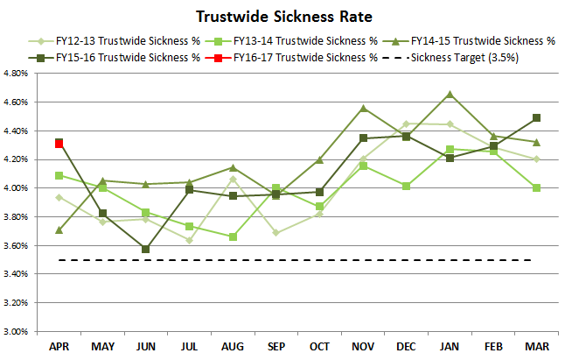
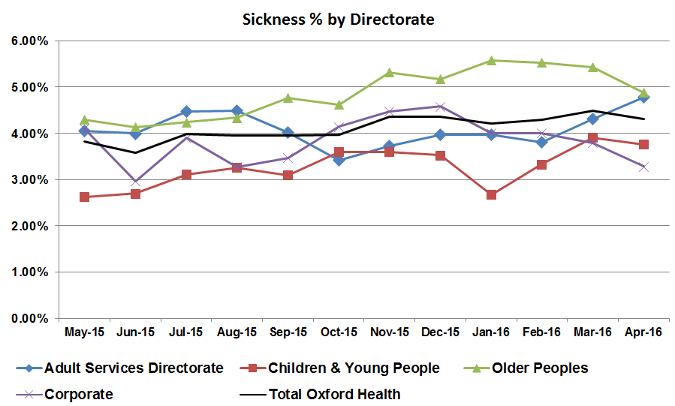
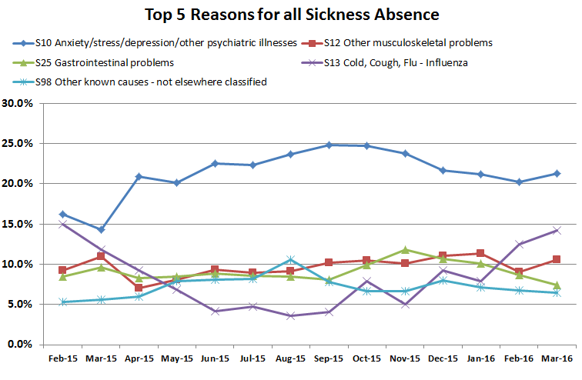
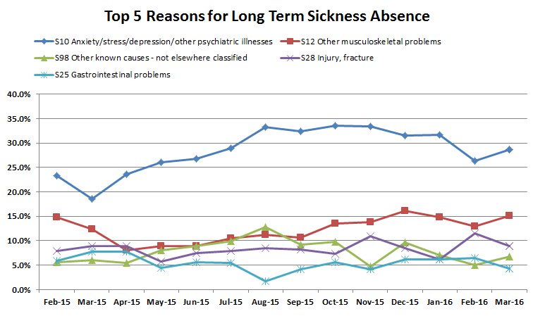
Sickness has decreased slightly to 4.31% from 4.49% in March. A decline in Older Peoples Directorate has been offset by an increase over the last two months in the Adult Services Directorate. The decline results from a reduction in absence due to seasonal cold and flu.
Sickness
Target: 3.50%
This Month: 4.31%
Last Month: 4.49 %
Last Year: 4.32%

Slide 5
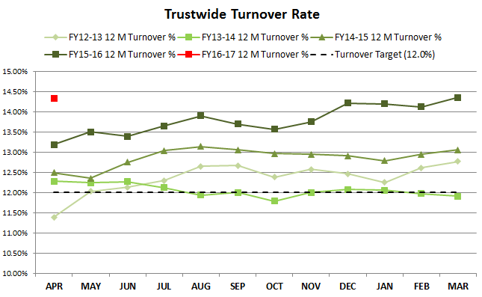
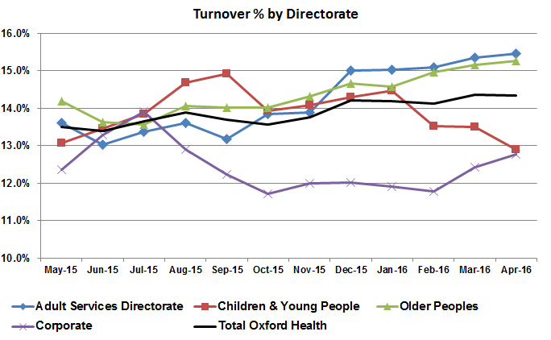
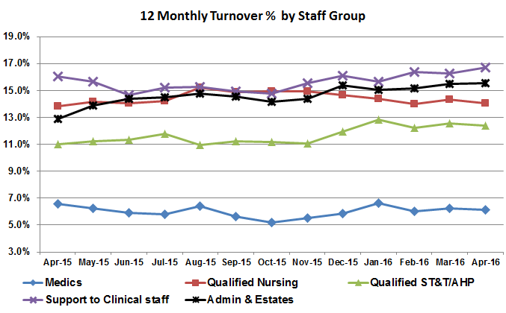
Turnover has remained unchanged at 14.33% against a value of 14.35% in March. However, turnover has increased in the Adult, Older Peoples and Corporate Directorates but this increase has been offset by a marked decline in the Children and Young People Directorate over the past three months.
Turnover
Target: 12.00%
This Month: 14.33%
Last Month: 14.35%
Last Year: 13.18%

