Slide 1
Workforce Performance Report
August 2016
CG 24/16
Agenda Item: 11
Mike McEnaney
Director of Finance

Slide 2
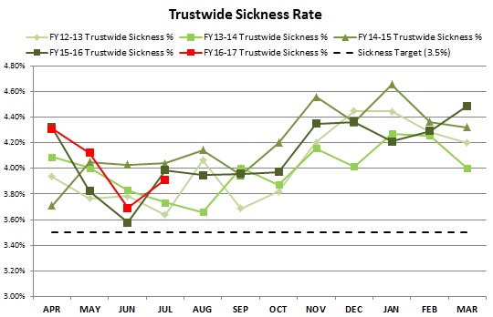
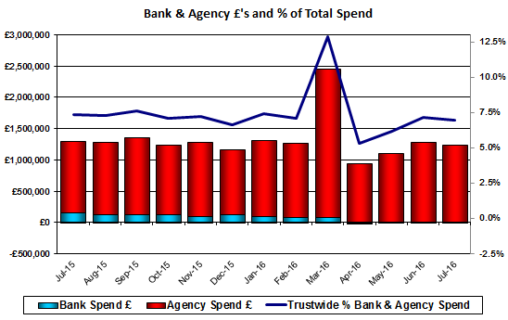
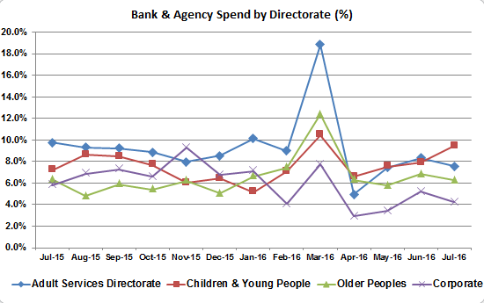
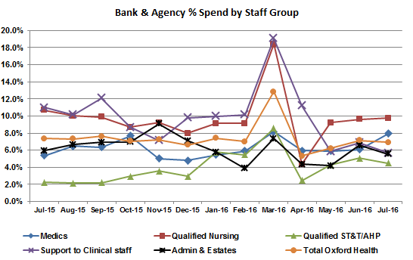
After a significant increased since April, Bank & Agency spend has decreased slightly in July to 6.93%. These figures now relate purely to Agency spend following the absorption of NHS Professional staff into the Trust. The increase has applied to all Directorates.
Bank & Agency Spend
Target: 5.00%
This Month: 6.93%
Last Month: 7.16%
Last Year: 7.31%

Slide 3
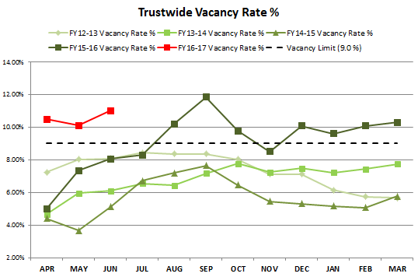
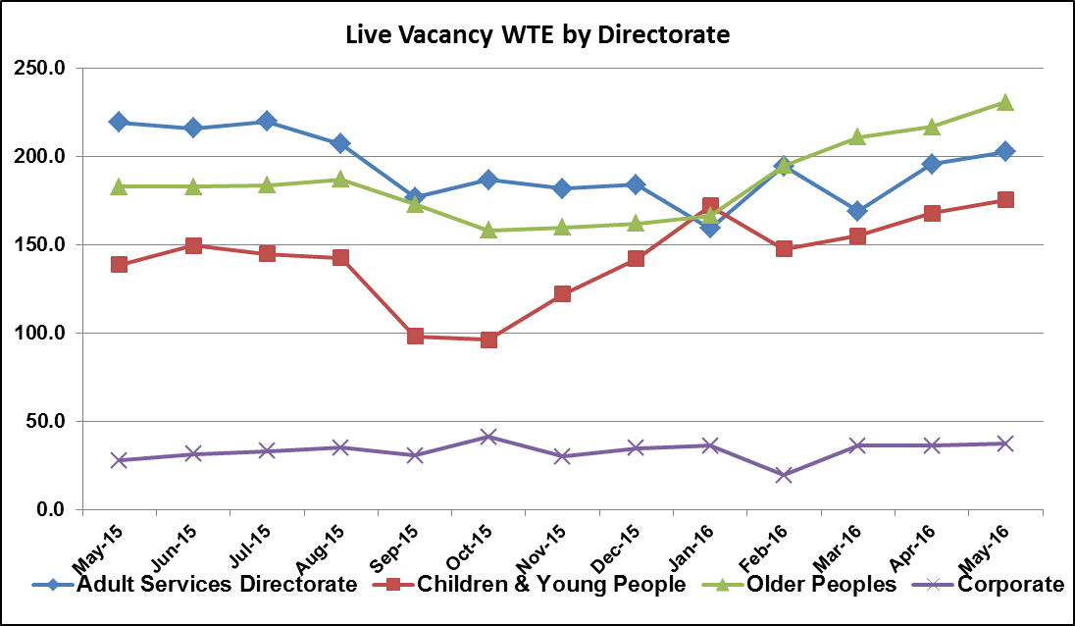
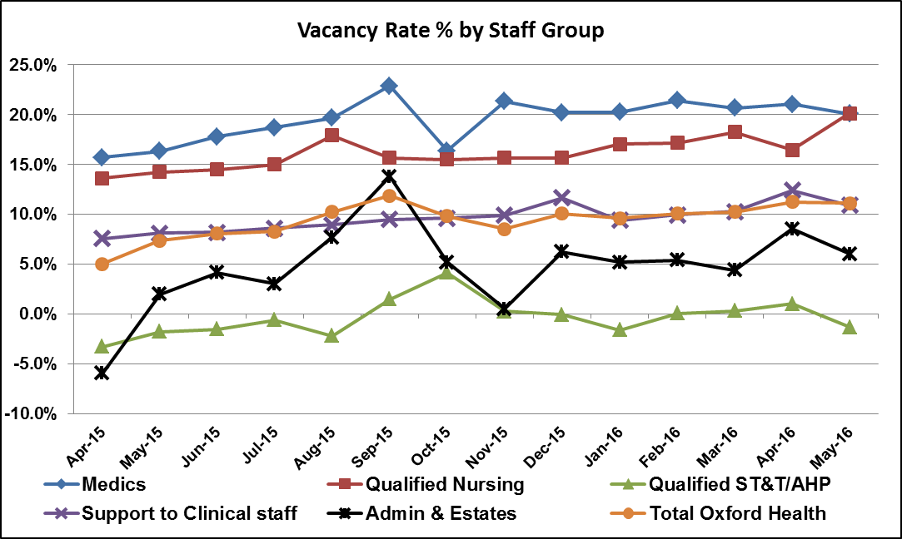
The Vacancy rate has increased to 11.02% in June from 10.10% in May. Vacancy demand has increased in all directorates except Corporate and follows the annual trend of increased staff intake over the summer.
Vacancy
Target: 9.00%
This Month: 11.02%
Last Month: 10.10%
Last Year: 7.35%

Slide 4
Recruitment Figures July 2016
Vacancy Stats
Directorate: | Total Number of Vacancies: | Live: (adverts pending) | Shortlisting: | At Interview: | Vacancies at Offer: | Number of Candidates going through pre-employment checks : | Candidates Cleared: | Candidates with a start date:
Adult Services | 226 | 103 (3) | 12 | 25 | 15 | 64 | 29 | 17
Children and Young People | 250 | 44 (1) | 28 | 17 | 43 | 116 | 42 | 30
Corporate | 82 | 31 (2) | 6 | 6 | 8 | 24 | 8 | 4
Older People | 293 | 66 (3) | 26 | 15 | 21 | 148 | 40 | 15
Grand Total: | 851 | 244 | 72 | 63 | 87 | 352 | 119 | 66

Slide 5
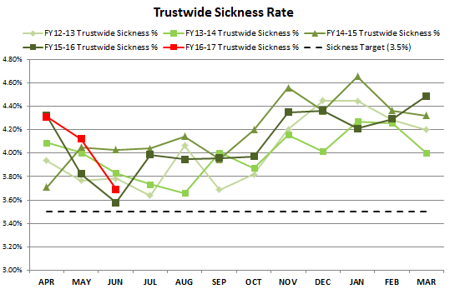
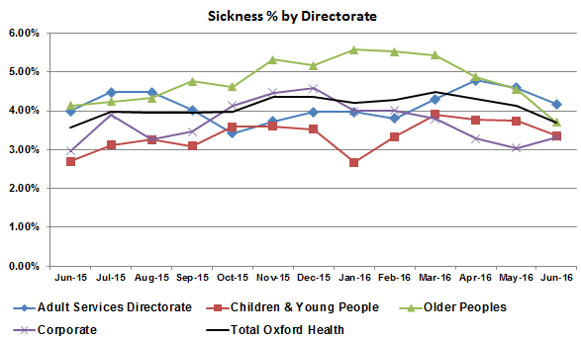
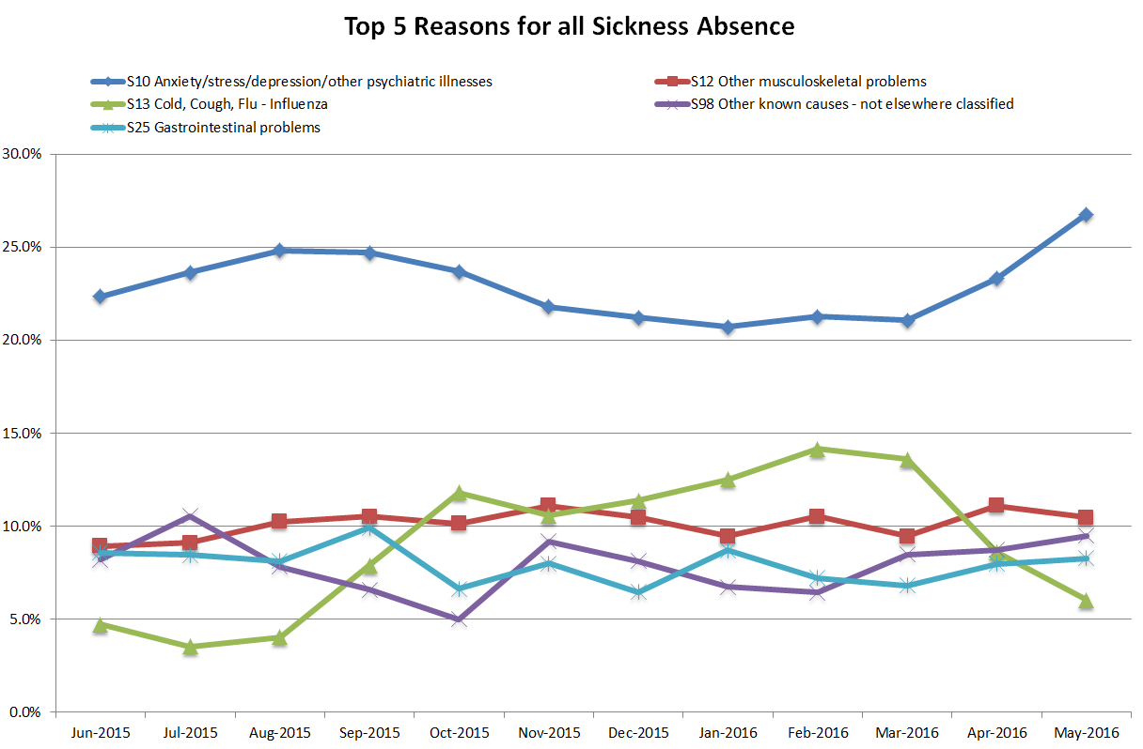
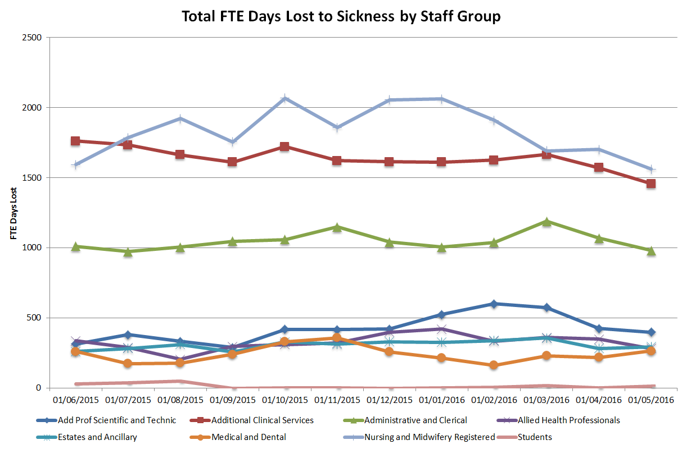
Sickness has decreased significantly over the last two months from 4.31% in April to 4.12% in May and 3.69% in June. The decline is driven by a reduction in days lost to ‘Cold, Cough and Flu’. However, there has been a notable increase in days lost to ‘Anxiety/Stress/Depression’ over the last two months.
Sickness
Target: 3.50%
This Month: 3.69%
Last Month: 4.12%
Last Year: 3.58%

Slide 6
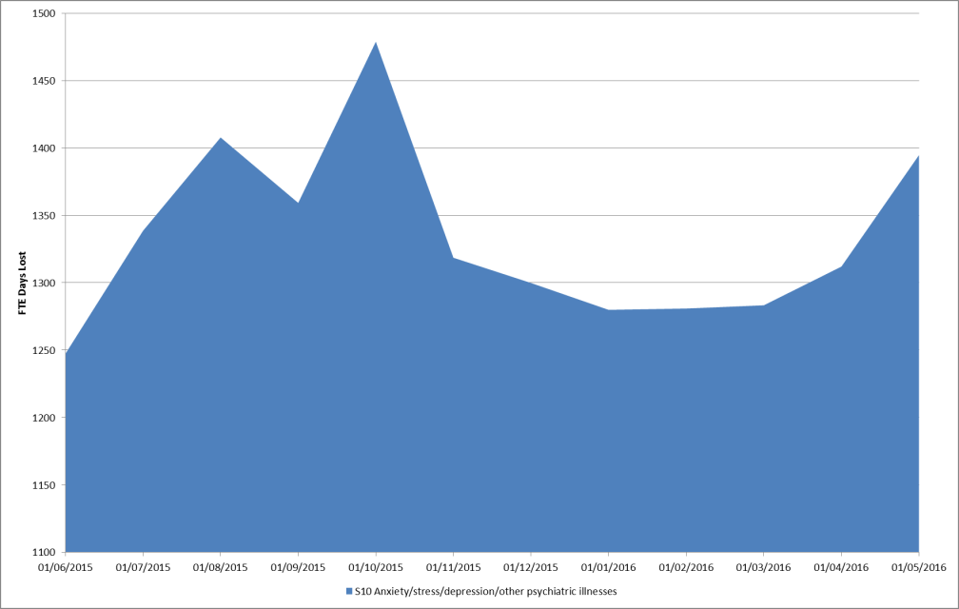
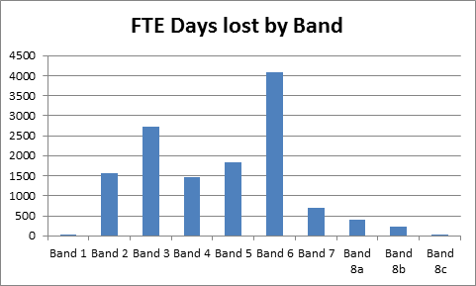
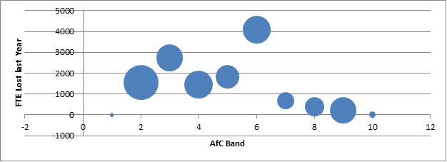
Absence days lost to Anxiety/Stress/Depression’ has increased significantly over the last two months.
The greatest impact in terms of FTE days lost to the Trust is from Bands 3 and 6.
Absolute FTE Days Lost
The bubble diagram displays the FTE days lost on the vertical axis whilst the size of the bubble denotes the percentage of FTE days lost to Anxiety/Stress relative to the total sickness lost for each Band.

Slide 7
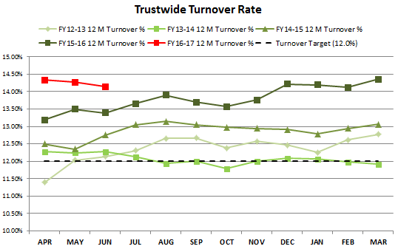
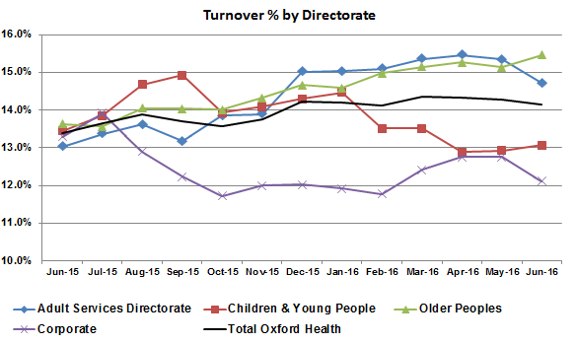
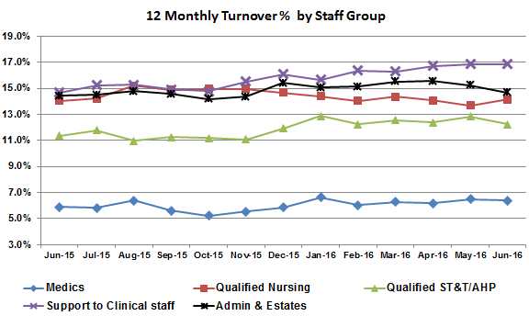
Turnover has decreased to 14.14% in June compared to 14.27% in May. The reduction has been driven by declines in the Adult and Corporate Directorates. This downward trend is likely to reverse given the intake of staff over the summer months.
Turnover
Target: 12.00%
This Month: 14.14%
Last Month: 14.27%
Last Year: 13.39%

