Slide 1
Workforce Performance Report
October 2016
Mike McEnaney
Director of Finance

Slide 2
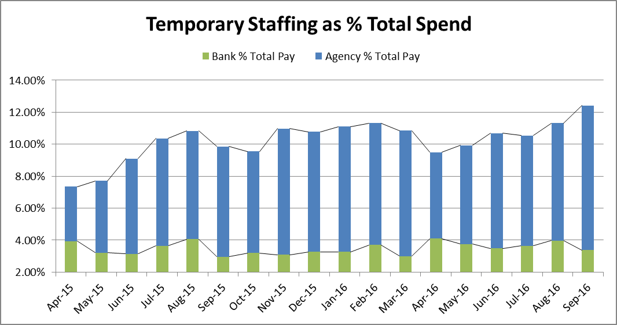
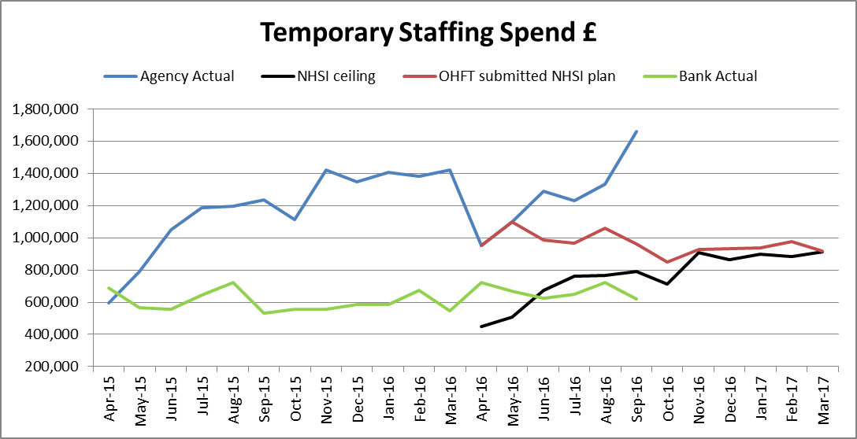
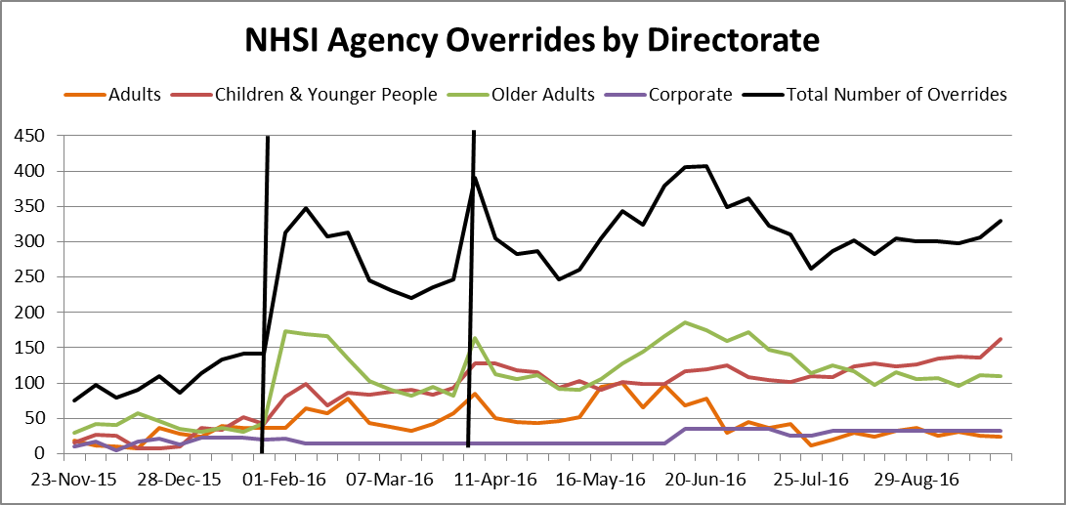
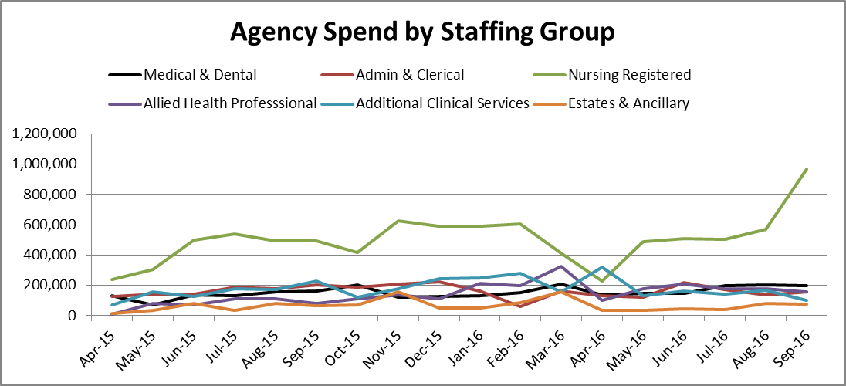
There is a lag of approximately one month in agency spend due to reporting from invoicing compared to Bank. Therefore the increase in Agency spend is August is reflective of the August holiday season, where as Bank spend in September decreased. August’s increase in temporary staffing spend correlates with an increased vacancy rate of 10.2% compared with 8.2% in July. The increase in agency spend in September was due to a continued increase in Registered Nursing spend.
Temporary Staffing Spend
This Month: 12.42%
£2.282m
Last Month: 11.31%
£2.055m
Last Year: 9.86%
£1.766m
Reduction
Reduction

Slide 3
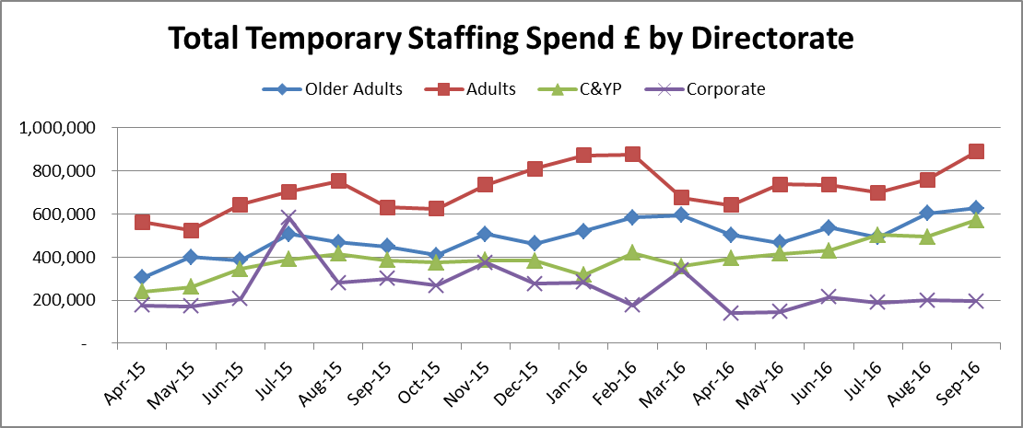
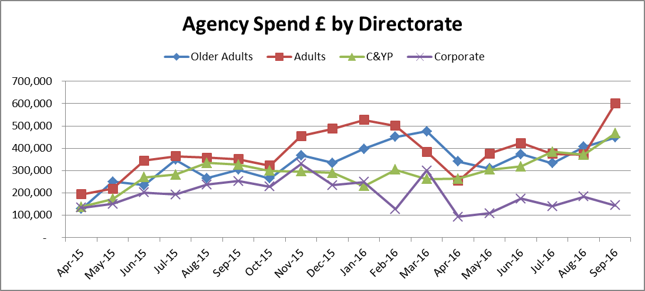
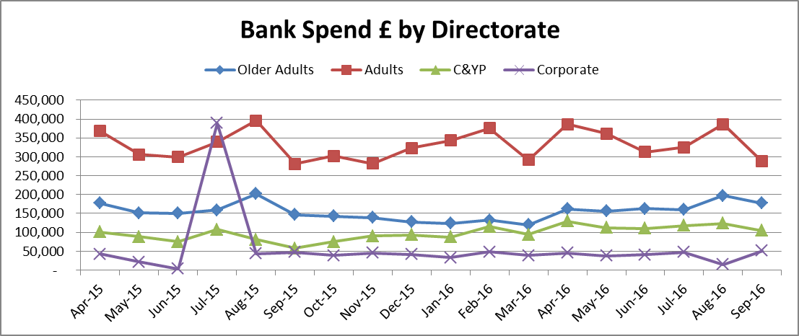
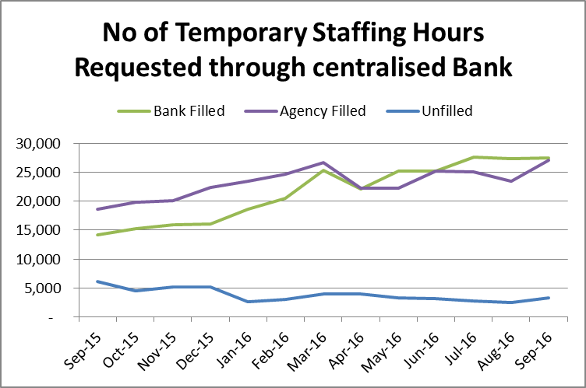
Temporary Staffing Spend
Temporary Staffing , especially agency spend increased significantly in the Adults directorate and across all operational directorates. This is likely to be due to the delay in invoices from staffing used in August, where as bank spend (used in September) declined. The top contributors to agency spend, which is 110% above the NHSI ceiling, are, SWB CAMHS medical, Oxford PCHAMS, Oxford City & NE Treatment AMHT, Podiatry service, Thames House, Continuing Care for Adults, Bucks South Treatment AMHT and the Highfield.

Slide 4
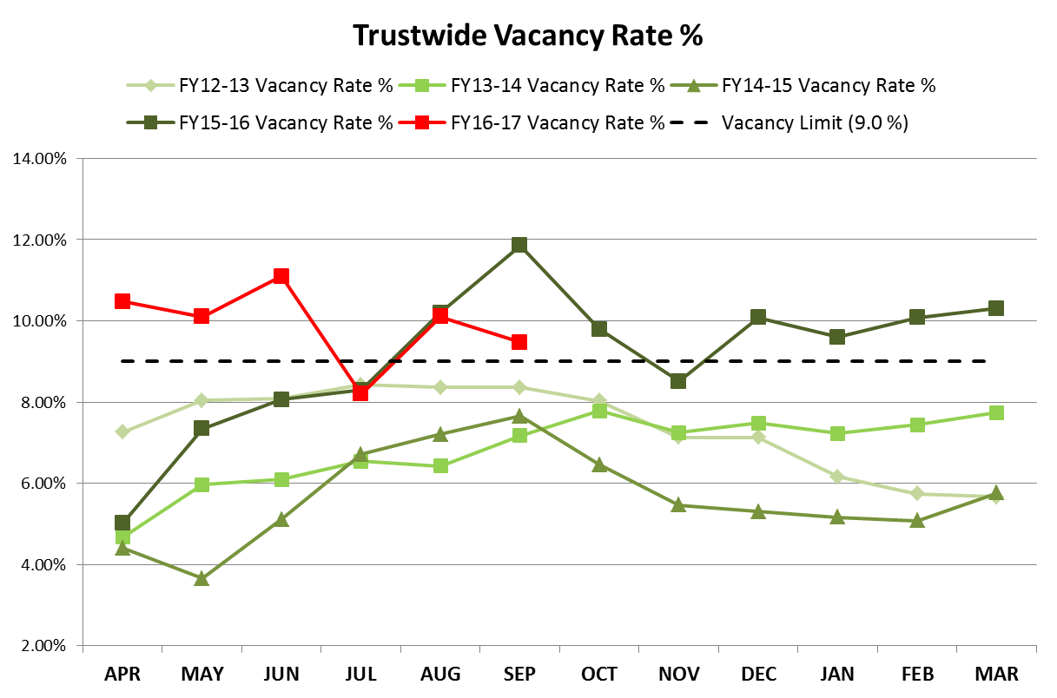
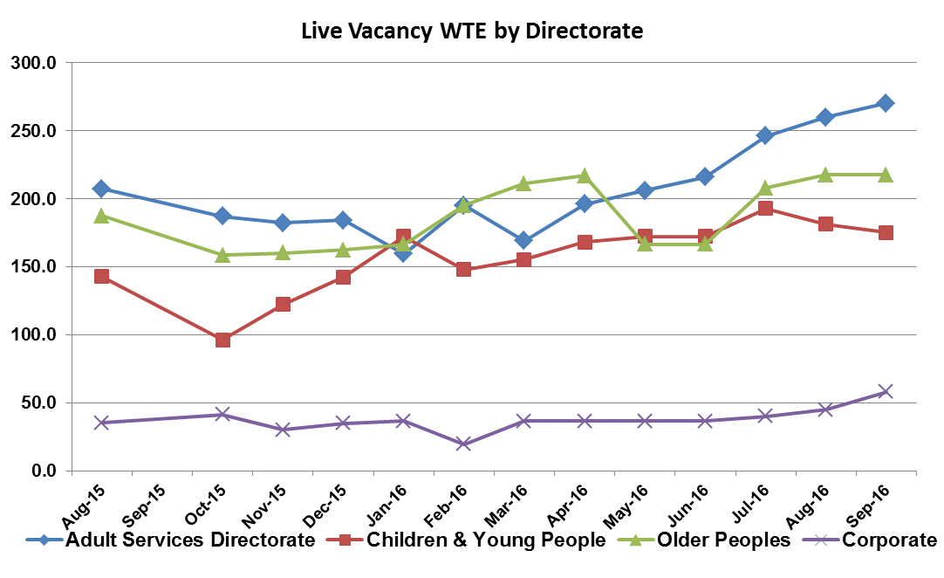
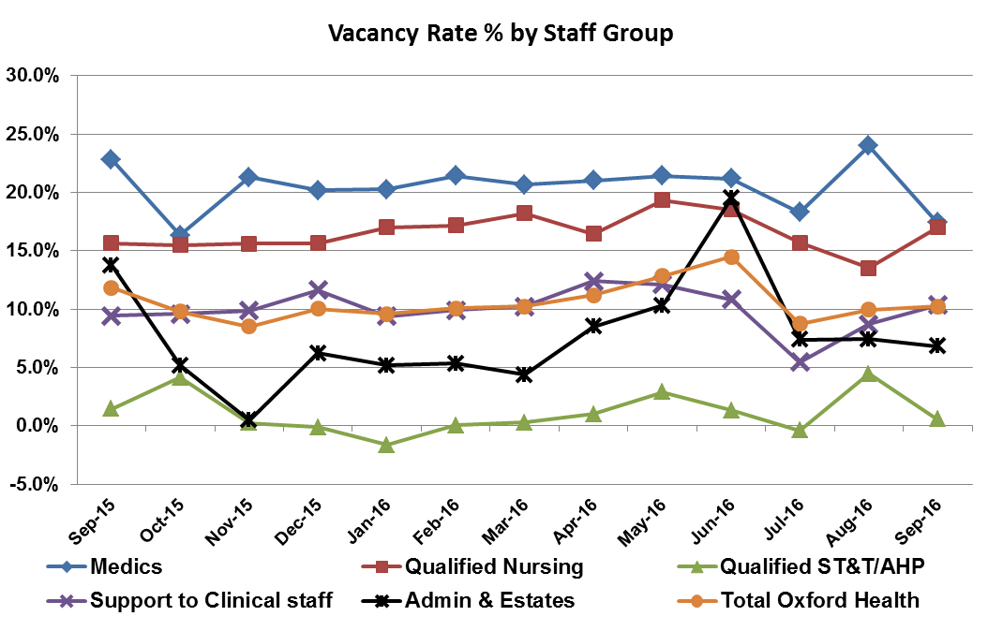
The Vacancy rate decreased to 9.47% in September compared to 10.10% in August. The main driver for the decrease has been the summer intake of Medics and a reduction in the vacancy rate for Allied Health Professionals (AHP).
Vacancy
Target: 9.00%
This Month: 9.47%
Last Month: 10.10%
Last Year: 11.85%

Slide 5
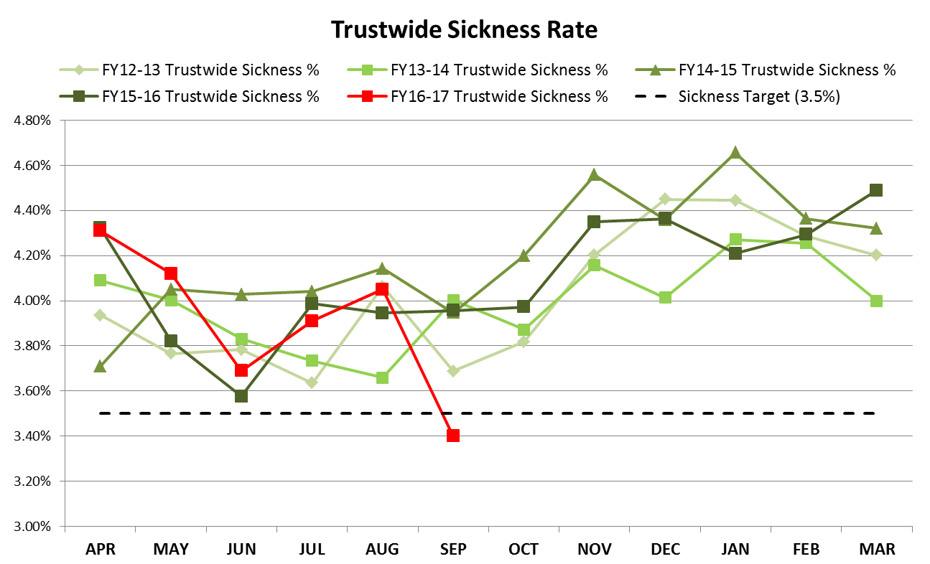
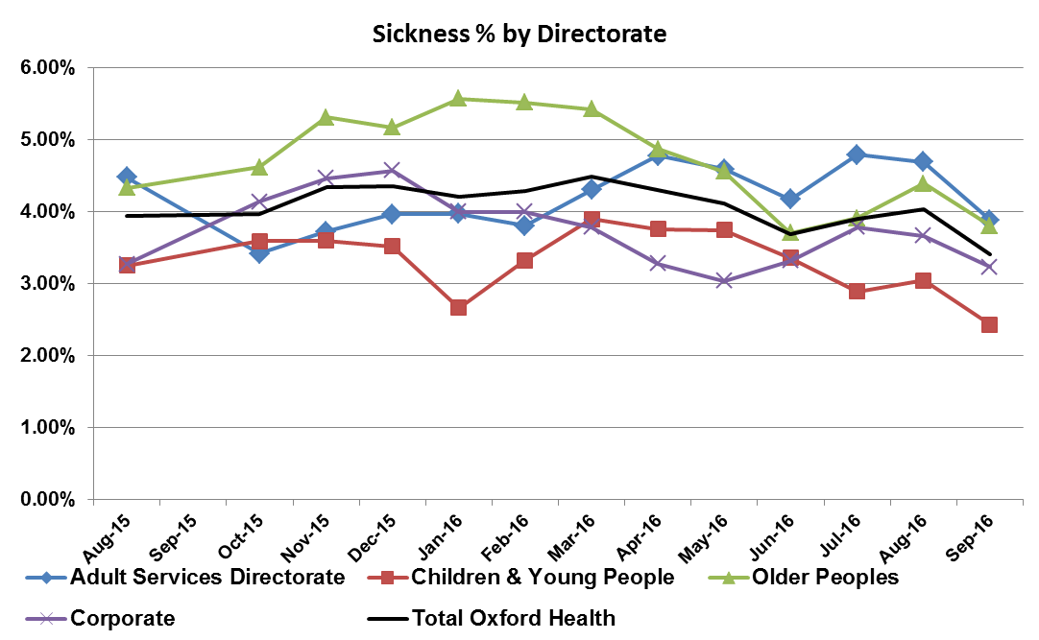
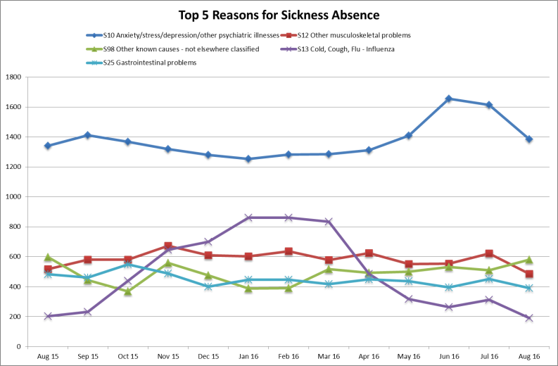
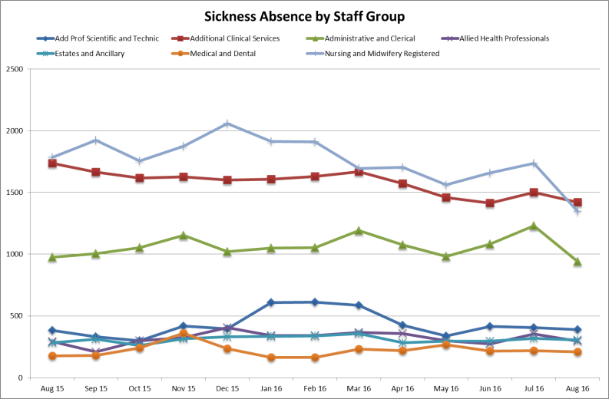
Sickness fell below the 3.5% target this month to stand at 3.4%. This significant decline resulted from a 14.2% fall in absence due to ‘Anxiety/Stress’, a 38% reduction in ‘Cold/Flu’. The overall decline will also be influenced by staff taking annual leave of the summer period.
Sickness
Target: 3.50%
This Month: 3.40%
Last Month: 4.05%
Last Year: 3.96%

Slide 6
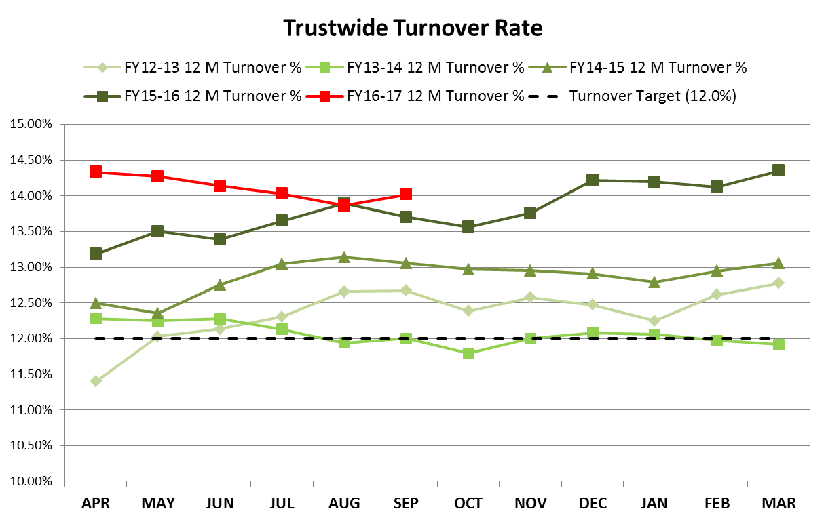
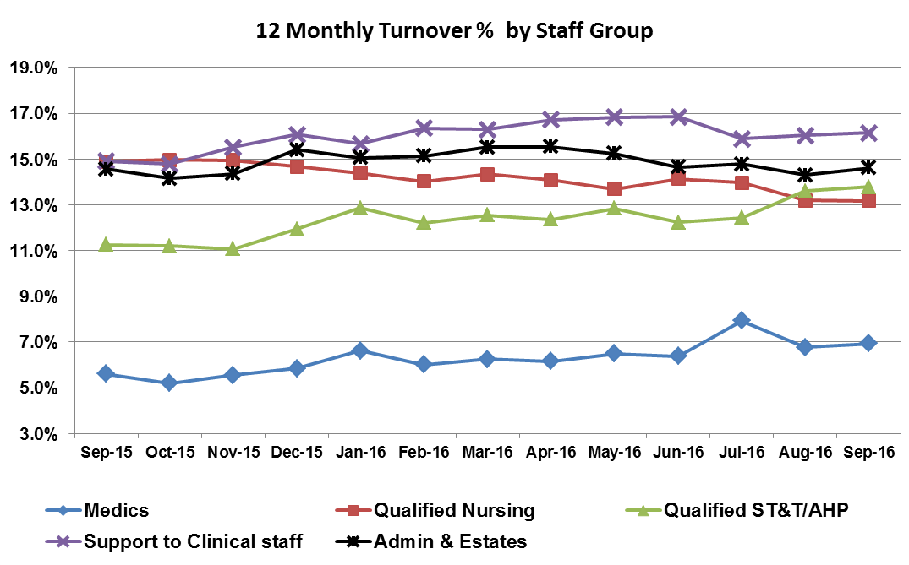
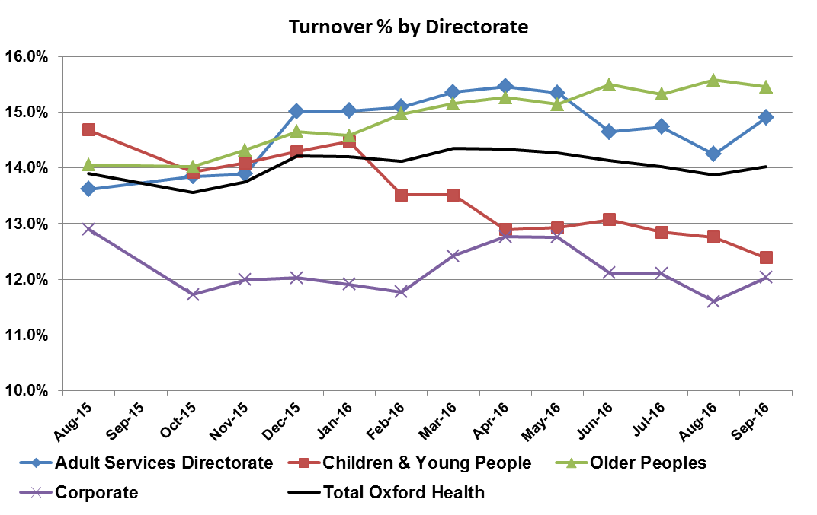
The Turnover figure has increased to 14.02% following a four month decline. The increase is driven by higher turnover in the Corporate and Adult Service Directorates but is spread evenly across all Staff Groups.
Turnover
Target: 12.00%
This Month: 14.02%
Last Month: 13.86%
Last Year: 13.70%

Slide 7
WRES 2016
Indicator | 2015 WRES | Agreed action Plan | Update
Relative likelihood of staff entering the formal disciplinary process, as measured by entry into a formal disciplinary investigation. | Relative likelihood of BME staff entering disciplinary process compared to White staff: 4.64 times greater | Extended session on Equality at Trust induction Introduction of Unconscious Bias training. Preliminary review at the earliest possible stage of any disciplinary process to ascertain if there are cultural issues that could be addressed outside the formal procedure. | Arrangements being made to pilot this in Forensic Service. It will then go to LAG. This preliminary review requires further “bedding in” in HR and arrangements are in place for this.
Relative likelihood of staff accessing non-mandatory training and CPD. | Relative likelihood of White staff accessing non-mandatory training compare to BME staff: 1.18 times greater | Action for L&D to review in 2016 | Helen Green reviewing but believes that ethnicity is not known by L&D

Slide 8
WRES 2016
Indicator | 2015 WRES | Agreed action Plan | Update
%age of staff experiencing bullying from patients , relatives | White: 28.67% BME: 27.35% | Line managers to continue to address concerns locally. Plans to set up network of ‘Fair Treatment at Work’ Facilitators under way. | Fair Treatment Facilitator training 17 October 2016. HR and union representatives inputting.
%age of staff experiencing bullying from staff | White: 22.98% BME: 26.87% | Line managers to continue to address concerns locally. A toolkit to allow managers to work with teams to address issues of local concern arising from staff survey has been implemented and feedback requested in September 2016 in the form of "You Said...We Did" Plans to set up network of ‘Fair Treatment at Work’ Facilitators under way. | Mixed response from Directorates re Staff Survey Action Planning. 2016 Staff Survey launched – review results once available. Fair Treatment Facilitator training October 2016
%age of staff believing the Trust provides equal opportunities | White: 88.8% BME: 70.51%

Slide 9
WRES 2016
Indicator | 2015 WRES | Agreed action Plan | Update
%age of staff experiencing discrimination at work | White: 6.12% BME: 16.37% | As above, line managers to continue to address concerns locally. A toolkit to allow managers to work with teams to address issues of local concern arising from staff survey is available. Plans to set up network of ‘Fair Treatment at Work’ Facilitators under way. E&D Lead in conjunction with HR and L&D will explore options for schemes to coach, mentor and provide shadowing opportunities at work to support the career advancement of staff from BME backgrounds. | As above, mixed response from Directorates re Staff Survey Action Planning. Training in October 2016. No update
Percentage difference between the organisations’ Board voting membership and its overall workforce. | -14.3

Slide 10
WRES 2016
Indicator | 2015 WRES | Agreed action Plan | Update
%age of staff experiencing discrimination at work (continued) Percentage difference between the organisations’ Board voting membership and its overall workforce. | -14.3 | E&D Lead to explore options for WRES Roadshow/ event during Black History Month Board to consider options to increase diversity (Associate Director role) | October 2016 - Trust celebrating its rich cultural diversity by marking Black History Month for the first time with events at Whiteleaf and LMHC. No update
Percentage difference between the organisations’ Board voting membership and its overall workforce. | -14.3

