Slide 1

Workforce Performance Report
October 2013
Jayne Halford
Deputy Director of HR
Caring, safe and excellent

Slide 2
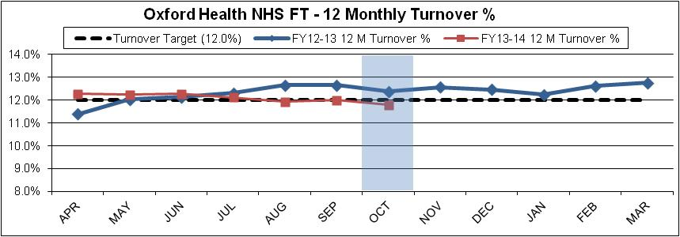
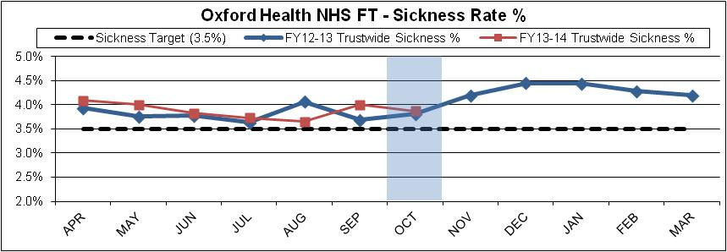
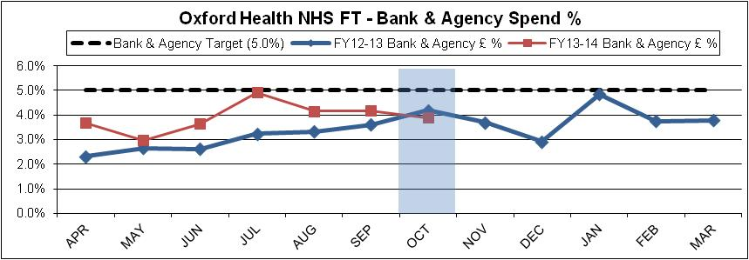
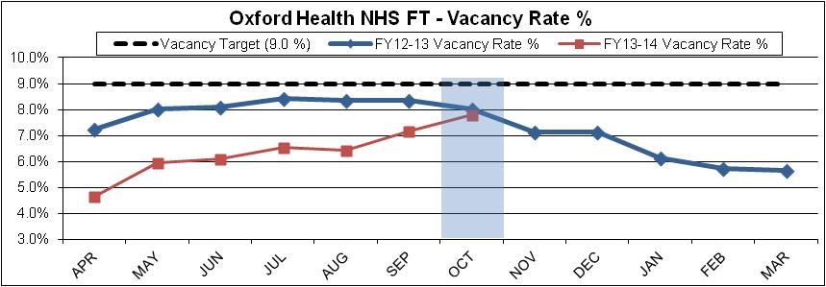
Headline HR KPIs
Turnover – Target 12% - Actual 11.79%
Turnover is at its lowest for a considerable period of time and continues to be a largely downward trend.
The stability figure has remained at around the 85% plus for the majority of the year . Nationally stability appears to be around the 90% mark, so although 85% represents a core stable workforce we could improve on this figure.
Sickness – Target 3.5% - Actual 3.87%
Sickness has also decreased after a seasonal peak last month but is still slightly higher than October 12. Long term absence is at 1.86% which is the lowest rate seen in the last 12 months and is as a result of intense sickness absence management. We should however expect a seasonal increase in short-term from next month. Flu prevention delivery is at 35% (49% of frontline staff)
Bank & Agency- Target 5% - Actual 3.9%
Bank and agency has seen a decrease from last month – although sessional use has increased from 2.7% to 2.9%. The use of additional hours has also increased particularly in Community Hospitals where it accounted for 2.8% of staff spend in October. These trends are likely to be due to the increase in vacancies. Whilst Bank and agency is consistently below target, trustwide there are pockets of high usage - in Prison Healthcare agency costs are above target to staff the new Substance Misuse Service. Posts in this service have been advertised. Agency use is also high in Estates & Facilities for a variety of planned reasons.
Vacancies - Target 9% - Actual 7.8%
Vacancies have increased on last month by 0.6% as leavers have outnumbered starters for the second consecutive month. Recruitment activity is up with 494 vacancies currently being recruited to.

Slide 3
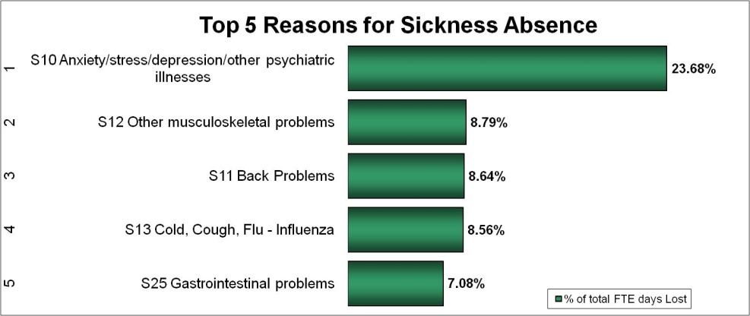
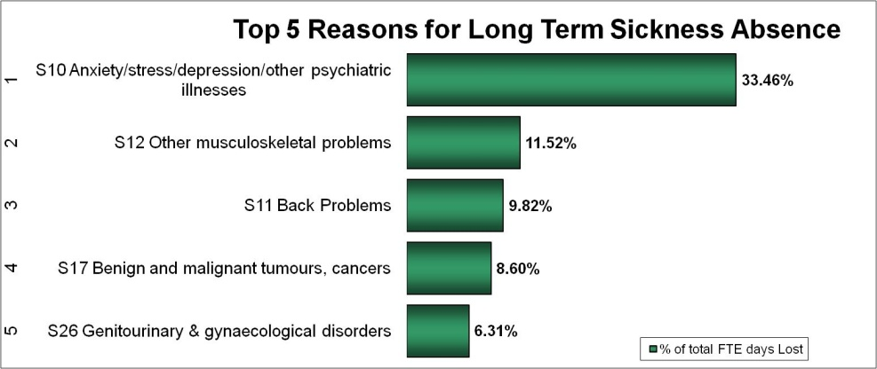
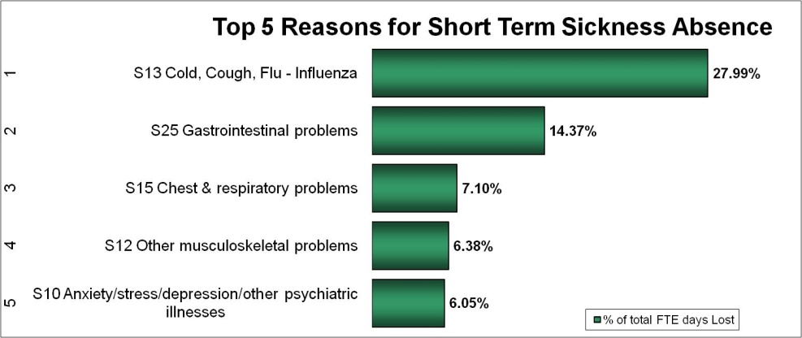
Headline HR KPIs - Sickness
Anxiety/stress and related illnesses continues to present as the highest reason for sickness absence overall and for long-term sickness.
The percentage of long term sickness caused by psychiatric illnesses has increased slightly on last month. Year to date Specialised services incur the highest incidence of this absence type. In the month Bucks and Oxon Adults of working age, community nursing and Tier 4 CAMHS have had high rates.
Musculoskeletal problems are highest in Community Nursing and Specialised Community Services.
Gastro- intestinal issues are highest in Eating Disorders and Childrens and Families management although the latter is skewed by small numbers.
Short-term sickness has increased to 1.04% from 0.95% last month and we can see that this is largely due to the increase in coughs and colds. This month coughs and colds have surpassed gastrointestinal problems considerably and have approximately doubled in the percentage short-term sickness absence that they cause. This is a general pattern that occurs moving into autumn/winter.
We will track whether this is seasonal and what effect the flu vaccination programme may have.

Slide 4
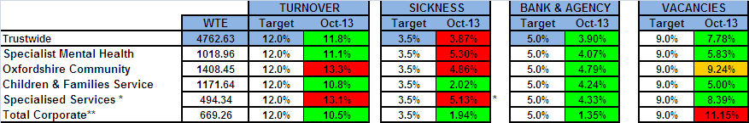
Divisional Performance – Headlines
Turnover Specialised Services and Community divisions remain above target even with the exclusion of Bullingdon Healthcare. Turnover has been consistently high with a number of leavers moving on after relatively short periods of service. Progress continues to ascertain why District Nurses are leaving the DN Service and a similar exercise is, being carried out in Community Hospitals. Sickness Most areas of Mental Health, Community and Specialised Services are above the Trust’s target of 3.5%. In Specialised Services levels have increased in long term and short term sickness. A number of individuals on long term sick leave have returned to work or left the Trust. Absence management continues in line with Trust policy. Areas of high absence include Prisons, Dental and Harm Minimisation. In the Community division managers are being trained in the new Sickness Absence policy which is on-going; and there is to be a session at Senior Management Team meeting on stress management and how it can be best approached in the service . An Action plan is now in place to tackle high absence levels in Re-ablement and planning is underway to extend the roll-out within Community Hospitals. In the Mental Health division sickness has increased which may be attributed to organisational change and the holding of vacancies in Community to ensure that we have roles for all staff prior to implementation. Formal sickness cases are being supported by HR and there have been a number of dismissals for reasons of Capability due to ill-health. Vacancies Arrangements to review all existing vacancies in the Trust continue and requests to fill vacant positions are reviewed weekly at the Operational Senior Management Team meeting with Divisional Directors. All Corporate vacancies are reviewed weekly by the Chief Executive.
* Turnover in Specialised Services now excludes all leavers from Bullingdon Prisons - Healthcare
** Includes Core Corporate services, also Junior Doctors, Students, Research & Development, Pharmacy and Estates & Facilities

Slide 5
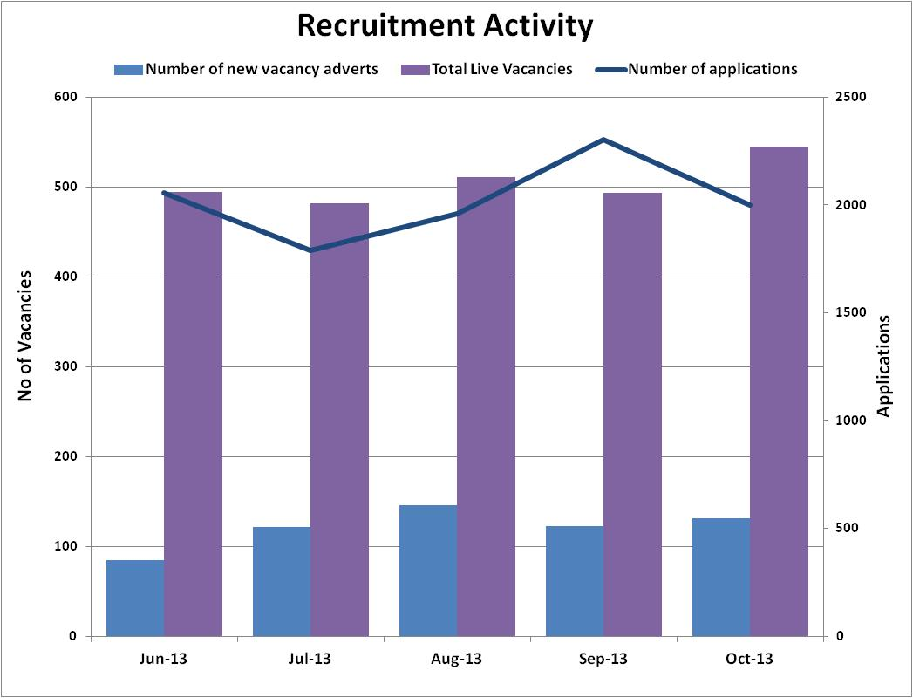
Recruitment Data
Vacancies and applications
The level of Vacancies and applications remains high, reflecting the Trust turnover figures. Between June 2013 and October 2013 the recruitment team processed over 2400 recruitment activities, averaging over 480 vacancies a month.
Recruitment continue to work with recruiting managers linking workforce planning/staff turnover to ensure a clear approach to recruitment. Each Division within the Trust has a Recruitment plan to tackle local recruitment issues and employ strategies that go beyond traditional recruitment methods such as:
Use of Social Media to advertise and attract suitable candidates
improving our links within the communities/Job Centre plus
attendance at Nursing job fairs and other recruitment events
keeping a register of interviewed candidates above the line, but not offered a position at the time, for re-consideration and rebranding to ensure our competitiveness in the primary labour market.
Recruitment Improvement Project
The Recruitment Improvement project launched in September 2013 was designed to improve how the Trust handles all recruitment processes in line with agreed timescales/KPIs; to review and improve our procedure for issuing honorary contracts, work experience and volunteer agreements, to review and come up with new ways of working to reduce reliance on paper based working.
The project work resulted in a re-launch of recruitment processes (Managers’ Portal introduced) with all forms and process reviewed to ensure greater simplification and speed. Initial feedback from managers on the re-launch has been very positive. The newly introduced Managers’ Portal has customer focus at its core and ensures managers are able to access recruitment and staff related information more easily and at the touch of a button.

Slide 6
Exit Questionnaire Data
What attracted you to your job?
Flexible Working Policies | |||||| | 2%
Job Security | |||||||||||||||||| | 6%
Location | |||||||||||||||||||||||||||||||||||||||||||||||||||||||||||| | 21%
Pay | |||||||||||||| | 5%
Pension Scheme | ||| | 1%
Promotional Prospects | ||||||||| | 3%
Reputation of the Trust | |||||||||||||||| | 6%
Role/Job Description | |||||||||||||||||||||||||||||||||||||||||||||||||||||||||||||||||||||||||||||||||| | 28%
Terms and Conditions | | | 0%
Training/Development Opportunities | |||||||||||||||||||||||||| | 9%
Working for the NHS | ||||||||||||||||||||||||||||||||||||||||||||||||||||| | 18%
Return Rate
The Return rate for October is 62.9% a significant increase from 38.3% in September. This increase is a result of the development and awareness of the Managers’ Portal and Exit Process enabling leavers’ forms to be completed online to improve delays. HR have also prioritised chasing leavers more frequently.
The Return Rate for June to October is 42.2%.
The 3 tables opposite illustrate why people join the Trust and what they enjoy about working in the Trust year to date.
Top 3 reasons for attracting new staff are Location, Role/Job Description and working for the NHS
Top 3 most satisfying parts of the job role are, Caring/Contact with service users, Working relationships and Contributing to the local community
Top 3 most unsatisfying parts of the job are, feeling valued and supported, Learning and development opportunities and flexible working
Top 3 reasons for leaving are, obtaining a better job/promotion, retirement, career change
Work will be undertaken to look at career progression and promotional opportunity.
.
What parts of your job did you enjoy?
Percent | Unsatisfying |  | Satisfying | Percent
6% | ||| | Caring/Contact with service users | ||||||||||||||||||||||||||||||||||||||||||||| | 94%
10% | ||||| | Contributing to the local community | ||||||||||||||||||||||||||||||||||||||||||| | 90%
13% | |||||| | Job content/variety of duties | |||||||||||||||||||||||||||||||||||||||||| | 88%
25% | |||||||||||| | Feeling valued and supported | |||||||||||||||||||||||||||||||||||| | 75%
6% | ||| | Working relationships | ||||||||||||||||||||||||||||||||||||||||||||| | 94%
15% | ||||||| | Communication/feeling involved | ||||||||||||||||||||||||||||||||||||||||| | 85%
10% | ||||| | Level of responsibility | ||||||||||||||||||||||||||||||||||||||||||| | 90%
21% | |||||||||| | Flexible working | |||||||||||||||||||||||||||||||||||||| | 79%
25% | |||||||||||| | Learning and development opportunities | |||||||||||||||||||||||||||||||||||| | 75%
Top 10 reasons for leaving
Controlled
Not treated fairly/equitably | ||||||||||||| | 5%
Obtaining a better job/promotion | |||||||||||||||||||||||||||||||||||||||| | 14%
Workload | ||||||||||||||| | 5%
Uncontrolled
Relocating | |||||||||||||||||||||||||| | 9%
Retirement | ||||||||||||||||||||||||||||||| | 11%
To undertake training/study | |||||||||||| | 4%
Travelling difficulties | ||||||||||||||||| | 6%
Career change | |||||||||||||||||||||||||||||||| | 11%
Change in family circumstances | ||||||||||||||||||| | 7%

Slide 7
Casework Data
There has been a steady decline in the number of cases overall this year. The casework is kept under close review within HR and is reported weekly to Nursing & Clinical Standards, where it is reviewed alongside complaints and incidents. Suspensions are reviewed regularly and numbers have reduced to 3 members of staff - this is a reduction of 4 since last month.
A review is being undertaken of recent Whistle-blowing cases to benchmark against other Trusts and to ensure appropriate reviews of outcomes and trends. The Whistle blowing policy has been amended to ensure consistent visibility and review at Executive Board level.
Timescales for casework investigations is also being reviewed and will be reported next quarter.

