Slide 1

Workforce Performance Report
February 2013
Graeme Armitage
Director of HR & OD
Caring, safe and excellent

Slide 2
Headline HR KPIs
Turnover
Turnover has reduced slightly in January, and is now lower than Oct by 0.4%. This is a cumulative reduction over 4 months of just under 1% The steady trend above target of 12% continues. Forecasts indicate that turnover could reach 13% in the next 2 months, slightly less than predicted earlier in the year. Staffing stability has increased slightly again to 85.6%. This indicates that the organisational staffing core is stable, and some key issues within individual divisions are being resolved.
Divisional breakdowns provide detail of actions being taken.
Bank and Agency Usage
Increase in Bank and Agency usage continues to be driven by the impact over the year of increasing levels of absence and turnover. The spike in January is specifically due to the opening of escalation beds to support discharge from the JR, and financial accruals, along with increased usage within Specialised Services and Specialist Mental Health. It is expected that spend at this level will continue to the end of the financial year
Live vacancies
Vacancy rate trends over the last 3 months are now showing a significant decrease in budgeted vacant posts of 2%. This has been significantly due to recruitment turnaround times and stabilisation of turnover

Slide 3

Workforce Performance Report
August 2012
Headline HR KPIs
Sickness /Absence
Whilst staff absence through sickness remained at 4% or below through 2012-13 to October, the last quarter continues to show a steep increase in sickness absence of over 1%, although the rate appears to have stabilised during January 13.
The cost to the organisation of all sickness absence over the last rolling 12 month period has been £4.9 million (including all staff groups and salary grades, based on an individuals salary at the point of sickness absence).
Outturn cost of sickness absence for Financial Year 12-13 is estimated to be £5.5 million. This cost does not include spend on backfill required to maintain service delivery. This equates to a total of 77,278 calendar days lost, or an average of 6439 days or 200 WTE per month across the organisation, an increase on the rolling average across the last 12 months, driven by the increase in absence since October 12.
The top 3 reasons for sickness to end December 12 continue to include anxiety and stress, and musculoskeletal problems. Cold and flu related sickness appear in the top 3 reasons in this month, indicating the end of the latest Norovirus occurrence .

Slide 4
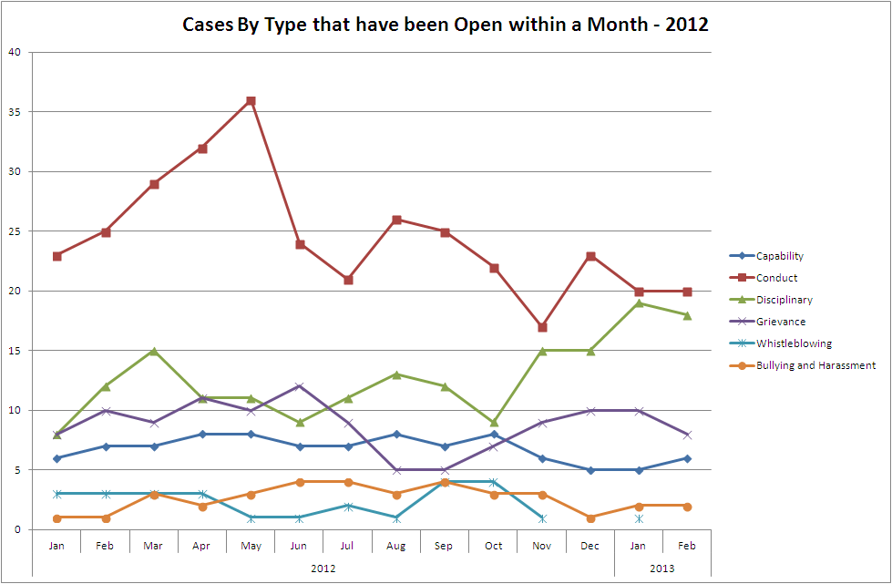
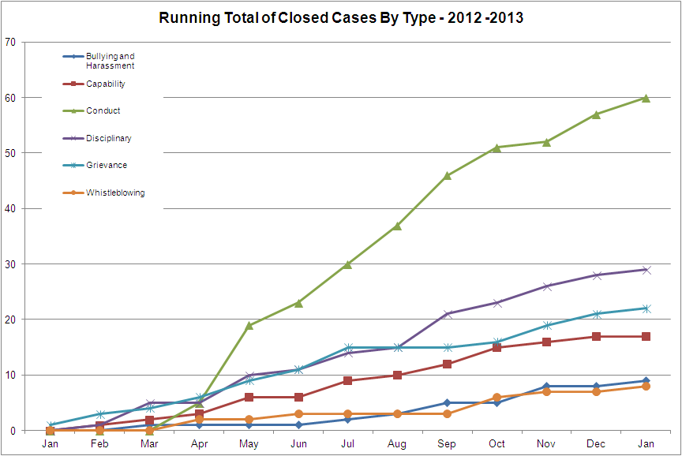
Workforce Performance Report
August 2012
Headline HR KPIs
Casework Management:
The graph shows a general reduction in casework levels.
During January the average number of cases in some form of formal HR process was 40. The number of cases in each division is:
Mental Health 5 cases
Children & Families 9 cases
Community 4 cases - although note that ill health capability cases are managed differently in Community and this figure excludes a number of such cases Corporate 5 cases
Specialised Services 13 cases
The majority of cases (47%) related to disciplinary cases. At the end of the month 9 staff members were suspended from duty pending investigation or panel hearings.
The majority of suspensions from duty are for periods in excess of 4 weeks (average of 19 weeks). Whilst this is of concern it is important to note that the figures are distorted by 2 complex cases where individuals have been suspended for periods in excess of 11 months. Progress of each case is kept under regular review and suspensions / restrictions on practice are reviewed at regular interviews to ascertain whether this remains an appropriate action.
The ER team have been trained in improved techniques to record and monitor the progress of casework. As a result of meetings with the Operations SMT a piece of work will be undertaken to benchmark HR processes against other health providers and to set target milestones for key stages of HR processes.
Further work around the training and utilisation of investigators will be undertaken. An options appraisal around the cost / benefits of external investigators will also be scoped.
The Senior HR Business Partners will review HR processes to ensure that delays to casework are minimised as far as possible, for example improving the process for arranging panel hearings.
A report of HR casework is presented weekly at the Corporate Clinical Governance meeting. This provides assurance in relation to casework progress and handling; it also allows for an overview of emergent themes or areas of concern. It also allows a review of referrals to LADO.

Slide 5
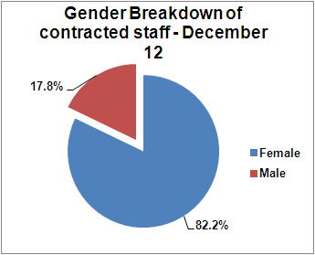
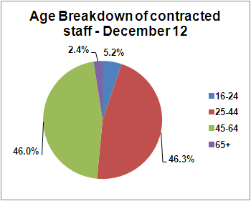
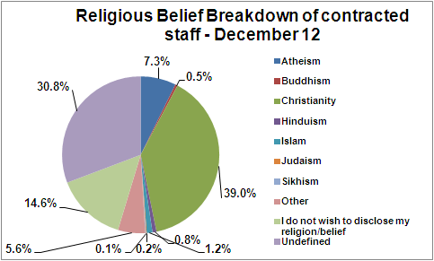
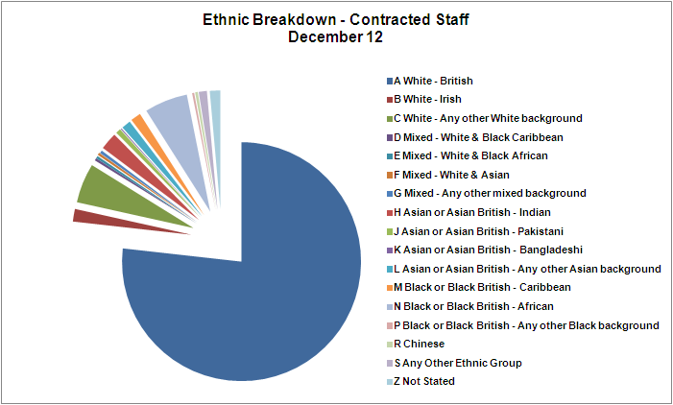
Workforce Performance Report
August 2012
Headline HR KPIs
Equality and Diversity
Since integration, the % of male employees has reduced by .5%. This reflects the overall increase in staffing within professions which are traditionally female orientated. Over the same period there has been a small increase in staff identifying themselves as White – British of 1.6% and reduction in employees within other ethnic groups. 46% of staff are aged between 45 and 64 years. In key staffing groups such as Qualified Nursing, 67% of the current workforce is aged 40 or above. Oxford Health NHS FT currently follows the national trend of the potential to lose 16% of its qualified nursing workforce to retirement over the next 5 years.

Slide 6
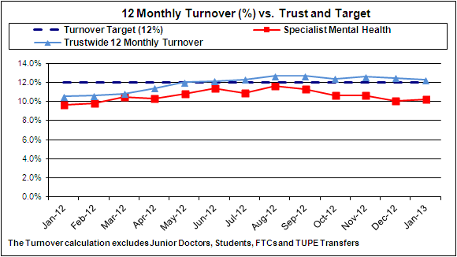
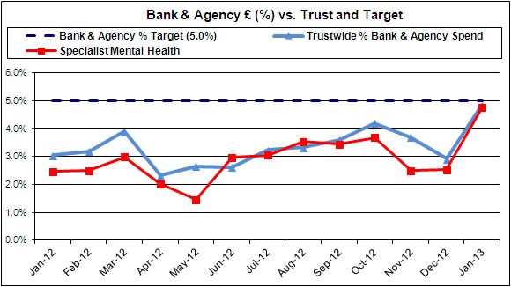
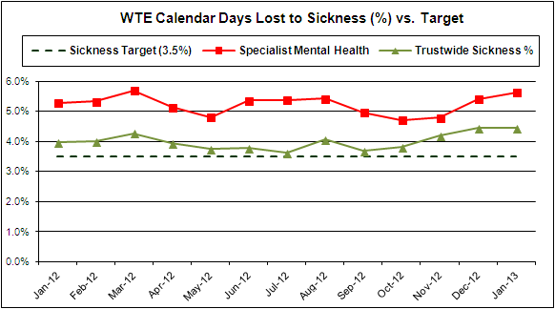
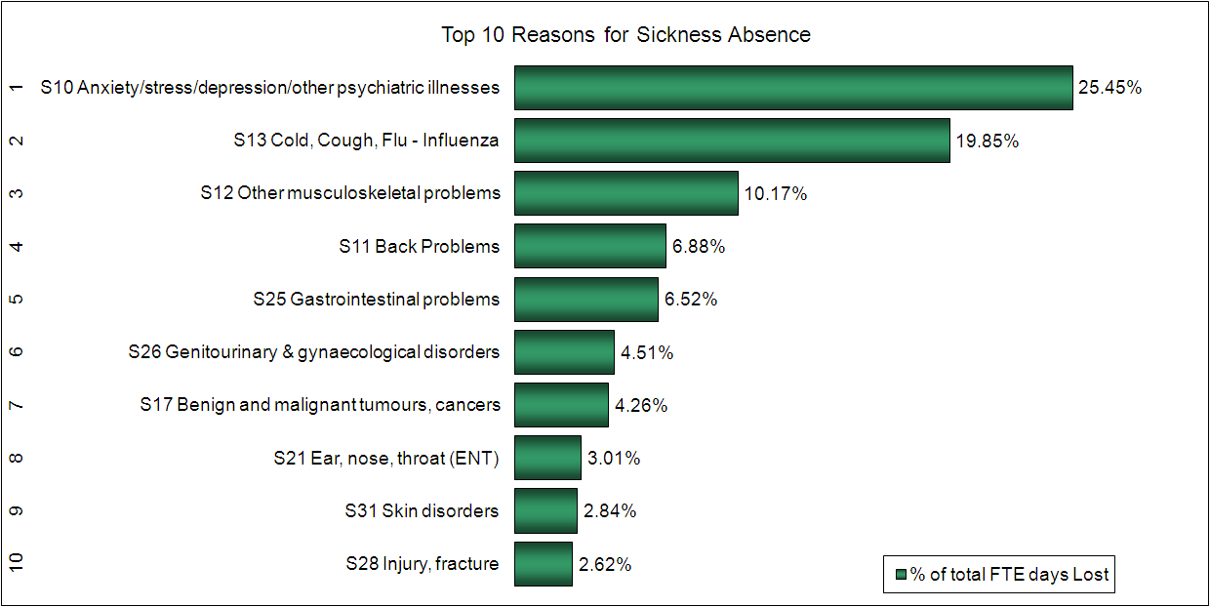
Specialist Mental Health Services - Performance against Target – All Indicators
Note: Some service areas have phased Statutory and Mandatory training targets which may result in achievement greater than 100%

Slide 7
Workforce Performance Report
August 2012
Specialist Mental Health Services - Performance against Target – All Indicators
ANALYSIS: Turnover Reduced from 10.65% and below Trust KPI. Bucks Adults of Working Age at 14% and Oxford Older Adults 12.2% are the two Pathways who are over target and the reasons for this have been reported in previous months. The Fiennes Unit has had an agreed increase of 4 staff following the outcome of a recent investigation which identified the needs for RGN’s and additional HCA’s. There are a number of staff who are choosing to retire ahead of the increase in Pension contributions. Robust HR support for managers is increasing the number of capability and sickness cases which in turn leads to staff being dismissed or resigning. Sickness Increased from 4.79% as anticipated and reported in the last workforce performance report. All pathways are over target except for Complex Needs with the Older Adult services in both Bucks and Oxford being a concern at 6.90% and 8.52% Bank & Agency Below Trust KPI but has increased significantly due to staff shortages and NHSP not being able to cover gaps. Below target in every area except Bucks Older Adults but we are aware that many wards are using agencies for clinical staff which they have not done previously. There have been a number of incidents on wards that have required additional staff for observations which can’t easily be filled with sessional workers Vacancies Below target but as expected with high turnover in the Older Adult wards in Oxford vacancies for this service are currently 13.78%. The actual vacancies in Mental Health are running at 117 – 4 live, 16 at short listing, 11 at interview, 12 at offer and 74 offer accepted Casework The number of cases 6 reduced from 30 when Oxford & Bucks Divisions joined. 3 staff are currently suspended. One will be going to a hearing on the 8/3/13 and the 2 suspended HCA’s are under investigation and their suspension reviewed regularly. ACTIONS: The HR team are contacting all leavers to encourage them to complete the on-line exit questionnaire and to offer an exit interview. There is a whistle blowing investigation starting on Mandalay where one of the areas to be probed is the high turnover of staff. Recruitment requests being scrutinised ahead of Service redesign. Priority is been given to pipeline for the OA wards which are suffering with staff shortages. The Operational Senior Management team are updated regularly with the sickness figures so they can monitor the situation regularly with manager during supervision. The teams with the highest sickness figures are contacted by HR and assisted with data and coaching to support back to work interviews, formal and informal sickness management and medical discharges. HR is a member of the operational working party which weekly monitors staffing levels on the wards which are due to vacancies, sickness, leave to be taken before the end of the financial year and releasing staff for training. There is increasing pressure on existing staff who are working either on shifts that are not staffed at the desired level of numbers or skill or are working a large number of additional shifts to support the service. Overstaffing the ward is under discussion and a pilot is taking place for central recruitment to see if that shortens the vacancy pipeline. A working group is meeting each Monday to anticipate the gaps in staffing over the following 2 weeks. Consideration will be given to requesting a worker for 3 months rather than requesting shift by shift. A meeting with NHSP is organised for 22/2/13. Discussion about attending recruitment fairs outside of Bucks and Oxford with the Community. Central recruitment being piloted in the Division. Recruitment training been given to new managers IMPACT: It is expected that turnover will increase during Q1 following Christmas and the New Year which are traditionally quiet periods for staff changing roles. We anticipate that Mandalay will reduce its turnover but the Oxford Older Adult service could see an increase due to the difficulty of recruiting and getting cover from NHSP is impacting on sickness and the possibility of moving to a less stressful environment. The Crisis team is now fully staffed after a long period of staff shortages and their turnover should decrease as a monthly figure. The number of referrals to Occupational Health has increased and the number of staff being formally and informally managed due to hitting the sickness trigger points has increased. Medical Discharge panels are taking place but in the short term sickness continues to rise through the winter months. There will continue to be a need for bank and agency staff due to staff sickness and the recruitment pipeline but existing staff working sessional contracts will always be offered vacant shifts first. Vacant shifts will be advised to NHSP earlier to increase the possibility of it being filled. The current recruitment process is working well but is constantly under review to improve the pipeline time.

Slide 8
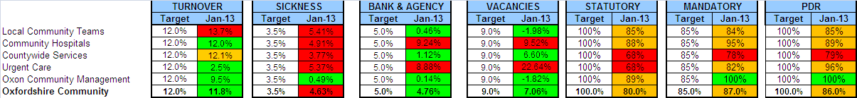
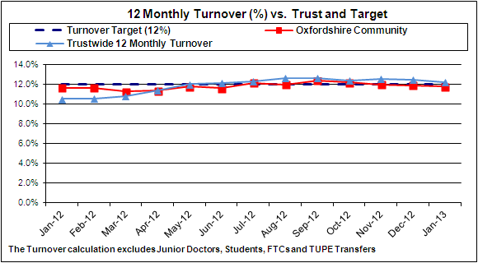
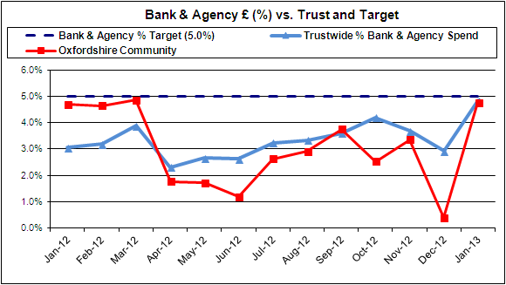
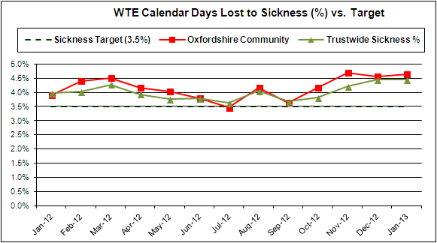
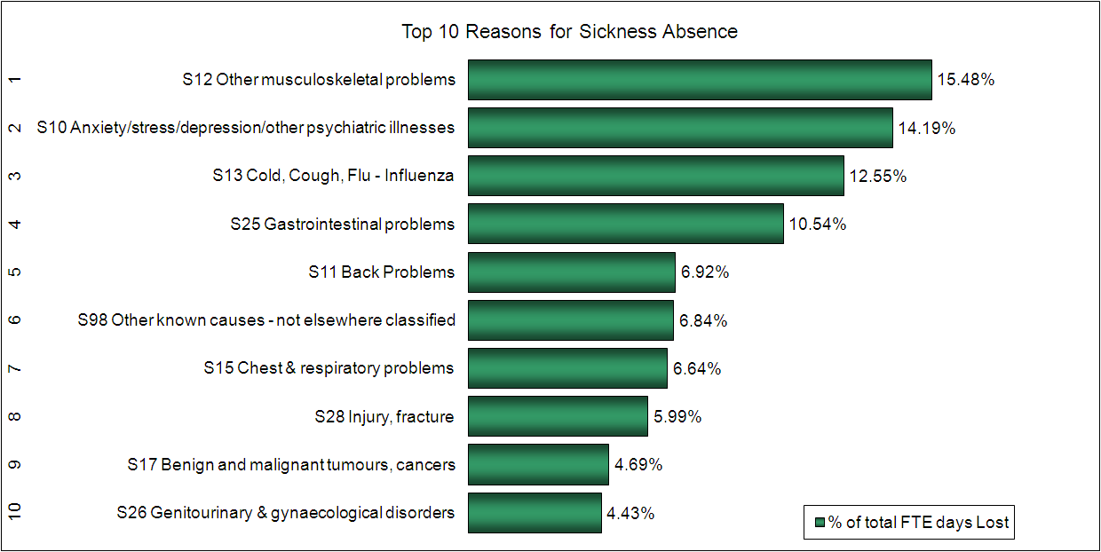
Workforce Performance Report
August 2012
Oxfordshire Community Services - Performance against Target – All Indicators
Note: Some service areas have phased Statutory and Mandatory training targets which may result in achievement greater than 100%

Slide 9
Workforce Performance Report
August 2012
Oxfordshire Community Services - Performance against Target – All Indicators
ANALYSIS: Turnover This has fallen to just slightly under the Trust target at 11.8%, with the only area where it is higher being Local Community teams (13.7%) and Countywide services , which incorporates Re-ablement ( 12.1%). The trend graph illustrates that Turnover sits at on or around the Trust target consistently with small amounts of variation. Sickness Sickness is above Trust target in all areas of the Division, with the exception Oxon Community Management. It is fairly consistent with the figures from last month. The trend graph illustrates that sickness is just slightly higher than in the same month last year. It is, however, a concern as it has been at high levels for the past 4 months and is a priority on the Divisional HR team’s agenda. Bank and Agency Bank and Agency use is currently just below the Trust’s target . There is however significant use within Community Hospitals. Wallingford, Townlands and Didcot had the highest usage (72% of the bookings). However, of the 64 shifts filled within Community Hospitals, only 6 (9%) were due to sickness. 91% of shifts were recorded as being due to escalation, vacancy or training. Vacancies The number of vacancies within Community Division has fallen significantly since the previous month. There are currently 151 vacancies, of which 30 are live. There are 25 candidates who are ready to start. ACTIONS: Whilst turnover does not appear to be a significant area for concern within the Division, the are high levels of turnover in Reablement. An action plan is being worked through to support managers in the Local Community teams in managing the current high levels of absence within the Service. The Business Area Review meeting (BARM) data has now been broken down further within Local Community teams so that the action plan can be further focused in the most problematic areas. Nine staff are currently being formally managed via the Capability process due to health or absence concerns – three of these cases are at Stage 3 and one staff member was dismissed this month. A meeting has taken place with Occupational Health to discuss high levels of muscoskeletal (MSK) injuries within the Division. All MSK cases will be reviewed by Occupational Health and managers will be given some guidance around when and how to refer staff at the earliest opportunity when there are early indications of an MSK injury. Bank and Agency use continues to be closely monitored through the BARM and through weekly reports in relation to use within Community Hospitals. A project is going to be undertaken within Community Services to harmonise arrangements for staff being paid on sessional contracts for additional hours. As part of this piece of work, the use of sessional contracts will be promoted across the Division. As part of the workforce planning process for the next financial year, a controlled and co-ordinated approach to planning Statutory and Mandatory training to avoid large numbers of staff requiring this training during the periods of most activity has been discussed. A presentation has been delivered to Community Division’s SMT to ensure clear understanding of the recruitment process and joint responsibilities, this will be cascaded further to managers to ensure that recruitment is happening as expediently as possible. A piece of project work is also being convened to review the recruitment strategy across the Division. This will include looking at job fairs, attendance at Recruitment events in Manchester and Ireland to target nursing vacancies, in particular, and reviewing the recruitment material and methods (JDs, adverts etc) to better “sell” the vacancies and attract the right types of candidate. IMPACT: Work is still on-going to triangulate the BARM data, Exit Questionnaires and the staff survey results so that a better picture will be available concerning reasons for leaving, which can then start to be addressed over the following 3 months in focused action plans in any areas where it is considered problematic. Overall, turnover is not an area of significant concern for the Division. Having reviewed the more detailed BARM data, HR support will be focused where it is most required. It is hoped that continuing to progress the sickness absence management action plan within the Locality teams will see an incremental reduction in sickness absence over the coming 3-6 months. Whilst disappointing that there does not appear to have been any immediate impact, it is perhaps too soon to see direct results and the plan will continue to be monitored and re-focused. It is anticipated that some use of Bank/Agency staff will lessen as winter pressures reduce. The use of Bank/Agency staff has been linked with high levels of vacancies in some areas. Vacancies have been filled at Didcot so performance here should improve in the next 1-2 months. Reviewing the approach to recruitment at Townlands and more planning of training interventions should help in the medium to long term. The picture with regard to vacancies has significantly improved over the last two months. It is hope that reviewing the recruitment strategy will result in further improvements over the coming months, particularly in areas where it is difficult to recruit such as the Community Hospitals at Didcot and Townlands and continuing to concentrate on Reablement where there is a high turnover rate.

Slide 10
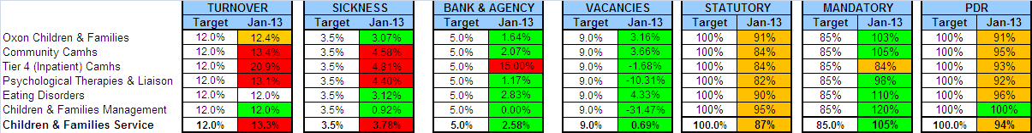
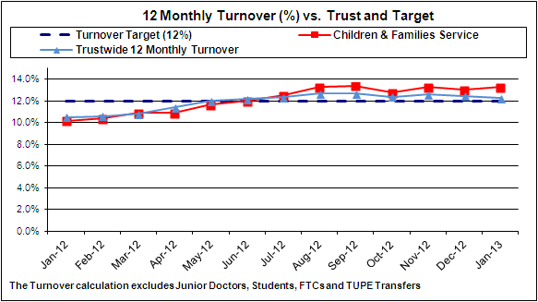
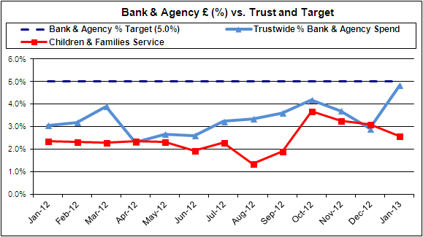
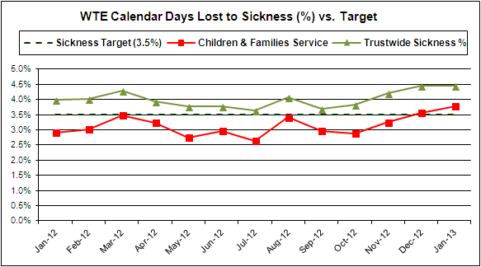
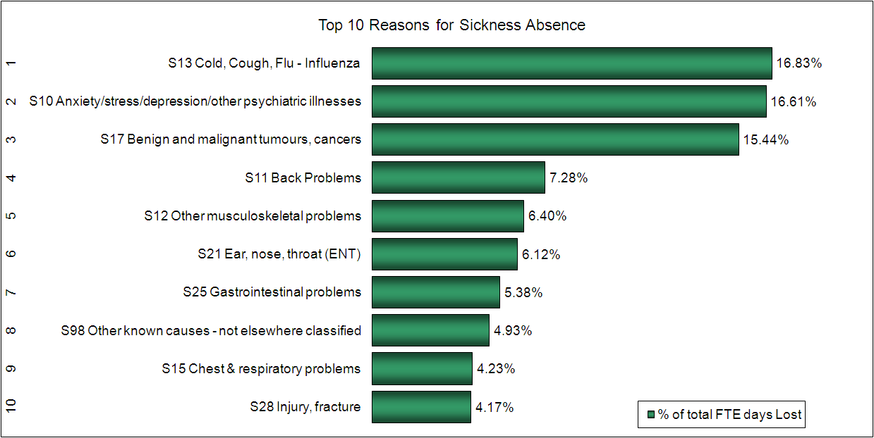
Workforce Performance Report
August 2012
Children & Families Services - Performance against Target – All Indicators
Note: Some service areas have phased Statutory and Mandatory training targets which may result in achievement greater than 100%

Slide 11
Workforce Performance Report
August 2012
Children and Families Services - Performance against Target – All Indicators
ANALYSIS: TURNOVER Turnover (12 monthly) has seen a slight increase from January of 0.3%. We have seen a decrease within Psychological Therapies & Liaison of 2.4%. T4 (inpatient ) Camhs do remain high at 20.9%. The second highest area is Community Camhs at 13.4%. SICKNESS Sickness 3.78% v Trust target 3.5% We have seen a slight increase this month of 0.22% Community Camhs has seen an increase of 0.74%. This is due to a number of serious long term sickness cases all of which have occupational health input. Eating Disorders has seen a decrease of 1.69% and CF management has decreased by 0.76%. The Divisions sickness rate is below the overall Trusts rate of 4.45% and the lowest % across all four divisions. BANK & AGENCY Bank & Agency 2.58% vs. Target 5.0% Agency spend has reduced this month by 0.51%.and still remains below trust target. Agency accounts for 2.3% and Bank 0.3%. Eating disorders have seen a significant drop of 6.25%. However Tier 4 (inpatient Camhs) has seen an increase of 5.29%, there appears to be two reasons for this: January included a large number of invoices relating to December (and December was low). In addition, to support the opening of the new Highfield Unit, Oxford, staff (new and existing) had to undergo further periods of training. ACTIONS: Turnover has been historically high within both Tier 4 and Psychological Therapies, this is partly due to the complex and challenging nature of the work. Recruitment of new staff needs to cover the nature of the work and this is particularly relevant for staff recruited into Tier 4 due to the high number of eating disorder cases. However we have seen a drop in turnover for Tier 4 over the last 2 months, and adopt a proactive approach in managing sickness absence, in which, we have also seen a decrease this month. HR will check trainee turnover is being entered correctly on ESR. Direct HR interventions will continue and focus on hot spot areas. To note, of the 17 staff approaching ½ pay we have managed; 1 dismissal/3 resignations /2 ill health/1 redeployment 1 unable to complete training seeking redeployment/3 short length of service so triggering pay reduction/3 long term serious health issues/3 RTW Use of locum medical cover is high due to covering long term sick and ER issues regarding on call rotas. Actions are in place to support staff. Senior HR management to meet with NHSP to discuss providing a service across Swindon/Marlborough areas, these areas are the highest users of agency. A resulting action plan will be developed. IMPACT: The turnover for the Division is 13.3% compared to the Trust overall turnover of 12.25% (difference of 1.05%). Reductions in sickness absence should improve staff morale, however a number of cases are long term and as such we are unlikely to see a signification drop in hotspots areas in the next quarter. This has also had an effect on the high usage of Bank & Agency. The division has a high number cases (10) falling under the absence reason benign and malignant tumours/cancers is so high compare to other Divisions, and has the potential to impact our long term sickness figures. This also impacts on the B&A usage.

Slide 12
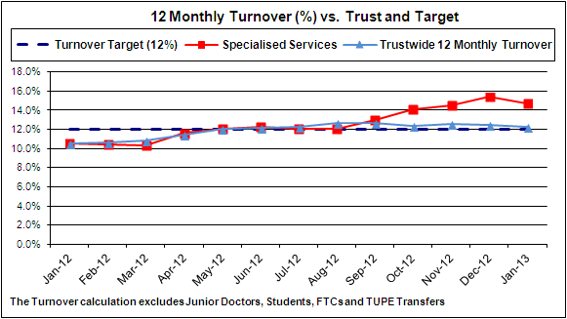
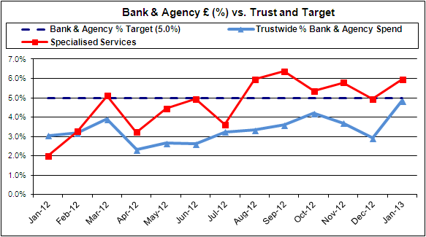
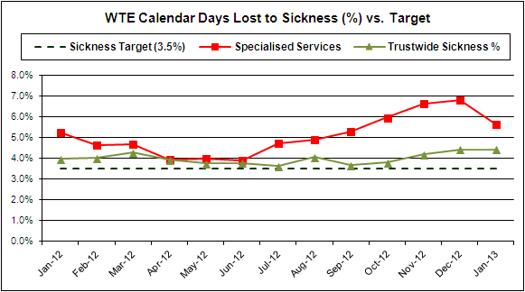
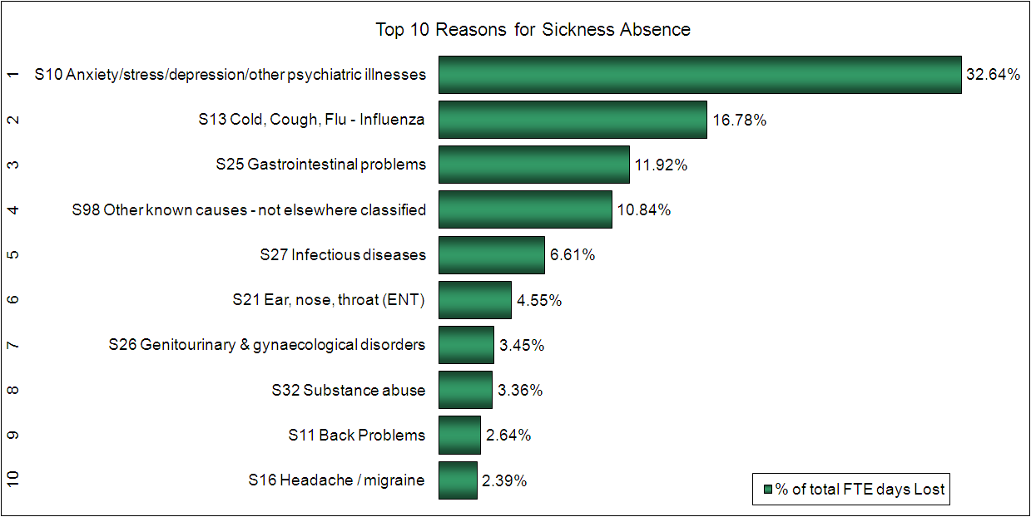
Workforce Performance Report
August 2012
Specialised Services - Performance against Target – All Indicators
Note: Some service areas have phased Statutory and Mandatory training targets which may result in achievement greater than 100% Figures for Bullingdon Prison have been excluded from the above statistics, to give a more realistic picture of core workforce issues

Slide 13
Workforce Performance Report
August 2012
Specialised Services - Performance against Target – All Indicators
ANALYSIS: Note that whilst Bullingdon healthcare has been removed from the statistics, it is still included in the 12 monthly trend charts. There were a range of issues in Bullingdon affecting sickness absence levels, turnover rate and bank & agency Turnover The Division wide turnover rate has improved since last month but remains slightly above target. Turnover rate in Forensic Services and Huntercombe Healthcare is within target. Specialised Community Services is high and has impacted the Division wide rate. Results from organisational change in Harm Min in April 2012 which has inflated the 12 months rolling average. Analysis of the monthly turnover rate suggests there is no underlying cause for concern Sickness The Division wide sickness rate has lowered since last month but remains above target Sickness rate is mainly driven by a number of long term cases; these are in appropriate management processes. This month’s statistics continue to include 1 long term sickness case where the individual sadly died in service in late December 2012. In the Forensic Service a number of staff were assaulted by a patient and this resulted in a number of long term absences. There are a number of co-incidental and unrelated absences in Salaried Dental Service Bank & Agency The Division wide use of bank & agency has increased this month but remains below target. High use of bank & agency in Huntercombe Healthcare – this is a small team with 2 long term sickness cases at present. High use of agency in Specialised Community Services where the Harm Min Manager post has been covered by agency worker ACTIONS: HR continue to monitor turnover rate in Specialised Community Services. However at present no underlying cause or cause for concern has been identified. Support continues to be provided to managers using absence management processes. Specific cases to progress: 1 long term case in Huntercombe will commence phased return to work late Feb 2013, 1 long term case in Forensic Service may be approved Ill Health Retirement and another has commenced a phased return Actions linked to bank and agency usage management include the review, use and authorisation process for booking agency with Huntercombe Modern Matron and the review of use of sessional Contracts in Huntercombe Healthcare. A new Harm Min Manager commences employment Feb 2013, and establishment levels in Forensic Service are to be reviewed. IMPACT: Rolling average in Specialised Services should stabilise in coming months. As long term cases are managed to conclusion, and as we leave the winter illness season, sickness levels should reduce. Whilst use of agency in Huntercombe will be reviewed, it will take some time before there is any impact on this.

Slide 14
Statutory Training - Trust
Trust performance - January 2013
An overall 1% decrease on the December 2012 position to 83%.
OCSD performance reduced by 3% to 80% with pressure on service levels across the whole Oxfordshire healthcare system during the winter months.
SSD reduced by 2% points largely due to performance in Prisons with the imminent TUPE of Bullingdon services at the quarter end.
Actions
The use of ‘risk based’ reporting has enabled Divisions in updating their action plans to ensure that the higher risk categories continue to complete training needs.
E-Learning solutions planned for delivery in Quarter 4 include:
  Falls Awareness
  Medicines Management
Comparison of e-learning use for statutory & mandatory training in the first 3 quarters of 2012/13 with the previous year shows an increase from 3700 to 10,000 sessions (165%). As e-learning accounts for 52% of statutory training, this rate of increase should support greater progress towards achieving performance targets.
From Q1 2013/14, the use of e-assessments is planned for several subjects (Safeguarding, Information Governance, Equality & Diversity) in order to further reduce the need for classroom attendance and thus time away from service provision.
The recently introduced ‘course calendar’ feature within Online Training Records is being promoted with line managers to enable them to see at a glance all the course bookings made by their staff over coming months. This helps with rostering and should reduce wastage of course places through late cancellations.

Slide 15
Statutory Training by Division
Activity | MHSD | OCSD | SSD | C&FSD | Corp |  | Activity | MHSD | OCSD | SSD | C&FSD | Corp
Equality & Diversity | 91% | 79% | 91% | 91% | 92% |  | Infection Control | 76% | 80% | 69% | 83% | 80%
Staff | 1162 | 1751 | 553 | 1386 | 613 |  | Staff | 2124 | 3445 | 1044 | 2615 | 483
Trained | 1061 | 1384 | 501 | 1267 | 565 |  | Trained | 1623 | 2758 | 725 | 2183 | 388
Booked | 21 | 38 | 6 | 18 | 2 |  | Booked | 169 | 28 | 167 | 56 | 6
Gap | 80 | 329 | 46 | 101 | 46 |  | Gap | 332 | 659 | 152 | 376 | 89
Fire | 81% | 73% | 82% | 81% | 79% |  | Moving & Handling | 77% | 78% | 72% | 83% | 83%
Staff | 1160 | 1754 | 553 | 1384 | 610 |  | Staff | 1158 | 1719 | 552 | 1384 | 613
Trained | 935 | 1286 | 453 | 1117 | 480 |  | Trained | 894 | 1336 | 398 | 1146 | 506
Booked | 63 | 87 | 26 | 55 | 16 |  | Booked | 90 | 73 | 45 | 48 | 3
Gap | 162 | 381 | 74 | 212 | 114 |  | Gap | 174 | 310 | 109 | 190 | 104
H&S | 67% | 63% | 86% | 77% | 68% |  | PMVA | 74% | 43% | 70% | 66% | 60%
Staff | 54 | 142 | 21 | 13 | 97 |  | Staff | 1769 | 500 | 1070 | 1028 | 236
Trained | 36 | 89 | 18 | 10 | 66 |  | Trained | 1302 | 214 | 753 | 678 | 142
Booked | 7 | 2 | 0 | 1 | 1 |  | Booked | 323 | 9 | 175 | 193 | 20
Gap | 11 | 51 | 3 | 2 | 30 |  | Gap | 144 | 277 | 142 | 157 | 74
Induction Corporate & Jnr Doc | 74% | 75% | 68% | 83% | 77% |  | Resuscitation | 70% | 74% | 78% | 76% | 53%
Staff | 121 | 357 | 53 | 199 | 124 |  | Staff | 1817 | 2863 | 969 | 2311 | 314
Trained | 90 | 266 | 36 | 165 | 95 |  | Trained | 1269 | 2113 | 755 | 1767 | 166
Booked | 17 | 10 | 5 | 12 | 2 |  | Booked | 100 | 104 | 43 | 98 | 14
Gap | 14 | 81 | 12 | 22 | 27 |  | Gap | 448 | 646 | 171 | 446 | 134
Local Workplace Induction | 69% | 41% | 55% | 74% | 54% |  | Safeguarding (adults/children) | 80% | 74% | 80% | 87% | 81%
Staff | 122 | 357 | 64 | 197 | 50 |  | Staff | 2149 | 3189 | 1066 | 2921 | 400
Trained | 84 | 148 | 35 | 146 | 27 |  | Trained | 1714 | 2351 | 858 | 2532 | 325
Booked | 0 | 0 | 0 | 0 | 0 |  | Booked | 154 | 108 | 58 | 147 | 16
Gap | 38 | 209 | 29 | 51 | 23 |  | Gap | 281 | 730 | 150 | 242 | 59
Notes:
Activity - each subject area of statutory training without showing individual course types
Booked - a committed place on a training course, i.e. a plan to achieve currency of training
Not booked - the remaining ‘gap’ where no action has been taken to achieve currency of training

Slide 16
Statutory Training - Risk Level 1 – Ward Registered Staff
The following courses have been selected as high risk for the highest risk group; All registered staff working on inpatient wards.
Course | Performance % | Total Staff | Staff Trained | Training required | Already Booked | Action required | Places available in next 3 months
Fire Awareness | 80 | 838 | 661 | 132 | 40 | Book 92 places & attend | 336
Induction - Local Workplace | 54 | 99 | 53 | 46 | 0 | Managers to input date on OTR
Infection Control - Classroom | 79 | 838 | 659 | 179 | 32 | Book 147 places & attend | 340
Infection control - Workbook | 70 | 744 | 521 | 223 | 0 | Completion of workbook by individual
PMVA Full Course Teamwork | 92 | 263 | 243 | 20 | 6 | Book 14 places & attend | 24
PMVA Full Course Recertification | 75 | 202 | 152 | 50 | 28 | Book 22 places & attend | 49
PMVA Short Course Teamwork | 84 | 95 | 80 | 15 | 8 | Book 7 places & attend | 16 places available in Feb
PMVA Short Course Recertification | 67 | 83 | 56 | 27 | 22 | Book 5 places & attend | 46
Resuscitation Assessment ABLS & AED | 74 | 838 | 621 | 217 | 70 | Book 147 places & attend | 245
Resuscitation eLearning ABLS & AED | 76 | 838 | 639 | 199 | 0 | Completion of eLearning by individual
Actions:
In conjunction with the Chief Operating Officer and the Director of Nursing & Clinical Standards, new strategic principles for statutory and mandatory training have now been agreed to prioritise patient safety and address staff perception. These include:
  Assign to staff groups a ‘risk’ rating to ensure that those in the higher risk category are given priority access to training
  Assign to each subject a ‘priority’ rating to reflect those with the greatest impact on patient (or personal) safety
  Rebrand ‘statutory & mandatory’ to ‘Patient & Personal Safety Training’ (PPS) from Q1 2013/14 to help shift the emphasis and increase relevance to patient safety. This follows success in other benchmarked Trusts.
Impact:
Performance can improve subject to the following:
recruiting to budgetted establishment
sickness and turnover being within target
the ability to release staff from wards whilst maintaining safe service delivery
training places booked are not cancelled and DNAs are avoided.

Slide 17
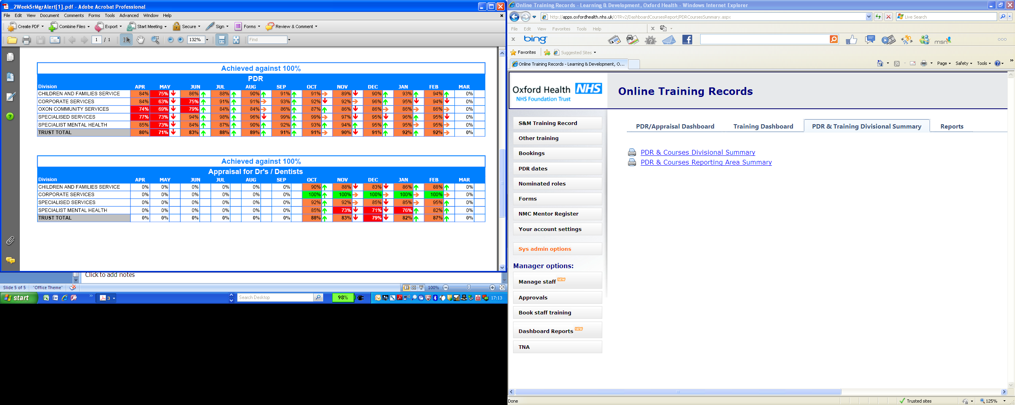
PDRs
January – improved to 92%
The current gap of 435 (non-medical) individuals without a reported PDR have been identified by name and notified to divisions to ensure managers resolve this by the end of Q4.
57% of these are within OCSD where the Divisional Director is taking action with Heads of Service to complete data entry and/or PDRs.
Data cleansing and information on completion dates is being concluded with line managers for two other units (Bucks S&LT and Re-Ablement Service) in which 140 staff have TUPE’d in to the Trust.
Numbers
77
29
250
25
54
435
Numbers
7
0
2
13
22

