Slide 1
Patient & Personal Safety Training (PPST) - Trust
Trust performance - April 2013
The Trust has replaced Statutory and Mandatory training with a new training framework called Patient & Personal Safety Training (PPST). PPST is designed to enhance patient safety and ensure safe working practices. All staff have a duty to meet the standards required through PPST, either through completing training or demonstrating competence. Professionally registered staff have additional obligations to maintain registration with adherence to PPST requirements.
There are 3 categories of risk for the training subject areas which broadly reflect the former ‘statutory’, ‘mandatory’ and ‘individual nominated’ groups.
A significant number of changes (highlighted) have been made during April which are reflected in the performance figures.
PPST Level 1
Equality & Diversity
Fire
Health & Safety
Induction
Infection Prevention & Control
Moving & Handling
Prevention & Management of Violence & Aggression
Resuscitation
Safeguarding
PPST Level 2
Care Programme Approach
Clinical Risk & Management
Complaints
Dual Diagnosis
Falls Awareness
Food Hygiene
Information Governance
Medicines Management
Mental Capacity Act
Mental Health Act
Safe & Supportive Observations
Security Awareness
Supervision
PPST Level 3 (Individual Nominated)
Medical Educational & Clinical Supervision
Medical Educational Supervisors Annual Review of Competence Progression
Medical Educational Supervisors Supporting the Trainee
Medical Workplace Based Assessment
Fire Marshal
First Aid – Appointed Person
H&S Care Risk & Safety Management
H&S Working Safely
Root Cause Analysis
Overview of Changes to Patient and Personal Safety Training (PPST)
PPST Level 1
Fire Awareness
• A combined annual fire awareness and evacuation training course introduced for staff working on the high risk inpatient wards. Phased target 25% Q1.
Equality & Diversity Training
• To align to the national framework equality and diversity training now has a requirement to be refreshed every 3 years. Phased target 60% Q1.
Infection Prevention & Control (IPC)
• A new training strategy has been introduced.
• Classroom training is for ward based staff every 3 years.
• Housekeepers have a classroom session specific to their needs every 3 years.
• Other staff groups complete new eLearning or workbook and online eAssessments
Resuscitation
Medical Staff
• Enhanced training on the Automated External Defibrillator (AED) has been included
CAMHS staff
• Paediatric Modifiers training has been included in the training requirement
Prevention & Management of Violence & Aggression
Full Course replaced Short Course within Older Adults & Eating Disorders, requested by service divisions.
PPST Level 2
Forensic staff
• Security Awareness Annual training included at the request of Specialised Services Division. Attendance records are being updated and will be completed in May to show a significant upturn.
PPST Level 3 (Individual Nominated) - Courses for medical staff with clinical and/or educational supervision responsibility added at the request of the Director of Medical Education. Attendance records are being updated and will be completed in May to show a significant upturn.

Slide 2
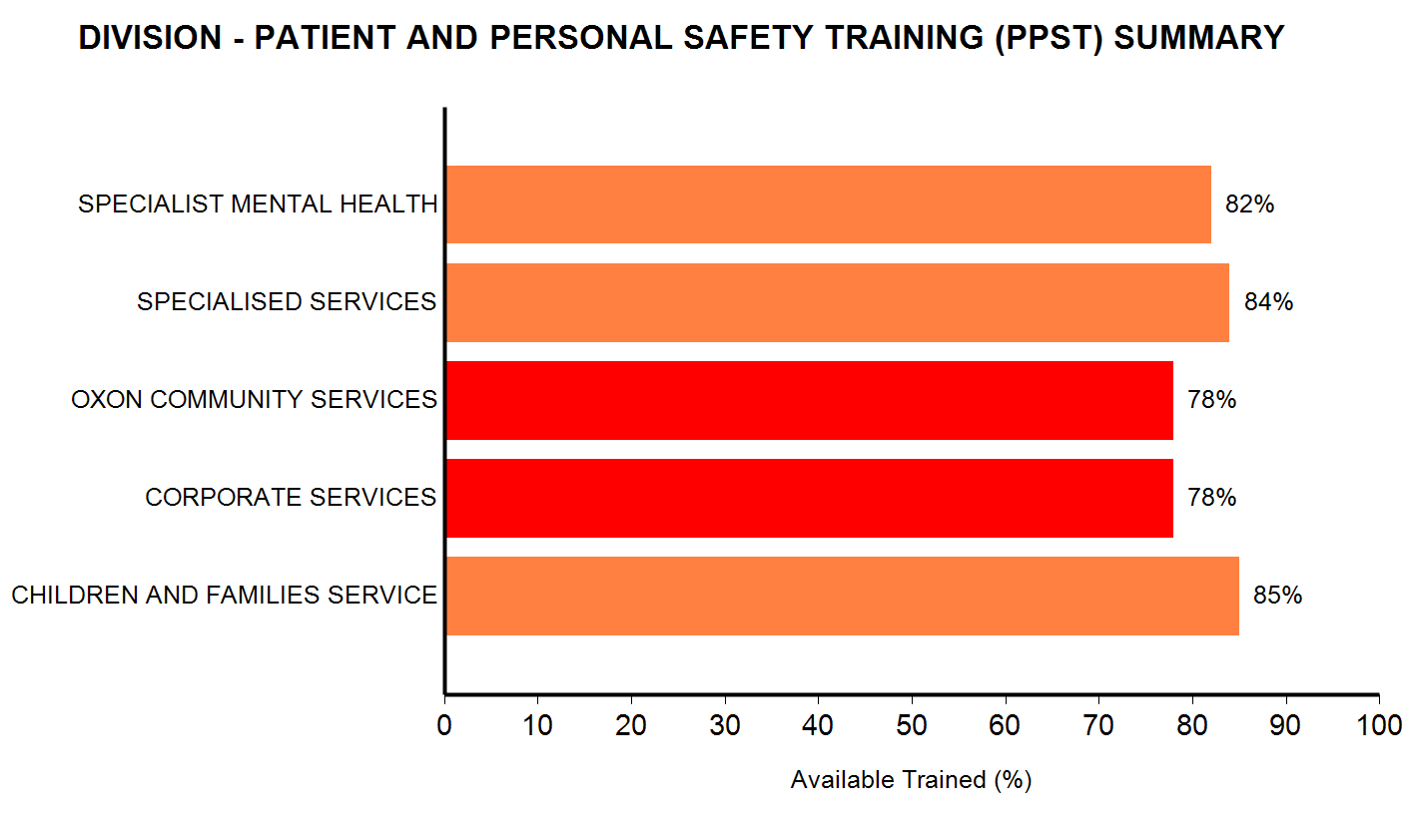
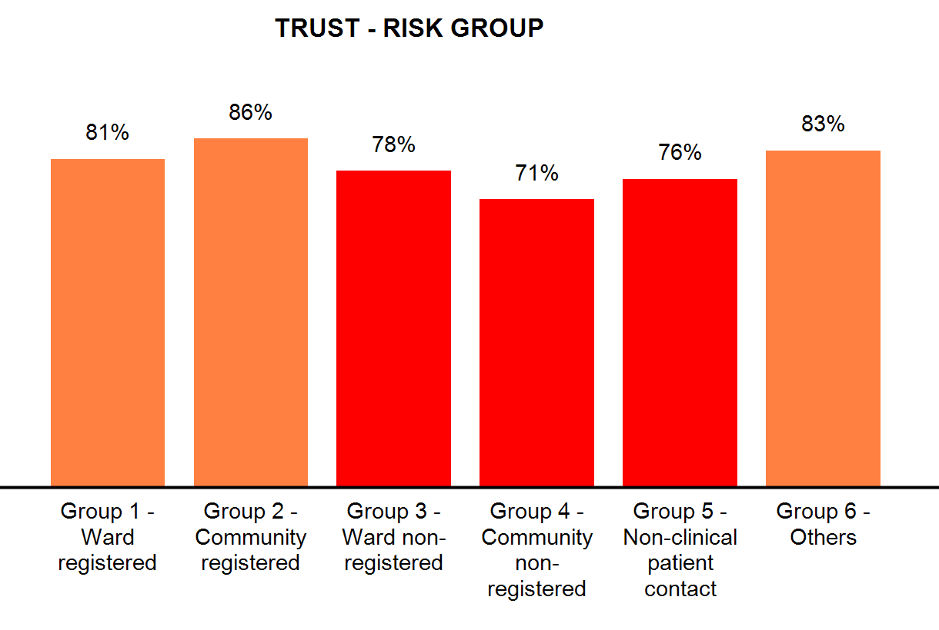
Patient & Personal Safety Training (PPST) – Combined Levels & Risk Groups
The PPST framework has 6 categories of risk for groups of staff reflecting the types of role performed.
The risk based approach is to ensure that training is more relevant and better focussed on the right roles within the Trust.
Risk Group 1 | Risk Group 2 | Risk Group 3 | Risk Group 4 | Risk Group 5 | Risk Group 6
Ward Based Registered | Community Based Registered | Ward Based Non Registered | Community Based Non Registered | Non Clinical Patient contact | Others
Within OCSD alternative approaches are under review with the Re-ablement Service to address the Risk Category 4 performance The Urgent Care and Out of Hours Service are being supported to achieve an improved performance.
Corporate Services - In conjunction with Medical Education Supervisors, the low performance of Junior Doctors is being targeted, particularly following the February intake.
Improvements to PPST include:
More choice of delivery (e.g. eLearning and workbook options )
Use of initial assessments to assess competence and avoid training refresher
Increased relevance to and tailoring of training for specific staff groups; for example the new Infection Prevention & Control training (5 targeted groups, 3 different refresher periods and 4 delivery methods).

Slide 3
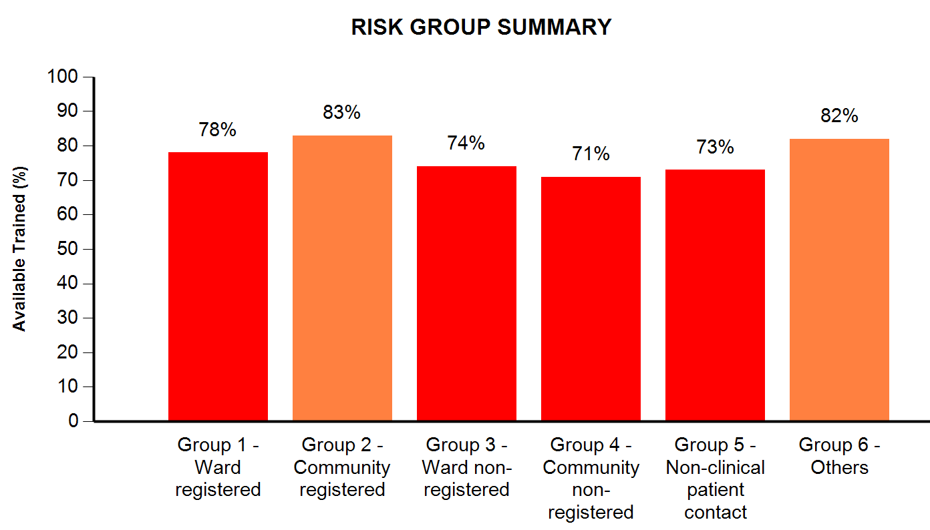
PPST Level 1 by Risk Groups and Division
PPST Level 1 | Target Achieved | Comments
Equality & Diversity | 92%* of phased target | Standards change – 3 yearly refresher implemented, *60% Phased target for Q1, 58% achieved month 1. Training Gap 350. Delivery eLearning & Classroom
Fire | 100%* of phased target | Standards change – combined annual Fire & Evacuation training. *Phased target 25% for Q1, 25% achieved month 1.
Induction | 70% | Includes Corporate, Local and Trainee Drs Induction programmes. Training Gap 85.
Infection Prevention & Control | 70% | Standards change – New strategy. Training Gap 293 (Note 1)
Moving & Handling | 76% | Training Gap 130. Delivery eLearning & Classroom
Prevention & Management of Violence & Aggression | 77% | Includes all PMVA Courses. Standards change – Full Course replaces Short Course. Annual refresher Training. 126 staff to be retrained on 5 day course. Delivery Classroom. (Note 2)
Resuscitation | 85%* of phased target | Standards changed Oct 12. *80% Phased target. 68% achieved month 7. Training Gap 421. Delivery e-Assessment, eLearning & Classroom (Note 3)
Safeguarding | 83% | Training Gap 221. Delivery e-Assessment, eLearning & Classroom
Actions:
1. Infection Prevention & Control - An eLearning solution for infection control has been developed and launched in April with sections tailored for specific groups.
2. PMVA training – Implemented service management decision for staff in Older Adult and Eating Disorders wards to have extended training in order to improve patient safety.
3. Resuscitation eLearning – Content is being redeveloped to enable an eAssessments to be completed, identifying gaps in knowledge which can addressed using the learning content.
4. Dedicated L&D - Staff resource is working with ward managers and their staff to ensure completion of eLearning.
Impact:
1. Infection Prevention & Control - Providing an alternative delivery method for infection control targeted at specific groups will enhance the relevance and completion of training.
2. PMVA training – Approximately 200 OA & Eating Disorders staff with increased training provision , which will reduce performance against target during implementation of the change
3. Resuscitation eLearning – This will reduce the time taken and focus on the needs of specific roles.
4. Dedicated L&D - Supporting staff on eLearning will provide an alternative to classroom attendance across several training subjects.

Slide 4
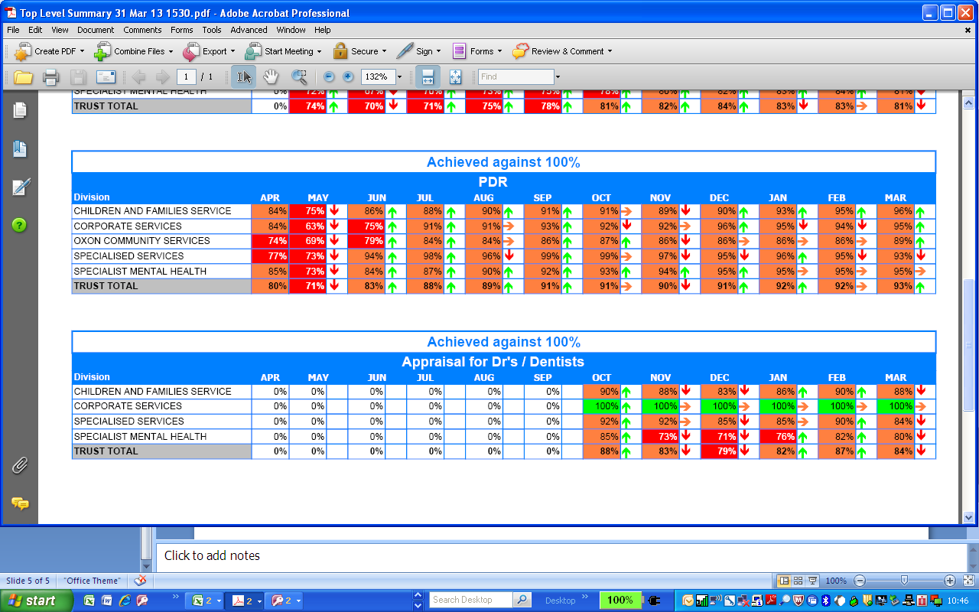
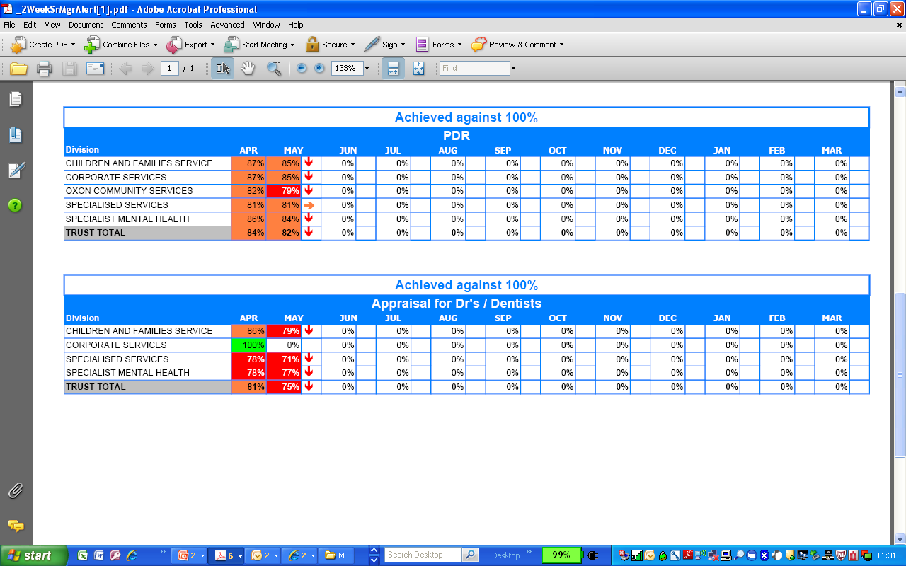
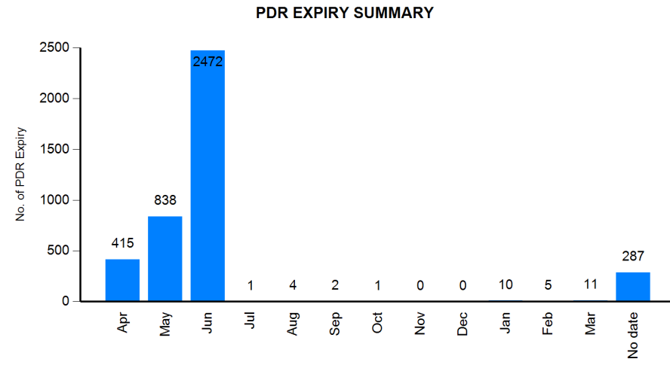
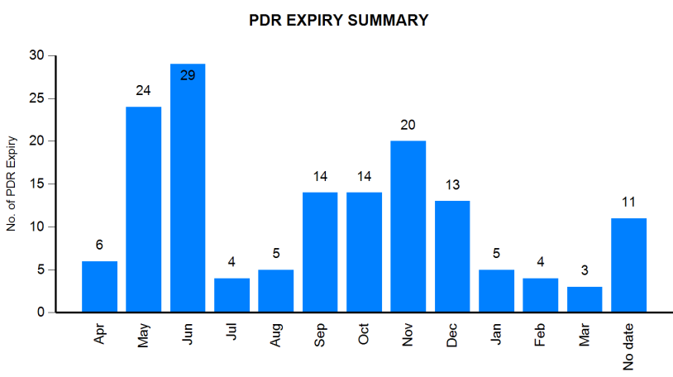
PDRs
April 2013
With the new PDR cycle starting from April, divisions need to complete all reviews by the end of Q1.
Forecast as at 12 May 2013
Numbers
205
77
380
93
174
929
Medical Staff & Dentists are outside the PDR cycle and have annual Appraisal reviews
Forecast as at 12 May 2013
Numbers
12
12
17
41

