Slide 1

Workforce Performance Report
May 2013
Jayne Halford
Deputy Director of HR
Caring, safe and excellent

Slide 2
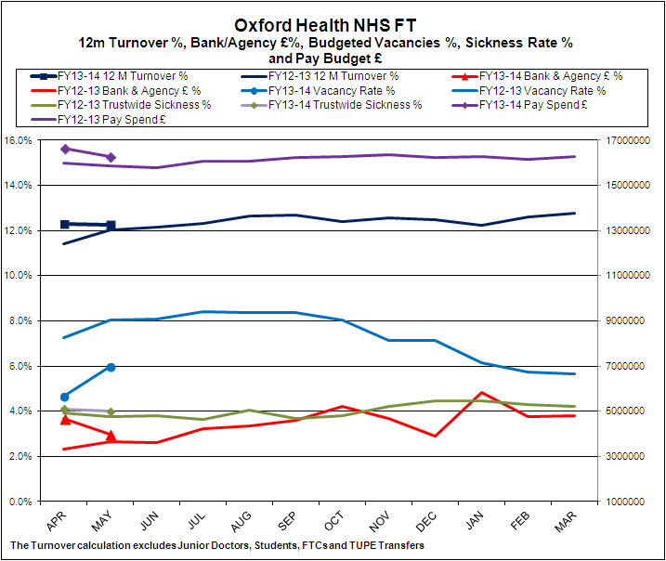
Headline HR KPIs
Turnover – Target 12% - Actual 12.3%
Trust Turnover has remained stable over the last 2 months and is now marginally above target. Earlier predictions of turnover reaching 13% now seem less likely. Staffing stability remains at 85.1%. This indicates that the organisational staffing core remains stable. A new and improved exit process has been developed and is being rolled out across the Trust. All leavers will be contacted personally by a member of the HR admin team who will facilitate the timely completion of the exit data. 33 staff were contacted in May 50% of whom completed questionnaires. Meaningful reports will be produced shortly.
. Bank & Agency- Target 5% - Actual 2.97%
Overall spend is below Trust Target although there are continuing areas of high spend in some areas. NHSP performance continues to be low and agency spend has decreased in the last month. An options appraisal was presented to the Executive Team at the end of May and further work has been requested. Sessional usage is at 2.6% of spend.
Vacancies - Target 9% - Actual 5.96%
The Vacancy rate has increased by almost 1.5% in this month. The rate remains below levels in early FY1213. This may be a single incidence of an increase due to implementation of FY1314 pay funding, where divisions are more actively recruiting to vacancies which were held during budget negotiations.
Sickness Absence - Target 3.5% - Actual 4%
Sickness absence has increased gradually since September 2012 although there been a continuing small decrease over the last 2 months. The top 3 reasons for absence continue to be anxiety and stress, colds and flu and musculo-skeletal complaints.

Slide 3
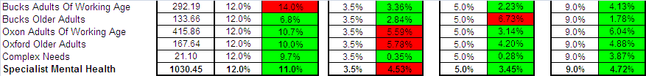
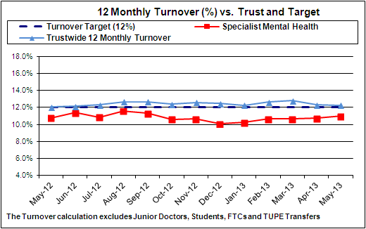
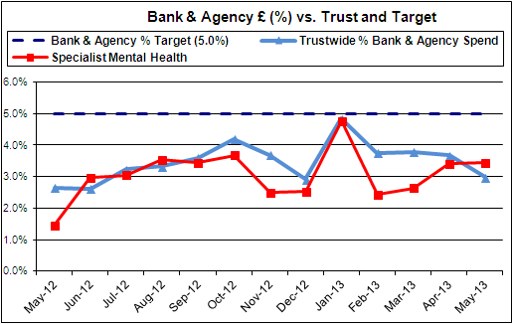
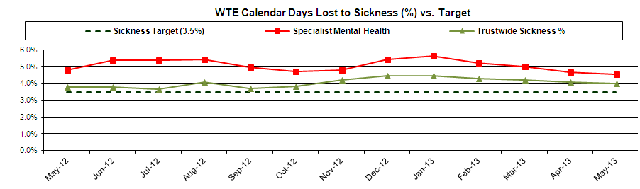
SPECIALIST MENTAL HEALTH SERVICES - PERFORMANCE AGAINST TARGET – ALL INDICATORS

Slide 4
SPECIALIST MENTAL HEALTH SERVICES - PERFORMANCE AGAINST TARGET
- ALL INDICATORS
Analysis/Actions being taken by the HR Team in Month
Turnover
The 3 month trend in turnover remains constant at a little under 11%.
The Bucks Adults of Working age remains at 14% but this is expected to improve over coming months.
Bucks Older Adults turnover trend has risen to 6.8% but this is still below target.
Sickness
Oxford Older Adult wards have historically high levels of long term sickness which is being addressed by management and HR team. This has resulted in a number of formal sickness processes.
Oxford Adults of Working Age have taken a robust line on sickness within the Wards as rising sickness was seen as a concern, improved results are being seen. This has resulted in return to work with adjustments.
Bucks sickness - monthly meetings with Managers are going well and improved results are being seen.
High sickness in the community is dominated by a small number of teams and the main reason for sickness is anxiety/stress/depression/other psychiatric illnesses. Management in those teams has been strengthened or supported by the Service Managers, the use of triggers reinforced and referrals to Occupational Health increased.
Bank and Agency
Bank and Agency costs have remained stable at 3.4% and sessional costs have decreased month on month . The ongoing spend is due to the ward shortages and high levels of observations.
As Mental Health has not historically been included on the NHSP agency agreement either the shifts remain unfilled or the use of sessional staff increases which can result in increased sickness. The Adult wards are booking short contract agency staff for the first time because NHSP cannot be relied upon to fill shifts. We will work with Procurement to ensure we are offered preferential rates by using agencies on the framework.
Vacancies
From the recent successful recruitment campaign 18 appointments have been made with 10 more at offer stage.
.

Slide 5
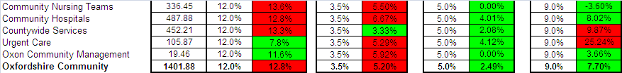
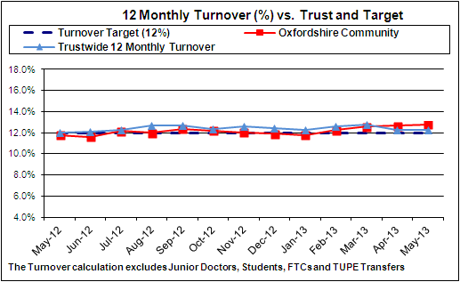
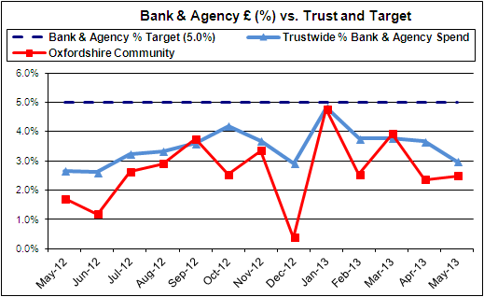
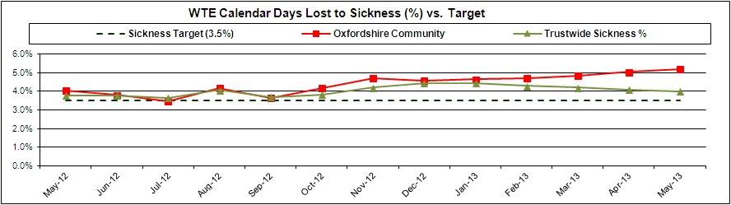
OXFORDSHIRE COMMUNITY SERVICES – PERFORMANCE AGAINST TARGET
– ALL INDICATORS

Slide 6
OXFORDSHIRE COMMUNITY SERVICES – PERFORMANCE AGAINST TARGET
- ALL INDICATORS
Analysis/Actions being taken by the HR Team in Month
Turnover
The Division remains slightly above Trust target at 12.8%: there remains variation across the services
The Staff survey results are being formulated into a presentation to managers which can then help to inform action plans at a Service level.
The new Exit process in which HR are proactively making contact with leavers to gain more detailed Exit information has been published to managers within the Division.
Sickness
Sickness has increased and remains above Trust target at 5.20%. It is above target in all areas of the Division with the exception of Countywide Services
Training in short term sickness absence management for the Band 6/7s in the Community Nursing teams has now been delivered to North East, South East (May) Oxford City and North Localities. We are in the process of arranging training for the South West locality.
Sickness has been higher than usual in some Community Hospitals due to recent outbreaks of D & V and Chest infections which were reported to the Health Protection Agency (HPA) which may have impacted upon the absence rate figures.
All Community Hospitals Managers have been trained in Absence Management in the past but refresher training needs are being reviewed and assessed.
There are now a number of cases going through the formal Capability process relating to sickness absence and ill health. HR are working proactively with Occupational Health and management to deal with these cases promptly.
The half pay/no pay report for all staff within the Division is reviewed monthly at the BARM meetings and each case is discussed to ensure that appropriate management action is being taken.
Bank and Agency
Bank and Agency usage is below Trust target and usage continues to be predominantly within Community hospitals.
Agency levels have fallen in recent weeks as the need for escalation beds has reduced in Community hospitals but remain high in some of the Community Hospitals where there are currently vacancies;
A meeting is arranged between HR, Finance and the Head of Service for Community Hospitals to review Bank and Agency spend and to discuss additional actions which may be taken to reduce the need for Bank and Agency in areas where the use is continually high. The areas where the vacancies are highest are the predominant users and therefore actions being taken in respect of vacancies, as detailed below, are also relevant.
Vacancies:
.The number of vacancies is currently 165 of which 27 are at offer and 83 are at offer accepted.
The number of vacancies has reduced over recent months but there remain pockets of vacancies to which it is proving difficult to recruit.
A Community Services Recruitment Project Group has been set up by HR and will be reviewing actions with regard to hard to fill vacancies . Agreed actions so far include attendance at the National RCN Recruitment fair in London and researching/costing the possibility of recruiting qualified nurses from Ireland as part of plans to cover Winter escalation beds.

Slide 7
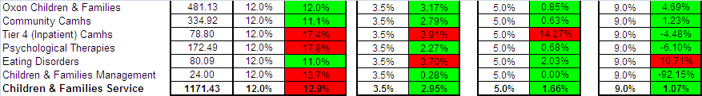
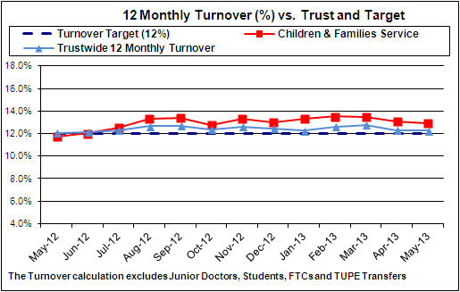
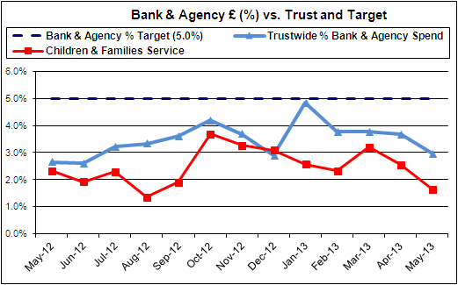
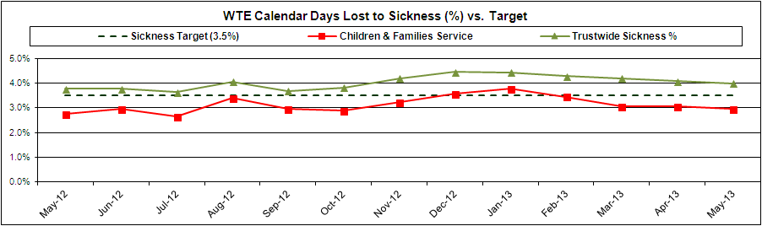
CHILDRENS & FAMILIES SERVICES – PERFORMANCE AGAINST TARGET
- ALL INDICATORS

Slide 8
CHILDRENS & FAMILIES SERVICES – PERFORMANCE AGAINST TARGET
– ALL INDICATORS
:
Analysis/Actions being taken by the HR Team in Month Turnover Current turnover is 12.94%, which is above trust target of 12% however we have seen a slight decrease of 0.14 since last month. HR will work with the Modern Matrons to determine the reasons for contrasting levels of turnover at service level and report findings next month. Number of leavers totalled 18 (WTD 9.92). Sickness Sickness absence continues below trust target at 2.95%, the lowest across all divisions. The top 3 reasons for absence are anxiety and stress at 33.18%, Gastrointestinal 10.81% and Tumours at 10.05%. This will be raised within the meeting arranged between the Senior HR Business Partner and Occupational Health, scheduled for June. Of the staff who are either approaching a ½ or nil pay situation, a number were returning to work in May and early June, with the remainder being monitored and supported by HR and line managers. Bank & Agency Currently 1.7% which is below trust target. Usage has been at or below target since December 2012. Services above target are Tier 4 inpatients at 14.3%, with Highfield Oxford at 16.2% and Highfield Swindon at 11.7% Eating disorders have shown no use of agency in month, with both Cotswold house Oxford & Marlborough making excellent use of sessional contracts Psychological Therapies have minimal bank usage at less than 1% Vacancies The budgeted establishment is 1184 with a contracted WTE of 1171 . Vacancy activity is currently 102. Of the 102 vacancies 13 are at the interview stage, 44 offers have been accepted, 2 cleared. High areas of recruitment are within Universal Services. Other In patient Pilot at Cotswold House Marlborough continuing, still no major concerns reported. Meetings are monthly, managers sharing comments book from staff with working group 14 May 13. Local feedback to date is similar to the community pilot e.g. staff are tired on long shifts and working patterns are beginning to impact on staffs days off. Two staff in Psychological Therapies have been temporarily moved to non registered posts in light of non renewal of registration. Managers of the services are aware and a formal investigation has been instigated for one member of staff.

Slide 9
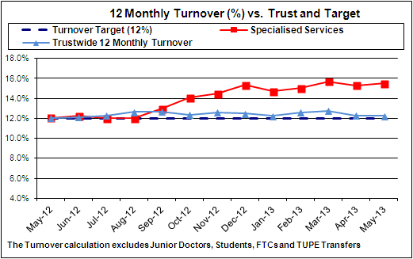
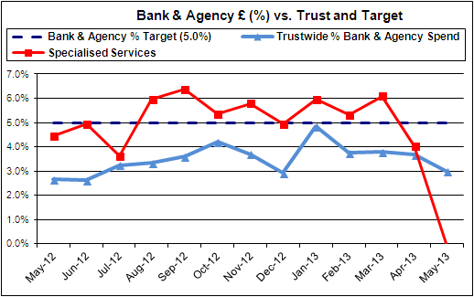
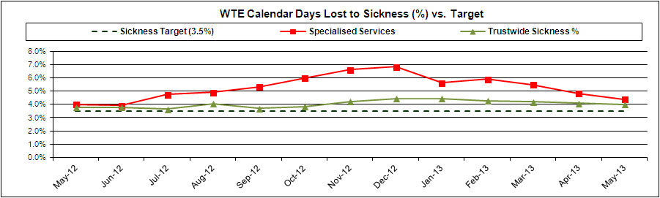
SPECIALISED SERVICES – PERFORMANCE AGAINST TARGET
- ALL INDICATORS

Slide 10
SPECIALISED SERVICES – PERFORMANCE AGAINST TARGET
- ALL INDICATORS
Analysis/Actions being taken by the HR Team in Month Turnover The turnover rate is above target at 15.5%, a marginal increase from 15.3% in the previous month Turnover in the Forensic Mental Health Services is above target in some areas, and service management and HR are considering initiatives to attempt to reduce turnover, but many of the suggestions are already in place. Sessional contracts will continue to be promoted to provide a large pool of sessional workers and offer secondments. Turnover will continue to be monitored by the HR team and further action plans developed as necessary Sickness The trend for overall sickness has reduced monthly since February. However at 4.4% absence levels remain above target The Forensic Services sickness absence rate has reduced to 4.5% (from 5.2% last month) as individuals on long term sick leave start to return to work as planned. There appeared to be a number of long term absences attributed to stress & anxiety in Low Secure services. The Prison Healthcare Service remains above target at 8.1%. Specialised Community Services remains marginally above target at 3.6%. This results from a peak of medium / long term absences which should reduce as individuals return to work as planned Sickness absence will continue to be monitored and reviewed with line managers Bank & Agency Use of bank & agency is generally within target in the Division. The Forensic Services prefer to use sessional contracts. Sessional use in Forensic Services was 11.2% Rota managers in Forensic Inpatient Services report that the Trust decision not to allow any carry forward of annual leave resulted in an increase in bank and agency use as staff used their remaining annual leave. Managers confirm that they monitor leave to ensure staff take as evenly as possible during the leave year The Modern Matron in Prison Services has tried to engage RGNs on sessional contracts. However there has not been a high level of interest in working in the prison. This is attributed to the difference in working behind prison walls and the remote location There appears to be a small increase in use of agency Housekeepers in Low Secure Service. The Recruitment Team will advise the manager that temporary resource of this type can now be supplied through Recruitment Solutions

Slide 11
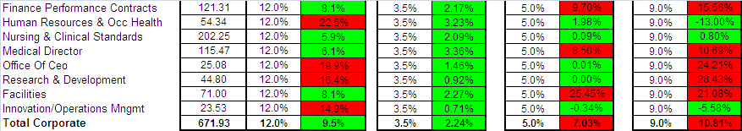
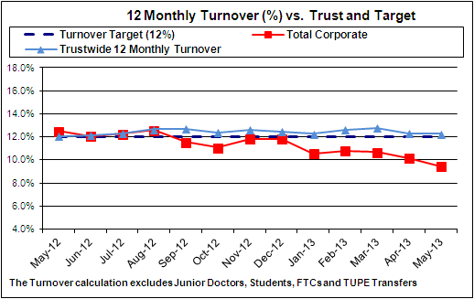
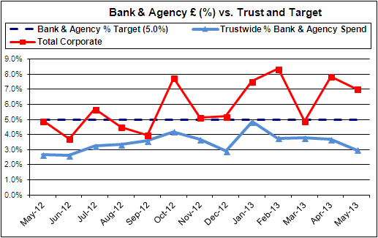
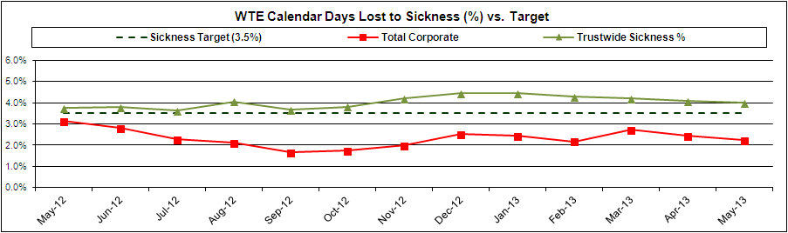
CORPORATE SERVICES - PERFORMANCE AGAINST TARGET – ALL INDICATORS

Slide 12
CORPORATE SERVICES – PERFORMANCE AGAINST TARGET – ALL INDICATORS
Analysis/Actions being taken by the HR Team in Month Turnover The turnover rate for Corporate Services as a whole was 9.5% against a target of 12% and is at its lowest level for 12 months. This compares to a Trust wide position of just over 12%. Sickness Overall sickness levels within Corporate Services are very good at 2.5 %. This is down roughly 0.5% on the previous month. This compares to a target of 3.5% and a Trustwide level for the month of 4%. Bank & Agency Bank & Agency spend for Corporate services as a whole is just above 7%. This is a slight improvement from last months figure of 7.9% Staff have now been/or are now being recruited substantively therefore agency costs will reduce after a period of hand-over. Vacancies The number of live vacancies across the Corporate services remains at 39.

