Slide 1

Workforce Performance Report
November and December 2013
Jayne Halford
Deputy Director of HR
Caring, safe and excellent

Slide 2
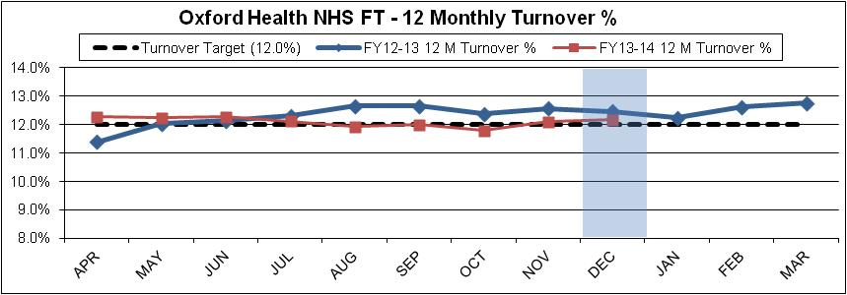
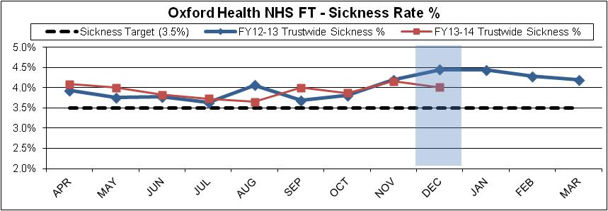
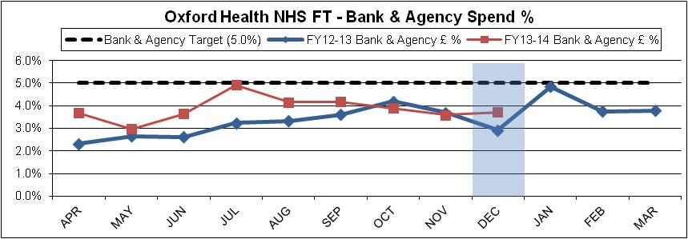
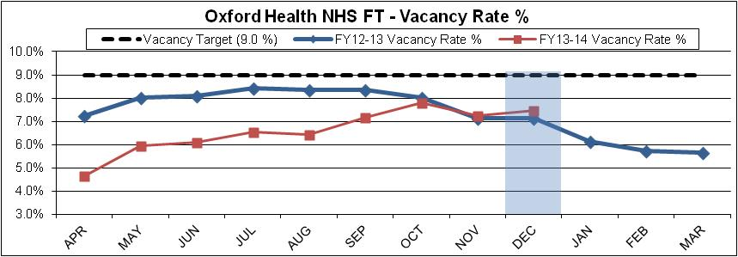
Headline HR KPIs
Turnover – Target 12% - Actual 12.08%
Turnover has increased for the third consecutive month, however it remains lower than a year ago. Indications from the monthly turnover are that this could improve next month.
Leavers outnumbered starters giving an overall decrease of 9.4 wte between November and December 2013.
Sickness – Target 3.5% - Actual 4.01%
Sickness has decreased after a seasonal peak last month and is significantly lower than December 2012. Long term absence is at 1.83% which is the lowest rate seen in the last 12 months and is as a result of intense sickness absence management.
Bank & Agency- Target 5% - Actual 3.71%
Bank and agency has also increased slightly from last month and despite sickness being lower, is higher than the same time a year ago. Sessional use has remained stable at 2.7% in both November and December. The use of additional hours increased further in November and again in December. It remained high in Community Hospitals where it accounted for 2.6% of staff spend in December, and increased in Children and Families Services to 1.4% of overall staff spend. High Agency usage continues in Tier 4 CAMHS and Prison Healthcare. Posts in these services have been advertised.
Vacancies - Target 9% - Actual 7.5%
Vacancies have increased marginally on last month by 0.2%. Recruitment activity is up with 526 vacancies currently being recruited to.
Spend
Overall staff spend in month was slightly overspent at £31k. Operational areas were £184k overspent possibly due to winter pressures.

Slide 3
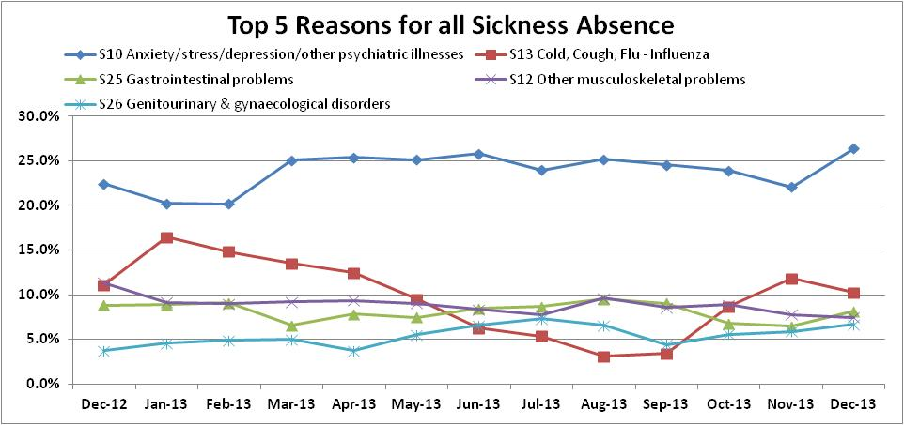
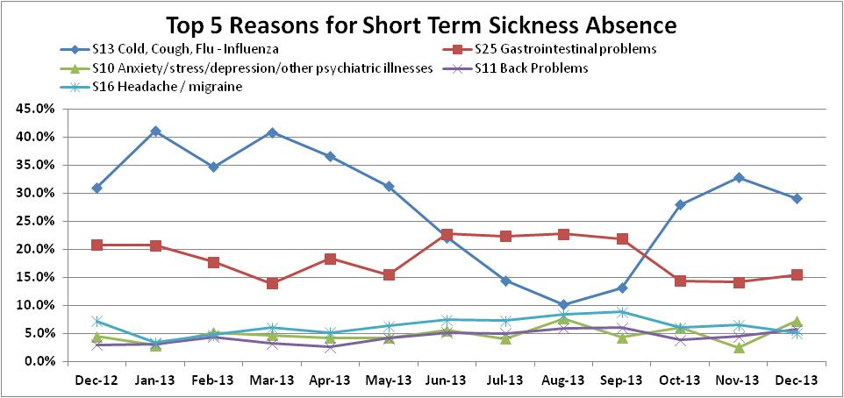
Headline HR KPIs - Sickness
Sickness The top reason for sickness absence continues to be anxiety/stress/depression, which in December 13 accounted for 26.4% of all sickness absence in that month. The increase of absence due to this reason seen in December is coming through medium term episodes where it now accounts for 34.4%, a 52% uplift. 19 of the 32 medium term episodes remained open at the end of the month and so are likely to go on to be long-term. Much of the increase is in Mental Health where 51.9% of medium-term absence is now due to anxiety/ stress/depression. Counselling services are in place through Occupational Health to support staff. Stress management courses are being planned; providers are currently being considered. Unsurprisingly Cold/Cough/Flu is the most common reason given for short term sickness for much of the year with the exception of the summer months. This is followed by Gastrointestinal Problems which appears to be less seasonal. The top 5 reasons for short-term sickness generally account for two thirds of all short-term sickness, but this does drop to just over 50% during the months of July, August and September, when the reasons become more varied. Flu vaccine date indicates 53% of frontline staff have received the vaccine. Monthly feedback is provided to Divisional Directors regarding current data. Occupational Health Dept has provided 73 Flu clinics, booked appointments at all peripatetic clinics, staff have access to flu clinics at OUH, GWH, Salisbury and Bucks Health Care OH Dept’s. Plans for January 2014, re-launch of Flu Campaign with additional clinics throughout the Trust being offered. Support from Comms Team with regard to ongoing publication of data on intranet and daily notification of clinics. Essential “buy-In” and support from all managers will be necessary to support the OH Dept in reaching the 75% target.

Slide 4
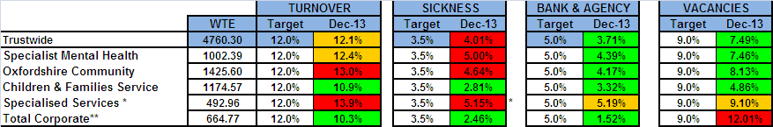
Divisional Performance – Headlines
Turnover An action plan to combat high turnover in Community Nursing has been created and including data gained from targeted exit questionnaires; it would appear that the turnover level has stabilised at the moment . Sickness In Community sickness absence is being managed in a number of ways : the sickness absence leaflet produced has been welcomed by managers and in some instances attached to payslips by managers; there has been one capability dismissal due to absence and 16 cases are being formally managed. Sickness in Specialised was down in December which is showing the impact of intense case management with 7 returns to work and 4 retirements. Vacancies Vacancies, other than in CYF and OCS are generally up since October and this is partly due to the review of all recruitment and freezing of posts whilst reorganisation is happening and some uncertainty over outcomes of reorganisation. Bank and agency Bank and agency has been variable in most areas over the 2 month period; in Community a sign-off policy is being strictly implemented. A significant drop in use in Corporate over the past few months is contributing to a below target figure.
* Turnover in Specialised Services now excludes all leavers from Bullingdon Prisons - Healthcare
** Includes Core Corporate services, also Junior Doctors, Students, Research & Development, Pharmacy and Estates & Facilities

Slide 5
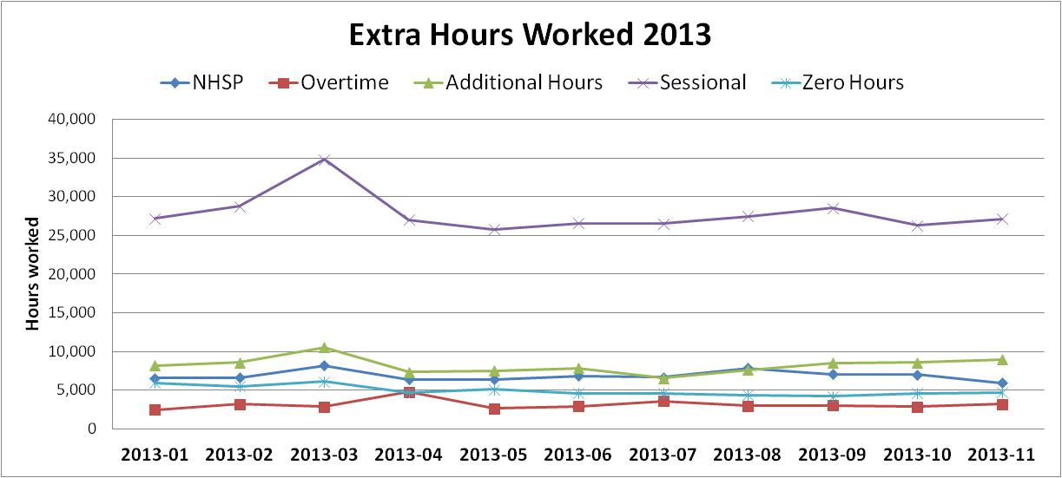
Divisional Performance – Headlines
Flexible Staff
49,986 hours, above those contracted were worked in November 2013. This doesn’t include Agency and equates to approximately an additional 307 WTE for the month. The WTE vacancies at this time were 377.

Slide 6
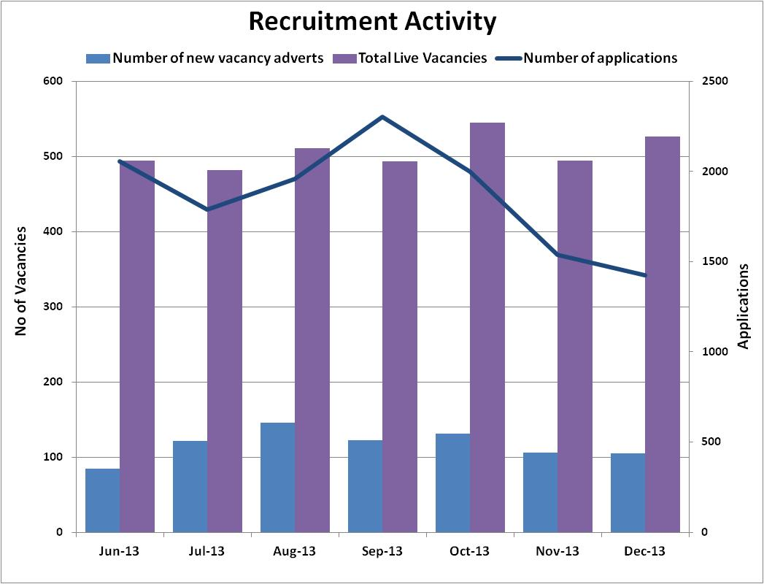
Recruitment Data
Vacancies and applicants
Local recruitment strategy
The Trust’s local recruitment strategy has a number of aims including;
encouraging local people to see the Trust as an ‘employer of
choice’
a proactive and planned approach to recruitment
cost effective recruitment solutions for managers.
The recruitment team has been working with school and college students, disabled people and the long term unemployed to provide work experience and support in gaining employment.
The recruitment process is accompanied by rigorous pre-employment assessment in numeracy and literacy skills, ensuring that these candidates have a level of attainment that is well above the minimum required by the trust. This approach has enabled the local recruitment team to provide cohorts of work experience candidates ready for employment especially in entry-level administrative and health care roles.
Senior HR recruitment staff will be working with their managerial and clinical colleagues over the next few months, to identify suitable vacancies and campaigns which may attract local candidates. The plan is to build on these local recruitment initiatives so that they are ready to use as part of the mainstream recruitment approach and to rely on a longer term perspective of investing in local people and our community.
The recruitment activity shows a typical seasonal drop in the number of applicants; the resourcing team advise that the December period is typically low in prospective candidates.

Slide 7
Exit Questionnaire Data
What attracted you to your job?
Flexible Working Policies | |||||| | 2%
Job Security | |||||||||||||||||| | 6%
Location | |||||||||||||||||||||||||||||||||||||||||||||||||||||||||||||| | 21%
Pay | |||||||||||||| | 5%
Pension Scheme | ||| | 1%
Promotional Prospects | ||||||||| | 3%
Reputation of the Trust | |||||||||||||||| | 6%
Role/Job Description | ||||||||||||||||||||||||||||||||||||||||||||||||||||||||||||||||||||||||||||||||||||| | 28%
Terms and Conditions | | | 0%
Training/Development Opportunities | ||||||||||||||||||||||||||| | 9%
Working for the NHS | ||||||||||||||||||||||||||||||||||||||||||||||||||||||| | 18%
Return Rate
The Return rate for November is 55.2% and the rate for December is 52.4% which is a slight decrease for last month but this was expected due to the Christmas period.
The 3 tables opposite illustrate why people join the Trust and what they enjoy about working in the Trust year to date.
Top 3 reasons for attracting new staff are; Role/Job Description, Location and working for the NHS
Top 3 most satisfying parts of the job role are, Caring/Contact with service users, Level of responsibility and Contributing to the local community
Top 3 most unsatisfying parts of the job are, feeling valued and supported, Learning and development opportunities and flexible working
Top 3 reasons for leaving are, obtaining a better job/promotion, retirement, career change
.
What parts of your job did you enjoy?
Percent | Unsatisfying |  | Satisfying | Percent
6% | ||| | Caring/Contact with service users | |||||||||||||||||||||||||||||||||||||||||||||| | 94%
10% | ||||| | Contributing to the local community | |||||||||||||||||||||||||||||||||||||||||||| | 90%
13% | |||||| | Job content/variety of duties | ||||||||||||||||||||||||||||||||||||||||||| | 88%
25% | |||||||||||| | Feeling valued and supported | ||||||||||||||||||||||||||||||||||||| | 75%
6% | ||| | Working relationships | |||||||||||||||||||||||||||||||||||||||||||||| | 94%
15% | ||||||| | Communication/feeling involved | |||||||||||||||||||||||||||||||||||||||||| | 85%
10% | ||||| | Level of responsibility | |||||||||||||||||||||||||||||||||||||||||||| | 90%
21% | |||||||||| | Flexible working | ||||||||||||||||||||||||||||||||||||||| | 79%
25% | |||||||||||| | Learning and development opportunities | ||||||||||||||||||||||||||||||||||||| | 75%
Top 10 reasons for leaving
Controlled
Lack of opportunity for promotion | |||||||||||||||||||| | 7%
Not treated fairly/equitably | ||||||||||||| | 5%
Workload | ||||||||||||||| | 5%
Uncontrolled
Retirement | |||||||||||||||||||||||||||||||| | 11%
To undertake training/study | |||||||||||| | 4%
Travelling difficulties | ||||||||||||||||| | 6%
Obtaining a better job/promotion | ||||||||||||||||||||||||||||||||||||||||| | 14%
Relocating | ||||||||||||||||||||||||||| | 9%

Slide 8
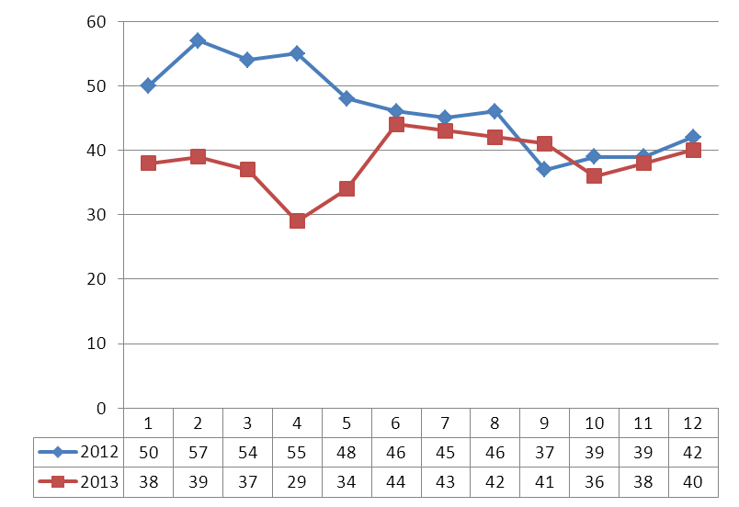
Casework Data
Open Cases by Month
The report relates to Disciplinary Casework only and excludes Cases of Capability (Performance &Health).
Overall the numbers continue around 40 in total.
Themes ,trends and precedents are reviewed regularly
There have been a number of new suspensions since the last report and the current breakdown of suspensions by service is as follows:
Specialised Services- 3
A/OA Mental Health – 2
Children’s & Families- 1
Community Services -1
Corporate Services -1
There is a robust process for management of suspensions and the average length of suspensions has reduced considerably. There is a focus on returning staff to the workplace as soon as practicable.

