Slide 1

Workforce Performance Report
March 2014
Jayne Halford
Deputy Director of HR
Caring, safe and excellent

Slide 2
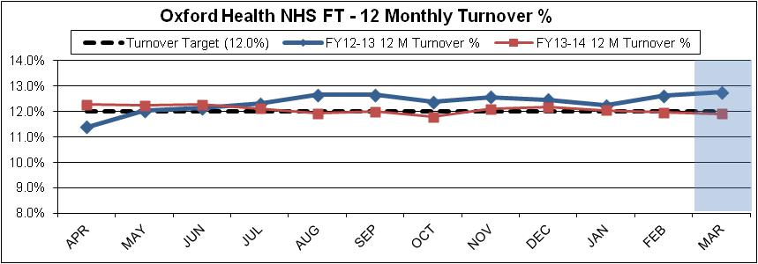
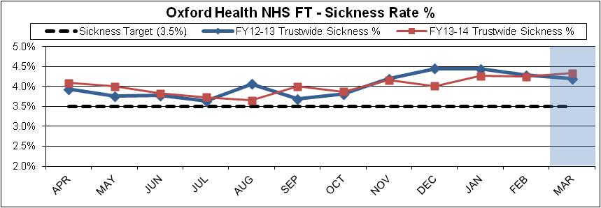
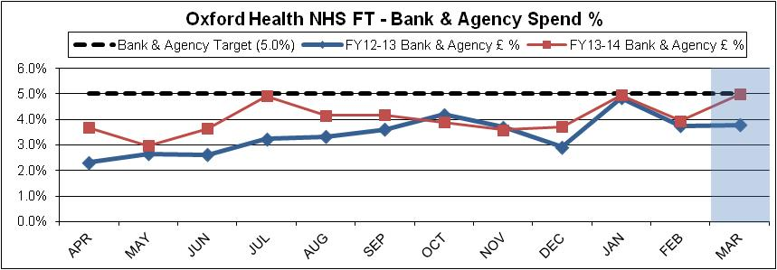
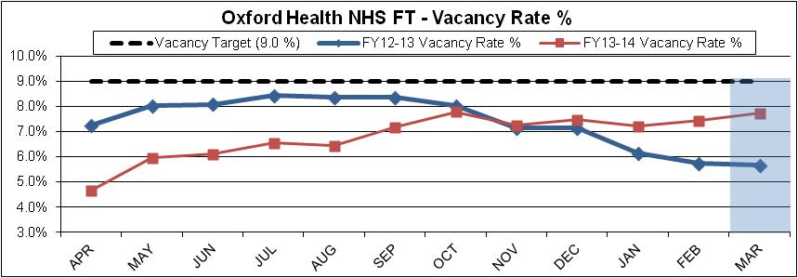
Headline HR KPIs
Turnover – Target 12% - Actual 11.92%
Turnover remains on or around target as it has done all year, despite the fact that leavers out –weighed starters in March . 17.9 of the 76.6 wte leavers were transferred from CASH under TUPE and therefore are not included in turnover calculations. Stability has fallen slightly to 83.7% which is the lowest reported in over 3 years. Retirement was the 3rd highest reason for leaving in March, behind Employee Transfer and Voluntary Resignation – Reason Unknown.
Sickness – Target 3.5% - Actual 4.34%
Overall Sickness has increased month on month and is higher than the same time a year ago. The increase is in long-term sickness, medium term and short term episodes have both seen a small decline as we move out of the winter months.
Bank & Agency- Target 5% - Actual 5%
There has been an increase in the use of Bank within Oxon Mental Health and Community Hospitals which is has caused Bank & Agency to increase to target this month. Despite there not being an increase in spend in March 2013 this is not an unusual trend for the last month in the financial year. The graph overleaf will demonstrate the link between bank , agency and sessional and annual leave taken.
Sessional spend also saw an increase from 2.8% to 3.1%
Vacancies - Target 9% - Actual 7.7%
Vacancies remain below target ; the tight control of recruitment continues and the MARS programme is ongoing.
Spend
Total pay increased by 3% month on month. This is an in-month overspend of £704K against Budgeted . The year end pay variance was £745 adverse. C 200k of this is offset by R and D income. The remainder largely represents undelivered CIPS. .

Slide 3
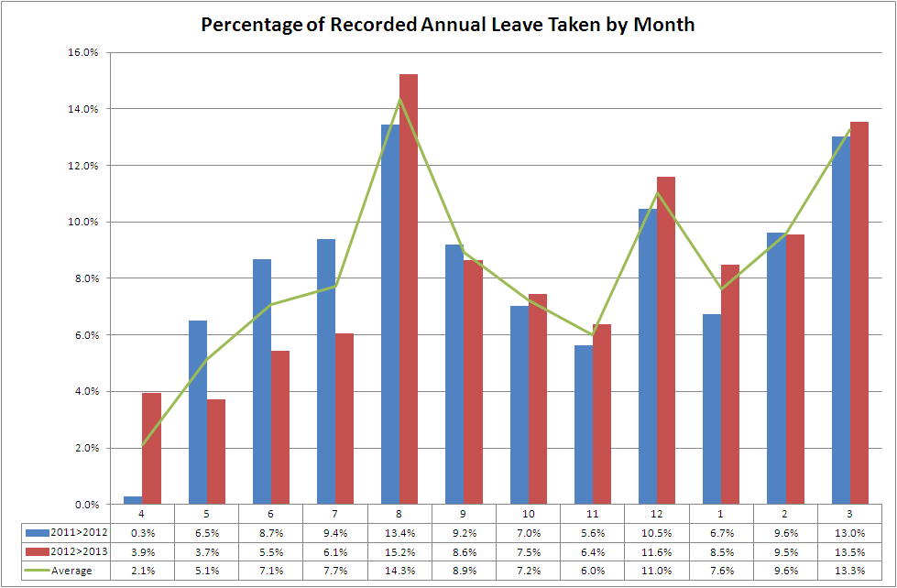
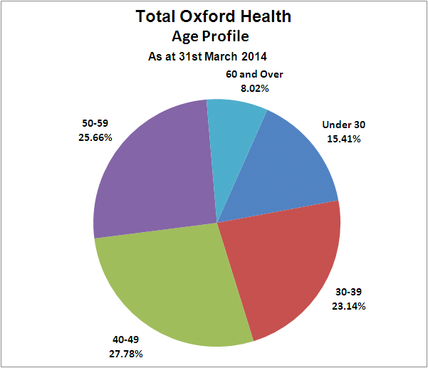
Headline HR KPIs
The record of annual leave taken corresponds with the spike in bank and agency in March. Other spikes naturally mirror major holiday months - August school holidays and Christmas. Managers are urged to plan for these known peaks.
The age profile below shows that a large percentage of staff are likely to have school age children.

Slide 4
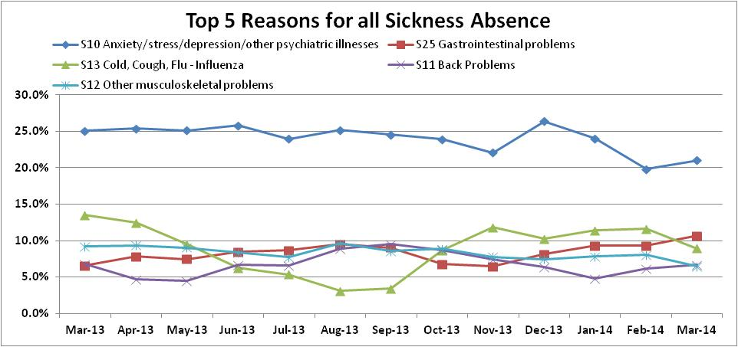
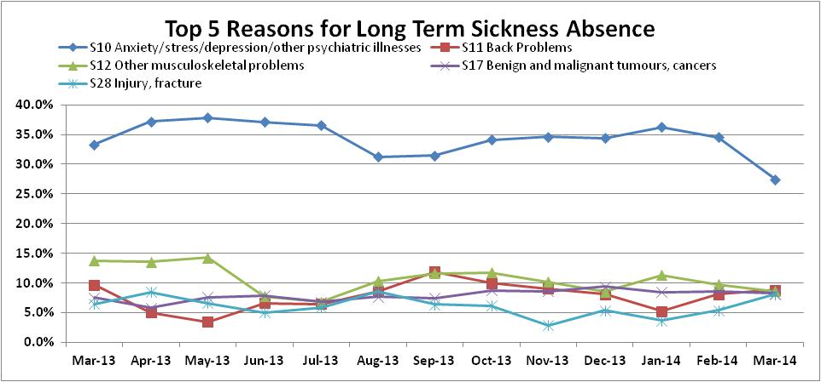
Headline HR KPIs - Sickness
Sickness Reasons The top reason continues to be Stress/Anxiety/ Depression, however, despite a slight increase from last month the % of sickness for this reason remains lower than it has been in the past 12 months. Stress management courses have been piloted and the restructuring in Adults Directorate is complete – so whilst there is a peak of absence related to stress it is likely now to fall. Coughs and colds reduce as we move into spring. Long Term Sickness There has been a significant drop in the proportion of long-term sickness due to Stress/Anxiety/ Depression. The majority of this decrease can be seen in Community Nursing teams where the percentage of long term sickness taken off for stress has dropped from 52.3% last month to 15.1% this month.

Slide 5
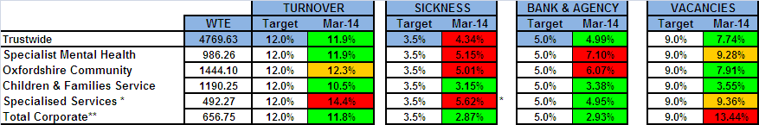
Divisional Performance – Headlines
Turnover In Community turnover has stabilised but needs to be monitored to see whether this is sustained following a specific programme of actions as described last month. Turnover continues over target in Specialised and the hot spot continues to be prison staffing where bank and agency usage is correspondingly high. Sickness Specialised Services saw an increase in sickness across all areas. High levels of long term sick in Specialised Community are largely in Dentistry. Of 6 long-term absences 2 are returning to work, 2 are in process and 2 are being managed. Much of the long and medium term sickness absence in Mental Health is due to stress related absences. HR are doing some more focused work with managers around this. In Community sickness has stabilised in some areas, particularly within DN teams where the sickness had been exceptionally high. A range of measures has had a positive impact. Pharmacy has experienced very high sickness levels for some time. HR and local management have been working together to support staff in managing their health and attendance and the downward trend is expected to continue. Due to the high levels of absence, agency spend has been high so the Resourcing Team will be meeting with local management to attempt to source suitable sessional workers for Pharmacy. In Mental Health there are 13 formal ill health capability cases – this is quite high but reflects the high levels of sickness that were showing in the KPIs. Bank and Agency In Community agency costs were £286k in month which is largely to trend but is an increase in spend of £47k when compared to February. Agency spend in community hospitals was £105k which is £8k higher than in month 11. The large majority of NHSP shifts have been utilised within Community Hospitals with Abingdon and Witney being the highest users. In the week ending 2nd March 14 there were 13 shift requests at Witney and there were 17 shift requests at Abingdon due to patients requiring 1:1 observation. This combined with relatively high numbers of vacancies (which are being actively recruited to) and high sickness absence rates has contributed to bank/agency spend being a little over Trust targets along with an increase in the provision of cost against Community Therapy Services related to Winter Pressures. Community services continue to utilise their bank and agency policy and booking framework and tightly monitor requests and spend.
* Turnover in Specialised Services now excludes all leavers from Bullingdon Prisons - Healthcare
** Includes Core Corporate services, also Junior Doctors, Students, Research & Development, Pharmacy and Estates and Facilities

Slide 6
Divisional Performance – Headlines
Other
In Childrens and Families attendance at HR surgeries and Clinical Governance Operational meetings alerts HR to potential issues early on allowing early intervention.
In Mental Health HR has supported a specific ward in increasing the number of staff completing mandatory training in particular resuscitation and is working proactively with staff who need redeployment to ensure that pay protection ceases as quickly as possible and we reach the agreed establishment numbers in the teams.
Specialised -Agency and overtime costs in HMP Huntercombe healthcare should reduce as the service has started to appoint sessional contract workers.
Mental Health
Overall there has been a slight reduction in bank and agency spend in the Adult Oxford wards, compared to the previous month, but usage remains above target. This is mainly attributable to an increase in sickness and pregnant staff removed from clinical duties. The Buckinghamshire wards had a higher amount of NHSP spend mainly due to moving to the Whiteleaf Centre and covering sickness.
Vacancies
The Mental Health HR team is working to develop some new initiatives to attract more candidates of better quality for what are proving to be hard to fill posts. This will improve the staffing section on the CQC report which is amber for staffing against a number of wards and also have an impact on sickness where staff are feeling stressed due to staffing shortages. Heads of Service and Service Managers are attending a recruitment event in Glasgow on the 9/10 April.

Slide 7
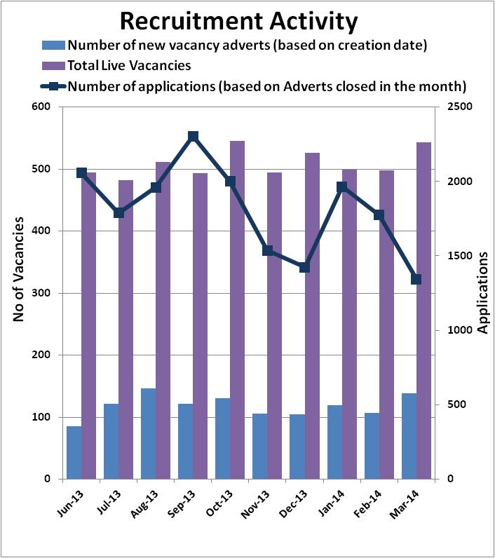
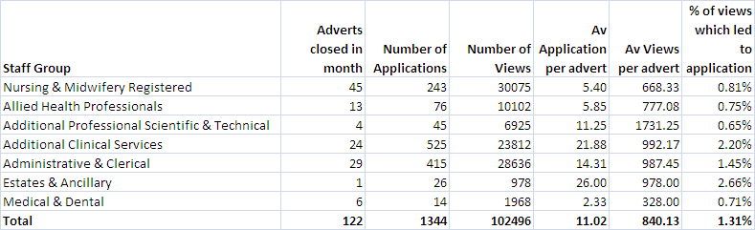
Recruitment Data
Recruitment Figures
We are now utilising the pre-application questions on NHS Jobs II where candidates have to answer role specific questions before they are able to complete an application form which is resulting in fewer non-relevant applications. The new approach has meant there is a small drop in applications being received. In previous months the level of applications has been high as we always see an increase in applications at the beginning of the year.
Resourcing Update
As part of our 'Right people, right skills, attitudes and behaviours to reflect trust values’ approach the Resourcing team have successfully launched two processes aimed at ensuring that all Trust staff make a contribution to organisational development and achieve full competence in their role. These are:
a. Probationary policy
From the 1st of April all new starters with the Trust now have to go through a probationary period where they will have objectives set by their line manager, agree a personal development plan and meet on a regular basis to discuss progress with formal reviews taking place before end of the six-month probationary period. The primary objective of this is to help new starters achieve the best possible level of performance.
b. Literacy and numeracy assessments
Also from the 1st of April all external candidates being interviewed for Band 1-5 non-qualified position are required to complete a literacy and numeracy assessment as part of the selection process. These assessments are designed to ensure we appoint candidates that demonstrated during their interview that they have the relevant skills and knowledge needed to competently undertake the role . Where there are gaps in their skill set/knowledge and it is deemed that they will benefit from support and development this will be addressed during the probationary period to help them develop the necessary knowledge/skills.

Slide 8
Exit Questionnaire Data
Exit questionnaire data remains problematic to collect with further work being carried out to capture staff leaving the Trust and ensuring managers and staff awareness. A working group will shortly review the findings.
The chart shows a spike in numbers of questionnaires completed in March which is due to a specific exercise carried out in Community Nursing.
The main reasons for leaving by division are:
Mental Health :
Relocation
Not treated fairly
Better job/promotion
Specialised
Better job/promotion
Relocation
Community
Better job/promotion
Relocation
Retirement
Corporate
Better job/promotion
Relocation
Workload
Completed submissions by division:
Specialist Mental Health 25
Specialised Services 16
Corporate Services 35
Community 67
Children and Families 41
Undefined 7
.

Slide 9
Casework Data
In March the number of new cases dropped slightly with a significant fall in Mental Health but a rise in Community and Corporate.
The number of staff on suspension relating to disciplinary or capability processes is 4, although one of these is AWOL rather than consciously suspended with no pay. In Mental Health 3 staff are currently suspended but have disciplinary panels scheduled for April.
Open cases are comprised as follows:
Bullying and Harassment 3
Capability-health 19
Capability-performance 8
Complaint (3rd party) 1
Conduct - other 3
Conduct - safeguarding 5
Disciplinary 16
Employment Tribunal 2
Grievance (individual) 6
There is no real change in breakdown by type over the previous month

Slide 10
Casework Data
As the chart shows March remains the month where cases show low numbers of cases closed. Overall the number of current cases open stands at 65 which represents 1.04% of staff.
6 staff are currently suspended but have disciplinary panels scheduled for April and May so this should reduce next month.
Duration for main cases is as follow. Overall there has been a slight improvement in case durations: with the increase in numbers of
Disciplinary – 111 days
Conduct - 129 days
Bullying and harassment - 123 days
Grievance - 128 days
Capability - (health) 162 days
There is no update on whistle-blowing this month as there have been no new cases and there are no open cases.

