Slide 1

Workforce Performance Report
April 2014
Jayne Halford
Deputy Director of HR
Caring, safe and excellent

Slide 2
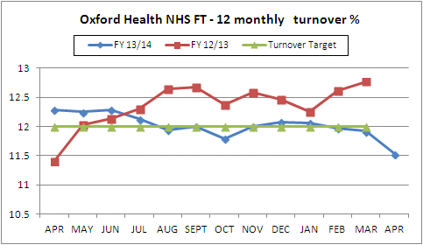
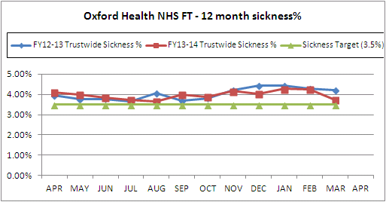
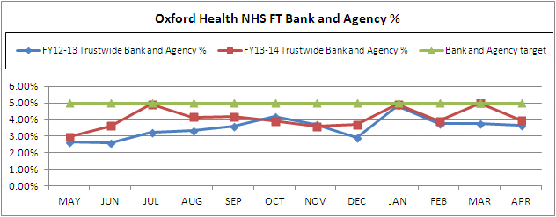
Headline HR KPIs
General Note: The new structures are not yet represented in this report as work takes place in May only to input revised cost centres and structures.
Turnover – Target 12% - Actual 11.53%
Turnover dropped to 11.53% in April, the lowest level for a considerable period; this does include 13 retirements the majority of whom had long service and this affects the stability rate which dropped slightly to 83.5% Total leavers (but not shown in turnover)included also 4 Podiatry staff tuped out and 2 leavers under MARS (Mutually Agreed Resignation Scheme).
Sickness – Target 3.5% - Actual 3.73%
Sickness absence has dropped considerably in comparison with recent months and is likely to be a result of the milder winter and the high levels of annual leave in March which we saw in the April Workforce Board Report. The HPA report influenza at a very low rate for 2013/14.
A further Wellbeing day is planned for June and Stress Awareness Courses are being launched. A full-time as opposed to part-time Well-being Coordinator has been recruited and will take up post in June.
Bank & Agency- Target 5% - Actual 3.99%
Bank and Agency has fallen from a high of 5% in March to 3.99% in April which is in line with previous years. Sessional use however is at 3.35 % ; use of sessional staff is in line with policy and shows a trend of increased use. Total use of flexible staffing has dropped from last month and is more in line with the same period last year. Usage for the year appears to have peaked at holiday time and when winter illness is likely to be high.
.

Slide 3
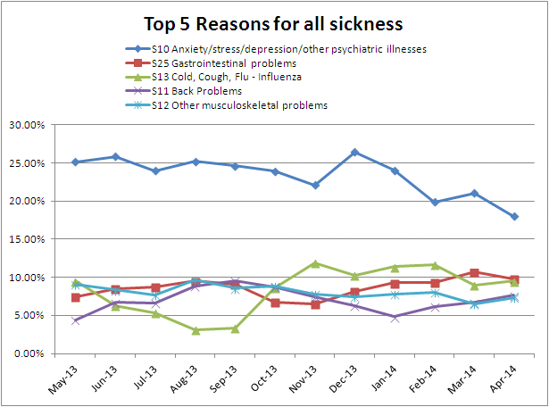
Headline HR KPIs - Sickness
NHS Employers have provided sickness absence statistics for 241 NHS Trusts for calendar year 2013; the average days absence per head is 9.46; at 9 days per head Oxford Health is below this figure – but above the figures for local comparators: Oxford University Hospitals 7.5 days Berkshire Healthcare NHS FT 8 days Buckinghamshire Healthcare NHS FT 8.6 days Oxford Health lies above mid-table at joint 99 of the 241 Trusts – the lowest figure being 3.1days (an organisation of 423 staff) and the highest 14.9 days (urban mental health trust). Anxiety and stress continues to be the main cause of sickness absence but is clearly on a downward trend; this may be linked to the fact that the organisational change in Adults (formerly Specialist Mental Health) has largely drawn to a close. Back problems and other musculoskeletal issues have increased slightly and these can sometimes be linked to stress.

Slide 4
Divisional Performance – Headlines
Children and Families At Highfield Oxford a staffing model has now been agreed and this should result in a reduction in Agency spend over the coming months. The Directorate was awarded the School Health Nurse tender and work has started on implementing the new commissioned model. Following the retention of the School Health Nursing contract, a SHN project board will monitor the contract for a period of 1 year – HR is included on that board. A very time consuming case which went to an ET has been concluded with the case being dismissed. HR are currently managing 10 formal cases, which comprise 4 disciplinary matters, 4 capabilities, an allegation of bullying and harassment and an ET submission. HR continues to work closely with managers and staff in all performance management matters, since the recording of formal cases on the casework database (2011), HR have closed approximately 54 cases. All disciplinary cases and a bullying and harassment case have an appointed investigation manager and investigations are underway. There are no suspensions in the division. Partnership working continues to ensure formal case work is at a low level. Community (now Older Adults) There are currently 16 formal ill health capability cases and the Directorate has good control of the long term sickness absence cases and is reviewing high Bradford scores to ensure appropriate management of repeated short term sickness absence management. More detailed narrative concerning workforce data is being provided to management teams to help them understand and address areas of concern. The Directorate continues to use the Bank/Agency policy and sign off procedures to ensure adequate scrutiny and governance around bank and agency usage within the Division – there has been some recent high usage due to “specialising” which is significant one to one nursing because of a patient’s complex needs.

Slide 5
Divisional Performance – Headlines
Mental Health (Adults)
Recruitment activity is high and Specialised Services and Psychological Services are now recorded under the Adult Mental Health Directorate.
Student Nurses completing their studies at Brookes University have been successful in applying for roles in the Trust. They will receive their PIN numbers in September but many are starting as Band 3 HCA’s in August.
A recruitment strategy has been drafted for consideration by the Directorate which will involve regular open days, improved Communications material to showcase the new hospital and a range of options for hard to fill posts.
Casework in Adult Mental Health has decreased but suspensions have increased to 3. Casework in Specialised Services remains consistently high and there are a number of suspensions. Medical Discharge hearings are increasing demonstrating focussed management of sickness absence.
Specialised (now part of Adults)
For the last few years, the NHS Staff Survey results relating to bullying/harassment and violence from staff have caused a concern in Specialised Services. The 2013 survey showed that 18% of respondents reported that they experienced violence from staff at work; 25% reported they experienced bullying / harassment from staff at work. It is noted that HR casework does not reflect these results but they are clearly of concern.
The Service Director has written a letter which has been cascaded to all staff expressing concern about these results, advising how concerns can be reported and assuring staff that allegations would be taken seriously. The Division has introduced a dedicated telephone number to allow individuals to be able to report concerns; this in addition to the normal line manager route.
The forensic services have asked Communications to update the Trust’s posters informing patients, carers and visitors that there is a zero tolerance policy towards people behaving inappropriately towards NHS staff. These will be displayed in appropriate areas once the Communications team have completed the work.

Slide 6
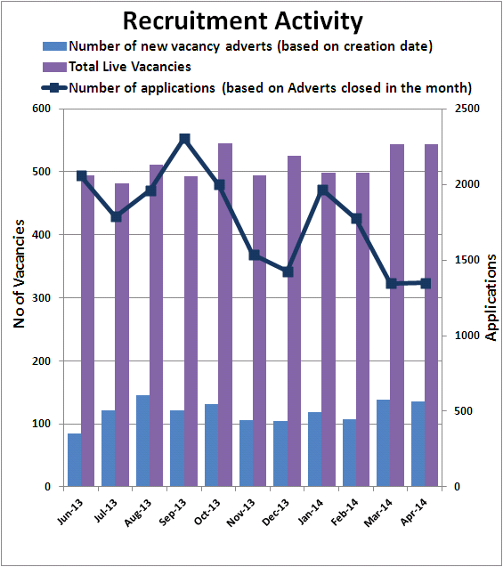
Recruitment Data
Recruitment figures
The rise in vacancy numbers that we experience in April and May each year as a result of advertising our student vacancies for a September start is apparent.
The number of applications has continued the March trend of dropping slightly due to the introduction of the pre-application questions on NHS Jobs, this is resulting in a reduction in applications that are not relevant for the specific vacancy.
Resourcing update
In April the Trust attended 2 recruitment events, one with the RCN in Scotland and one with Skills4Health in Ireland. The majority of the attendees spoken to were staff due to qualify this summer. We are currently in contact with the attendees from these events advising them of our current vacancies and the process of applying for the vacancies for which they wish to be considered . We will be receiving these applications directly into the resourcing team rather than the NHS Jobs website so that we can organise the necessary days for Skype interviews and to enable us to analyse the success rate of attending the events in far greater detail.
We are also working with our colleagues in Adult Services to hold a recruitment open day for their inpatient services at the beginning of July, this will involve developing recruitment literature specifically for the adult mental health services as well as revising our current merchandise/literature.
.

Slide 7
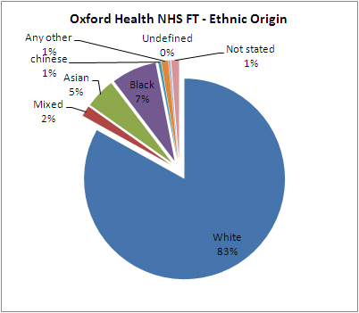
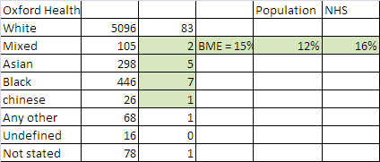
Equality Data
NHS Employers have recently published NHS-wide Equality Data which allows a comparison with our data.
Ethnic Origin
Oxford Health’s ethnicity breakdown is in line with the NHS overall breakdown and more than reflective of the overall population.
Against January 2013 figures , these ethnic origins as a proportion have increased:
Mixed
Asian
Chinese
Whilst black ethnicity has decreased from 7.6% to 7%. As a result of data cleansing the not stated category has reduced from 1.4% to 0% (16 records).
Disability
Numbers of disabled staff have fallen since 2013 although again data has improved as a result of a data cleansing exercise so that numbers of undefined status have halved however a significant number of staff do not wish to declare their status.
14% of the population are disabled; 2% of NHS employees are disabled; 45% of NHS staff have not disclosed their status therefore Oxford Health statistics compare favourably with overall NHS statistics at 2% and 39% but not with national statistics. Further data cleansing is planned to improve on the unknown category of data.

Slide 8
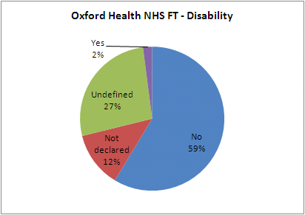
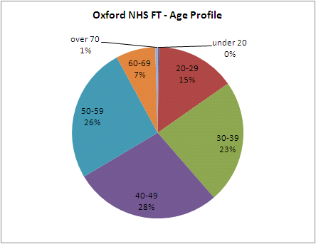
Equality Data
Oxford Health’s age profile as seen last month has varied little from approximately the same time in 2013; with a small decrease in over 60s and a commensurate increase in under 30s. The introduction of an apprenticeship scheme and resourcing strategies such as going in to local schools and participation in a work experience scheme may increase the numbers of staff aged under 30.

Slide 9
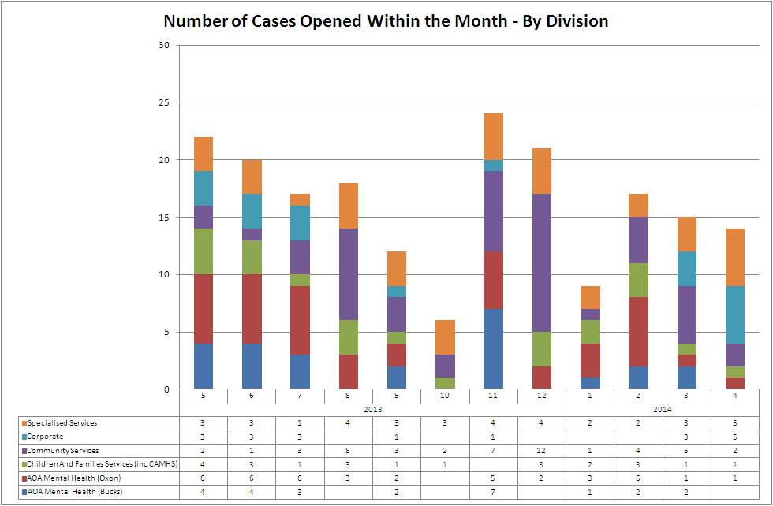
Casework Data
In April fewer cases were opened continuing a downward trend; The overall number of open cases is 59 - a drop on last month and representing only 0.95% of staff. In Corporate one grievance and one disciplinary concern the same member of staff.
There were no new Whistleblowing cases within the month .
Duration for main cases is as follow. For the second month running case duration has dropped in all main case types as a result of new streamlined policies and better coaching of managers.
Disciplinary – 82.29 days
Conduct - 129 days
Bullying and harassment - 123 days
Grievance - 128 days
Capability - (health) 162 days

Slide 10
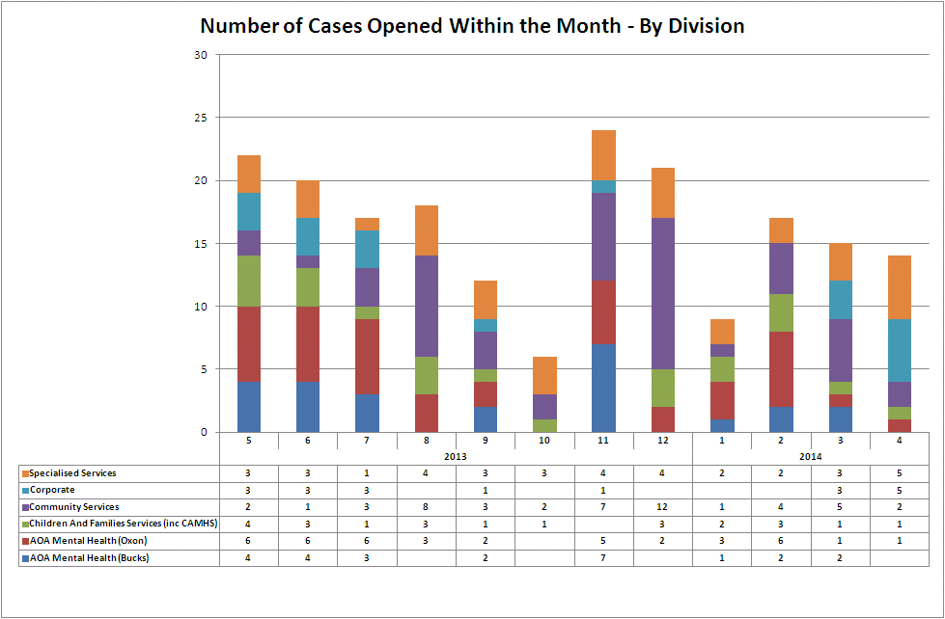
Casework Data
Main case types continue to be grievance, disciplinary and capability (on health grounds). The number of health capability cases underlines the focus on managing sickness absence . Numbers of these cases are as follows:
Case Type Total
Bullying and Harassment 3
Capability Performance 5
Capability Health 20
Conduct – Other 2
Disciplinary 19
Employment Tribunal 2
Grievance (IND) 8
Grand Total 59

