Slide 1
Workforce Performance Report
August 2017
Mike McEnaney
Director of Finance

Slide 2
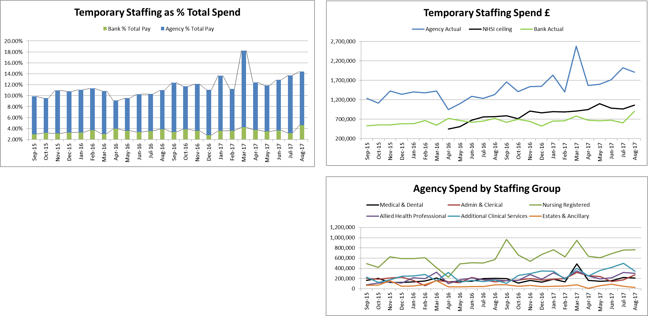
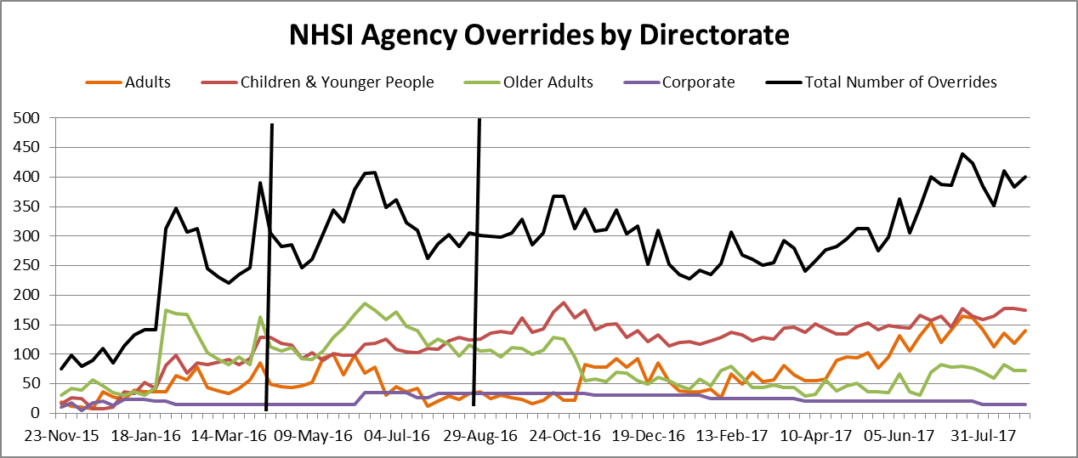
Temporary staffing spend now includes GPs in the OOH service that have moved onto payroll. Without this temporary staffing spend in August would have remained at July’s levels. This also accounts for £190K of the £300k increase in bank spend . Removing this factor Bank spend still increased to near its height. Bank spend returned to average level in the Adults directorate with little change elsewhere (excluding OOH GP impact).
There has been a £100k decrease in agency spend compared to July, despite peak holiday season. This decrease is due to a £150k decrease in the Additional Clinical Services staffing group, 1/3 of which was offset by an increase in bank the remainder being an overall decrease in temporary staffing use. Agency spend was 80.74% above the ceiling set by NHSI and overrides have continued to rise since the start of the FY. Reported reason for Agency use for units on the WFMS has increased steadily from the beginning of the FY from 52% to 62%. 20% was used for increased workload / acuity and 4% for sickness.
Temporary Staffing Spend
This Month: 14.43%
£2.819m
Last Month: 13.72%
£2.629m
Last Year: 11.01%
£2.055m
Reduction
Reduction

Slide 3
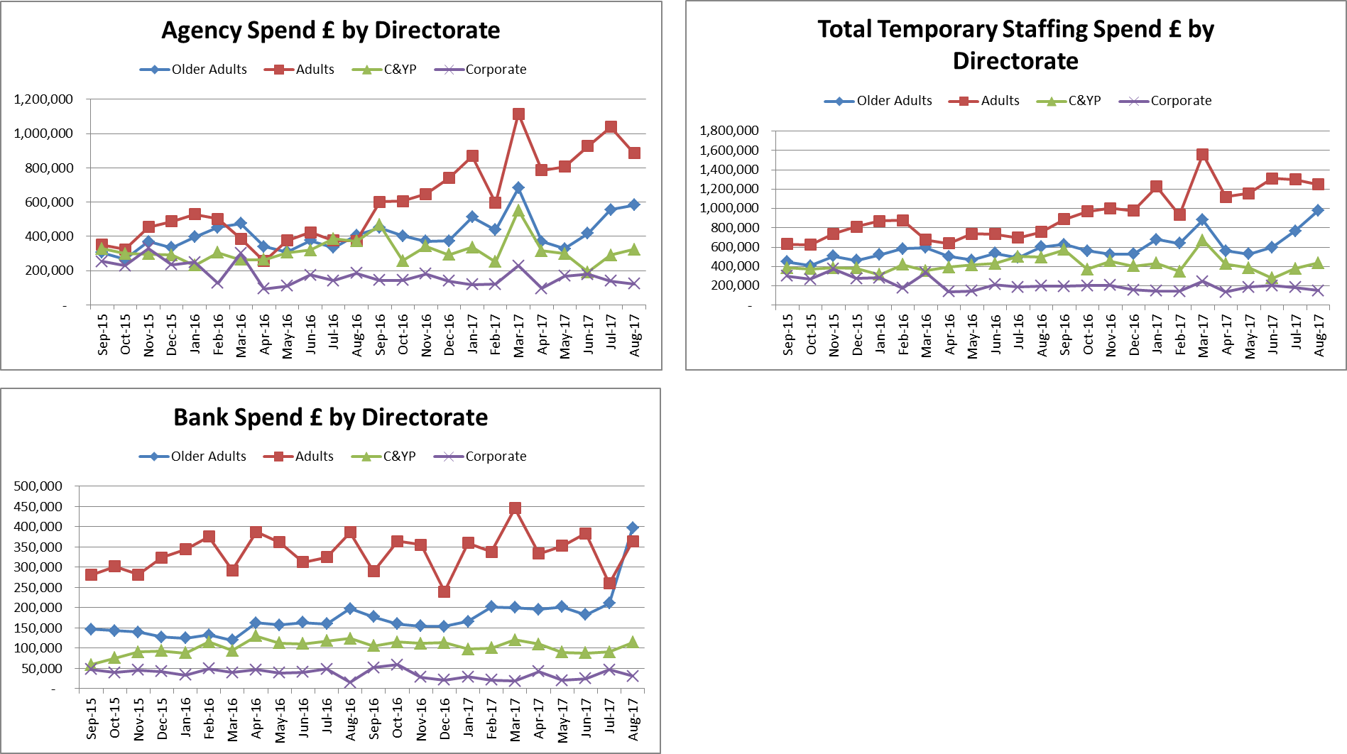
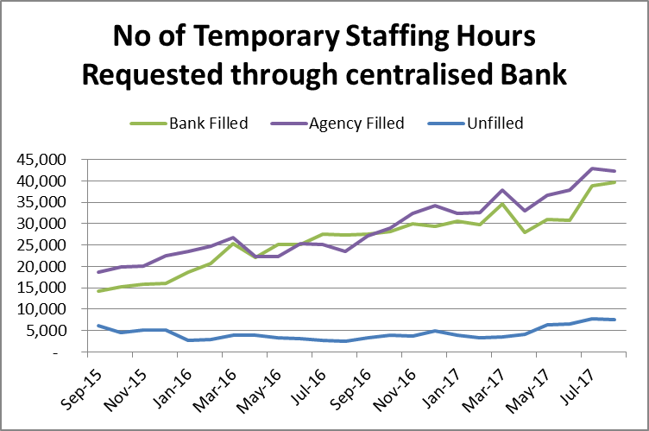
Temporary Staffing Spend
Recruitment of Flexible Workers has now moved to the core recruitment team and additional posts are in place to support increased recruitment activity which is being supported by the “Bank with Us” challenge that was launched on 1 September.
Centralisation of the management of all agency spend is well underway and all agency spend with the aim of all spend being on the WFMS form 2 October.
Implementation of the SafeCare module of the Workforce Management system which allows the Trust to compare actual staffing with demand driven by patient acuity across inpatient units is currently being implemented and should be complete by the end of October. This will support the Trust to ensure staffing levels are appropriate to patient needs.
The Carter 90 Day improvement challenge is focusing the Trust on floor to Board Rostering reporting with the aim of improving the equity, efficiency and safety of rosters.

Slide 4
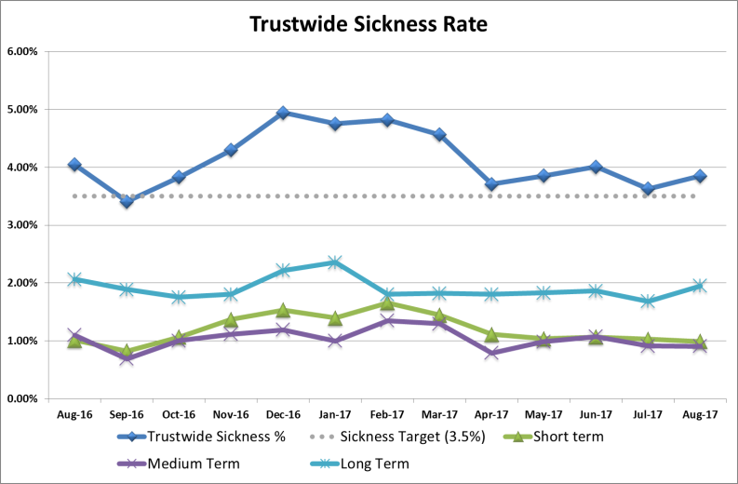
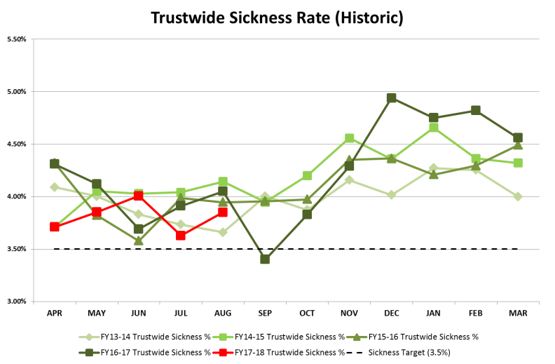
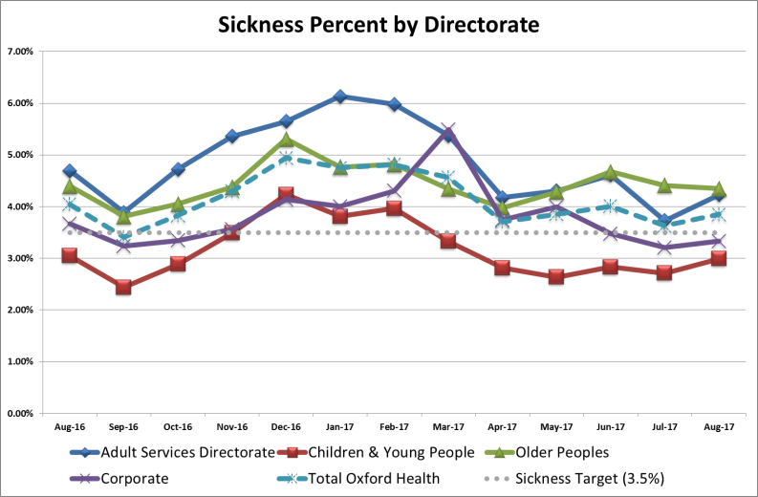
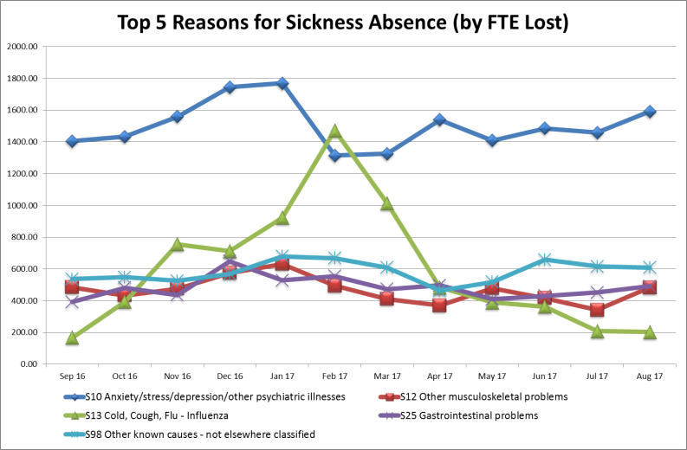
Sickness has increased slightly in August to stand at 3.85%. The increase has been experienced across all directorates except Older Peoples. The current rate is above the Trust target but below comparable periods over the last three previous years. The increase has been driven by a rise in long-term sickness episodes, particularly those relating to stress and musculoskeletal problems. Cold and flu absence is now very low but likely to rise as we move into the autumn. Occupation Health will be promoting Flu vaccinations to try to counter the likely increase.
Sickness
Target: 3.50%
This Month: 3.85%
Last Month: 3.63%
Last Year: 4.05%

Slide 5
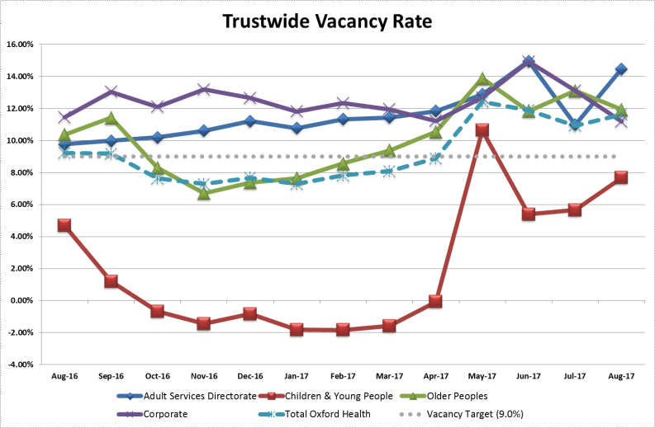
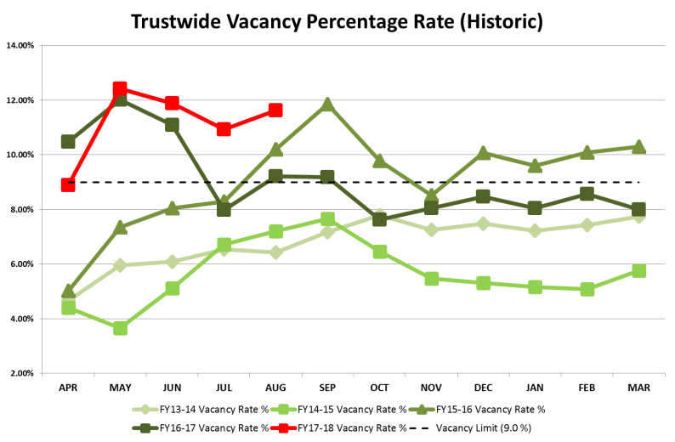
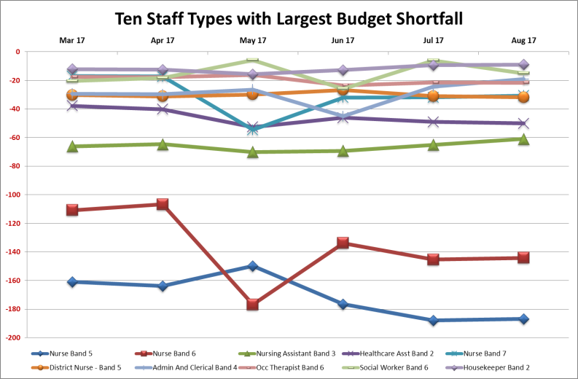
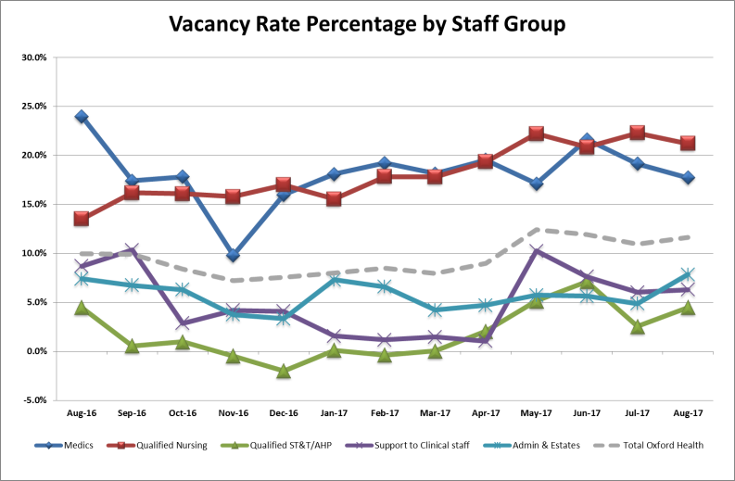
The vacancy rate has increased slightly to 11.62% in August from 10.93% in July. The long-term increase in the Trust vacancy rate is driven by the growing budget shortfall in Qualified Nursing staff , most particularly bands 5 and 6.
Vacancy
Target: 9.0%
This Month: 11.62%
Last Month: 10.93%
Last Year: 79.22%

Slide 6
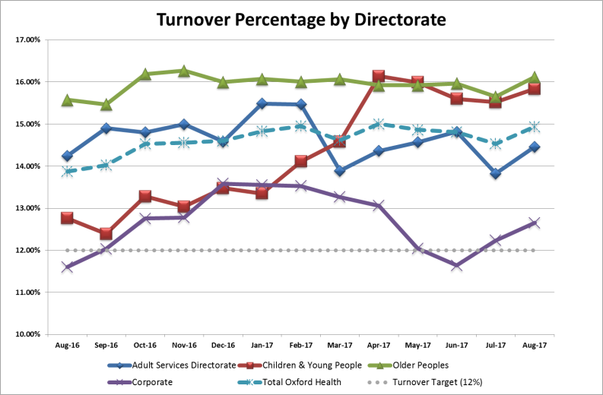
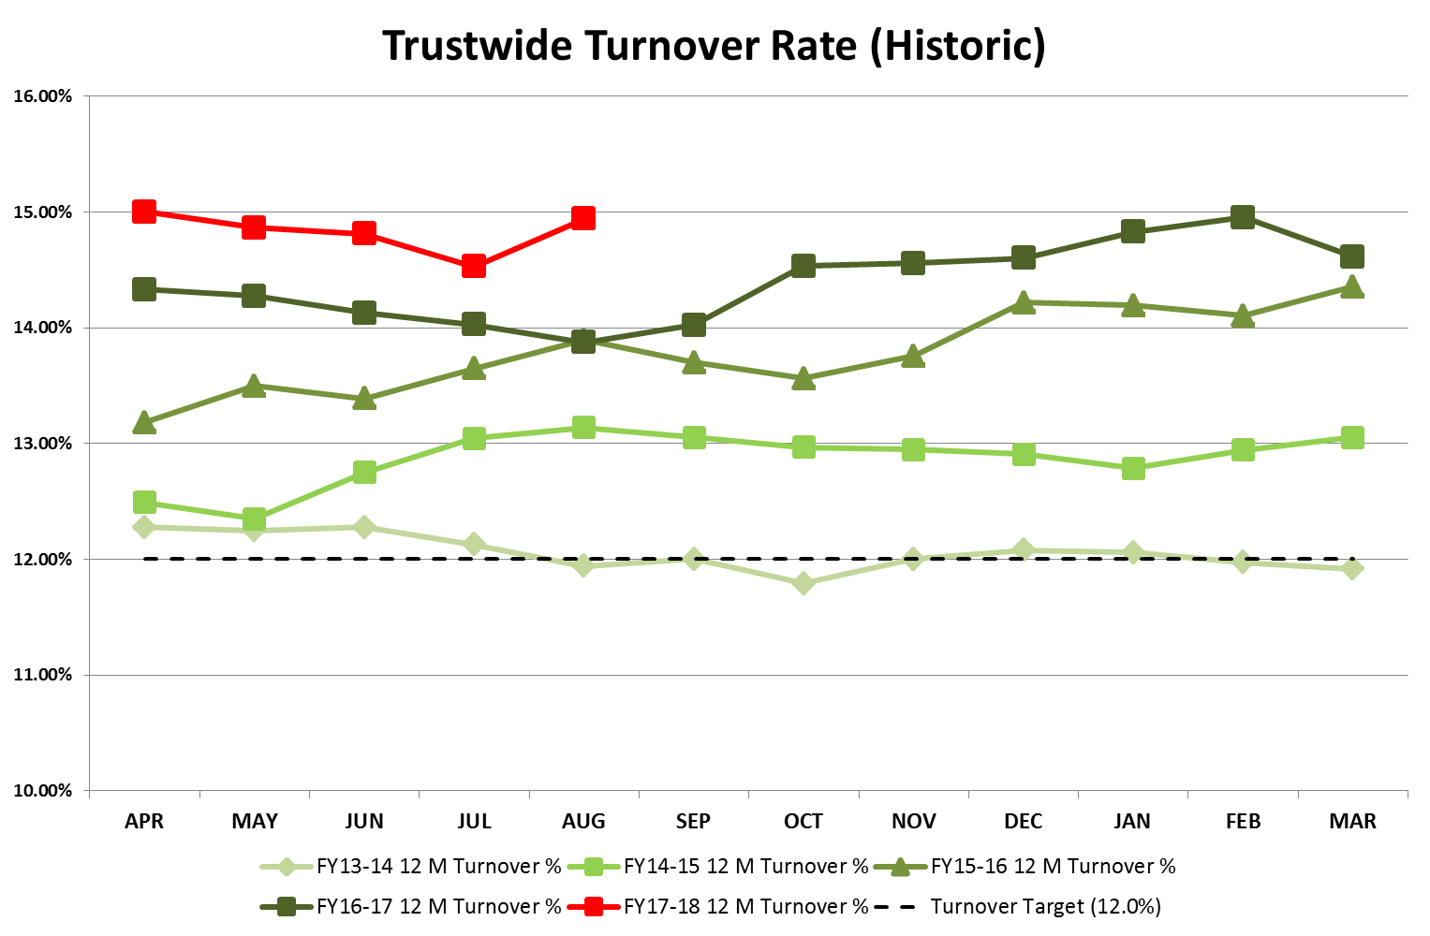
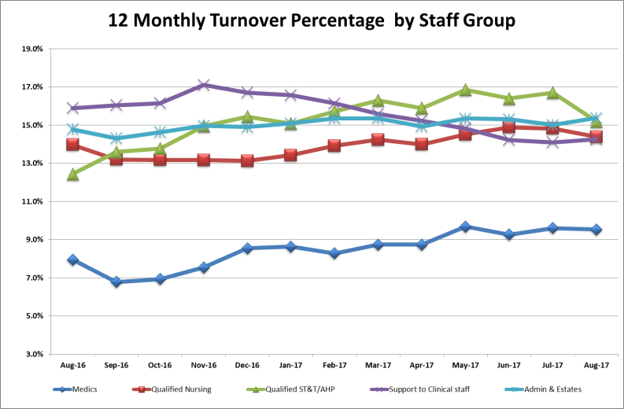
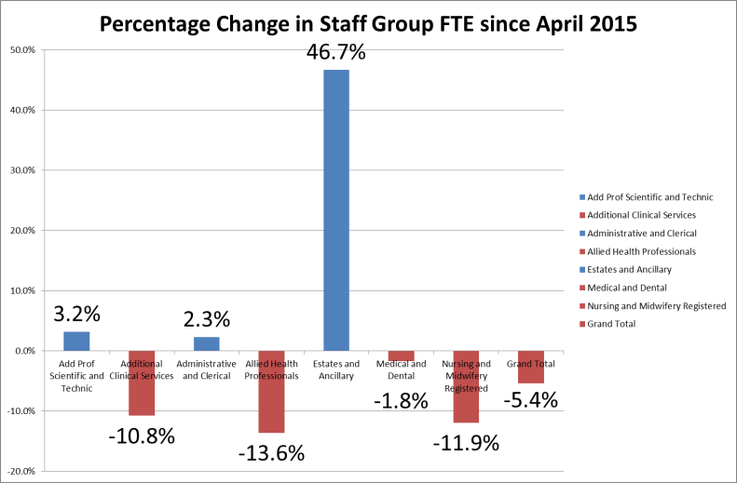
The Turnover figure has increased to stand at 14.94% in August from 14.53% in July.
The increase was visible across all directorates. The Trust turnover rate is being driven by a long-term increase in turnover in the Medical, Qualified Nursing, Scientific staff groups.
Turnover
Target: 12.00%
This Month: 14.94%
Last Month: 14.53%
Last Year: 13.87%

Slide 7
WRES

Slide 8
WRES

