Slide 1
Workforce Performance Report
March 2017
Mike McEnaney
Director of Finance

Slide 2
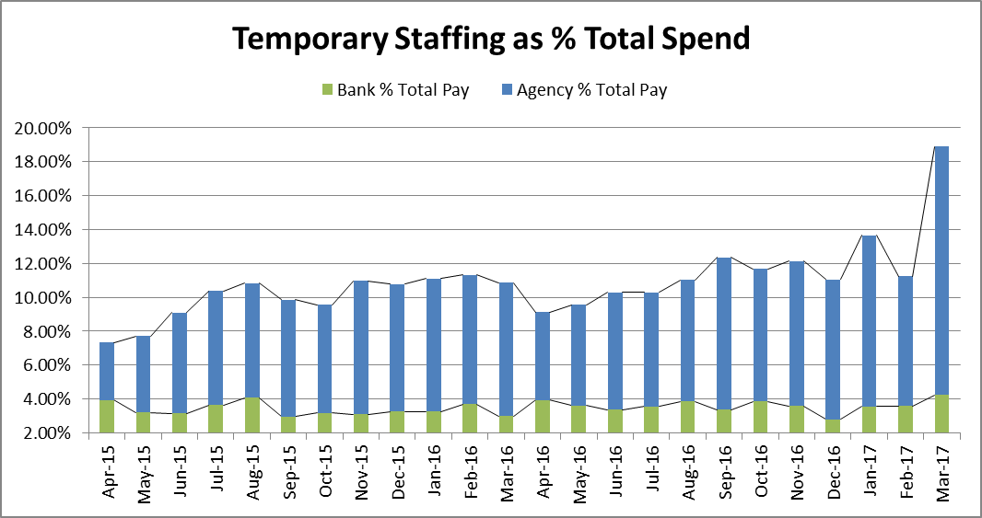
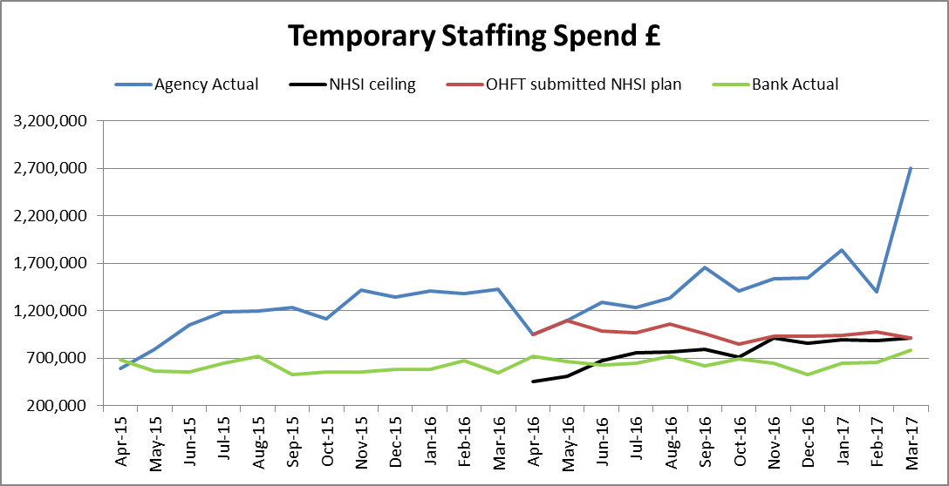
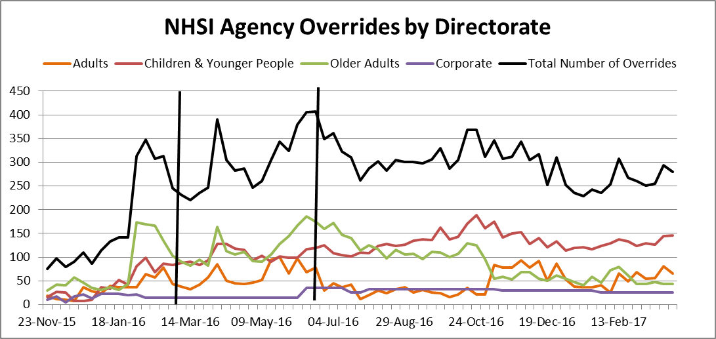
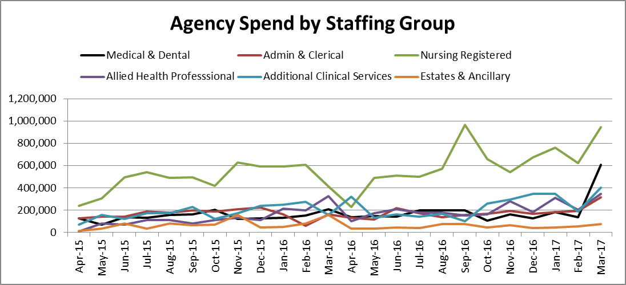
There has been an increase of £1.3m in agency spend compared to February, £1.275m of which is for units that are not on WFMS. It is believed that this is largely due to a correction in account coding and holiday cover. Of the increase £470k is in medical and dental staffing , £324K is in Nursing and £214k is in Additional Clinical Services. Agency spend was 196% above the ceiling set by NHSI. NHSI overrides have remained static.
Temporary Staffing Spend
This Month: 18.90%
£3.483m
Last Month: 11.23%
£2.064m
Last Year: 10.85%
£1.967m
Reduction
Reduction

Slide 3
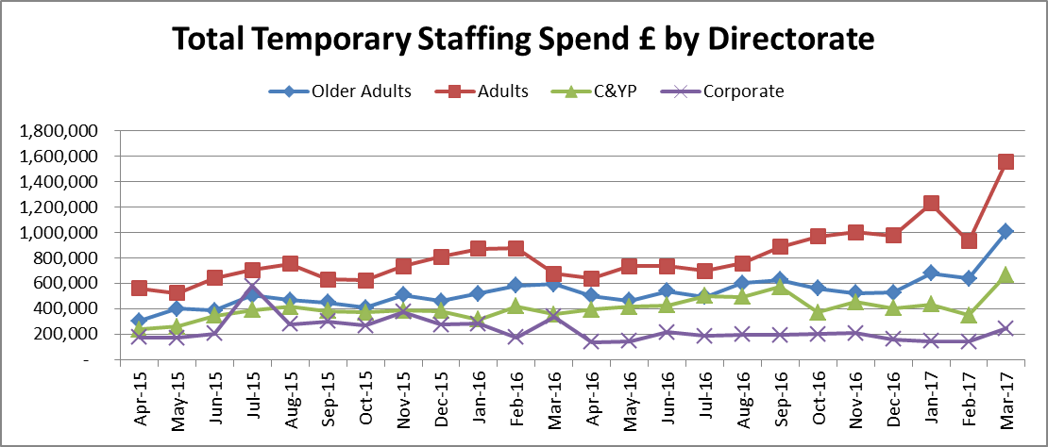
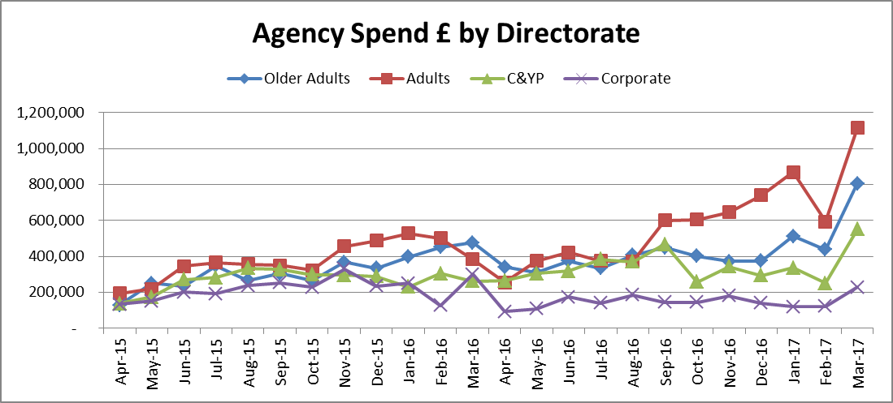
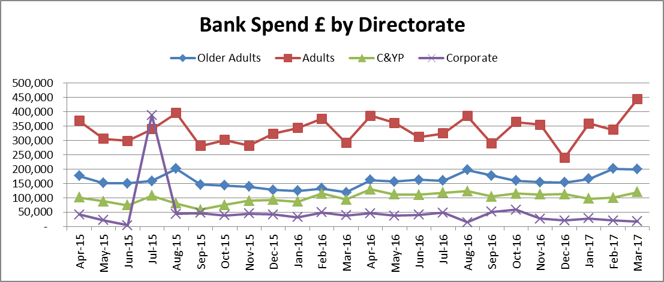
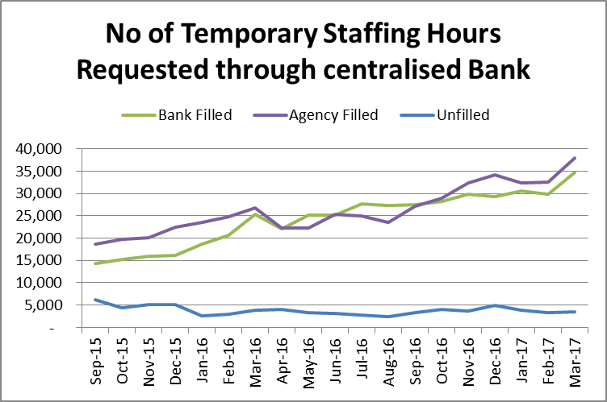
Temporary Staffing Spend
There was a 12.6% (123K) increase in agency spend for units on the WFMS in March 2017. The reasons for use are broadly similar to February 56% to cover vacancies, 19% for increased workload. Sickness has reduced by 1% to 3.9% whilst temporary staffing used for annual leave used above budget is 1.92% (12k)

Slide 4
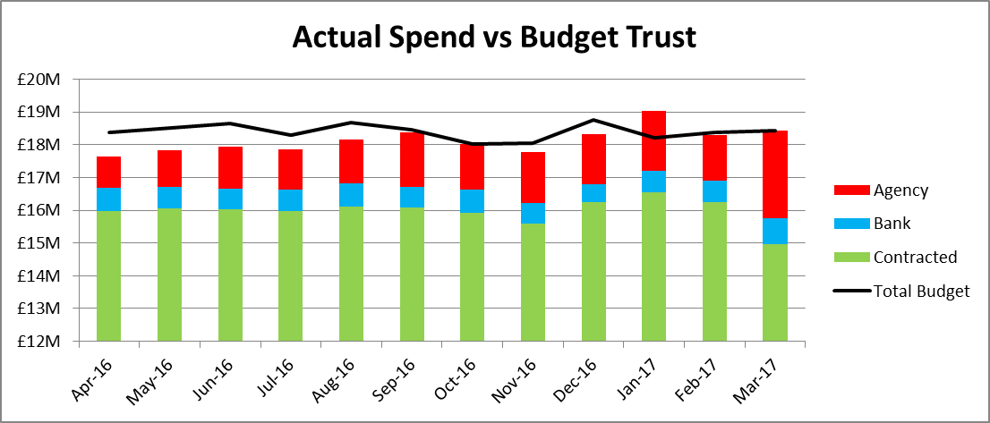
Total Payroll Spend
The Trust overspent the payroll budget by £600k in March . For the financial year the Trust is underspent by £2.5m.
For March all directorates are overspend with the exception of corporate.
For the financial year, Adults is underspent by £1m, C&YP is overspent by £1m, Older Peoples is underspent by £615k and Corporate is underspent by £3m
directorates overspent the payroll budget in February.

Slide 5
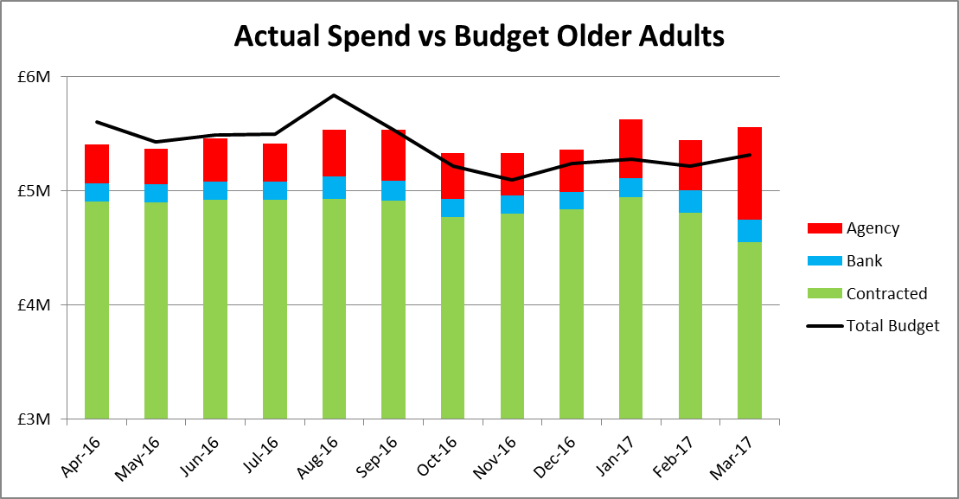
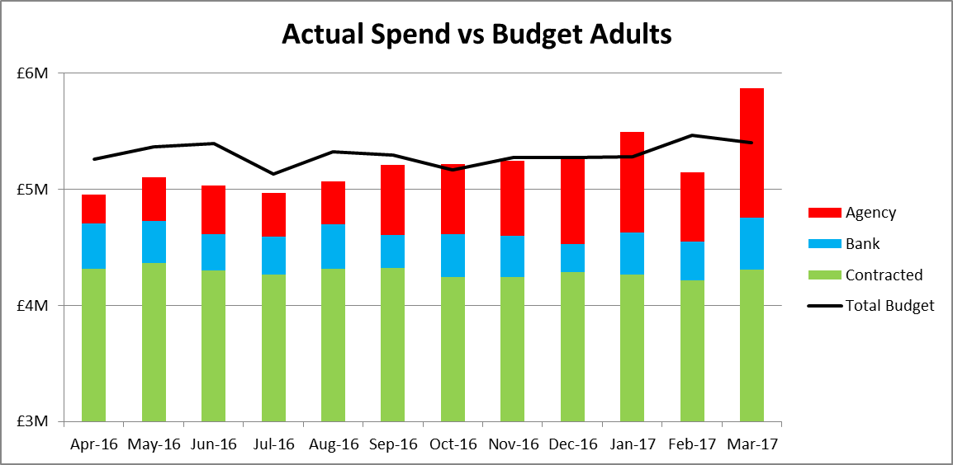
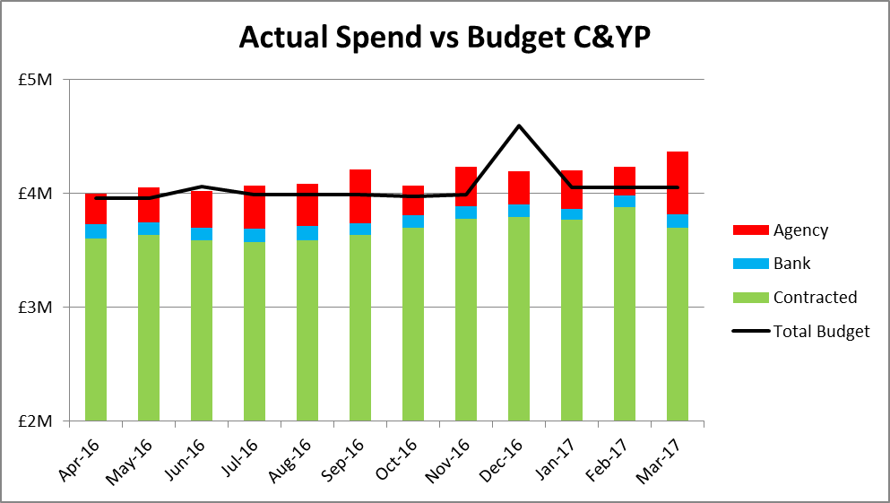
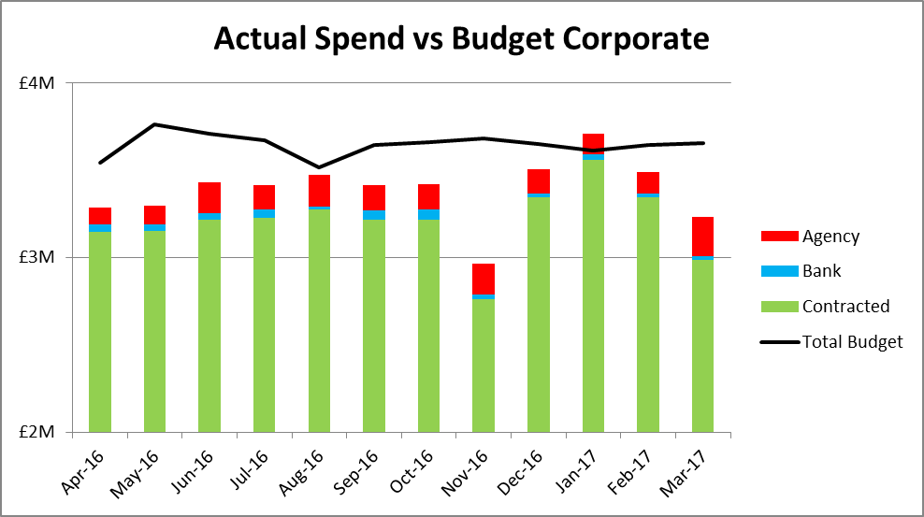
Total Payroll Spend

Slide 6
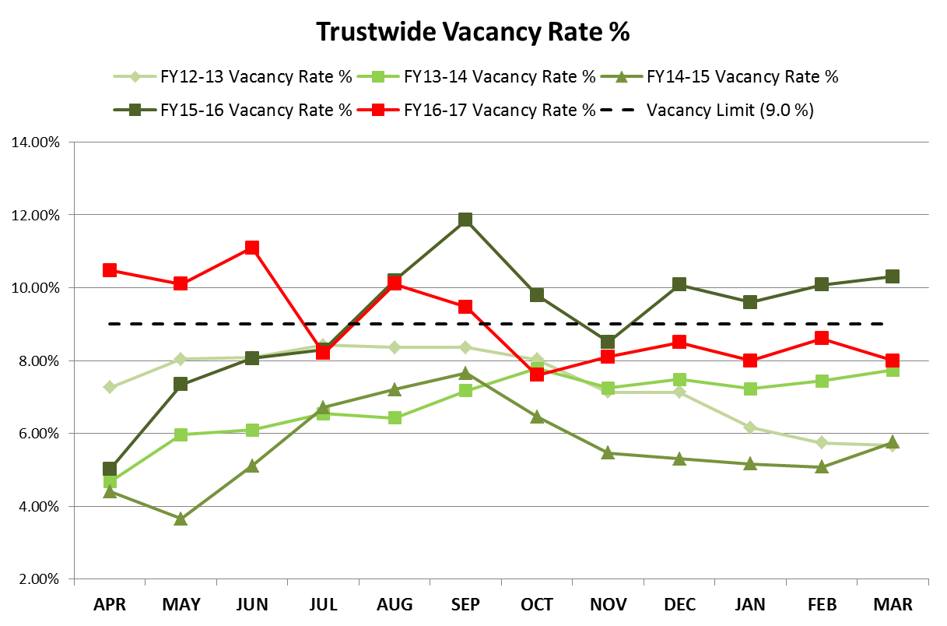
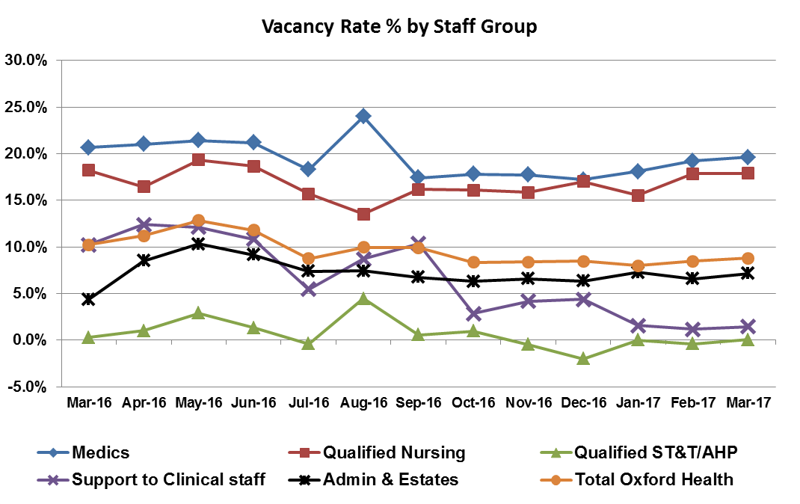
The Vacancy rate has decreased slightly this month from 8.6% in February to 8.0% in March and remains below the 9.0% Trust target. Over Financial Year 2016-17 the vacancy rate has shown a significant downturn from 10.48% in April to plateau around 8% over the last six months.
Vacancy
Target: 9.0%
This Month: 8.0%
Last Month: 8.6%
Last Year: 10.3%

Slide 7
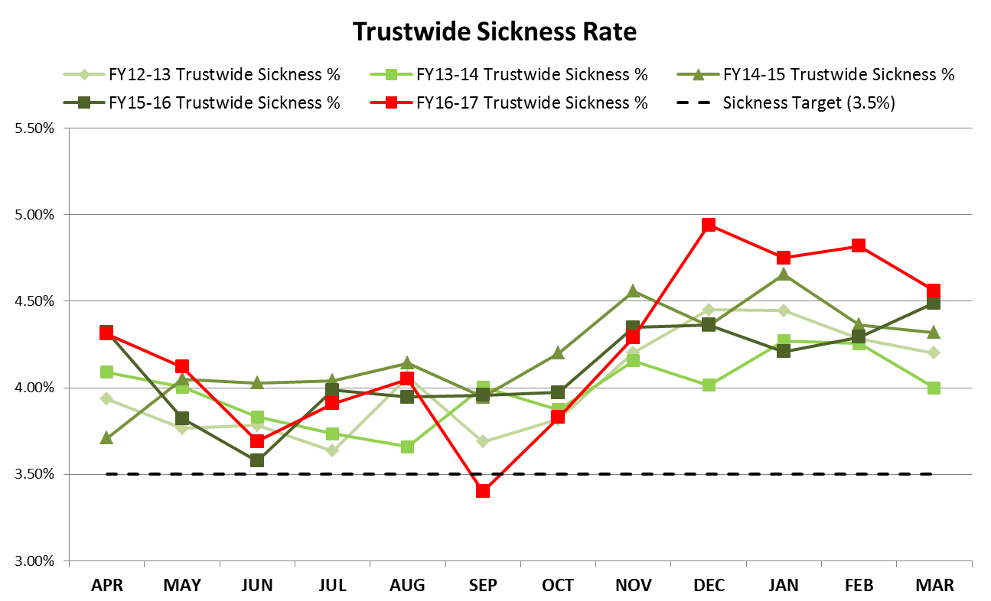
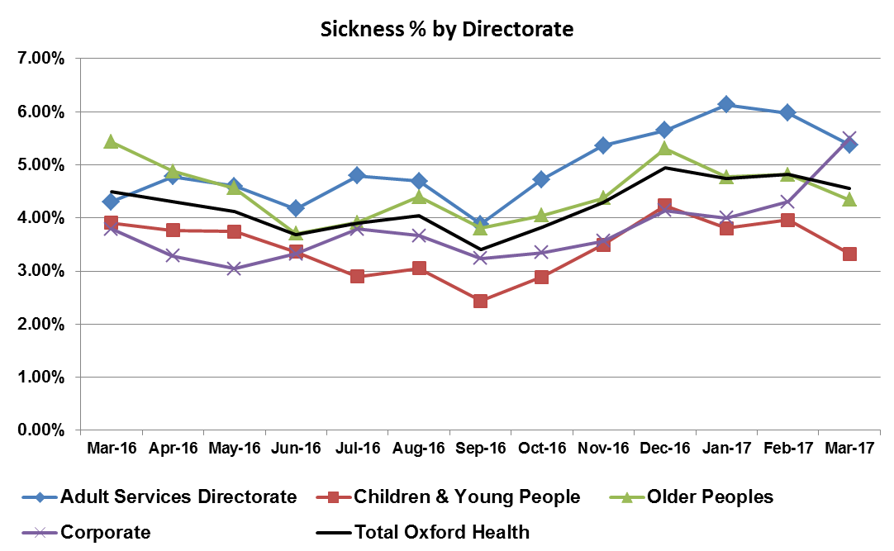
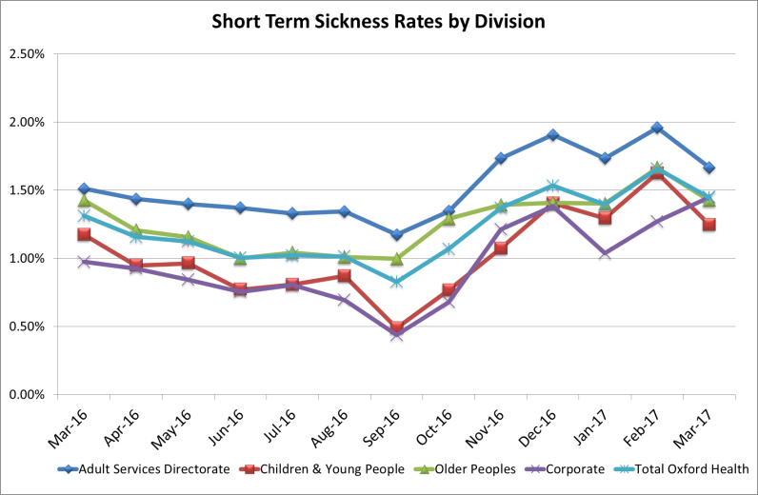
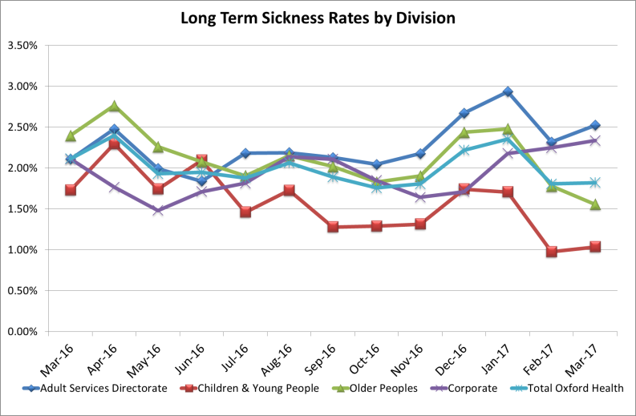
Sickness has decreased in March to stand at 4.56% from a peak in December 2016. This reflects a combined reduction in short-term episodes of Cold/Flu and long-term sickness episodes. All directorates, except Corporate, have seen a decline in short-term sickness as we move out off the Winter period.
Sickness
Target: 3.50%
This Month: 4.56%
Last Month: 4.82%
Last Year: 4.49%

Slide 8
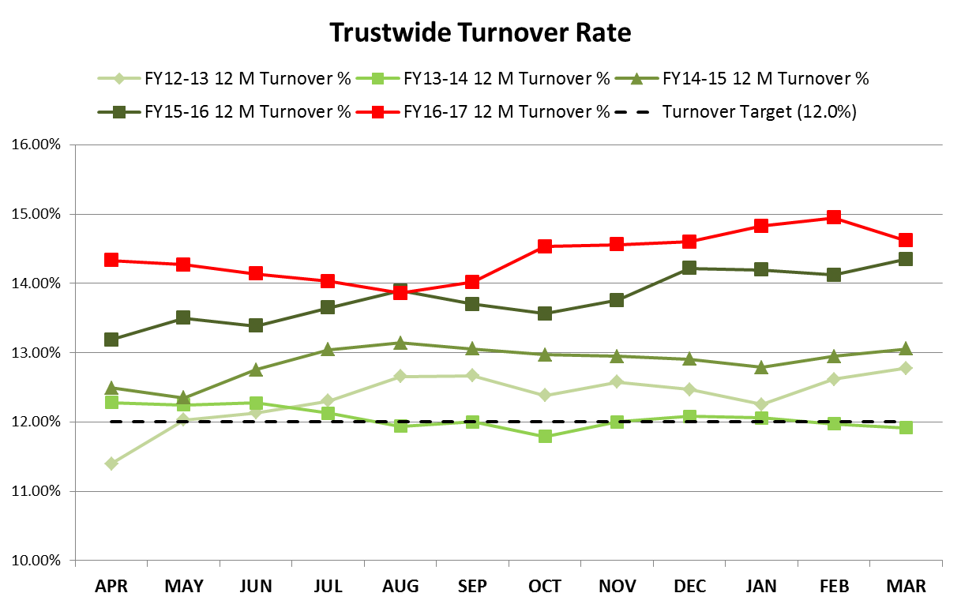
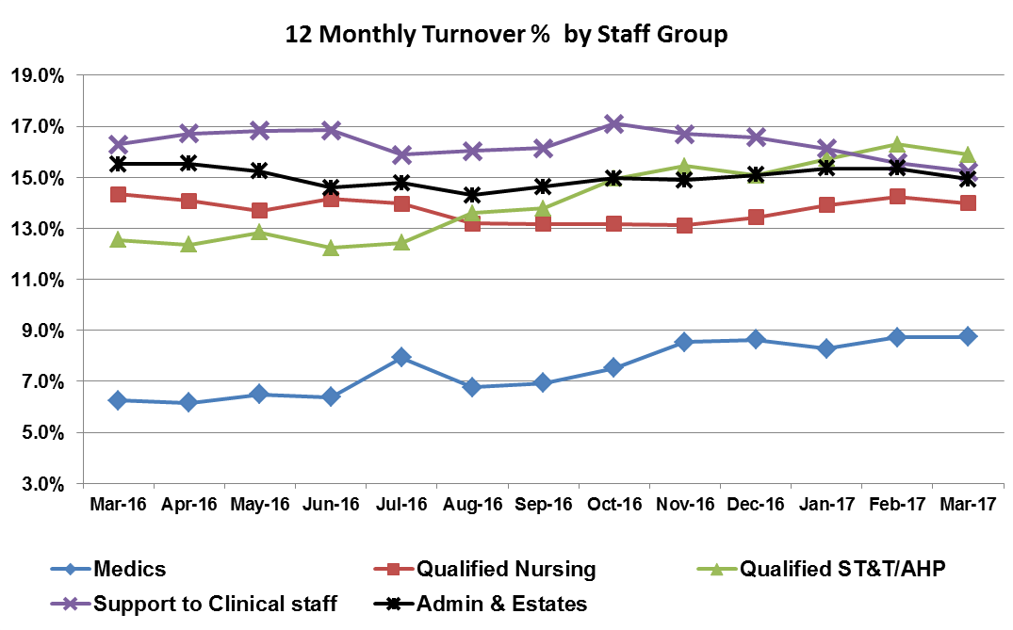
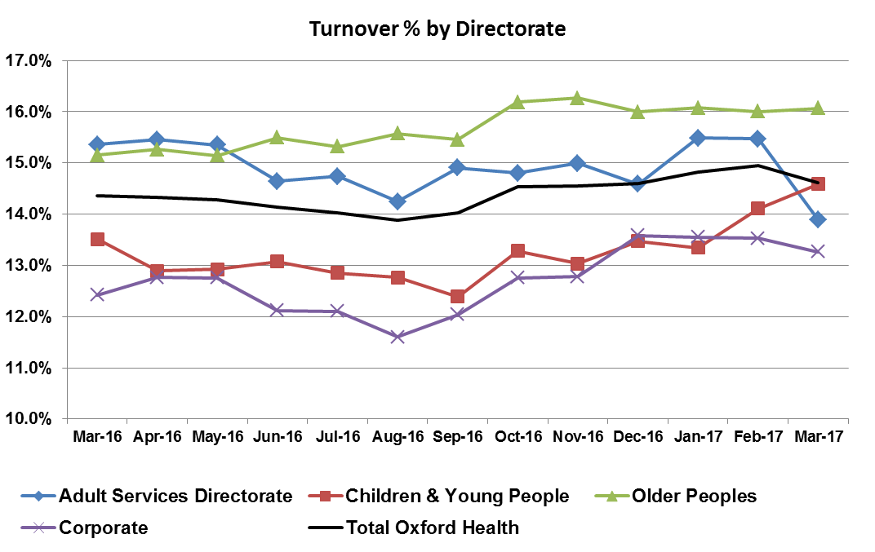
The Turnover figure has decreased slightly from 14.95% in February to 14.62% in March.
The primary driver for the decrease has been the reduction in turnover in the Clinical Support staff group. Both the Adult and Corporate Directorates saw a fall in turnover this month whilst the Children and Young People Directorate is showing a long-term increase over the last six months.
Turnover
Target: 12.00%
This Month: 14.62%
Last Month: 14.95%
Last Year: 14.35%

Slide 9
Recruitment Report – April 2017
Vacancies
Advertisement & Interview
Of which
Directorate:
being
Live on
At
Interview
Awaiting
Total at
Being
Checks
Start date
recruited
NHS Jobs/
Shortlist
Arranged
interview
offer
checked
cleared
agreed
to
at advert
outcome
Adult Services
252
128
21
23
5
75
59
16
12
Children and
146
52
2
21
3
68
41
27
23
Young People
Corporate
67
9
4
20
3
31
20
11
4
Older People
265
64
16
49
23
113
66
47
30
Vacancy
730
253
43
113
34
287
186
101
69
Summary Totals
%age at each
100%
34.66%
5.89%
15.48%
4.66%
39.32%
stage
OOH GP
30
30
0
0
Staffing Solutions
37
22
15
1
Apprentices
Grand Total:
730
253
43
113
34
354
238
116
70

