Slide 1
Workforce Performance Report
February 2018
Tim Boylin
Director of Human Resources

Slide 2
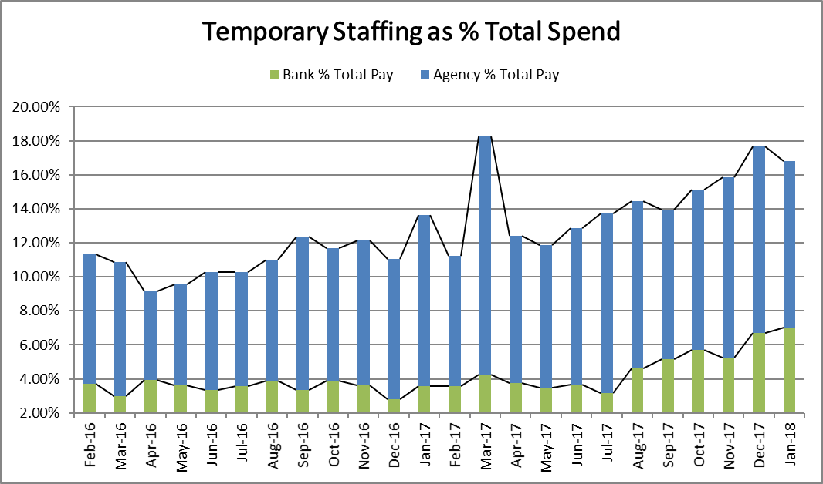
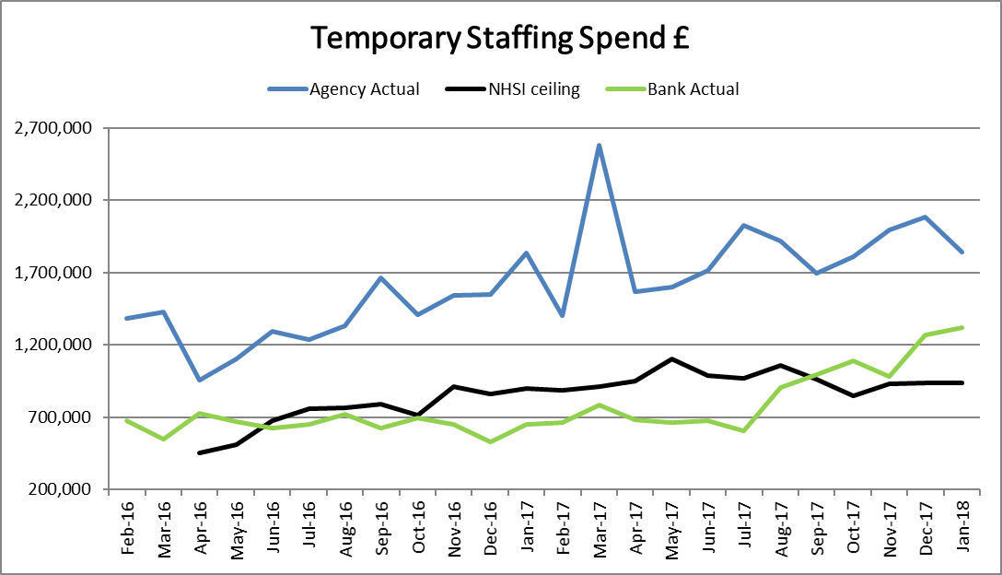
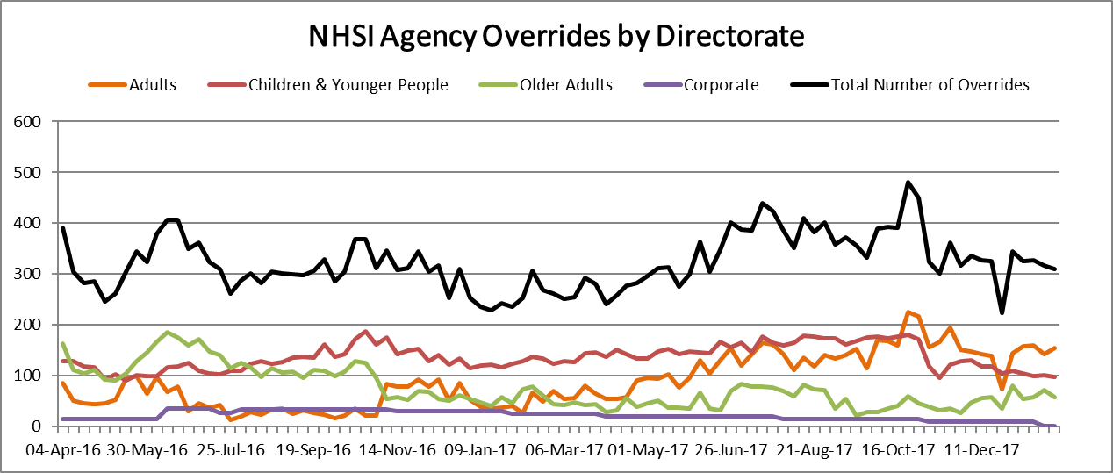
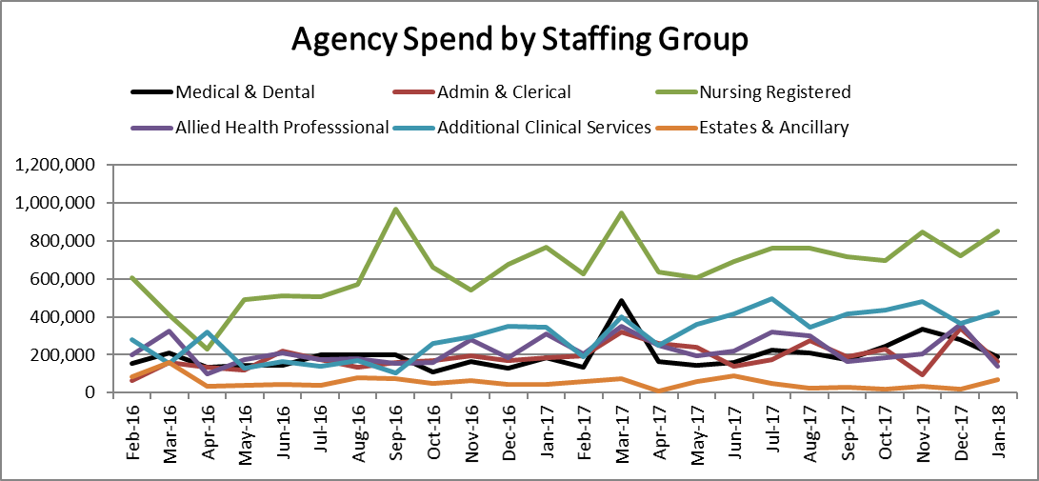
Total temporary staffing spend decreased by £191K to £3.16m (16.80%) of payroll. Bank spend (excluding GPs) increased again in January to £863k this is mainly due to increased use of AHPs. Bank HCA use decreased by 8k whilst agency increased by 61K. This was mainly due to additional use on Sapphire and previous recharging on Ashurst.
Overall Agency spend decreased by £160k to £1.8m in January, £300k more than in December 2016. The increase was in Nursing and Additional Clinical Services. Agency spend has increased in C&YP Directorate. Agency spend was 96.28% above the ceiling set by NHSI and NHSI Agency rule overrides rose by 8% to 1313 shifts in the 4 weeks of January. It is thought that some of this is due to improved reporting through the centralisation of agency management. A new agency authorisation process will be adopted at the end of February with all off framework and over price cap agency use requiring Director sign off. 54% of temporary staffing shifts booked through the WFMS were to cover vacancies.
Temporary Staffing Spend
This Month: 16.80%
£3.161m
Last Month: 17.66%
£3.352m
Last Year: 13.65%
£2.488m

Slide 3
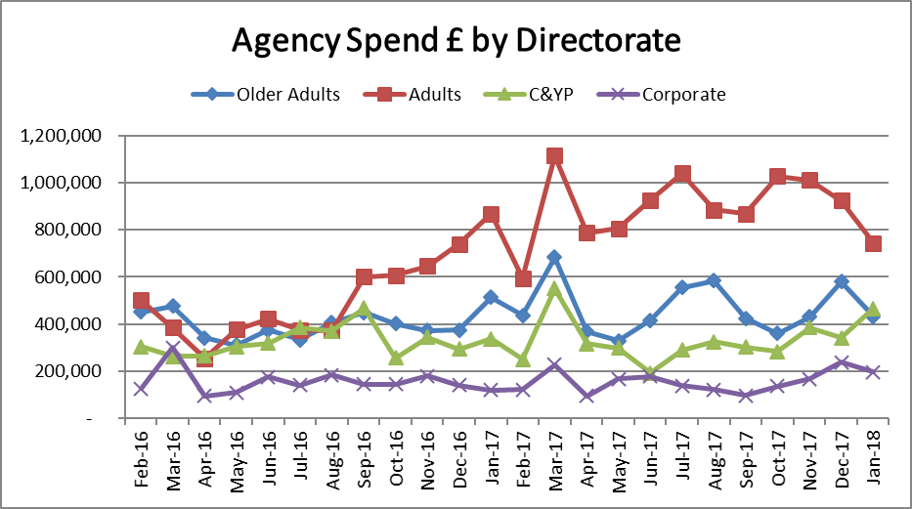
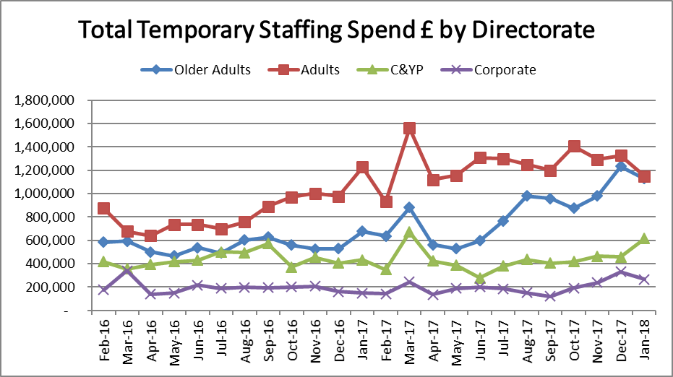
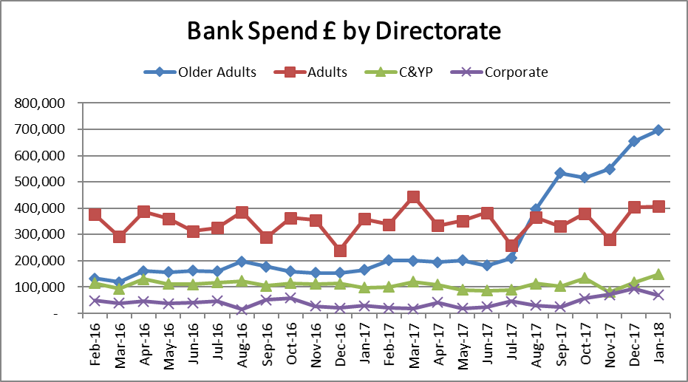
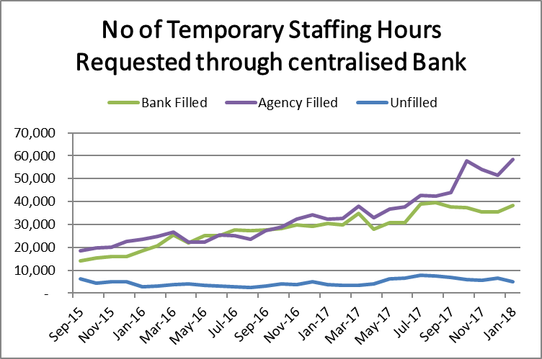
Temporary Staffing Spend
Bank spend has increased in the C&YP directorate in January in CH Marlborough and Marlborough House Swindon and for medics in the OOH GP service. Agency spend has decreased in all areas with the exception of C&YP where it increased by £115k. This cost is being recharged to another organisation.
In January 39 Pure Flexible offers were made with 25 workers able to start. 70 Substantive Flexible Worker assignments have been processed. Since the Work for us challenge started in September 95 new Pure Flexible Workers have started and 286 substantive Flexible Worker contracts have been issued.

Slide 4
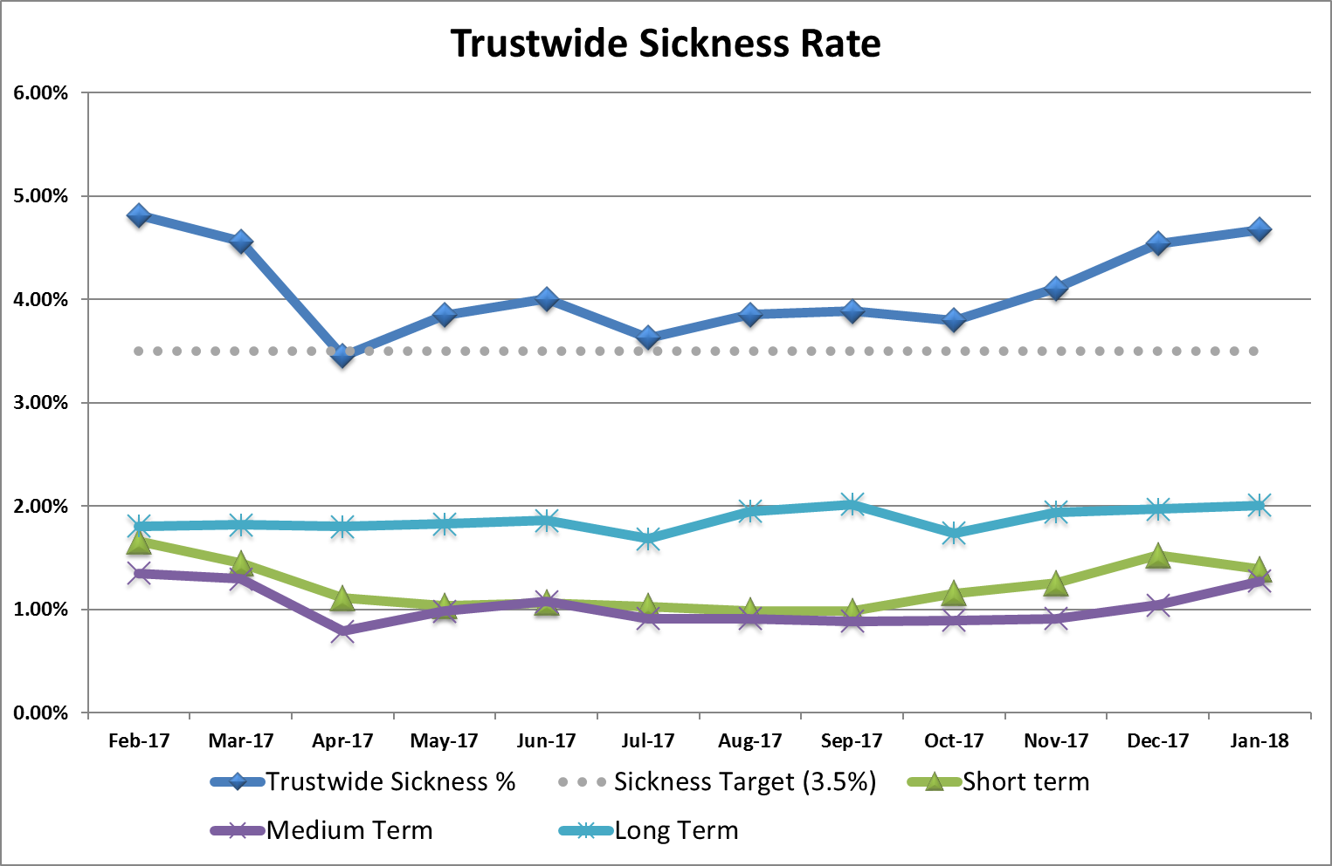
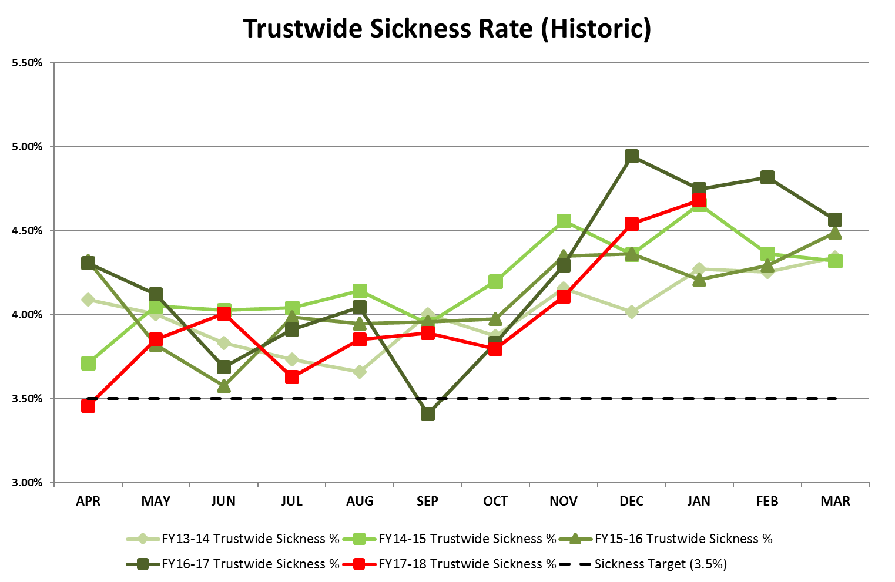
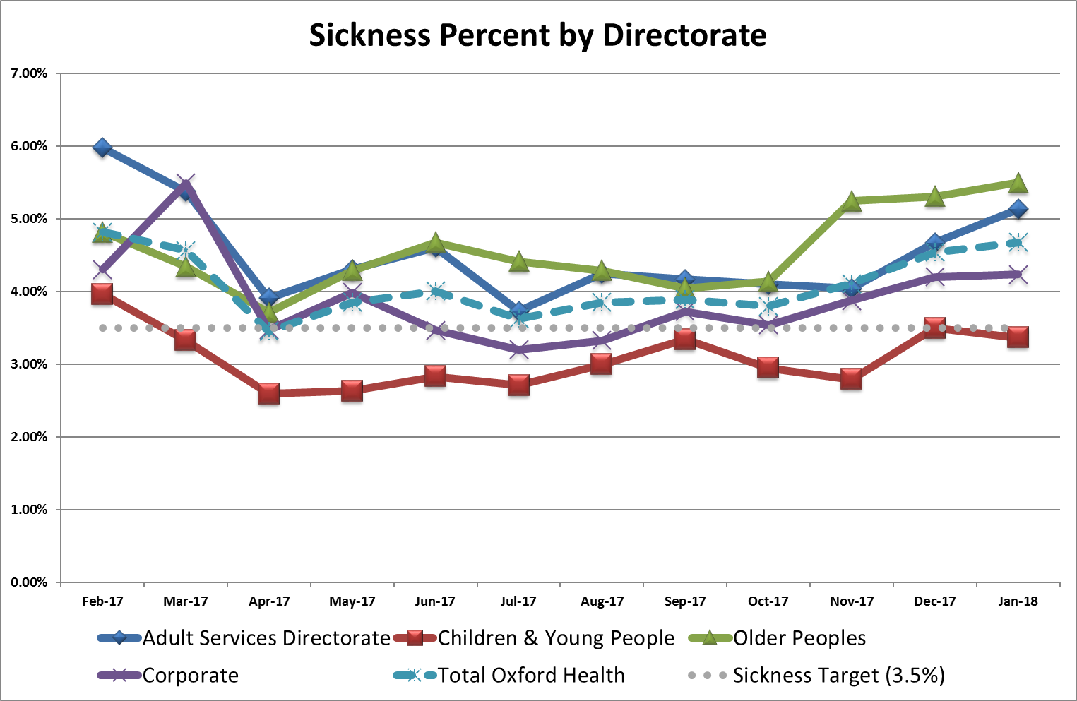
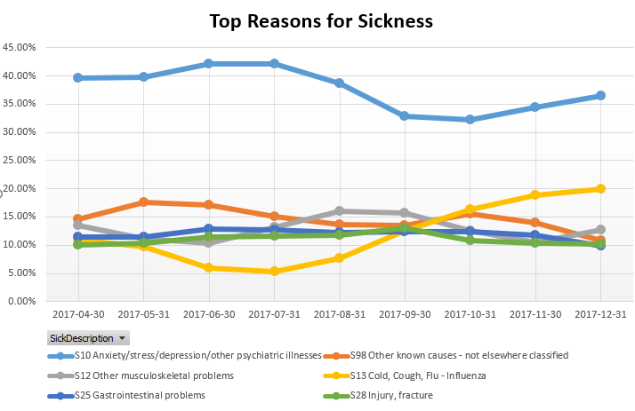
Sickness has increased over the last three months to stand at 4.68%. The increase has been experienced across all directorates. The current rate is above the Trust target but below comparable periods over the last three previous years. The increase has been driven by a short-term episodes of Cold and flu.
Sickness
Target: 3.50%
This Month: 4.68%
Last Month: 4.54%
Last Year: 4.75%

Slide 5
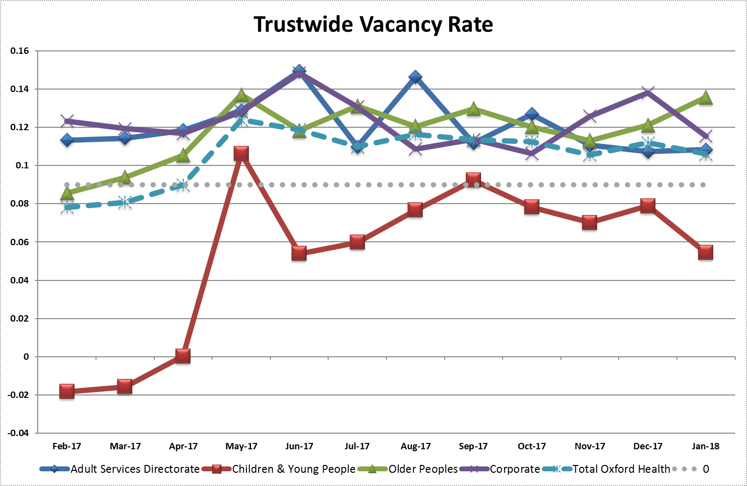
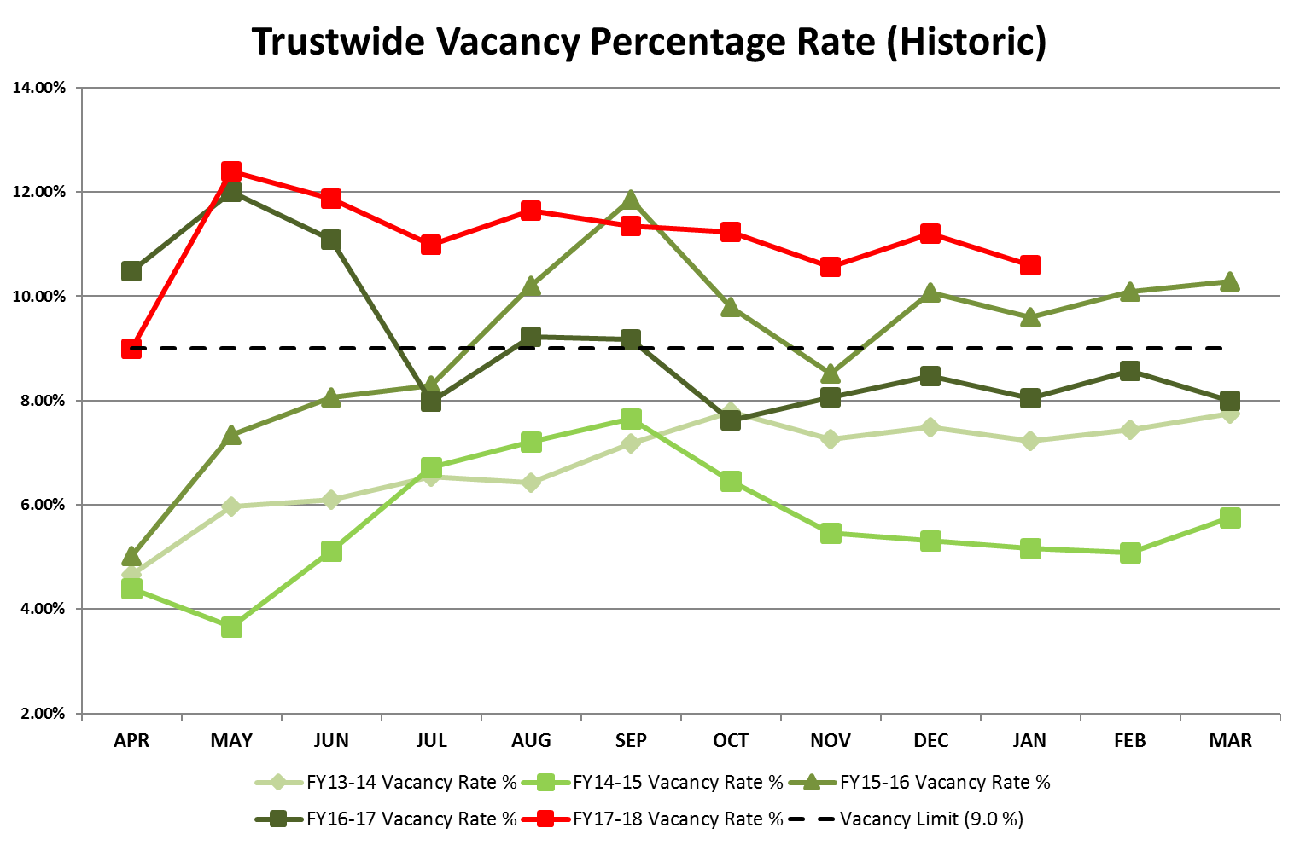
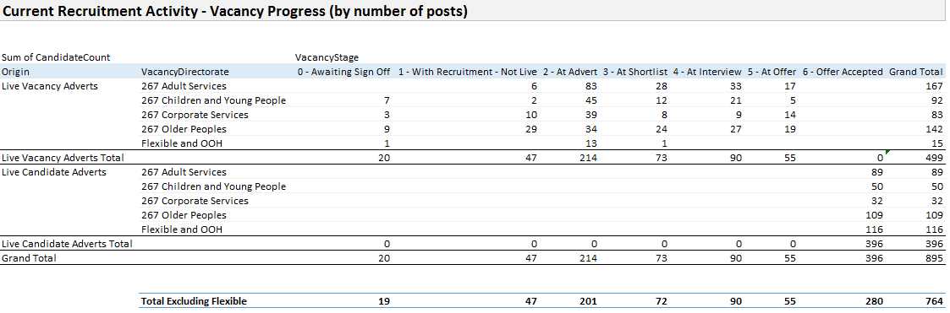
The vacancy rate has decreased to 10.6% in January. This continues the general downward trend in the vacancy rate from a peak of 12.39% in May 2017. All directorates except Older Peoples has seen a reduction in the vacancy rate in January.
Vacancy
Target: 9.0%
This Month: 10.6%
Last Month: 11.2%
Last Year: 8.05%

Slide 6
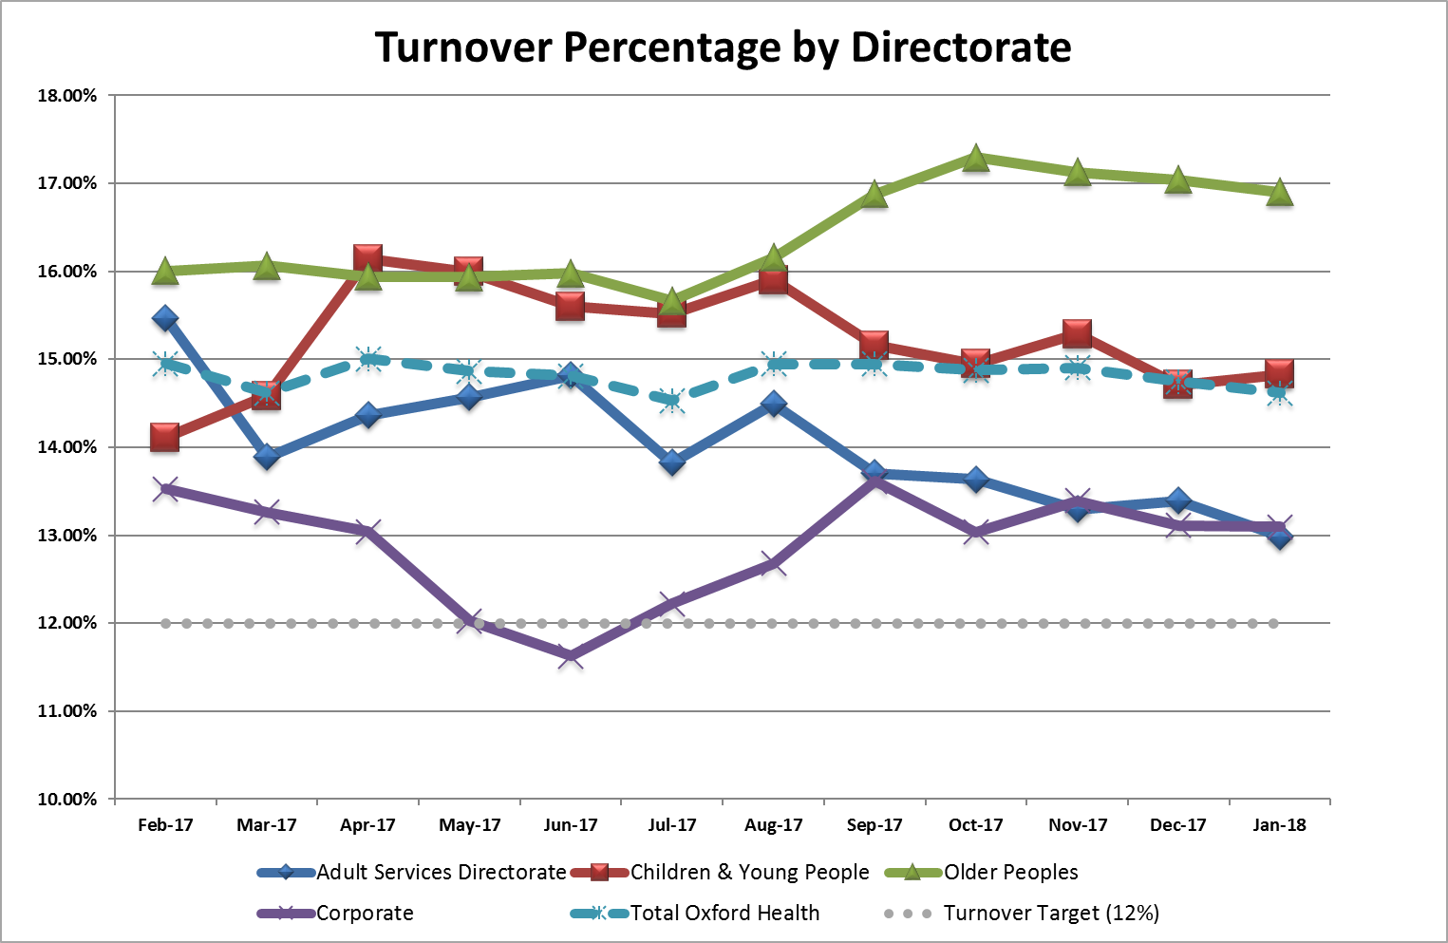
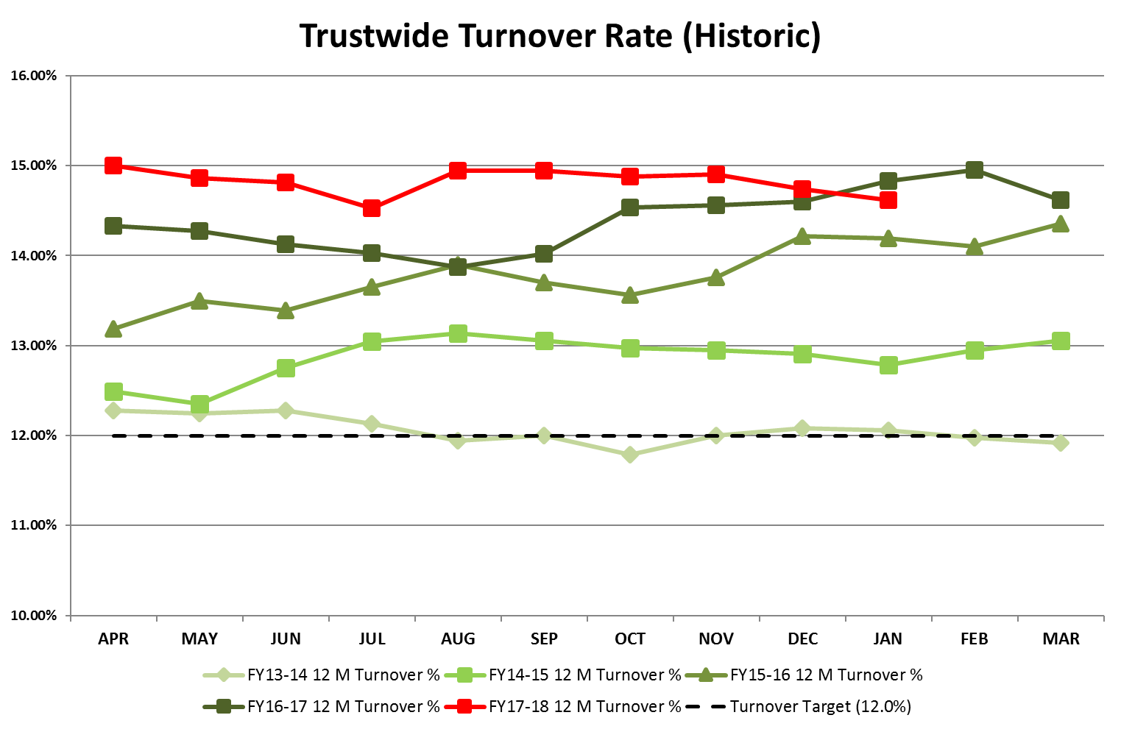
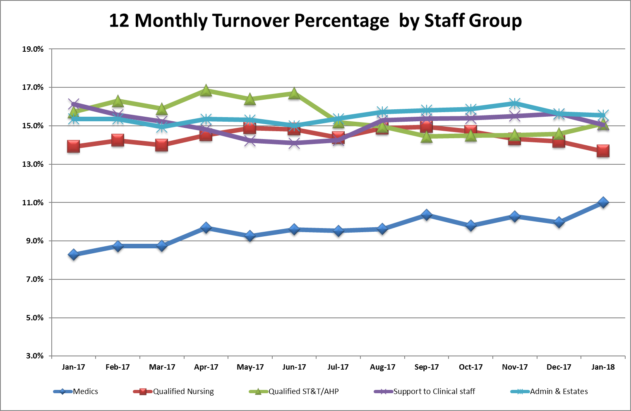
The Turnover figure has decreased in January to stand at 14.62%. All directorates have seen a reduction in turnover over the last quarter with long-term reductions in Children & Young Peoples and Adult Services in particular.
Turnover
Target: 12.00%
This Month: 14.62%
Last Month: 14.74%
Last Year: 14.83%

Slide 7
WRES

Slide 8
WRES

