Slide 1
Workforce Performance Report
June 2018
Tim Boylin
Director of Human Resources

Slide 2
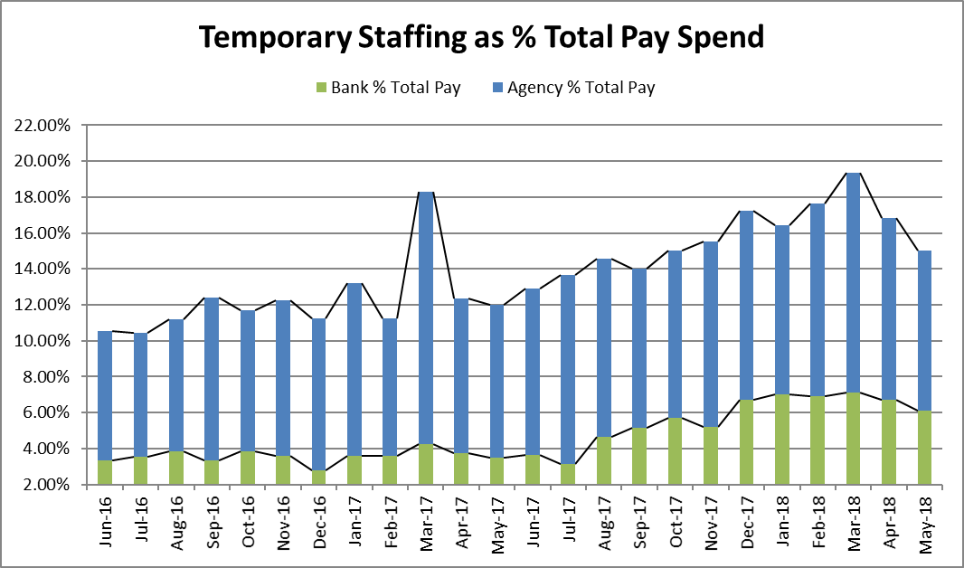
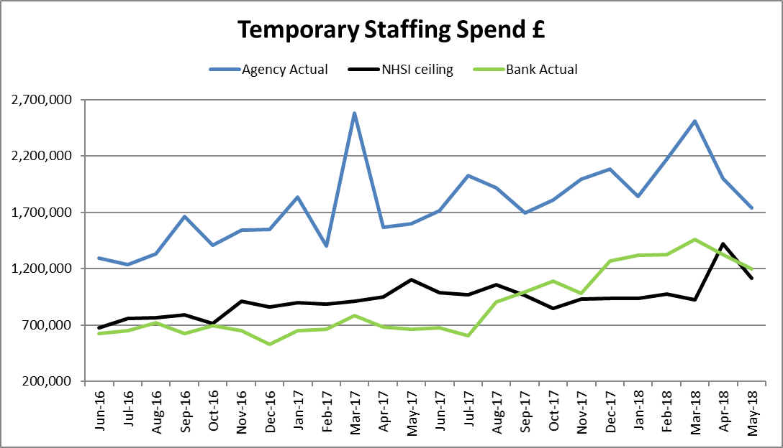
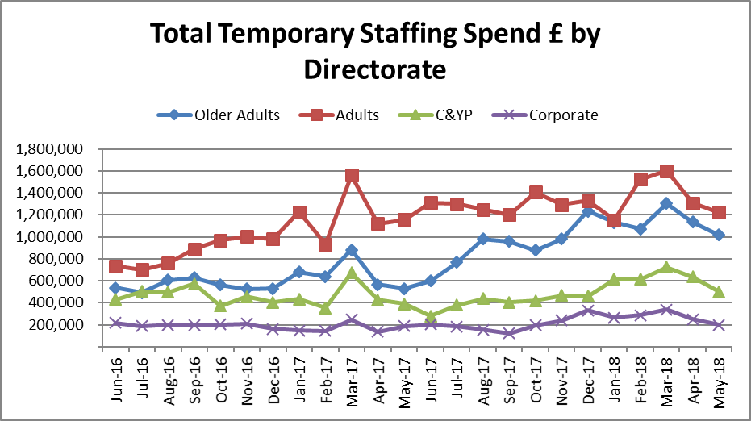
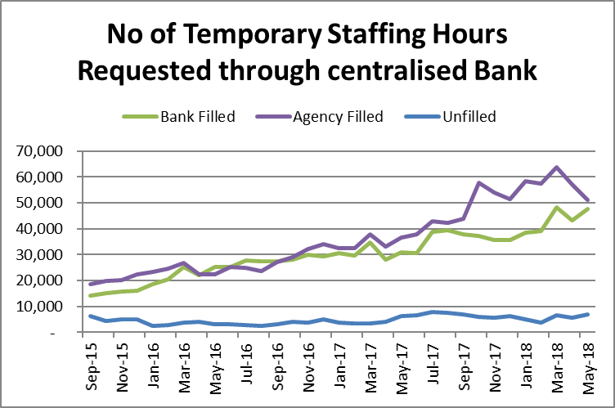
Total temporary staffing spend decreased by £371K to £2.94m, 15.03% of payroll, the lowest since September 2017 and the first time there has been a reduction of 2 months in a row. Total temporary staffing spend has reduced by over £1m since March and agency spend has reduced by £776K. This can in part be attributed to the Removal of agency HCA use in Inpatient Units since 14 May.
Temporary Staffing Spend
This Month: 15.03%
£2.94m
Last Month: 16.83%
£3.33m
Last Year: 11.85%
£2.26m

Slide 3
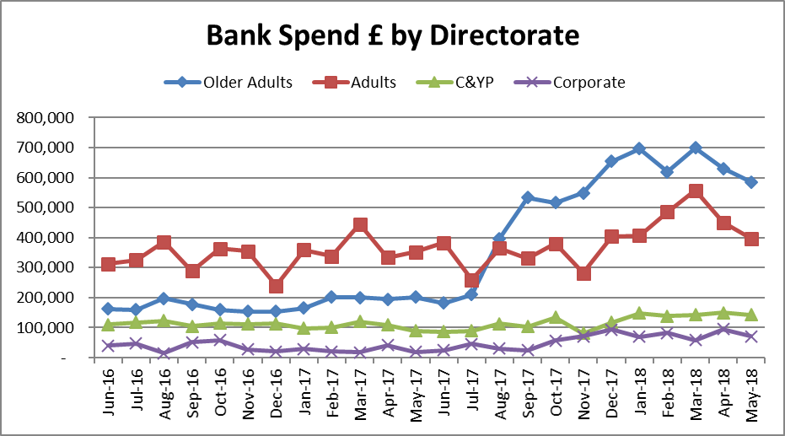
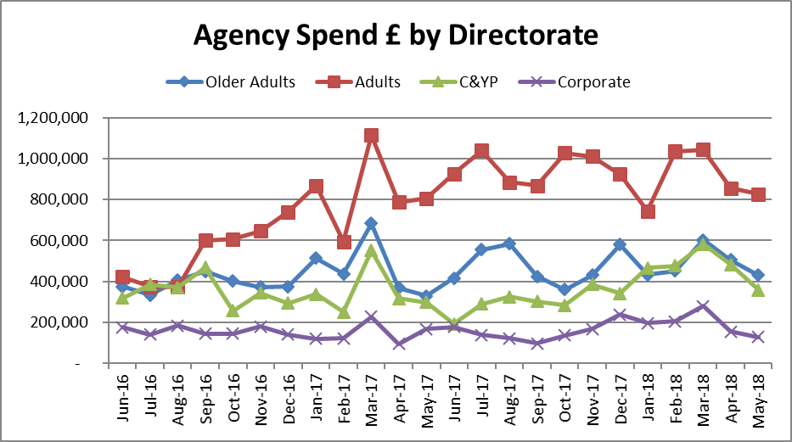
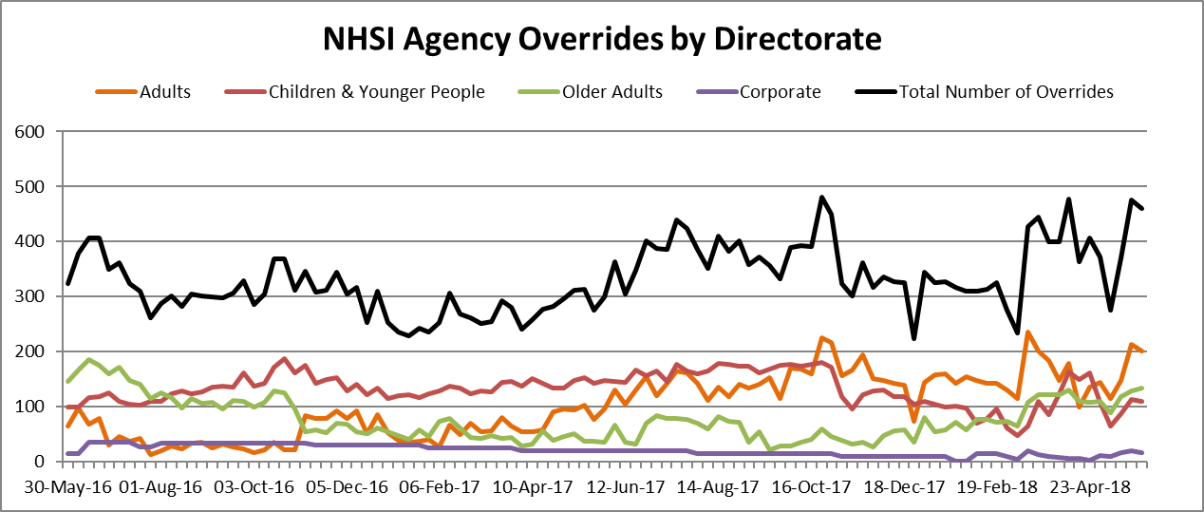
Temporary Staffing Spend
Agency spend decreased by £258k to £1.74m in May, 8.88% of payroll, its lowest since September. The greatest decrease of £213k was in Additional Clinical Services followed by £169k in the Registered Nursing staffing group.
Agency spend has again decreased in all Directorates, most notably in the C&YP directorate where it fell by £125k, followed by Older Adults which fell by £76k. NHSI Agency rule overrides fell by 9% to 1,494 shifts in the 4 weeks of May. This decrease in overrides can mainly be seen in the C&YP Directorate where a drop of 124 overrides was seen. 56% of temporary staffing shifts booked through the WFMS were to cover vacancies.

Slide 4
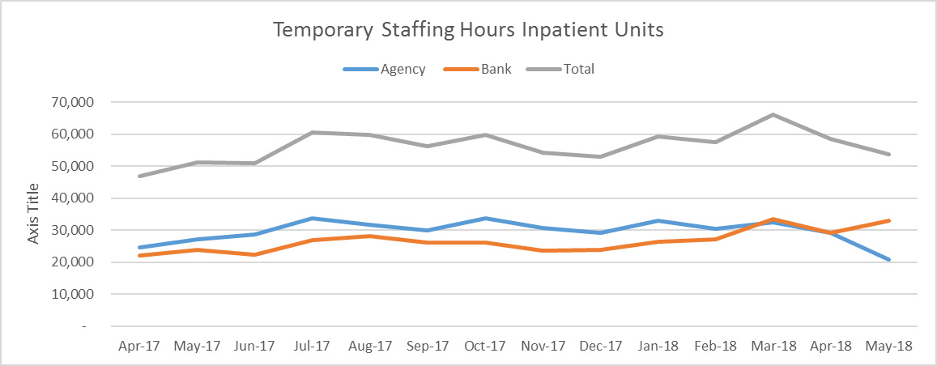
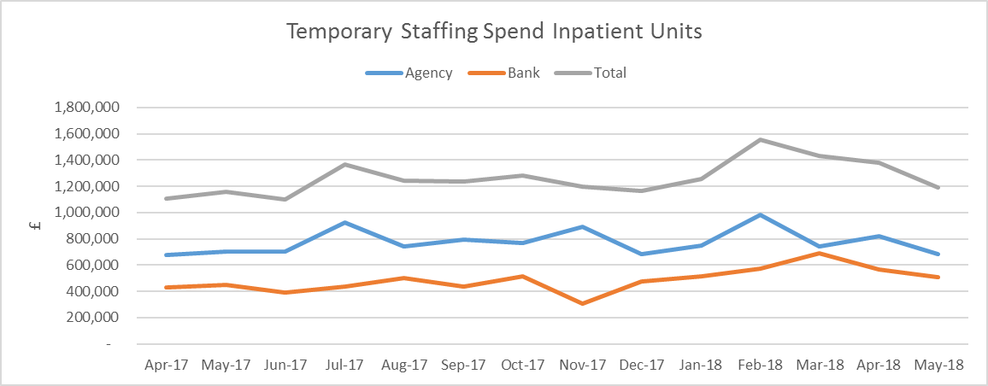
HCA Agency Spend Reduction
Since November 2017 a multi-disciplinary project group comprising of operations, nursing, recruitment and staffing solutions has been working towards removing all HCA agency use across inpatient units from 14 April 2018. Since 14 May 10 HCA agency shifts have been used. The graphs below show the reduction in agency hours used and cost.
The Trust has decided to engage registered Flexible Workers where an agency HCA worker could not be sourced. Overall this has not led to an increase in temporary staffing cost and units have reported benefits from the increased skill mix. No detrimental effect to patient care has been seen.
Recruitment of HCA Flexible Workers is continuing to reduce the number of grade swops and agency overrides. Floating bank workers are also being booked for each site to support last minute requirements and prevent agency usage. The success of the project has been due to a co-ordinated effort from operations, Staffing Solutions and the nursing directorate.
Agency spend in the Additional Clinical Services staffing group has fallen from £382k in April to £169k in May and by £295K since February. The graphs below show the trends in temporary staffing use across inpatient units since April 2017.

Slide 5
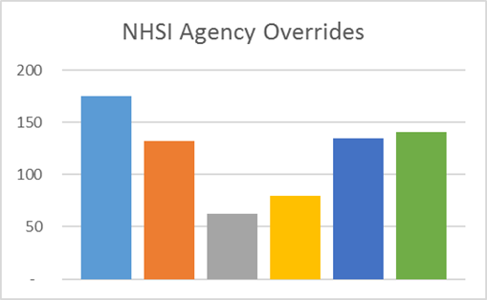
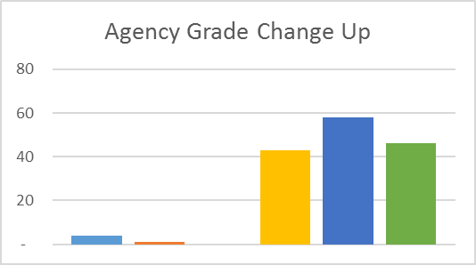
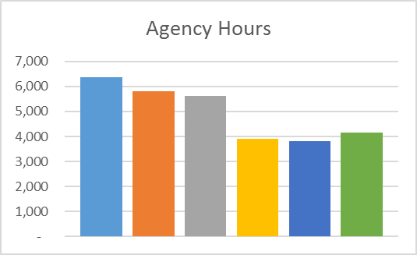
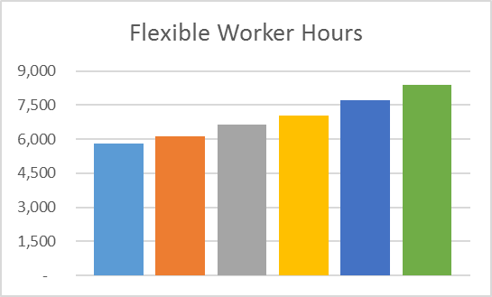
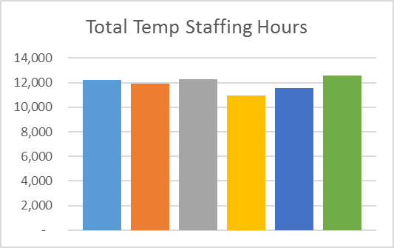
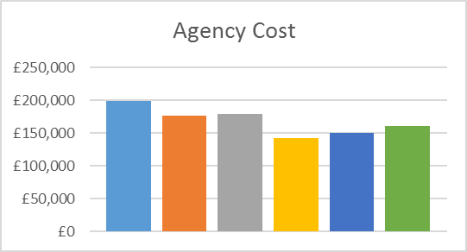
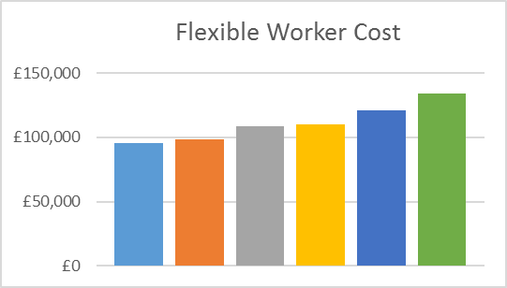
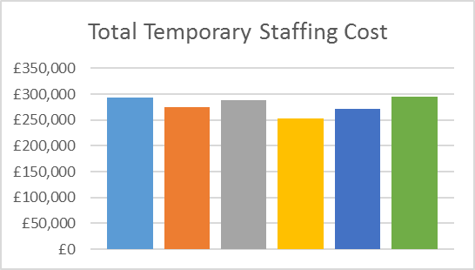
HCA Agency Spend Reduction
The graphs below show the impact of this on temporary staffing across all inpatient units. The change took place in the week of the yellow column and the green column included May bank holiday and half term.

Slide 6
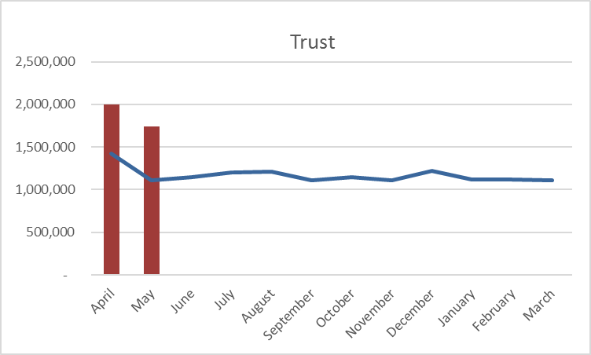
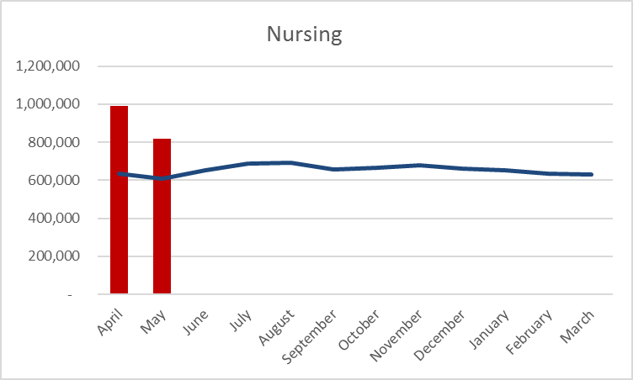
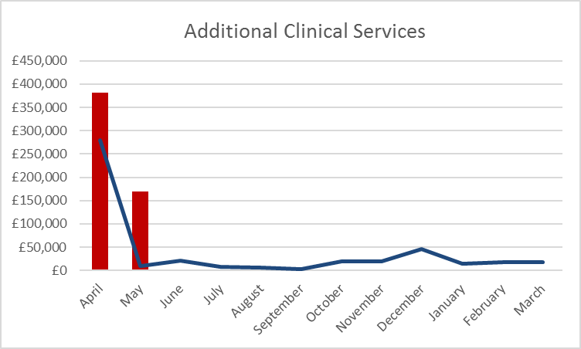
Agency Spend
The graphs show Agency spend by staffing group against the target submitted to NHSI.
Whilst agency spend has decreased notably there is still some way to go to hit the targets submitted to NHSI. June should see the first full month effect of the removal of HCA agency use across inpatient units.
Recruitment is now underway following the decision to invest in the Staffing Solutions team. It is anticipated that the new structure will be in place in the autumn which will provide the resource to target further areas of improvement.
In the interim specific scrutiny is being given to admin and clerical agency use in an attempt to reduce this area.

Slide 7
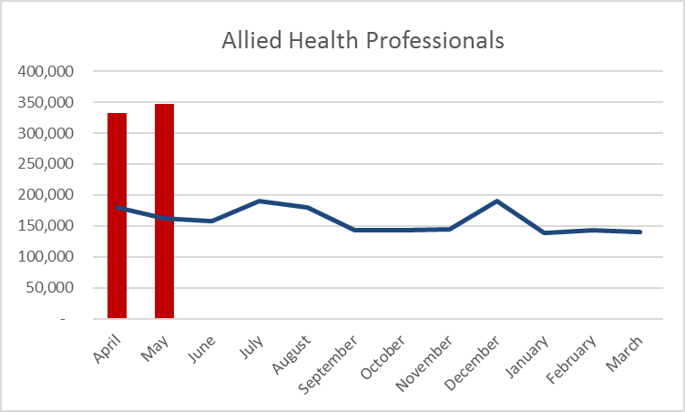
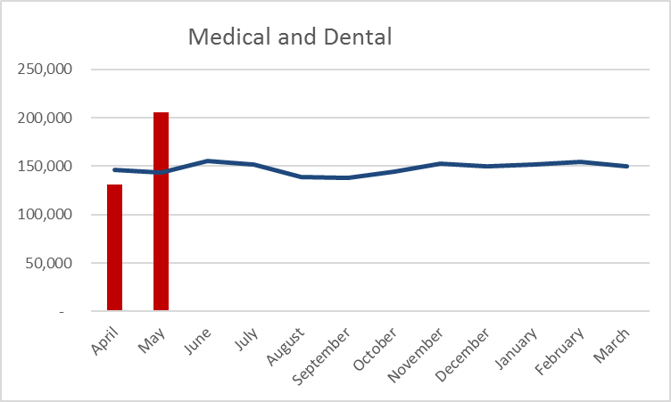
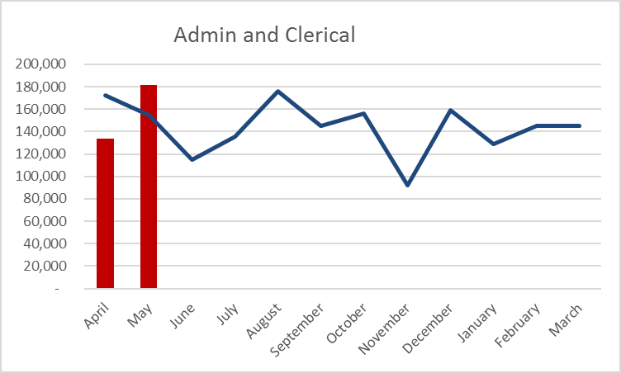
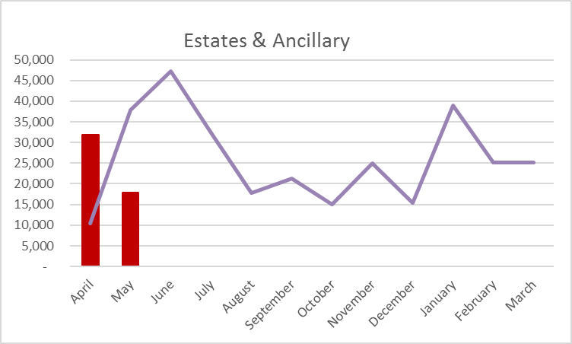

Slide 8
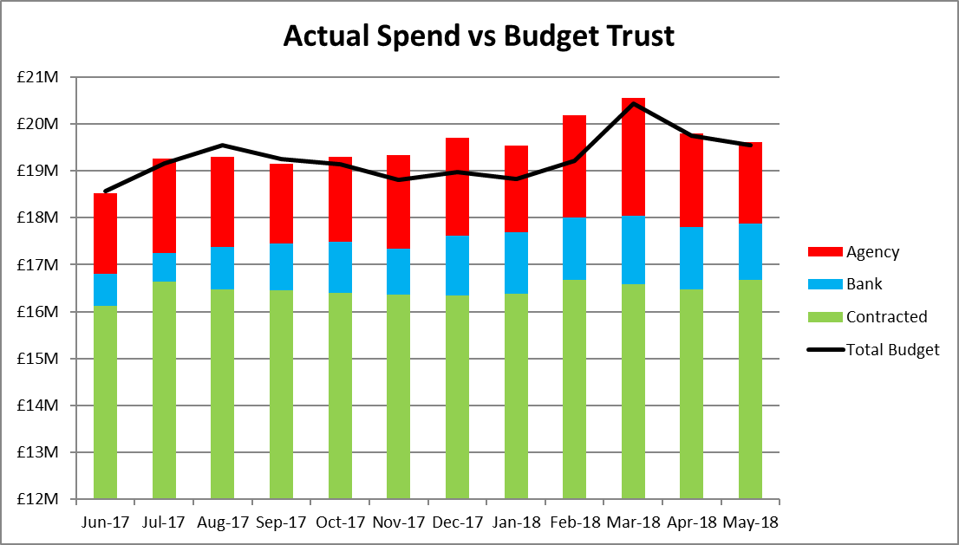
Total Payroll Spend
The Trust overspent the payroll budget by £60k in May and is £104K overspend YTD
        May YTD
Older Peoples: - £190k - £286k
Adults: + £102k + £85K
C&YP: + £188k + £353K
Corporate: - £41.3k - £49.5K

Slide 9
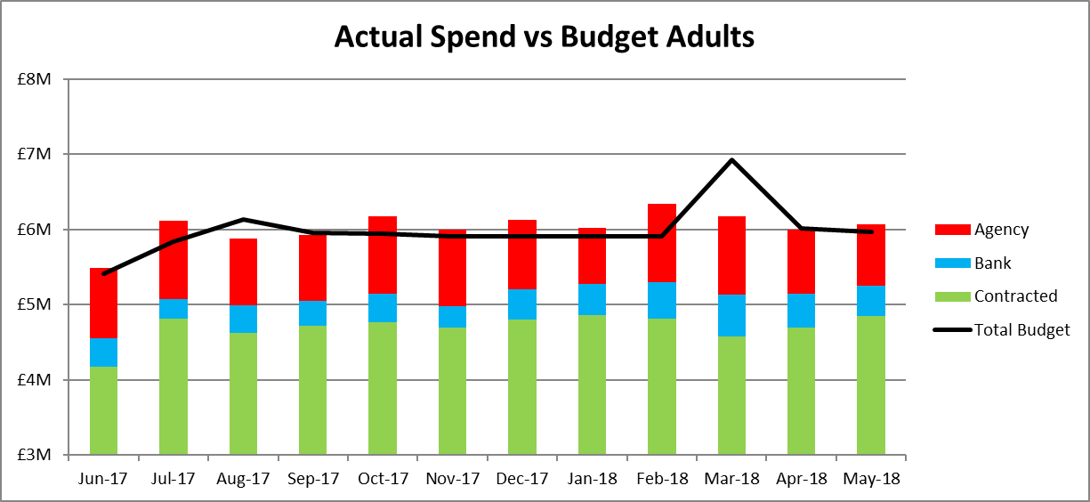
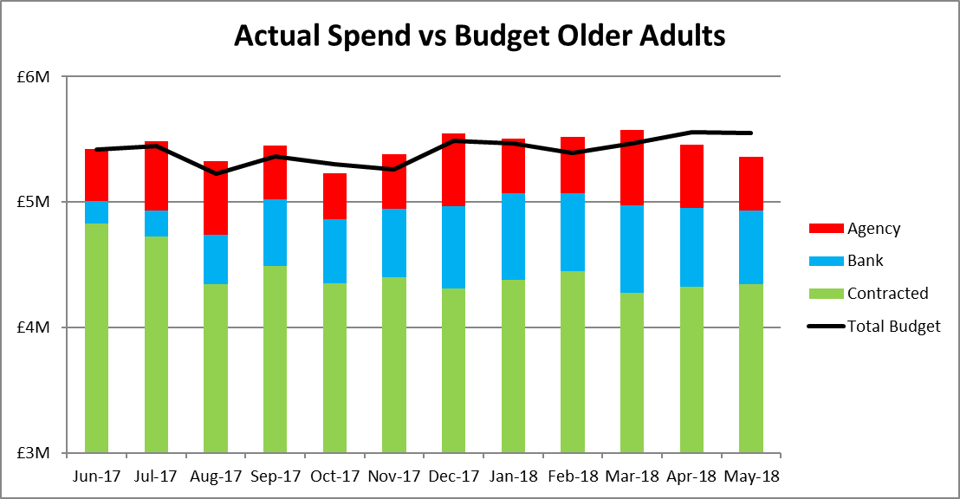
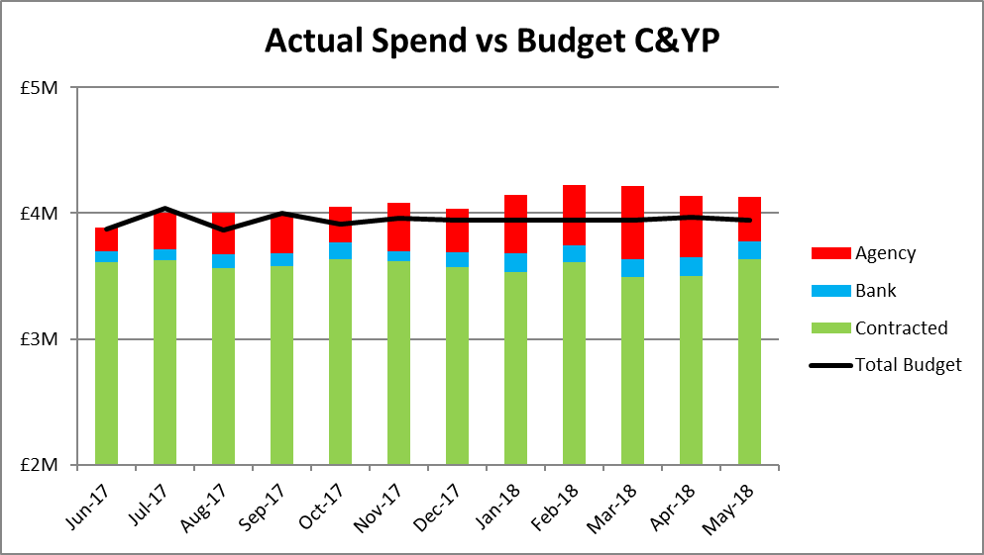
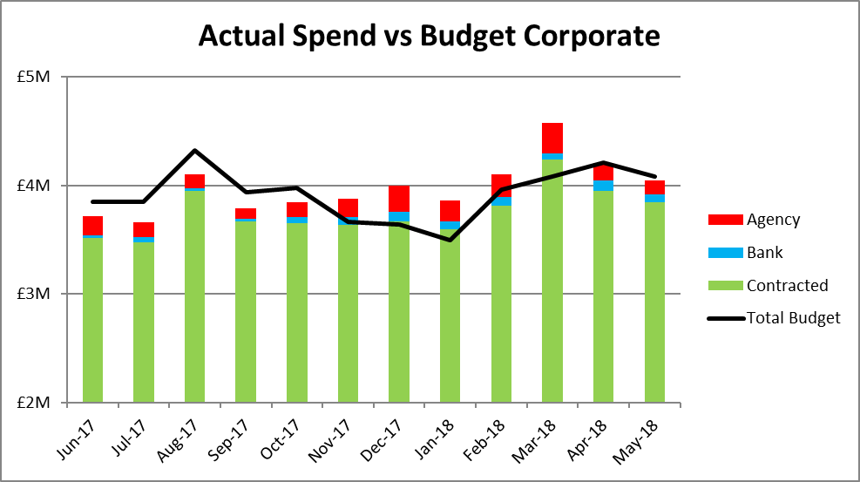
Total Payroll Spend

Slide 10
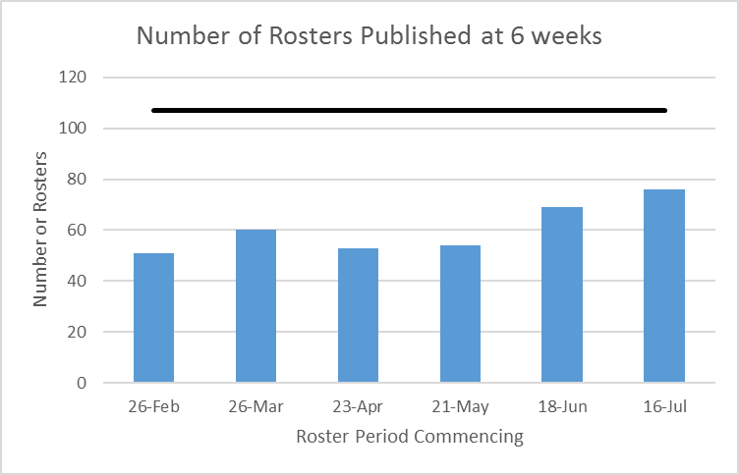
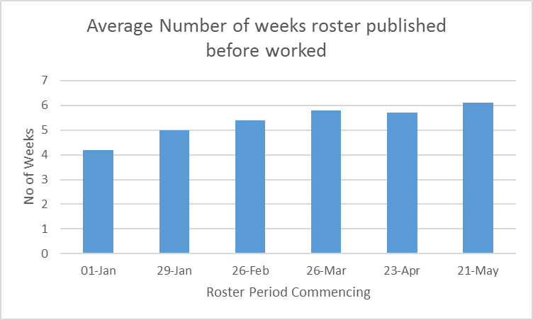
Roster Publication
Since the Autumn the Trust has been working to improve rostering for units on the Workforce Management System specifically :
Ensuring rosters are robustly reviewed prior to publication
Publishing rosters 6 weeks in advance.
Sending shifts that cannot be filled by substantive workers to bank as soon as possible.
Cancelling unrequired duties.
Through improvement in these areas it is anticipated that staff, patient and carers satisfaction and wellbeing will increase and efficiency savings will be made as:
A robust roster review process will support the effective management of unavailability and contracted hours whilst ensuring a safe skill mix and fair rostering.
Publishing rosters 6 weeks in advance will support staff to plan their work and home life and enable shifts that cannot be filled to be sent to bank earlier reducing agency use. Staff are unable to view their duties through Employee on Line (EOL) if rosters are not published.
Evidence suggests that sending shifts to bank earlier reduces agency spend by up to 50%.
Cancelling unrequired duties means that we can accurately report on risks associated with required duties that we are unable to fill.
76 out of the 107 rosters were published 6 weeks prior to being worked for rosters due to commence 16 July, 7 more than in the previous month. 3 remain unpublished at time of writing, 8 days after due.

Slide 11
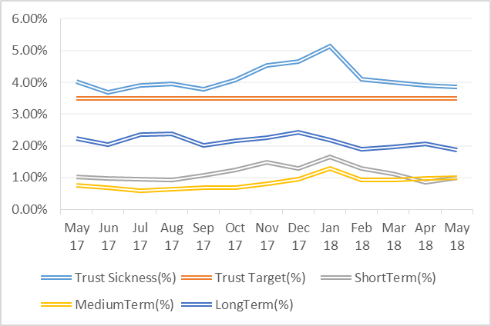
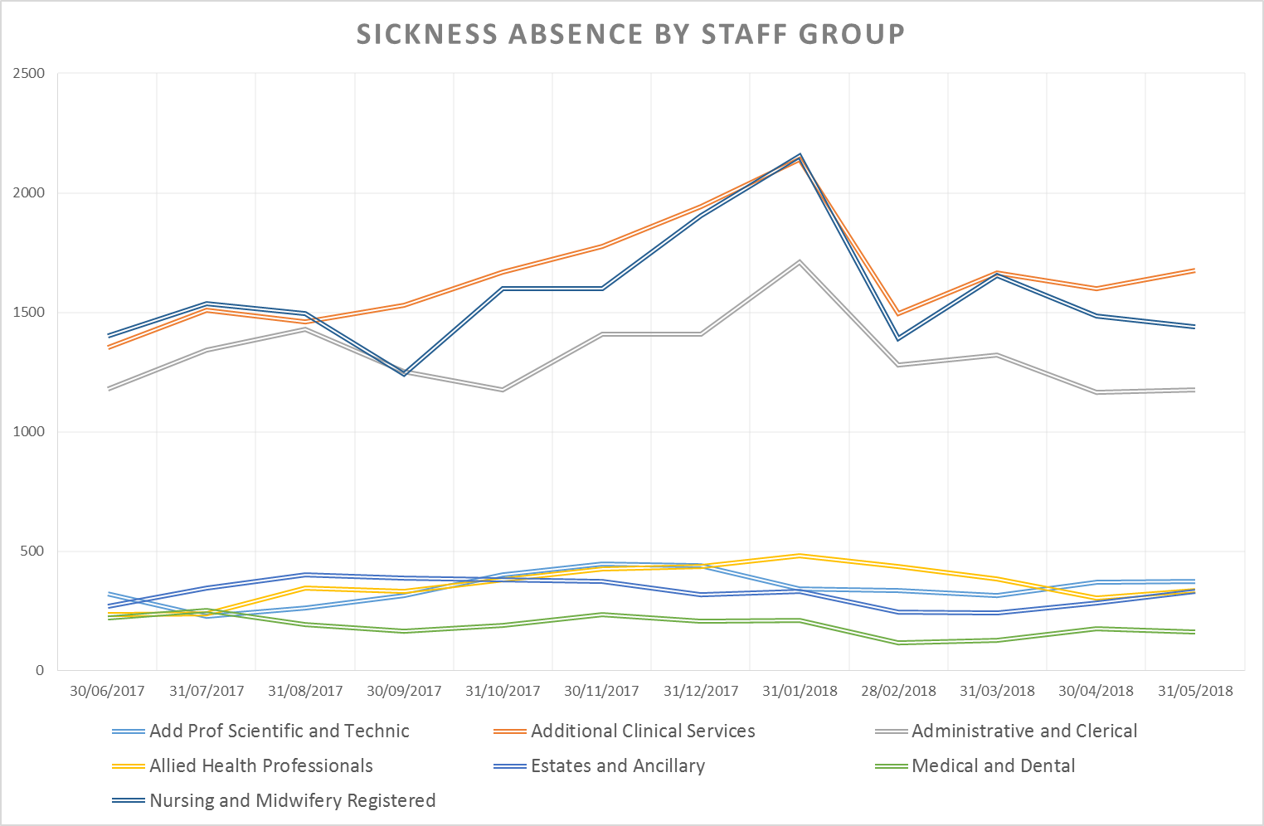
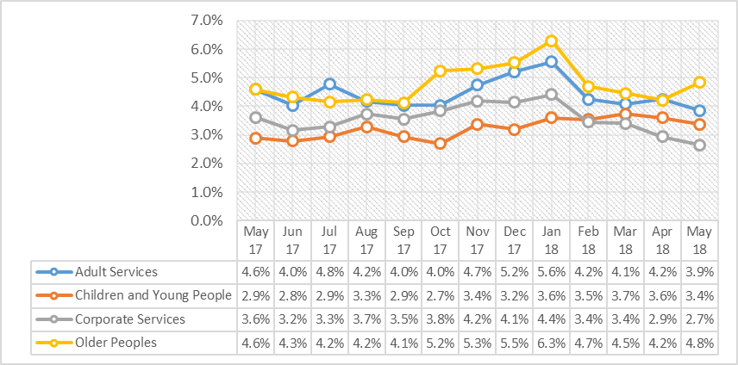
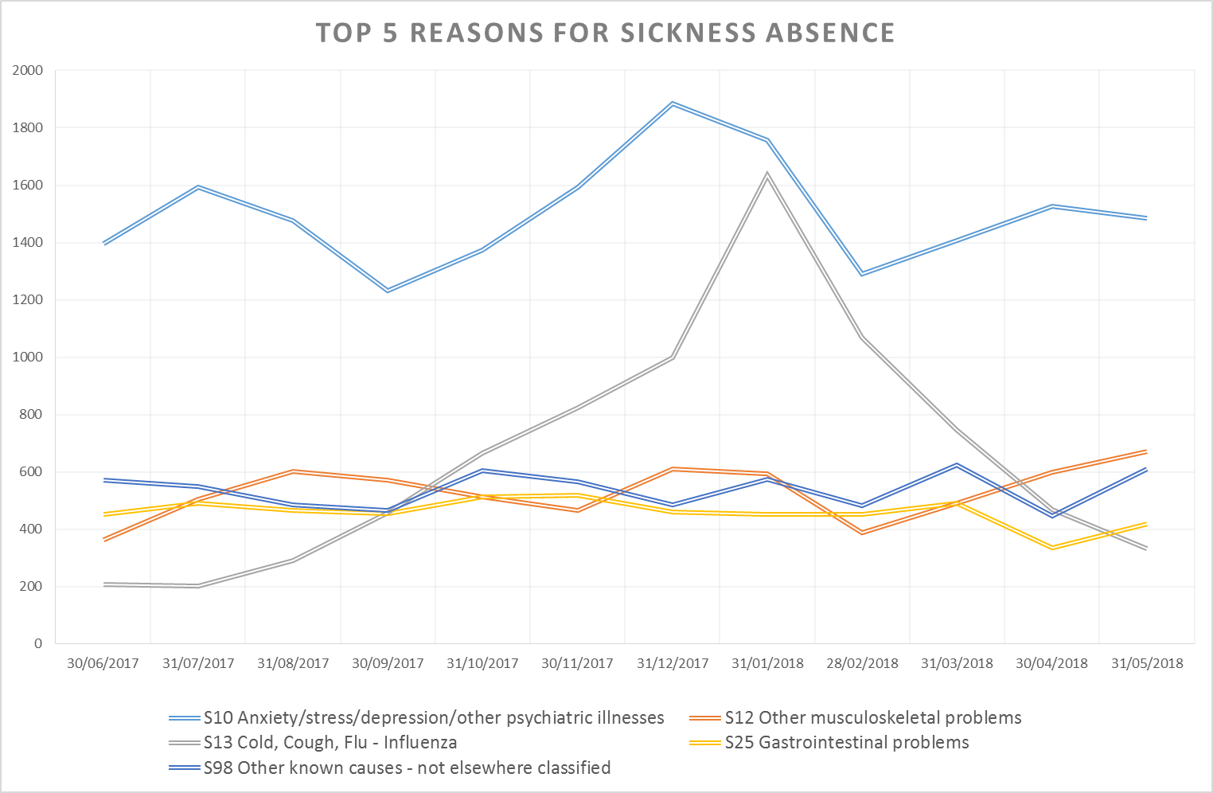
Sickness has decreased over the last four months to stand at 3.86%. The general decrease has been experienced across all directorates. However, May has seen an increase in the Older Peoples Directorate in the Mental Health Inpatient and Urgent Care Services.
Sickness
Target: 3.50%
This Month: 3.86%
Last Month: 3.89%
Last Year: 4.02%

Slide 12
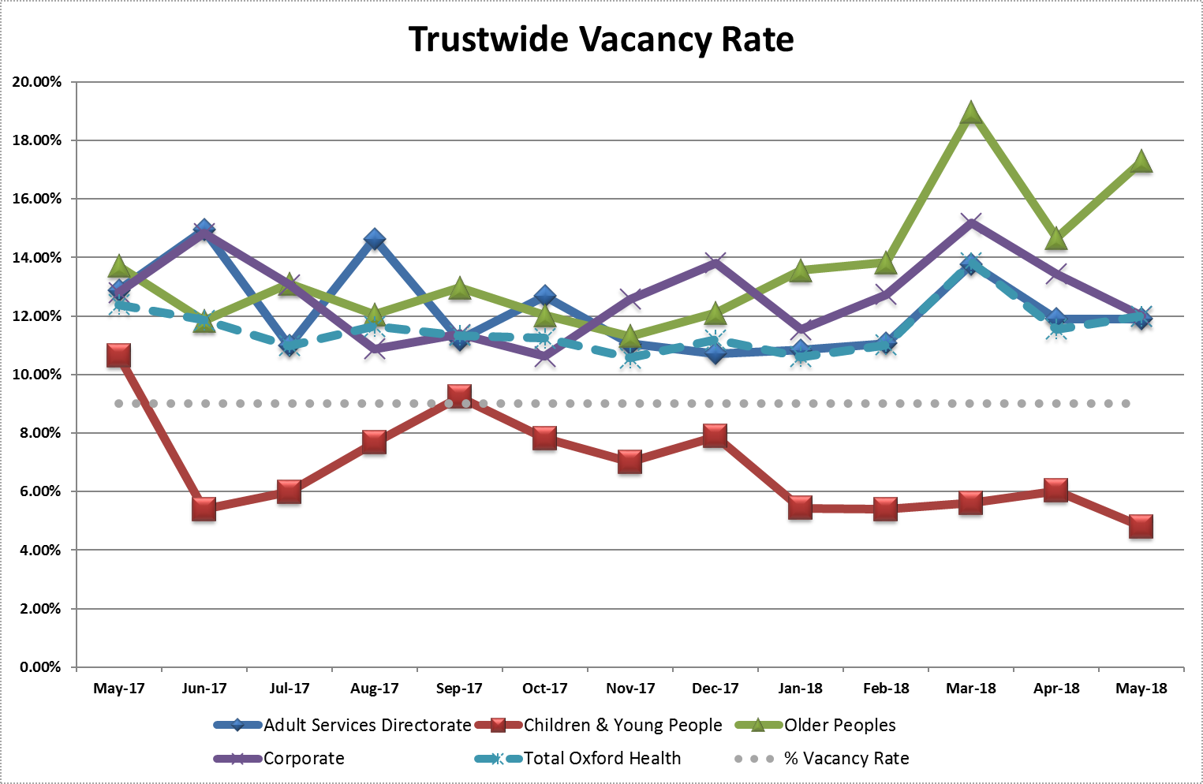
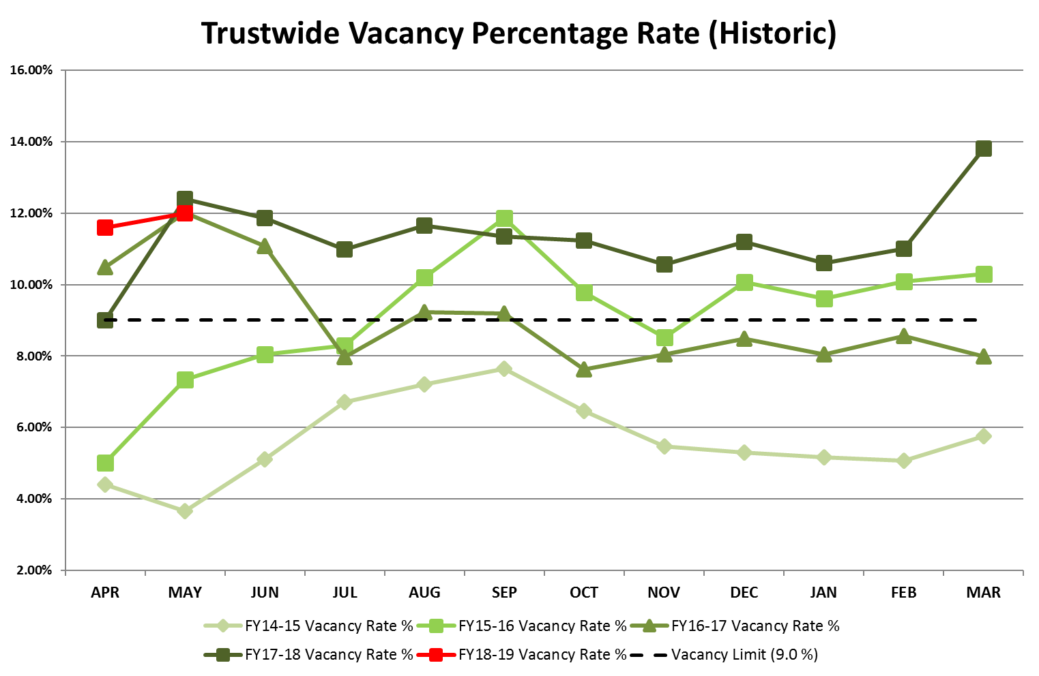
The Vacancy rate has increased to 12.0% in May from 11.4% in April. The increase was driven by an addition to budgeted FTE for the Older Peoples directorate.
Vacancy
Target: 9.0%
This Month: 14.3%
Last Month: 11.4%
Last Year: 14.2%

Slide 13
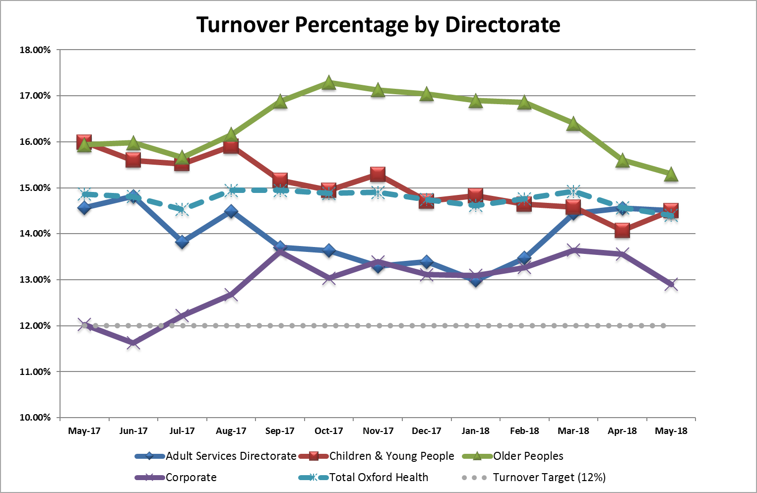
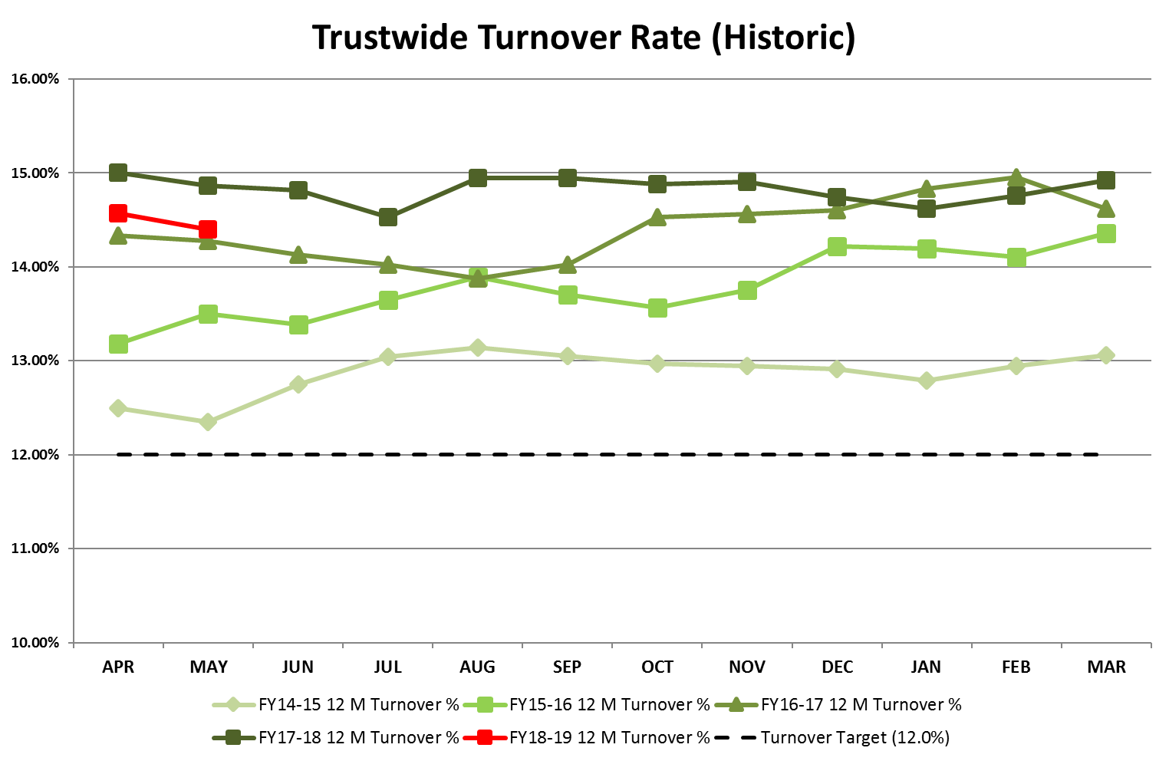
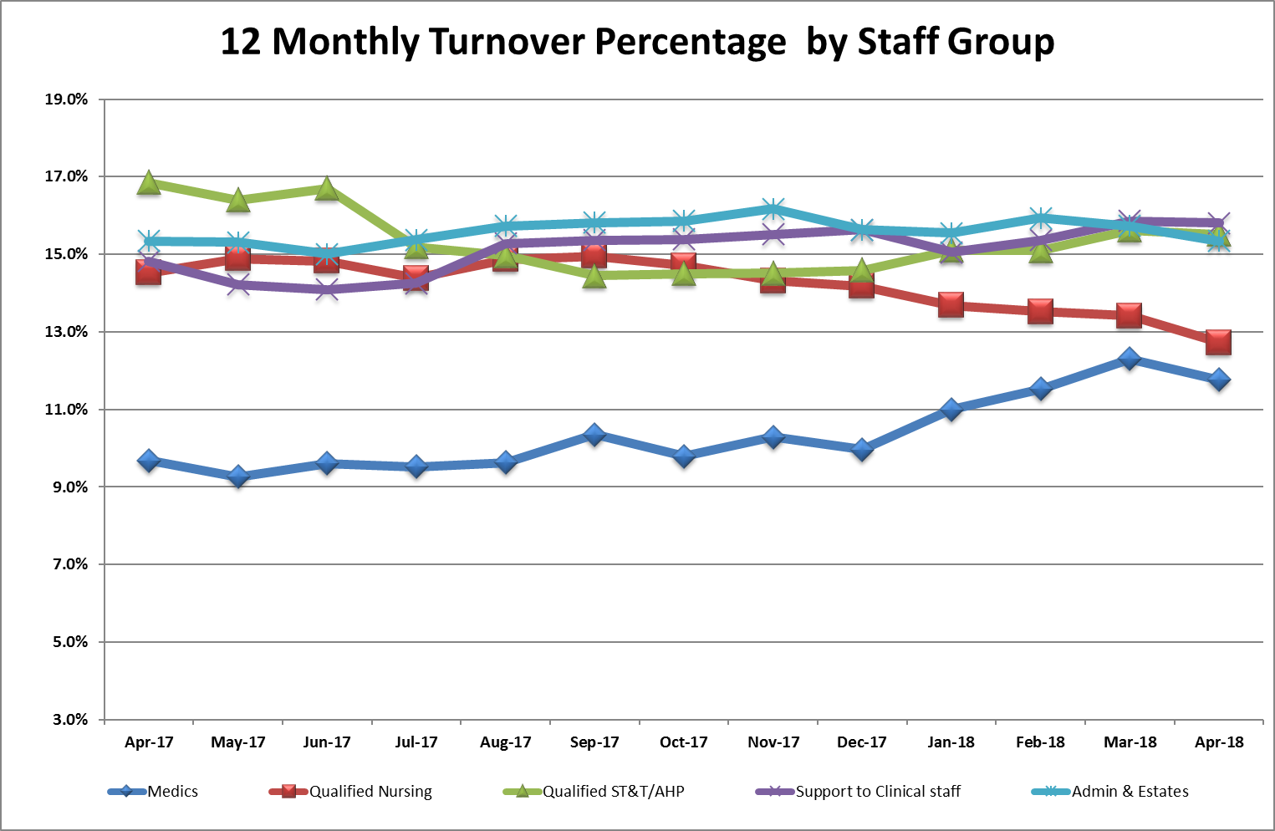
The Turnover figure has continued to decreased to stand at 14.4%. The decrease has been driven by a long term decline over the last six months in the Adult and Children and Young Peoples directorates.
Turnover
Target: 12.0%
This Month: 14.4%
Last Month: 14.5%
Last Year: 14.8%

Slide 14
WRES

Slide 15
WRES

