Slide 1
Inpatient CBT-E:
Program Overview &
Psychological Implications
Dr Hannah Stratford

Slide 2
Practical changes… psychological aims
Increase collaboration with staff and with treatment
Encourage proactive engagement not passive compliance (or rebellion!)
Increase sense of control for young people
Address maintaining mechanisms:
  Reduce preoccupation with eating, weight, and shape
  Increase other valued areas of life
  Reduce body checking / avoidance
  Address dietary rules and/or restriction
  Normalise weight
  Improve ability to cope with events and moods

Slide 3
General EDP structure & expectations
Attend on time and complete within time limit 3 meals (30 minutes) and 3 breaks (20 mins)
Staff supervision at the meal table
Finish everything that they are presented with (including fluids)
All avoided food will be “sat out” with staff until presented with a replacement.
All missed diet will be replaced (after 30 mins 1x ensure twocal for any hot food, and for any dessert).
No negotiation at the table
ED behaviours are discouraged using Ensure replacements
Supervision after eating to reduce exercise and purging.
Seated in main lounge
engaging in distraction/coping strategies
1 hour after meals, 30 mins after breaks
Generic meal plans that are individualised

Slide 4
General EDP structure & expectations
Dislike list of 3 items (not 3 food groups)
must be pre-existing.
Vegetarianism, religious/cultural requirements, and medically prescribed diets are honoured.
Progression onto Stage 2; collaborative
Increased preparation of own food
Reduced supervision then no supervision
Attendance at Pizza club and Sandwich club.
Family supported meals
Aim to promote family support of YP with eating.
FBT model
Progression from staff-led with HFU food, to family-led with own food
EDP group weekly
includes dietician, medic, psychology, nursing input.
Psychoeducation with FBT and CBTE aspects.

Slide 5
New adjustments for CBT-E
Round Table Review
1:1 CBTE assisted eating
CBT-E style weight graphs
Change to activity levels
Development of a young person friendly workbook
Shared formulation to coordinate case teams
CBTE components in EDP group
Use of EDE-Q, CIA & starvation checklist; recovery is not just about weight restoration
Greater choice and variety in meals and snacks

Slide 6
CBT-E style weight graphs
Viewed and interpreted weekly, together
Measured to half kilo accuracy only
Expectation to gain 1 – 1.5kg/week
Described in kilos
Mantra of “you can’t interpret a single reading, look for the trend”
Emphasis on trends not individual weights
Reduction in preoccupation with meaningless fluctuation
Repetition of psychoeducation about avoidance and frequent measurement
Notes:
Simplification; is weight increasing (meaningfully), staying the same, or decreasing? Rather than splitting hairs over insignificant changes

Slide 7
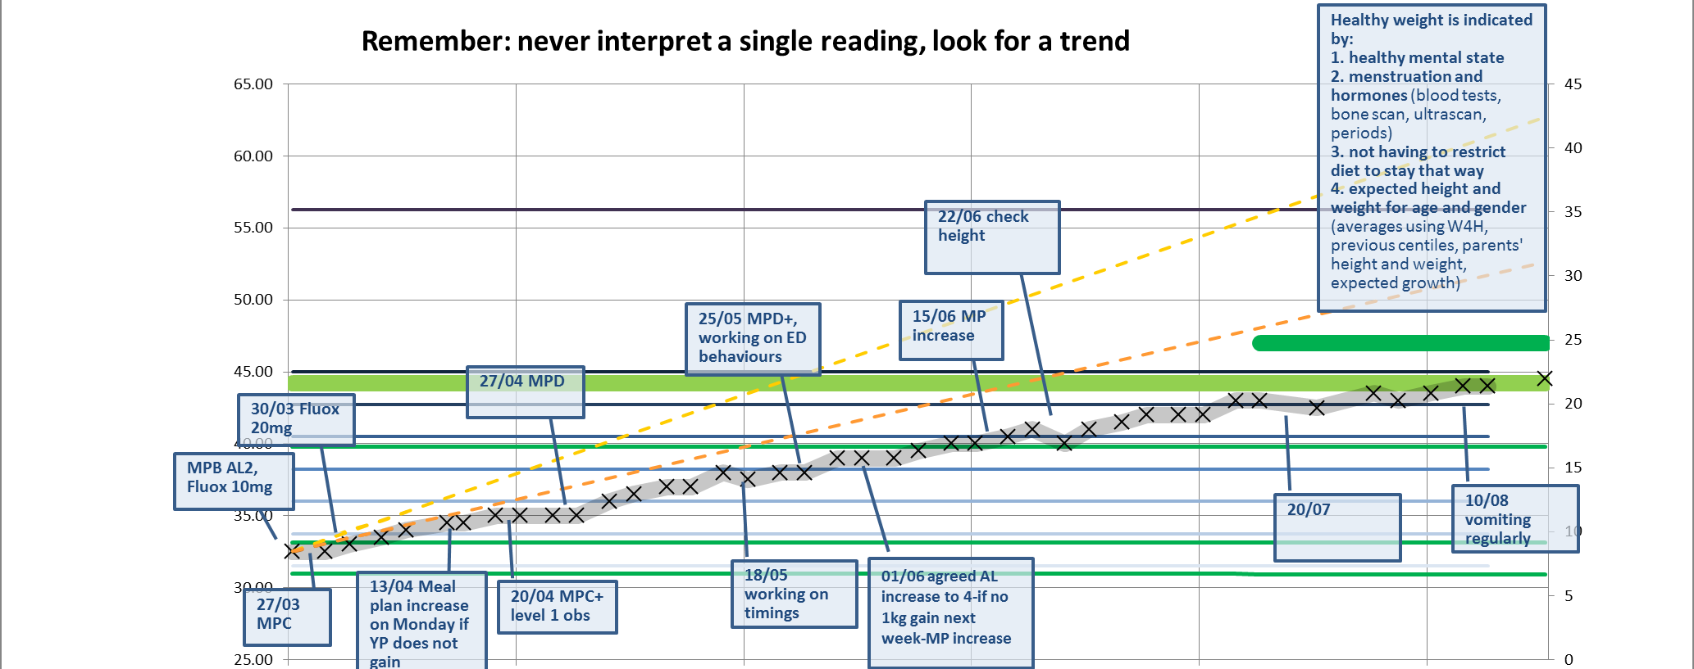
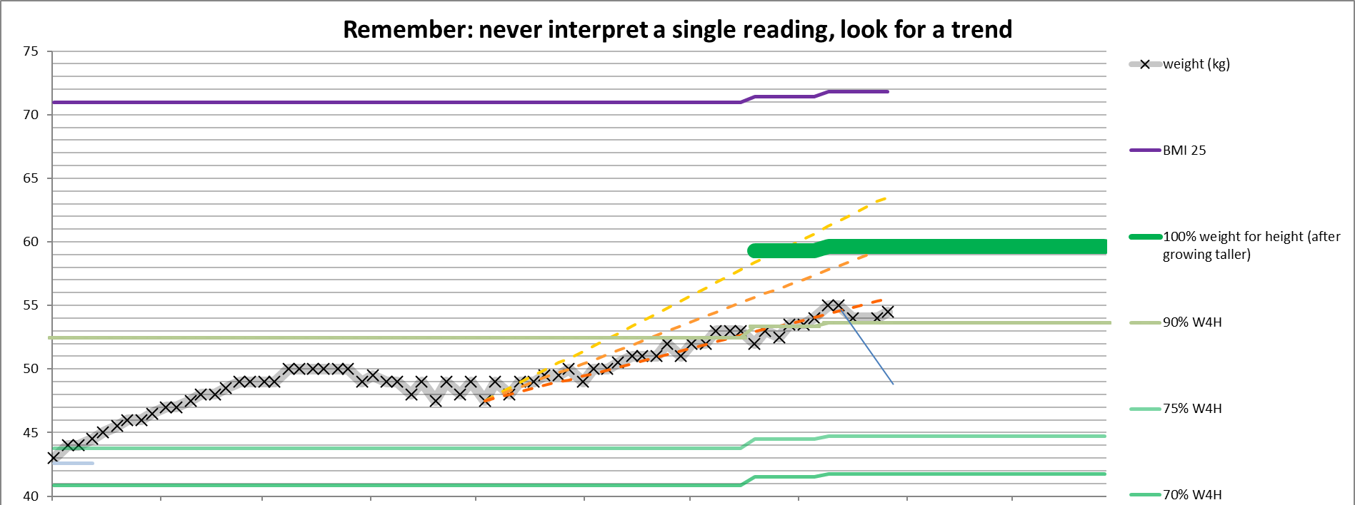

Slide 8
Activity Levels
Limited only when physically compromised
Gradually increasing activity, individualised
No absolute limit
Reduction in preoccupation with minutes of exercise
Activity level not seen as “leverage” re diet plans
More naturalistic to community
Reduces sense of exercise being solely to burn off calories
Reduction in friction between staff and young people
Notes:
(I’ll just stick to my AL better), emphasis on using diet plans to achieve balance of activity in/activity out

Slide 9
Weight Deficit | Level | Title | Description
≥ 40% | 1 | Bed Rest | Stage 1: Meals in room, up for toilet and baths Stage 2: Up for meals
35-40% | 2 | Couch Rest 2.1 2.2 | Wheelchair use. Feet up when in living/social areas. Meals in the lounge. Baths limited and monitored. OT involvement if appropriate. Only upstairs access for therapeutic meetings (e.g. 16+, EDP CBT group) and then only in lift/wheelchair. Wheelchair use only for longer distances (e.g. corridor), able to eat at the table. Baths; as above. OT or teaching involvement as appropriate. Only upstairs access for therapeutic meetings (e.g. 16+, EDP CBT group) and then only in lift/wheelchair.
30-35% | 3 | Chair Rest Home Leave | Able to walk without the use of the wheelchair (if physically stable). To remain for the majority of the day in living/social areas or patio if warm. Stage 1: Up for meals, toilet, and bath/shower. Only upstairs access for therapeutic meetings (e.g. 16+, EDP CBT group) and then in lift. Stage 2: One trip up to school/OT (in lift) Home leave, dependent upon physical state and as negotiated with family
 | 4 | Chair Rest Home Leave | Full school attendance/OT and scheduled therapeutic activities Movement to Level 4 when physical observations are stable Home leave, dependent upon physical state and as negotiated with family
25-30% | 5 | Gentle Activities on Unit Home Leave/Time off Unit with Family | Examples: pool, table tennis for 10 minutes at a time, about twice per day, after school/Unit structure (including pottery but no use of wheel) Able to have time in room No off-Unit activities/trips with peers/staff Home leave, dependent upon physical state/as negotiated with family 10 minutes gentle activity at home twice a day at weekend
20-25% 15-20% 10-15% | 6:1 6:2 6:3 | Gentle Activities off Unit | Stage 1: 10-15 minutes PE/activities; short walk in grounds on days there is no other outside activity. Examples: relaxation swimming (10/60 if swimming; 15/60 if less active) able to do PE warm-up/stretches. Pottery, (able to use wheel) No attendance on school trips or OT activities off of the unit. Home/weekend leave to be negotiated dependent upon physical state and ability to manage diet/activity appropriately; activity as above (e.g. 10-15 minutes of gentle (e.g. walk) twice per day). Stage 2: Attendance on most school trips allowed (apart from those longer in duration or more active). Able to walk down to the Cowley Road (dependent upon other activity that day). Activity level and amount of participation to be determined by staff; guidelines of; 15-20 minutes PE/swimming, walks of 15 minutes in the grounds, accompanied by staff/parents, 2-3 times per day (dependent upon other activities in the day). Home/weekend leave expected; similar activity allowed as above (e.g. 15-20 minutes 2-3 times per day of gentle activity). Stage 3: Walks of 15-20 minutes on own or with peers, 2-3 times per day Longer period of time in PE and swimming (20 minutes) Home/weekend leave expected; activity on leave 15-20 minutes of moderate activity 2-3 times per day unsupervised if appropriate.
<10% | 7 | Moderate Activities | Can participate in moderate activities, including all school trips, PE, general swimming, and games; same expectations for weekend leave Continue to be monitored by staff and family
Target wt | 8 | Full Activities | Stage 1: Full range of activities, but monitored Stage 2: Full range of activities, not monitored
Highfield Unit Activity Levels (Before and After)

Slide 10
Activity Level
1 | Chair Rest or Wheelchair For people medically at risk. To be advised by medics and nursing staff. Consider blood results/blood pressure/pulse/weight deficit. Consider upstairs access/school individually. Wheelchair – expected to use wheelchair unless sitting in lounge, bedroom or classroom. If in wheelchair, need to move to chair rest before moving to activity level 2. Chair rest – expected to sit down at all times, minimal walking e.g. be sat down all day (can access school via stairs unless Medics advise against).
2 | Moderate Activity Consider this with bone scan results. Some people may need individual care plans around exercise. The following will be planned at Round Table and considered in a staged approach: Step 1. Walks 70% weight for height. Start with facilitated staff walk in grounds at lunchtime and yoga. Step 2. Off Unit Activities 75% Weight for height eg school trips, Cowley Rd + P.E. 75% weight for height. 15 -20 minutes. Gym: 15 -20 minutes of gym Step 3. Moderate activity 90% weight for height Full P.E Full gym use (see gym guidelines) When on stage 2 can do walk to and from sandwich club and pizza club

Slide 11
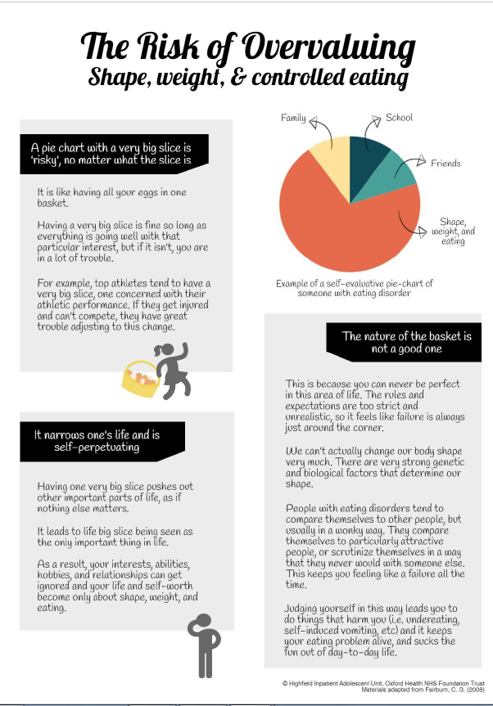
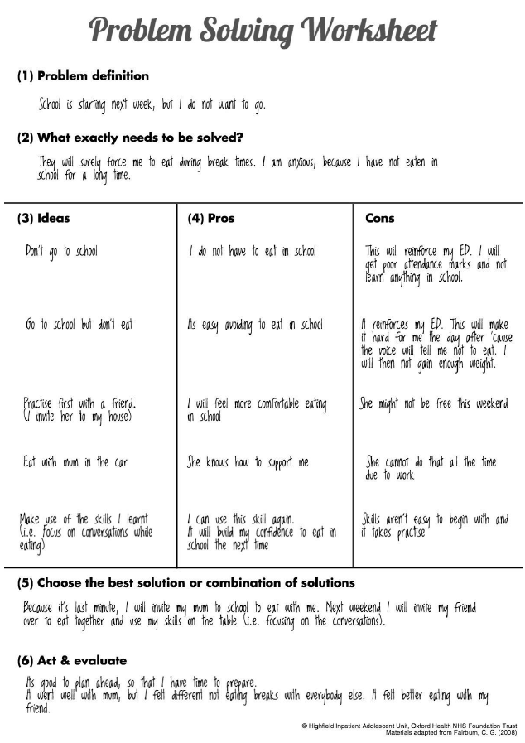
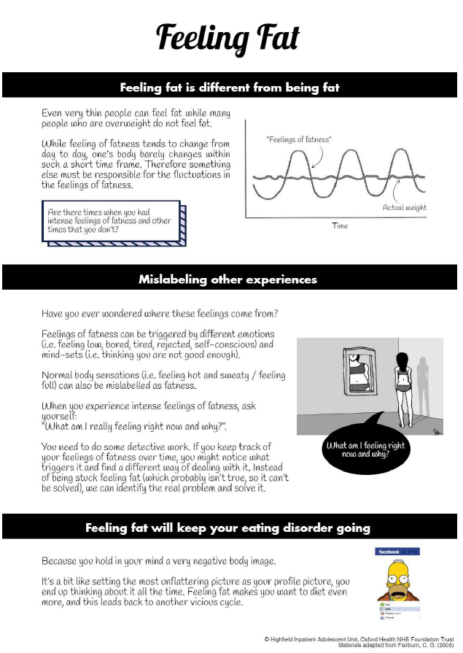
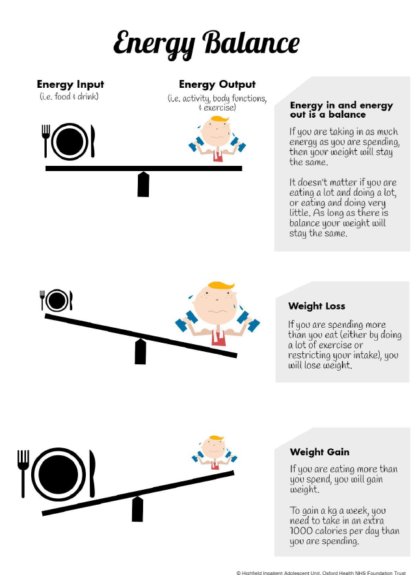
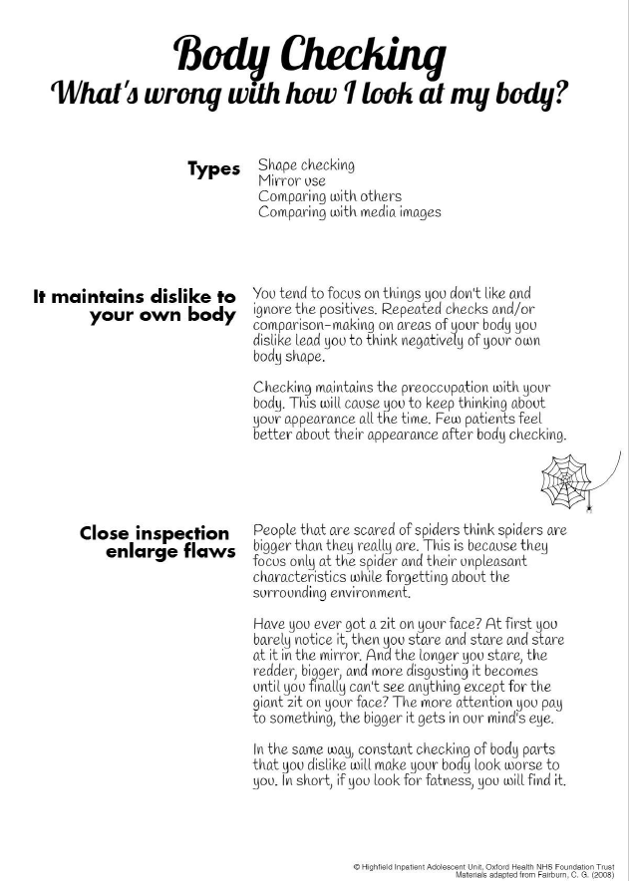
CBT-E workbook
Faithful to CBT-E manual
Visually appealing
More accessible language
Interactive worksheets
Follows the patient

Slide 12
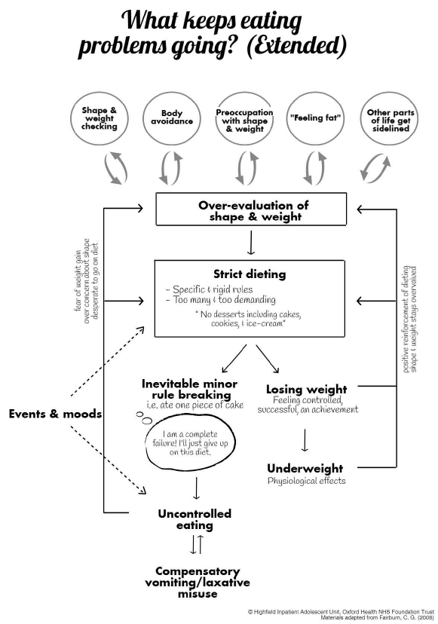
Coordination of case teams using CBT-E formulation
1:1 CBT-E sessions
Assisted eating (dietary rules, managing eating)
Primary nurse/HCA meetings (food shopping, body checking, eating out, clothes shopping, body image work…)
Occupational therapist (other areas of life)
Support at the table (decentring, distancing)
Continuity between inpatient and outpatient care

Slide 13
New adjustments for CBT-E
Round Table Review
1:1 CBTE assisted eating
CBT-E style weight graphs
Change to activity levels
Development of a young person friendly workbook
Shared formulation to coordinate case teams
CBTE components in EDP group
Use of EDE-Q, CIA & starvation checklist; recovery is not just about weight restoration
Greater choice and variety in meals and snacks

Slide 14
Outcomes
Offering CBT-E since 2016.
55 patients; 15 patients on CBT-E
Length of stay
  2015-16 pre CBTE 130 days
  2016-current
    CBT-E 119 days
    Other patients 104 days
Notes:
Since then, 15 of our patients were thought to be suitable for CBT-E and completed the treatment either at the Highfield, or continued in the community following discharge.
It may be worth noting that of those 15 patients, one completed CBT-E alongside family therapy, another had CBT-E informed psychology sessions, and another had a 4 week intensive version of the CBT-E treatment due to time constraints.

Slide 16
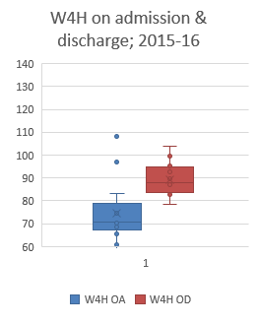
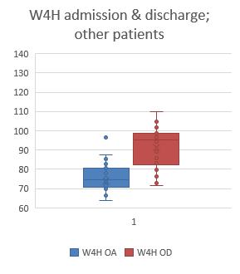
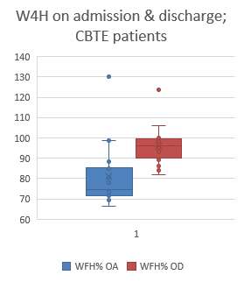
Weight restoration
2015-16 Pre CBT-E: 69.6 → 88.1
2016-current: 76.0 → 92.3
  CBT-E 76.5 → 95.0
  Other patients 75.7 → 90.8
Notes:
Greater variety in admission weight for those on CBTE
More reliably weight restoring on CBTE

Slide 17
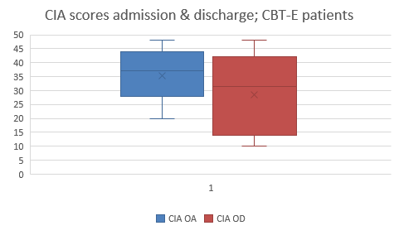
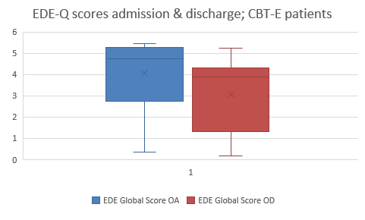
Notes:
Stage 1/2 completed inpatient

Slide 18
Challenges in implementing CBTE
It is not our only model
  what about when they clash
  Developing expertise in both and remaining up to date
  Unpredictable numbers of young people on each model
  Scope for incentivising CBTE within a relatively structured EDP
  Psychoeducation vs. group therapy and YP feedback
These are not our only patients
  Other groups (skills, HUG, 16+ etc.) and staff capacity prevent more groups / exercise groups etc.
NHS context
  Pressure on CAMHS beds; admission and discharge on therapeutic decisions vs risk and need, leading to transitions mid treatment
  Sectioned patients; can’t pull on collaboration for therapeutic milieu like Italian model
  Incidents can interrupt planned appointments and impact milieu
Pressure on community teams and crisis re intensive outreach e.g. supported meals at home
Difficulty with transition
  change of intensity, loss of structure and boundaries, may be mid-therapy.

