Slide 1
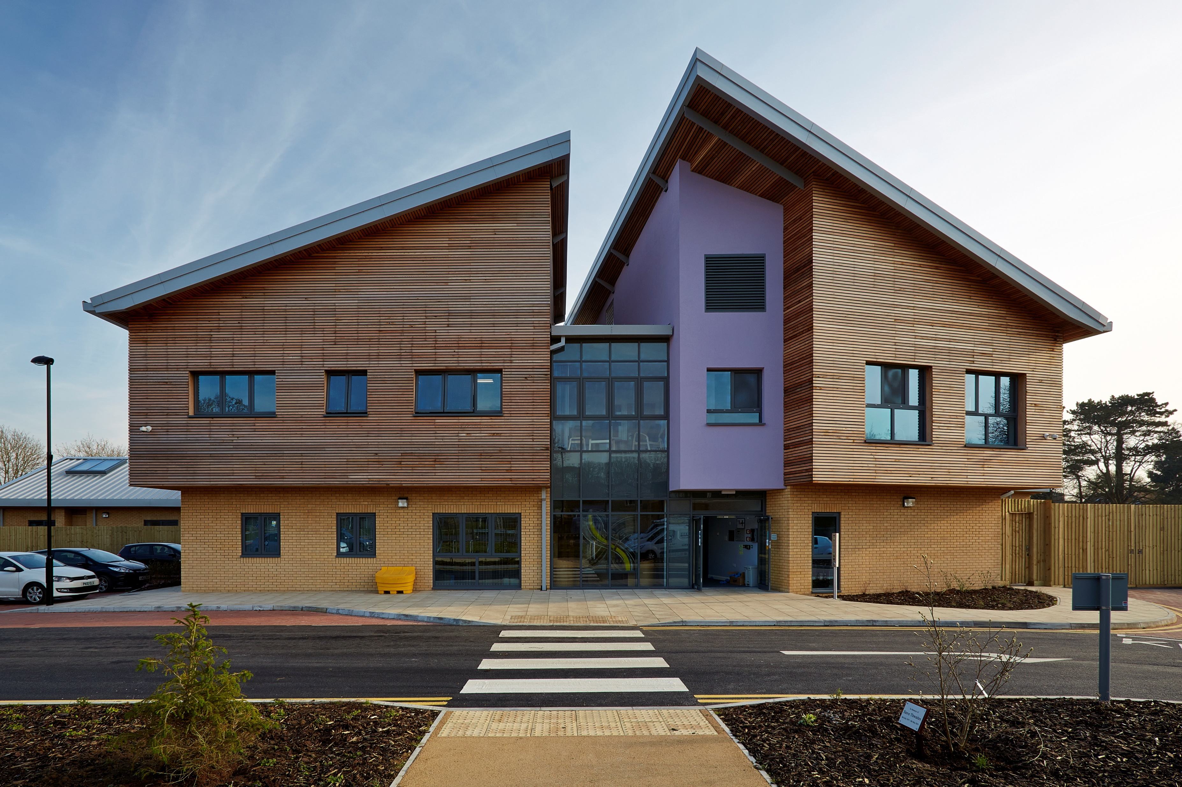

Implementing CBT-e in inpatient setting: The Round Table (Weekly Review Meeting)
Dr Lakshmeesh & Lucy Gardner, RD
Notes:
Dr L- Introducing LG and Dr L
One of the several steps taken towards implementation of principles of CBTe in an inpatient setting
Based on CBTe training with Prof Fairburn and Ricardo Delle Grave
Discussion with Ricardo Delle Grave’s team about aspects of round table

Slide 2
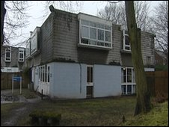

Historical Context (2011)
The “Dietitian’s Meeting”
Every Thursday 10-11am
Nursing staff and Dietitian
Starting meal plan 600kcal/day
Weight expectation 0.5-1kg/week
Late shift nursing staff would inform patients of recommendations
Notes:
LG-
There has been previous presentations about historical aspects of Eating Disorder management in inpatient setting
Talk about how plans of treatment were made for eating disorder patients- highlighting the above points

Slide 3
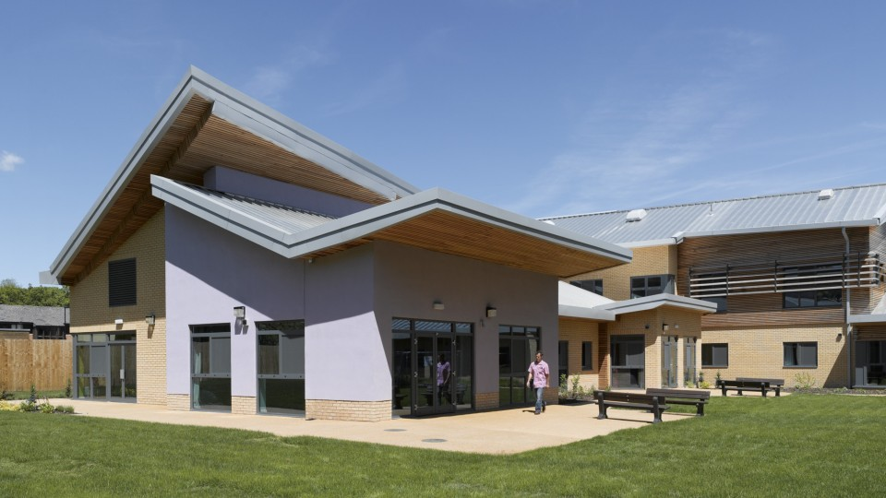
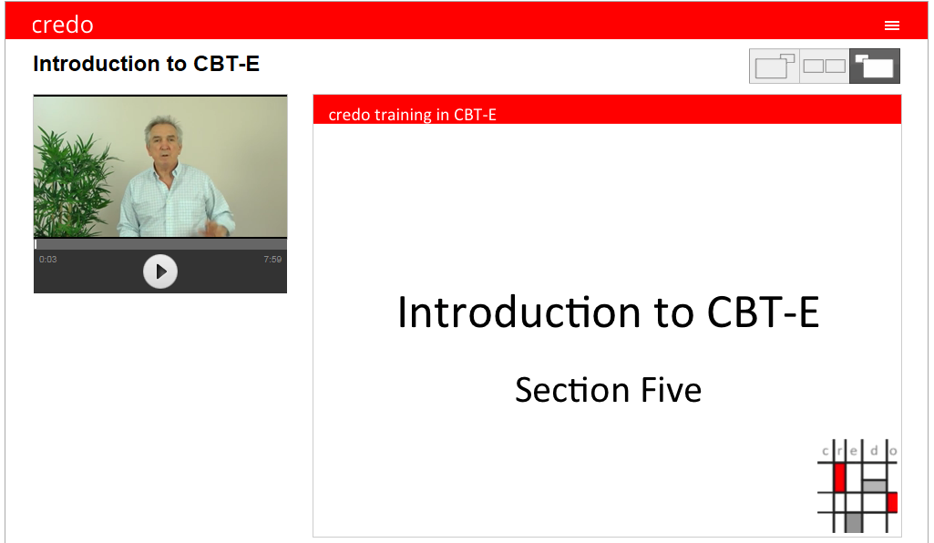


Unit’s Eating Disorder Working Party - identified simple first steps:
Move to the new building
Weekly online training, to read relevant books and aim to take on patients ourselves
Change the format of the weekly review meeting – The Round Table review
Change the scales from 100g to 500g increments
Change the weight graphs – expectation instead of 0.5-1kg to 1-1.5kg/week
Meal plans starting from 1000kcal/d; Change the meal plans – more choice
Agree weekly plans with the patient
Notes:
Dr L- first 3 points
LG- the next points

Slide 4

The Round Table Format
Purpose=
to promote engagement, open minded discussion
exploration of thoughts or worries (not just weight gain!)
independence, experimenting, implementing aims / goals
accurate interpretation of changes and
to support / sustain motivation to change
Young person, nurse, dietitian, psychologist, medic, care coordinator
The patient brings their CBTe folder
Review formulation, check list / questionnaires, feedback from patient, family and staff
Each patient is allocated 15- 20 minutes
Agenda set by patient (to be discussed list)
Once a week on the same day as weighing,
Weight graph interpretation
Notes:
Dr L- Purpose
LG- Other points around the purpose

Slide 5

A typical reflection and review of the week
  Agenda
    Patient requests or aims for the meeting
  Review weight graph and interpret changes together- offer explanation
  Review-
    Patient feedback
    Nursing feedback- Eating disorder behaviours / purging / exercise noted,
    Assisted meals
    Supported meals
    Stages of eating disorder programme - stage 1 or stage 2
    Medical feedback
    CBTe feedback
    Attendance to structure including therapeutic groups / individual meetings / family meetings
  Plans-
    Alteration in diet intake based on energy spent discussed
    Challenges for coming week discussed
    Continue CBTe, medical plans and family meetings
    Planned leave including introducing participation in sandwich club / pizza club
    Written weekly plans given to patient
Notes:
Dr L- Agenda, review of weight graph, medical and CBTe feedbacks
LG- other feedbacks and plans

Slide 6
The Changes so far: Typical Weight Graph
Notes:
LG- Summarising a typical weight graph
Dr L- elaborating on interpretation

Slide 7
Video and discussion of round table review
- https://www.dropbox.com/s/ck4tab5bqa1barx/CBTe%20ROUND%20TABLE.mov?dl=0
Discussion

Slide 8
Ongoing Plans
Continue with the format
Therapeutic opportunity
Introduce experimentation and collaborative working,
Flexibility vs boundaries
Encourage consistent engagement
Focus not just on weight!
Notes:
Dr L- to conclude with above points

