Slide 1
Workforce Performance Report
August 2018
Tim Boylin
Director of Human Resources

Slide 2
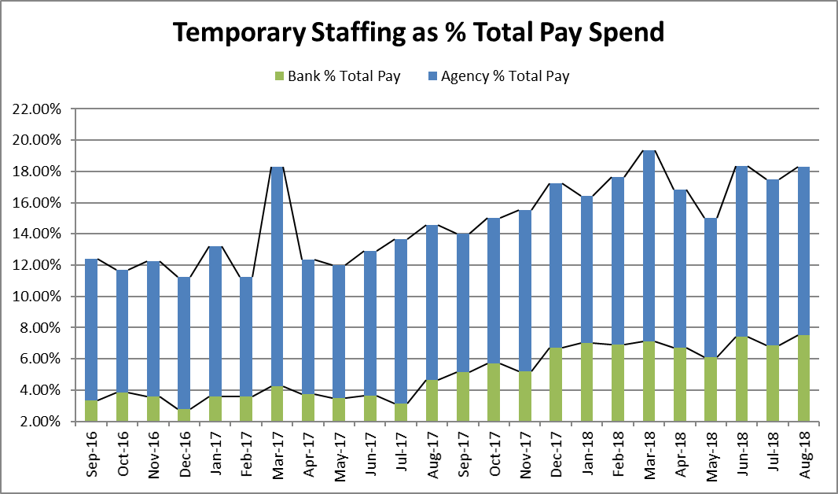
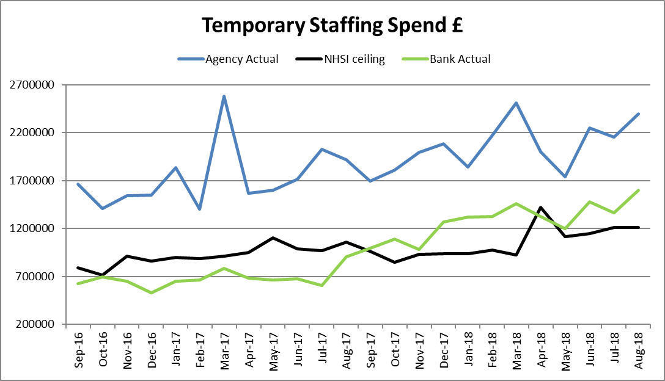
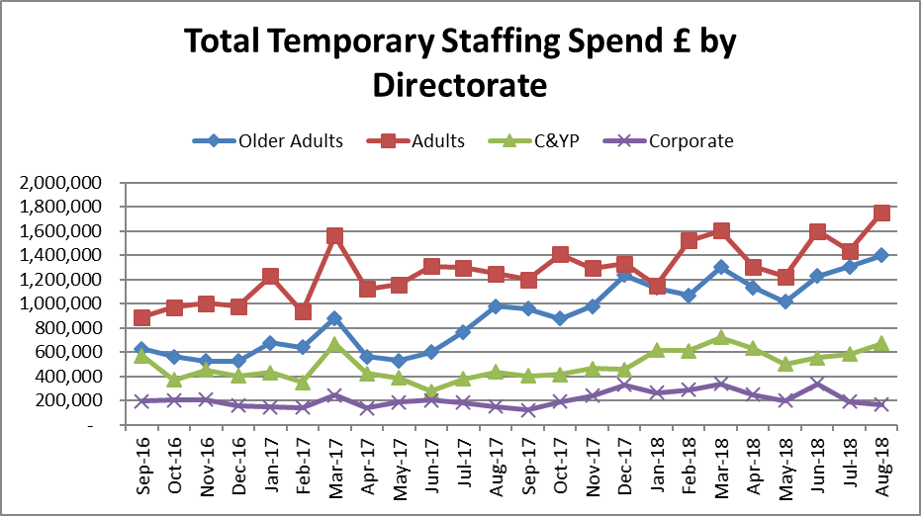
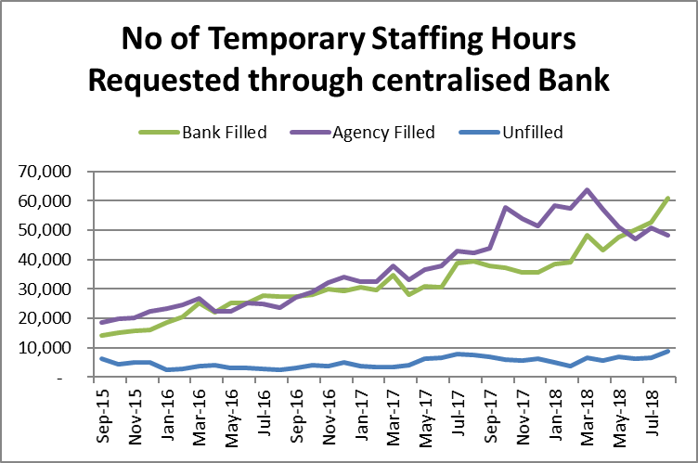
Bank Costs for August include April, May and June back pay for the changes to Flexible Worker pay and the national pay award. Agencies generally increase their costs in line with the NHSI price caps.
Total temporary staffing spend increased by £478K to £3.99m, 18.78% of payroll, 4.35% more than Last year. The majority of this increase ,3.49% has been absorbed by increased bank use with agency use only increasing by 0.86%. Bank use has increased by 67% (607k to £1.6m) in the past year. Increased bank use is not resulting in decreased agency use due to higher levels of demand.
Temporary Staffing Spend
This Month: 18.78%
£3.99m
Last Month: 17.68%
£3.51m
Last Year: 14.43%
£2.82m

Slide 3
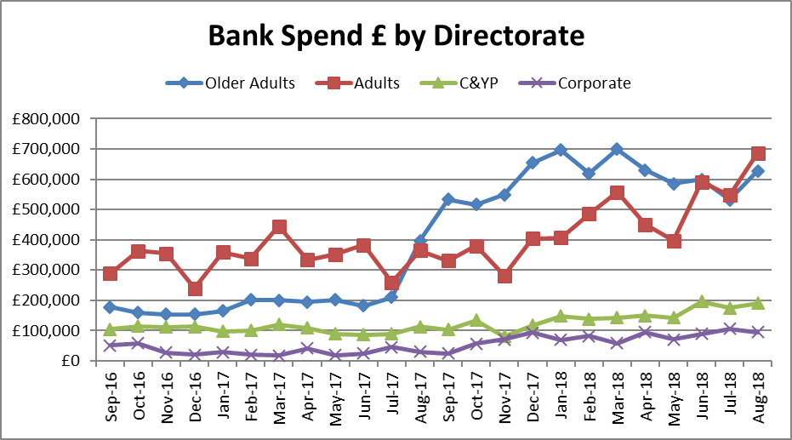
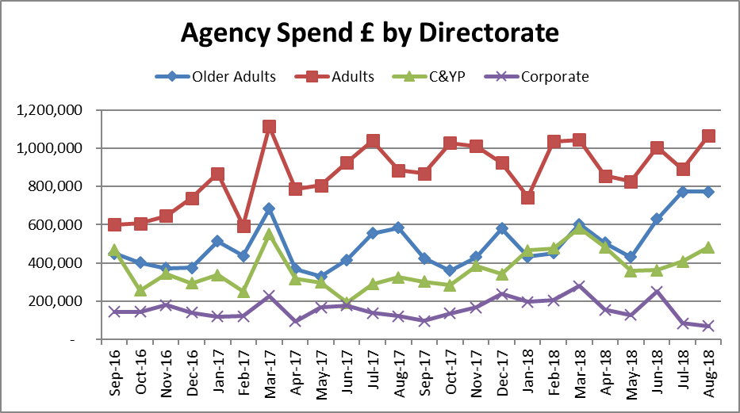
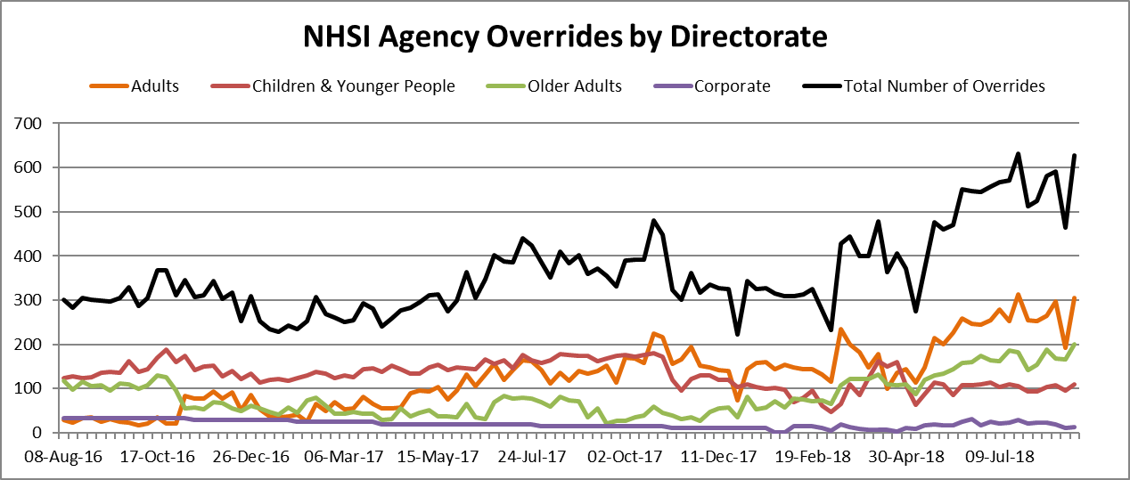
Temporary Staffing Spend
Agency Spend increased by £237k to £2.39m, 10.78% of payroll. The increase was seen in Registered Nursing which can be attributed to both inpatient and community teams and medical and dental. Agency spend in corporate services had fallen considerably.
The number of NHSI overrides has continued to rise again this cannot be wholly attributed to the HCA agency reduction programme.

Slide 4
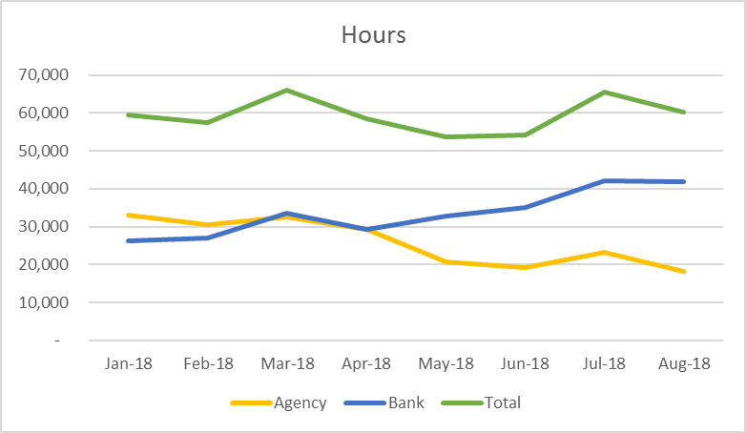
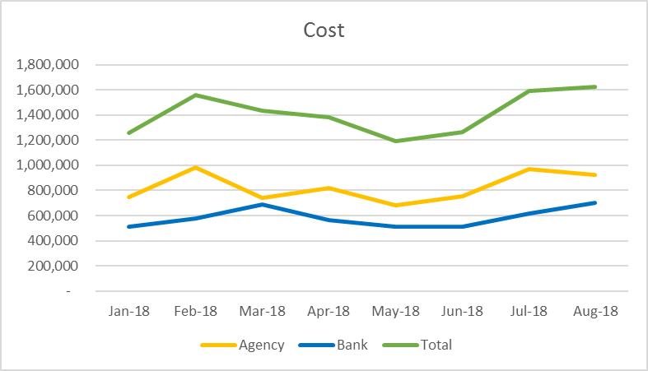
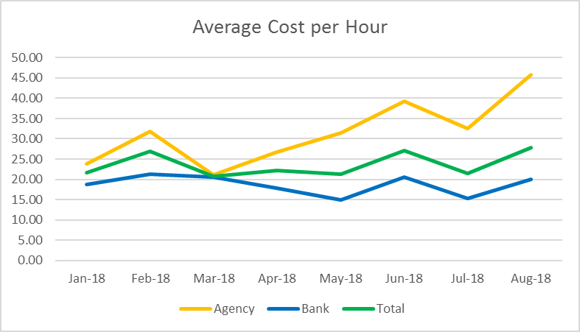
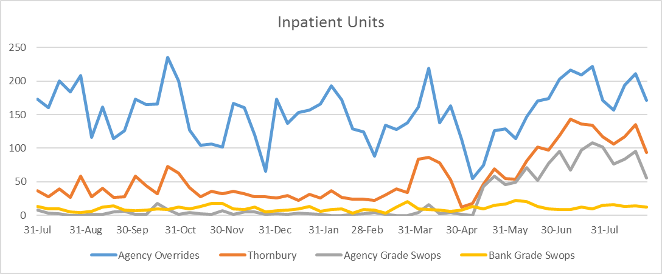
HCA Agency Spend Reduction
On 14 May the Trust stopped using Agency HCA workers across inpatient units. Where a HCA Flexible Worker cannot be sourced Registered Nurses are used. The graphs below show a sustained increase in the number of bank hours used and a corresponding decrease in agency hours. Bank Costs from July reflect the changes to Flexible Worker pay and the national pay award. Using Registered Nurse agency shifts instead of HCA agency shifts and increased use of NHSI price cap overrides has resulted in an increase in average cost per hour for temporary staffing although this has decreased significantly in July back to pre initiative levels. Work continues to grow the HCA Flexible Worker bank with additional training spaces being made available for new starters. Flexible Site workers have been introduced to try and reduce the requirement for last minute agency use which is frequently above price caps.

Slide 5
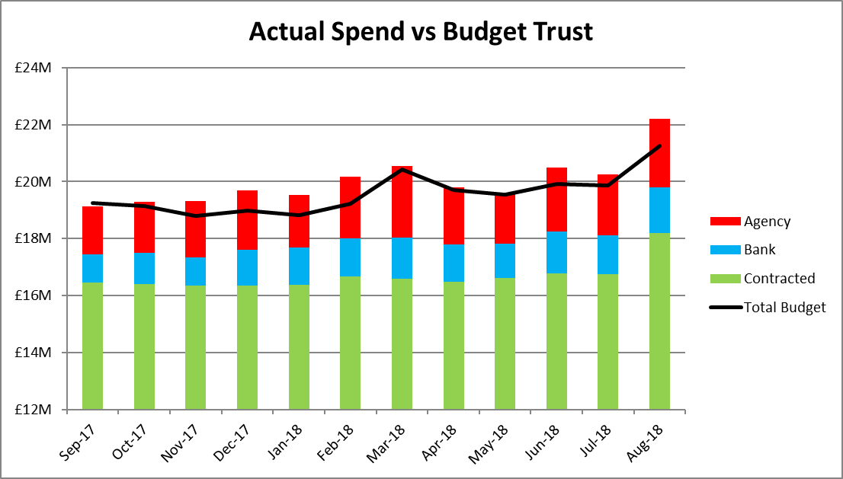
Total Payroll Spend
The Trust overspent the payroll budget by £937k in August and is £2m overspent YTD. Budgets and actuals have been updated to include the pay review for AfC staff with August including back pay for April, May and June.
August YTD
Older Peoples: + £105k - £184k
Adults: + £647k + £1,076K
C&YP: + £274k + £968K
Corporate: -+£59k +£137K

Slide 6
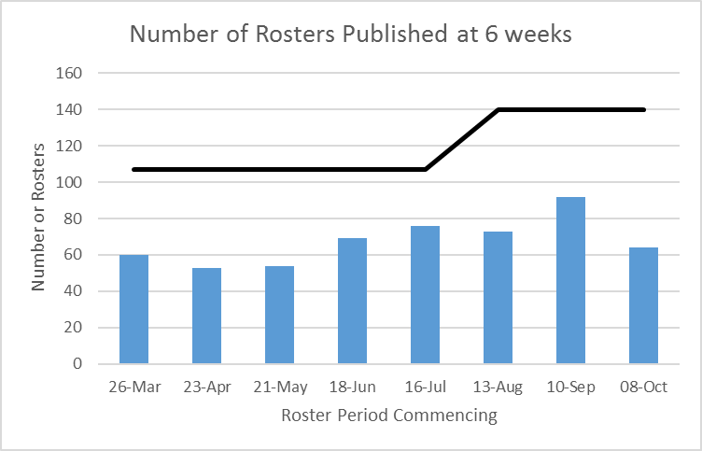
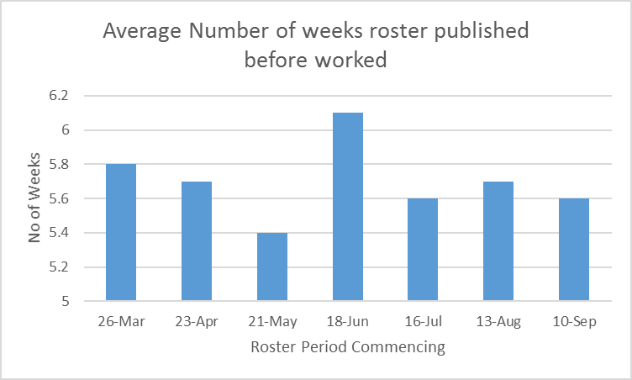
Roster Publication
Since the Autumn the Trust has been working to improve rostering for units on the Workforce Management System specifically :
Ensuring rosters are robustly reviewed prior to publication
Publishing rosters 6 weeks in advance.
Sending shifts that cannot be filled by substantive workers to bank as soon as possible.
Cancelling unrequired duties.
Through improvement in these areas it is anticipated that staff, patient and carers satisfaction and wellbeing will increase and efficiency savings will be made as:
A robust roster review process will support the effective management of unavailability and contracted hours whilst ensuring a safe skill mix and fair rostering.
Publishing rosters 6 weeks in advance will support staff to plan their work and home life and enable shifts that cannot be filled to be sent to bank earlier reducing agency use. Staff are unable to view their duties through Employee on Line (EOL) if rosters are not published.
Evidence suggests that sending shifts to bank earlier reduces agency spend by up to 50%.
Cancelling unrequired duties means that we can accurately report on risks associated with required duties that we are unable to fill.
Wave 4 units have now been added into the number of rosters bringing the total number of units reported on to 140, 33 more than the previous month. 64 out of the 140 rosters were published 6 weeks prior to being worked for rosters due to commence 08 October, 7 less than in the previous month. 21 remain unpublished at time of writing, 12 days after due.

Slide 7
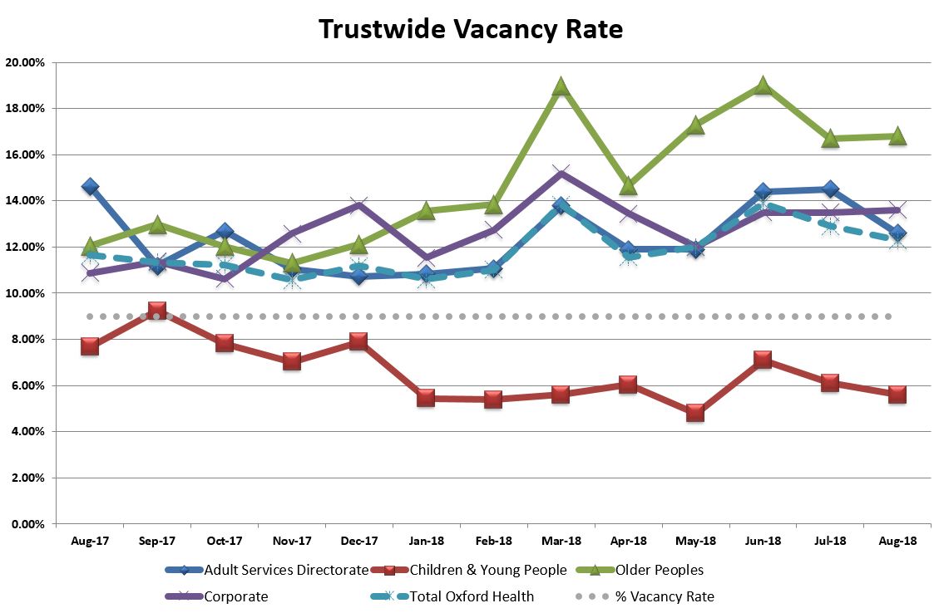
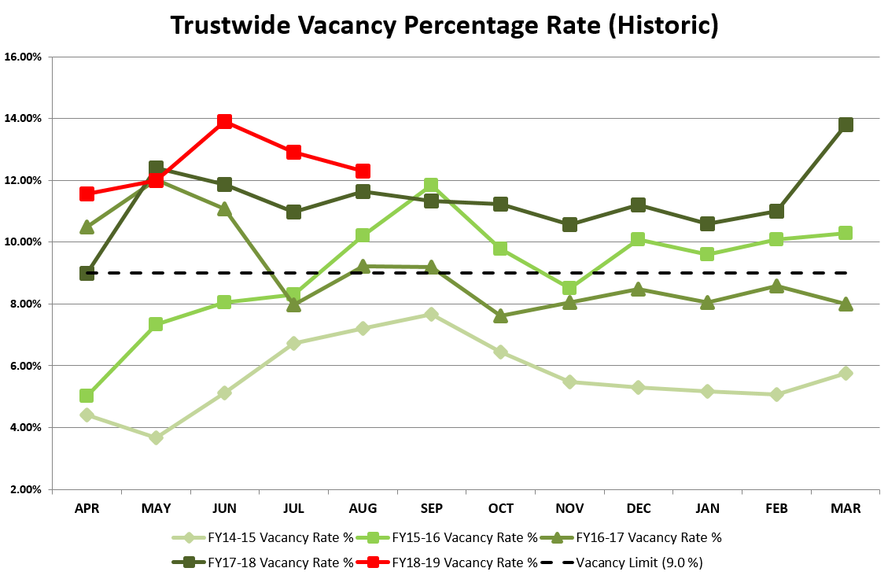
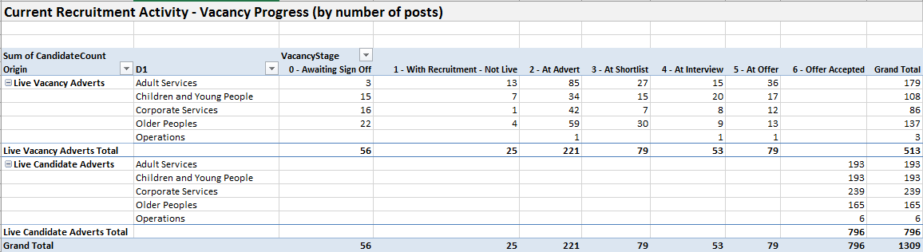
The vacancy rate reduced to 12.3% in August from a peak of 13.9% in June. The Adult and Children and Young People Directorates have driven the reduction with the other two directorates remaining largely unchanged.
Vacancy
Target: 9.0%
This Month: 12.3%
Last Month: 12.9%
Last Year: 9.8%

Slide 8
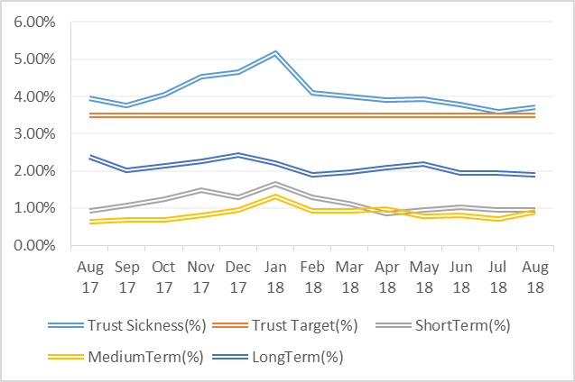
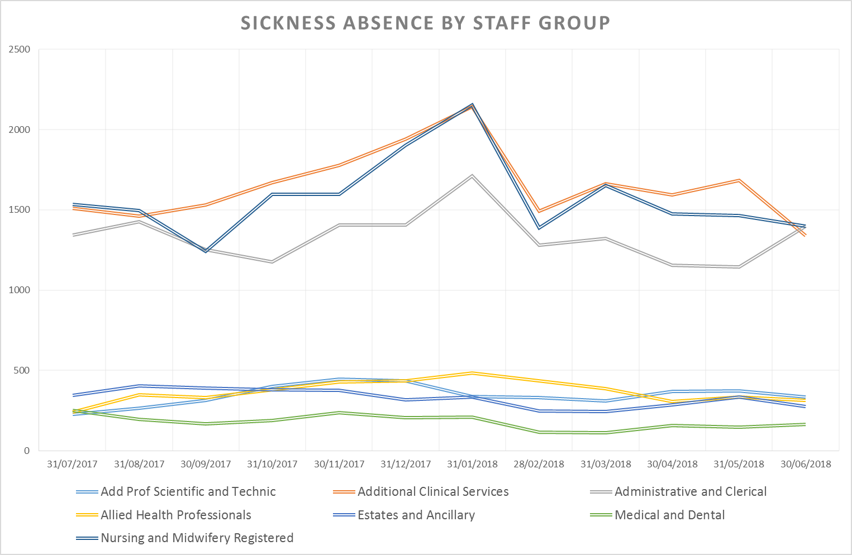
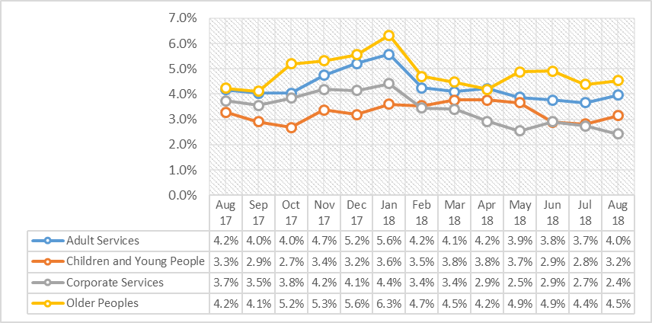
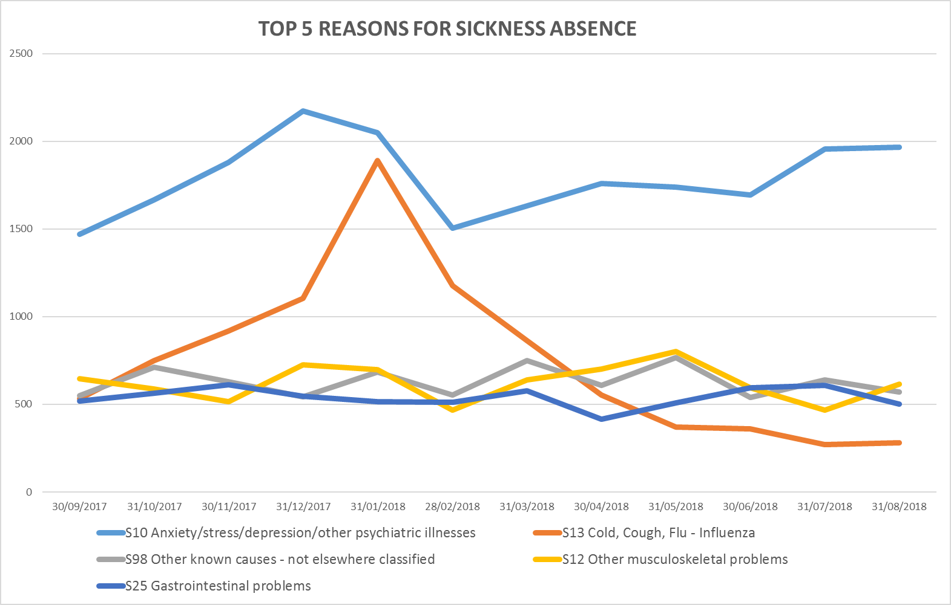
Sickness has increased slightly to 3.72% in August from 3.60% last month. The rise has been driven by a long increase in Anxiety/Stress over the last 5 months and a recent increase in Musculoskeletal absence.
Sickness
Target: 3.50%
This Month: 3.72%
Last Month: 3.60%
Last Year: 3.94%

Slide 9
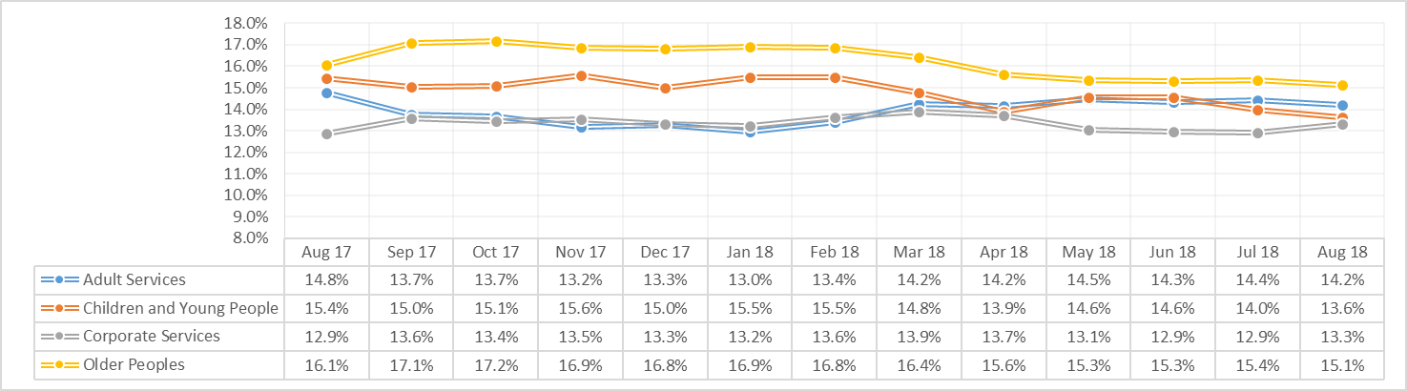
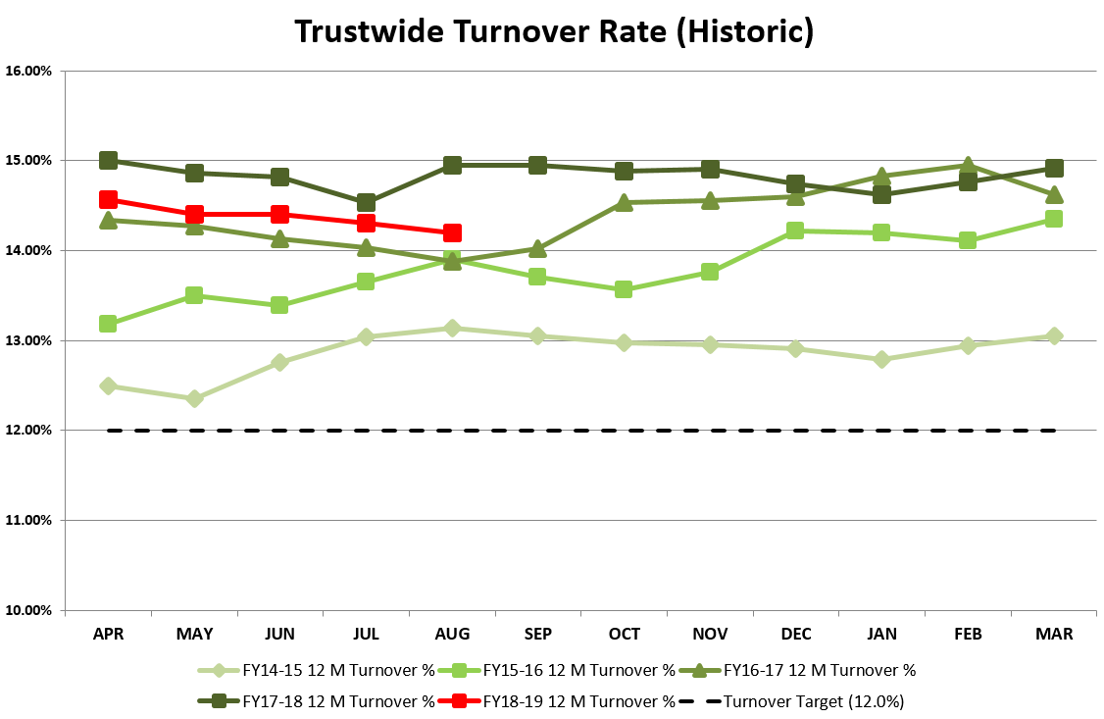
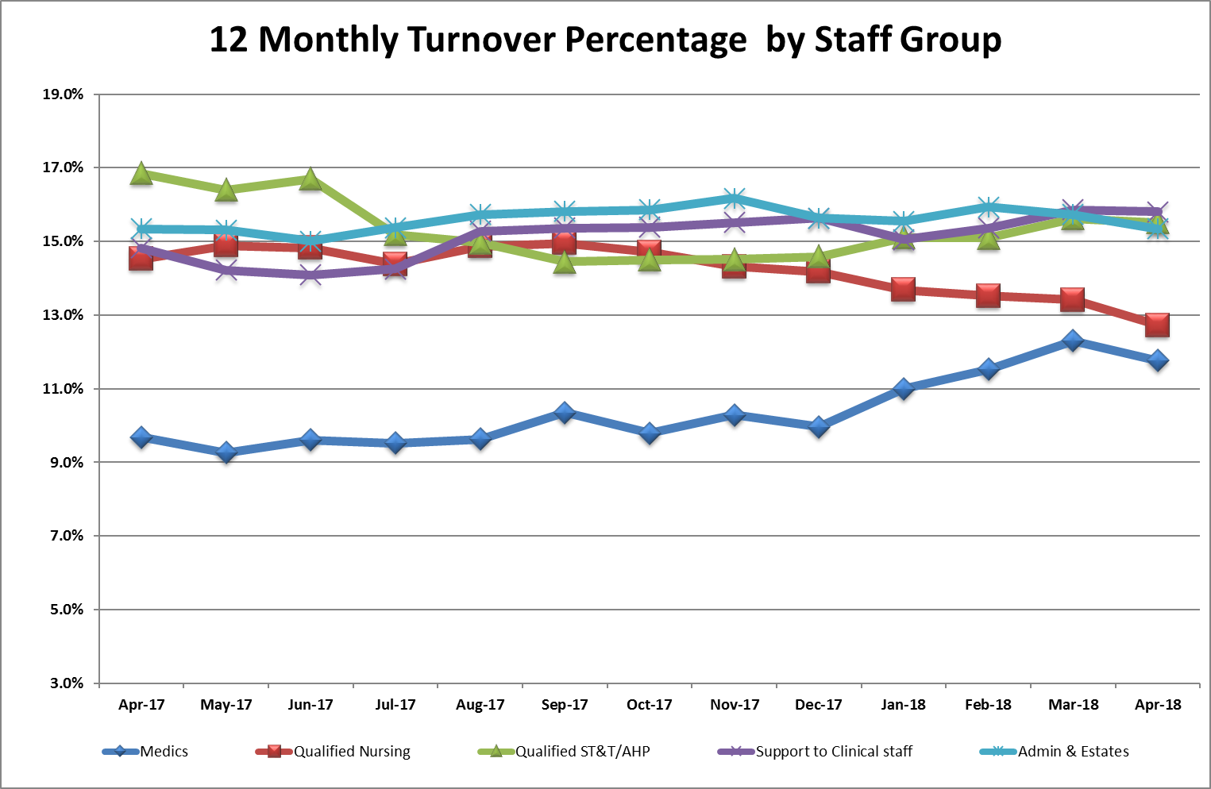
Turnover has continued it slow reduction over the last 5 months to stand at 14.2% in August. The Older Adults and Children and Young People Directorates have seen the largest reduction over the period whilst Adults Directorate has seen an increase.
Turnover
Target: 12.0%
This Month: 14.2%
Last Month: 14.3%
Last Year: 15.0%

Slide 10
WRES

Slide 11
WRES

