Slide 1
Workforce Performance Report
October 2018
Tim Boylin
Director of Human Resources

Slide 2
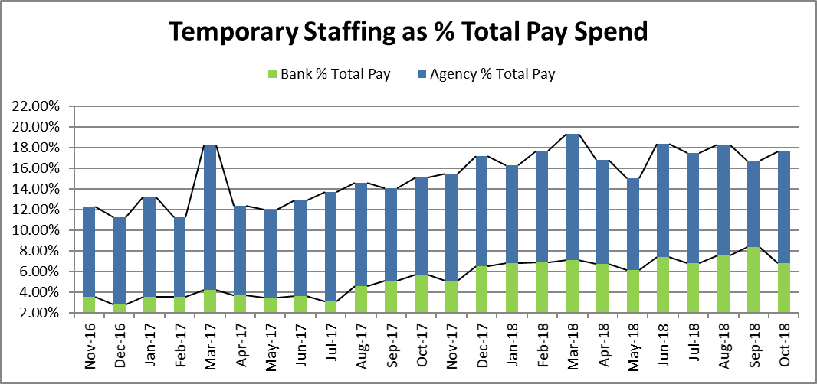
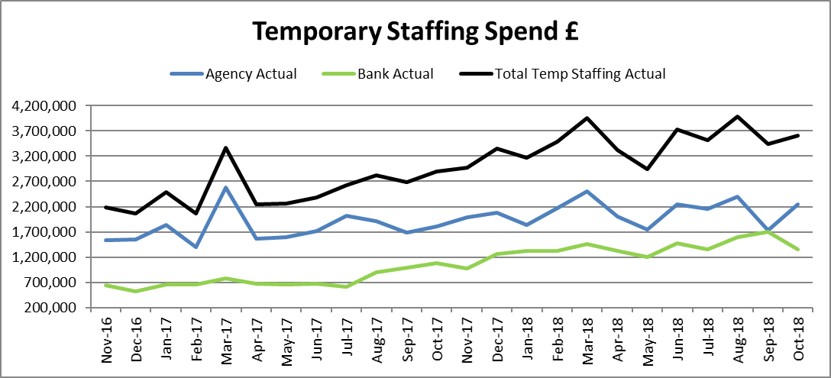
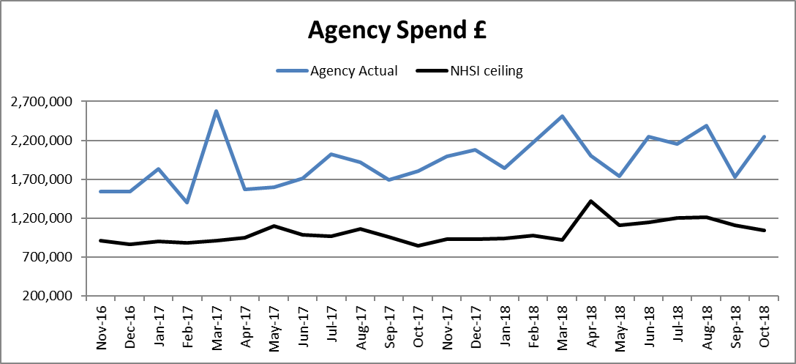
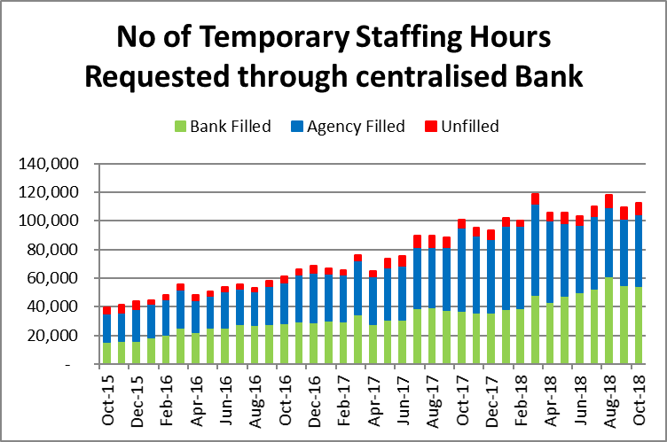
Agency spend increased by £511k in September £245K of this is increase is due to the previous months reversal of over accrual of agency use in Continuing Healthcare, resulting in a true increase of £265K. Bank spend decreased by £343k, to £1.36m, £121k of this reduction was in inpatient where 1550 less bank hours were worked than in the previous month.
Overall, total temporary staffing spend increased by £168K to £3.6m, 18.02% of payroll. Bank spend is 6.8% of total pay, £1.36m.
Temporary Staffing Spend
This Month: 18.02%
£3.60m
Last Month: 16.95%
£3.43m
Last Year: 15.12%
£2.89m

Slide 3
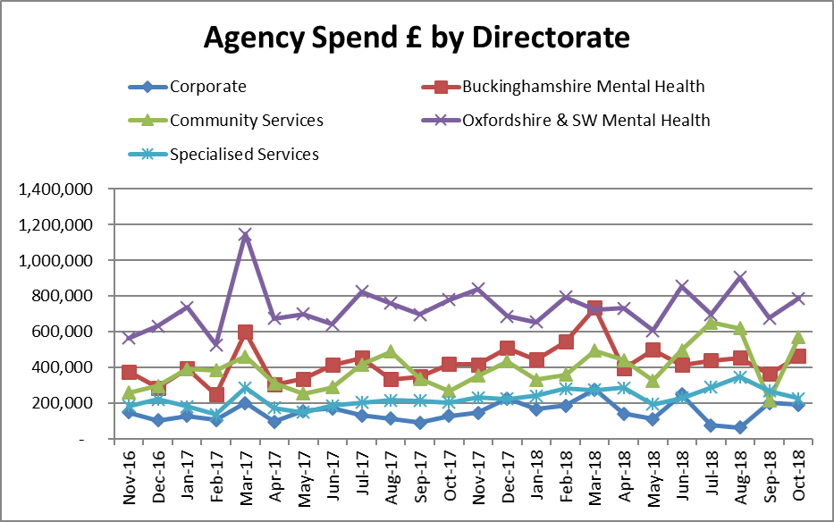
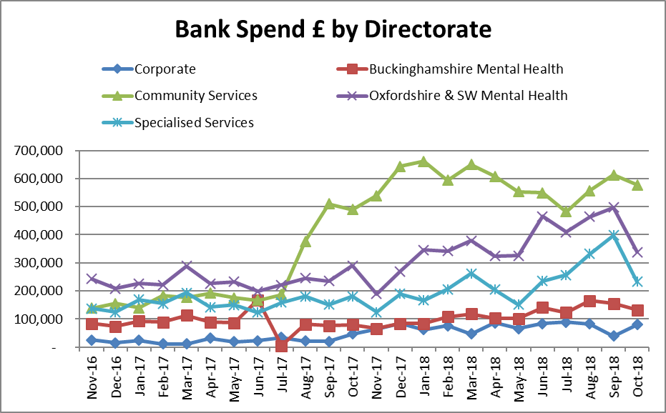
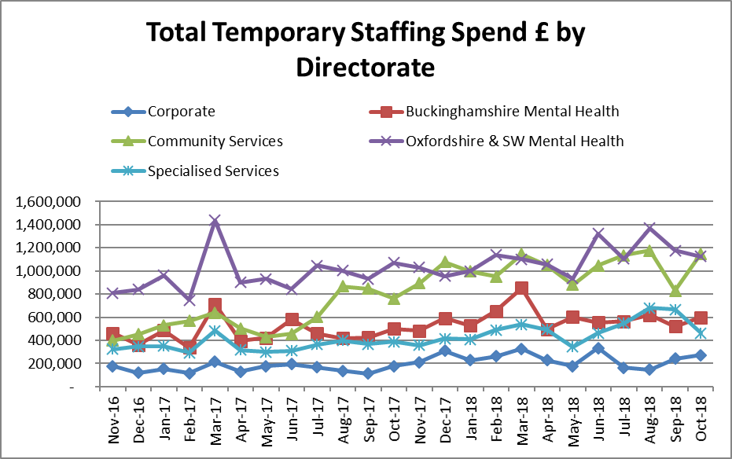
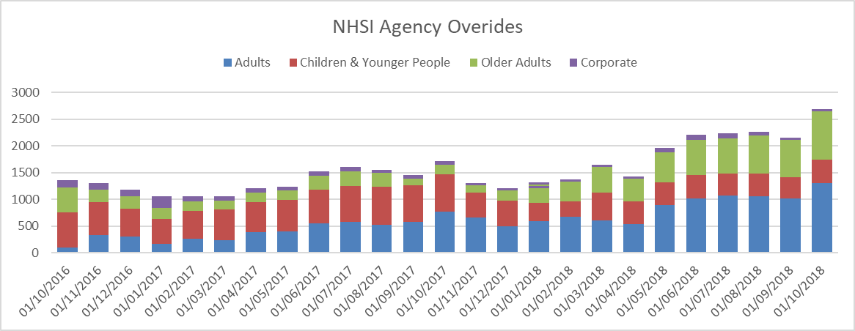
Temporary Staffing Spend
Agency Spend increased across most areas and staffing groups with the exception of estates and additional clinical services. The Trust is working with NHSI to develop a strategy to reduce the number of agency overrides which increased in Adults and Older Adults. Agency spend continues to be significantly in excess of the NHSI ceiling agency ceiling, however the NHSI agency team which visited in October were pleased with the progress that the Trust is making reporting that the “Overall the grip and control is very apparent, senior buy in and an overall high level of engagement was evident.”

Slide 4
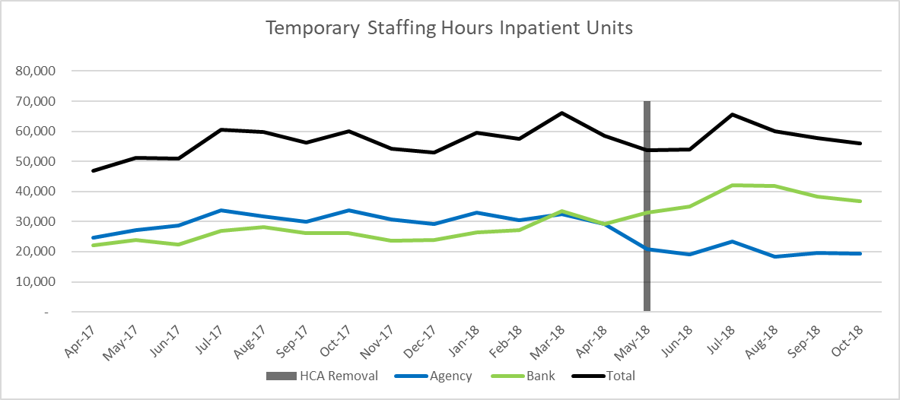
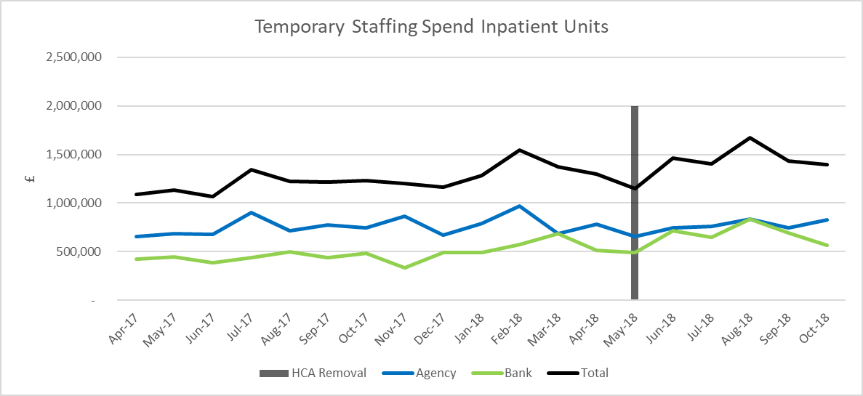
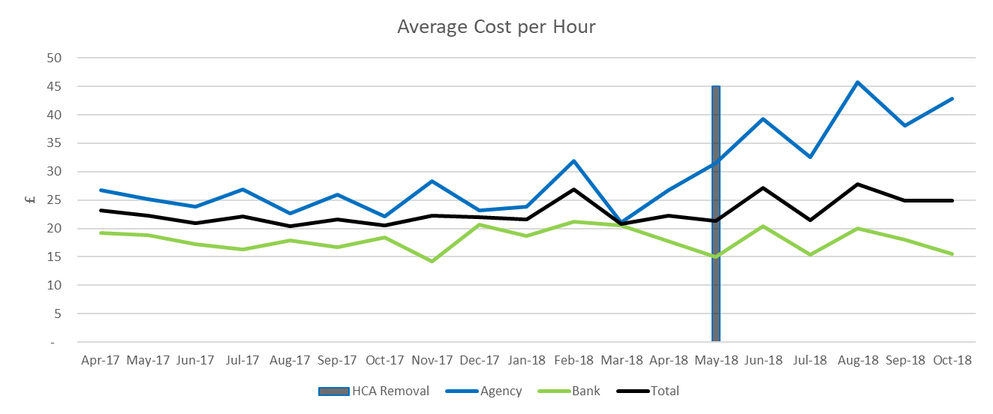
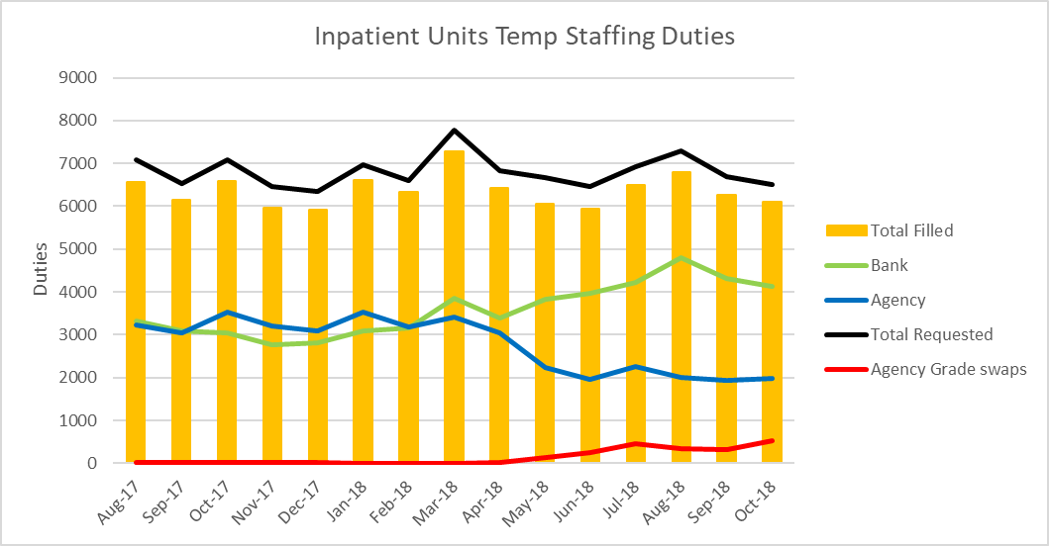
On 14 May the Trust stopped using Agency HCA workers across inpatient units. Where a HCA Flexible Worker cannot be sourced Registered Nurses are used. The number of temporary staffing shifts worked across inpatient units reduced by 157 between September and October the number of unfilled shifts also reduced.
Agency use has remained constant for the last 3 months with the number of agency grade swops increasing slightly in October. This is thought to be due to the October half term. Availability of training remains a significant barrier to growing the bank. As an interim measure the Director of Nursing has agreed for Flexible Workers with previous care experience to commence prior to completing their PPST training. A review of the amount of training courses required to meet the demand driven by Flexible Workers is to take place.
HCA Agency Spend Reduction

Slide 5

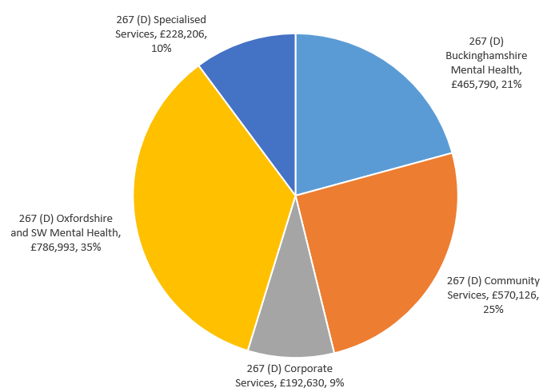
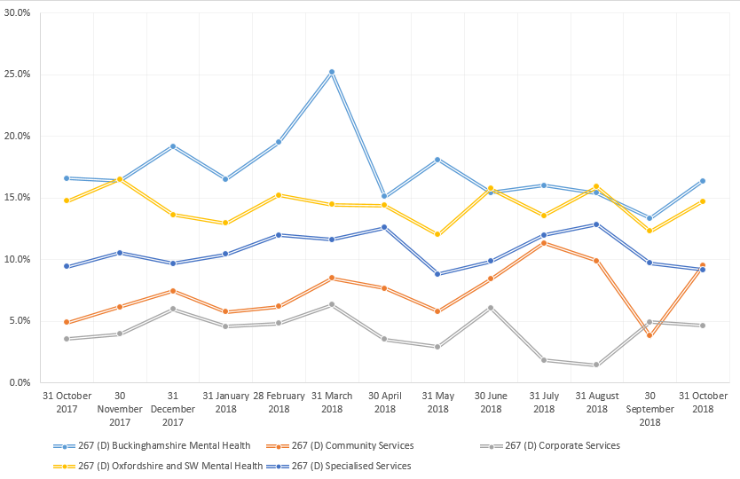
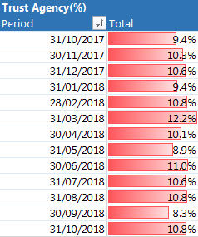
Agency
Distribution of Agency Spend (£)
Agency Spend (%) By Directorate

Slide 6
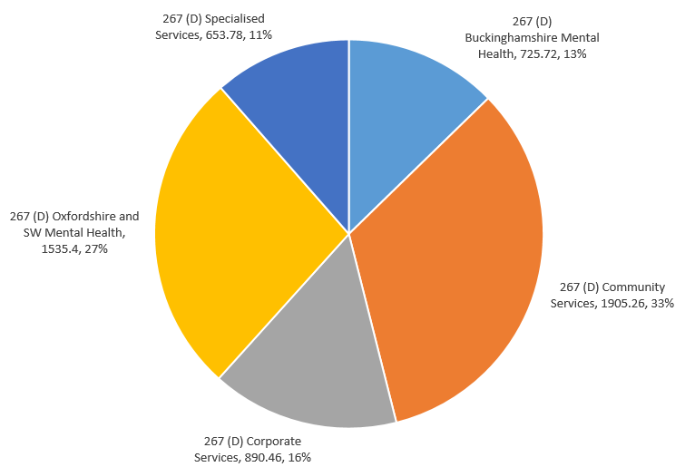
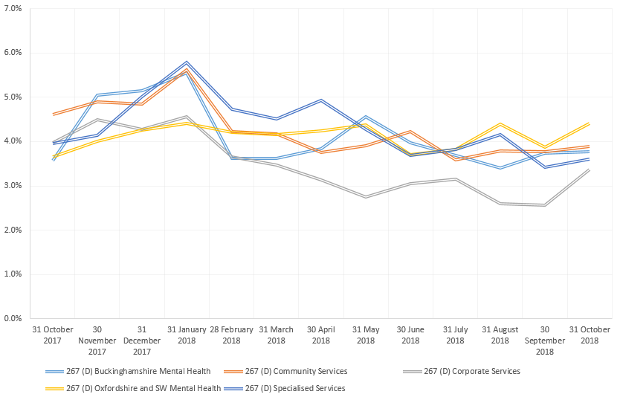
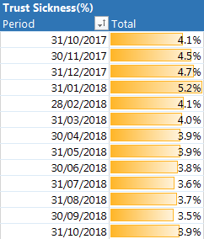
Sickness
Distribution of Sickness (FTE Days Lost)
Sickness (%) By Directorate

Slide 7
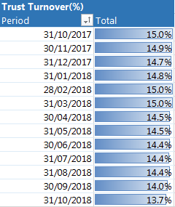
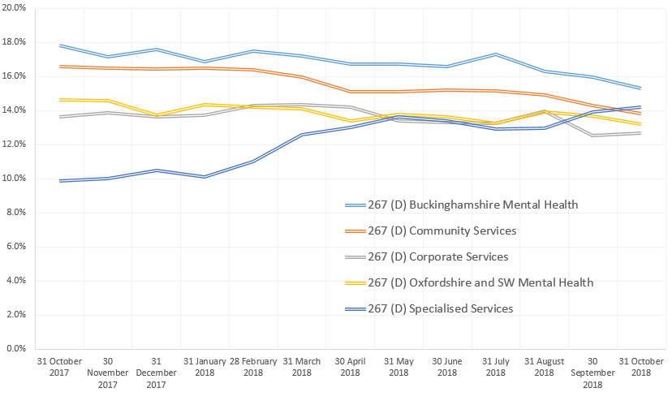
Turnover
Turnover (%) By Directorate

Slide 8
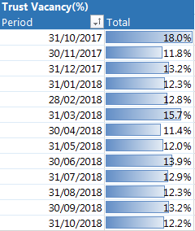
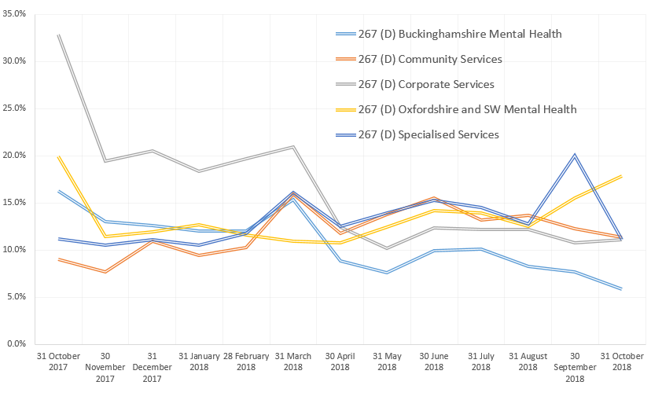
Vacancy
Vacancy (%) By Directorate

Slide 9
WRES

Slide 10
WRES

