Slide 1
Workforce Performance Report
January 2019
Tim Boylin
Director of Human Resources

Slide 2
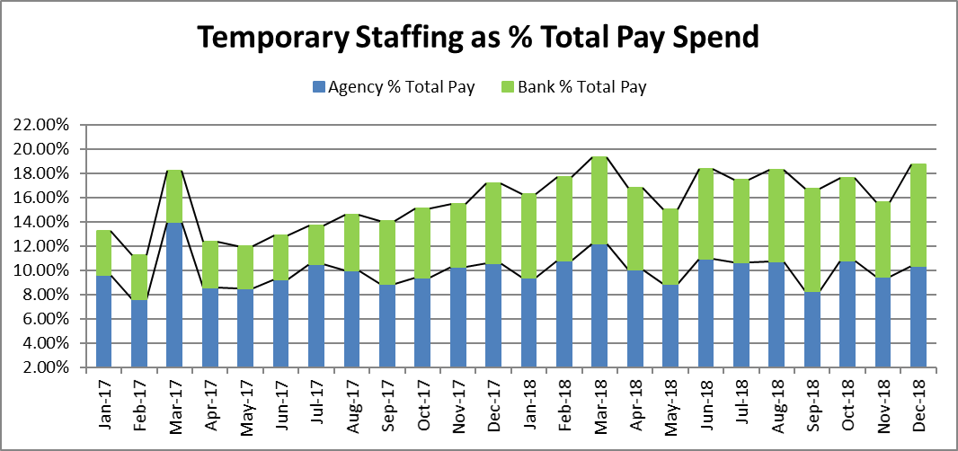
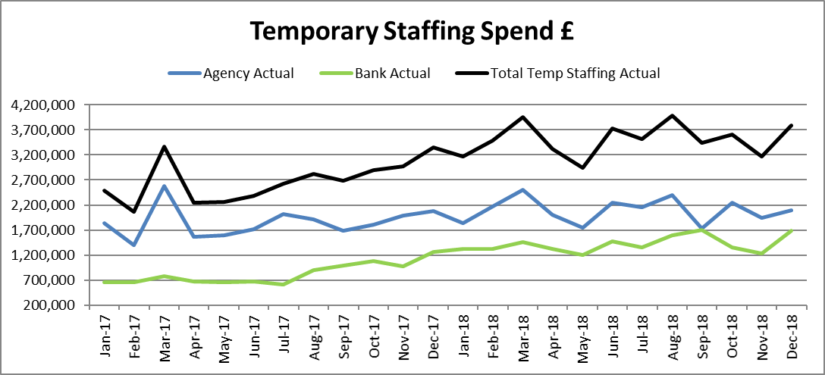
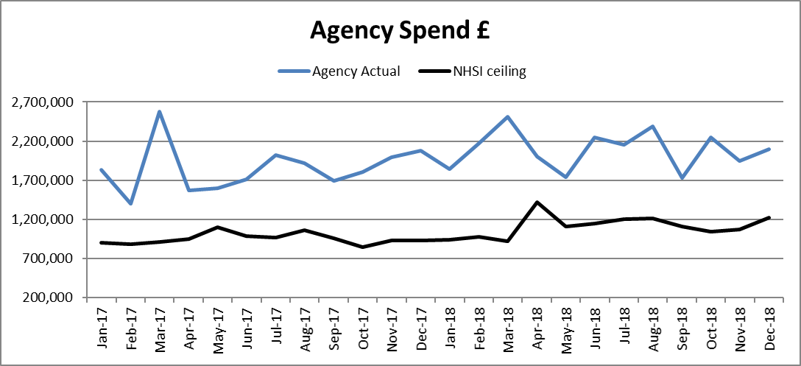
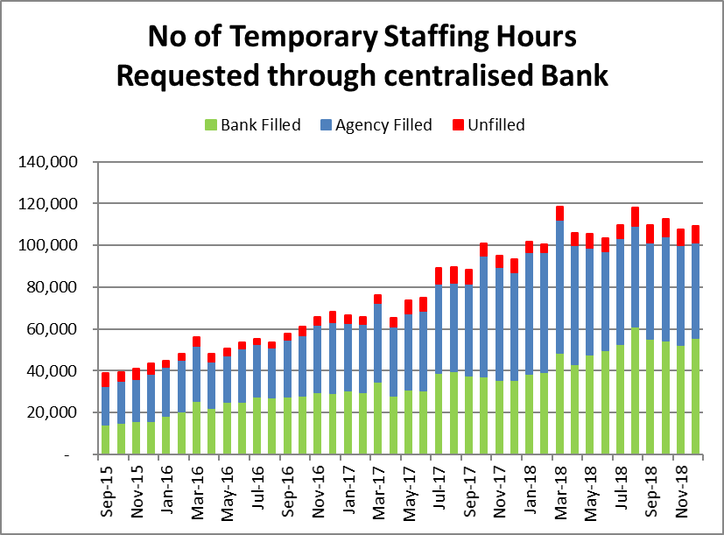
Temporary Staffing spend increased by 614K to £3.78m, the second highest spend ever, 18.76% of payroll. The majority of this additional spend, £467k was absorbed by Bank workers with an additional £147k of agency cost. Bank spend was at its second highest ever.
£484k of the temporary staffing spend increase was across inpatient units where the number of temporary hours used increased by 8%.
Temporary Staffing Spend
This Month: 18.76%
£3.78m
Last Month: 15.77%
£3.17m
Last Year: 17.30%
£3.35m

Slide 3
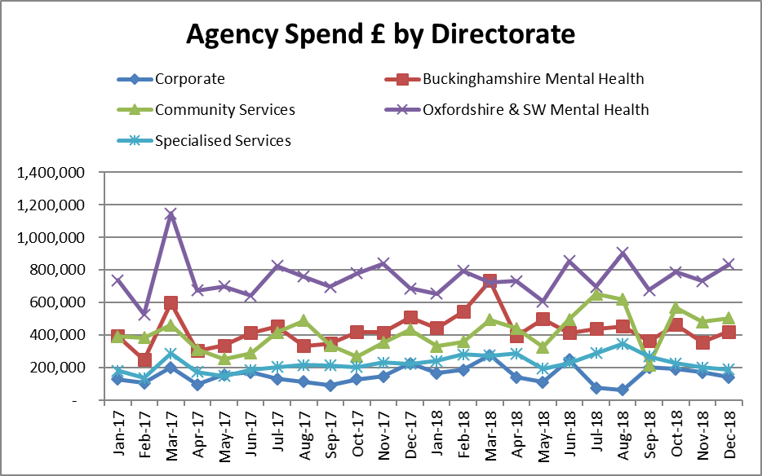
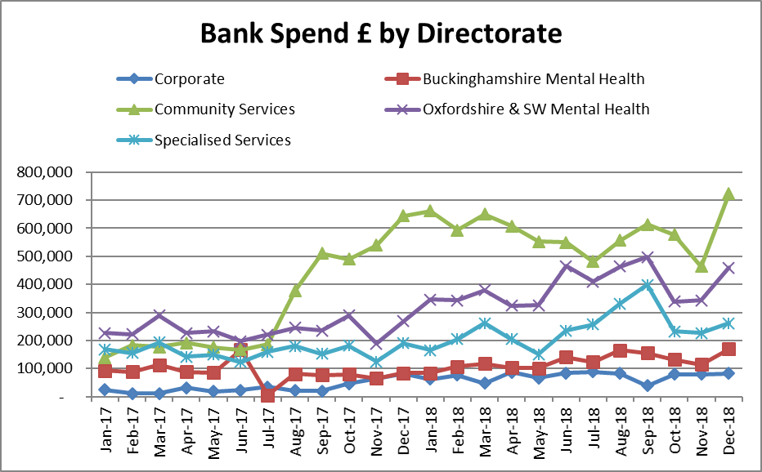
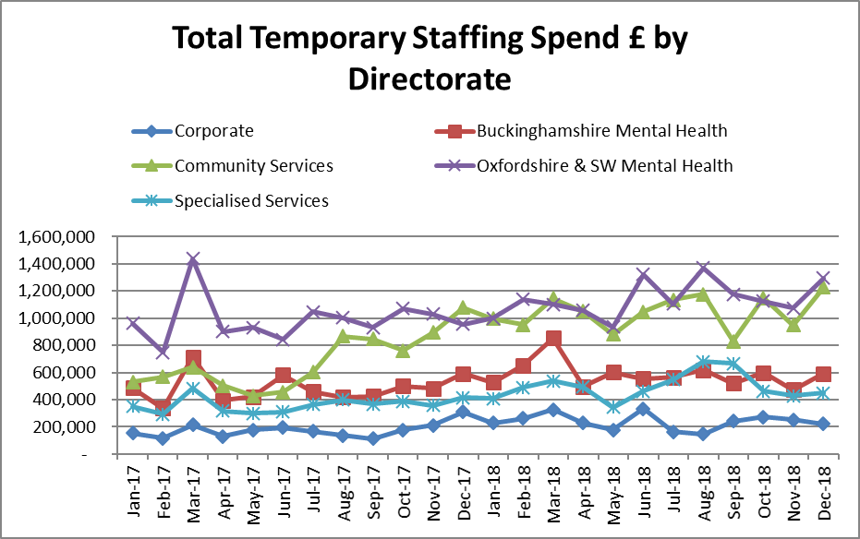
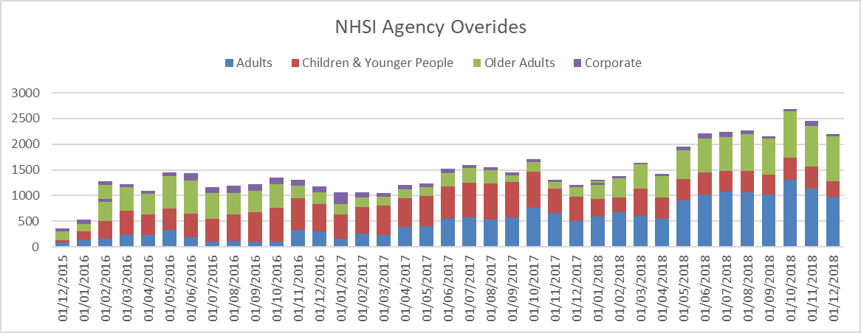
Temporary Staffing Spend
Agency Spend increased most significantly in Bucks and Oxford & SW Mental Health directorates . Bank spend increased significantly in community services and Oxfordshire & SW Mental Health. Total temporary staffing spend increased most significantly in Community and Oxfordshire &SW Mental Health Directorates. NHSI agency rule overrides fell for the third month in a row.

Slide 4
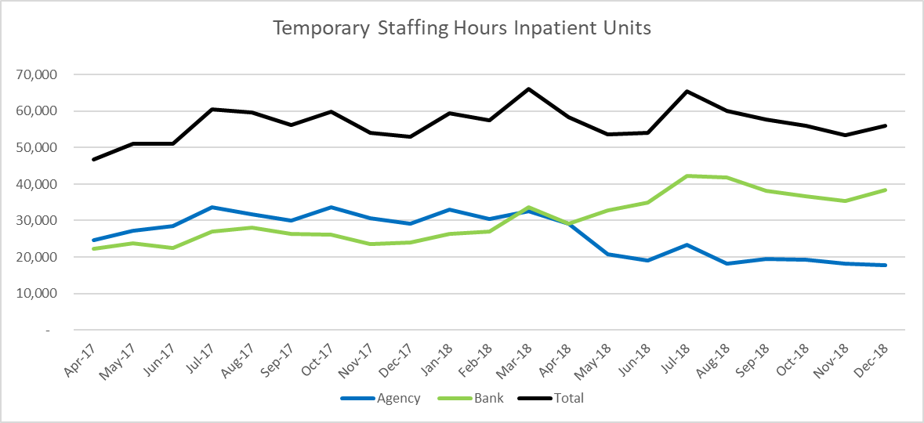
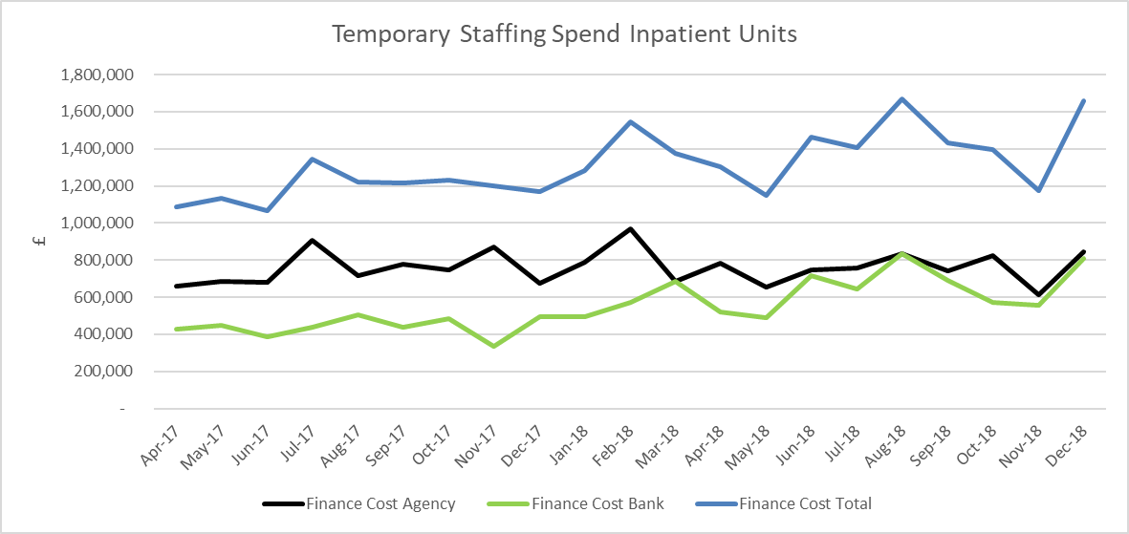
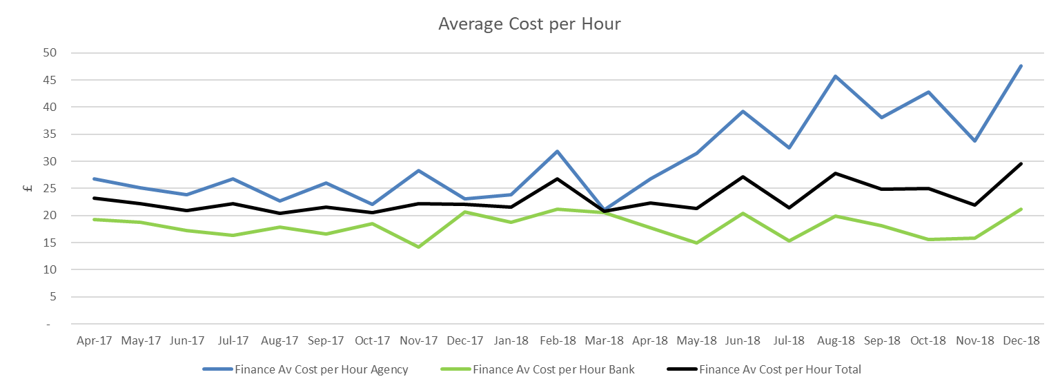
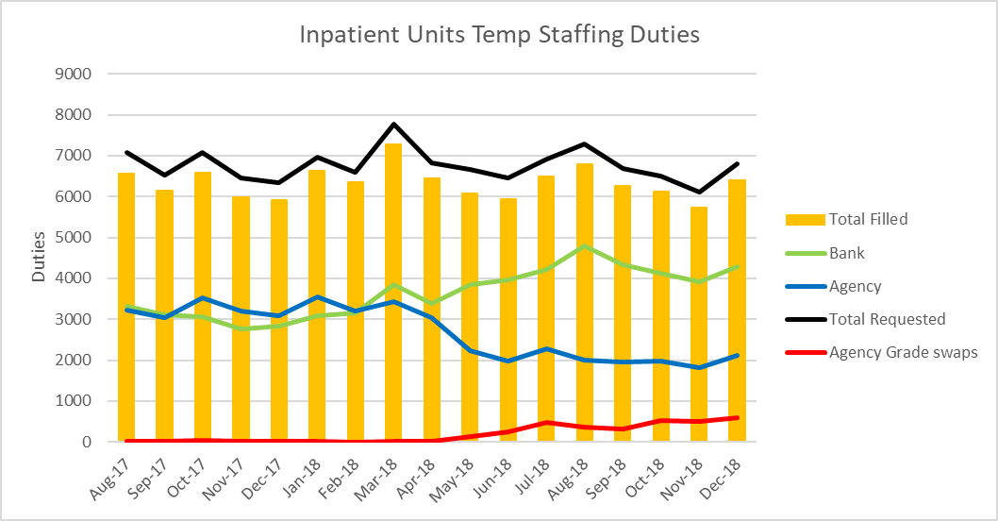
HCA Agency Spend Reduction
On 14 May the Trust stopped using Agency HCA workers across inpatient units. Where a HCA Flexible Worker cannot be sourced Registered Nurses are used. The number of temporary staffing shifts worked across inpatient units increased by 564 between November and December. 366 of these additional duties were filled by bank and 198 by agency.
NHSI Agency rule overrides rose by 8 to 841, however the use of Thornbury rose from 318 to 457 shifts, similar levels to those seen in October and August. Grade Swops increased by 100 to 592. The number of unfilled shifts remained at 6%, 416 shifts.
Amber, Sapphire and Sandford, had high levels of Thornbury and grade swops in addition to the previous areas of concern Ashurst, Kestrel, Kingfisher, Evenlode, Ruby and Highfield.
Availability of training remains a significant barrier to growing the bank. Recruitment of new bank HCA workers has been halted until this issue is resolved.

Slide 5
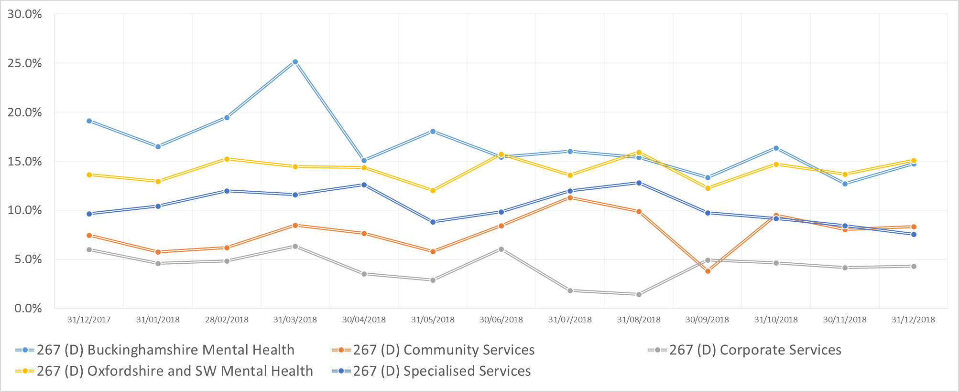
Agency
Target
5.0%
Agency Spend (%) By Directorate

Slide 6
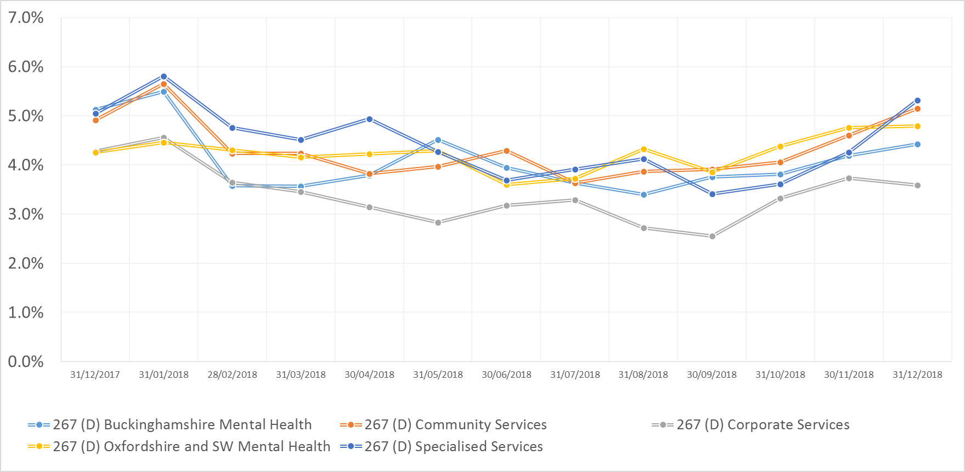
Sickness
Target
3.5%
Sickness (%) By Directorate

Slide 7
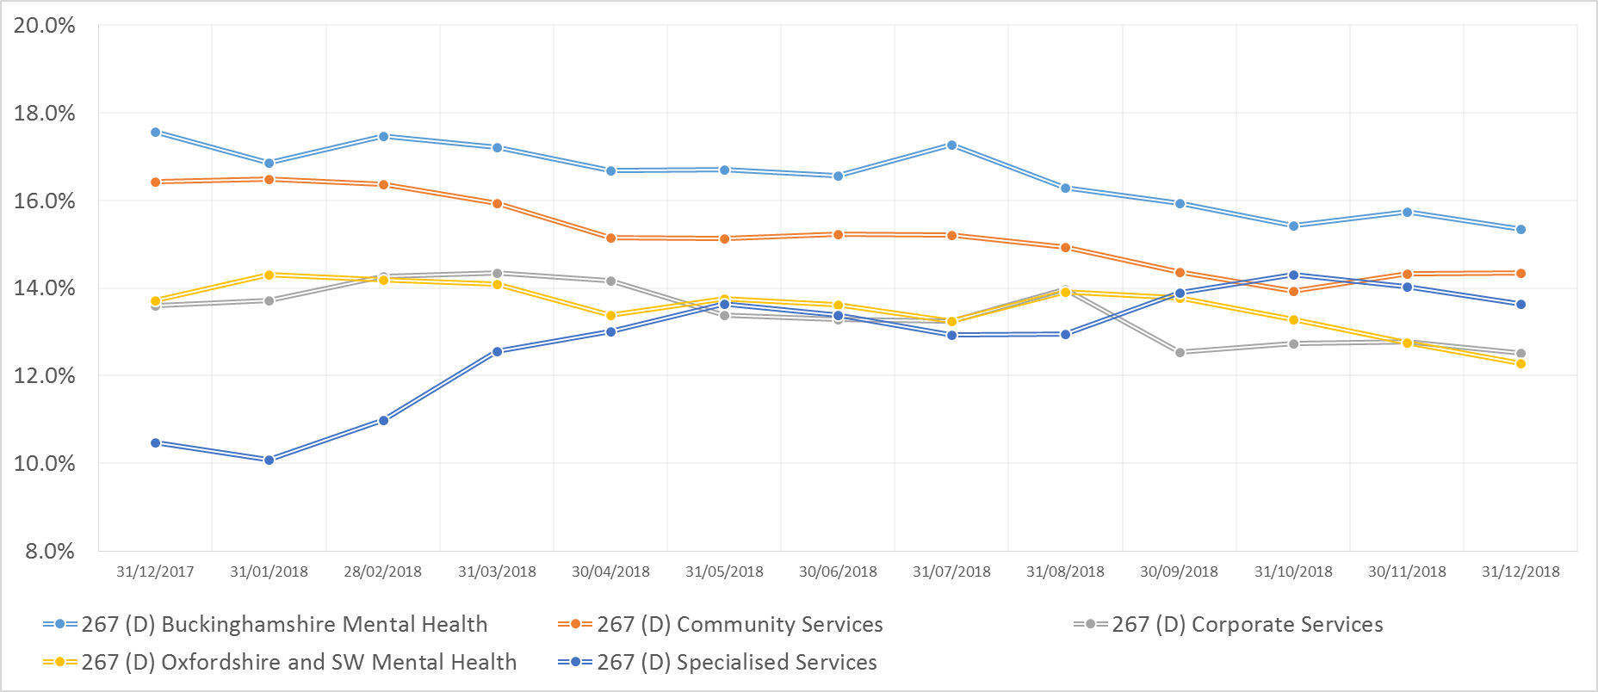
Turnover
Target
12.0%
Turnover (%) By Directorate

Slide 8
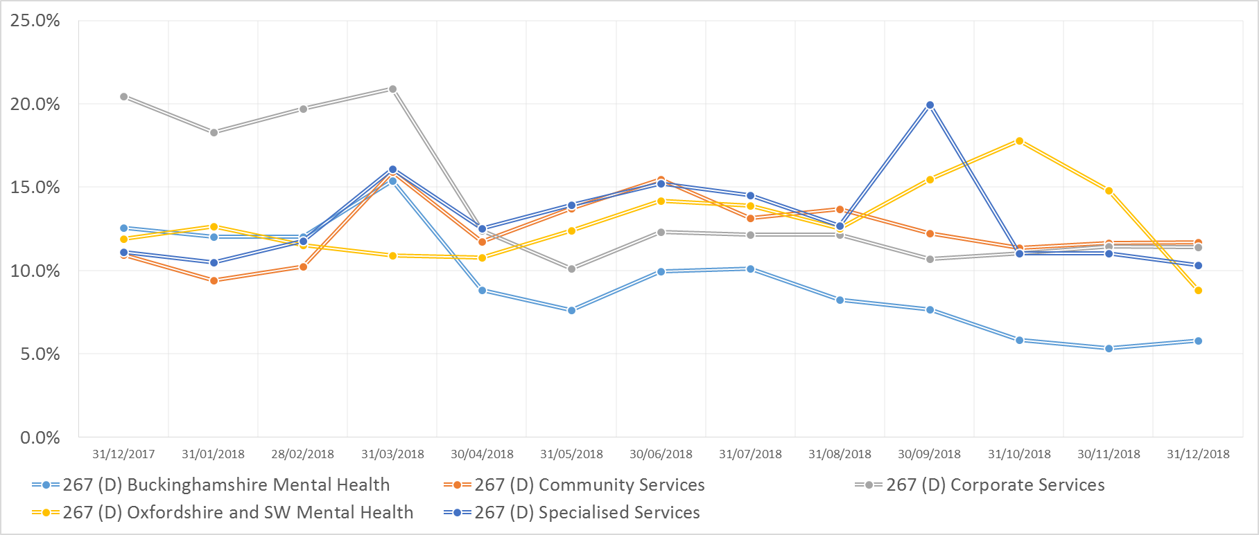
Vacancy
Target
9.0%
Vacancy (%) By Directorate

Slide 9
WRES

Slide 10
WRES

