Slide 1
Workforce Performance Report
April 2019
Tim Boylin
Director of Human Resources

Slide 2
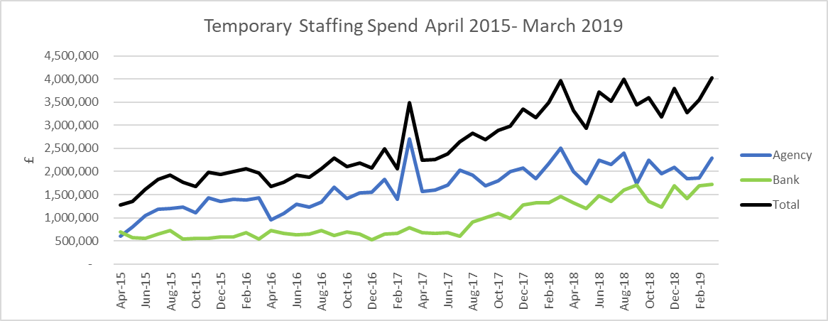
Review of Temporary Staffing Use
The graph above shows temporary staffing spend April 2015. In July 2017 the OOH GPs transferred onto the bank, they did not previously show in temporary staffing spend
The graph shows that the upward trajectory of spend on temporary staffing has steadied in FY19 and the increase in spend has been absorbed by growing the bank rather than by increasing agency use.
It is hoped that the current use of temporary staffing can be maintained or reduced and therefore in FY20 through growing the bank further rather than maintaining agency spend it will decrease.

Slide 3
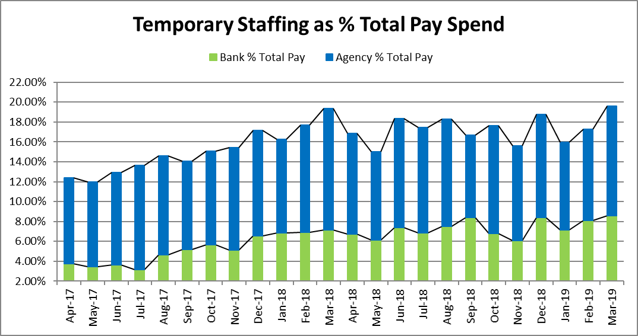
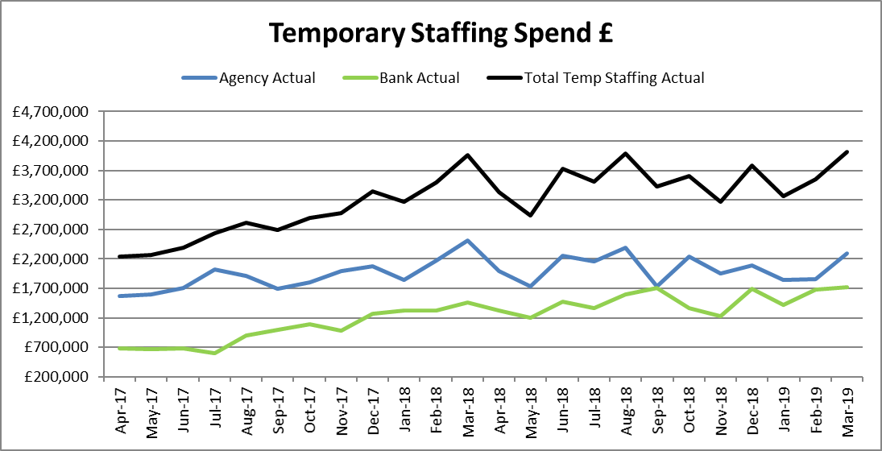
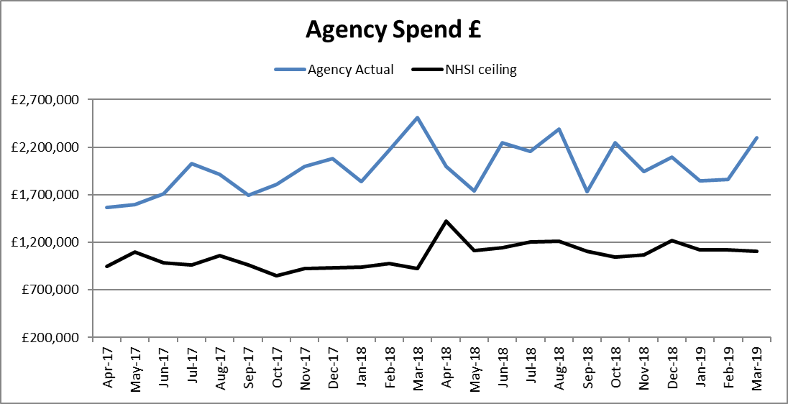
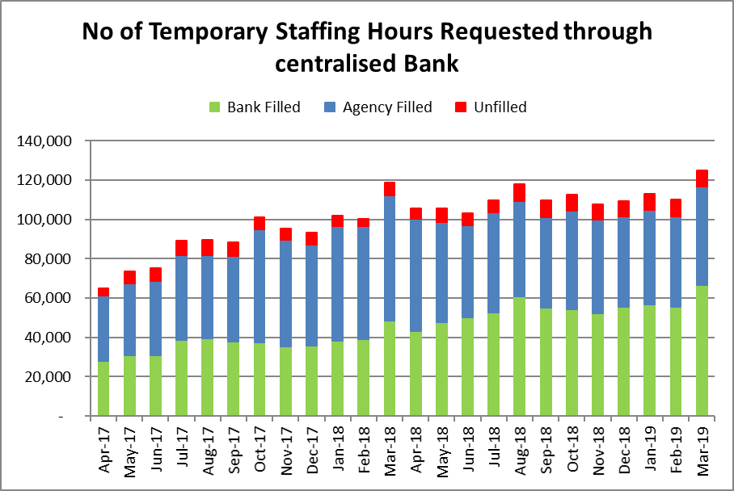
Temporary staffing spend increased by 474K (13%) to £4.02m, in line with normal annual trends, but the highest ever. For the first time, there is full confidence that agency spend is Actual for the month rather than inflated due to invoicing issues. Spend was 20.07% of payroll approximately the same cost and a slightly higher % than last year with the amount of bank use increased by £266k whilst agency decreased by £209k. 57% of total temporary staffing spend was agency a 5% increase on the previous month. £353k of the increase in temporary staffing spend is attributable to Inpatient units, of which £288k was through Bank. Bucks AMHTS and Bucks CAMHS Medical also saw a significant increase in agency spend.
Temporary Staffing Spend
This Month: 20.07%
£4.02m
Last Month: 17.00%
£3.54m
Last Year: 19.40%
£3.96m

Slide 4
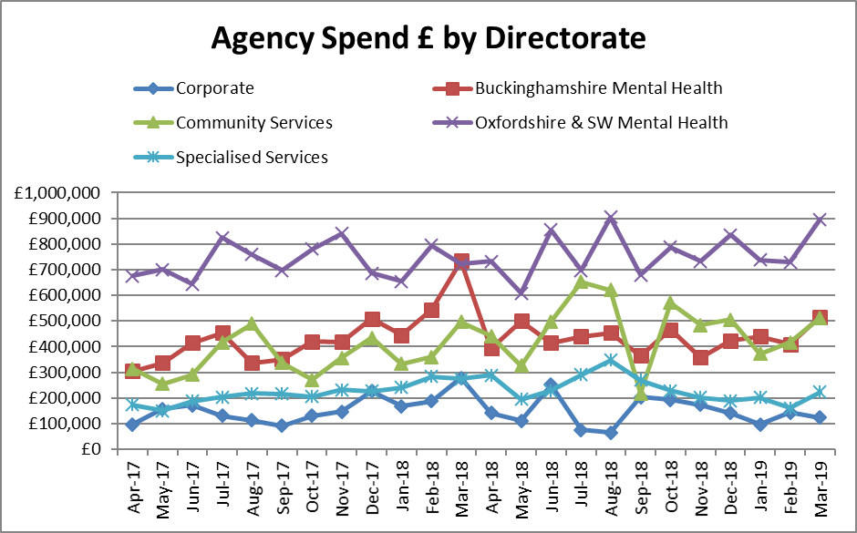
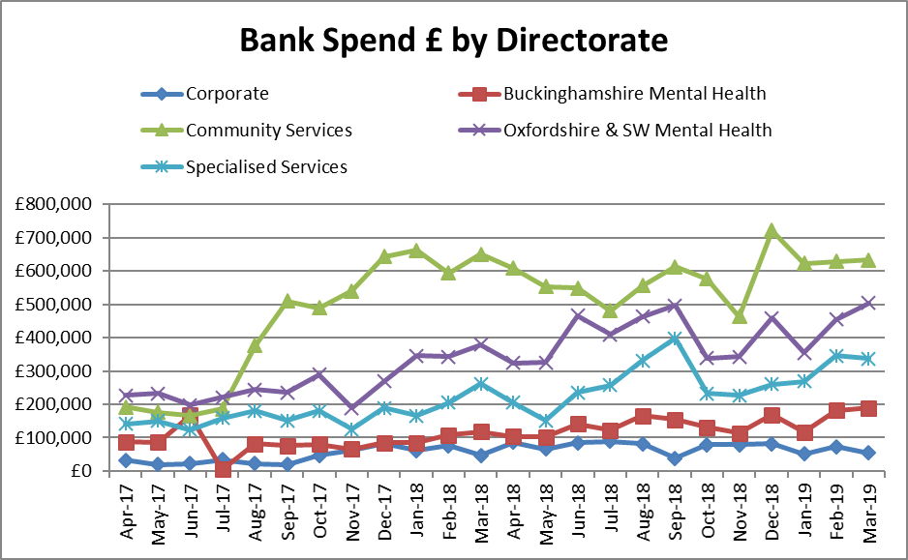
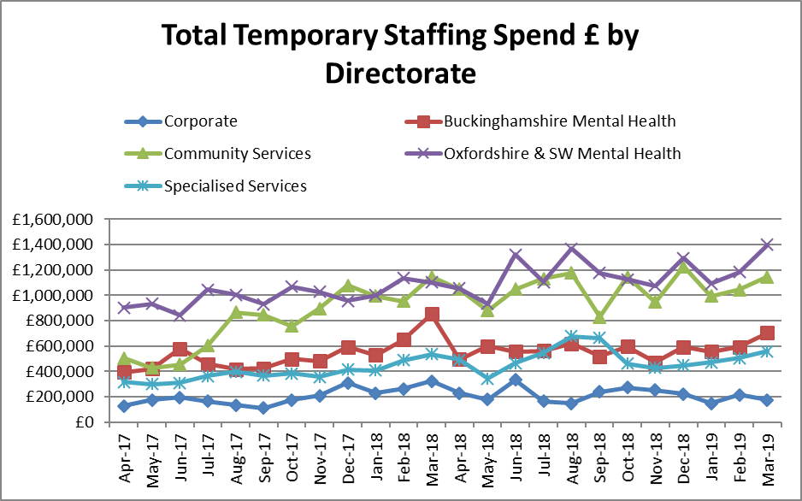
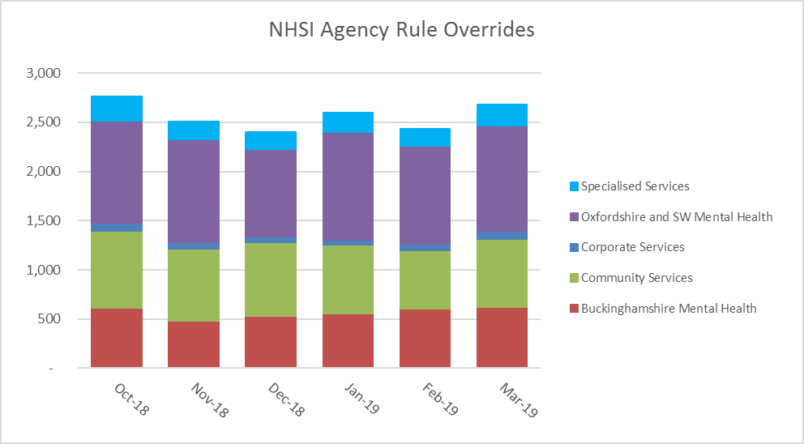
Temporary Staffing Spend
Agency Spend increased in the 4 operational directorates with bank spend increasing significantly in Oxfordshire & SW MH. NHSI agency rule overrides are now being reported against the new directorates and are reported in true calendar months rather than aggregated weeks.

Slide 5
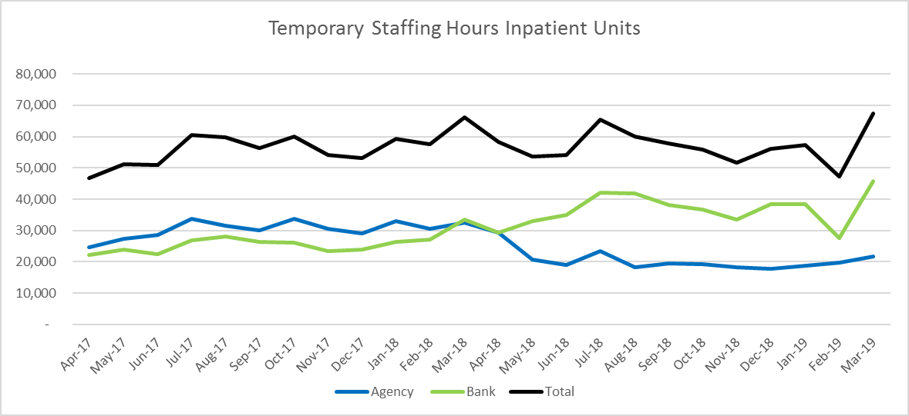
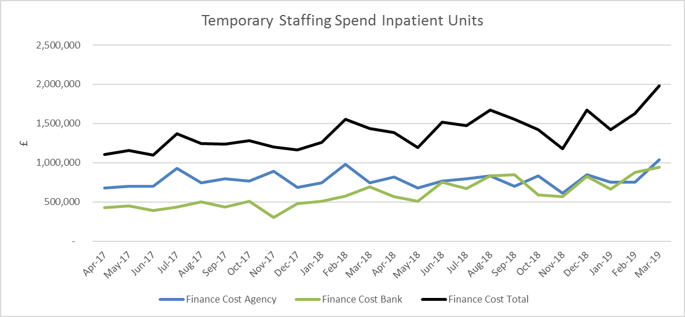
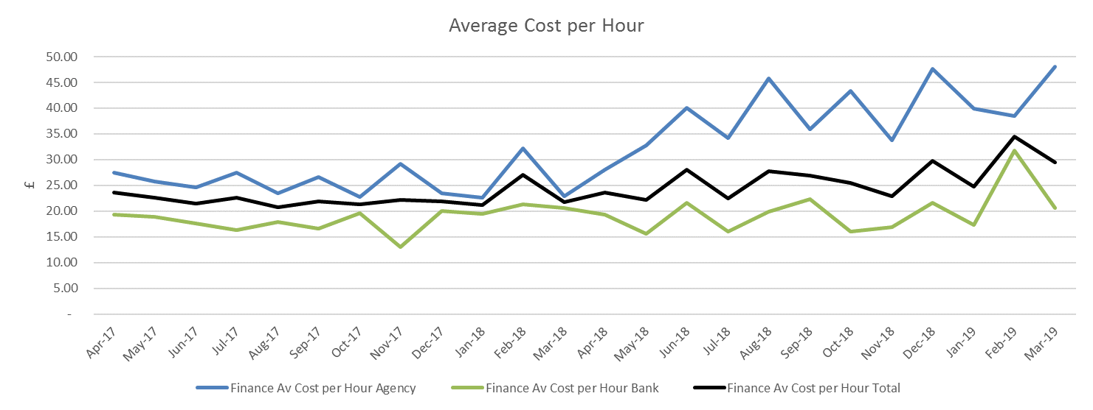
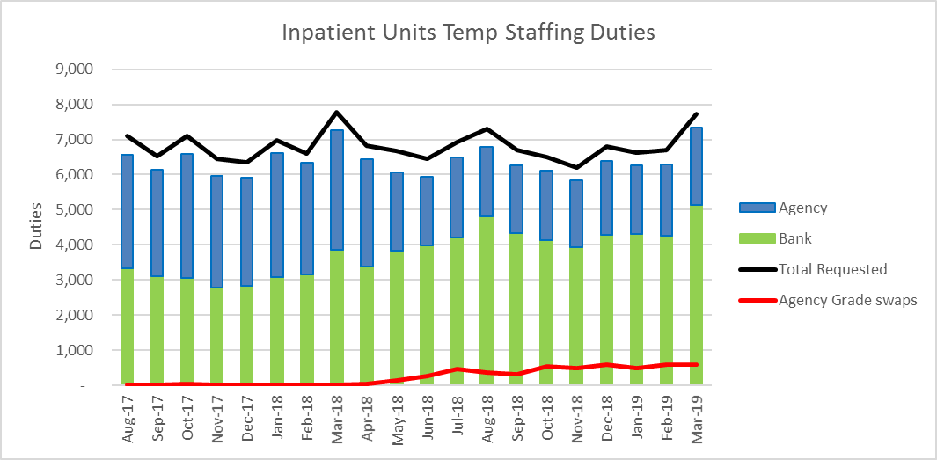
HCA Agency Spend Reduction
On 14 May 2018 the Trust stopped using Agency HCA workers across inpatient units. Where a HCA Flexible Worker cannot be sourced Registered Nurses are used.
In March the number of temporary staffing hours used in inpatient units increased by 40%, from 27,555 to 45,750 this was not reflected in the number of additional shifts recorded at 17% from 6287 to 7342 – staff worked longer shifts. It is thought that this steep rise was due to substantive employees working a Flexible Worker shift whilst taking annual leave on their substantive post.
NHSI Agency rule overrides which are now reported in true calendar months increased to 1008 from 878. It s thought that this is due to the increased demand for agency worker across all Trusts at the end of the financial year.. Agency grade swops remained at a similar level to the previous month. The number of Thornbury shifts used increased to their highest level.

Slide 6
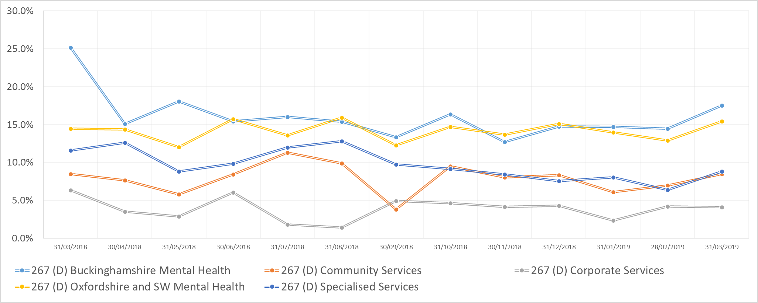
Agency
Target
5.0%
Agency Spend (%) By Directorate

Slide 7
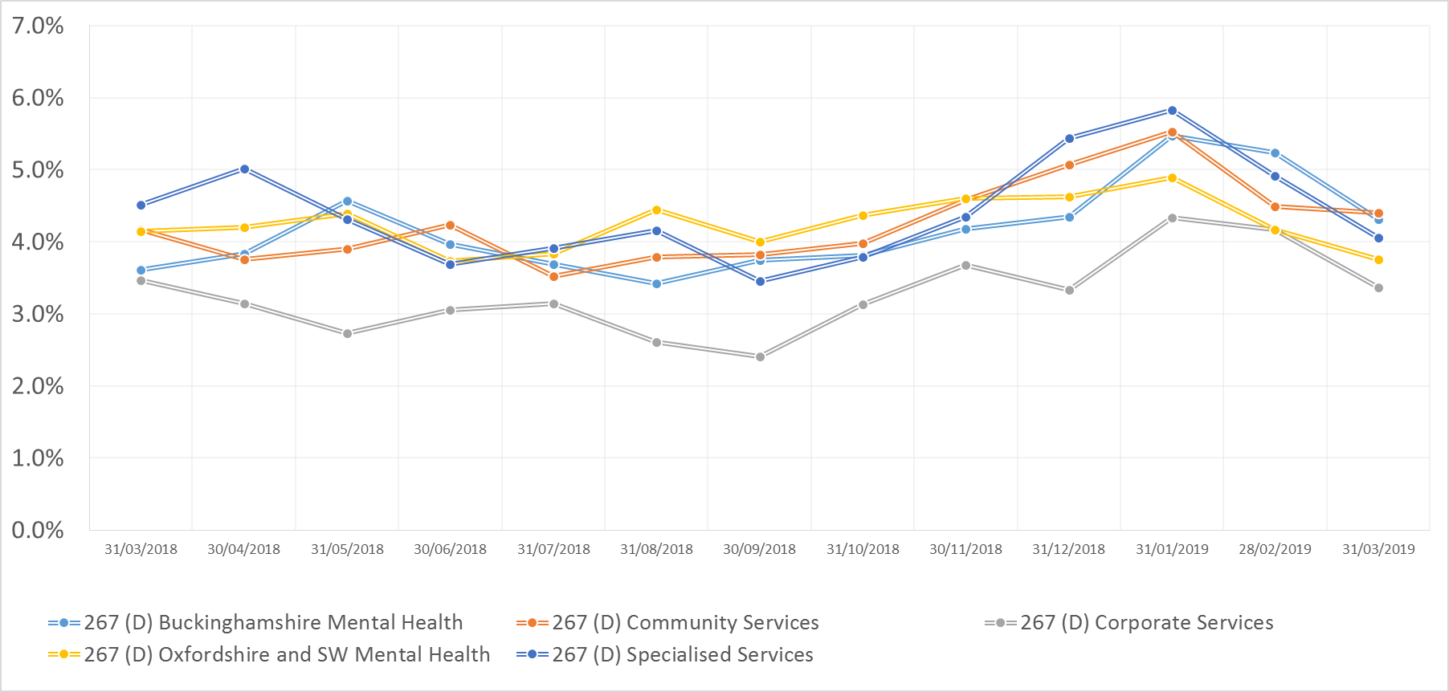
Sickness
Target
3.5%
Sickness (%) By Directorate

Slide 8
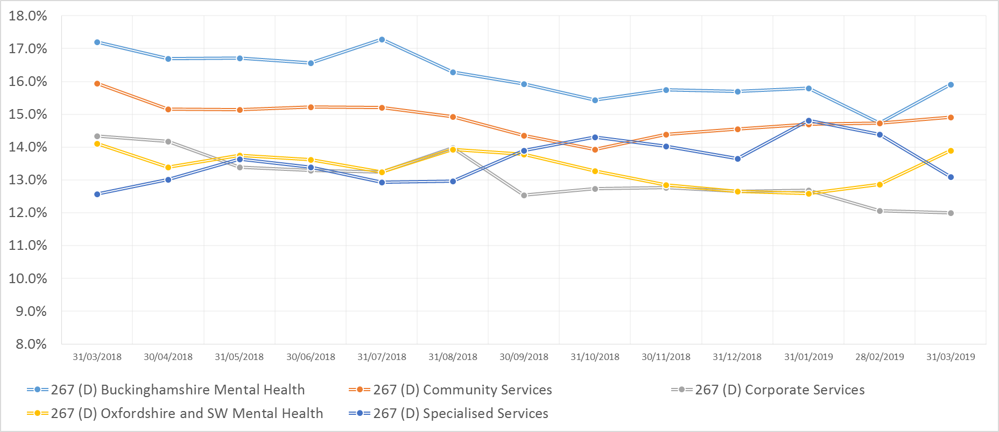
Turnover
Target
12.0%
Turnover (%) By Directorate

Slide 9
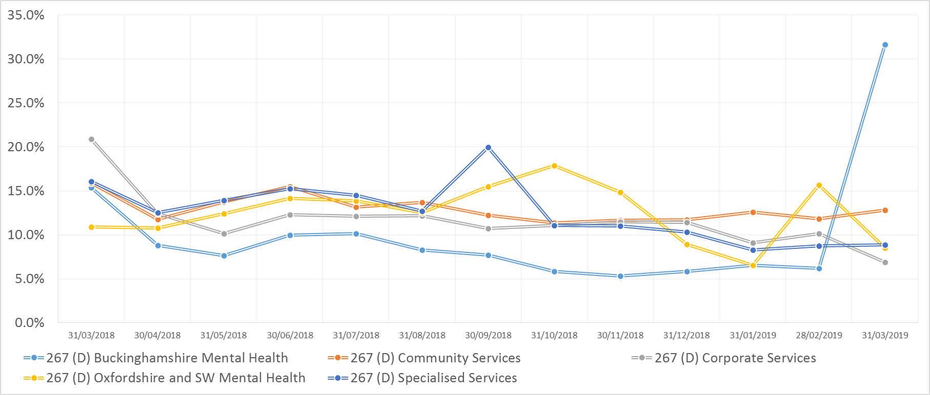
Vacancy
Target
9.0%
Vacancy (%) By Directorate

Slide 10
WRES

Slide 11
WRES

