Slide 1
Workforce Performance Report
January 2020
Tim Boylin
Director of Human Resources

Slide 2
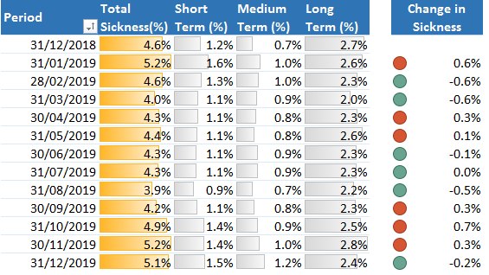
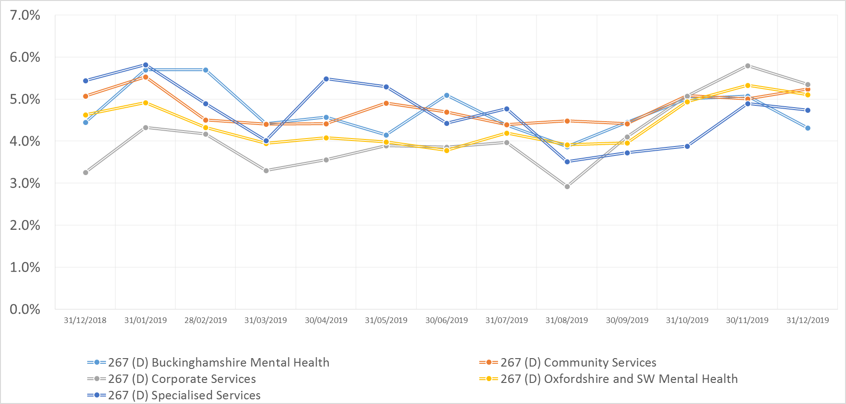
Sickness
Target
3.5%
Actual
5.1%
Sickness (%) By Directorate

Slide 3
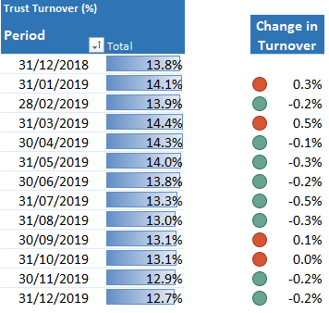
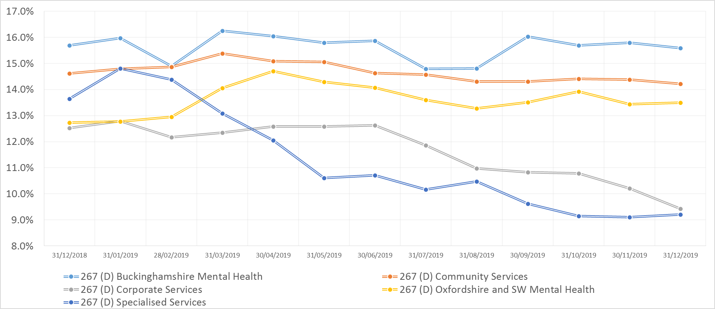
Turnover
Target
12.0%
Actual
12.7%
Turnover (%) By Directorate

Slide 4
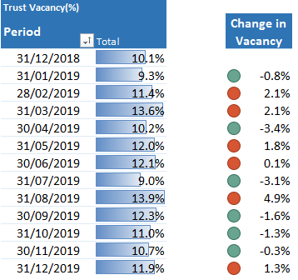
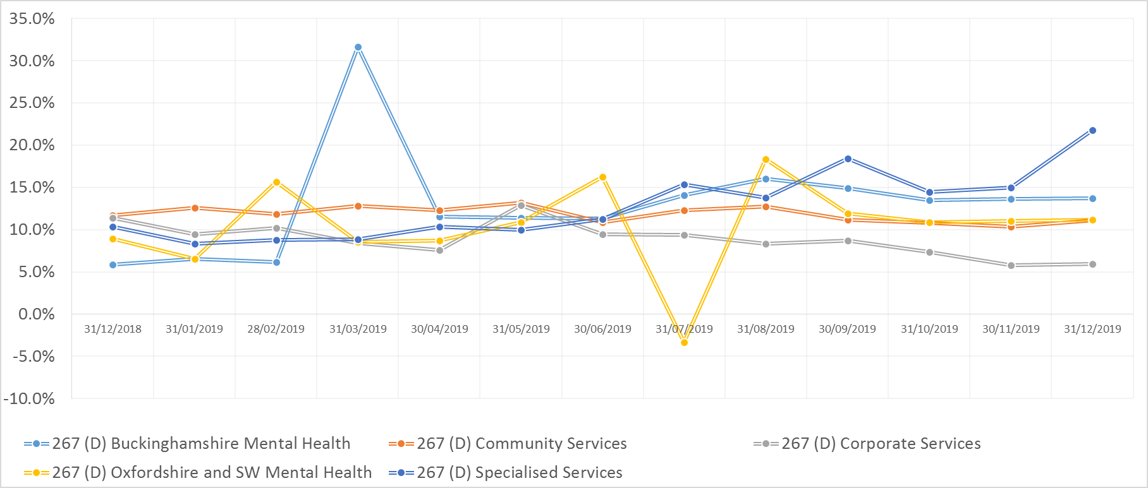
Vacancy
Target
9.0%
Actual
11.9%
Vacancy (%) By Directorate

Slide 5
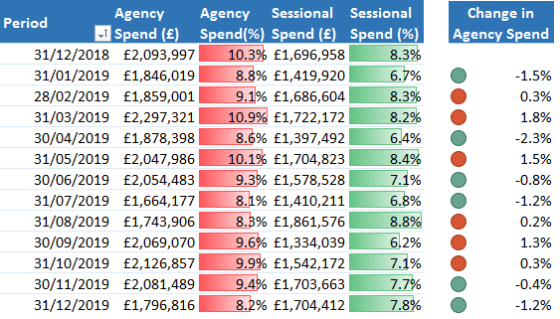
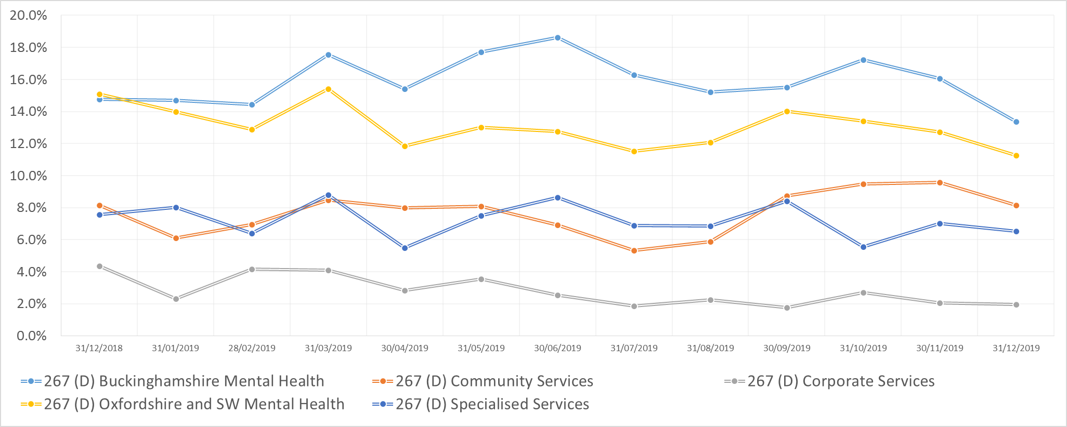
Agency
Target
5.0%
Actual
8.2%
Agency (%) By Directorate

Slide 6
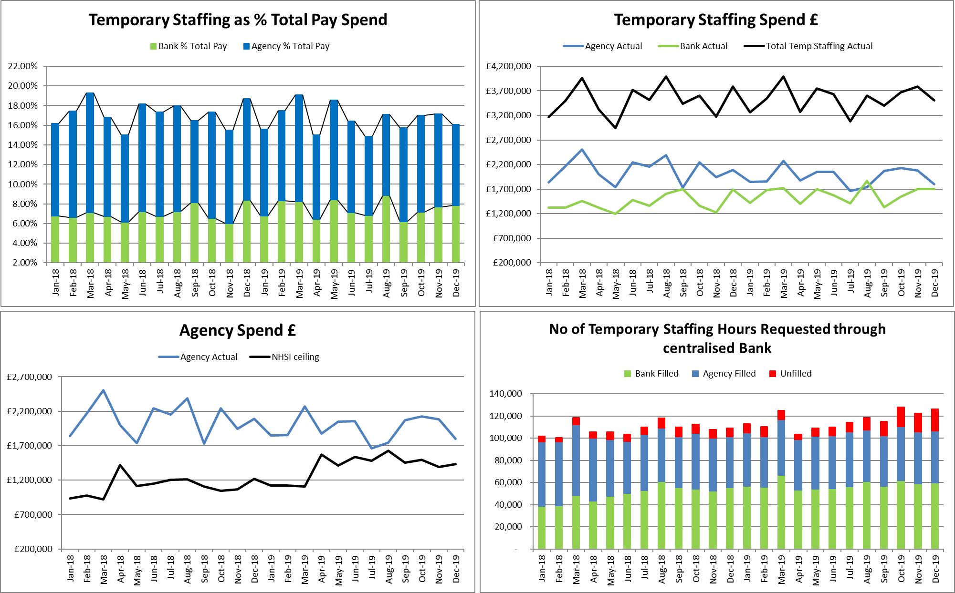
Temporary staffing spend decreased this month by £283k to £3.5m, 16.06% of payroll. Significantly less than the previous month and previous year. Agency spend decreased by £284K to 8.24% of payroll. Inpatient units agency spend decreased by £14k. Agency spend remains above the NHSI ceiling. Bank spend was flat against last month at £1.7m with inpatient units decreasing by £130k. Through the WFMS 47% of hours were filled by bank, 37% by agency and 16% were unfilled. 60% of agency spend was in non inpatient teams.
Temporary Staffing Spend

Slide 7
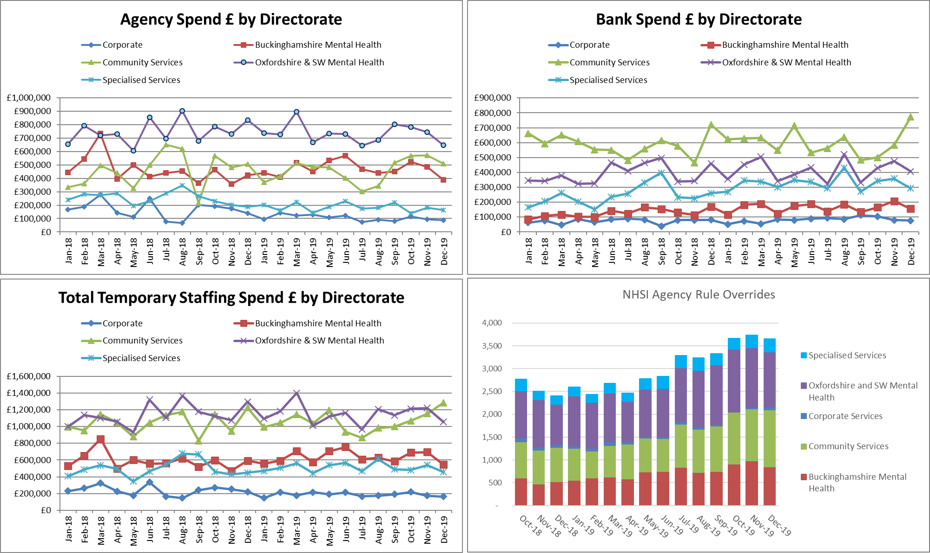
Temporary Staffing Spend
Agency spend in non inpatient teams continues to remain high at £1m with CHC Bucks and Bucks South AMHT Treatment both spending in excess of £180k on agency workers in December. Bank Spend increased within Community due to an £187k increase in spend within OOH/MIU – Drivers/Receptionists this month.

Slide 8
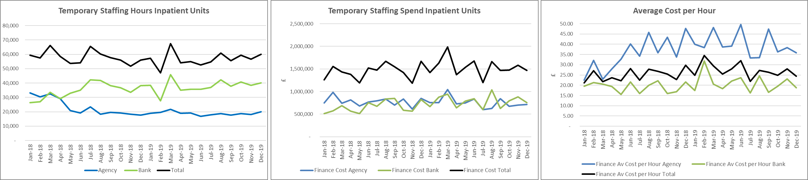
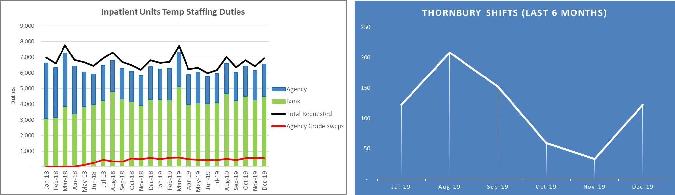
Inpatient Temporary Staffing Use
67% of temporary staffing hours in Inpatient units were worked through bank. The number of high cost off framework agency Thornbury shifts have increased to 122 due to high acuity and staffing issues within Community Hospitals in December.
NHSI Agency rule overrides increased by 193 to 1,461. Agency grade swops remain high at 556 despite increasing Flexible Site Worker shifts. A review will be undertaken in the new year regarding the management of these.

