Slide 1
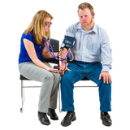
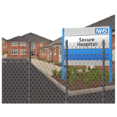
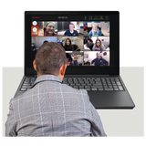
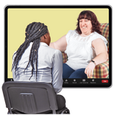
My story
Patient story : Learning disability forensic Services
To be presented at Trust board on:
How the story will be presented:
You will see a co-produced presentation about Evenlode Voices group. The group have agreed that this will be presented by Rachel Miller.
Evenlode voices is a patient group who meet every week. They work together to improve the ward and service.
What is the story about?
The story is about a few of the pieces of work the group have worked on and would like to tell you about.

Slide 2
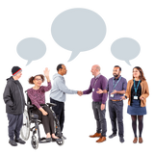
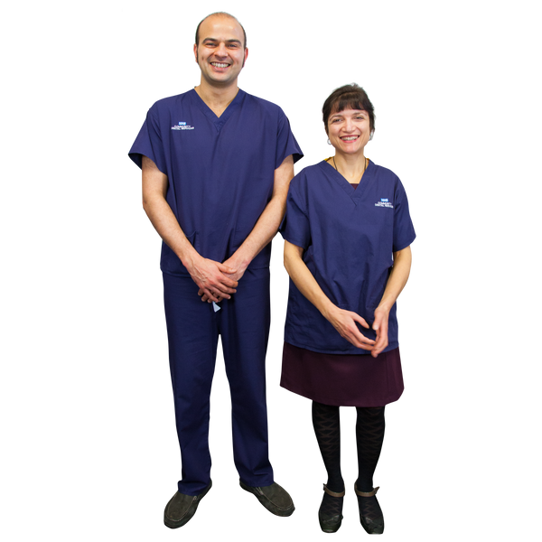
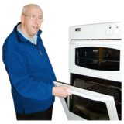
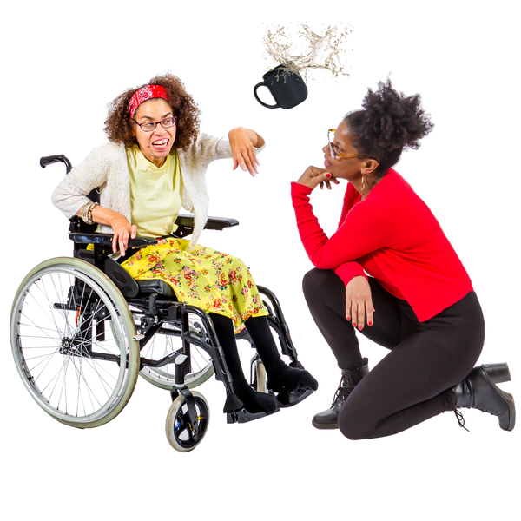
About the service
Evenlode is a secure hospital ward. Evenlodes patients are:
-adult men with a learning disability.
- Who have a history of offending. -They may also have mental health problems or autism.
About the staff and the treatment
Staff include Occupational Therapists, nurses, social workers, Psychiatrists, health care assistants, pharmacy a ward manager and matron.
Patients are helped to care for themselves. So that they can become as independent as possible.
If they have a mental illness or Autism support/treatment is provided for this.
Challenges for the service
There are lots of times on the ward when something happens and someone is physically or verbally aggressive..
The ward is trying to reduce the amount of time this happens by improving the way it supports patients. The ward uses a positive behaviour support approach.
-The patients often have communication difficulties.
--The patients are encouraged to be as involved as possible in planning their care.

Slide 3
-The High Dependency area is in need of improvement and building work has started.
-The Evenlode garden will hopefully be improved once the building work has been completed.
Positive Changes
-The Sensory Room has been installed.
-The gentlemen are able to cook their lunches and eat together again.
-Evenlode Voices is now able to meet in person again
Rachel Miller
Patient Experience and Involvement lead , Learning Disabilities

