Slide 1
Integrated Performance Report (IPR) Report:
March 2022
February 2022 data
Assuring the Board on the delivery of the Trust’s 4 strategic objectives; quality, people, sustainability and research and education

Slide 2
Section 1:
Introduction to the Trust strategy 2021-2026

Slide 3
Introduction to the Trust Strategy 2021-2026
Executive Summary: Martyn Ward, Director of Strategy and CIO
Introduction to the Trust Strategy 2021-26 Oxford Health NHS Foundation Trust (OHFT, the Trust) has developed an organisational strategy for the five year period 2021-26. The aim of the strategy is to set the Trust’s long-term direction, guide decision-making and address strategic challenges – for example rising demand for and complexity of healthcare, recruiting and retaining a stable workforce, and ensuring sufficient resourcing. Following the publication of the 2021 NHS White Paper, the NHS is likely to change over the period of the strategy - shifting from a commissioner/provider model to one characterised more by system working and collaboration with healthcare partners (NHS, local authority, independent and third sector) focused on collectively improving overall population health and addressing health inequalities. The Trust’s vision is Outstanding care by an outstanding team, complemented by the values of being Caring, Safe & Excellent. Flowing from the vision and values are four strategic objectives: 1. Deliver the best possible care and outcomes (Quality) 2. Be a great place to work (People) 3. Make the best use of our resources and protect the environment (Sustainability) 4. Become a leader in healthcare research and education (Research & Education) Key focus areas and Objective Key Results To move the strategy into a focus on delivery, each strategic objective has been developed into a set of key focus areas (workstream descriptors). The aim of the key focus areas is to identify priority activities and workstreams for the Trust over the coming years and to provide a bridge between the high-level ambitions of the strategic objectives and a set measures and metrics to track progress. Existing and new measures and metrics have been gathered and/or created using an Objective Key Results (OKRs) approach. OKRs allow for measurement of activities that contribute to key areas of focus and workstreams and will be reported to relevant Board committees and Board via an Integrated Performance Reporting approach. While the key focus areas are intended to be fixed for the lifespan of this strategy, the OKRs can be updated and added to as required. To enable this, the OKRs are an appendix to the main Trust strategy document. This approach allows for a consistency of approach for the strategy but the flexibility to adapt the metrics used to measure progress. For example, a specific OKR may be achieved and can then be replaced with a new target. This report reports delivery of the strategy and performance against the OKRs. Supporting data and narrative is supplied where there is underperformance.

Slide 4
Section 2:
Trust Headlines;
Key risks, issues and highlights from Executive Managing Directors

Slide 5
Directorate highlights and escalations: Mental Health, Learning Disabilities and Autism
Executive Director commentary: Tehmeena Ajmal, Executive Managing Director, Mental Health, Learning Disabilities and Autism
Headline | Risk, Issue or Highlight? | Description (including action plan where applicable and please quote performance/data where applicable)
Workforce challenges | Issue | Ongoing vacancy rates, including challenges with attracting staff, and with timely onboarding of successful candidates. Directorates are developing targeted approaches to recruitment and advertising, and working closely with HR to support with recruitment processes.
Female inpatient capacity | Issue | National challenge with female beds, and complex patients with EUPD are putting pressure on our inpatient wards and HBPOS. Daily reviews across the trust, including opportunities for early discharge are undertaken to maintain flow and manage risk
CIP programme | Risk | Significant savings to be identified in addition to reduction on covid funding. Coordinated approach across directorates, service change and financial teams to identify opportunities for transformational change to deliver savings.
CAMHS/NDC | Issue | Waiting times for neuro developmental conditions pathway continue to be extremely long. Coordinated approach across BOB to identify potential solutions

Slide 6
Directorate highlights: mental health, learning disability and autism
Executive Director commentary: Tehmeena Ajmal, Executive Managing Director, Mental Health & Learning Disabilities
MH Inpatient services the teams have continued their focus on reducing length of stay across all inpatient wards and progress continues to be realised. It is likely that the average length of stay will remain volatile given the impact of patients discharged after a long length of stay. Specifically to note that Ruby Ward is experiencing ongoing challenges with medical cover and some recent concerns from CQC and the team are working hard to identify mitigations, including a short term cap on bed numbers. There has been a national shortage of female beds in recent weeks and this has created pressure on our health based places of safety An increase in covid infections is having an impact on staffing; however, wards teams continue to manage outbreaks well Forensic services the community activity is now being reported differently on Carenotes which may have resulted in the increase in activity – the team is investigating this but likely to be a data error. Workforce this continues to be a key concern, with pressures across directorates and corporate services having an impact on recruitment and onboarding processes. Teams are working closely together to mitigate. In Bucks the Directorate has now created a recruitment and retention forum chaired by the head of nursing with input from HR/Recruitment colleagues working to a 12 month schedule of planned recruitment activities. Partnerships the Talking Space Plus service is an integrated partnership in Oxfordshire between the Trust, Oxfordshire MIND and PML. We have entered into a around of contract negotiations for the delivery of Step 2 for 2022/23. The Oxfordshire Place Board is also considering the renewal of the Outcomes Based Contract with voluntary sector partners, with a delegated budget and stretching to above 65 and below 18. CAMHS demand remains high across the whole trust. In Oxfordshire the team met with HOSC and achieved recognition for the severe challenges the service is under and an agreement for review the whole pathway within the county’s emotional health and wellbeing strategy. Across BOB the three rapid improvement events are being concluded, with the intention of developing an ICB-wide solution to long waits in the neuro developmental conditions pathway Learning disability acuity remains high, and while demand is reaching pre-pandemic numbers the wider system response has not recovered since the pandemic

Slide 7
Directorate highlights and escalations: Primary, Community and Dental Care
Executive Director commentary: Dr Ben Riley, Executive Managing Director for Primary, Community and Dental Care
Headline | Risk, Issue or Highlight? | Description (including action plan where applicable and please quote performance/data where applicable)
Workforce challenges | Issue | Ongoing vacancy rates, including challenges with attracting staff, and with timely onboarding of successful candidates. Directorates are developing targeted approaches to recruitment and advertising, and working closely with HR to support with recruitment processes.
CIP programme | Risk | Significant savings to be identified in addition to reduction on covid funding. Coordinated approach across directorates, service change and financial teams to identify opportunities for transformational change to deliver savings.
Health Visiting – space and workforce challenges | Issue | Staff within health visiting are trying to restore the service to pre pandemic offer and work with children and families face to face as far as possible. This is being hampered by available space and workforce.
Childrens Therapy Service Waits | Issue | Long waits for assessment and treatment having a detrimental impact on outcomes for children, especially accessing education
End of Life beds in Community Hospitals | For information | An end of project review has been completed. The CCG target was 1 patient per month and there have been 7 admissions (1 readmission) since the launch of beds at Wallingford Hospital. One patient has died on the ward, all other patients were on symptom management and have benefited greatly. Further three patients were too unwell to transfer from acute hospital and were not transferred. Working relationship with Sue Ryder is developing well.
Launch of Directorate Quality Improvement (QI) Hub | Highlight | Primary, Community and Dental directorate QI hub was launched in November 2021. Next community hub meeting 29th March 2022, this date was pushed from February due to capacity issues in the directorate. Some directorate staff have gone through training and identified priority projects.

Slide 8
Directorate highlights and escalations: Primary, Community and Dental Care
Executive Director commentary: Dr Ben Riley, Executive Managing Director for Primary, Community and Dental Care
Headline | Risk, Issue or Highlight? | Description (including action plan where applicable and please quote performance/data where applicable)
Patient/Service user experience | Highlight | The Iwantgreatcare (IWGC) text messaging service was trialled for the first time in the MIU and OOH service in the directorate. Changes in guidance around patients waiting areas had meant that most patients would have to wait in cars instead of waiting rooms. This has impacted on service user experience and collecting patient feedback has been challenging. The IWGC text messaging service was trialled in the services in Feb 2022. The service feedback has increased by 119% (193 reviews) in 3 weeks of start of the trial.
Chat Health | Highlight | The confidential text messaging service to seek health professional guidance was launched in Oxfordshire, on 14 Feb 2022. The service is aimed at meeting the needs of specific groups within Health visiting service - these are parents of children aged 0-4, parents of children aged 5-11 and young people themselves aged 11-19. Messages are assigned to the most appropriately skilled healthcare professional rostered for the service. The service has been a great success and within a month of launch the service has received overwhelming response. Oxfordshire has received and responded to 2468 messages.

Slide 9
Directorate highlights: Primary, Community and Dental Care
Executive Director commentary: Dr Ben Riley, Executive Managing Director, Primary, Community and Dental Care
Demand/Pressures - We continue to operate in a system that is highly challenged from a demand and capacity perspective. Our services, especially community hospitals, Urgent Community Response, District Nurses, and our Community Therapy staff continue to work hard to support system flow and ensure patients are cared for as close to their own homes as possible. the pressure on primary and community care services across the Oxfordshire system continues to be impacted further due to steady increases in Covid 19 related staff absences. The Directorate led a system day aimed to prevent conveyance to hospital and instead maintain patients safely at home. Call before you Convey requested that paramedics rang through to our Single Point of Access and sought clinical help assessing that patient and to consider if an alternative plan could be made to keep the patient at home. The day was a huge success and allowed us to see our own potential but also enabled us to demonstrate to the system what we are capable of as a trusted, effective community provider. We have been asked to share this good practice at several external events. The Urgent Community Response referral rates continue to steadily rise, we are now accepting 13-15 patients per day into this service, which was our original target for daily activity. We are working collaboratively with the OUH to ensure we utilise the skills of the reablement workforce they are no longer using to provide reablement (the HART workforce) to augment and further develop this capacity and ensure we continue to develop this urgent response to best meet the needs of our patients. The Urgent care Centre is now fully operational in Banbury supporting patients attending the Emergency department at the Horton to access more appropriate care. This service operates 7 days a week and is run in conjunction with PML and our Out of Hours Service. Patient feedback is being sought via text messaging and to date is extremely positive. OUH feedback is excellent also with them recognising the excellent service being provided and the benefit to the flow issues. The District Nursing improvement plan continues to get a solid grip of the issues facing the service. We have regular system discussions about improvements in this service- working closely with our Primary Care colleagues. We are looking to add some medical support from the directorate into that discussion. The recent far reaching recruitment campaign had a positive impact for us and staff seeing those adverts were thrilled to see something so tangible.

Slide 10
Directorate highlights: Primary, Community and Dental Care
Executive Director commentary: Dr Ben Riley, Executive Managing Director, Primary, Community and Dental Care
Podiatry collaboration with OUH - Recent discussions with the OUH regarding podiatry have been very productive. Collaboratively the two organisations are working to focus on shared recruitment, workforce development, training and also developing the clinical pathway to ensure that patients are seen at the most appropriate place defined by clinical need, regardless of which organisation employs the staff or delivers that part of the pathway. The added bonus to this work will be the development of a podiatry apprenticeship programme which as individual providers we would not have been able to deliver. Together we can! Our Childrens Therapy service remains in a challenged place however we are starting to see some progress. A paper is going to Place Board in March that makes recommendations for some interim funding and also a system wide review of the services for children accessing this service. End of Life beds in Community Hospitals - An end of project review has been completed. The CCG target was 1 patient per month and there have been 7 admissions (1 readmission) since the launch of beds at Wallingford Hospital. One patient has died on the ward, all other patients were on symptom management and have benefited greatly. Further three patients were too unwell to transfer from acute hospital and were not transferred. Working relationship with Sue Ryder is developing well. Community Rehabilitation service - OHFT GPs have commenced posts in Didcot and Wallingford wards. Once settled it is hoped that this will stabilise and improve medical cover on these two wards.

Slide 11
Section 4:
NHS Oversight Framework performance, SE Regional performance and
Comparative/Benchmarking Data

Slide 12
National objective: Compliance with the NHS Oversight Framework
This year, the NHS Oversight Framework indicators that have targets are; | Target | National position | Latest Trust Position | Trend
(N1) A&E maximum waiting time of four hours from arrival to admission/transfer/ discharge | 95% | 73.3% (Feb) | 95.6% (Feb) | ⬇
(N2) People with a first episode of psychosis begin treatment with a NICE-recommended care package within two weeks of referral (MHSDS) (quarterly) | 56% | 69.4% (Sept) | 90% (Dec) | ⬆
(N3) Data Quality Maturity Index (DQMI) MHSDS dataset score - reported quarterly | 95% | 68.4% (Jun) | 97.6% (Sept) | ⬆
(N4) IAPT - Percentage of people completing a course of IAPT treatment moving to recovery (quarterly) | 50% | 45.6% (Dec) | 50.5% (Dec) | ⬆
(N5) IAPT - Percentage of people waiting six weeks or less from referral to entering a course of talking treatment under Improving Access to Psychological Therapies (IAPT) | 75% | 90.8% (Nov) | 98.8% (Nov) | ⬆
(N6) IAPT - 18 weeks or less from referral to entering a course of talking treatment under IAPT | 95% | 98.5% (Nov) | 100% (Nov) | ➔
(N7a) Inappropriate out-of-area placements (OAPs) for adult mental health services - OAP bed days used (Bucks) – local figures | 0 | n/a | 0 (Feb) | ⬇
(N7b) Inappropriate out-of-area placements (OAPs) for adult mental health services – OAP bed days used (Oxon) – local figures | 0 | n/a | 84 (Feb) | ⬆
Governance:
Executive Director: Director of Digital and Transformation | Responsible Committee: Quality Committee | Responsible reporter: Claire Page
Executive Summary: Martyn Ward, Director of Digital and Transformation | Narrative updated: 10 March 2022
About: The NHS Oversight Framework replaced the provider Single Oversight Framework and the clinical commissioning group (CCG) Improvement and Assessment Framework (IAF) in 2019/20 and informs assessment of providers. It is intended as a focal point for joint work, support and dialogue between NHS England and NHS Improvement, CCGs, providers and sustainability and transformation partnerships, and integrated care systems. The table above shows the Trust’s performance against the targeted indicators in the framework. Areas of non-compliance are explained overleaf. Performance: Overall performance is good with all indicators consistently achieved over the past 12 months, with the exception of the number of inappropriate out of area placements Oxon. Please see overleaf for more information on OAPs

Slide 13
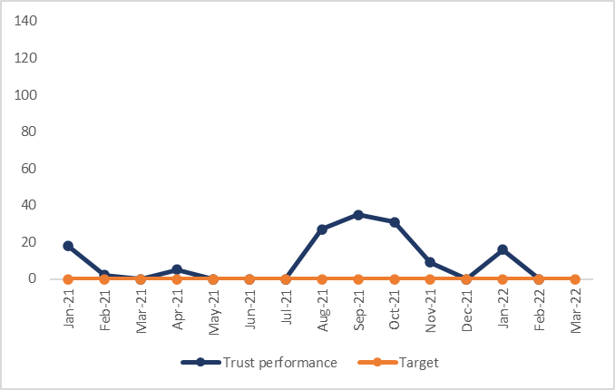
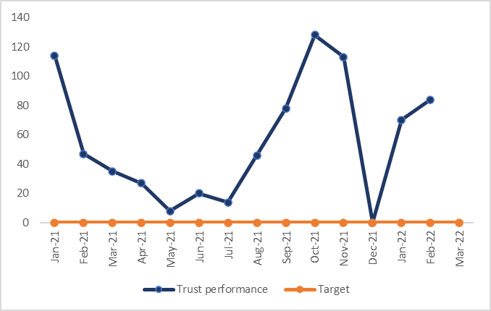
National Objective: areas of underperformance
Objective Key Result (OKR) | Target | Actual
(N7a) Inappropriate out-of-area placements (OAPs) for adult mental health services – aim to reduce OAP bed days used (Bucks) | 0 | 0
Objective Key Result (OKR) | Target | Actual
(N7b) Inappropriate out-of-area placements (OAPs) for adult mental health services – aim to reduce OAP bed days used (Oxon) | 0 | 84
Executive Director commentary: Martyn Ward, Director of Strategy and CIO Narrative updated: 10 March 2022
The issue and cause The Trust achieved the OAPs target in December. The Trust continues to have reduced bed capacity as a result of Infection Prevention Control (IPC) guidance. The Trust has been operating throughout the year with up to 15% less capacity in the Adult and Older Adult Mental Health wards. The interim closure of beds has resulted in additional Out of Area placements which the Trust has mitigated by purchasing a block contract beds. The plan or mitigation Following recent NHSE/I guidance the Trust has reviewed the use of OAPs and is assured that continuity of care principles are adhered to. Reporting from April 2021 reflects this change and please note this change when viewing performance against historical trend. February 2022 locally reported usage was 0 OAP beddays in Bucks, and 84 OAP beddays in Oxon. In April, changes to IPC guidance have allowed the facilitation of patients who have completed their 14-day period of isolation and are COVID negative to be repatriated to vacant Oxford Health beds. Therefore, maximising bed capacity and reducing the need to purchase further inappropriate OAP.

Slide 14
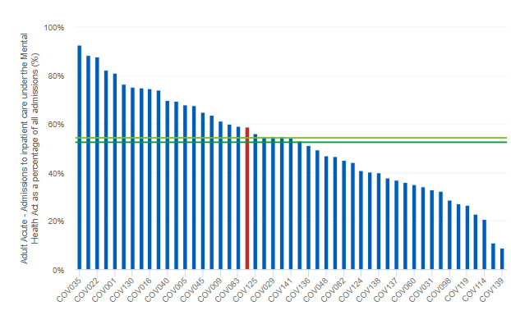
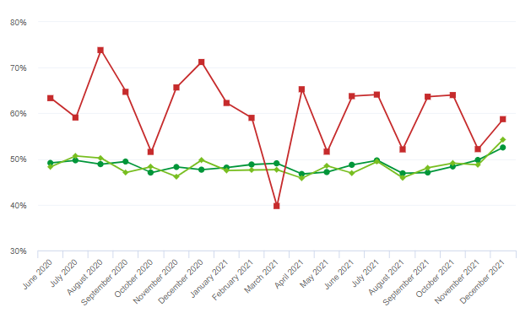
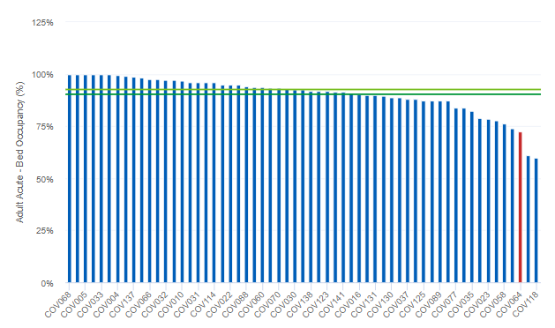
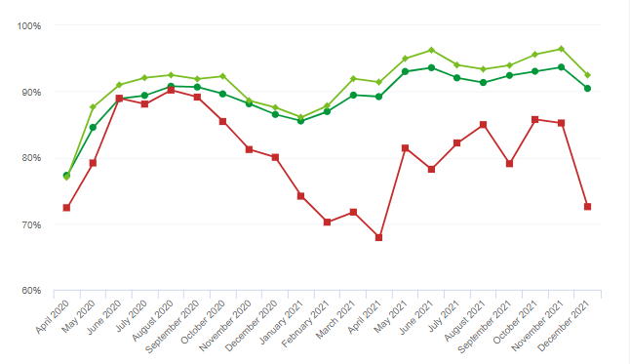
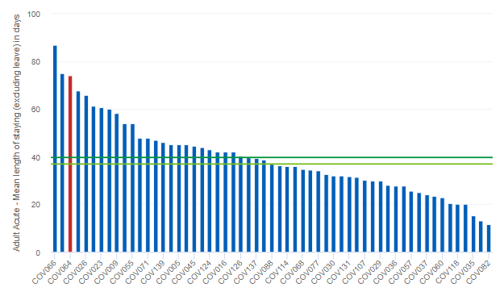
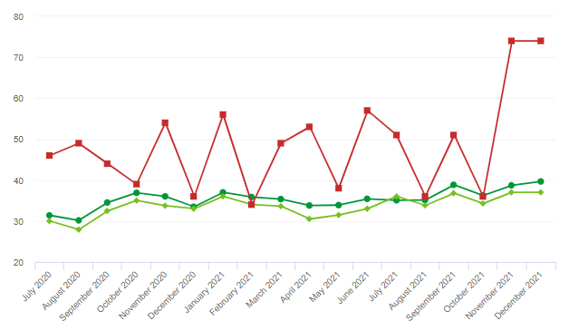
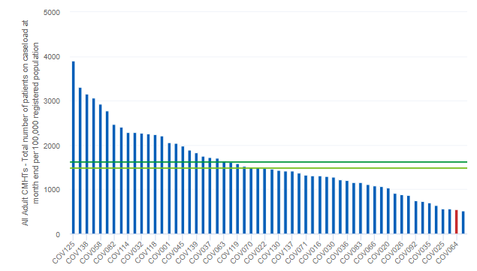
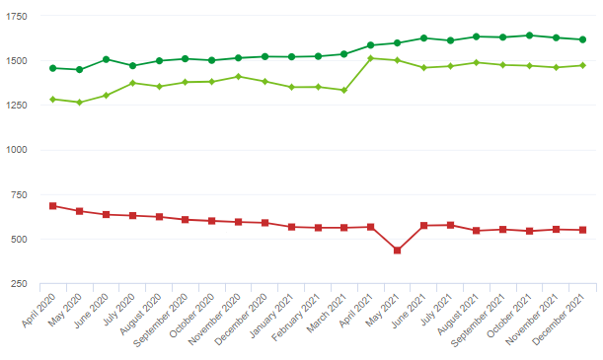
How do we benchmark (Dec 2021* MH & LD Covid-19 Monthly Benchmarking) *latest data available
?
Service Area / Currency | Latest Trust Position | Trust Trend | Latest Trust Position | National average (mean) | OHFT versus National | Commentary
Admissions to inpatient care under the MHA as a % of all admissions |  |  | 58.73% | 52.53% | Higher | OHFT has a low number of adult acute beds when benchmarked nationally; 12.57 OHFT adult acute beds per 100,000 registered population compared to national mean of 20.50. This impacts on the acuity of patients admitted with higher numbers being detained under the MHA. The annual benchmarking indicates that the Trust bed provision is more costly per OBD than the national average.
Adult Acute Bed Occupancy (%) |  |  | 72.57% | 90.46% | Lower | OHFT has continued to have reduced bed occupancy to facilitate compliance with infection prevention controls. This has more impact in Oxon where the age of estate presents greater challenges. In addition due to Covid and other operational issues in December bed occupancy was further reduced. Oxon adult acute wards occupancy April to Dec 21 average is 65.66% compared to 64.88% in Bucks.
Adult Acute Mean LOS (exc leave) in Days |  |  | 74.00 | 39.65 | Higher | OHFT LOS in Dec 21 was higher than national average. There is variation month on month in LOS. Monthly LOS figures are impacted by inclusion of patients discharged from extended leave. Operational services are exploring ways of reducing LOS in Oxfordshire. In the annual benchmarking for the same measure the Trust was the highest nationally based on 20/21 data
Adult CMHTs Total number of patients on caseload at month end per 100,000 reg pop |  |  | 547.76 | 1616.41 | Lower | This monthly benchmarking exercise only counts as being on caseload where there are two face to face contacts delivered. There are a number of factors why this approach would make OHFT lower: Our high use of digital/telephone methods of delivery of care Our system configuration does not allow for transfer from team to team so we may not achieve 2 contacts within a referral as quickly as other Trusts who can transfer the referral from one service to another Challenges in some services with accurately recording all appointments delivered. Enhancements to Carenotes were introduced at the end of Nov 21 to support easier recording of activity information. In the annual benchmarking for the measure total cost per contact to Adult CMHTs the Trust benchmarked higher than the national average.

Slide 15
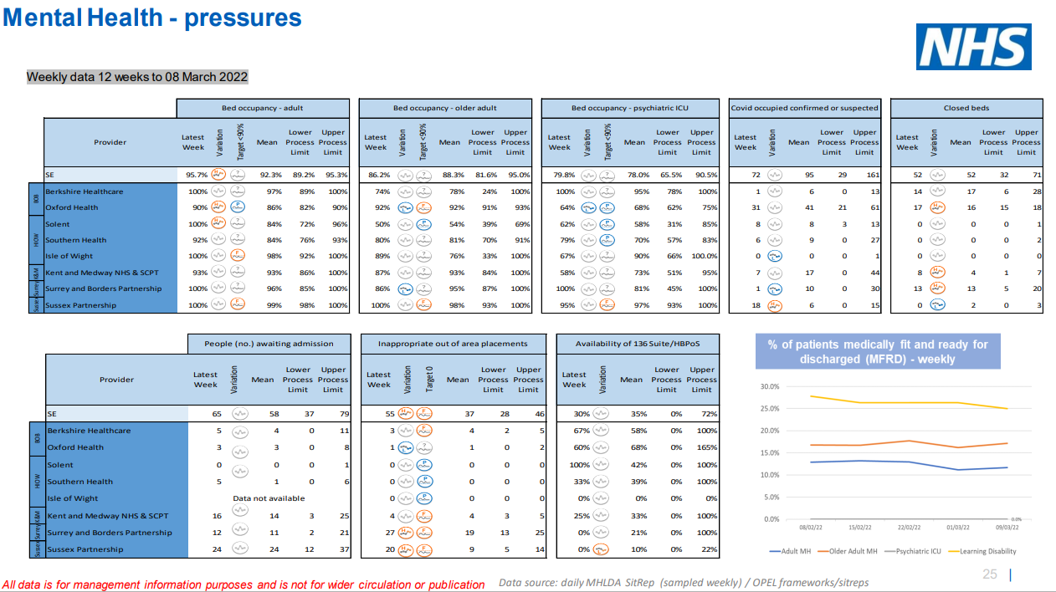
Regional Performance – South East Integrated Performance Report - 11 March 2022
Please see the following slides for performance headlines in relation to the above.

Slide 16
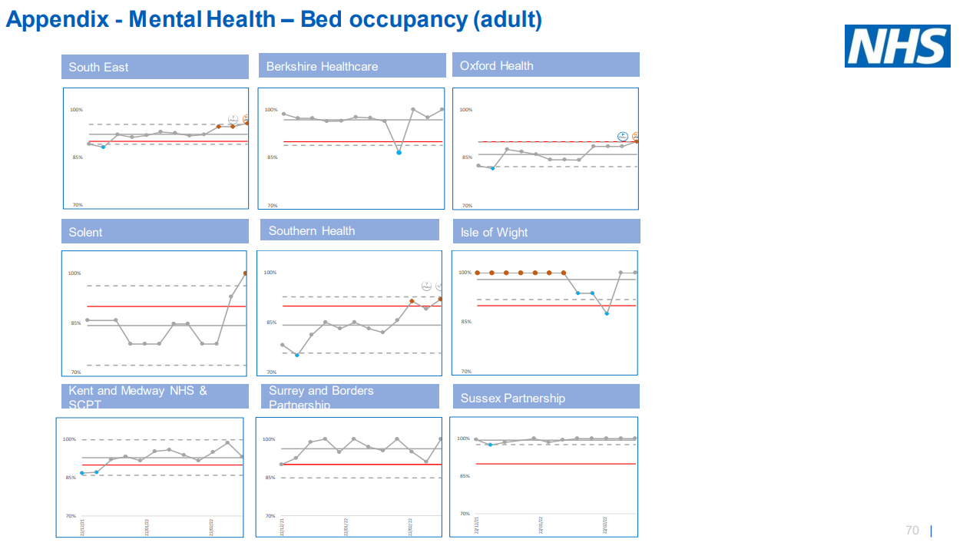
Regional Performance – South East Integrated Performance Report - 11 March 2022
Oxford Health adult bed occupancy was among the lowest in the region, averaging 86% over the past 12 weeks compared to the region average of 95.7%.
OHFT has continued to have reduced bed occupancy to facilitate compliance with infection prevention controls. This has more impact in Oxon where the age of estate presents greater challenges.

Slide 17
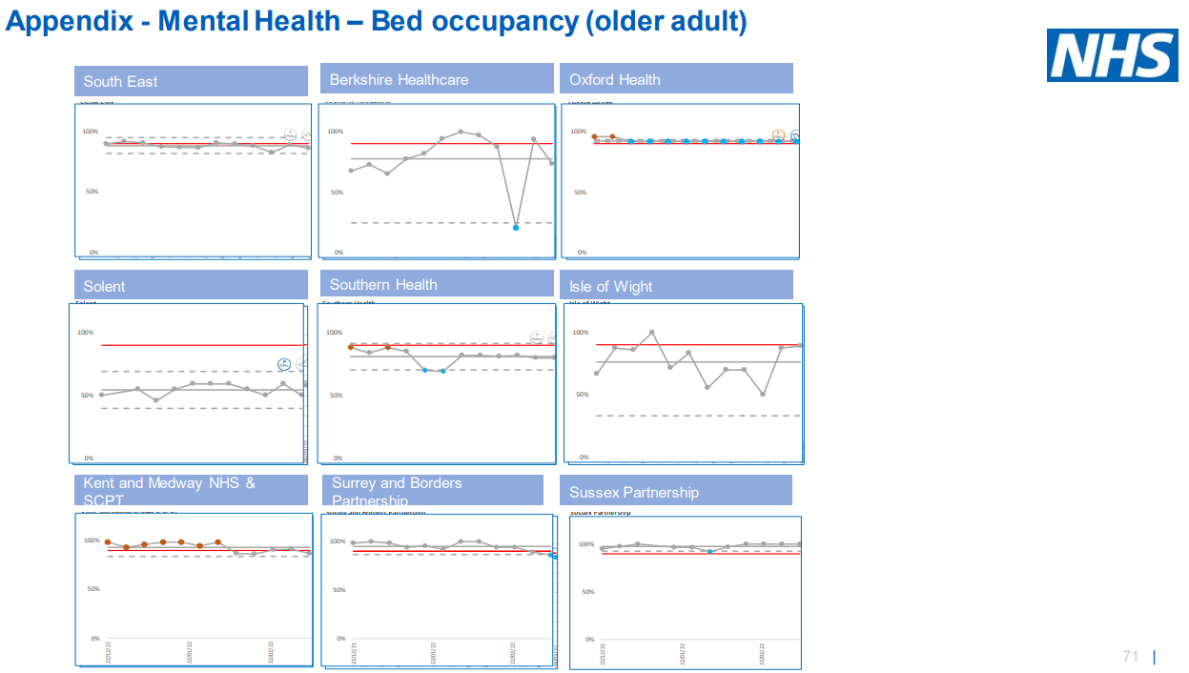
Regional Performance – South East Integrated Performance Report - 11 March 2022
Oxford Health older adult bed occupancy was among the highest in the region, averaging 92% over the past 12 weeks compared to the region average of 88.3%.

Slide 18
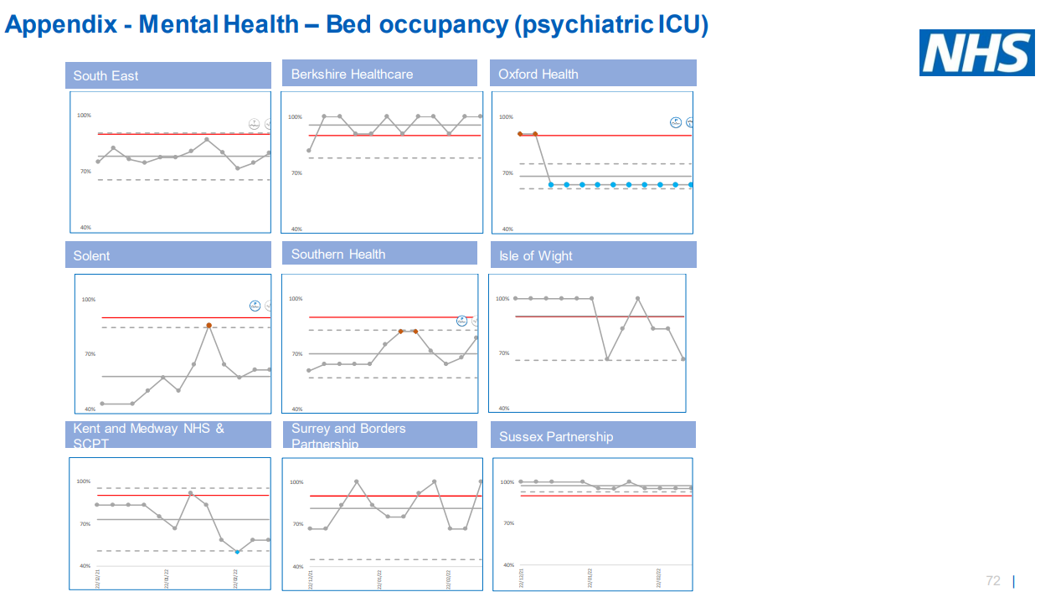
Regional Performance – South East Integrated Performance Report - 11 March 2022
Oxford Health Psychiatric ICU bed occupancy was among the lowest in the region, averaging 68% over the past 12 weeks compared to the region average of 78%.

Slide 19
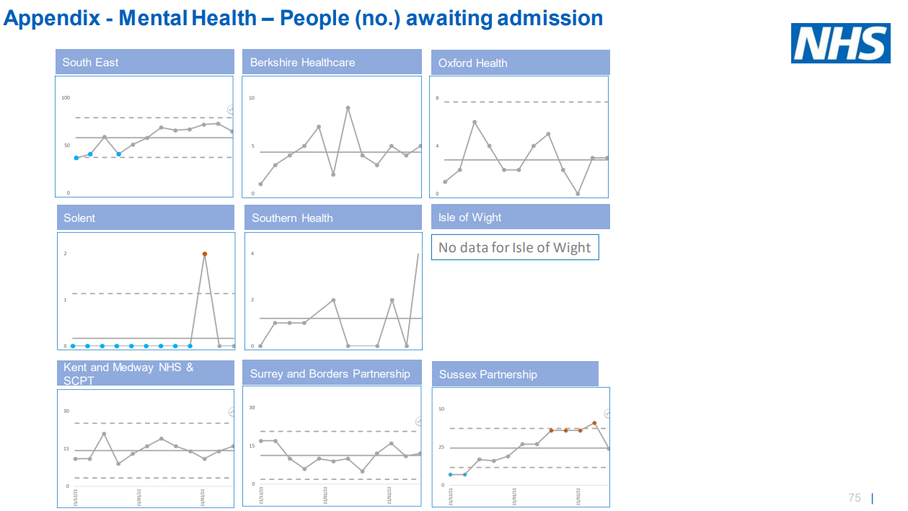
Regional Performance – South East Integrated Performance Report - 11 March 2022
The number of people awaiting admission to Oxford Health is low in the region, averaging 3 people over the past 12 weeks. The highest number of patients awaiting admission is in Sussex Partnership averaging 24 people.
Across 7 providers the total number of people awaiting admission is 58 on average each week. On average, 5% of people awaiting admission in the region are to Oxford Health.

Slide 20
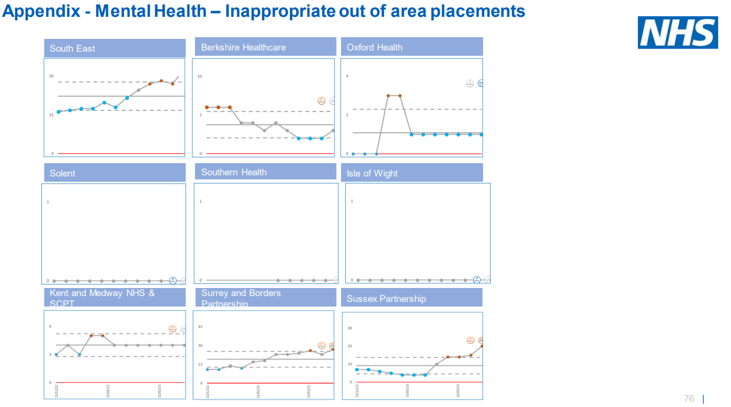
Regional Performance – South East Integrated Performance Report - 11 March 2022
Oxford Health had low numbers of inappropriate out of area placements over the past 12 weeks; averaging 1 per week and in February this equated to 84 bed days used.
Across 8 providers the total number of people awaiting admission is 38 on average each week. On average, 3% of inappropriate OAPs in the region relate to Oxford Health.

Slide 21
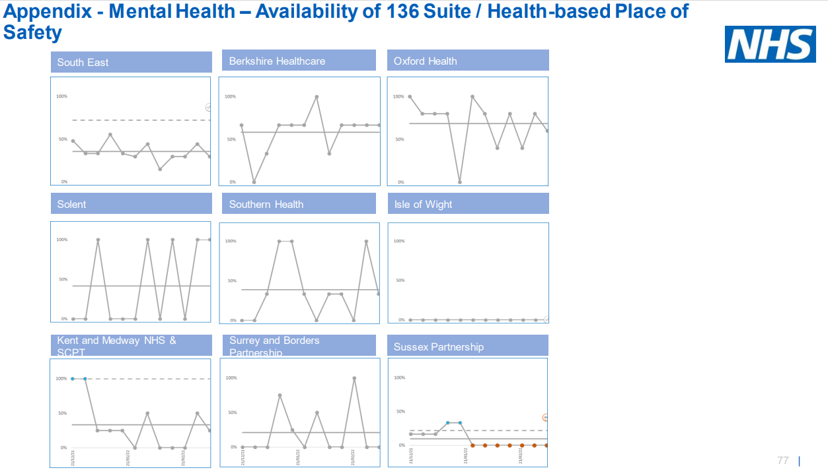
Regional Performance – South East Integrated Performance Report - 11 March 2022
136 suite availability in Oxford Health is one of the highest in the region averaging 68% availability over the past 12 weeks compared to the regional average of 35%.

Slide 22
Section 5:
Delivery of our four strategic objectives

Slide 23
Objective 1: Quality - Deliver the best possible care and outcomes
Governance: Executive Director: Chief Nurse | Responsible Committee: Quality Committee
All data relates to February unless otherwise indicated in brackets in the penultimate column
This year, our Objective Key Results (OKRs) are; | Target | Comm Services | Oxon & BSW | Bucks | LD |  | Forensic | Phar | Trust* | Trust Trend
(1a) Clinical supervision completion rate | 85% | 34% | 33% | 21% | 41% 38% |  |  | 0% | 34% | ⬇
(1b) Staff trained in restorative just culture | 25 year end | - | - | - | - | - | - | - | 26 YTD | ➔
(1c) BAME representation across all pay bands including board level – quarterly | 19% | 12.7% ↑ | 17.9% ↑ | 31.8%↓ | 12.1%↓ | 44.4%↑ | 44.4%↑ | 22.6%↓ | 19.5% (Q3) | ⬆
(1d) Cases of preventable hospital acquired infections - YTD | <3 | - | - | - | - | - | - | - | 0* YTD | ➔
(1e) Reduction in use of prone restraint by 25% in year 1 – YTD | <220 YTD | - | - | - | - | - | - | - | See narrative | ⬆ adverse
(1f) Patient safety partners employed to be part of the governance structure – quarterly | 2 partners year end | - | - | - | - | - | - | - | 0 | n/a
(1fa) Improved completion of the Lester Tool for people with enduring serious mental illness (SMI) (EIP teams) | 90% | - | 94% | 87% | - | - | - | - | 91.1% | ➔
(1fb) Improved completion of the Lester Tool for people with enduring SMI (Comm) | 75% | - | 55% | 67% | - | - | - | - | 60.4% | ➔
(1g) Evidence patients have been involved in creating their care plan (clinical audits) - bi-monthly | 95% | No relevant audits | 92% | 92% | No relevant audits | 91% | 100% | - | 92% (Bi-mth) | ⬆
(1h) 30% of clinical staff in non-learning disability services have completed internal eLearning on autism | 30% year end | - | - | - | - | - | - | - | See narrative | ➔
*1 possible CDI case YTD identified in Oct 2021 which has been investigated as a PSI and the system health economy meeting was postponed to 22/03/22 to decide if it was preventable.
The arrows indicate the trend against the last reported position.

Slide 24
Objective 1: Quality - Deliver the best possible care and outcomes
Governance: Executive Director: Chief Nurse | Responsible Committee: Quality Committee
All data relates to February unless otherwise indicated in brackets in the penultimate column
This year, our Objective Key Results (OKRs) are; | Target | Comm Services | Oxon & BSW | Bucks | LD | Forensic | Trust* | Trust Trend
(1g) Numbers of Pressure Ulcers developed in service category 3 and grade 4 | TBC | 16 | 1 | 0 | 0 | 0 | 17
(1h) 48 hour follow up for those discharged from mental health wards | TBC |  |  | - | - | -
(1i) 72 hour follow up for those discharged from mental health wards | 80% | - | 78% (21/27) | 74% (17/23) | - | - | 77% | ⬆
(1j) Inpatient Length of Stay (LOS) excl delay/leave – Mental Health Adult Acute | TBC |  | 41 days | 53 days |  |  | 48 days | ⬆ adverse
(1k) Inpatient Length of Stay (LOS) – EMU | TBC | 8 days | - | - | - | - | 8 days | ➔
(1l) Inpatient Length of Stay – Stroke | TBC | 26 days | - | - | - | - | 26 days | ⬆
(1m) Inpatient Length of Stay – Rehab | TBC | 26 days | - | - | - | - | 26 days | ⬆
(1n) Delayed Transfers of Care (DToC) – Community | TBC | 19 | - | - | - | - | 19 | ⬆
The arrows indicate the trend against the last reported position.

Slide 25
Objective 1: Quality - Deliver the best possible care and outcomes
Governance
Executive Director: Chief Nurse | Responsible Committee: Quality Committee
Executive Summary: Marie Crofts, Chief Nurse Narrative updated: February 2022
The majority of the Quality OKRs are a sub-list of the quality objectives which form the annual Quality Account. The objectives were identified following a review of our risks, themes from quality information, recovery work and feedback from stakeholders. The last progress update on all of the quality objectives for 2021/22 was presented to the Quality and Clinical Governance Sub-Committee in February 2022. Eight new quality OKRs have been added this month, with some information being populated this month and all information should be in the next months report. Six of the OKRs are underperforming at this point in time. Please see overleaf for more information by measure on the cause of the underperformance and the plans to mitigate and improve performance. The Trust has started the following Quality Improvement Projects to address the relevant OKRs in the Quality section; Positive and Safe – reduction in restrictive practice Improving the Physical Health monitoring of patients with SMI Risk Assessment formulation and documentation Working with families and carers Measuring success of race equality framework for change

Slide 26
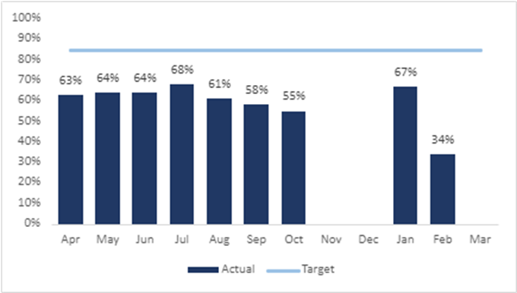
Objective 1: Quality; areas of underperformance
Objective Key Result (OKR) | Target | Actual
(1a) Clinical supervision completion rate | 85% | 34%
Executive Director commentary: Marie Crofts, Chief Nurse
The risk or issue The risk is staff may be struggling in their role and feel unsupported to manage difficult situations which may then impact on their well-being. The cause Operational pressures due to responding and recovering from COVID-19 and issues with recording and accuracy of reporting from OTR. What is the plan or mitigation? Actions are being led and monitored by a supervision steering group. Each directorate also has a task and finish group which reports into the steering group. The group have developed a driver diagram to identify the actions to take. The four key drivers of the workplan are; compliance with professional standards Training policy and definitions staff experience and quality of supervisions. Work continues to ensure accuracy of reporting from OTR. Recording functions are being improved eg to record group supervision. Re-launch of supervision to raise awareness of importance and changes to OTR planned for April 2022. Number of QI projects across directorates to understand barriers to low compliance and recording challenges on OTR. Supervision training relaunched and available. Policy has been updated and waiting for sign off.

Slide 27
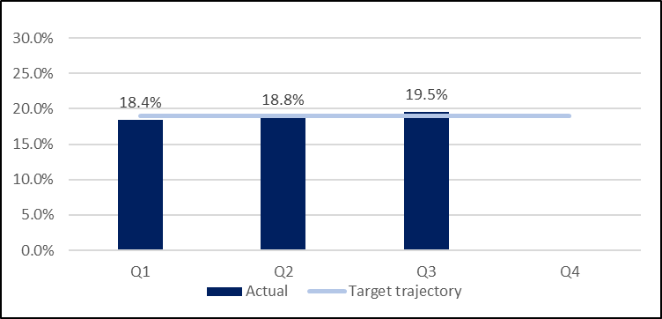
Objective 1: Quality; areas of underperformance
Objective Key Result (OKR) | Target | Actual
(1c) BAME representation across all pay bands including board level - quarterly | 19% | 19.5% Q3
Executive Director commentary: Marie Crofts, Chief Nurse
The risk or issue The target is to achieve 19% representation across all bands by 2025. Overall the target has now been reached although not across every directorate or every pay band. Based on modelling from the 2011 census, the Joint Strategic Needs Assessments show 16% of the Oxfordshire population are from ethnically diverse backgrounds and 14% of the Buckinghamshire population are from ethnically diverse backgrounds. The target is not being met in the Oxon Community Services Directorate (12.7%); Oxon & BSW Directorate (17.9%); or Learning Disability services (12.1%). There is also an underrepresentation across the Trust at higher pay bands (8a and above). Our organisation would benefit from an ethnically diverse workforce which represents the diversities of the communities we serve The cause The under-representation of ethnic minority groups in certain bands and occupational groups within Oxford health and the NHS is widely known. What is the plan or mitigation? There is an ICS BOB level action plan to improve the race disparity ratio and meet the 6 national EDI actions. The Trust has developed a Race Equality ‘Framework for Change’ Strategy being led by the Chief Nurse and Executive Managing Director for MH, LD and Autism with the support of the EDI Steering Group and Race Equality Staff Network. Some of the workstreams are being led by volunteers from the Race Equality Network who are using this work experience as part of their professional development.

Slide 28
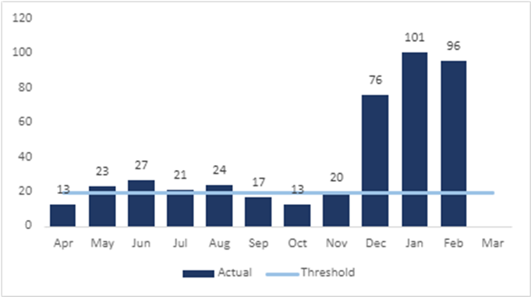
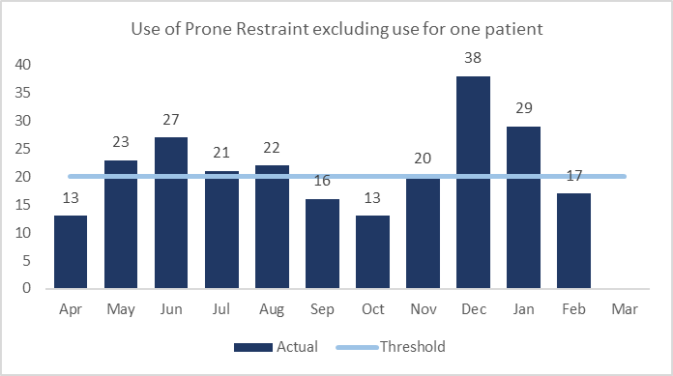
Objective 1: Quality; areas of underperformance
Objective Key Result (OKR) | Target | Actual
(1e) Reduction in use of prone restraint by 25% | 220 YTD (less than 240 at year end) | 431 YTD (239 excl. use of prone for 1 patient)
Executive Director commentary: Marie Crofts, Chief Nurse
The risk or issue​ Use of prone restraint carries increased risks for patients and should be avoided and only used for the shortest possible time.​ ​ The cause​ YTD the position is 431 uses against a YTD target of 220. The use has been close to the reduction target up until Dec 21, with on average 5 uses of prone restraint per week. From Dec 21 to Feb 22 there has been an increase in use of prone restraint, this predominantly relates to one patient with acute needs. Prone restraint was used 177 times with this patient between Dec-Feb. The reason for using prone was due to a risk of violence causing harm to themselves and/ or staff. A more appropriate setting is being sought for the patient. The second graph below shows the use of prone restraint excluding the data for this one patient​​. What is the plan or mitigation? ​ A large-scale QI project is in progress to reduce the use of restrictive practice, including looking at alternative IM injection sites and using safety pods to reduce the use of prone restraint. ​ Following detailed analysis and liaison with QI sponsors, a number of wards have been identified to be part of the programme to reduce restrictive practices. Bespoke QI training has been delivered to each of the inpatient teams. Progress with the QI project actions, and impact is monitored through the Positive and Safe Committee. ​ ​ On a weekly basis all prone restraints are reviewed at the Weekly Review Meeting, including looking at duration of restraints. All prone restraints lasting longer than 5 mins are reviewed by a Head of Nursing. (YTD =19 cases).

Slide 29
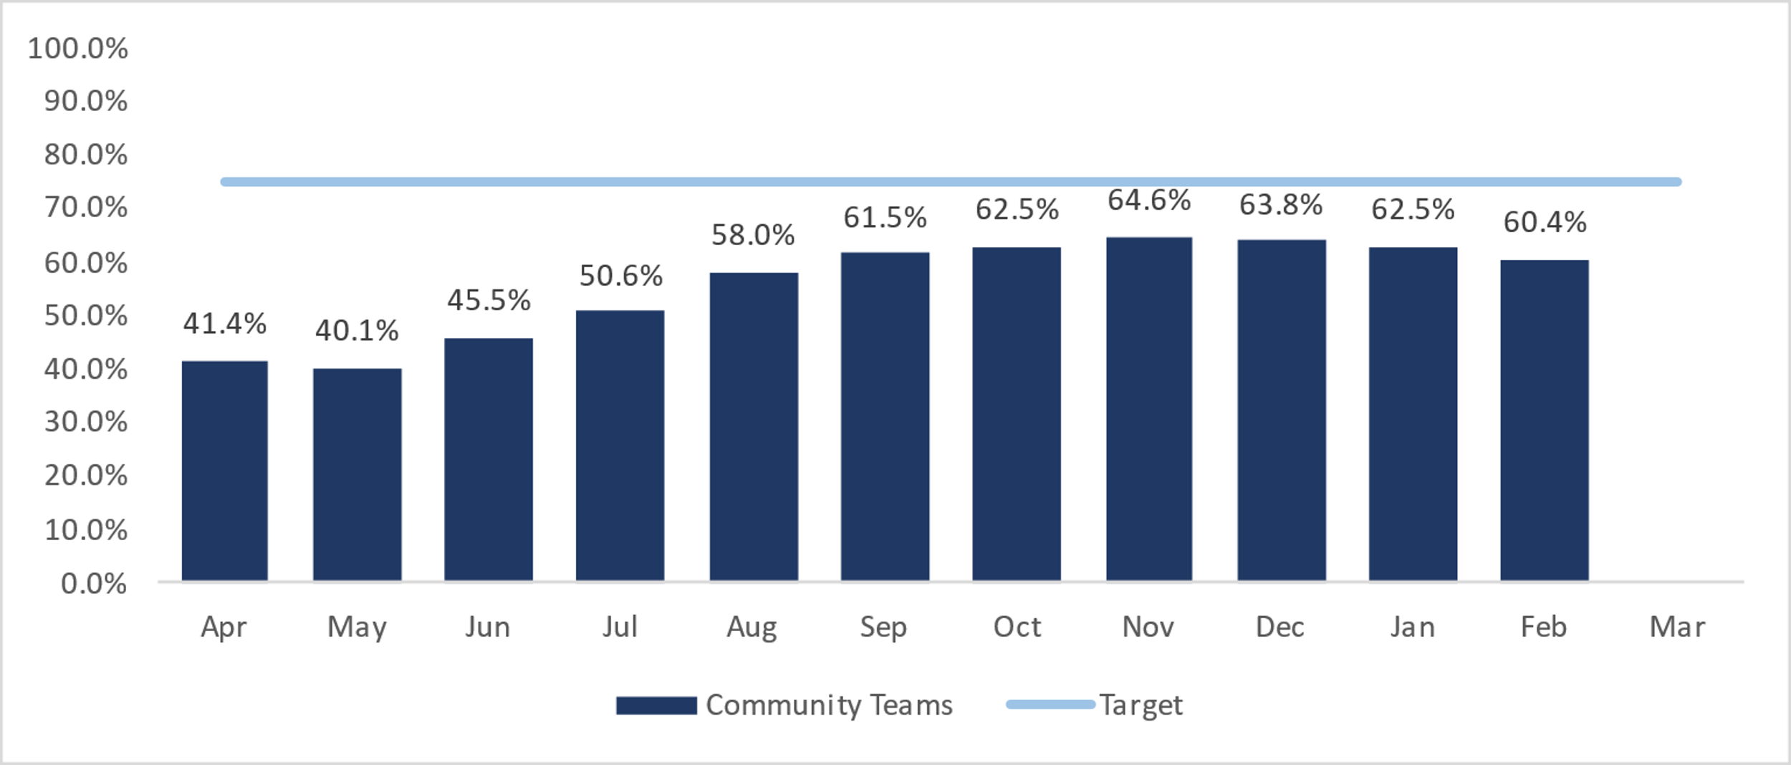
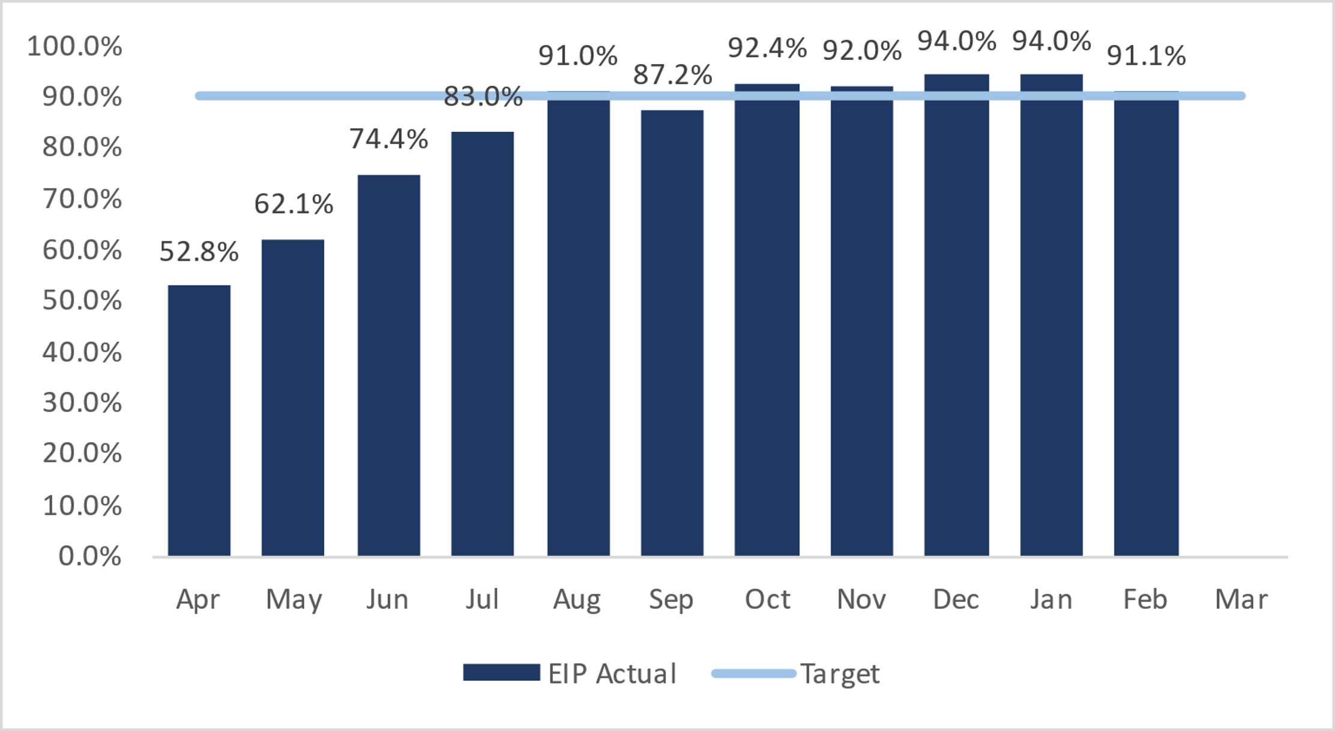
Objective 1: Quality – areas of underperformance
Objective Key Result (OKR) | Target | Actual
(1fb) Improved completion of the Lester Tool for people with enduring serious mental illness (Community teams for patients on CPA) | 75% | 60.4%
Executive Director commentary: Marie Crofts, Chief Nurse
Context The indicator is based on the completion of the comprehensive Lester physical health assessment tool for patients with a serious mental illness. The tool covers 8 elements including smoking status, lifestyle, BMI, blood pressure, glucose and cholesterol, and the associated interventions. The risk or issue There is significant evidence that people with mental health issues are at higher risk of morbidity and mortality, resulting in a life expectancy of 15-25 years compared to the general population. The cause There was a lack of focus on implementing the Lester tool across directorates which has resulted in a compliance rate below expected. The plan or mitigation A recovery plan and trajectory is in place and delivered through a task and finish group led by a senior clinician. This group reports regularly to the Quality and Clinical Governance Sub-Committee. Key actions being taken include; - New physical assessment form introduced in Feb 2022. - Review of reporting specification, amendments made for example to include information gathered in any physical health form completed in the last 12 months not just the latest form. - Change in senior lead for work who is reviewing current structures/processes within both directorates, looking at gaps and to agree with directorates and PH leads where we need to concentrate our energy and focus to strengthen our interventions. The EIP teams have achieved and sustained the target for a number of months.
Objective Key Result (OKR) | Target | Actual
(1fa) Improved completion of the Lester Tool for people with enduring serious mental illness (EIP teams for patients on CPA) | 90% | 91.1% achieved

Slide 30
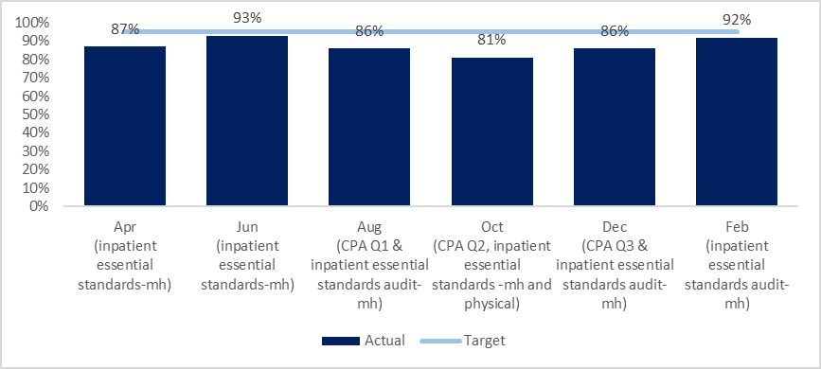
Objective 1: Quality; areas of underperformance
Objective Key Result (OKR) | Target | Actual
(1g) Evidence patients have been involved in creating their care plan (bi-monthly clinical audit) | 95% | 92%
Executive Director commentary: Marie Crofts, Chief Nurse
Context The information reported is from the relevant clinical audits completed in Jan or Feb 22. In this report the information is taken from the mental health inpatient essential standards (n=88 records). This area for improvement is also identified as a theme in concerns/ complaints, feedback from local surveys and the results from the 2021 national patient survey. The risk or issue Patients are not always being involved in their plan of care impacting on their experience and outcomes. The plan or mitigation Peer support workers and new paid roles for people with a lived experience are being increased to start to change and challenge how we approach working with patients. Achieving provider status to deliver HEE peer support training will help achieve our aim. Experts are being more involved in QI and transformation work to help improve the services and care provided. The use of Patient Reported Outcome Measures are being expanded across the mental health teams. Specific QI projects are underway include; CAMHS staff working with young people to develop a care plan template that is more accessible and focuses on their needs and goals. This is being rolled out across all Counties. QI patient centred care in community hospital wards Improving pre-appointment planning in Dental services and information for patients with autism so that they can be more involved. Collaborative care planning with patients embracing the use of digital technology, piloting in an AMHT and CMHT Forensic services are working on needs led care planning

Slide 31
Objective 1: Quality – areas of underperformance
Objective Key Result (OKR) | Target | Actual
(1h) 30% of clinical staff in non-learning disability services have completed internal eLearning on autism | 30% year end | See narrative
Executive Director commentary: Marie Crofts, Chief Nurse
Context New internal training was being developed to support staff with communicating effectively with people with Autism and making the adjustments needed to support with access to health care. This training has been put on TEMPORARY HOLD as the Trust is part of the national Oliver McGowan Autism training pilot. Following the pilot, the national training is planned to be rolled out to all staff in 2022/23. The Trusts target will not be achieved this year. The plan or mitigation As the internal training has been put on hold. Below are some of the other activities we are doing to improve how we work with and support people with autism: 125 staff attended the national pilot training (Oliver McGowan) = 5% as of Feb 2022. The Reasonable Adjustment Service is supporting mental health clinicians to better understand and support the needs of autistic individuals with reasonable adjustments and adaptions. The service is planning to be expanded with additional funding – recruitment is underway. 6 autism webinars were delivered in Q1 for staff and recorded for people to watch later (around 45 staff attended the live sessions) Bespoke training sessions are being delivered to mental health wards and community teams, as well as regular support sessions for inpatient staff to discuss specific patients. Working with our autistic experts by experience we are developing an autism reasonable adjustment passport to support access to mental health services. This is being piloted. Resources have been developed to support clinical teams with making communication more autistic inclusive. We are also providing consultation and support from an adjustment perspective to individuals who do not meet the criteria for LD services but our mental health services are inaccessible. There has been work from an employee perspective ie supporting the employee dyslexia support group and autism support group.

Slide 32
Objective 2: People – be a great place to work
Governance: Executive Director: Chief People Officer | Responsible Committee: People, Leadership and Culture Committee
All data relates to February unless otherwise indicated in brackets in the penultimate column
This year, our Objective Key Results are; | Target | Comm Services | Oxon & BSW | Bucks | LD | Forensic | Pharm | Corporate & Trading | Trust | National comparator | Trust Trend
(2a) People Pulse Staff Engagement scoreQ4 | >/= | 6.78 | 6.88 | 6.40 | 7.40 | 7.57 | 6.62 | 7.08 | 6.87 | n/a | n/a
(2b) Reduce agency usage to NHSE/I target Excludes covid spend | </=22.0% | 12.8% ↑ | 19.8% ↑ | 27.7%↑ | 0%→ | 10.3%↓ | 4.4%↑ | 2.9%↑ | 15.1% | ModHos 4.9%/ Peer 6.8% | ⬆
(2c) Reducing staff sickness to 3.5% over 2021/22 | </=3.5% | 7.2%↓ | 5.1%↓ | 6.2%↓ | 2.4%↑ | 7.8%↓ | 4.9%↓ | 3.9%↓ | 5.8% | National avg 9.1% | ⬇
(2e) Reduction in % labour turnover | </=10% | 13.8%↓ | 13.7%↓ | 13.6%↑ | 25.3%↑ | 13.5%↓ | 4.5%↑ | 11.1%↑ | 13.3% | ModHos 0.98% Peer 1.02% | ⬇
(2f) Reduction in % Early labour turnover |  | 18.4%↑ | 21.8%↓ | 16.9%↑ | 23.9%↓ | 17.4%↓ | 0.0%→ | 13.1%↑ | 17.7% | None | ⬇
(2g) Reduction in % vacancies | </=9% | 3.6%↓ | 7.5%↓ | 13.0%↑ | 14.7%↑ | 19.3%↓ | -4.6%↑ | 10.9%↓ | 8.6% | ModHoss 7.90%Peer 11.03% | ⬇
(2h) PDR compliance | >=90% | ^{34%↓} | ^{33%↓} | ^{21%↓} | ^{41%↓} | ^{38%↓} | ^{39%↓} | ^{32%↓} | ^{34%↓} | None | ⬇
(2i) PPST compliance | >=90% | 72%↑ | 66%↑ | 69% | 67% | 75%↑ | 54%↓ | 69%↑ | 70% | None | ⬆
(2j) Number of Apprentices as % substantive employees | >=2.3% | 5.3% → | 3.5% → | 8.4% → | 2.2% → | 1.8% → | 0.0% → | 2.3% → | 5.48% | None | ⬇

Slide 33
Objective 2: People – be a great place to work
Governance
Executive Director: Chief People Officer | Responsible Committee: People, Leadership and Culture Committee
Executive Summary: Charmaine De Souza, Chief People Officer, Narrative updated: February 2022
Omicron variant: The period since the last Council of Governors report and meeting in November 2021 has been dominated by the response required to deal with a new wave of Covid 19 precipitated by the new variant. This has had a considerable impact on staff with significant staff absence related to both Covid and general winter pressures. Absence levels rose peaking at 7.0% in December with 1.45% of staff absent with COVID and 6.82% in December with 2.43% absent due to Covid. This compares to 0.8% absent due to covid in November. Covid absence dropped in February to 1.52% of sickness with a total absence of 5.88% the lowest since June 2021. The focus then has been on ensuring that there is emphasis on wellbeing and doing all we can to provide adequate cover over the Christmas and New year Bank Holidays. A winter incentive scheme designed to incentivise staff to be on call across the Christmas period was implemented, and the Chief Nurse and Chief People Officer are evaluating the impact of this. Wellbeing: In recognition of the extraordinary efforts of everyone in the #oneOHFT team in 2021, the Board of Directors has agreed to give an additional day of paid leave known as a Wellbeing Day to all eligible substantive staff. It is hoped that this symbolic day of thanks and gratitude will be used by staff to focus on themselves and their wellbeing. Initial feedback has been extremely positive. A series of initiatives have been agreed by the Executive team in recognition of their efforts during the Covid pandemic. These will be announced during the forthcoming financial year. Vaccinations as a Condition of Employment: Running in parallel with this was the work to prepare for the implementation of Vaccinations as a Condition of Employment (VCOD). OHFT had already had some exposure to this given that staff were in scope for the earlier November 2021 legislation related to staff who undertook patient care in care home settings and so we were able to build on this albeit the VCOD legislation being more complex and far reaching. The Regulations were paused in early February and a consultation regarding whether they should be revoked was launched. At the beginning of March the Government announced the consultation and its intention to revoke the regulations across all health and social care settings. The legislation has yet to be passed by parliament and further guidance regarding recording of vaccinations, recruitment etc is yet to be provided. The Trust is continuing to encourage all staff to be fully vaccinated. Further guidance from NHS England is also awaited regarding other COVID matters including LFT Testing, management of individuals with Long Covid, pay for individuals with adjustments due to covid etc. Once this guidance is delivered a review of these areas will take place. A considerable amount of HR resource was required to manage this between December and March 2022, which has resulted in a delay to other areas of work.

Slide 34
Objective 2: People – be a great place to work
Governance
Executive Director: Chief People Officer | Responsible Committee: People, Leadership and Culture Committee
Executive Summary: Charmaine De Souza, Chief People Officer, Narrative updated: February 2022
The new HR Structure which went live in November is now starting to embed into new ways of working and initial signs are that this is having a positive impact both within the HR team and upon the work that it is delivering to the wider Trusts. Some roles are still being recruited to and as a result of the restructure some changes are being considered within individual teams. To further strengthen the Trust’s people agenda the L&D and HR teams are integrating from 1 April which will provide opportunities for developing a more integrated approach to leadership, workforce planning, career development, OD and systems. 2021 Staff Survey – The 2021 response rate increased by 2% from 2020 to 55%. The Staff Survey is now aligned with the 7 elements of the NHS People Promise. The Trust scored higher than average for 3 of the 7 elements; We are compassionate and inclusive, We are recognised and rewarded, and we each have a voice that counts. The Trust score was in line with the average for 3 out of the 7 elements of the People Promise; We are safe and healthy, We are always learning, and we are a team. The Trust score was below the average for one element of the People Promise; we work flexibly. The Trust also scored above the average for Staff Engagement and in line with the average for morale. The OD Team have attended all 6 Directorate SMT's to present their high level 2021 Staff Survey and January 2022 People Pulse results. Each SMT has identified a Lead to work with the OD team to take forward 1 to 2 simple actions in response to their staff survey feedback by September 2022 (when the 2022 Staff Survey commences). Organisational Development - The OD Team are facilitating organisation-wide action on the areas identified as needing particular attention from the 2021 staff survey feedback: •Personal Development Review (PDR) will be a Trust wide Quality Improvement Project. •The Improving Quality Reducing Agency (IQRA) Board is putting measures in place to support teams capacity. •A Flexible Working Project Change Team is in place reporting into the IQRA Retention Workstream. A business case has been agreed by the Executive Management Committee for significant new funding to be made available to the Medical Staffing team. A review of the structure of the team is currently underway and the funding will enable the creation of additional posts in the new structure. The structure will ensure that the team has sufficient resource and is set up to support the Chief Medical Officer to achieve his objectives.

Slide 35
Objective 2: People – be a great place to work
Governance
Executive Director: Chief People Officer | Responsible Committee: People, Leadership and Culture Committee
Executive Summary: Charmaine De Souza, Chief People Officer, Narrative updated: February 2022
The Improving Quality and Reducing Agency Programme has several workstreams which aim to improve the quality of our services whilst reducing agency spend. One of the workstreams, Retention, will focus on improving retention which will be supported by the new HR Structure with a greater emphasis on organisational development, culture, development and succession planning. Work is also in progress to review the budgeted establishments across inpatient units this is likely to result in an increase in vacancies. A Workforce Planning role is being recruited to which will support the process to ensure budgets are accurate. A piece of work has been undertaken to map out the workforce requirements for next 5-7 years, this will support future workforce planning decisions. This workforce tool will take into account current committed workforce education programmes such as nurse associate training, top up degrees and advanced clinical practice. The recruitment workstream is undertaking a piece of work to map out the career pathways for clinical registered, non-registered and administrative staff, this will identify any gaps with the training that is available as well as become a tool to facilitate career conversations with both new and existing staff which will feed through to a talent pipeline. The Recruitment Campaign Consultants are in the process of contacting the services that have been identified as hotspot areas for recruitment to discuss their challenges in recruiting and to start the development of campaigns to address these. A clear process has been agreed following the successful landing of international nurses to reduce the Trust’s reliance on agency workforce and ending lines of work or negotiating reduced agency pay rates where appropriate. The levels of Mandatory Training, Supervision and PDR’s recorded as complete are significantly below target. This is due to a combination of factors including, a reduction in focus due to pressures associated with Covid, a review of training matrices, renewable training courses for previous once only courses and the introduction of a new OTR system in August, two months earlier than anticipated with no testing. This was due to a confirmed cyber attack on the old system. It is believed that these issues have now been predominantly resolved and that performance against targets should improve. The L&D team will continue to monitor the new system and ask for system changes where the system is not behaving as expected but this is now rare. They will also revise the training matrices for the small number of teams that are still outstanding and work with teams and areas where compliance is particularly low to get managers to encourage staff to complete their training. The priority for the next period will be to agree a plan on how mandatory training rates are to be increased, with an assessment of the barriers in relation to implementation so that these can be removed.

Slide 36
Objective 2: People; areas of underperformance
Objective Key Result (OKR) | Target | Actual
(2c) Reducing staff sickness to 3.5% | </=3.5% | 6.9%
Objective Key Result (OKR) | Target | Actual
(2e/f) Reduction in % labour turnover | <10% | 13.3%
Executive Director commentary: Charmaine De Souza, Chief People Officer
The risk or issue The sickness absence rate has decreased in February from 6.8% to 5.9%. Excluding Covid absences the rate was 4.36%, 0.86% above the target of 3.5% The cause Whilst the amount of absence due to COVID reduced in February, accounting for 1.52%, confirmed Covid cases remained the top cause of absence in February with 250 cases. The second highest reason is non-work-related stress followed by work related stress. The number of staff absent with long term sickness has reduced significantly with 155 employees being absent for more than 4 weeks in February compared with 167 in January and 276 in December. The plan or mitigation A project is underway to support the reduction in absence in the community directorate focusing on: Top 10 areas of sickness – by days lost and %. Top 30 staff with highest number of episodes Top 50 staff with highest number of days lost. An essential part of this work will be to support and coach managers to ensure that sickness absence is being actively managed utilising the data available in Goodshape.
Executive Director commentary: Charmaine De Souza, Chief People Officer
The risk or issue Staff turnover has decreased to 13.3%. High levels of turnover will impact on vacancies, agency spend, quality of patient care and staff experience. The cause 37 people left the Trust’s employment in February compared with 85 in the previous month. 70.7% of leavers resigned voluntarily for various reasons, 6.03% retired. Analysis has indicated that people below the age of 30 and staff from a BAME background leave the Trust in much higher numbers than other groups. The plan or mitigation The Retention workstream of the IQRA programme is focusing on: Process mapping to ensure people new to the Trust have an excellent recruitment, induction, training and local induction experience and feel fully supported in their roles. Review of leaving data to highlight any hotspot teams/directorates Review of staff survey results Focus on equality and diversity throughout the programme to ensure processes are improved from several different angles QI project to improve the PDR experience for staff to ensure people have high quality appraisals and meaningful conversations with their managers Further development and increase in adoption of Flexible Working opportunities

Slide 37
Objective 2: People; areas of underperformance
Objective Key Result (OKR) | Target | Actual
(2h) PDR compliance | >/=90% | 34%
Objective Key Result (OKR) | Target | Actual
(2i) PPST compliance | >/=90% | 70%
Executive Director commentary: Marie Crofts, Chief Nurse
The risk or Issue The percentage of staff receiving a PDR in the past 12 months has decreased. Individuals who do not receive a PDR may not be receiving appropriate feedback, support and development. Staff are holding records locally and not uploading to OTR. For the period November to January inclusive clinical staff were excluded from reporting giving an incorrect compliance rate of 40% higher than actual. The cause Some of the low compliance may be an issue of lack of recording rather than undertaking. PDRs were not seen as a priority during covid. The plan or mitigation Teams able to record PDRs on the new OTR. There has been a communication and training package to support this. The L&D department will provide additional guidance to teams where the level of completion is low.
Executive Director commentary: Marie Crofts, Chief Nurse
The risk or issue The percentage of PPST training completed in February has increased. Individuals who have not completed their PPST training may not have the adequate skills to carry out their role safely. The cause A % of staff 8 accounts did not have the correct matrix allocated which was completed in February, so they did not attend their PPST sessions. Focus on PPST reduced during pandemic and some teams do not appreciate the importance of ensuring PPST training is completed. The plan or mitigation Work continues to resolve the issues with the new OTR system and updating the data in ESR which feeds OTR with correct role titles and email addresses. The L&D department will provide additional guidance to teams where the level of completion is low and ensure appropriate classes are available

Slide 38
Objective 3: Sustainability; make the best use of our resources and protect the environment
This year, our Objective Key Results (OKRs) are; | Comm Services | Oxon & BSW | Bucks | LD | Forensics | Pharm | Corporate & Trading | Trust | Trust Trend
(3a) working capital |  |  |  |  |  |  |  | £13.9m | ⬆
(3b) Favourable performance against financial plan (YTD) | £1.3m adv ↓ | £2.8m adv ↓ | £0.4m fav ↓ | £0.5m adv ↑ | £0.9m adv ↓ | £0.1m fav | £1.0m fav ↑ | £4.0m fav | ⬆
(3c) Cost Improvement Plan (CIP) delivery (YTD) |  |  |  |  |  |  |  | £2.7m adv | ⬇
(3d) 95% of estate to achieve condition B rating by 2025 (75% in 2021) |  |  |  |  |  |  |  | 75% | ➔
(3e) Delivery of estates related CO2 reduction target of 1623 tonnes by 2025 (10,862 in 2021) | - | - | - | - |  |  | - | 10,862 tonnes | ➔
(3f) Achievement of all 8 targeted measures in the NHS Oversight Framework (see section 2 of this report) | - | - | - | - |  |  | - | 7/8 achieved
Governance
Executive Director: Director of Finance | Responsible Committee: Finance and Investment Committee | Responsible reporters: Paul Pattison/ Christina Foster | All data relates to the position as at end of January unless indicated in the penultimate column
Executive Summary: Mike McEnaney, Director of Finance Narrative updated: end of February 2021
The working capital position is a positive £13.9m. I&E is £4.0m favourable to plan driven by investment slippage and underspend against the Covid allocation and despite high level of agency and bank spend, particularly in the Oxon & BSW MH directorate, and under-delivery on CIP. The CIP plan for the year is £4.7m with £1.3m to be delivered in H1 and £3.4m in H2. £1.7m has been delivered at month 11. This is £2.7m adverse to plan due to delays in implementation of agency savings as a result of Covid-19.

Slide 39
Objective 3: Sustainability – areas of underperformance
Objective Key Result (OKR) | Trust
(3b) Favourable performance against financial plan | £4.0m favourable
Objective Key Result (OKR) | Trust
(3c) Cost Improvement Plan (CIP) Delivery | £2.7m adverse
Executive Director commentary: Mike McEnaney, Director of Finance
The risk or issue Financial performance against plan is £4.0m favourable at month 11. The cause Overspends in Community, Specialised and Oxon & BSW MH directorates and under-delivery of CIP offset by slippage on investment plans. The plan or mitigation Plans and budgets have now been agreed for new mental health investment funding for FY22 and slippage on these investments have contributed to the favourable position. In FY23 slippage is anticipated to be much less so the reliance on the Trust’s programme to improve quality, reduce agency and CIP will be crucial to delivering the FY23 plan. Finance continue to work with directorates to understand costs drivers and how they are used to keep spend in line with budget and develop CIP.
Executive Director commentary: Mike McEnaney, Director of Finance
The risk or issue CIP Performance against plan is £2.7m adverse at month 11. The cause Engagement with the CIP Programme and the main scheme of reducing agency have been delayed due to Covid-19 The plan or mitigation International Recruitment programme and other plans as part of the Improving Quality, Reducing Agency programme to reduce agency spend. Further engagement required for additional schemes to meet the plan.

Slide 40
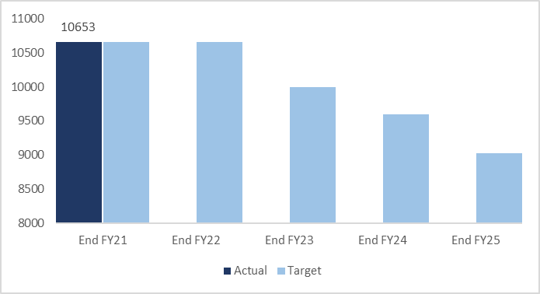
Objective 3: Sustainability – areas of underperformance
Objective Key Result (OKR) | Target | Actual
(3d) 100% of estate to achieve condition B rating by 2025 | 75% | TBC
Objective Key Result (OKR) | Target | Actual
(3e) Delivery of estates related Co2 reduction target of 1623 tonnes by 2025 | 10,862 | 10,862
Executive Director commentary: Martyn Ward – Executive Director: Digital & Transformation
The risk or issue It has now been several years since the Trust completed a condition rating survey and it is likely that a number of buildings that were previously classified as rating B are now at rating C. The cause Lack of investment. In recent years the operational capital budget has been reduced by substantial amounts due to the Trust's financial position. This, along with difficulties maintaining sites during COVID has resulted in a backlog/shorfall of maintenance and repair. What is the plan or mitigation? Work is now underway to carry out a six facet survey and this indicator will be updated once that work is complete.
Executive Director commentary: Mike McEnaney, Director of Finance
The risk or issue In FY21, the Trust consumed 10,862 tonnes of Co2. The aim is to reduce consumption to 9030 by 2025. The improvement trajectory is shown on the graph above. The cause The Trust has an obligation under Statute and the NHS Contract to reduce carbon emissions generally, becoming a net carbon organisation by 2045. This objective relates only to plans to reduce carbon emissions linked to the estate What is the plan or mitigation? The estates department has an action plan detailing potential schemes and associated investment required to reduce our carbon emissions.

Slide 41
Objective 4: Become a leader in healthcare research and education (Research & Education)
Governance: Executive Director: Chief Medical Officer | Responsible Committee:
This year, our Objective Key Results are; | Target | Comm Services | Oxon & BSW | Bucks | Corporate Inc R&D | Trust | National comparator | Trust Trend
Participants recruited to CRN Portfolio studies | 1929 (FY) | 71 | 209 | 22 | 1570 | 1872 5th Nationally | No.1 ranked Trust 27,178
CRN Portfolio studies running as at month end | - | 3 | 16 | 3 | 45 | 67 2nd Nationally | No. 1 ranked Trust 82
Executive Summary: Karl Marlowe, Chief Medical Officer Narrative updated: March 2022
As yet, we have not set a Trust target for recruitment. The figure included as the target is the estimated recruitment for FY22 as provided by the research teams for a recent Local Clinical Research Network (LCRN) request The National ranking compares research active Mental Health Trusts. In some Trusts this will include Community based and non-mental Health studies Note: 1073 recruits came from one study led by Prof Keith Hawton the "Oxford Monitoring System for attempted Suicide"

Slide 42
Section 6:
Did you know?
Facts and figures for your information

Slide 43
The arrows indicate whether the trend is up or down against the previous last reported figure
Quality
Workforce
Finance
L&D
PSIs, Complaints & Feedback
⬇ 9 PSIs reported to STEIS in February (of which 4 COVID-19 outbreaks). Average of 7 per month. YTD 82 PSIs declared excl. downgrades (28 deaths, 20 pressure damage and 17 COVID-19 outbreaks), compared to 79 last year.
18 Formal Complaints received in February. Average of 18 per month. YTD 204 complaints compared to 187 last year. In comparison to similar NHS Trusts in 2020/21 (Berkshire, CNTW, East London) OHFT received the lowest number of complaints per 1000 staff.
FFT patient feedback – in February community services: 84% said Very Good (national ave. 83%). Mental health: 61% said Very Good (national ave. 62%).
New starters, Leavers &
HR mgmt. cases resolved
⬇ 87 new starters in February, 51 lower than last month (138) and 10% higher than the 2019/20 monthly average of 79
⬇ 37 leavers in February, 48 lower than last month (85) and 41% lower than the 2019/20 monthly average of 63
⬆ 25 HR management cases resolved in February. 7 higher than last month (18) and 4% higher than the 2019/20 monthly average of 24
Finance
⬆ £662k spent on Out of Area Placements in month 11. +148% higher than the 2019/20 monthly average of £232k and more than month 10 ( £529k).
£5,796k spent on Agency Staff in month 11. +154% higher than the 2019/20 monthly average of £2,034k, and more than month 10 (£5,081k).
⬆ £143k spent on travel claims. -45% lower than the 2019/20monthly average (£129k) and more than month 10 (£125k)
Appraisals,
Supervision & Training
⬇ 103 appraisals completed in Feb 22. Decrease on Jan 2022 at 195 completed
1002 Supervision sessions carried out in February 2022 decrease on 1964 in January 2022
⬇ 2175 Training courses attended (digital and classroom) increase on the previous month of January 2022

Slide 44
Patient Activity and Demand - Exceptions
Introduction and Headlines
The following activity levels are monitored using statistic process control (SPC) charts which indicate whether activity is outside of ‘usual/expected’ levels. This month’s activity is compared to the pre-COVID 2019/20 monthly average (which is the Trust’s current benchmark of ‘normal’ activity levels (unless specified otherwise). Referrals received Appointments delivered Admissions Inpatient length of stay Bed occupancy Headlines: There are 30 services/teams that have HIGHER than usual/expected activity levels; 7 in community services, 9 in Bucks Mental Health, 11 in Oxon and BSW Mental Health and 3 in Specialist Services. Please see the following two slides which provides the list of services and levels of activity above the Trust’s benchmark or ‘normal’ activity. There are 27 services/teams that have LOWER than usual/expected activity levels; 8 in community services, 3 in Bucks Mental Health, 16 in Oxon and BSW Mental Health. 16 service lines have lower referrals levels and 11 service lines have delivered less activity (appointments). The latter predominantly relates to BSW CAMHS services. Please see the following slides which provides the list of services and levels of activity below the Trust’s benchmark or ‘normal’ activity. For detailed information, please refer to the IPR Supporting Report. Commentary for each of the service lines is provided that states whether this level of activity is expected, is a problem and whether any action is required.​

Slide 45
Activity Exceptions: High
The following services/teams have higher levels of activity than pre-pandemic levels
Directorate | Service | Currency | Activity this month compared to 19/20 monthly average | No. this month /19/20 monthly ave
Community | EMU, RACU and Hospital at Home | Referrals | +3% | 503 / 487
Community | Care Home Support Service | Referrals | +105% | 289 / 141
Community | Care Home Support Service | Appointments | +753% | 972 / 114
Community | District Nursing | Referrals | +18% | 2839 / 2409
Community | Childrens Integrated Therapies | Urgent referrals | +332% | 108 / 25
Community | Tissue Viability | Emergency referrals | +638% | 96 / 13
Community | Respiratory | Appointments | +18% | 1815 / 1532
Bucks Mental Health | Autism and ADHD | Referrals | +188% | 103 / 43
Bucks Mental Health | Perinatal Service | Referrals | +40% | 28 / 20
Bucks Mental Health | Memory Assessment Service | Referrals | +19% | 170 / 143
Bucks Mental Health | ADHD | Appointments | +159% | 83 / 32
Bucks Mental Health | Crisis Team | Appointments | +153% | 1012 / 400
Bucks Mental Health | Memory Service | Appointments | +17% | 505 / 430
Bucks Mental Health | OSCA | Appointments | +48% | 285 / 192
Bucks Mental Health | Reconnect | Appointments | +54% | 80 / 52
Bucks Mental Health | CAMHS SPA | Appointments | +83% | 212 / 116

Slide 46
Activity Exceptions: High
The following services/teams have higher levels of activity than pre-pandemic levels
Directorate | Service | Currency | Activity compared to 19/20 monthly average | No. this month / 19/20 monthly average
Oxon & BSW Mental Health | SCAS Triage | Referrals | +736% | 351 / 42
Oxon & BSW Mental Health | SCAS Triage | Appointments | +176% | 320 / 116
Oxon & BSW Mental Health | MHST | Appointments | +1054% | 404 / 35
Oxon & BSW Mental Health | AMHO Specialist Psychological Intervention Treatment Team | Appointments | +800% | 45 / 5
Oxon & BSW Mental Health | CAMHS O Perinatal | Appointments | +76% | 60 / 34
Oxon & BSW Mental Health | BSW CAMHS South Swindon ED Getting More Help | Appointments | +194% | 100 / 34
Oxon & BSW Mental Health | BSW CAMHS W and Banes FASS Getting More Help | Appointments | +39% | 28 / 39
Oxon & BSW Mental Health | BSW CAMHS W Salisbury ED Getting More Help | Appointments | +131% | 141 / 61
Oxon & BSW Mental Health | Memory Assessment Service | Referrals | +33% | 150 / 113
Oxon & BSW Mental Health | Older Adult CMHTs | Referrals | +12% | 129 / 145
Oxon & BSW Mental Health | BSW CAMHS S YOT | Appointments | +33%
Specialist Services | Forensic Community | Appointments | +99% | 349 / 175
Specialist Services | FIND team | Appointments | +50% | 24 / 16
Specialist Services | Pathfinder Team | Appointments | +5100% | 65 / 1.25

Slide 47
Activity Exceptions: Low
The following services/teams have lower levels of activity than pre-pandemic levels
Directorate | Service | Currency | Activity compared to 19/20 monthly average | No. this month / 19/20 monthly average
Community | Phlebotomy | Referrals | -9% | 126 / 139
Community | Community Therapy Service | Emergency/urgent referrals | -94% | 5 / 84
Community | SPA | Routine referrals | -38% | 86 / 139
Community | OOH Henley | Referrals | -89% | 10 / 87
Community | Witney Wenrisc EMU | Admissions | -44% | 10 / 18
Community | MIU Henley | Referrals | -5% | 918 / 963
Community | OOH Witney | Referrals | -47% | 459 / 867
Community | Diabetes | Referrals | -20% | 466 / 582
Bucks Mental Health | Perinatal Preconception Team | Referrals | -97% | 1 / 32
Bucks Mental Health | Street Triage | Referrals | -88% | 13 / 104
Bucks Mental Health | CAMHS LD | Referrals | -28% | 85 / 118
Oxon & BSW Mental Health | ADHD | Referrals | -73% | 3 / 11
Oxon & BSW Mental Health | North and West Assessment Team | Emergency referrals | -67% | 1 / 3
Oxon & BSW Mental Health | EIS | Urgent and routine referrals | -91% | 1 / 11
Oxon & BSW Mental Health | AMHO South Assessment Team | Urgent referrals | -15% | 39 / 46
Oxon & BSW Mental Health | AMHO South Treatment Team | Urgent referrals | -67% | 2 / 6

Slide 48
Activity Exceptions: Low
The following services/teams have lower levels of activity than pre-pandemic levels
Directorate | Service | Currency | Activity compared to 19/20 monthly average | No thi month / 19/20 monthly average
Oxon & BSW Mental Health | Oxon Complex Needs | Appointments | -82% | 46 / 257
Oxon & BSW Mental Health | Oxon Getting Help | Appointments | -16% | 534 / 649
Oxon & BSW Mental Health | BSW CAMHS S Swindon Getting More Help | Appointments | -27% | 409 / 557
Oxon & BSW Mental Health | BSW CAMHS S Swindon LD Getting More Help | Appointments | -65% | 38 / 109
Oxon & BSW Mental Health | BSW CAMHS Swindon OSCA Risk | Appointments | -74% | 12 / 144
Oxon & BSW Mental Health | BSW CAMHS W Banes Getting More Help | Appointments | -43% | 156 / 272
Oxon & BSW Mental Health | BSW CAMHS W Banes OSCA Risk | Appointments | -67% | 32 / 97
Oxon & BSW Mental Health | BSW CAMHS W Melksham SPOC | Appointments | -83% | 1 / 6
Oxon & BSW Mental Health | BSW CAMHS Wilts OSCA Risk | Appointments | -92% | 34 / 429
Oxon & BSW Mental Health | Older Adult Cherwell Ward | Admissions | -40% | 3 / 5

