Slide 1


Integrated Performance Report (IPR) - Supporting Report
COVID-19
Patient Activity and Demand
Benchmarking – how we compare
Waiting Times and Waiting Lists
Contractual KPI Performance
Trust Board Meeting – March 2022

Slide 2
Section 1:
COVID-19 Headlines

Slide 3
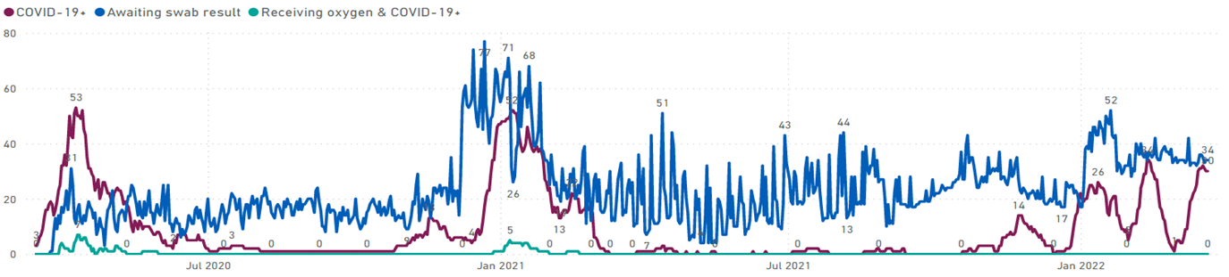
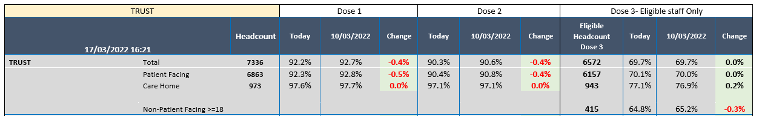
1. COVID-19 Headlines
1.1 COVID-19 positive patients on inpatient wards as at 23 March 2022: 23 patients
1.2 Cumulative figures and staff impacted by COVID-19: decreased this month
Activity | On 17 Jan ‘22 | On 21 Mar ‘22 | Difference | Trend
Cumulative number of inpatients confirmed COVID-19 positive | 486 | 583 | +97 | ↑
Cumulative number of COVID-19 deaths in our inpatient settings | 35 | 36 | +1 | ↑
Cumulative number of community patients confirmed COVID-19 positive | 840 | 950 | +110 | ↑
Number of staff impacted by COVID19 and not working | 96 | 109 | +13 | ↑
Number of staff impacted by COVID and working from home | 7 | 16 | +9 | ↑
1.3 COVID-19 vaccination uptake as at 17 March 2022: Dose 1 = 92.2%, Dose 2 = 90.3% and Dose 3 (eligible staff only) 69.7%. Patient Facing Dose 1 = 92.3%, Dose 2 = 90.4% and Dose 3 (eligible staff only) 70.1%

Slide 4
Section 2:
Patient Activity and Demand
Referrals, appointments, admissions and inpatient length of stay headlines and noteworthy exceptions by (as determined by statistical control process (SPC)) by Directorate
Narrative regarding noteworthy exceptions is provided in Section 2 c

Slide 5
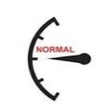



2. Patient Activity and Demand
2. Introduction and section content
This section provides an overview/scorecard of the following activity levels by Directorate; Referrals received Appointments delivered Admissions Inpatient length of stay Bed Occupancy In response to feedback from the Executive Team, the information is illustrated as follows; Activity over time is shown using statistic process control (SPC) charts which indicate whether activity is outside of ‘usual/expected’ levels. This is highlighted using the following icons: This month’s activity is compared to the pre-COVID 2019/20 monthly average (which is the Trust’s current benchmark of ‘normal’ activity levels (unless specified otherwise). The percentage difference is shown.
Normal: Data demonstrates normal variation
Monitor: Data demonstrates a single point outside the process limits, to watch/monitor the position in future months
No change: Data highlights variation which has previously been reviewed and narrative provided, no further action/comment identified at this time
Alert: Data highlights variation requiring further investigation/comment

Slide 6
Section 2a:
Community Patient Activity and Demand
Referrals and appointments overview

Slide 7
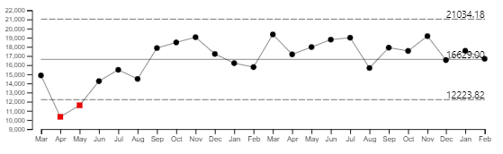
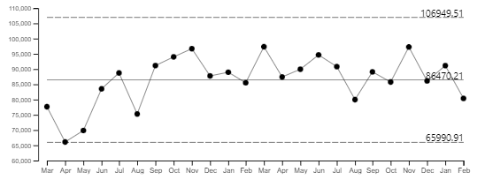
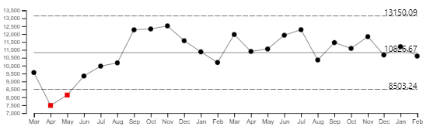
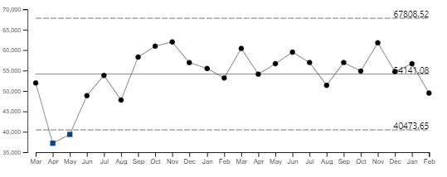
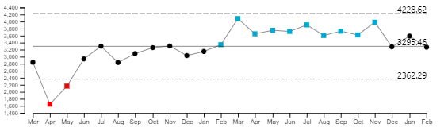
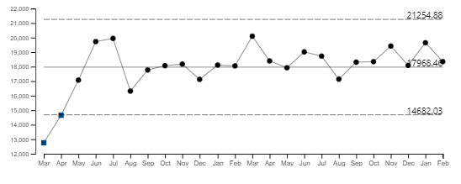
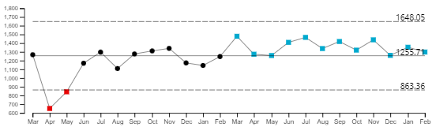
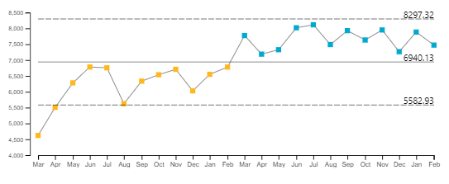
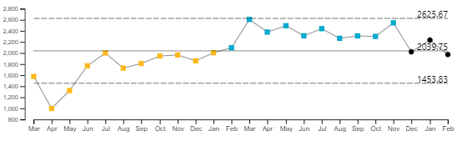
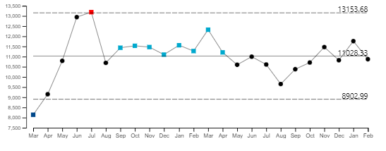
Patient Activity and Demand Overview: Community referrals and appointments
 | Referrals |  |  |  |  | Appointments
Specialty | Trend over time | Activity in month | SPC Analysis Variation | 2019/20 average | +/-% | Trend over time | Activity in month | SPC Analysis Variation | 2019/20 average | +/-%
Trust (excluding IAPT, Dental, OOH/MIU) |  | 16,692 |  | 15,776 | +6% |  | 80,389 |  | 83,028 | -3%
Community Services (excluding Dental, OOH and MIU) |  | 10,606 |  | 10,190 | +4% |  | 49,473 |  | 57,372 | -14%
Adult and Older Adult Mental Health (excluding IAPT) |  | 3,271 |  | 3,142 | +4% |  | 18,346 |  | 13,482 | +36%
Buckinghamshire |  | 1,298 |  | 1,336 | -3% |  | 7,473 |  | 5,455 | +37%
Oxfordshire |  | 1,973 |  | 1,806 | +9% |  | 10,873 |  | 8026 | +35%

Slide 8
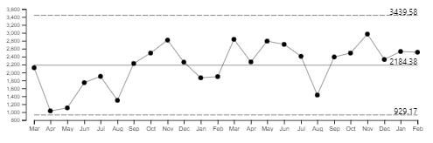
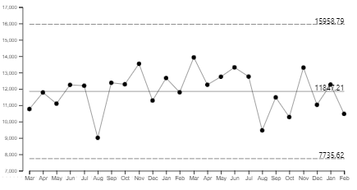
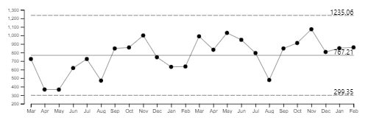
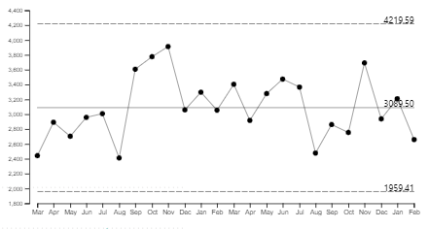
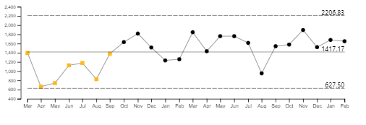
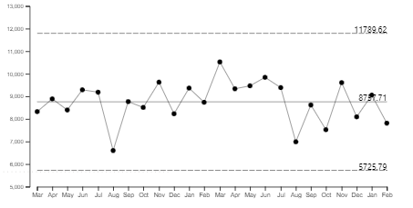
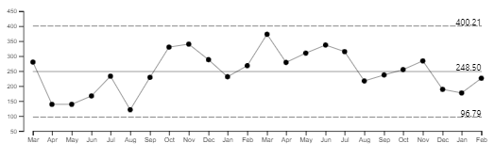
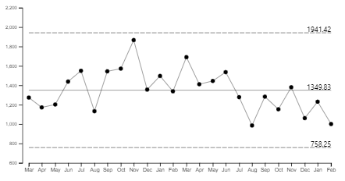
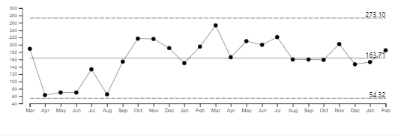
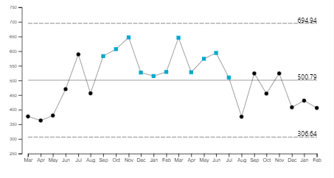
Patient Activity and Demand Overview: Community referrals and appointments
 | Referrals |  |  |  |  | Appointments
Specialty | Trend over time | Activity this month | SPC Analysis Variation | 2019/20 average | +/-% | Trend over time | Activity in month | SPC Analysis Variation | 2019/20 average | +/-%
Children and Young People - CAMHS |  | 2,511 |  | 2,076 | +23% |  | 10,474 |  | 9,996 | +5%
Buckinghamshire |  | 860 |  | 615 | +40% |  | 2,659 |  | 2,203 | +21%
Oxfordshire & BSW |  | 1,651 |  | 1460 | +13% |  | 7,815 |  | 7793 | 0%
Children and Young People - Neuro Developmental Services |  | 226 |  | 295 | -23% |  | 1,001 |  | 1271 | -21%
Buckinghamshire |  | 185 |  | 185 | 0% |  | 406 |  | 399 | +2%

Slide 9
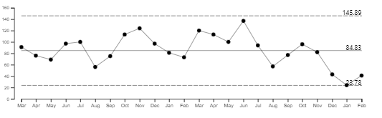
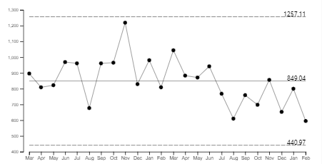
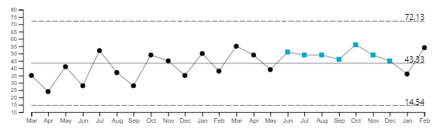
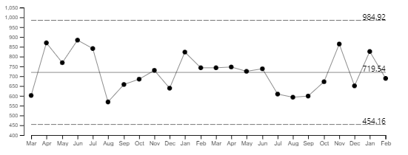
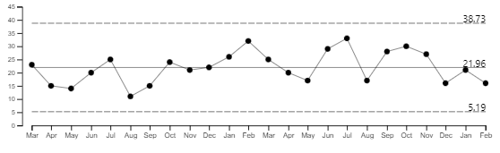
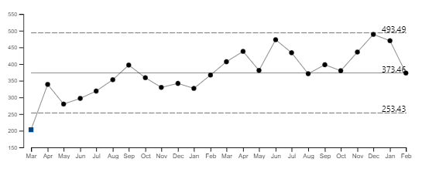
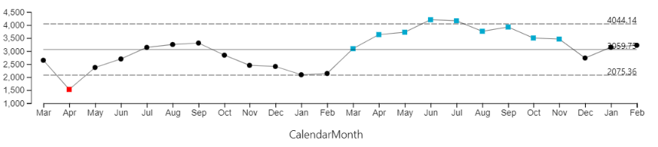
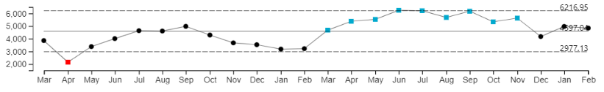
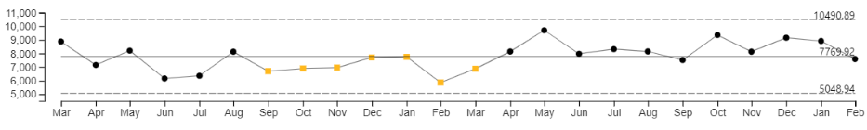
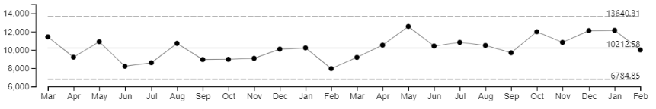
Patient Activity and Demand Overview: Community referrals and appointments
 | Referrals |  |  |  |  | Appointments
Specialty | Trend over time | Activity in month | SPC Analysis Variation | 2019/20 average | +/-% | Trend over time | Activity in month | SPC Analysis Variation | 2019/20 average | +/-%
Oxfordshire & BSW |  | 41* |  | 110 | -63% |  | 595 |  | 871 | -32%
Learning Disabilities |  | 54 |  | 43 | +26% |  | 689 |  | 692 | 0%
Forensics |  | 16 |  | 21 | -24% |  | 373 |  | 175 | +113%
Dental | Not available data not yet in warehouse | 329 | SPC not available | 762 | -57% | Not available data not yet in warehouse | 1,574 | SPC not available | 1,926 | -18%
IAPT | Not available data not yet in warehouse | 2,738 | SPC not available | 2,429 | +13% | Not available data not yet in warehouse | 13,011 | SPC not available | 8,785 | +48%
MIU |  | 3,206 |  | 3,642 | -12% |  | 4,839 |  | 5,201 | -7%
OOH |  | 7,587 |  | 9,255 | -18% |  | 10,001 |  | 12,333 | -19%
*Oxon NDC: concerns data quality issues identified – service manager starting piece of work with P&I team as significant markers are incorrect,; this includes number of referrals, waits, etc; team has a significant number of vacancies (over 20% of clinical team)

Slide 10
Section 2b:
Inpatient Patient Activity and Demand
Inpatient admissions and length of stay overview and noteworthy exceptions

Slide 11
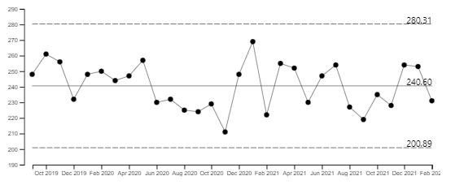
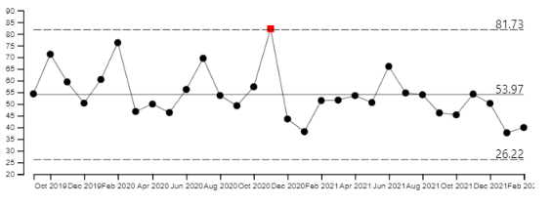

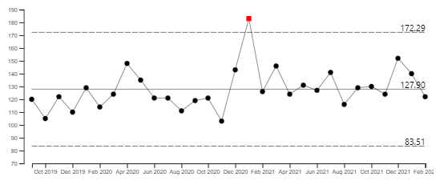
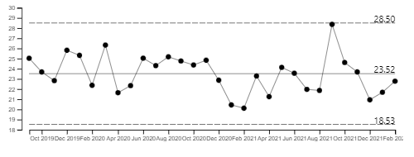

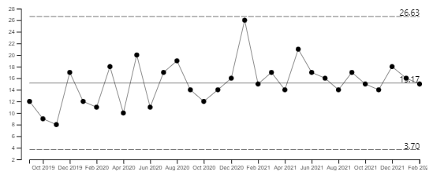
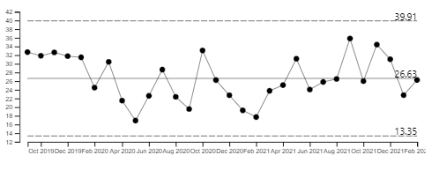
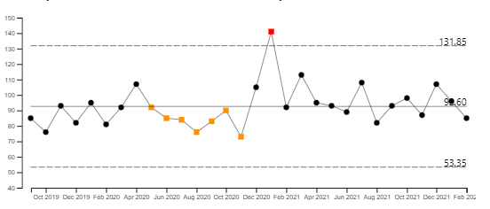
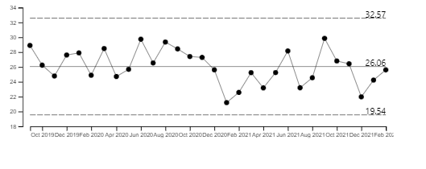
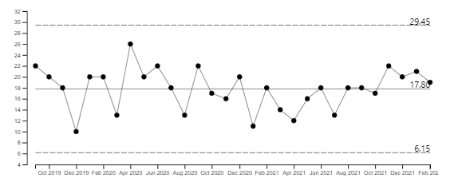
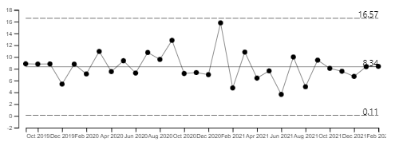
Patient Activity and Demand Overview: Inpatient admissions and length of stay (LOS)
 | Admissions |  |  |  |  | Length of Stay (exc leave/delay)
Specialty | Trend over time | Activity this month | SPC Analysis Variation | 2019/20 average | +/-% | Trend over time | Activity in month | SPC Analysis Variation | Assurance | 2019/20 average | +/-%
Trust |  | 231 |  | 242 | -5% |  | 40 |  | Positive improvement v 19/20 | 65 | -38%
Community Services |  | 122 |  | 112 | +9% |  | 23 |  | Positive improvement v 19/20 | 25 | -8%
Community Stroke |  | 15 |  | 13 | +15% |  | 26 |  | Positive improvement v 19/20 | 29 | -10%
Community Rehab |  | 85 |  | 80 | +6% |  | 26 |  | Positive improvement v 19/20 | 27 | -4%
Community EMU |  | 19 |  | 18 | +6% |  | 8 |  | Positive improvement v 19/20 | 9 | -11%

Slide 12
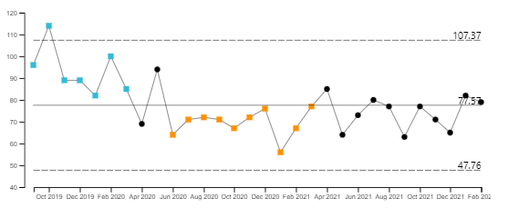

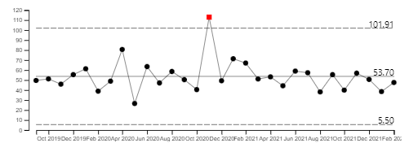

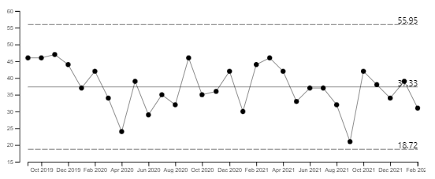
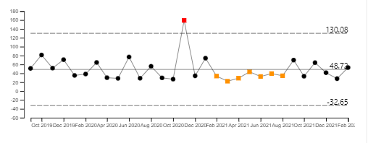
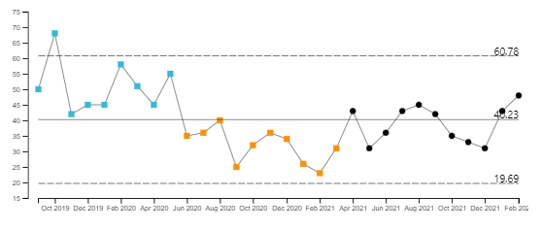
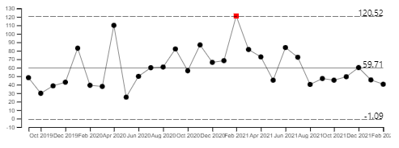
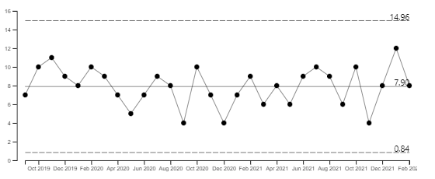



Patient Activity and Demand Overview: Inpatient admissions and length of stay (LOS)
 | Admissions |  |  |  |  | Length of Stay
Specialty | Trend over time | Activity in month | SPC Analysis Variation | 2019/20 average | +/-% | Trend over time | Activity in month | SPC Analysis Variation | Assurance | 2019/20 average | +/-%
Adult Mental Health |  | 79 |  | 91 | -13% |  | 48 |  | Positive improvement v 19/20 | 51 | -6%
Buckinghamshire (inc Opal) |  | 31 |  | 41 | -24% |  | 53 |  | Positive improvement v 19/20 | 57 | -7%
Oxfordshire |  | 48 |  | 50 | -4% |  | 41 |  | Positive improvement v 19/20 | 46 | -11%
CYP Mental Health (information presented is OHFT provision only, use of resources is managed as part of a provider collaborative) |  | 8 |  | 9 | -11% |  | 134 |  | Worsening position v 19/20 | 81 | +65%
Eating Disorders (information presented is OHFT provision only, use of resources is managed as part of a provider collaborative) |  | 4 |  | 7 | -43% |  | 137 |  | Worsening position v 19/20 | 76 | +80%

Slide 13









Patient Activity and Demand Overview: Inpatient admissions and length of stay (LOS)
 | Admissions |  |  |  |  | Length of Stay
Specialty | Trend over time | Activity in month | SPC Analysis Variation | 2019/20 average | +/-% | Trend over time | Activity in month | SPC Analysis Variation | Assurance | 2019/20 average | +/-%
Older Adult Mental Health |  | 11 |  | 15 | -27% |  | 63 |  | Positive improvement v 19/20 | 85 | -26%
Buckinghamshire |  | 2 |  | 7 | -71% |  | 59 |  | Positive improvement v 19/20 | 75 | -21%
Oxfordshire |  | 9 |  | 8 | +13% |  | 67 |  | Positive improvement v 19/20 | 92 | -27%
Forensic |  | 7 |  | 5 | +40% |  | 196 |  | Positive improvement v 19/20 | 915 | -79%

Slide 14





Patient Activity and Demand Overview: Inpatient bed occupancy
 | Bed Occupancy
Specialty | Trend over time | Activity this month | SPC Analysis Variation | 2019/20 | Variance*
Adult Mental Health |  | 84.73% |  | 91.8% | -8%
Buckinghamshire |  | 85.60% |  | 93.0% | -8%
Oxfordshire |  | 84.10% |  | 91.0% | -8%
CYP Mental Health (information presented is OHFT provision only, use of resources is managed as part of a provider collaborative) |  | 76.90% |  | 73.6% | +4%
Eating Disorders (information presented is OHFT provision only, use of resources is managed as part of a provider collaborative) |  | 62.23% |  | 74.1% | -16%

Slide 15




Patient Activity and Demand Overview: Inpatient bed occupancy
 | Bed Occupancy
Specialty | Trend over time | Activity this month | SPC Analysis Variation | 2019/20 | Variance*
Older Adult Mental Health |  | 94.57% |  | 90.6% | +4%
Buckinghamshire |  | 95.18% |  | 92.0% | +3%
Oxfordshire |  | 94.13% |  | 89.7% | +5%
Forensic |  | 88.26% |  | 87.0% | +1%
* Data for Community Hospitals bed occupancy not currently available

Slide 16
Section 2c:
Community & Inpatient Patient Activity and Demand
Narrative regarding noteworthy exceptions

Slide 17




Patient Activity and Demand: Community Services Noteworthy exceptions
Specialty / Directorate | Currency / Service Line | Trend over time | Activity in month | SPC Analysis Variation | 2019/20 average | +/-%* | Commentary
Community Services Care Home Support Service | Referrals: Care Home Support Service |  | 289 |  | 141 | +105% | Is performance within usual levels? No referral numbers for the last 13 months have been above average and on or near the UCL. Is it expected? Yes, during COVID there was limited access to Care Homes. The service now receiving far higher volumes of referrals than pre pandemic levels, in Feb 105% more than 19/20 average. Development of new care homes has also placed additional pressures on the service. It is a problem? Yes, the staffing levels have not increased in line with this increased demand. Is any action required? Yes, the service is seeking to develop a business case to reflect this increased demand.
Community Services Community Health Urgent Care | Referrals: EMUs, RACU, H@H |  | 503 |  | 487 | +3% | Is performance within usual levels? No referral numbers for the last 10 months have been above average (see visual). In addition the service has seen emergency referrals above the UCL for the last 3 months. Is it expected? Yes, the average is impacted by lower referral numbers during pandemic It is a problem? Yes for EMU and RACU CBYC (calls before you convey) and SDEC (same day emergency care) will increase demand. For H@H there is and will be increasing demand due to CBCY for more complex patients to be treated in the community. Is any action required? Ongoing monitoring
Community Services Diabetes | Referrals: Diabetes |  | 316 |  | 317 | 0% | Is performance within usual levels: Referrals for the last 14 months have been higher than average. Is it expected? Yes, services saw a reduction in referrals during initial Covid waves. More patients living with diabetes are now wanting a refresher on how to manage this long term condition. It is a problem? No Is any action required? No, ongoing monitoring.
Community Services District Nursing | Referrals: District Nursing |  | 2839 |  | 2409 | +18% | Is performance within usual levels? No referral numbers for the last 7 months have been below average. This is across all referral urgencies. The average is impacted by a surge in referrals between Aug and Dec 2020. Is it expected? Yes as above data impacted by surge post lockdown. It is a problem? Yes the service is receiving higher volumes of referrals than pre-pandemic (+18% in Feb). The service remains on level red 1 escalation due to capacity concerns and increased caseload complexity to meet the demand. Is any action required? Ongoing

Slide 18




Patient Activity and Demand: Community Services Noteworthy exceptions
Specialty / Directorate | Currency / Service Line | Trend over time | Activity in month | SPC Analysis Variation | 2019/20 average | +/-%* | Commentary
Community Services Phlebotomy | Referrals: Phlebotomy |  | 126 |  | 139 | -9% | Is performance within usual levels? No referral numbers for the last 11 months below average with some months below the LCL. This relates to routine referrals. Is it expected? Yes – this has been impacted by the supply chain affecting the stock of blood tubes It is a problem? No concerns to raise Is any action required? Ongoing monitoring of situation re national supply chain issues.
Community Services Community Therapy Service | Emergency & Urgent Referrals: CTS |  | 5 |  | 84 | -94% | Is performance within usual levels? No referral numbers for Emergency referrals for the last 15 months below average with some months below the LCL (see visual). Urgent referrals have been below average for the last 7 months. Is it expected? Yes, there has been a change in the type of referrals which CTS service receive following development of urgent care pathways It is a problem? No Is any action required? Ongoing monitoring
Community Services Childrens Integrated Therpies | Urgent Referrals: CIT |  | 108 |  | 25 | +332% | Is performance within usual levels? No referral numbers for Urgent referrals for the last 11 months above average with some months above the UCL (see visual). Is it expected? Yes​ It is a problem? No concerns to raise​ Is any action required? CIT has been undergoing a full service review and are in the process of developing a business case and proposing a new model of care
Community Services Respiratory | Emergency Referrals: Respiratory |  | 62 |  | 7 | +786% | Not required first month outside normal process limit, monitor position.

Slide 19



Patient Activity and Demand: Community Services Noteworthy exceptions
Specialty / Directorate | Currency / Service Line | Trend over time | Activity in month | SPC Analysis Variation | 2019/20 average | +/-%* | Commentary
Community Services Tissue Viability | Emergency Referrals: Tissue Viability |  | 96 |  | 13 | +638% | Is performance within usual levels? No referral numbers for Emergency referrals for the last 5 months above UCL. Urgent referrals have been above UCL for last 2 months. Routine referral volumes have decreased and have been below LCL for the last 5 months. Is it expected? Yes, the service has been responding to higher levels of activity to support the DN service which is currently on Red Level 1 escalation due to capacity concerns vs demand/complexity. It is a problem? Yes, across all DN and community nursing service lines a review of contacts/service specifications and negotiation with CCG is required. Is any action required? Yes, review as above has commenced. A woundcare recovery plan is being agreed for the DN service.
Community Services SPA | Routine Referrals: SPA |  | 86 |  | 139 | -38% | Is performance within usual levels? No referral numbers for Routine referrals for the last 7 months below average. Overall all urgencies combined the referral numbers to SPA are in line with averages. Is it expected? No It is a problem? No Is any action required? No. however, this is likely to indicate an increase in acuity of DN/CTS activity.
Community Services Out of Hours Services | Referrals: Out of Hours Banbury |  | 41 |  | 313 | -87% | Not required first month outside normal process limit, monitor position.

Slide 20




Patient Activity and Demand: Community Services Noteworthy exceptions
Specialty / Directorate | Currency / Service Line | Trend over time | Activity in month | SPC Analysis Variation | 2019/20 average | +/-%* | Commentary
Community Services Out of Hours Services | Referrals: Out of Hours Henley |  | 10 |  | 87 | -89% | Is performance within usual levels? No referral numbers for the last 9 months below average. Is it expected? Yes, all referrals managed via countywide telephone triage since start of Covid 19 It is a problem? No Is any action required? No
Community Services Minor Injuries Unit | Appointments: MIU Henley |  | 918 |  | 963 | -5% | Is performance within usual levels? No appointment numbers for the last 10 months below average. Is it expected? Yes and expected to see increase appointments as part of seasonal variation over summer It is a problem? Yes Is any action required? Yes, QI project to review MIU capacity and demand in process
Community Services Out of Hours | Appointments: Out of Hours Witney |  | 459 |  | 867 | -47% | Is performance within usual levels? No, all appointment numbers for the last 7 months above average. Length of appointment times for telephone triage and face to face appointments at base taking longer due to Covid and increased acuity. Is it expected? Yes It is a problem? Yes, limited physical space to extend Is any action required? Site expansion (in process) and review of tariff costs (in process)
Community Services Community Hospitals | Admissions: Witney Wenrisc EMU Basket of Care |  | 10 |  | 18 | -44% | Is performance within usual levels: No for the last 3 months admission numbers for EMU BoC to Witney Wenrisc have been above the UCL. The variance in activity is in the process of being reviewed to understand cause/implications

Slide 21



Patient Activity and Demand: Community Services Noteworthy exceptions
Specialty / Directorate | Currency / Service Line | Trend over time | Activity in month | SPC Analysis Variation | 2019/20 average | +/-%* | Commentary
Community Services Care Home Support Service | Appointments: Care Home Support Service |  | 972 |  | 114 | +753% | Is performance within usual levels? No appointment numbers for the last 11 months have been above average and some months above the UCL. Is it expected? Yes, during COVID there was limited access to Care Homes. The service is now returning to business as usual. Additionally since Sept 2020 the service has been more accurately capturing all activity volumes Is it a problem? Yes, the staffing levels have not increased in line with this increased demand. Is any action required? Yes, the service is seeking to develop a business case to reflect this increased demand.
Community Services Respiratory Service | Appointments: Respiratory |  | 1815 |  | 1532 | +18% | Is performance within usual levels No appointment numbers for the last 14 months have been above average Is it expected? Yes, there has been an increase in service delivery in response to Covid. Is it a problem? None identified at this time Any action required? Ongoing monitoring
Community Services Diabetes Service | Appointments: Diabetes |  | 466 |  | 582 | -20% | Is performance within usual levels No appointment numbers for the last 11 months have been below average Is it expected? Yes, during covid the service carried additional caseload to support other services. This caseload is now being scaled back with each case being risk assessed and activity will now returned to expected norms. Additionally the education services offered by the service has not yet returned to pre-pandemic levels and currently issues with DNAs with average of 50/60%, in line with national average. Is it a problem? None identified at this time Any action required? Ongoing monitoring

Slide 22



Patient Activity and Demand: Bucks MH Noteworthy exceptions
Specialty / Directorate | Currency / Service Line | Trend over time | Activity in month | SPC Analysis Variation | 2019/20 average | +/-%* | Commentary
Bucks Adult Community ADHD & Autism Service | Referrals: Autism & ADHD teams combined |  | 103 |  | 43 | +188% | Is performance within usual levels? No referrals for the last 8 months have been above average, this relates to routine referrals Is it expected? Yes for ADHD as there is a national increase in demand of ADHD services. It is a problem? Yes, there are currently several hundred people on both ASD and ADHD waiting lists. Any action required? Yes, papers being drafted to increase permanent and temporary staffing.
Bucks Adult Community Perinatal Team | Referrals: Perinatal Team |  | 28 |  | 20 | +40% | Is performance within usual levels? No referrals for the last 9 months have been above average. Is it expected? Yes, In line with LTP ambition there is an expectation to increase numbers of women seen and Services are now at a point whereby demand is outstripping capacity. As well as the challenge of increasing demand, expectations around the scope and breadth of patient groups and interventions on offer have also increased. It is a problem? Yes. Not expanding services at this rate not only limits BOB’s ability to meet access requirements to treat and care for more women and partners but is also having an adverse impact on existing service delivery and workforce. Staff sickness has increased in recent months Any action required? Ongoing monitoring, support service and workforce expansion in line with LTP.
Bucks Community Memory Assessment Service | Referrals: Memory Assessment Services |  | 170 |  | 143 | +19% | Is performance within usual levels? No referrals for the last 9 months have been above average Is it expected? Yes, the service experienced significant reduction in referrals during the first wave of Covid, impacting on historical trends. Added staffing pressures have resulted in reduced availability if appointments. It is a problem? No concerns to raised Any action required? Ongoing monitoring and continued recruitment efforts

Slide 23



Patient Activity and Demand: Bucks MH Noteworthy exceptions
Specialty / Directorate | Currency / Service Line | Trend over time | Activity in month | SPC Analysis Variation | 2019/20 average | +/-%* | Commentary
Bucks Adult Community ADHD Service | Appointments: ADHD Service |  | 83 |  | 32 | +159% | Is performance within usual levels? No appointments for the last 2 months have been above the UCL. Is it expected? Yes, activity is higher than in the previous years due to the ASD/ADHD waiting list initiative. It is a problem? Yes Referrals to the service are much higher than the commissioned resource which leads to a large number of patients with long waits. Any action required? Ongoing monitoring
Bucks Adult Community Perinatal pre-conception team | Appointments: Perinatal pre-conception team |  | 1 |  | 32 | -97% | Is performance within usual levels? No appointments for the last 7 months have been below average. Is it expected? Historically appointments although the pandemic has further impacted on the demand. Situation is expected to improve as social distancing restrictions are being relaxed. It is a problem? No Any action required? No Ongoing montioring
Bucks Adult Street Triage | Appointments: Street Triage team |  | 13 |  | 104 | -88% | Is performance within usual levels? No appointments for the last 8 months have been below average. Is it expected? Yes, there have been challenges for the team due to the Covid restrictions that have meant clinicians have been unable to with the same proximity to officers as they did previously. It is a problem? No. All calls are triaged by the clinicians and those service users who require an appointment, either face to face or telephone, will receive one. Other referrals are managed through signposting and advice. Any action required? None, although the service will change with the advent of the new tri-triage model of care.

Slide 24


Patient Activity and Demand: Bucks MH Noteworthy exceptions
Specialty / Directorate | Currency / Service Line | Trend over time | Activity in month | SPC Analysis Variation | 2019/20 average | +/-%* | Commentary
Bucks Adult Crisis Teams Combined | Appointments: Crisis Teams combined |  | 1012 |  | 400 | +153% | Is performance within usual levels? No appointment numbers have been above historical averages. This is driven by the CRHT from Oct 2020. Comparison against previous years is difficult due to service and system configuration changes which skew the data to some extent. Is it expected? The service delivery model has changed to increase telephone and digital consultations resulting in delivery of higher volume of appointments. It is a problem? There is a potential impact on the quality of appointments via telephone consultations. Is any action required? The service are encouraging more face to face and digital appointments so the position may reduce in coming months.
Bucks CAMHs Learning Disabilities | Appointments: CAMHS Learning Disabilities |  | 85 |  | 118 | -28% | Is performance within usual levels? No appointments for the last 7 months have been below average. Is it expected? Yes they have had significant staffing shortage with several vacancies, this has now improved. It is a problem? No Any action required? No

Slide 25



Patient Activity and Demand: Bucks MH Noteworthy exceptions
Specialty / Directorate | Currency / Service Line | Trend over time | Activity in month | SPC Analysis Variation | 2019/20 average | +/-%* | Commentary
Bucks Older Adult MH Memory Services | Appointments: Memory Services |  | 505 |  | 430 | +17% | Is performance within usual levels? No appointment numbers for the last 10 months have been above average with some months above or on UCL. Is it expected? Yes, the south teams have been delivery activity above commissioned levels to support reducing the wait for memory assessments. The service delivery model has changed to increase telephone and digital consultations resulting in delivery of higher volume of appointments. It is a problem? There is a potential impact on the quality of appointments via telephone consultations. Additionally, patients have chosen to wait longer as they did not want to have a digital consultation. Is any action required? The service are encouraging more face to face and digital appointments so the position may reduce in coming months. The service are exploring the model of delivery for memory services to support assessments in a timely manner and speed up provision of treatment
Bucks CAMHS OSCA | Appointments: OSCA |  | 285 |  | 192 | +48% | Is performance within usual levels: For the last 9 months appointment volumes for the OSCA Crisis and OSCA Outreach teams combined have been below average. This month activity is higher than average for FY 19/20. There has been variation in activity levels in last 2 years. Is it expected? Yes, there was surge period spike when schools returned following Covid restrictions. That activity was outside normal ranges and now they are seeing normal expected demand for the service. It is a problem? No Is any action required? Ongoing monitoring.
Bucks CAMHs Reconnect | Appointments: Reconnect |  | 80 |  | 52 | +54% | Is performance within usual levels? No appointment numbers for last 10 months have been above average with some months above UCL. Is it expected? Yes, due the decrease in referrals to the service during Covid and staff shortages it is difficult to compare activity. It is a problem? No the activity now being delivery is more in line with normal expectations. Is any action required? No

Slide 26

Patient Activity and Demand: Bucks MH Noteworthy exceptions
Specialty / Directorate | Currency / Service Line | Trend over time | Activity in month | SPC Analysis Variation | 2019/20 average | +/-%* | Commentary
Bucks CAMHs SPA | Appointments: CAMHS SPA |  | 212 |  | 116 | +83% | Is performance within usual levels? No appointments for the last 7 months have been below average. Is it expected? The data is impacted by a surge following end of lockdown. The SPA continues to operate in same practice of offering triage and consultations. It is a problem? No Any action required? No

Slide 27



Patient Activity and Demand: Oxon & BSW Noteworthy exceptions
Specialty / Directorate | Currency / Service Line | Trend over time | Activity in month | SPC Analysis Variation | 2019/20 average | +/-%* | Commentary
Oxon & BSW Adults Community | Referrals: ADHD |  | 3 |  | 11 | -73% | Is performance within usual levels? No referral numbers for the last 12 months have been below average, this relates to routine referrals. Is it expected? See below It is a problem? Unfortunately we have found issues within admin processes which mean referrals haven’t been correctly added to Care Notes – this is now being urgently addressed. The team do keep a spreadsheet which shows the following referral numbers: October ‘21 = 62 November ‘21 = 180 December ’21 = 118 January ‘22 = 134 February ‘22 = 94 Is any action required? As above
Oxon & BSW Adults Community | Emergency Referrals: North & West Oxon Assessment Team |  | 1 |  | 3 | -67% | Is performance within usual levels? No referral numbers for Emergency referrals for the last 8 months have been below average. Is it expected? See below It is a problem? The drop correlates with the commencement of use of the ereferral forms which clearly documents the referral timeframes – the expectation is that GPs are now referring to the appropriate urgency Is any action required None
Oxon & BSW Adults Community | Referrals: EIS Service (Urgent & Routine) |  | 1 |  | 11 | -91% | Is performance within usual levels? No referral numbers for Urgent referrals for the last 14 months have been below average (see visual). In contrast the volume of routine referrals has been above average for the last 7 months. With numbers for urgencies combined in line with averages. Is it expected? See below It is a problem? We aim to deal with referrals as quickly as we can due to the Referral to Treatment target so Assessment Function clinicians do have conversations about referrals which may explain why the majority are recorded as routine. Having built relationships with surgeries and AMHTs there are more informal discussions about referrals. Is any action required None

Slide 28




Patient Activity and Demand: Oxon & BSW Noteworthy exceptions
Specialty / Directorate | Currency / Service Line | Trend over time | Activity in month | SPC Analysis Variation | 2019/20 average | +/-%* | Commentary
Oxon & BSW Adults Community | Urgent Referrals: AMHO South Assessment Team |  | 39 |  | 46 | -15% | Is performance within usual levels? No referral numbers for Urgent referrals for the last 9 months have been below average. Is it expected? See below It is a problem? The drop correlates with the commencement of use of the e-referral forms which clearly documents the referral timeframes – the expectation is that GPs are now referring to the appropriate urgency Is any action required None
Oxon & BSW Adults Community | Urgent Referrals: AMHO South Treatment Team |  | 2 |  | 6 | -67% | Is performance within usual levels? No referral numbers for Urgent referrals for the last 11 months have been below average. Is it expected? See below It is a problem? The drop correlates with the commencement of use of the e-referral forms which clearly documents the referral timeframes – the expectation is that GPs are now referring to the appropriate urgency Is any action required None
Oxon & BSW Adults Community | Referrals; SCAS Triage |  | 351 |  | 42 | +736% | Is performance within usual levels? No referral numbers for the last 13 months have been above or near the UCL based on last 2.5 years. Is it expected? Yes this is as a result of planned development of services. The SCAS service is a new service fully operational 24/7 from Dec 2020, alongside Home Treatment/CRHT which commenced in July 2020. Both of these have lead to the increase in referrals and appointments shown in the data It is a problem? No Is any action required? No
Oxon & BSW Adults Community | Appointments: AMHO Specialist Psychological Intervention Treatment Team |  | 45 |  | 5 | +800% | Is performance within usual levels: For the last 9 months appointment volumes for routine referrals have been above average. The variance in activity is in the process of being reviewed to understand cause/implications

Slide 29


Patient Activity and Demand: Oxon & BSW Noteworthy exceptions
Specialty / Directorate | Currency / Service Line | Trend over time | Activity in month | SPC Analysis Variation | 2019/20 average | +/-%* | Commentary
Oxon & BSW Older Adults | Referrals: Memory Assessment Services |  | 150 |  | 113 | +33% | Is performance within usual levels: For the last 12 months referral volumes have been above average. Is it expected? Yes, during the first wave of Covid there was a reduction in referrals made for memory assessments. It is a problem? Yes capacity issues within CMHTs to meet the demand. This is a long capacity gap since removal of S75 and lack of investment in service over a significant time frame. Is any action required? SBARD completed to increase resources across the CMHTs awaiting funding decision.
Oxon & BSW Older Adults | Referrals: Old Adult CMHTs |  | 145 |  | 129 | +12% | Is performance within usual levels: For the last 9 months referral volumes for routine referrals have been above average. The service has also seen a decline in the number of Urgent referrals, for the last 15 months these have been below average. Is it expected? It is a surprise that there hasn’t been an increase in urgent as the teams feels much busier and the acuity feels higher. But the fact that there is an increase In routine referrals is expected especially when the normal supports routes to patients such as GP aren’t or charity / 3rd sector aren’t as available. Triage has also been reviewed and is stricter meaning that there may be more focus on criteria and downgrading more as a result, this is linked to the business in the team. In addition within the improvements and need to manage triage better a number of routine/ urgent referrals will be responded to in a 2 week window as the triaged acuity is not so risky that the response needs to be within 7 days but to risk to wait for 28 days. It is a problem? The overall capacity of the teams, which have not changed for 12 years and the evident ongoing increase in demand has been significant. The current level of operation is not sustainable if there isn’t urgent investment into the OA services. Is any action required? There is currently a QI project which requires support in terms of looking the skills and knowledge around triage as well as the quality of referrals and the work is going to include a clear process around supporting GPs and referrers to appropriately refer.

Slide 30


Patient Activity and Demand: Oxon & BSW Noteworthy exceptions
Specialty / Directorate | Currency / Service Line | Trend over time | Activity in month | SPC Analysis Variation | 2019/20 average | +/-%* | Commentary
Oxon & BSW Urgent Care | Appointments: SCAS Triage |  | 320 |  | 116 | +176% | Is performance within usual levels? No appointment numbers for the last 14 months have been above or near the UCL based on last 2.5 years. Is it expected? Yes this is as a result of planned development of services. The SCAS service is a new service fully operational 24/7 from Dec 2020, alongside Home Treatment/CRHT which commenced in July 2020. Both of these have lead to the increase in referrals and appointments shown in the data It is a problem? No Is any action required? No
Oxon & BSW Complex Needs | Appointments: Complex Needs |  | 46 |  | 257 | -82% | Is performance within usual levels? No; appointment numbers for the last 9 months have been below the LCL. Throughout the Covid period there has been a decline in activity delivered in the Complex Needs service. Is it expected/a problem? Activity has been reduced to be down due to a change in Carenotes configuration to make processes less time consuming for clinicians. As a service we have expanded provision with the service changes. The configuration changes have taken a while to be implemented and as a result some activity has not been recorded. Is any action required? Work is progressing to resolve the system configuration. The new episodes are now on TOBI and work ongoing with CAST to transfer the historical data

Slide 31


Patient Activity and Demand: Oxon & BSW Noteworthy exceptions
Specialty / Directorate | Currency / Service Line | Trend over time | Activity in month | SPC Analysis Variation | 2019/20 average | +/-%* | Commentary
Oxon & BSW CAMHS | Appointments: Oxon Getting Help Teams (combined) |  | 534 |  | 639 | -16% | Is performance within usual levels: For the last 7 months appointments volumes have been below average. Is it expected? Yes It is a problem? Team has significant vacancies and levels of sickness. With some staff having reduced work loads due to return to work plans and on going medication reasons. Due to long treatment waiting lists, assessments and commenced of treatment has been slowed to provide capacity for the development of the group work programme. The service is looking to ensure al staff have been accurately recording their activity. Is any action required? Yes as follows: Some staff returning to work with support Ongoing recruitment drive Team regularly reminded of importance of appropriate data recording, including case management and team meetings. Once group plan ready to launch, performance expected to increase although still unclear if able to return to previous performance if no further recruitment occurs.
Oxon & BSW CAMHS | Appointments: Oxon MHST (combined) |  | 404 |  | 35 | +1054% | Is performance within usual levels: For the last 2 months appointments volumes have been above the UCL. Is it expected? New team manager in place, who is reviewing all processes, including that all activity is recorded, and also providing clear expectations re: job plan and contacts It is a problem? No Is any action required? Ongoing monitoring to ascertain if current number of contacts is sustainable in the longer term, given that the team had significant capacity to pick up a significant number of new cases

Slide 32




Patient Activity and Demand: Oxon & BSW Noteworthy exceptions
Specialty / Directorate | Currency / Service Line | Trend over time | Activity in month | SPC Analysis Variation | 2019/20 average | +/-%* | Commentary
Oxon & BSW CAMHS O Perinatal | Appointments: Oxon CAMHS O Perinatal |  | 60 |  | 34 | +76% | Is performance within usual levels? No appointment numbers for the last 10 months have been below average based on last 2.5 years. Is it expected? Yes - Some sickness in team and some vacancy / Data quality issues; clinicians not recording all appts – mainly indirect / Ineffective processes within service pathway – now reviewed clarified and improved. It is a problem? Yes Is any action required? Yes – see below • Consistent standardised case management • Office manager supporting admin to improve • Deep dive into care notes to ensure accurate and up to date • Improved focus on wait and throughput
Oxon & BSW CAMHS S Swindon ED GMH | Appointments: BSW CAMHS S Swindon ED GMH |  | 100 |  | 34 | +194% | Is performance within usual levels? No appointment numbers for the last 13 months have been above average based on last 2.5 years. The variance in activity is in the process of being reviewed to understand cause/implications.
Oxon & BSW CAMHS S Swindon GMH | Appointments: BSW CAMHS S Swindon GMH |  | 409 |  | 557 | -27% | Is performance within usual levels? No appointment numbers for the last 7 months have been below average based on last 2.5 years. The variance in activity is in the process of being reviewed to understand cause/implications.
Oxon & BSW CAMHS S Swindon LD GMH | Appointments: BSW CAMHS S Swindon LD GMH |  | 38 |  | 109 | -65% | Is performance within usual levels? No appointment numbers for the last 7 months have been below average based on last 2.5 years. The variance in activity is in the process of being reviewed to understand cause/implications

Slide 33





Patient Activity and Demand: Oxon & BSW Noteworthy exceptions
Specialty / Directorate | Currency / Service Line | Trend over time | Activity in month | SPC Analysis Variation | 2019/20 average | +/-%* | Commentary
Oxon & BSW CAMHS S Swindon OSCA Risk | Appointments: BSW CAMHS S Swindon OSCA Risk |  | 12 |  | 144 | -74% | Is performance within usual levels? No appointment numbers for the last 10 months have been below average based on last 2 years. The variance in activity is in the process of being reviewed to understand cause/implications
Oxon & BSW CAMHS S YOT | Appointments: BSW CAMHS S YOT |  | 31 |  | 18 | +33% | Is performance within usual levels? No appointment numbers for the last 2 months have been above the UCL. The variance in activity is in the process of being reviewed to understand cause/implications
Oxon & BSW CAMHS W & BaNES FASS GMH | Appointments: BSW CAMHS W & BaNES FASS GMH |  | 39 |  | 28 | +39% | Is performance within usual levels? No appointment numbers for the last 1 months have been below average based on last 2 years The variance in activity is in the process of being reviewed to understand cause/implications
Oxon & BSW CAMHS W BaNES GMH | Appointments: BSW CAMHS W BaNES GMH |  | 156 |  | 272 | -43% | Is performance within usual levels? No appointment numbers for the last 9 months have been below average. The variance in activity is in the process of being reviewed to understand cause/implications
Oxon & BSW CAMHS W BaNES Liaison Risk | Appointments: BSW CAMHS W BaNES Liaison Risk |  | 47 |  | 49 | -4% | Is performance within usual levels? No appointment numbers for the last 9 months have been below average. The variance in activity is in the process of being reviewed to understand cause/implications

Slide 34





Patient Activity and Demand: Oxon & BSW Noteworthy exceptions
Specialty / Directorate | Currency / Service Line | Trend over time | Activity in month | SPC Analysis Variation | 2019/20 average | +/-%* | Commentary
Oxon & BSW CAMHS W BaNES MHST CO | Appointments: BSW CAMHS W BaNES MHST CO |  | 92 |  | 0 | n/a new service | Is performance within usual levels? No appointment numbers for the last 2 months have been above the UCL. The variance in activity is in the process of being reviewed to understand cause/implications
Oxon & BSW CAMHS W BaNES OSCA Risk | Appointments: BSW CAMHS W BaNES OSCA Risk |  | 32 |  | 97 | -67% | Is performance within usual levels? No appointment numbers for the last 2 months have been above the UCL. The variance in activity is in the process of being reviewed to understand cause/implications
Oxon & BSW CAMHS W BaNES SPOC | Appointments: BSW CAMHS W BaNES SPOC |  | 14 |  | 1 | +1300% | Not required first month outside normal process limit, monitor position.
Oxon & BSW CAMHS W Melksham SPOC | Appointments: BSW CAMHS W Melksham SPOC |  | 1 |  | 6 | -83% | Is performance within usual levels? No appointment numbers for the last 7 months have been below average The variance in activity is in the process of being reviewed to understand cause/implications
Oxon & BSW CAMHS W Sailsbury ED GMH | Appointments: BSW CAMHS W Sailsbury ED GMH |  | 141 |  | 61 | +131 | Is performance within usual levels? No appointment numbers for the last 7 months have been below average The variance in activity is in the process of being reviewed to understand cause/implications

Slide 35


Patient Activity and Demand: Oxon & BSW Noteworthy exceptions
Specialty / Directorate | Currency / Service Line | Trend over time | Activity in month | SPC Analysis Variation | 2019/20 average | +/-%* | Commentary
Oxon & BSW CAMHS Wiltshire OSCA RISK | Appointments: CAMHS Wiltshire OSCA RISK |  | 34 |  | 429 | -92% | Is performance within usual levels? No appointment numbers for the last 11 months have been below average and last 3 below the LCL. Is it expected? Yes – a lot of the work previously done under Wiltshire OSCA is now picked up by the Liaison team. The Wilts Liaison team currently sits elsewhere in the team hierarchy (not in Wiltshire Risk) It is a problem? No Is any action required? No action required
Oxon & BSW Inpatients | Admissions Older Adult Cherwell Ward |  | 3 |  | 5 | -40% | Is performance within usual levels? No admission numbers for the last 8 months have been below average Is it expected? admissions have been based on the requests for beds. during February there were 2 other OA admission who were accommodated in other inpatient settings due to lack of capacity on Cherwell It is a problem? Potentially a challenge to appropriate care settings for admission due to challenge with care package and care home provision to expedite discharge. (eg one lady has been declined by 15 care homes) High levels of observation on the ward through February and March has also meant even if there has been a bed it has not always been safe to admit. Is any action required? Challenging around discharges continue to be escalated at the weekly system silver call

Slide 36


Patient Activity and Demand: Inpatient Noteworthy exceptions
Specialty / Directorate | Currency / Service Line | Trend over time | Activity in month | SPC Analysis Variation | 2019/20 average | +/-%* | Commentary
Specialised Services: Forensic Community | Appointments: Overall |  | 349 |  | 175 | +99% | Is performance within usual levels? No appointment numbers for the last 10 months have been above average based on last 2.5 years. This is driven mainly by the TV Pathfinder Team (since Sept 2020) Is it expected? Yes, the service had not previously captured their activity on Carenotes, this changed from Sept 2020 hence the increase in activity reported. It is a problem? No Is any action required? No
Specialised Services: Forensic Community | Appointments: FIND Team |  | 24 |  | 16 | +50% | Is performance within usual levels? No appointment numbers for the last 12 months have been below average based on last 2 years. FINDS was established in April 2019 and the first year we tended to attend face to face meetings across Thames valley and Wessex so often were attending 1 meeting a day daily, it also took some months to be established. FINDS now attend meetings virtually and have more referrals for consultations. We have also been putting in contacts to follow up referrals, which we were not always recording in our first year. ​ Is it expected? Yes​ It is a problem? No​ Is any action required? No

Slide 37


Patient Activity and Demand: Inpatient Noteworthy exceptions
Specialty / Directorate | Currency / Service Line | Trend over time | Activity in month | SPC Analysis Variation | 2019/20 average | +/-%* | Commentary
Specialised Services: Forensic Community | Appointments: Forensic Pathfinder Team |  | 65 |  | 1.25 | +5100% | As per overall appointments comment
Specialised Services: Forensic Community | Appointments: Forensic Oxford Clinic Clinical Team |  | 10 |  | 10 | 0% | Is performance within usual levels: For the last 8 months appointment volumes have been below average. Is it expected? Yes​ It is a problem? No​ Is any action required? This relates to a data migration issue. The Oxford Community team is now under ‘Forensic Oxon Community Team’ and the ‘Oxford Clinic Clinical Team’ was discontinued as part of the data clean up, but there are some ongoing data migration issues to work through

Slide 38
Section 3:
Waiting Lists and Waiting Times to generic waiting time standards
Information on
the number of patients waiting to be seen by referral urgency and
the waiting times for patients who were seen in February

Slide 39


Waiting Times and Lists
Buckinghamshire Mental Health Directorate - Adults
Patients waiting – refreshed weekly
Patients seen in February
Indicator | No. | Trend
Emergency referrals waiting for their first contact >48 hours after referral | 0 | ⬇
Last week’s position | 1
Indicator | No. | Trend
Urgent referrals waiting for their first contact >7 days after referral | 3 | ⬆
Last week’s position | 0
Referral urgency | Pts seen | Pts Seen in Time (Generic) | Median Wait | % seen <target
Emergency | 94 | 94 | 1 hour | 100%
Urgent | 280 | 280 | 10 hours | 100%
Escalations: none
Escalations: below are the teams where urgent patients have been waiting >7 days
Monthly Trends Below
Exceptions: Emergency & Urgent referrals
None
The number of urgent patients waiting is increasing – see below

Slide 40


Waiting Times and Lists
Buckinghamshire Mental Health Directorate - CAMHS
Patients waiting – refreshed weekly
Patients seen in February
Indicator | No. | Trend
Emergency referrals waiting for their first contact >48 hours after referral | 0 | ➔
Last week’s position | 0
Indicator | No. | Trend
Urgent referrals waiting for their first contact >7 days after referral | 2 | ⬆
Last week’s position | 0
Referral urgency | Pts seen | Pts Seen in Time (Generic) | Median Wait | % seen <target
Emergency | 0
Urgent | 38 | 30 | 0 days | 100%
Escalations: none
Escalations: below are the teams where urgent patients have been waiting >7 days
Monthly Trends Below
Exceptions: Emergency & Urgent referrals
None
The number of emergency patients waiting has stabilising – none since May 2020 more than 48 hours
The number of urgent patients waiting is stabilising – see below

Slide 41


Waiting Times and Lists
Buckinghamshire Mental Health Directorate – Childrens & Young People NDC
Patients waiting – refreshed weekly
Patients seen in February
Indicator | No. | Trend
Routine referrals waiting for their first contact >28 days after referral | 2005 | ⬆
Last week’s position | 1992
Referral urgency | Pts seen | Pts Seen in Time (Generic) | Median Wait | % seen <target
Emergency
Urgent
Routine | 66 | 10 | 107 | 15%
Escalations: below are the teams where routine patients have been waiting >28 days
These teams only have routine referrals
Monthly Trends Below
Exceptions: Emergency & Urgent referrals
None The application of the generic 28 days is not an appropriate standard for NDC the above is provided for information only. Work is underway to develop measurement of waits against clinically meaningful standards for individual services. This will be available in Q4.
The number of routine patients waiting increased this month following trend of increasing waits and is above UCL– see below

Slide 42




Waiting Times and Lists
Oxon and BSW Mental Health Directorate - Adults
Patients waiting – refreshed weekly
Patients seen in February
Indicator | No. | Trend
Emergency referrals waiting for their first contact >48 hours after referral | 2 | ➔
Last week’s position | 2
Indicator | No. | Trend
Urgent referrals waiting for their first contact >7 days after referral | 48 | ⬆
Last week’s position | 39
Referral urgency | Pts seen | Pts Seen in Time (Generic) | Median Wait | % seen <target
Emergency | 247 | 242 | 1 hours | 98%
Urgent | 375 | 358 | 0 days | 95%
Escalations: below are the teams where emergency patients have been waiting >2 days
Escalations: below are the teams where urgent patients have been waiting >7 days (Top 8 teams)
Monthly Trends Below
Exceptions: Emergency & Urgent referrals
None
The number of emergency patients waiting decreased in February
The number of urgent patients waiting increased in February– see below

Slide 43





Waiting Times and Lists
Oxon and BSW Mental Health Directorate - CAMHS
Patients waiting – refreshed weekly
Patients seen in February
Indicator | No. | Trend
Emergency referrals waiting for their first contact >48 hours after referral | 4 | ⬇
Last week’s position | 5
Indicator | No. | Trend
Urgent referrals waiting for their first contact >7 days after referral | 31 | ⬇
Last week’s position | 38
Referral urgency | Pts seen | Pts Seen in Time (Generic) | Median Wait | % seen <target
Emergency | 45 | 42 | 2 hours | 93%
Urgent | 85 | 66 | 2 days | 78%
Escalations: below are the teams where emergency patients have been waiting >2 days
Escalations: below are the teams where urgent patients have been waiting >7 days
Monthly Trends Below
Exceptions: Emergency & Urgent referrals
Urgent referrals: 13% were seen within 14 days and 9% at longer than 14 days. The longest wait for an urgent referral was 69 days. Above shows further information on top 7 teams with longest waits on Urgent referrals seen in February.
The number of emergency patients waiting is decreasing – see below
The number of urgent patients waiting increased in February– see below

Slide 44


Waiting Times and Lists
Oxon and BSW Mental Health Directorate – Childrens and Young People NDC
Patients waiting – refreshed weekly
Patients seen in February
Indicator | No. | Trend
Routine referrals waiting for their first contact >28 days after referral | 2125 | ⬆
Last week’s position | 2113
Referral urgency | Pts seen | Pts Seen in Time (Generic) | Median Wait | % seen <target
Emergency
Urgent
Routine | 50 | 8 | 268 | 16%
Escalations: below are the teams where routine patients have been waiting >28 days
These teams only have routine referrals
Monthly Trends Below
Exceptions: Emergency & Urgent referrals
None The application of the generic 28 days is not an appropriate standard for NDC the above is provided for information only. Work is underway to develop measurement of waits against clinically meaningful standards for individual services. This will be available in Q4. The service have identified some data quality issues which they are working with P&I to address.
The number of routine patients waiting decreased this month following trend of increasing waits. Looks to be stabilising.

Slide 45




Waiting Times and Lists
Community Directorate
Patients waiting – refreshed weekly
Patients seen in February
Indicator | No. | Trend
Emergency referrals waiting for their first contact >48 hours after referral | 87 | ⬇
Last week’s position | 93
Indicator | No. | Trend
Urgent referrals waiting for their first contact >7 days after referral | 513 | ⬆
Last week’s position | 504
Referral urgency | Pts seen | Pts Seen in Time (Generic) | Median Wait | % seen <target
Emergency | 106 | 59 | 31 hours | 56%
Urgent | 971 | 811 | 1 day | 84%
Escalations: below are the teams where emergency patients have been waiting >2 days (Top 10 teams)
Escalations: below are the teams where urgent patients have been waiting >7 days (Top 10 teams)
Exceptions: Emergency & Urgent referrals
None The application of the generic wait times are not an appropriate standard for many services in the Community Directorate. Work is underway to develop measurement of waits against clinically meaningful standards for individual services. This will be available in Q4.
Monthly Trends Below
The number of emergency patients waiting is increasing – see below
The number of urgent patients waiting is increasing – see below

Slide 46
Waiting Times and Lists
Forensic Services
Patients waiting – refreshed weekly
Patients seen in February
Indicator | No. | Trend
Emergency referrals waiting for their first contact >48 hours after referral | 0 | ➔
Last week’s position | 0
Indicator | No. | Trend
Urgent referrals waiting for their first contact >7 days after referral | 0 | ⬇
Last week’s position | 1
Referral urgency | Pts seen | Pts Seen in Time (Generic) | Median Wait | % seen <target
Emergency
Urgent
Escalations: None
Escalations: none
Exceptions: Emergency & Urgent referrals
None
Monthly Trends Below

Slide 47
Waiting Times and Lists
Specialised – Learning Disability Services
Patients waiting – refreshed weekly
Patients seen in February
Indicator | No. | Trend
Emergency referrals waiting for their first contact >48 hours after referral | 0 | ➔
Last week’s position | 0
Indicator | No. | Trend
Urgent referrals waiting for their first contact >7 days after referral | 0 | ⬇
Last week’s position | 1
Referral urgency | Pts seen | Pts Seen in Time (Generic) | Median Wait | % seen <target
Emergency
Urgent | 3 | 2 | 2 days | 67%
Escalations: None
Escalations: None
Exceptions: Emergency & Urgent referrals
Urgent waits: 1 patient not seen in generic time of 7 days was seen within 11 days.
Monthly Trends Below

Slide 48
Section 4:
Contractual Performance – Key Performance Indicators

Slide 49

Contractual performance: Key Performance Indicators

Slide 50

Contractual performance: Key Performance Indicators

Slide 51

Contractual performance: Key Performance Indicators

Slide 52

3.1 Contractual performance: Key Performance Indicator breaches

Slide 53
Section 5:
Mental Health Long Term Plan (LTP) Performance Latest available data
Update as submitted to MH Oversight Group 17 March 2022)

Slide 54
MH Long Term Plan Metrics Performance – BOB overview
Indicator | BOB Target | Latest Published Date | BOB Current Month (Previous Month) |  | BUCKS Current Month (Previous Month) |  | OXON Current Month (Previous Month) |  | BERKS WEST Current Month (Previous Month)
Number of A&E 12 hr waits – Adult | n/a | Dec-21 | 55 (100) |  | 15 (15) |  | 30 (80) |  | 5
Percentage of A&E 12 hr waits – Adult | n/a | Dec-21 | 9% (14%) |  | 13% (11%) |  | 10% (22%) |  | 4%
Number of A&E 12 hr waits – CYP | n/a | Dec-21 | 5 (10) |  | n/a |  | 5 (5)% |  | n/a
Percentage of A&E 12 hr waits – CYP | n/a | Dec-21 | 5% (4%) |  | n/a |  | 6% (7%) |  | n/a
Discharges followed up within 72 hours | >80% | Nov-21 | 72% (77%) | ↓ | 73% (72%) | ↑ | 67% (76%) | ↓ | 77% (83%) | ↓
Acute admissions with no prior contacts - All inpatients | n/a | Nov-21 | 14% (14%) |  | 14% (14%) |  | 14% (13%) |  | 14% (14%)
Admissions With No Prior Contacts – BAME | n/a | Nov-21 | 17% (22%) |  | 24% |  | 19% (21%) |  | 24% (29%)
Admissions With No Prior Contacts - White British | n/a | Nov-21 | 11% (8%) |  | 12% (12%) |  | 11% (9%) |  | 11% (9%)
Community Mental Health access - 2+ Contacts | n/a | Nov-21 | 14,430 (14,425) |  | 4,805 (4,810) |  | 6,660 (6,645) |  | 2,995 (2,990)
CYP access - 1+ Contact | 20,083 | Nov-21 | 20,700 (20,515) | ↑ | 7,030 (7,020) |  | 7,165 (7,080) |  | 6,525 (6,435)
CYP Eating disorder waiting time – Routine | >95% | Dec-21 | 39% (48%) | ↓ | 37% (47%) | ↓ | 31% (39%) | ↓ | 72% (81%) | ↓
CYP Eating disorder waiting time – Urgent | >95% | Dec-21 | 57% (64%) | ↓ | 80% (80%) | - | 67% (77%) | ↓ | 48% (52%) | ↓
Dementia Diagnosis Rate | >66.7% | Jan-22 | 59% (59%) | - | 57% (57%) | - | 61% (61%) | - | 59% (59%) | -
* There are delays with NHSD publications resulting in national platforms not being fully updated and no data on new LTP metrics is yet available

Slide 55
MH Long Term Plan Metrics Performance – BOB overview
Indicator | BOB Target | Latest Published Date | BOB Current Month (Previous Month) |  | BUCKS Current Month (Previous Month) |  | OXON Current Month (Previous Month) |  | BERKS WEST Current Month (Previous Month)
Percentage of EIP referrals waiting 2 weeks or less | >60% | Nov-21 | 65% (68%) | ↓ | 80% (73%) | ↑ | 61% (74%) | ↓ | 57% (46%) | ↑
Percentage of IAPT referrals receiving an appointment within 6 weeks | >75% | Nov-21 | 99% (98%) | ↑ | 99% (98%) | ↑ | 99% (99%) | - | 97% (97%) | -
Percentage of IAPT referrals receiving an appointment within 18 weeks | >95% | Nov-21 | 100% (100%) | - | 100% (100%) | - | 100% (100%) | - | 100% (100%) | -
Percentage of first to second IAPT treatment over 90 days | <10% | Nov-21 | 10% (10%) | - | 2% (3%) | ↓ | 16% (16%) | - | 12% (11%) | ↑
IAPT access - over 65 years | n/a | Sep-21 | 610 (580) |  | 250 (225) |  | 205 (205) |  | 160 (150)
Number people accessing IAPT services – monthly | 3,374 | Nov-21 | 3,525 (2,900) | ↑ | 955 (880) | ↑ | 1,450 (1,190) | ↑ | 1,120 (830) | ↑
Number people accessing IAPT services - rolling quarter | 10,056 | Nov-21 | 9,295 (8,285) | ↑ | 2,775 (2,625) | ↑ | 3,700 (3,195) | ↑ | 2,820 (2,465) | ↑
IAPT Recovery Rate – monthly | >50% | Nov-21 | 51% (50%) | ↑ | 53% (54%) | ↓ | 47% (41%) | ↑ | 53% (54%) | ↓
IAPT Recovery Rate - Black, Asian and Minority Ethnic | n/a | Sep-21 | 50% (51%) |  | 54% (56%) |  | 45% (45%) |  | 50% (53%)
IAPT Recovery Rate - White British | n/a | Sep-21 | 52% (54%) |  | 55% (59%) |  | 48% (47%) |  | 54% (56%)
Number accessing Individual Placement and Support services | n/a | Nov-21 | 360 (325) | ↑ | 135 (120) | ↑ | 130 (125) | ↑ | 90 (80) | ↑
Rate of adult acute mental health length of stay, over 60 days | <8.0 | Nov-21 | 7.4 (7.5) | ↓ | 4.4 (4.4) | - | 9.8 (9.8) | - | 7.4 (7.7) | ↓
* There are delays with NHSD publications resulting in national platforms not being fully updated and no data on new LTP metrics is yet available

Slide 56
MH Long Term Plan Metrics Performance – BOB overview
Indicator | BOB Target | Latest Published Date | BOB Current Month (Previous Month) |  | BUCKS Current Month (Previous Month) |  | OXON Current Month (Previous Month) |  | BERKS WEST Current Month (Previous Month)
Rate of adult acute mental health length of stay, over 90 days | <10.75 | Nov-21 | 6.7 (6.4) | ↑ | 5.8 (5.7) | ↑ | 7.2 (6.4) | ↑ | 9.9 (12.3) | ↓
Percentage of inappropriate OAP bed days that are external | n/a | Nov-21 | 100% (100%) |  | 100% (100%) |  | 100% (100%) |  | 100% (100%)
No. of days where patients were placed out of area due to unavailable beds | n/a | Nov-21 | 1,030 (985) |  | 105 (110) |  | 395 (355) |  | 530 (515)
Perinatal Access - Rolling 12 months | n/a | Nov-21 | 1,225 (1,215) |  | 345 (340) |  | 520 (510) |  | 370 (370)
Perinatal Access - Year to Date | 1,700 | Dec-21 | 1,020 (980) | ↑ | 290 (285) | ↑ | 415 (405) | ↑ | 315 (290) | ↑
No. with SMI receiving a physical health check within 12 months | 6,643 | Dec-21 | 4,868 (4,020) | ↑ | 1,535 (1,280) |  | 1,893 (1,484) |  | 1,440 (1,256)
Data Quality – Consistency | n/a | Nov-21 | 98% (90%) |  | n/a |  | n/a |  | n/a
Data Quality – Coverage | >85% | Nov-21 | 83% (82%) | ↑ | n/a |  | n/a |  | n/a
Data Quality – Outcomes | >40% | Nov-21 | 17% (17%) | - | n/a |  | n/a |  | n/a
Data Quality - DQMI Score | >80.0 | Sep-21 | 68 (69) | ↓ | n/a |  | n/a |  | n/a
Data Quality - SNOMED CT | >85% | Nov-21 | 93% (94%) | ↓ | n/a |  | n/a |  | n/a
* There are delays with NHSD publications resulting in national platforms not being fully updated and no data on new LTP metrics is yet available

Slide 57
MH Long Term Plan Metrics Performance – STP Benchmarking
Indicator | Regional Target | Latest Published Date | Region |  | STP
 |  |  | South East Region | BOB Position | BOB | FHC | HIOW | K&M | SHH | SHC
Number of A&E 12 hr waits – Adult | n/a | Dec-21 | 425 | 3rd | 55 | 40 | 90 | 110 | 40 | 85
Percentage of A&E 12 hr waits – Adult | n/a | Dec-21 | 11% | Joint 1st | 9% | 10% | 11% | 18% | 9% | 9%
Number of A&E 12 hr waits – CYP | n/a | Dec-21 | 30 | Joint 1st | 5 | n/a | n/a | 10 | 5 | n/a
Percentage of A&E 12 hr waits – CYP | n/a | Dec-21 | 4% | Joint 1st | 5% | n/a | n/a | 5% | 6% | n/a
Discharges followed up within 72 hours | >80% | Nov-21 | 78% | 4th | 72% | 71% | 76% | 88% | 56% | 89%
Acute admissions with no prior contacts - All inpatients | n/a | Nov-21 | 12% | 4th | 14% | 19% | 17% | 7% | 10% | 8%
Admissions With No Prior Contacts - Black, Asian and Minority Ethnic | n/a | Nov-21 | 16% | 4th | 17% | 16% | 20% | 19% | 12% | 10%
Admissions With No Prior Contacts - White British | n/a | Nov-21 | 9% | 4th | 11% | 17% | 13% | 5% | 9% | 5%
Community Mental Health access - 2+ Contacts | n/a | Nov-21 | 86,650 | 3rd | 14,430 | 5,935 | 12,290 | 25,080 | 10,500 | 18,810
CYP access - 1+ Contact | 101,213 | Nov-21 | 102,020 | 2nd | 20,700 | 7,995 | 18,320 | 26,065 | 12,895 | 16,275
CYP Eating disorder waiting time – Routine | >95% | Dec-21 | 58% | 5th | 39% | 72% | 65% | 97% | 100% | 29%
CYP Eating disorder waiting time – Urgent | >95% | Dec-21 | 41% | 4th | 57% | 74% | 44% | 99% | 99% | 25%
Dementia Diagnosis Rate | >66.7% | Jan-22 | 60% | 5th | 59% | 63% | 60% | 57% | 63% | 60%

Slide 58
MH Long Term Plan Metrics Performance – STP Benchmarking
Indicator | Regional Target | Latest Published Date | Region |  | STP
 |  |  | South East Region | BOB Position | BOB | FHC | HIOW | K&M | SHH | SHC
Percentage of EIP referrals waiting 2 weeks or less | >60% | Nov-21 | 66% | 4th | 65% | 82% | 66% | 79% | 56% | 57%
Percentage of IAPT referrals receiving an appointment within 6 weeks | >75% | Nov-21 | 93% | 1st | 99% | 97% | 95% | 81% | 94% | 95%
Percentage of IAPT referrals receiving an appointment within 18 weeks | >95% | Nov-21 | 100% | Joint 1st | 100% | 100% | 100% | 99% | 100% | 100%
Percentage of first to second IAPT treatment over 90 days | <10% | Nov-21 | 13% | 2nd | 10% | 7% | 16% | 14% | 13% | 14%
IAPT access - over 65 years | n/a | Sep-21 | 3,075 | 2nd | 610 | 275 | 600 | 535 | 400 | 655
Number people accessing IAPT services – monthly | 18,819 | Nov-21 | 16,985 | 3rd | 3,525 | 1,475 | 3,545 | 3,635 | 1,975 | 2,835
Number people accessing IAPT services - rolling quarter | 56,071 | Nov-21 | 46,070 | 3rd | 9,295 | 4,160 | 9,560 | 9,510 | 5,575 | 7,970
IAPT Recovery Rate – monthly | >50% | Nov-21 | 49% | 2nd | 51% | 50% | 50% | 45% | 45% | 53%
IAPT Recovery Rate - Black, Asian and Minority Ethnic | n/a | Sep-21 | 51% | 5th | 50% | 53% | 53% | 48% | 53% | 51%
IAPT Recovery Rate - White British | n/a | Sep-21 | 51% | 3rd | 52% | 53% | 51% | 48% | 48% | 54%
Number accessing Individual Placement and Support services | 3192 | Nov-21 | 1,035 | 1st | 360 | 125 | 80 | 345 | 5 | 120
Rate of adult acute mental health length of stay, over 60 days | <8.0 | Nov-21 | 6.4 | 5th | 7.4 | 6.2 | 5.9 | 5.0 | 6.3 | 7.5

Slide 59
MH Long Term Plan Metrics Performance – STP Benchmarking
Indicator | Regional Target | Latest Published Date | Region |  | STP
 |  |  | South East Region | BOB Position | BOB | FHC | HIOW | K&M | SHH | SHC
Rate of adult acute mental health length of stay, over 90 days | <10.75 | Nov-21 | 9.1 | 1st | 6.7 | 10.7 | 7.9 | 8.2 | 10.9 | 11.7
Percentage of inappropriate OAP bed days that are external | n/a | Nov-21 | 100% | Joint 2nd | 100% | 100% | 100% | 100% | 100% | 99%
No. of days patients were placed out of area due to unavailable beds | n/a | Nov-21 | 4,310 | 5th | 1,030 | 420 | 440 | 235 | 760 | 1,425
Perinatal Access - Rolling 12 months | n/a | Nov-21 | n/a | n/a | n/a | n/a | n/a | n/a | n/a | n/a
Perinatal Access - Year to Date | 5,633 | Nov-21 | 4,730 | 3rd | 980 | 315 | 780 | 1,005 | 585 | 1,085
No. with SMI receiving a physical health check within 12 months | 34,980 | Dec-21 | 20,045 | 1st | 4,868 | 2,458 | 3,967 | 2,992 | 2,365 | 3,395
Data Quality – Consistency | n/a | Nov-21 | 94% | 2nd | 98% | 100% | 93% | 94% | 89% | 95%
Data Quality – Coverage | >85% | Nov-21 | 63% | 2nd | 83% | 100% | 60% | 59% | 54% | 58%
Data Quality – Outcomes | >40% | Nov-21 | 22% | 5th | 17% | 43% | 41% | 25% | 2% | 29%
Data Quality - DQMI Score | >80.0 | Sep-21 | 62.9 | 3rd | 67.7 | 52.0 | 78.1 | 74.8 | 63.7 | 47.8
Data Quality - SNOMED CT | >85% | Nov-21 | 68% | 1st | 93% | 87% | 37% | 90% | 8% | 87%

Slide 60
Exceptions/Non-Compliance: Learning Disabilities and Autism
BOB
Level
CCG
Level
Commentary:
“Reporting change to use national end of month numbers rather than week 1 regional performance review data. Adjustments to December 2021: Adults 41 vs. target of 40 and CYP: 14 vs. target of 12. Q3 finished behind trajectory and has recovered for Jan 2022. Local Feb 2022 numbers show a continuation of this recovery. Note that the target 70% for Annual Health Checks is not an official NHSE/I target for this year but there is an expectation from NHSE/I and informal agreement from the ICS to achieve the 70%. We are performing on par with previous years, with a precaution that due to continued pressure on GP practices the end of year uplift pattern may not be as strong this year. LeDer platform issues remain. Q3 compliance provided by NHSE/I national team – 98.2% . With 56 live reviews as at Feb 2022, this is only 1 review completed outside of the 6-month timeframe. 10 reviews were completed during January.” - Nicki Greening (14.03.2022) Definitions LeDer: Completion percentage of eligible notifications (> 6 month notification date) Annual Health Checks (AHCs): Improving the uptake of AHCs in Primary Care for people with a learning disability, so that at by 2023/2024 at least 75% of those eligible (aged 14+) have a health check each year. Adult In-patients: By 2023/24, no more than 30 adults per million with a learning disability or autism cared for in an inpatient unit. For BOB, that is 40 for the population target, and 37 as a LTP target CYP In-patients: By 2023/24, no more than 12-15 children and young people (CYP) per million with a learning disability or autism cared for in an inpatient unit. For BOB, 5 for the population and LTP targets

Slide 61






BOB MH Priorities for Recovery
LTP Indicator | Target | Actual
Physical Health Check SMI – quarterly | 6,643 | 4,868 Dec-21
LTP Indicator | Target | Actual
Dementia Diagnosis Rate – monthly | 66.7% | 59% Jan-21
LTP Indicator | Target | Actual
Perinatal MH Access – Year to Date | 1,133 | 980 Nov-21
LTP Indicator | Target | Actual
CYP ED Urgent wait – quarterly | 95% | 57% Dec-21
LTP Indicator | Target | Actual
CYP ED Routine wait – quarterly | 95% | 39% Dec-21
LTP Indicator | Target | Actual
Out of Area Bed Days - inappropriate | 0 days | 1,030 Nov-21
Commentary:
Inappropriate OAPs: The STP trend for inappropriate Out of Area Placements (OAPs) has stayed relatively level for 4 months after a steady decline over a 5 month period. Oxfordshire and Buckinghamshire are observing the lowest number of OAPs in the past 6-12 months. Berkshire’s figures remain relatively high by comparison, although in the past 3-4 months they have seen a slight reduction in OAPs.

Slide 62



Exceptions/Non-Compliance: Discharges Followed Up Within 72 Hours
Buckinghamshire CCG
Oxfordshire CCG
Berkshire West CCG
LTP Indicator | Target | Actual
Discharges Followed Up Within 72 Hours | 80% | 73% Nov-21
LTP Indicator | Target | Actual
Discharges Followed Up Within 72 Hours | 80% | 67% Nov-21
LTP Indicator | Target | Actual
Discharges Followed Up Within 72 Hours | 80% | 77% Nov-21
Commentary:
Is performance on track? Nationally published figures indicate under performance but there is some variation from OHFT data (see local figures provided below). If not, what is the issue? We are in liaison with the national team to explore reasons for this variance and establish how we can identify providers where performance is under target. What is the plan to address? OHFT is developing this measure in the TOBI PAD app to enable services to understand where patients have not been followed up in time and to take action for future discharges. Are we anticipated to achieve this? By when See above OHFT figures: Nov 21: 81.3% Dec 21: 65.8% Jan 22: 92%
Commentary:
Is performance on track? Nationally published figures indicate under performance but there is some variation from OHFT data (see local figures provided below). If not, what is the issue? We are in liaison with the national team to explore reasons for this variance and establish how we can identify providers where performance is under target. In Oxon under performance is also associated with patients discharged from longer term S17 leave and not followed up within 72 hour of that discharge for example in Jan 22 all breaches were S17 patients. What is the plan to address? OHFT is developing this measure in the TOBI PAD app to enable services to understand where patients have not been followed up in time and to take action for future discharges. Additionally the In Patient Pathway Improvement Project is reviewing S17 practices. Are we anticipated to achieve this? By when See above OHFT figures: Nov 21: 68.4% Dec 62.2% Jan: 65.9%
Commentary:
Is performance on track? Yes. Local records show compliance rate of 85% against 80% target for discharges from Mental Health Inpatients. In addition the Trust followed up 5/6 patients placed out of area. The one client that was not followed up was staying out of area and the local CRHTT (Crawley) team were due to follow them up. If not, what is the issue? n/a What is the plan to address? n/a Are we anticipated to achieve this? n/a

Slide 63



Exceptions/Non-Compliance: CYP Eating Disorder Waiting Time (Routine)
Buckinghamshire CCG
Oxfordshire CCG
Berkshire West CCG
LTP Indicator | Target | Actual
CYP ED Waiting Time (Routine) | 95% | 37% Dec-21
LTP Indicator | Target | Actual
CYP ED Waiting Time (Routine) | 95% | 31% Dec-21
LTP Indicator | Target | Actual
CYP ED Waiting Time (Routine) | 95% | 72% Dec-21
Commentary:
Is performance on track? No. 37% against a target of 95% for December. If not, what is the issue? Increased referrals into the service and increase in acuity, has meant higher demand for assessment and treatment work whilst vacancies in service. Increased caseload levels impacts our ability to extend capacity in assessment clinics to respond to increased demand, which results in increased wait times for assessments. What is the plan to address? Appointed to 2 nurse posts starting March 22 (paediatric liaison nurse & preceptorship nurse). Work with OH recruitment consultants to fill vacancies for Band 7 nurse, Band 7 family therapist or family therapist, B7 deputy & 8a clinical psychologist. Adverts re-listed mid March. Are we anticipated to achieve this by when? Interviews start April 22, if positions filled with recruitment checks and notice periods anticipate any new staff would start June 22.
Commentary:
Is performance on track? No. 31% against a target of 95% for December. If not, what is the issue? Increase in demand and staff vacancies. 63% increase in referrals and caseload has increased by 55%. Loss of clinical staff due to maternity leave and recruitment issues. Current vacancies are 8.2 WTE. What is the plan to address? Investment monies have been provided and service is working with HR and vacancies are being advertised. Also the service is working with system partners to come up with possible solutions. Are we anticipated to achieve this? By when We would hope to see an improvement in the next 6 – 9 months once staff have been recruited into the vacant roles.
Commentary:
Is performance on track? No If not, what is the issue? Capacity (staff shortages and absences). What is the plan to address? Creative ways of working and subject to successful recruitment. Are we anticipated to achieve this? Improve performance by July 2022 when vacancies are filled.

Slide 64



Exceptions/Non-Compliance: CYP Eating Disorder Waiting Time (Urgent)
Buckinghamshire CCG
Oxfordshire CCG
Berkshire West CCG
LTP Indicator | Target | Actual
CYP ED Waiting Time (Urgent) | 95% | 80% Dec-21
LTP Indicator | Target | Actual
CYP ED Waiting Time (Urgent) | 95% | 67% Dec-21
LTP Indicator | Target | Actual
CYP ED Waiting Time (Urgent) | 95% | 48% Dec-21
Commentary:
Is performance on track? Nationally published figures indicate under performance. OHFT data indicates performance is above target and higher than the 80% national figure. If not, what is the issue? OHFT data shows 100% 3/3 patients in quarter seen in time. We assume other providers seeing Bucks CCG patients are included in these figures, which could be the reason for the lower performance. We are in liaison with the national team to explore reasons for this variance and establish how we can identify providers where performance is under target What is the plan to address? As above Are we anticipated to achieve this? By when As above
Commentary:
Is performance on track? Nationally published figures indicate under performance. OHFT data indicates performance is still below target but higher than the 67% national figure. If not, what is the issue? OHFT data shows 80% 4/5 patients in quarter seen in time. We assume other providers seeing Oxon CCG patients are included in these figures, which could be the reason for the lower performance. We are in liaison with the national team to explore reasons for this variance and establish how we can identify providers where performance is under target. What is the plan to address? As above Are we anticipated to achieve this? By when As above
Commentary:
Is performance on track? No If not, what is the issue? BEDS not always receiving referrals from CPE in time, to avoid breach due to insufficient information on referral to direct to BEDS appropriately. What is the plan to address? Working collaboratively with other services on this, as part of our QI program. Are we anticipated to achieve this? Uncertain

Slide 65



Exceptions/Non-Compliance: Dementia Diagnosis Rate
Buckinghamshire CCG
Oxfordshire CCG
Berkshire West CCG
LTP Indicator | Target | Actual
Dementia Diagnosis Rate | 66.7% | 57% Jan-21
LTP Indicator | Target | Actual
Dementia Diagnosis Rate | 66.7% | 61% Jan-21
LTP Indicator | Target | Actual
Dementia Diagnosis Rate | 66.7% | 59% Jan-21
Commentary:
Is performance on track? No, 57% against a target of 66.7%. If not, what is the issue? This data is pulled from GP systems. The pandemic resulted in suspension of memory clinic services for several months in the spring and summer of 2020, creating a backlog of patients awaiting initial assessment. Evidence suggests that Covid-19 also led to fewer people seeking medical support to receive an accurate and timely diagnosis of dementia, resulting in large national reductions in performance against the DDR target. Staffing pressures have resulted in the service being unable to reach the activity levels that were consistently achieved prior to the pandemic. Support is also required from our primary care, acute hospital and community service partners in order to optimise (presently often missed) opportunities to diagnose dementia out with the memory clinic pathway. What is the plan to address? Within memory clinic services, additional locum Band 7 memory clinic nurse specialists have been funded to increase assessment numbers; however recruitment challenges (in addition to sickness within existing staff) have limited the impact of this intervention. We plan to engage system partners to enhance both the diagnosis and recording of dementia cases across primary care and the local integrated acute hospital and community services provider. Are we anticipated to achieve this? By when Given the extent of additional diagnoses required to meet the DDR target (approximately 675), a full review of the system wide approach to dementia diagnosis is required. By when For progress update by summer 2022
Commentary:
Is performance on track? No, 61% against a target of 66.7%. If not, what is the issue? This data is pulled from GP systems. Memory clinics are running in all areas, however all clinics are limited in their capacity due to Covid-19, Additional data recording issue has been identified in primary care as well as feeding diagnostic rates from community health and acute trusts. What is the plan to address? We are working with system partners to improve the dementia diagnosis recording in primary care, community health and the acute Trusts. We are looking into options of be able to find additional space within the trust and are working with our estates team. The implementation of the dementia strategy will aim to continue to support staff from all areas across the Trust to access support/expertise to improve the diagnostic rates and to bridge the gap to areas where dementia rates are lower than anticipated. Are we anticipated to achieve this? By when Summer 2022
Commentary:
Is performance on track? No. DDR remains below the national target. If not, what is the issue? Backlog of Memory Assessments due to Covid and staffing challenges, plus some gaps in diagnosis recording in Primary Care. What is the plan to address? Spending review funding has provided additional resource to increase the number of memory assessments and wait times are gradually improving. Work completed using Connected Care to identify where dementia diagnoses recorded on our clinical system are missing from Primary Care records. Reports to be shared with GPs so that they can update their records, which will in turn improve the DDR. Recruitment underway, reporting should start in May/June. Are we anticipated to achieve this? Early reports suggest that the DDR could be increased by 200+ diagnoses which should bring the target within reach.
This metric is based on data captured on GP systems so unable to provide updated local figures

Slide 66



Exceptions/Non-Compliance: IAPT Access (rolling quarter)
Buckinghamshire CCG
Oxfordshire CCG
Berkshire West CCG
LTP Indicator | Target | Actual
IAPT Access (rolling quarter) | 2,979 | 2,775 Nov-21
LTP Indicator | Target | Actual
IAPT Access (rolling quarter) | 4,050 | 3,700 Nov-21
LTP Indicator | Target | Actual
IAPT Access (rolling quarter) | 3,027 | 2,820 Nov-21
Commentary:
Is performance on track? No If not, what is the issue? What is the plan to address? Buckinghamshire IAPT service has agreed a smooth trajectory by which they will achieve the LTP (papers submitted to BOB last year). Increases to achieve the LTP are still very challenging e.g., in FY21-22 Buckinghamshire IAPT is required to increase access (previously called entering treatment) by an additional 1504 people. The service is actively engaged in marketing campaigns and outreach to hard to reach communities to increase referrals. We continue to develop our Long Covid pathway. We have also invested in an online booking system. For the rolling quarter Oct-Dec21, 2598 patients accessed IAPT services against a smooth trajectory target of 2724.
Commentary:
Is performance on track? No If not, what is the issue?, What is the plan to address? Oxfordshire IAPT service has agreed a smooth trajectory by which they will achieve the LTP (papers submitted to BOB last year). Increases to achieve the LTP are still very challenging e.g., in FY21-22 Oxfordshire IAPT is required to enter into treatment an additional 3,054 people. Historically Q2 has been a challenging quarter due to seasonal variation and we have seen this again this year and the service fell short of its entering treatment target. As expected, most of this shortfall was in August. The service is actively engaged in marketing campaigns to increase referrals as well as investing resource into outreach programmes for BAME communities and older adults not only to improve access but also clinical outcomes. We are also engaging in and responsive to request from our primary care and health care professional colleagues to provide information sessions. We continue to develop our Long Covid pathway. We have also invested in an online booking system.
Commentary:
Is performance on track? No If not, what is the issue? Access to IAPT services has dropped nationally during the pandemic. Berkshire West has followed a similar pattern however has met the agreed monthly trajectory in some months. Seasonal variation has made it challenging to achieve the monthly trajectory consistently. What is the plan to address? The service is investing into community outreach and marketing campaigns to improve access in under-represented groups. Plans to support increased access over winter include: a communications campaign in partnership with West Berkshire CCG, paid-for advert placement, a web audit to improve online engagement and targeted clinical engagement with professionals in local healthcare services to boost referrals. We continue to develop our long covid pathways. We have introduced online booking systems and we are reviewing our patient information that we send to all referrals.

Slide 67



Exceptions/Non-Compliance: Individual Placement and Support Service
Buckinghamshire CCG
Oxfordshire CCG
Berkshire West CCG
LTP Indicator | Target | Actual
Individual Placement & Support | 181 | 135 Nov-21
LTP Indicator | Target | Actual
Individual Placement & Support | 232 | 130 Nov-21
LTP Indicator | Target | Actual
Individual Placement & Support | 165 | 90 Nov-21
Commentary:
Is performance on track? No 135 against a target of 181 If not, what is the issue? No allocated funding at start of the year meant we have been working with the previous year’s workforce . Expansion was needed to meet the trajectory of the LTP. MHDS Data is not pulling out employment outcomes currently working with P&I team to address this. What is the plan to address? New employment specialist funded by the CMHF will support expansion in Bucks IPS Team , the benefits of this will be seen as we move into the next financial year . Funding will be needed next year to meet NHSE ambitious targets. Working with P&I Team to ensure data collection quality within the service . Employment forms need to be built on to care notes as a priority in the service this is a key risk for escalation. Are we anticipated to achieve this? This will be dependant on funding, we have produced a LTP which underlines the resource needed to meet access targets within IPS. Currently not likely to meet trajectory.
Commentary:
Is performance on track? No, 130 against a target of 232 If not, what is the issue? Delayed allocation of funding at start of the year in Ox IPS meant that the newly funded posts have only just been fully recruited for as we come into Q4. Staff long term absence had a significant impact on referral access rates for existing workforce for most of the year. MHDS data is not pulling out employment outcomes currently working with P&I Team to address this. What is the plan to address? Will start to see impact on referral data from the new posts as we move into next financial year. More funding needed to meet ambitious targets set by NHSE. Third Sector (Restore) are in a formal process with one of the Long Term absent posts that should be resolved shortly. Working with P&I Team to build Employment forms on to care notes as a priority in the service. This is a key risk for escalation. Are we anticipated to achieve this? This is dependant on funding, we have produced a LTP which underlines resource needed to meet access targets within IPS. Currently not likely to achieve trajectory.
Commentary:
Is performance on track? No. Currently 140 against a target of 165. If not, what is the issue? We did not receive the required additional funding to meet the LTP trajectory. Therefore this financial year we have been working with the previous year’s workforce and thus we have continued to work with the previous year’s target, which we are exceeding. However, due to not having the required resources we are not meeting the trajectory of the LTP. The delayed start of the primary care hubs in the West due to Covid has also meant we have not been able to start supporting clients with SMI in primary care. What is the plan to address? Funding will be required next year to meet the NHSE ambitious access target of 426. With the required funding we will be able to expand our IPS offer to all clients within BHFT services who have SMI and are in need of employment or retention support. To do this we will need four additional employment specialists. Are we anticipated to achieve this? We have produced our own LTP which underlines the resources needed to meet NHS trajectory. Without additional funding there will be no way to achieve this.

Slide 68



Exceptions/Non-Compliance: Perinatal Access – Year to Date
Buckinghamshire CCG
Oxfordshire CCG
Berkshire West CCG
LTP Indicator | Target | Actual
Perinatal Access Rate | 525 | 290 Dec-21
LTP Indicator | Target | Actual
Perinatal Access Rate | 650 | 415 Dec-21
LTP Indicator | Target | Actual
Perinatal Access Rate | 520 | 315 Dec-21
Commentary:
Is performance on track? As a county the service have not achieved the access rate. If not, what is the issue? We are aware that the national target is against for 2016 live birth rate which doesn’t reflect the known 8% decline in birth rate locally. What is the plan to address? We are actively marketing the service with comms team in a variety of ways to counteract this. In view of the increased national target 8.6% Y1/22 , Are we anticipated to achieve this? By when The Performance & Information team have produced a trajectory for the service. Assuming the service meets the targets for the remainder of the year, by year end the service will now be in the region of 120 short of this year’s target. OHFT figures: Jan: 348 and Feb: 345 Projected YE: 118 below target
Commentary:
Is performance on track? As a county the service have not achieved the access rate. If not, what is the issue? We are aware that the national target is against for 2016 live birth rate which doesn’t reflect the known 7% decline in birth rate locally. What is the plan to address? E referral process for GP’s directly to the team instead of via the AMHT. There are closer links with the midwifery service and health visitors' Joint assessments being offered alongside other agencies, i.e., IPPS. BOB MMHS transformation work is on way developing a birth trauma pathway, and this will sit with the perinatal service working closely with maternity services at OUH, this will hopefully increase the access rate as well, Are we anticipated to achieve this? By when The Service are anticipating to meet the access target by September 2022. OHFT figures: Jan: 435 and Feb: 554 Projected YE: 50 below target
Commentary:
Is performance on track? As a county the service has not achieved the access rate. If not, what is the issue? The national target is set against the 2016 live birth rate which doesn’t reflect the known 4.1% decline in the birth rate nationally. There is also the issue of patient preference, non-engagement clients and DNA. The Perinatal Service has ongoing staffing issues due to sickness and staff leaving (temporarily and permanently) with challenges recruiting all impacting on the ability to carry out initial assessments. Noting a reduction in referrals to the service over the past few months possibly due to Covid pressures across the health system. What is the plan to address? Currently conducting approximately 25 face to face (F2F)/video assessment per month. To increase access work, we are recruiting additional duty Clinicians to support with initial assessment/well-being assessments. This will reduce waiting times and enable the service to meet its KPIs. To date we have recruited 3 support workers and share assessments across the Multi-Disciplinary Team (MDT). Are we anticipated to achieve this? The service has set a trajectory to increase access on a month-to-month basis with a view of achieving target by September 2022, through an increase in F2F/ Video and Telephone assessments.

Slide 69



Exceptions/Non-Compliance: SMI – Physical Health Checks Activity (quarterly)
Buckinghamshire CCG
Oxfordshire CCG
Berkshire West CCG
LTP Indicator | Target | Actual
SMI achievement (quarterly) | No CCG target | 1,535 Dec-21
LTP Indicator | Target | Actual
SMI achievement (quarterly) | No CCG target | 1,893 Dec-21
LTP Indicator | Target | Actual
SMI % achievement (quarterly) | No CCG target | 1,440 Dec-21
Commentary:
Is performance on track? February 2022 data shows that Buckinghamshire CCG is at 45.9% completion, which is an improvement from January (42.4%). If not, what is the issue? However, National data is provided by the GP systems looking at the whole population. What is the plan to address? Data is being provided and communicated to each PCN and monthly meetings held with OHFT – Bucks and Commissioners to monitor progress. Continued focus with Physical Health Leads within OHFT and data sharing with Primary Care.
Commentary:
Is performance on track? No If not, what is the issue? National data is provided by the GP systems looking at the whole population. The OHFT Oxon local performance is 65% on Physical Health Checks for SMI caseload. What is the plan to address? Oxford Health have work very closely with the CCG and local GP to create a new data flow process which went live last year and has improved information flow and performance of this indicator
Commentary:
Is performance on track? An improved picture from January. If not, what is the issue? National data is provided by the GP systems looking at the whole population. The BHFT position is in excess of 80%. What is the plan to address? BHFT have worked very closely with the CCG and local GPs to create a new data flow process which went live last year and has improved information flow and performance of this indicator.
This metric is based on data captured on GP systems

Slide 70



Exceptions/Non-Compliance: Out of Area Placements (Inappropriate ONLY)
Buckinghamshire CCG
Oxfordshire CCG
Berkshire West CCG
LTP Indicator | Target | Actual
Out of Area Placements | 0 days | 105 days Nov-21
LTP Indicator | Target | Actual
Out of Area Placements | 0 days | 395 days Nov-21
LTP Indicator | Target | Actual
Out of Area Placements | 0 days | 530 days Nov-21
Commentary: This is a 3 Months Rolling Measure
Is performance on track? The Trust did not achieve the OAPs trajectory due to the ongoing changes in bed capacity, as a result of Infection Prevention Control (IPC) guidance. If not, what is the issue? The Trust has been operating throughout the year with up to 15% less capacity in the Adult and Older Adult Mental Health wards. What is the plan to address? The interim closure of beds has resulted in additional Out of Area placements which the Trust has mitigated by purchasing a block contract of 10 beds, which incrementally increased to 18 beds by April 2021 with a private provider Elysium Healthcare. Following recent NHSE/I guidance the Trust has reviewed the use of OAPs and is assured that continuity of care principles are adhered to. Reporting from April 2021 will reflect this change. In April, changes to IPC guidance have allowed the facilitation of patients who have completed their 14-day period of isolation and are COVID negative to be repatriated to vacant Oxford Health beds. Therefore, maximizing bed capacity and reducing the need to purchase further inappropriate OAPS. Dec 21: 0 inappropriate OAPs days Bucks CCG and 0 inappropriate OAPs days Oxon CCG Jan 22: 16 inappropriate OAP days Bucks CCG and 70 inappropriate OAPs days Oxon CCG Feb 22: 0 inappropriate OAP days Bucks CCG and 56 inappropriate OAP days Oxon CCG
Commentary:
Is performance on track? There is an improved position from the January data. If not, what is the issue? We continue to have beds closed to admission due to IPC requirements. The acuity and complexity of the inpatient population remains high. What is the plan to address? We plan to continue to pre-commission beds where we are assured we can meet the continuity of care principles. Are we anticipated to achieve this? March 2023. In February 2022, the number of inappropriate OAPs in BHFT was 56 bed days.

Slide 71



Exceptions/Non-Compliance: Data Quality
BOB Level
BOB Level
BOB Level
LTP Indicator | Target | Actual
Data Quality - Coverage | > 85% | 83% Nov-21
LTP Indicator | Target | Actual
Data Quality - Outcomes | > 40% | 17% Nov-21
LTP Indicator | Target | Actual
Data Quality – DQMI Score | > 80.0 | 68 Sep-21
Commentary:
Is performance on track? No, there is inconsistent performance month on month. In June and July BOB achieved coverage indicator. Aug – Nov 21 has been slightly below target If not, what is the issue? The underperformance appears to be attributed to two providers (Autism Berkshire and NO5 Young People). What is the plan to address? BHFT are reviewing to establish who is best placed to liaise with providers (BHFT or CCG dependant on who the contract is held with)
Commentary:
Is performance on track? No, there is considerable under performance against this indicator. This indicator is based on the proportion of closed referrals where the same outcome measure has been used at least twice. If not, what is the issue? Underperformance relates to all provides submitting outcome data which is OHFT, Brighter Futures for Children, University of Reading, West Berks County and Wokingham Borough Council. Reasons for this underperformance are being explored. In OHFT it is linked to challenges with current lack of PROM tool in operation. What is the plan to address? OHFT have a project underway to develop outcomes within the Trust including meeting reporting requirements. BHFT are reviewing to establish who is best placed to liaise with providers (BHFT or CCG dependant on who the contract is held with)
Commentary:
Is performance on track? No, there is under performance against this indicator. If not, what is the issue? The underperformance appears to be attributed to the following providers (ARC Youth Counselling, Autism Berkshire, Parenting Special Children, Solutions4Health Ltd and Time to Talk West Berkshire). What is the plan to address? BHFT are reviewing to establish who is best placed to liaise with providers (BHFT or CCG dependant on who the contract is held with)

Slide 72
Exceptions/Non-Compliance: CYP Neurodevelopmental Conditions
Buckinghamshire CCG
Oxfordshire CCG
Berkshire West CCG
LTP Indicator | Target | Actual
Patients Waiting – NEURO | - | 2,134 Feb-21
LTP Indicator | Target | Actual
Patients Waiting – NEURO | - | 2,090 Feb-21
LTP Indicator | Target | Actual
Patients Waiting – NEURO | - | 2,921 Feb-21
 | Sep-21 | Oct-21 | Nov-21 | Dec-21 | Jan-22 | Feb-22
Total Referrals - waiting | 3094 | 3163 | 3114 | 3089 | 3020 | 2918
No. waiting 0 - 12 weeks | 411 | 380 | 398 | 332 | 266 | 190
No. waiting 12 - 52 weeks | 1375 | 1388 | 1310 | 1281 | 1305 | 1271
No. waiting > 52 weeks | 1308 | 1395 | 1406 | 1476 | 1449 | 1457
Commentary:
Is performance on track? No, the service is significantly under-resourced for the demand. This is a collaboration between BHT for under 11’s and OHFT for over 11’s. If not, what is the issue? Not enough funding for OHFT or BHT to employ the number of clinical staff required to meet demand. What is the plan to address? There has been a commissioners led review which has been underway for 18 months which aims to address the issues and funding shortfall. Are we anticipated to achieve this? By when. This will be dependant on funding, we have produced a trajectory which underlines the resource needed to bring the wait list to within 12 months initially but are awaiting a decision from commissioners. N.B: At [16:047] on [01/03/2022] there were 1,124 patients waiting under 11 years of age and 1,010 patients waiting over 11 years of age. Of the 2,033 waiting, 384 are waiting 0-12 weeks, 1,032 are waiting 12-52 weeks and 718 are waiting >52 weeks.
Commentary:
Is performance on track? No If not, what is the issue? Not enough funding for OHFT to employ the number of clinical staff required to meet demand. Service severely affected by Covid-19 extensive D&C work undertaken by the service, noting much higher number of demand than current capacity. Service is able to respond to urgent and priority requests, but waiting lists and waiting times continue to increase for routine referrals. What is the plan to address? Continued discussions with CCG and system partners regarding capacity and possible solutions are being held regularly. N.B: Of the 2,090 waiting, 75 are waiting 0-12 weeks, 638 are waiting 12-52 weeks and 1,377 are waiting >52 weeks.
Commentary:
Is performance on track? No If not, what is the issue? Due to long standing demand and capacity issues, CYP and their families are experiencing long waits for autism assessments and ADHD assessments, medication initiation, titration and review. Waits have been further impacted by pandemic and referrals continue to increase. What is the plan to address? Following comprehensive demand, capacity, workforce and transformation modelling carried out by BHFT, Berkshire West CCG provided significant additional investment to the Neurodiversity Services in BHFT, with the aim of reducing the wait for autism and ADHD assessments to a maximum of 12 months. This is enabling a service expansion and for BHFT to work in partnership with private providers to boost the service capacity (contracts in place for both autism and ADHD assessment and medication titration). Are we anticipated to achieve this? BHFT anticipate achieving a meaningful reduction in waiting time as new staff are recruited, and partnership work continues with private providers.

Slide 73
Section 6:
Abbreviations
A glossary of abbreviations used within the report

Slide 74
BOB MH Priorities for Recovery

Slide 75
BOB MH Priorities for Recovery

