Slide 1
IQRA Programme 2022/2023 review to Board of Directors 24th May 2023 Matt Edwards – Director of Clinical Workforce Transformation

Slide 2
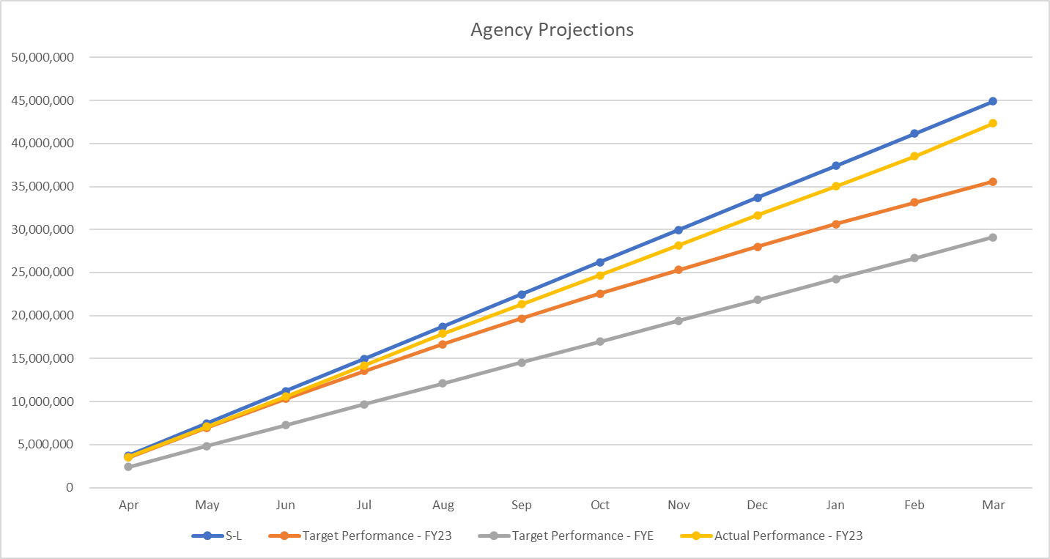
Agency End of Year Position - 2022/2023
Staff Group | FY22 Total | FY22 Apr-Mar | FY23 YTD | Variance FY22-FY23
Medical Agency | £8,319,634.69 | £8,319,634.69 | £13,260,861.00 | £4,941,226.31
Nursing Agency | £29,318,072.74 | £29,318,072.74 | £24,105,093.00 | -£5,212,979.74
AHP/HSS | £3,076,362.82 | £3,076,362.82 | £3,092,699.00 | £16,336.18
Admin & Clerical | £1,875,294.94 | £1,875,294.94 | £1,485,851.00 | -£389,443.94
Estates | £569,459.77 | £569,459.77 | £414,879.00 | -£154,580.77
Total | £43,158,824.96 | £43,158,824.96 | £42,359,383.00 | -£799,441.96
VC's | £23,950,000.00 | £23,950,000.00 | £8,767,351.36 | -£15,182,648.64
Total + VC's | £67,108,824.96 | £67,108,824.96 | £51,126,734.36 | -£15,982,090.60

Slide 3
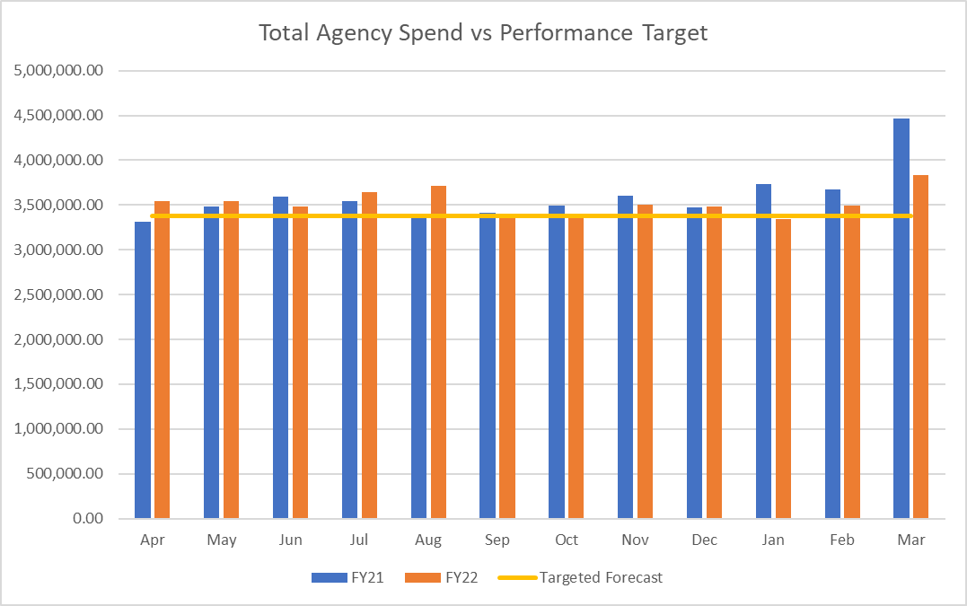
Agency Monthly Run Rate
Agency spend is £42.33m which is £826k less than FY22.
Nursing spend is -£5.2m less than FY22.
Medical spend remains high – it is £4.9m higher than FY22.
A&C has seen a saving of £389k in FY22.
End of year position 22/23 is £1.8m above NHSEI target (4.48%).
Spend vs Target | Apr | May | Jun | Jul | Aug | Sep | Oct | Nov | Dec | Jan | Feb | Mar | Total
FY21 | 3,315,486.66 | 3,485,139.72 | 3,593,584.58 | 3,541,903.84 | 3,350,342.27 | 3,416,427.10 | 3,491,780.64 | 3,603,373.90 | 3,473,842.79 | 3,738,341.40 | 3,678,702.34 | 4,469,899.72 | 43,158,824.96
FY22 | 3,539,973.22 | 3,546,835.66 | 3,481,069.22 | 3,646,572.19 | 3,710,208.61 | 3,401,875.35 | 3,351,537.64 | 3,505,663.07 | 3,480,000.02 | 3,346,487.61 | 3,490,266.00 | 3,832,340.00 | 42,332,828.59
Variance | 224,486.56 | 61,695.94 | -112,515.36 | 104,668.35 | 359,866.34 | -14,551.75 | -140,243.00 | -97,710.83 | 6,157.23 | -391,853.79 | -188,436.34 | -637,559.72 | -825,996.37
Targeted Forecast | 3,376,416.00 | 3,376,416.00 | 3,376,416.00 | 3,376,416.00 | 3,376,416.00 | 3,376,416.00 | 3,376,416.00 | 3,376,416.00 | 3,376,416.00 | 3,376,416.00 | 3,376,416.00 | 3,376,416.00 | 40,516,992.00
Performance vs Target | 163,557.22 | 170,419.66 | 104,653.22 | 270,156.19 | 333,792.61 | 25,459.35 | -24,878.36 | 129,247.07 | 103,584.02 | -29,928.39 | 113,850.00 | 455,924.00 | 1,815,836.59

Slide 4
Agency Spend Reduction – Target vs Actual Performance

Slide 5
Recruitment & Retention Activity 2022/2023
Support Staff
Registered Nurses
Retention

Slide 6
Key Achievements
Arrival of 107 Internationally Educated Nurses (IENs), 77 of which are undertaking NMC registered nursing roles. Agency cost avoidance achieved to date is £2,45M.
The recruitment KPI achieved cost avoidance of £2,023,500.00 which is 92.48 % of target. For inpatient services this was predominately achieved through the recruitment of student nurses in 2022/23.
Agency spend is £42.33M, which is £826K less than this time last year. This is inclusive of an extra £4.9M on medical spend against last year.
Nursing agency spend is £5.2M less than this time last year, this is due to the Trust’s need for accessing qualified and unqualified nursing shifts has been reduced by 20% due to the interventions.
Development and procurement of 5 external contracts has been achieved within 2022/2023.
NHSP bank contract went live 13th February (significant challenges through implementation).
Master Vendor Contract for Nursing, AHP and Admin & Clerical with ID Medical went live 13th February.
Guaranteed Volume Contract with TFS Healthcare for Littlemore site had a soft launch 30th January.
Internal medical bank partnership with Patchwork, implementation plan currently being scoped, target date is 26th June 2023.
Master Vendor contract and direct engagement model for Medical Workforce contract awarded 23rd March, target date for implementation end of June 2023.

Slide 7
Unrealised Benefits
Recruitment activity for registered nurses within inpatient units, from the total nurses recruited for inpatient teams only 0.77 ETW was attributed to domestic recruitment.
26 of the target 40 peripatetic team workers recruited, missed agency cost avoidance of £295,425.
Improvement in turnover figures, the Trust were unable to deliver any reductions in staff turnover in registered and unregistered roles.
Medical agency spend has continued to increase throughout 2022/2023, although the workstream was set up in August there has been a number of delays across the identified workplan.

Slide 8
Agency Contracts
NHSP KPIs - 1-28 March 2023
Qualified nursing shifts in April were 37% which is 13% behind target, however, this represents a 12% improvement on the baseline hours pre-transfer.
Admin shifts have seen a 20% shift fill improvement since the beginning of the contract.
ID Medical – cost effective replacements
Proactive engagement with agency supply chain has identified alternative supplies/new workforce to provide shifts at a reduced charge rate.
 | Baseline | March |  | April |  | April Total Demand Hours | April Total Bank Fill Hours
 | Bank Hours % | KPI-Bank % | Actual Fill | KPI-Bank % | Actual Fill %
Admin & Clerical Man (Band 7 -9) | 36% | 36% | 70% | 50% | 50% | 1,474 | 742
Admin & Clerical Non Man (Band 1 - 6) | 70% | 70% | 87% | 90% | 90% | 11,701 | 10,539
Allied Health Professionals | 51% | 51% | 43% | 55% | 42% | 5,579 | 2,359
Health Care Scientists | 52% | 52% | 95% | 60% | 90% | 1,646 | 1,479
Nursing Qualified | 25% | 40% | 36% | 50% | 37% | 53,606 | 20,066
Nursing Unqualified | 72% | 72% | 68% | 75% | 78% | 46,178 | 36,048
Support | 69% | 69% | 82% | 70% | 86% | 4,437 | 3,820
TOTAL |  | 56% | 55% | 63% | 60% | 129,076 | 77,055
 | Feb |  |  | March
 | Shifts | Avg Rate Reduction | Est Savings | Shifts | Avg Rate Reduction | Est Savings
Band 2&3 | 37 | £7.00 | £2,978.50 | 104 | £7.00 | £8,372.00
Band 5 | 105 | £5.00 | £6,037.50 | 207 | £5.00 | £11,902.50

