Slide 1
General Meeting of Council of Governors
Easy Read Agenda

Slide 2
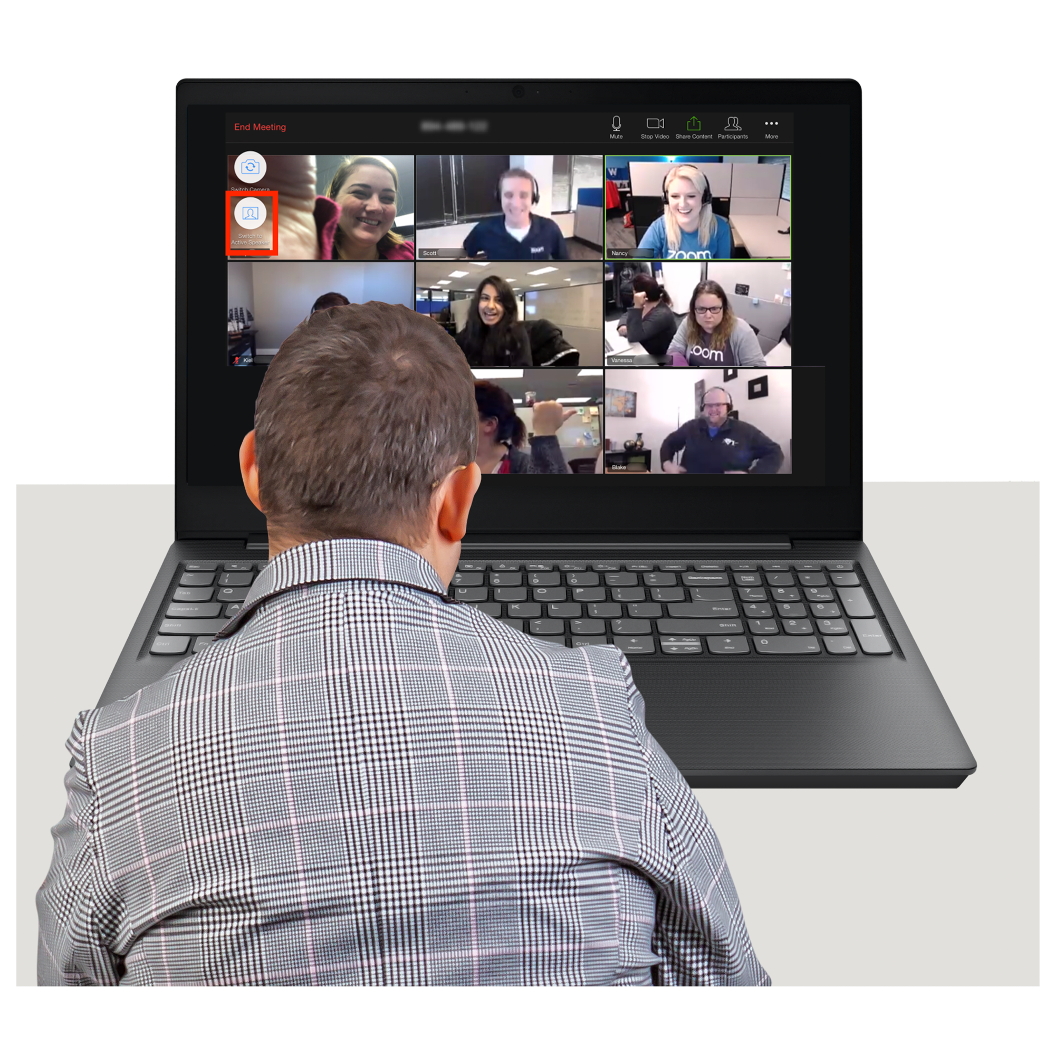
 | Agenda item | Who is Speaking
 | 14th June 2023 5.30pm -7.30pm
 | Virtual meeting on Microsoft Teams
 | Introductions and welcome | Chair

Slide 3
 | 2. Apologies from people not able to be at the meeting Check that there are enough people at the meeting to make decisions | Chair
 | 3. Declaration of interests | Chair
 | 4. Patient Story- Community\Nutrition and Dietetics Service | Marie Croft /Nicole Robinson

Slide 4
 | 5.Minutes of meeting on 15th March Matters arising from Minutes of last meeting | Chair
 | 6. Update Report from Chair Approval of Interim Chief Executive Officer | Chair
 | 7. Non Executive Director Update Rick Trainor - reflections of a Non-Executive Director
Rick Trainor

Slide 5
 | 8. Update Report from Chief Executive Officer
 | 9. Update Report from Lead Governor | Mike Hobbs
 | 10. Governor Planning Discussion to help plan the July Council of Governors development session
Chief Executive Officer
Deputy Director of Corporate Affairs

Slide 6
Grant Macdonald
 | 11. Governor Questions and Answers Child and Adolescent Mental Health services waiting times Edenfield Learning
 | 12. Patient Safety Incident Response Framework Presentation | Jane Kershaw
 | 13. Questions from the public | Chair
Marie Crofts

Slide 7
 | 14. Close of meeting | Chair
 | Dates of next meetings Council of Governors Development session Council of Governors meeting 14th September

