Slide 1





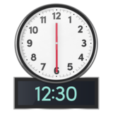

Board of Directors Meeting
Wednesday 22nd May 2024
9am -12.30am
Microsoft Teams meeting

Slide 2


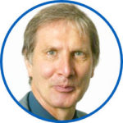



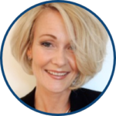


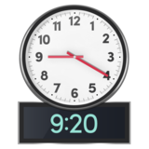
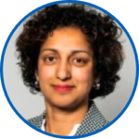
 | Agenda Hello my name is…… Apologies from people not able to be at the meeting | Purpose
 | 2. Patient Story: Buckinghamshire Adult Mental health Services
 | 3.Staff Story from Abingdon Community Hospital
Chair
Chief Nurse
Chief People Officer

Slide 3






 | 4. Register of Directors’ Interests | Purpose
 | 5. Minutes and matters arising of the meeting held on 27th March 2024
 | 6. Trust Chair’s Report
Chair
Chair
Chair

Slide 4
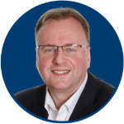





 | 7. Chief Executive’s Report
 | 8. Corporate Affairs report including updates on: Legal, Regulatory and Policy; Board Assurance Framework (strategic risks); Charity and Involvement impact and updates; and Communications and Engagement |  | Associate Director of Corporate Affairs
Chief Executive
2023-2024

Slide 5





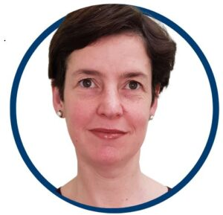




Chief Finance Officer
 | 9. Annual Plan 2024/25
 | 10. Integrated performance and sustainability reporting: Integrated Performance Report; Safety & Quality Dashboard; and Finance report |  | Executive Team
 | 10 Minute break if needed
?

Slide 6




 | 11. Board Committees’ update reports and recommendations. 3As reports (matters for Alert, Advice and Assurance) from Committees Committee recommendations: Quality Committee recommendations; and People, Leadership & Culture recommendations. |  | Committee Chairs
?

Slide 7





 | 12. Freedom To Speak Up Guardians’ annual report |  | Chief People Officer
 | 13. Patient Safety Incident Reports |  | Chief Nurse
 | 14. Corporate Registers: receipt of gifts and hospitality |  | Associate Director of Corporate Affairs

Slide 8



 | 15. Any Other Business |  | Chair
 | 16. Questions from the public and any governors or staff attending.

Slide 9


 | 17. Review of meeting
 | 18. Resolution for Board to meet in private for Confidential matters
 | Meeting Close
Chair
Chair
?
Confidential

Slide 10


 | Next public meetings Annual Report and Accounts 26th June
Public Board meeting

