Slide 1







Board of Directors Meeting
Wednesday 31st January 2024
9am -11.50am
POWIC Conference Room, Warneford Hospital Site, Oxford OX3 7JX
and Microsoft Teams-hybrid and in person.

Slide 2







 | Agenda Hello my name is…… Apologies from people not able to be at the meeting | Purpose
 | 2. Patient Story
Chair
Chief Nurse

Slide 3




 | 3. Register of Directors’ Interests | Purpose
 | 4. Minutes and matters arising of the meeting held on 29th November 2023
 | 5. Trust Chair’s Report
Chair
?
Chair
Chair

Slide 4






 | 6. Chief Executive’s Report
 | 7. Corporate Affairs report including updates on: Legal, Regulatory and Policy; Board Assurance Framework (strategic risks); Charity and Involvement impact and updates; and Communications and Engagement
Chief Executive
Director of Corporate Affairs

Slide 5
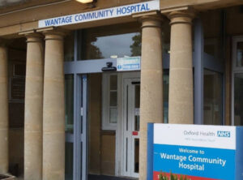






 | 8. Wantage Community Hospital update
 | 5 minutes’ break if needed
 | 9. Integrated performance and sustainability reporting: a. Integrated Performance Report; and b. Finance Report |  | Executive Team
Exec MD for
Primary, Comm-
unity & Dental

Slide 6




 | 10. Board Committee’ update reports and recommendations: a. Matters for Alert, Advice and Assurance from recent meetings |  | Committee Chairs

Slide 7


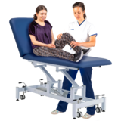





 | 11. Allied Health Professionals strategy |  | Chief Nurse
 | 12. Patient Safety Incidents report |  | Chief Nurse
 | 13. Any Other Business
?
Chair

Slide 8


 | 14. Questions from the public and any governors or staff attending
 | 15. Review of meeting
 | 16. Resolution for Board to meet in private for Confidential matters
Chair
Chair
?
Chair
Confidential

Slide 9


 | Meeting closed
 | Next public meeting
Chair

