Slide 1

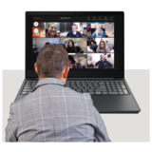

General Meeting of Council of Governors
Easy Read Agenda

Slide 2






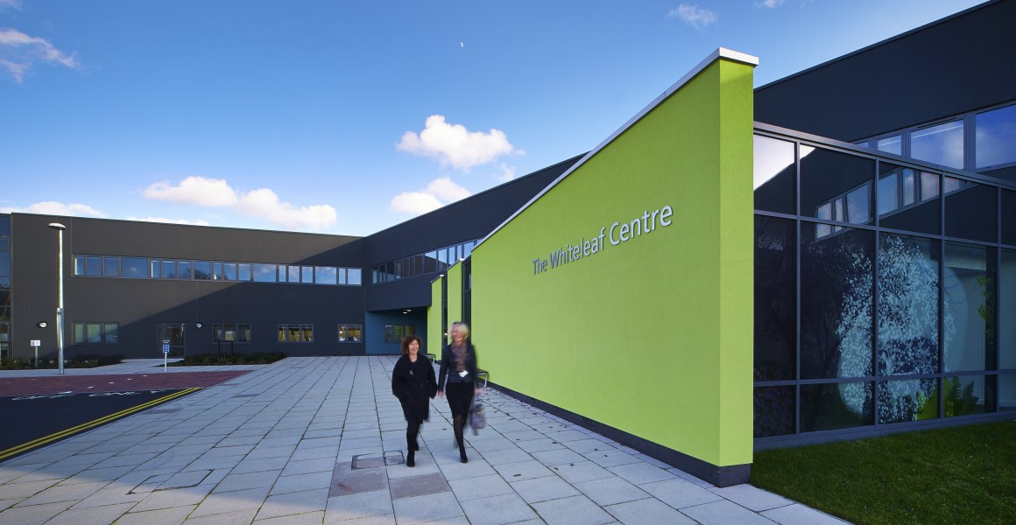

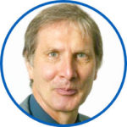
 | Agenda item | Who Speaking
 | 12th June 2024 5.30pm -7.30pm
 | Conference Room,The Whiteleaf Centre, Bierton Road, Aylesbury, HP20 1EG
 | 1. Introductions and welcome | Chair

Slide 3





 | 2. Apologies from people not able to be at the meeting Check that there are enough people at the meeting to make decisions | Chair
 | 3. Declaration of interests | Chair
 | 4. Minutes of the last meeting on 14th March 2024 and matters arising | Chair

Slide 4







 | 5. Patient Story – Buckinghamshire Adult Mental Health Services | Chair
 | 6. Update Report from Chair | Chair
 | 7. Update Report from Chief Executive | Chief Executive

Slide 5




 | 8. Update Report from Lead Governor
 | 9. NHS Staff Survey results | Chief People Officer
 | 10. Early intervention in Psychosis
Lead Governor
Bill Tiplady

Slide 6






 | 11. Non-Executive Director update. David Clark – reflections of a NED. | David Clark
 | 12. Council of Governors Engagement in Community Services Transformation Programme | Ben Riley/Susannah Butt
 | 13. Governor elections, induction and member engagement | Deputy Director of Corporate Affairs

Slide 7






 | 14. Nominations & Remuneration Committee recommendation for appointments to the committee | Associate Director of Corporate Affairs
 | 15. Questions from the public Questions arising from papers in the reading room | Chair
 | 16. Close of meeting | Chair
 | Next meeting:

