Slide 1






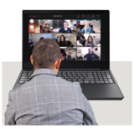
Board of Directors Meeting
Wednesday 25th September 2024
09.00am -12.20pm
Microsoft Teams meeting

Slide 2









 | Agenda Hello my name is…… Apologies from people not able to be at the meeting. | Purpose
 | 2.Declarations and Register of Directors Interests
 | 3. Minutes and matters arising of the meeting held on 24th July 2024
Chair
Chair
?
Chair

Slide 3








 | 4. Trust Chair’s Report | Purpose
 | 5. Chief Executive’s Report.
 | 6. Corporate Affairs Report
Chair
Chief Executive
AD of Corporate Affairs

Slide 4
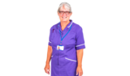

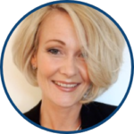




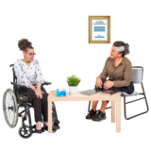


 | 7. Patient Journey-School Health Nursing Service and 0-19 Services. |  | Chief Nurse
 | 8. Staff Story-Oxfordshire Talking Therapies Service.
 | 9. Talking Therapies: outcome monitoring. |  | Dr John Pimm/Jo Ryder/Chief Medical Officer.
Chief People Officer

Slide 5




 | 10. Integrated performance and sustainability reporting Integrated performance Report Quality and Safety Dashboard Finance report |  | Executive Team
 | 10 minute break if needed

Slide 6




 | 11 Board committees’ update reports and recommendations -Matters for Alert, Advice and Assurance from Committees -Quality Committee recommendation: Safeguarding Service annual report -People, Leadership & Culture Committee recommendation: Medical Appraisal and Revalidation report -Charity Committee recommendation: fundraising report |  | Committee Chairs
?

Slide 7

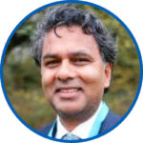





 | 12.Research and Innovation report. |  | R&D Director and Chief Medical officer
 | 13. Mortality and Suicide Prevention Report |  | Chief Medical Officer
 | 14. Patient Safety Incidents Reports |  | Chief nurse

Slide 8





 | 15. Update report: Board Committee annual reports and Terms of Reference |  | Associate Director of Corporate Affairs
 | 16. Corporate Registers: (i) application of Trust seal; and (ii) receipt of gifts and hospitality |  | Associate Director of Corporate Affairs
 | 17. Any Other Business |  | Chair

Slide 9


 | 18. Questions from the public and any governors or staff attending. |  | Chair
 | 19. Review of meeting |  | Chair
 | 20.Resolution for Board to meet in private for Confidential matters. |  | Chair
?
Confidential

Slide 10



 | Meeting Close
 | Next meeting in public.

