Slide 1






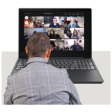
Board of Directors Meeting
Wednesday 27th March 2024
9am -12.40am
Microsoft Teams meeting

Slide 2
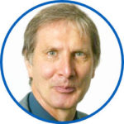
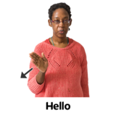


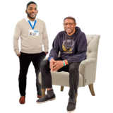
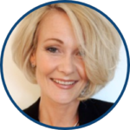



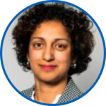

 | Agenda Hello my name is…… Apologies from people not able to be at the meeting. | Purpose
 | 2. Patient Story: Oxfordshire Adult and Older Adult Mental Health Services
 | 3.Staff Story from the Race Equality Network
Chair
Chief Nurse
Chief People Officer

Slide 3






 | 4. Register of Directors Interests | Purpose
 | 5. Minutes and matters arising of the meeting held on 31st January 2024
 | 6. Trust Chair Report
Chair
Chair
Chair

Slide 4
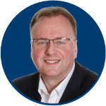



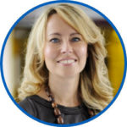


 | 7. Chief Executive Report
 | 8. Corporate Affairs report including updates on: Legal, Regulatory and Policy; Board Assurance Framework (strategic risks); Charity and Involvement impact and updates; and Communications and Engagement
Chief Executive
Company Secretary
2023-2024

Slide 5
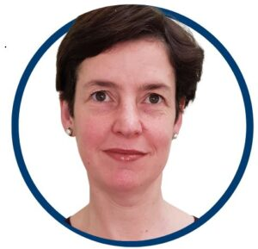










 | 9.Annual Plan 2024/25
 | 10. Staff Survey Results |  | Chief People Officer
 | 10 Minute break if needed
?
Chief Finance Officer
?

Slide 6






 | 11. Integrated performance and sustainability reporting: -Integrated Performance Report -Safety and Quality Dashboard -Finance Report |  | Executive Team.
 | 12. Board committee update reports and recommendations. Matters for Alert, Advice and Assurance from Committees. Audit Committee Recommendation: Board Standing Orders. |  | Committee Chairs
?

Slide 7

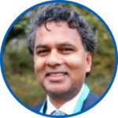

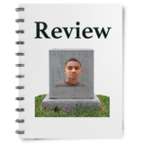



 | 13. Research and Innovation report. |  | Chief Medical Officer
 | 14. Mortality and Suicide prevention reporting. |  | Chief Medical Officer
 | 15. Patient Safety Incidents. |  | Chief Nurse

Slide 8





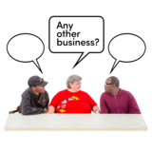

 | 16. Journey to Excellence update. |  | Chief Nurse
 | 17. Corporate Registers: Application of Trust seal. Receipt of gifts and hospitality |  | DoCA / CoSec.
 | 18. Any Other Business |  | Chair

Slide 9


 | 19. Questions from the public and any governors or staff attending.
 | 20. Review of meeting
 | 21. Resolution for Board to meet in private for Confidential matters.
Chair
Chair
?
Chair
Confidential

Slide 10
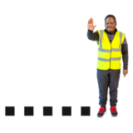

 | 21.. Resolution by Board to conduct business in private when needed. Confidential
 | Meeting closed
 | Next public meeting
?
David Walker
Confidential
David Walker

