Slide 1
Creating Oxford City Community Healthcare Hubs
Proposed changes will only affect our community physical health services – such as podiatry, district nursing, health visitors (so not mental health services)
There will be no changes for patients who get their care at home
But some clinics – for example podiatry and our regional dental service – will move to the new sites
Oxfordshire Joint Health Overview and Scrutiny Committee briefing
13 March 2024

Slide 2
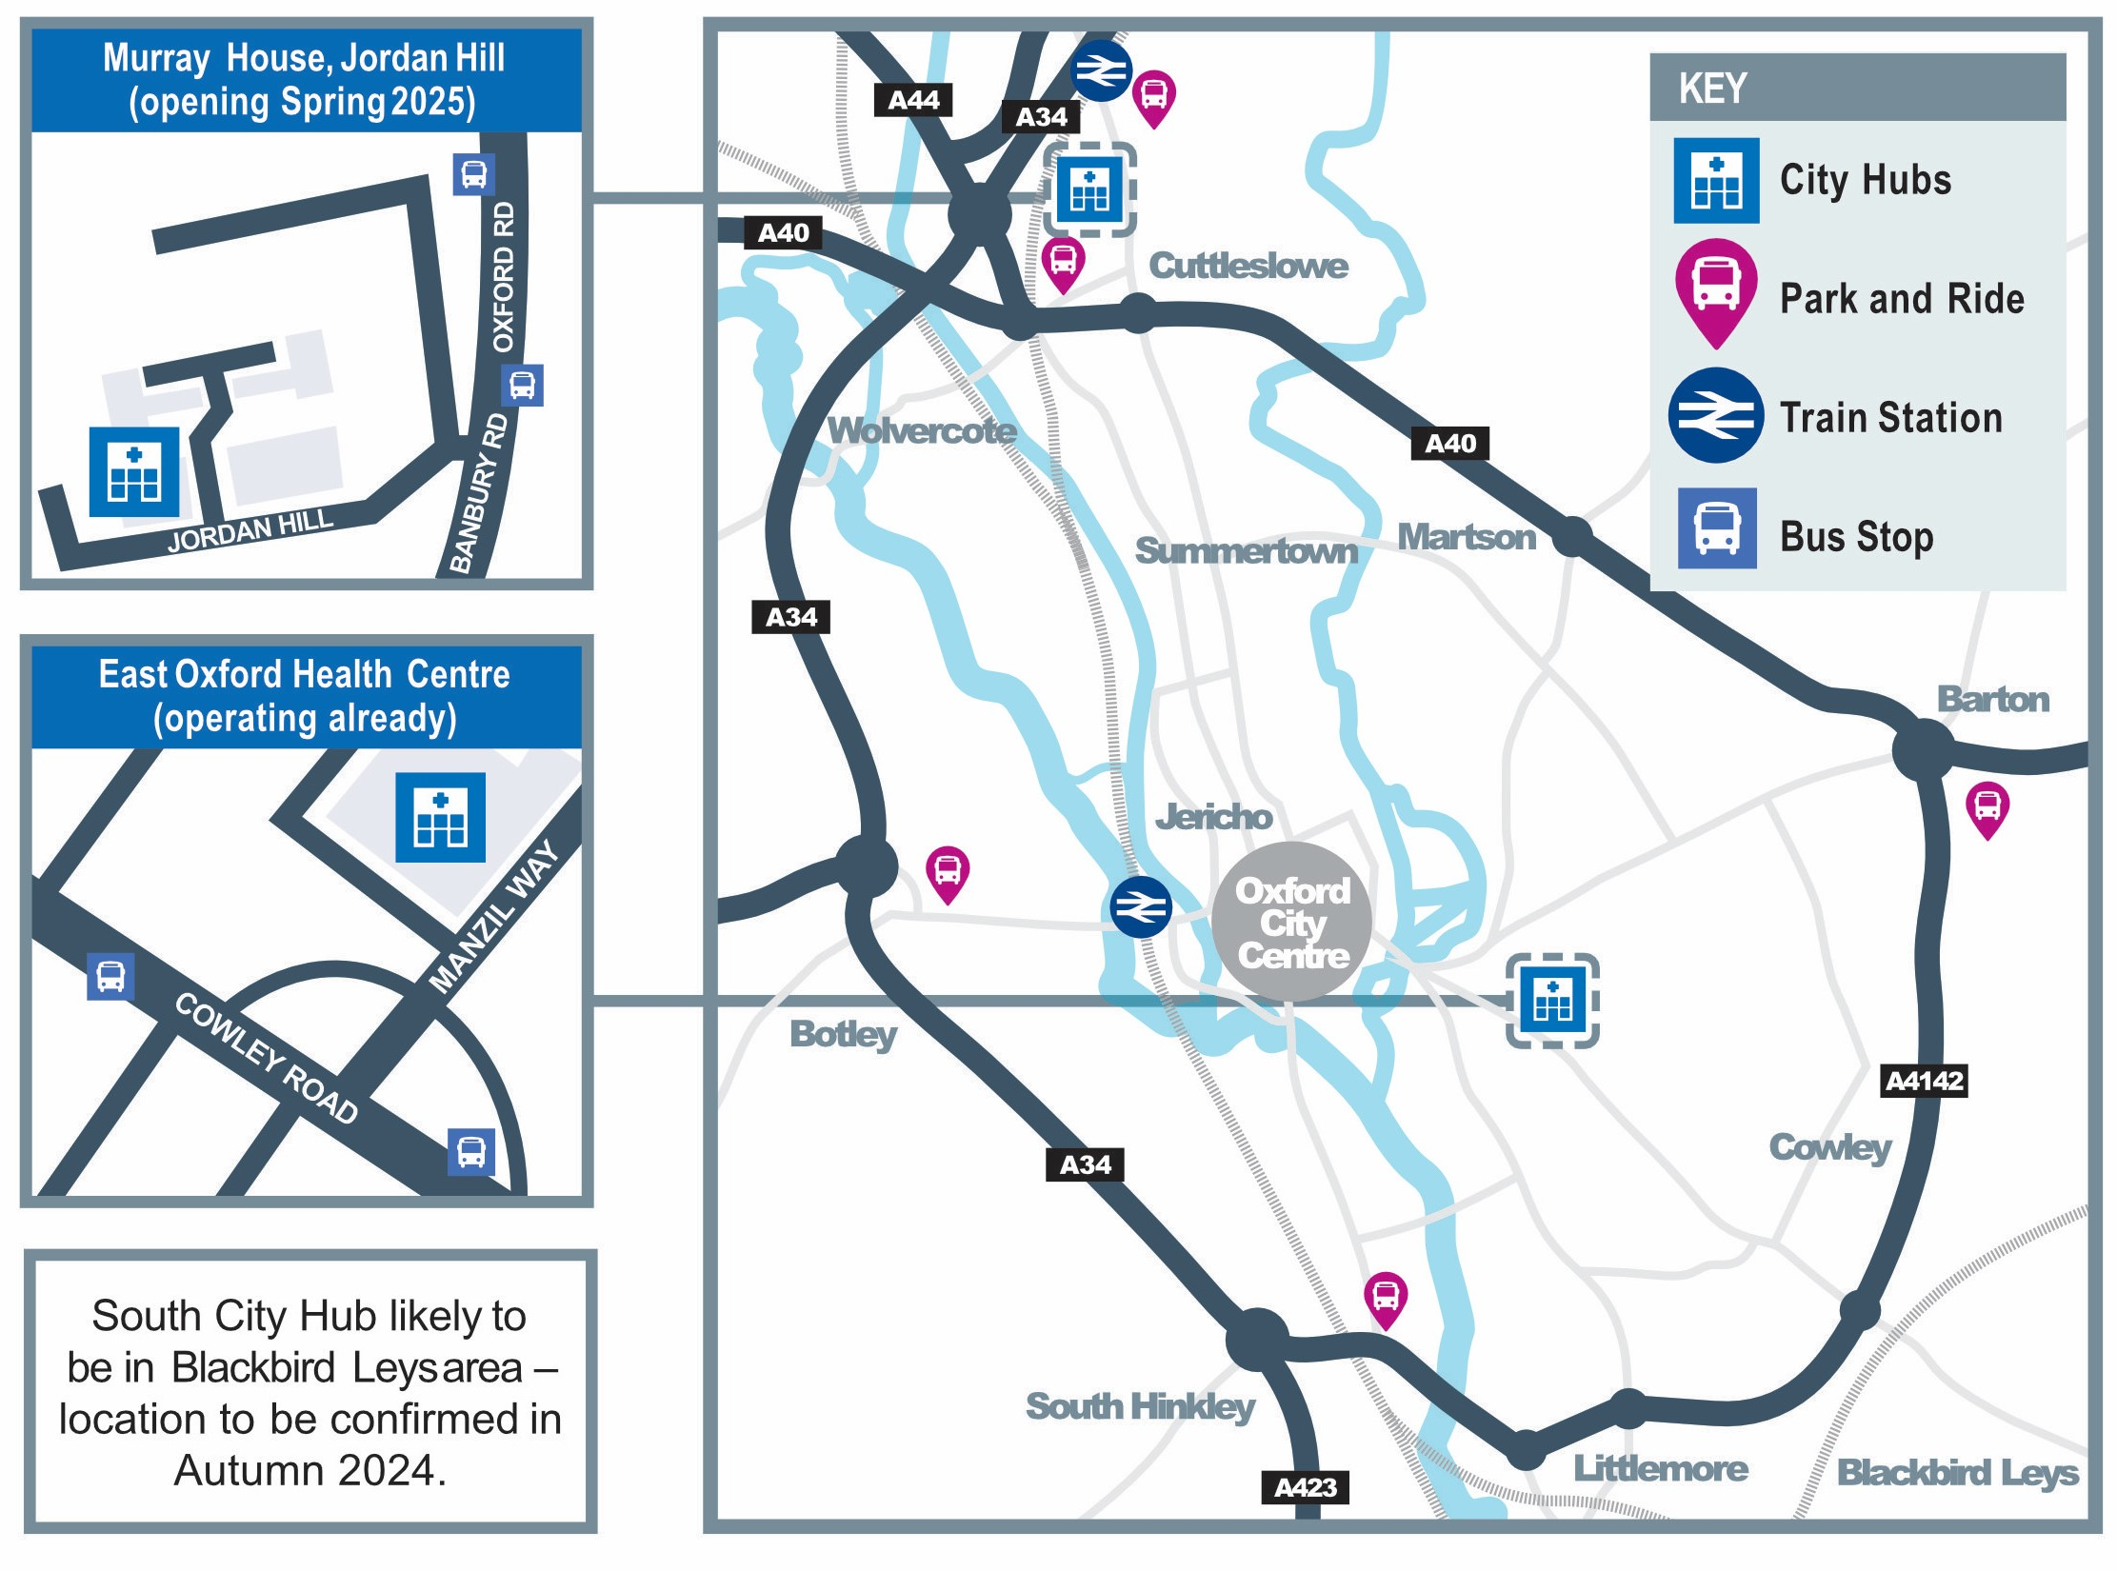
Oxford’s new healthcare hubs
Integrating Oxford’s community healthcare services:
Around 300 staff across some 40 teams
Reducing nine existing bases into three new modern hubs

Slide 3
Services that will move
Although the majority of teams visit people where they live, some clinics will be moving from their current locations to the new hubs.
North City Hub (Murray House, Jordan Hill) – clinics include:
Health visitor review clinics at Jericho, Kidlington, South Parade and Northway House
Children’s speech and language, physiotherapy and occupational therapy clinics at Cornwallis House
Children’s bladder and bowel clinic (a county-wide service) at South Parade
District nursing clinics (for example catheters and leg ulcers) at Kidlington and other sites in North Oxford
Heart failure clinic at Kidlington
Podiatry clinics at Kidlington and St Barnabas
All dental clinics at Kidlington
Central City Hub (East Oxford Health Centre) – all clinics at this hub already will remain in place
South City Hub – site and proposed services still to be confirmed

Slide 4
Oxford City Community Healthcare Hubs – have your voice heard
If a clinic you use is moving to the North City Hub, how will you travel there?
Will that journey be easier or more difficult than now?
What can we do to help?
Would you like to advise us on the new building’s design by joining our external patient group?
Oxfordshire Joint Health Overview and Scrutiny Committee briefing
13 March 2024

