Slide 1
Role of nutrition in preventing and treating pressure ulcers
Stop The Pressure Week
Presented by
Lauren Fisher – Community Dietitian
Nicky Fernandez – Oxfordshire Stroke Rehabilitation Unit Dietitian

Slide 2
What we will cover
Nutritional risk factors for the development of pressure sores
The MUST Tool and identifying those at nutritional risk
The dietary management of undernutrition
The dietary management of overnutrition
Activity
Any questions?
Please put these in the ‘Chat’ and we will answer them at the end of the session

Slide 3
Step 1: Identify and Assess

Slide 4
Nutritional risk factors
Low body mass index
Malnutrition
Unintentional weight loss
Obesity
Nutritional deficiencies
Impaired ability to eat independently
But how can we assess the presence of these factors?

Slide 5
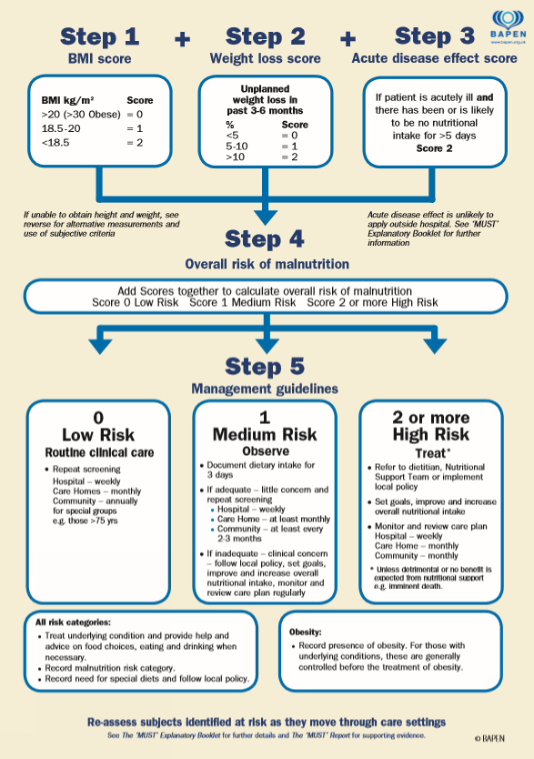
Use a validated screening tool for assessing risk of malnutrition e.g. Malnutrition Universal Screening Tool (MUST)
Can be completed by any trained member of the healthcare team.
Inpatients: Screen on admission and repeat weekly.
Community patients: Screen on first contact and repeat as clinical concerns arise.
Bitesize training – 'MUST' screening in Community Hospital.mp4

Slide 6
Step 2: Act

Slide 7
Energy
Guidelines recommend intake of 24 to 35kcal/kg/day.
Sufficient caloric intake supports anabolism and spares the use of protein as an energy source.
Carbohydrates are broken down into glucose which provides a major fuel source for the body.
Dietary sources include bread, pasta, rice, potatoes, oats.

Slide 8
Protein
PENG, 2018 recommend 1.25 to 1.5g/kg of protein per day.
Required for body tissue synthesis, maintenance and repair.
Dietary sources include beans, pulses, fish, eggs, meat and dairy products.
Aim to include a portion at each mealtime, which is approximately 20-30g of protein or around a palm-size.
Protein should be included as part of a balanced diet to ensure that it can be utilised properly.

Slide 9
Fluid
PENG, 2018 recommend 30-35ml/kg dependent on age, unless medically restricted.
Increase in fluid loss from wound increases risk of dehydration.
General guidance is 6-8 cups per day.
Water, tea, coffee, fruit juice, milk, soup all count.

Slide 10
Iron
Involved in collagen formation and transport of oxygen and nutrients to tissues.
Vitamin C
Involved in collagen synthesis.
Dietary sources include red meat, fish, poultry, pulses, legumes, dark green vegetables, nuts and seeds.
Dietary sources include citrus fruits, peppers, potatoes, green vegetables, strawberries and blackcurrants.
Zinc
Involved in cell proliferation and metabolism of carbohydrates, fat and protein.
Dietary sources include meat, shellfish, dairy products, bread and cereals.

Slide 11
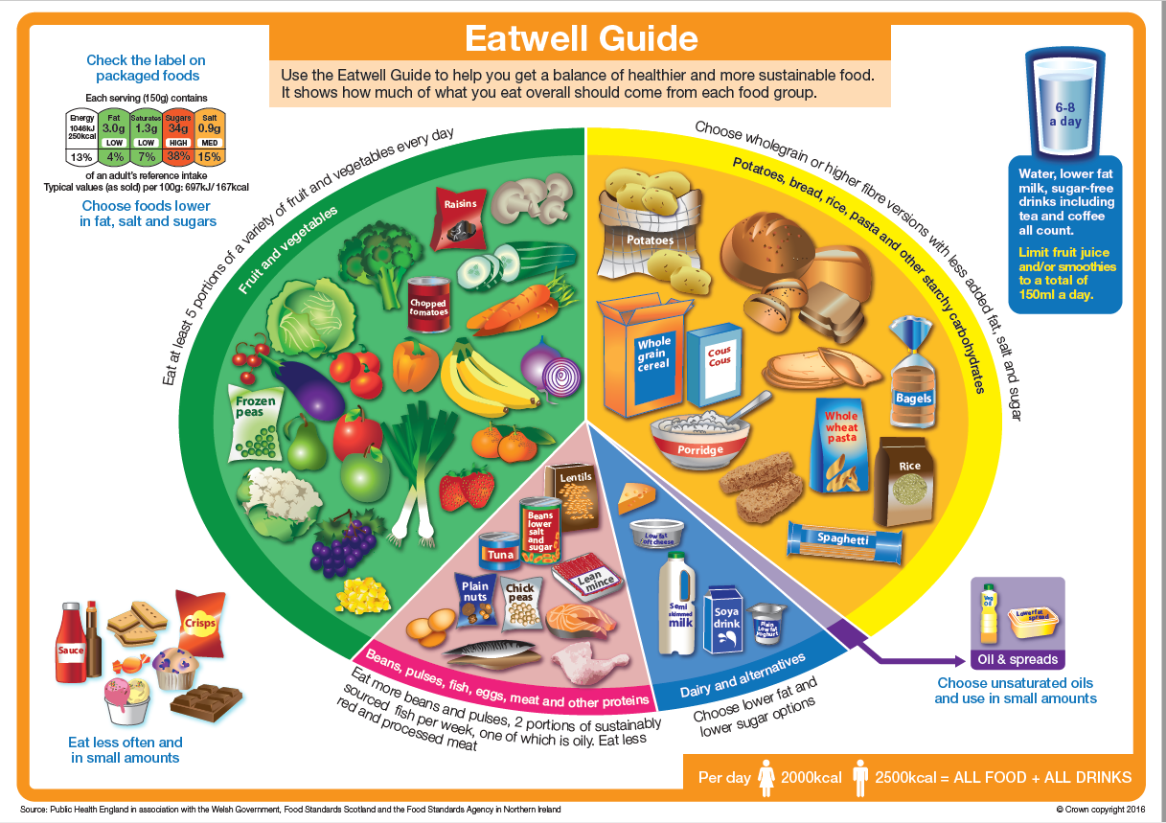

Slide 12
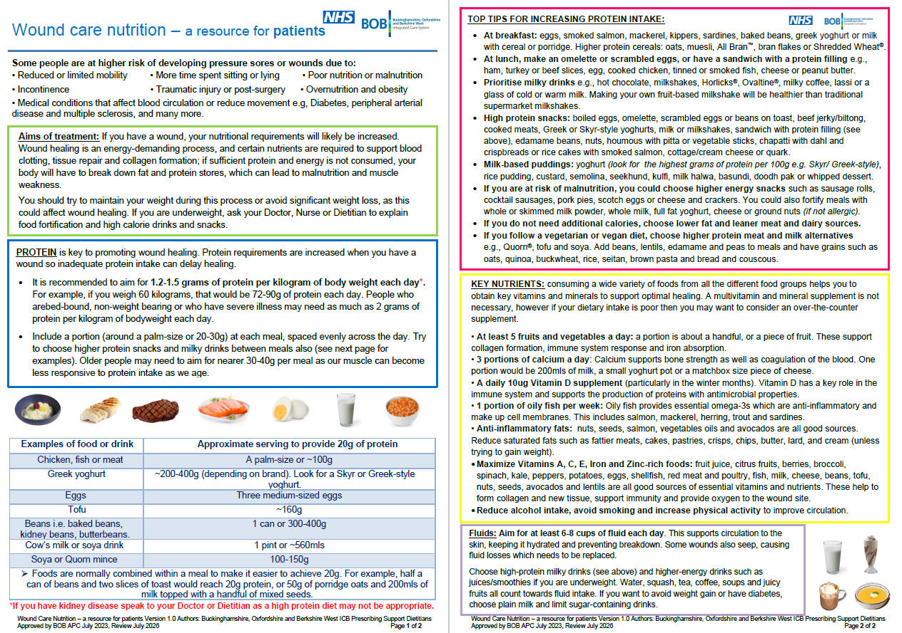

Slide 13
If your patient is underweight or has lost weight unintentionally…
Try to have one pint of whole milk per day
Incorporate this into cereal, cooking, nourishing drinks (e.g. homemade milkshake, malted milk, hot chocolate)
Fortify whole milk using skimmed/whole milk powder
Dairy free alternatives: soya is usually highest in protein, check if fortified with iron and calcium, ‘barista’ styles

Slide 14
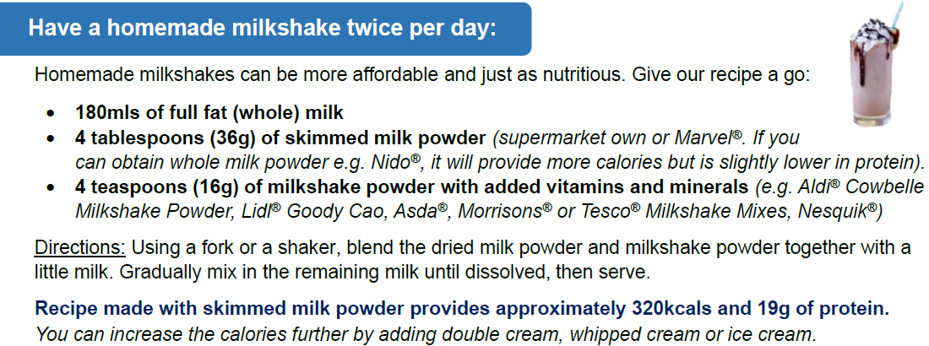


Slide 15
Include high energy and protein snacks between meals
Peanut butter on toast
Handful of nuts
Rice pudding
Full fat yoghurt with fruit
Houmous with breadsticks
Eggs

Slide 16
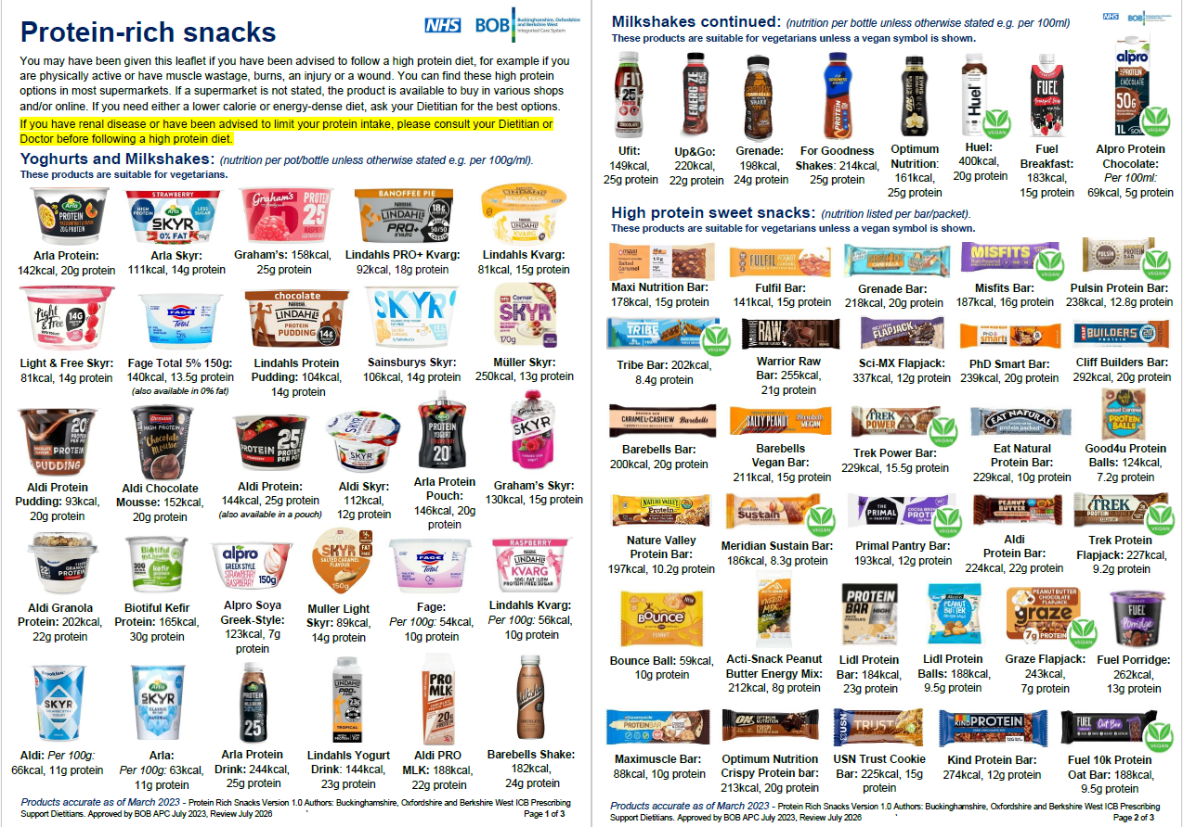

Slide 17
If your patient is underweight or has lost weight unintentionally…
Fortify foods to add additional calories and protein
Fortified milk
Full fat yoghurt
Cheese
Ground nuts
Milk powder
Avocado
Nut butter
Double cream

Slide 18
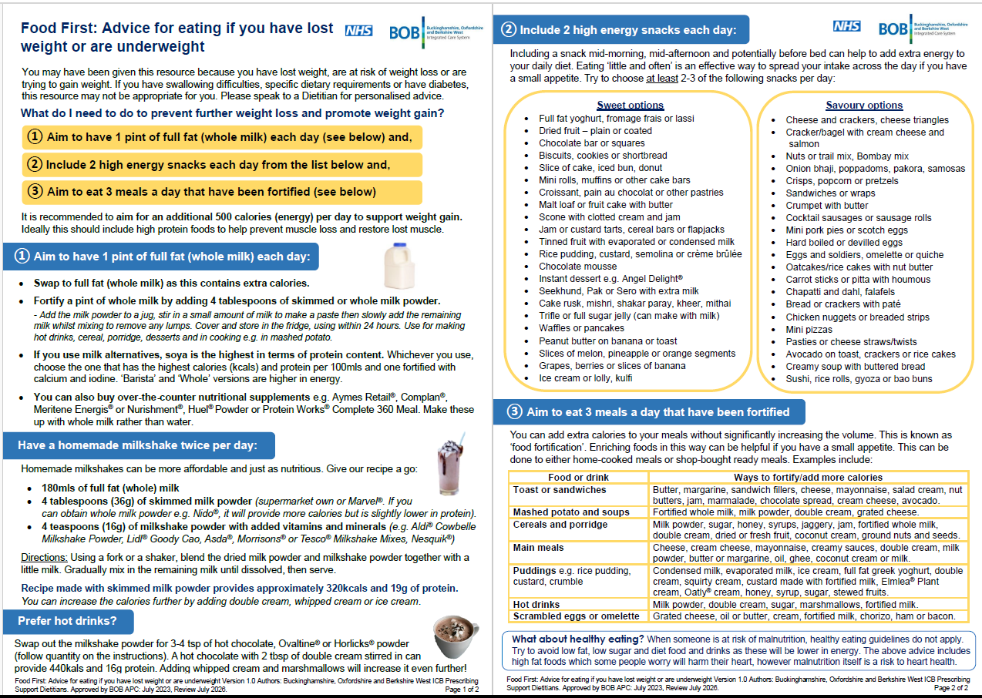

Slide 19
Considerations with a Food First approach
What is the patient’s current food/fluid intake like?
Who will prepare nourishing drinks / fortified foods / snacks?
Can the patient access the suggested food/fluids – physically, financially?
Any swallowing difficulties?
Presence of comorbidities? E.g. type 2 diabetes, renal disease

Slide 20
Use of oral nutritional supplements (ONS)
“Do not offer nutritional supplements specifically to prevent a pressure ulcer in adults whose nutritional intake is adequate.”
“Do not offer nutritional supplements to treat a pressure ulcer in adults whose nutritional intake is adequate.”
“Offer nutritional supplements to adults with a pressure ulcer who have a nutritional deficiency.”
(NICE, 2014)

Slide 21
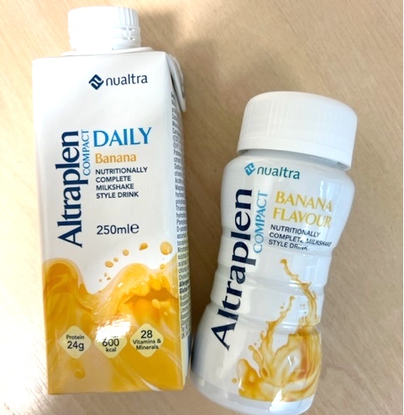
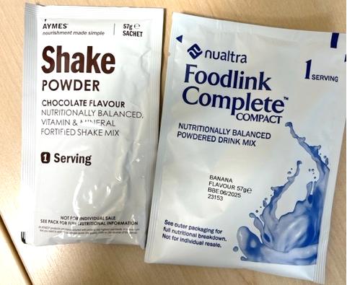
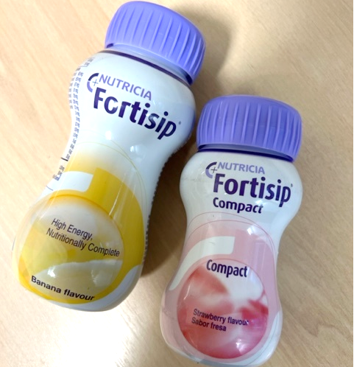
Use of nutritional supplements in the community
Second Line:
Ready to Drink ONS
First Line: Powdered ONS

Slide 22

If your patient is living with overweight or obesity…
Increase protein
Aim for 3 regular and balanced meals.
Choose lower energy, high protein snacks:
  High protein yoghurt
  Boiled eggs
  Low fat rice pudding and custard
  Milky drinks made with semi-skimmed or skimmed milk
  Low fat cheese and crackers.
Choose drinks that are sugar-free.
Increase micronutrients
Moderate calories

Slide 23
Activity: How could you fortify this diet to increase the energy and protein content?
 | Normal diet
Breakfast | Porridge made with semi-skimmed milk
Mid-morning snack
Lunch | Tomato soup with 1 slice of bread and low-fat spread
Mid-afternoon snack
Dinner | Beef stew with mashed potato and carrots Pot of low-fat yoghurt
Bedtime snack | Cup of hot chocolate made with semi-skimmed milk

Slide 24
 | Normal diet | Fortified diet
Breakfast | Porridge made with semi-skimmed milk | Porridge made with fortified milk, topped with fresh fruit, ground nuts and honey
Mid-morning snack |  | Handful of nuts / slice of peanut butter on toast
Lunch | Tomato soup with 1 slice of bread and low-fat spread | Tomato soup with added skimmed milk powder / cheese / butter / double cream 1-2 slices of bread with butter or cream cheese
Mid-afternoon snack |  | Homemade milkshake
Dinner | Beef stew with mashed potato and carrots Pot of low-fat yoghurt | Beef stew with added double cream and topped with grated cheese Mashed potato with added skimmed milk powder / fortified milk / cheese / butter / double cream Carrots drizzled with olive oil Pot of full fat Greek style yoghurt
Bedtime snack | Cup of hot chocolate made with semi-skimmed milk | Cup of hot chocolate made with fortified milk

Slide 25
Resources
BDA Food Fact Sheets: Food Facts (bda.uk.com)
BDA Food Fact Sheet: Prevention and Management of Pressure Injuries Prevention and management of pressure injuries (bda.uk.com)
BOB ICB resources including food first, high protein snacks, nourishing drink recipes, wound care nutrition: Nutrition - ClinOx
BAPEN MUST Calculator: MUST Online Calculator - Malnutrition Universal Screening Tool (bapen.org.uk)

Slide 26
Any questions?

Slide 27
References and further reading
BAPEN, 2020. The ‘MUST’ Toolkit. [Online] Available at: https://www.bapen.org.uk/screening-and-must/must/must-toolkit [Accessed 12 November 2023].
Buckinghamshire, Oxfordshire and Berkshire West Integrated Care Board [BOB ICB], 2023. Adult Oral Nutritional Supplement (ONS) and Tube Feed Formulary. [Online] Available at: https://clinox.info/clinical-support/local-pathways-and-guidelines/Clinical%20Guidelines/BOB%20ICB%20Adult%20Oral%20Nutritional%20Supplement%20and%20Tube%20Feed%20Formulary.pdf [Accessed 12 November 2023].
BOB ICB, 2023. Nutrition and Dietetic Food First Resources. [Online] Available at: https://clinox.info/clinical-support/Medicines/medicines-management/nutrition-copy.htm [Accessed 12 November 2023].
European Pressure Ulcer Advisory Panel, National Pressure Injury Advisory Panel and Pan Pacific Pressure Injury Alliance [EPUAP/NPIAP/PPPIA], 2019. Prevention and Treatment of Pressure Ulcers/Injuries: Quick Reference Guide. Prague: EPUAP/NPIAP/PPPIA.
Merryfield, C., 2019. Wound healing, tissue viability and pressure sores. In: J. Gandy, ed. Manual of Dietetic Practice. New Jersey: John Wiley & Sons, Inc, p. 321.
Parenteral and Enteral Nutrition Group [PENG], 2018. Estimating nutritional requirements for adults. In: V. E. Todorovic & B. Mafrici, eds. A Pocket Guide to Clinical Nutrition. Birmingham: British Dietetic Association, pp. 3.1-3.102.
Public Health England, 2018. The Eatwell Guide. London: Public Health England.

