Slide 1


Background to Urinary Incontinence
Carrie Lincoln - Clinical Lead for Oxfordshire Adult Bladder & Bowel Service

Slide 2
Aims & Objectives
  To understand the following topics:
    The anatomy of the urinary system, and how it is controlled.
    The extent to which urinary incontinence is an issue in the UK.
    The many types of incontinence.
    The causes of incontinence.
    Diagnosis, treatment and practical management.
    Continence Assessment - The Colley Model
    Bladder & Bowel Services

Slide 3
Urinary System Function
The kidneys regulate blood volume and composition, which help to regulate blood pressure and urinary pH, participate in red blood cell production and synthesis of vitamin D, and excrete waste products and foreign substances.
The ureters transport urine from the kidneys to the urinary bladder.
The urinary bladder stores urine and expels urine into the urethra
The urethra discharges urine from the body.

Slide 4
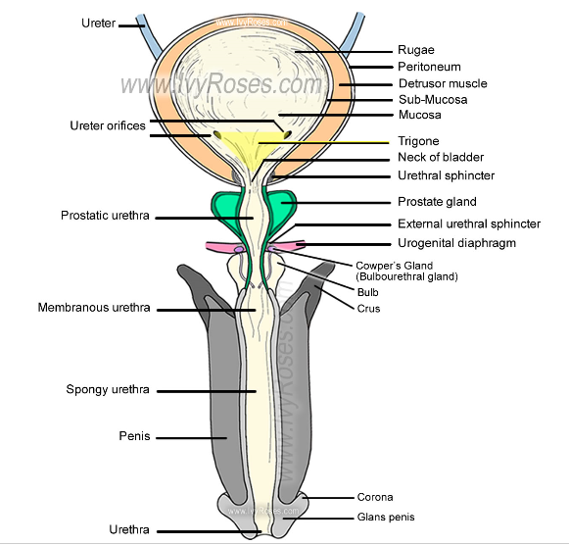
Anatomy – Male Urinary System

Slide 5
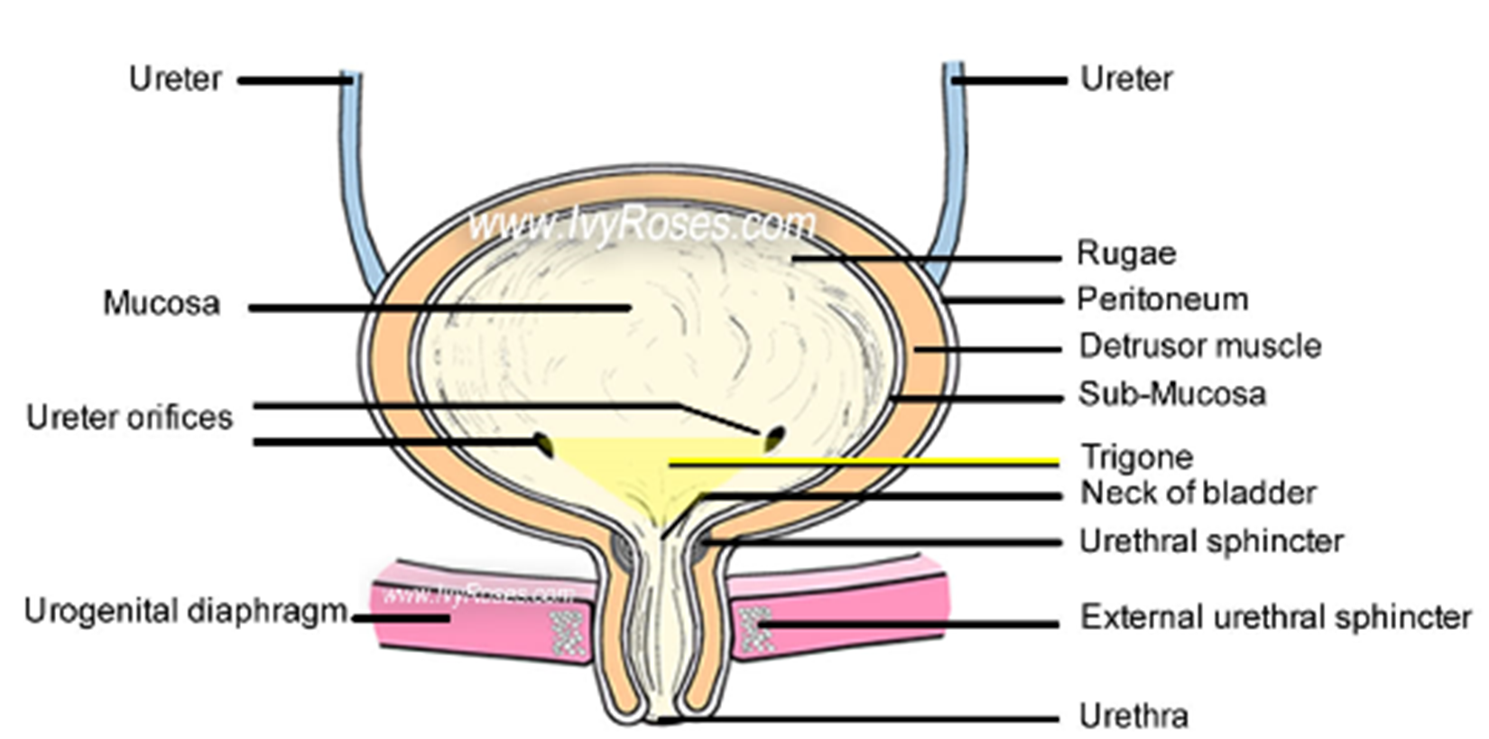
Anatomy – Female Urinary System

Slide 6
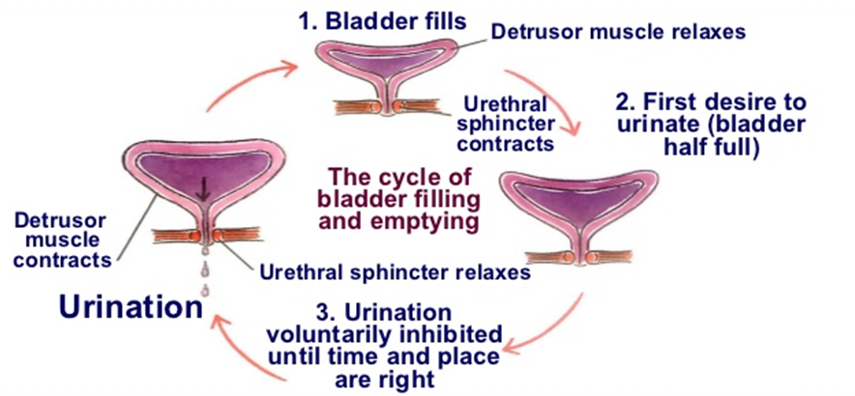
Healthy Bladder Function

Slide 7
Extent of The Problem
1 in 5 over the age of 40 suffer from overactive bladder or urgency or frequency symptoms.
Between 4 & 6 million people are regularly incontinent.
In the nursing home population, at least 50 percent of residents have bladder and/or bowel symptoms- increased in this group due to reduced mobility, reduced cognition, overactive bladder, constipation and carer availability.
Urology & Continence treatment costs the NHS over £2 billion per year.
"Incontinence is a common part of aging but it is never normal,"
Elderly people may:
  Leak urine occasionally.
  Constantly dribble urine.
  Have no bladder control or function at all.

Slide 8
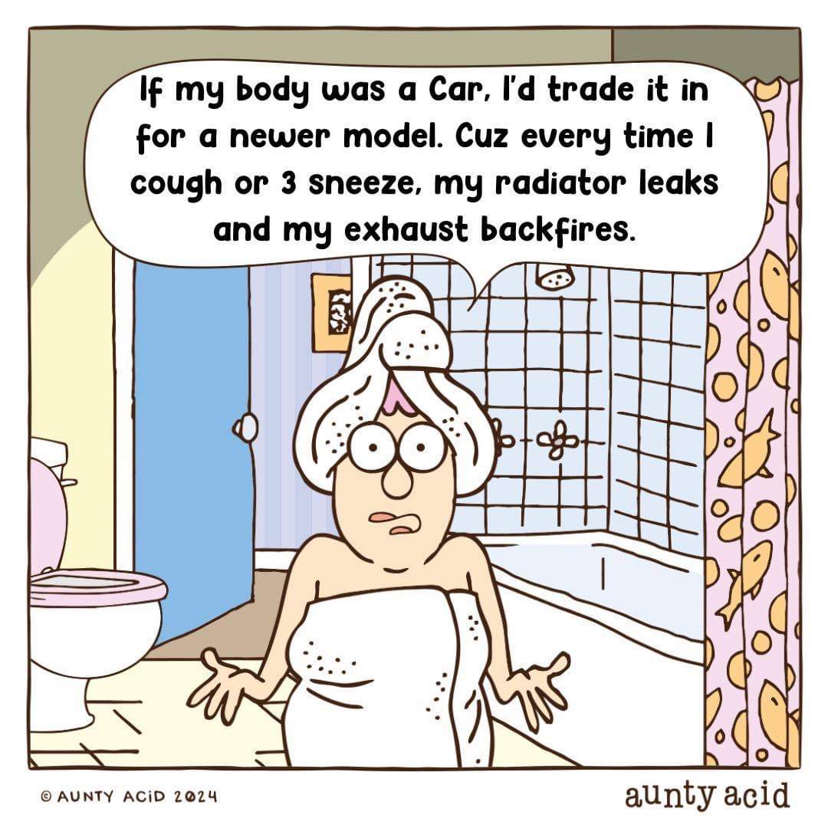
Is this normal?

Slide 9
Type | Definition | Causes | Symptoms
Urge Incontinence | Need to go to toilet suddenly, bladder contracts when it shouldn’t | Strokes, Dementia, AD, MS, Parkinson's, injuries, pelvic floor atrophy, prostate enlargement, constipation | Urgency Involuntary contractions of the bladder
Stress Incontinence | Increase in abdominal pressure overcomes the closing pressure of the bladder | Pregnancy and childbirth lack of estrogen post menopause cause muscular atrophy enlarged prostate, prostate cancer treatments or prostate surgery | Incontinent when sneeze, laugh, climb stairs, or lift objects
Overflow Incontinence | Bladder never completely empties due to weak bladder contractions, or inability to contract | Obstruction, enlarged prostate, prostate surgery, constipation, faecal impaction, and nerve damage from strokes or diabetes | Sufferers frequently feel the need to go and often leak small amounts of urine
Functional Incontinence | Caused by other disabilities | Arthritis, hip, knee, reduced function, neurological disorders, stroke complications, AD, MS | Still feel the need to void but just cant get there in time
Mixed Incontinence | Combination of stress and urge incontinence | Severe dementia, Parkinson's disease, neurological disorders, strokes
Types of Urinary Incontinence

Slide 10

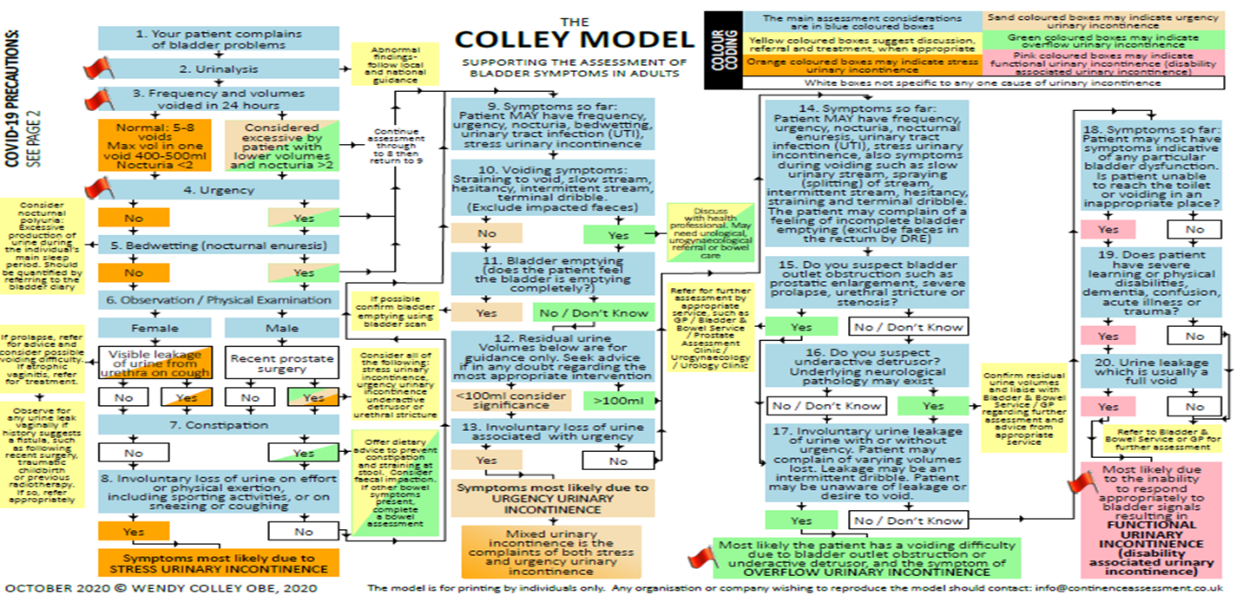
Continence Assessment – The Colley Model
https://www.continenceassessment.co.uk/colley_model/

Slide 11
Low fluid intake
Inflamed bladder wall
Disease
infection
Pregnancy and childbirth
Onset of menopause can lead to incontinence.
Prostate
Even drinking coffee or tea or taking prescribed medications can aggravate your bladder
As one ages, changes in the body can make elderly urinary incontinence a more likely occurrence.
neurological
Cauda Equina
Causes of Incontinence

Slide 12
Diagnosis
A urinalysis to rule out infection or blood in the urine N.B. urinalysis stick should be stored correctly, in date and are read at the correct intervals.
Blood tests to check on kidney function, calcium and glucose levels.
A thorough discussion of one's medical history.
Undertake a visual check (if appropriate and consent is given) for obvious prolapse, anal fissures, haemorrhoids and abnormalities.
A complete physical exam, bladder scan, Vaginal assessment, including a rectal exam and a pelvic exam for women, and a urological exam for men may be required

Slide 13
Bladder training
  Scheduled bathroom trips, emptying techniques, positioning.
  Pelvic floor muscles exercises, retraining techniques
  Fluid and diet management. 1.5- 2L of non-irritant fluid.
  The nice thing about behavioural therapies is that there are no side effects, and the response is proportional to the work of the patient.
Medications:
Anticholinergic or Antispasmodic Drugs.
  These are usually prescribed for urge incontinence.
Hormone Replacement.
  Estrogen therapy-with a vaginal cream, ring, or patch-is used to counteract the atrophy of the skin lining of the urethra and vagina in post-menopausal women.
Antibiotics.
  These are prescribed when incontinence is caused by a urinary tract infection or an inflamed prostate gland.
D-mannose, Hipprex, cranberry products
Treatment & Practical Management

Slide 14
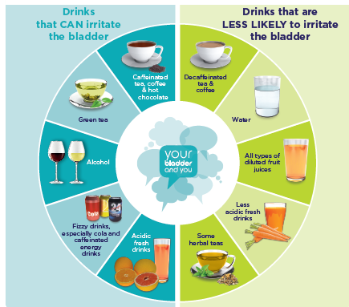
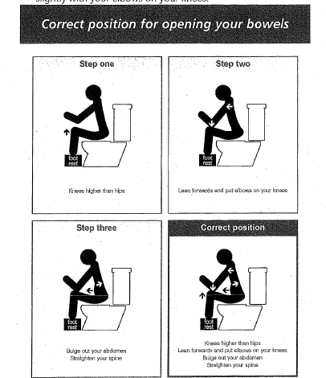
Avoid Irritant drinks
Avoiding constipation
Positioning on toilet
Treatment & Practical Management

Slide 15
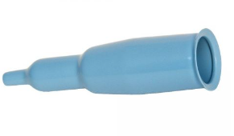
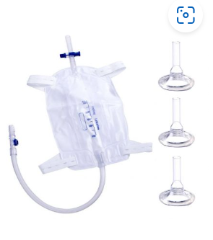
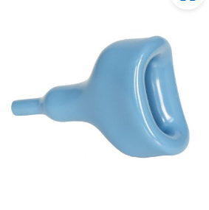
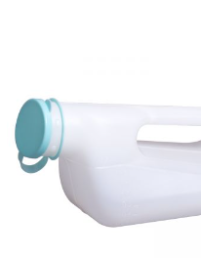
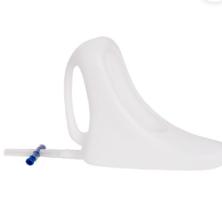
Provision of continence products
Beambrigdemedical.com

Slide 16



Washables

Slide 17
Pads
Absorbency, worked out by fluid intake using 3 day bladder diary
If pads are too absorbent can draw moisture from the skin.
No double padding.

Slide 18
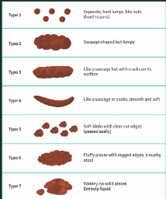
Community continence assessment
3dd – looking at input and output
7dd – looking at bowel regularity and stool type
Reducing Irritant fluids.

Slide 19
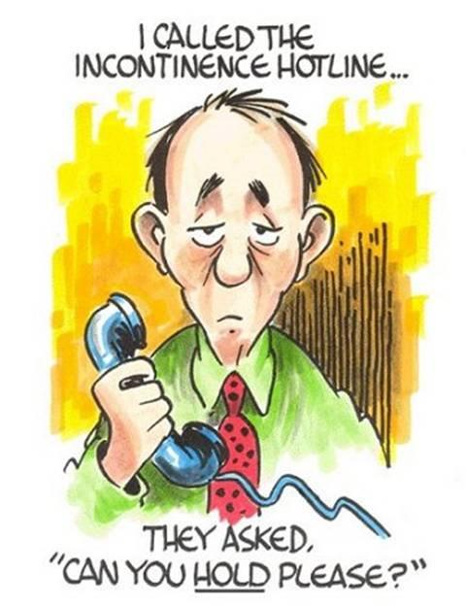
Urinalysis.
Bladder scanning.
Pelvic floor muscle assessment and exercises.
Bladder retraining.
Toileting programmes.
Self-help measures.
Intermittent self-catheterisation tuition and support.
Advice regarding constipation and faecal incontinence.
Product support.
Assessment for rectal irrigation.
Bladder & Bowel Service Provision

