Slide 1


Oxford Health NHS Foundation Trust
Neurogenic Bladder and Bowel Pathways
Sponsored by

Slide 2
Purpose
The following content has been created to assist HCPs with the assessment and treatment of patients with neurogenic bladder and bowel dysfunction.
Developed in conjunction with Coloplast, the pathways have been created to help HCPs navigate the assessment, treatment and referral process for neurogenic patients across Oxford. The pathways ensure consistency and equality of care for all patients.
Supporting information has been included to aid knowledge building and provide clinical rationale behind the pathways.

Slide 3
Content
Slide Numbers | Subject
4 | B&B assessment protocol inc. NICE Guidance on urinary incontinence in neurological disease: assessment and management.
5 | B&B Health questionnaires (The starting point for most of the pathways)
6 - 8 | Neuro Bladder management pathways.
9 | Questionnaire to support a decision for TWOC.
10 | TWOC Management Pathway.
11 - 14 | Bladder management information inc. UTI risk factors and device related Infection prevention.
15 | Medical management of constipation in patients with MS.
16 | Neuro Bowel management pathway inc. NICE Guidance MTG36 (Peristeen)
17 | TAI suitability assessment form / Request for support.
.
Sponsored by

Slide 4
Bladder and Bowel Assessment Protocol
Acute
All patients with neuro BaB symptoms to have BaB assessment as part of neuro review or admission.
(At least annually.)
Refer to BaB Service once discharged.
Neuro Services
All pts with neuro BaB symptoms to complete a Bladder and Bowel Assessment annually.
BaBS
All pts with neuro BaB symptoms referred into the service to have a BaB review as part of their initial assessment.
Refer back to Specialist Service if needed.
Overview | Urinary incontinence in neurological disease: assessment and management | Guidance | NICE
Sponsored by

Slide 5
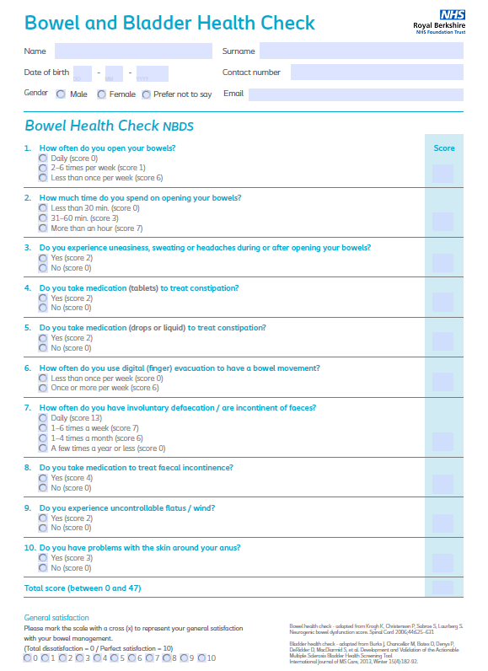
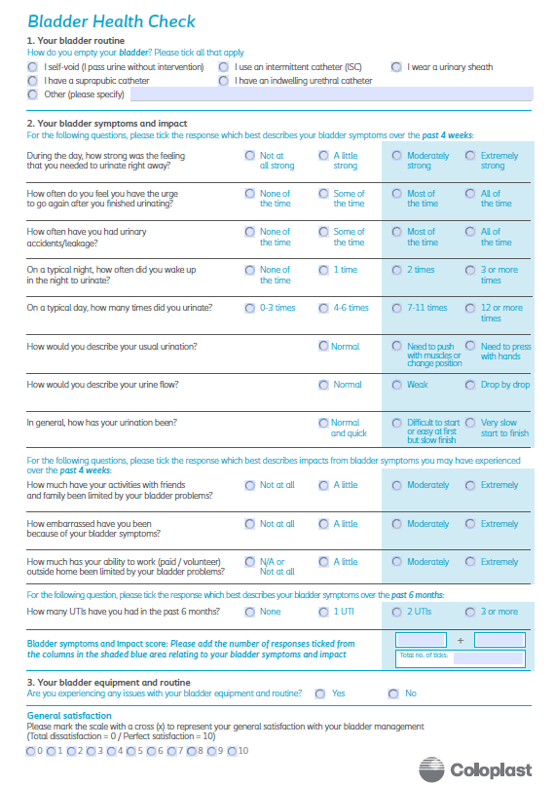
Please contact your
local BaB service for a
copy of this
Assessment form.
Sponsored by

Slide 6
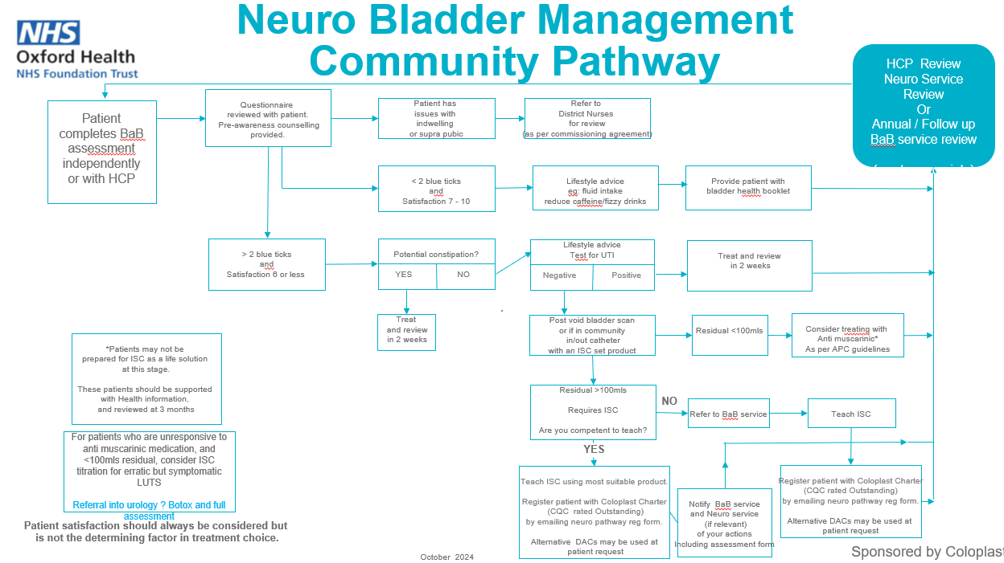

Slide 7
ISC Management in Neuro
With identified LUTS
< 2 blue ticks
And
Satisfaction >6
Telehealth
Review
3-6 months
Assess using
BBAS
Residual>100mls
Teach ISC
( Or increase frequency)
Register new patients with
Coloplast Charter
(CQC Outstanding)
Concurrent
Patient has
>2 blue ticks
And/Or
Satisfaction <6
Test for UTI
Exclude and manage
Constipation*
Bladder Scan
(1-3)
Residual <100mls
Treat with Anti muscarinic*
As per APC guidelines
Treat UTI
Sponsored by

Slide 8
Transition from ISC to Indwelling..
Objective: Preserve ISC where possible
Is person Struggling with ISC?
Can support/
encouragement help overcome challenge
Can a change of catheter ( Eg SET product) overcome issues?
Can aids and adaptations help over come challenges
Can family/care help overcome challenges
No. Is unable to/unwilling to continue with ISC
Yes
No
Yes
Assess for appropriate long term management
Urethral
Suprapubic
Yes
Yes
Yes
Continue with routine
Introduce changes and review in 2/52
Change product and review in 2/52
Introduce changes and review in 2/52
Introduce changes and review in 2/52
Sponsored by

Slide 9
Questionnaire to support a decision for TWOC.
Patient Name: | NHS Number:
Address: Postcode: Telephone: | D.O.B
 | Consultant (if relevant):
 | G.P: (name) (practice)
Referred for TWOC on (date): First TWOC Yes/No | TWOC nurse: (name) (base) (contact no) (email address)
All patients with indwelling catheters should be considered for Trial Without Catheter.
This questionnaire is an aid to the decision-making process.
If a patient scores “YES” for any of the above, you must either review again after the timeline or discuss within the MDT.
Alternatively, discuss with your local BaB service.
RED FLAG | YES | NO | SIGN | DATE
Radical prostatectomy within the last 3 months | ☐ | ☐
Transurethral resection of prostate (TURP) within the last eight weeks | ☐ | ☐
Bladder neck incision within the last eight weeks | ☐ | ☐
Optical urethrotomy within the last eight weeks | ☐ | ☐
Open or endoscopic prostatectomy within the last eight weeks | ☐ | ☐
Transurethral resection of bladder tumour (TURBT) within the last 4 weeks. Urethral stricture | ☐ | ☐
Undiagnosed haematuria | ☐ | ☐
Clot retention | ☐
Systemically unwell | ☐ | ☐
Known pathology of the lower urinary tract, such as cancer | ☐ | ☐
Patients who withhold consent | ☐ | ☐
Patients, families or carers who are unable to alert the community nurse of any difficulties when undergoing a TWOC (community only) | ☐ | ☐
Patients who are constipated - with no bowel movement for 3 days or more (This must be addressed) | ☐ | ☐
Confirmed urinary tract infection or recurrent urinary tract infections clinical review to assess the clinical need for the catheter | ☐ | ☐
Please contact your local BaB service for a
copy of this Assessment form.
Initial Contact | State Variance | Sign | Date
Ensure reversible causes of urinary retention have been treated, eg: constipation/medication – if not, defer TWOC
MEN ONLY commenced an alpha blocker (if appropriate) at least 48 hours before TWOC - if not defer TWOC
Ensure patient has AUR/TWOC information leaflet (if in community, add community nurses and bladder diary)
Ensure catheter supplies and measuring jug to record urine output, are available.

Slide 10
TWOC Management Pathway
Any “YES” answers
Discuss with BABS or medical tea
For further advice
Complete TWOC
contraindications
questionnaire
All “No” answers
Proceed with TWOC
Remove indwelling catheter
Encourage fluids,
record fluid intake,
Check that patient has passed
urine within 6 hours
Patient passes
urine successfully
Give patient TWOC leaflet
For patients who are unresponsive to anti muscarinic medication,
and <100mls residual, consider ISC titration for erratic but symptomatic LUTS
Referral into urology ? Botox and full assessment
Patient unable to pass urine
successfully
Bladder Scan
Residual <100mls
Treat with Anti muscarinic*
As per APC guidelines
Residual >100mls
Re-catheter with flip/flow to mimic
bladder function.
Refer to BABS
to teach ISC*
Give patient
catheter passport
BABS Annual review if using ISC
*Patients may not be
prepared for ISC as a life solution
at this stage
These patients should be supported
with Health information,
and reviewed at 3/12
Sponsored by

Slide 11
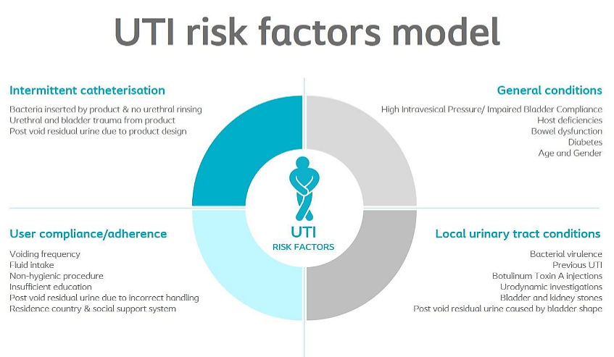
.
.
.
Sponsored by
..

Slide 12
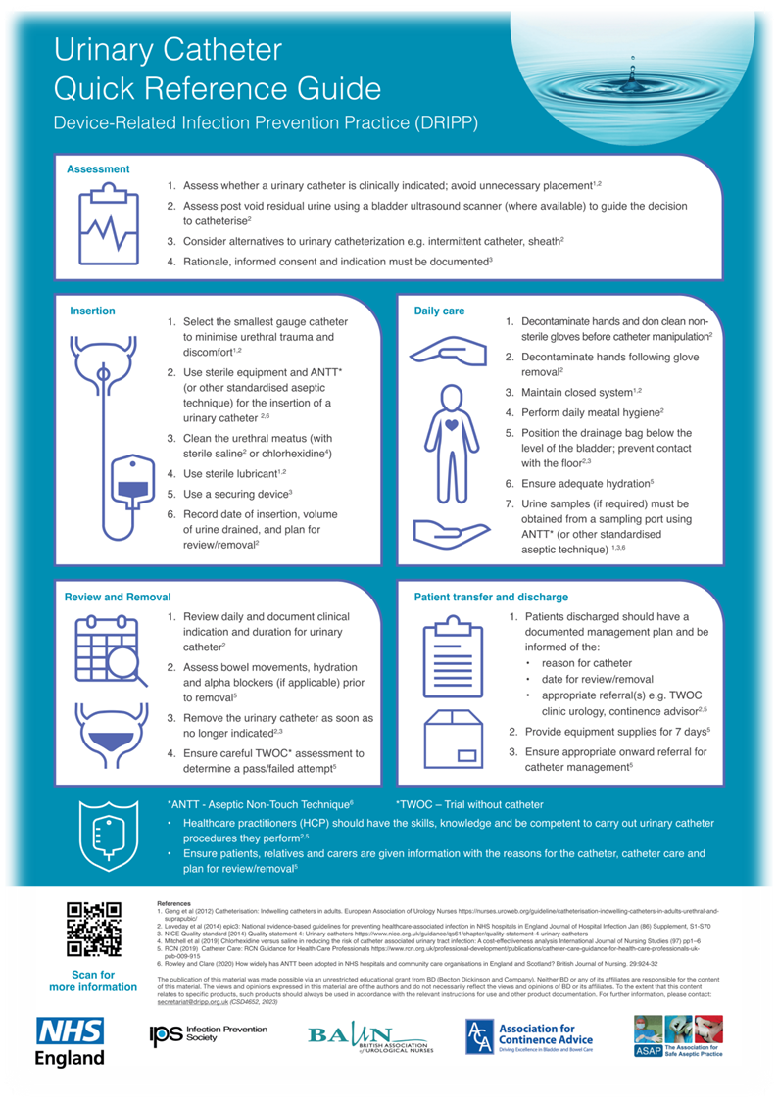
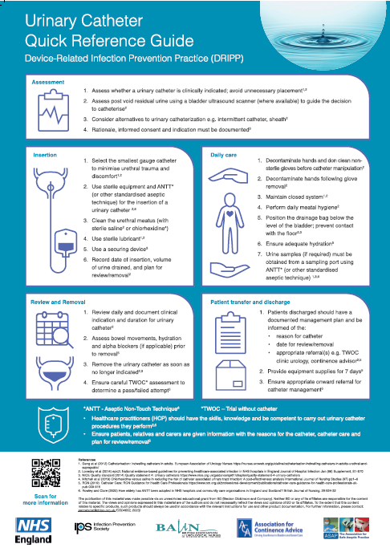
Catheter Quick Reference Guide
Recognized by NHS England and The Infection Prevention Society

Slide 13
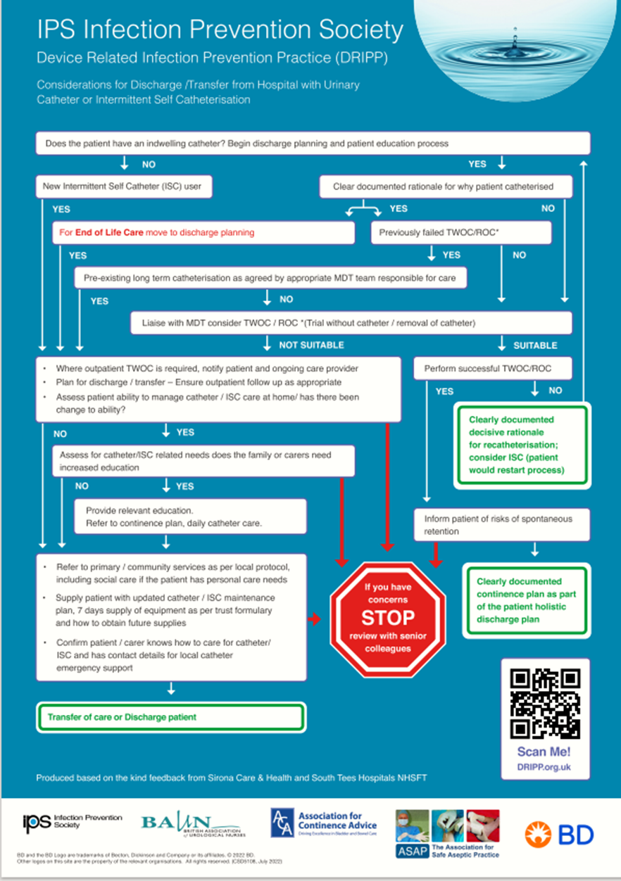
Hospital Discharge / Transfer Considerations
Recognized by NHS England and The Infection Prevention Society

Slide 14
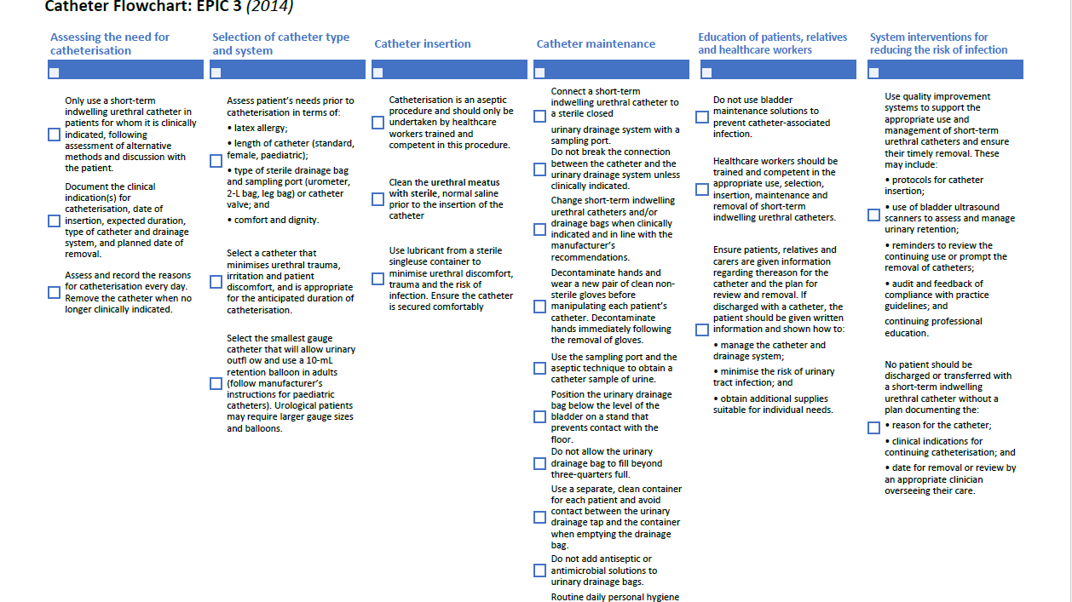

Slide 15
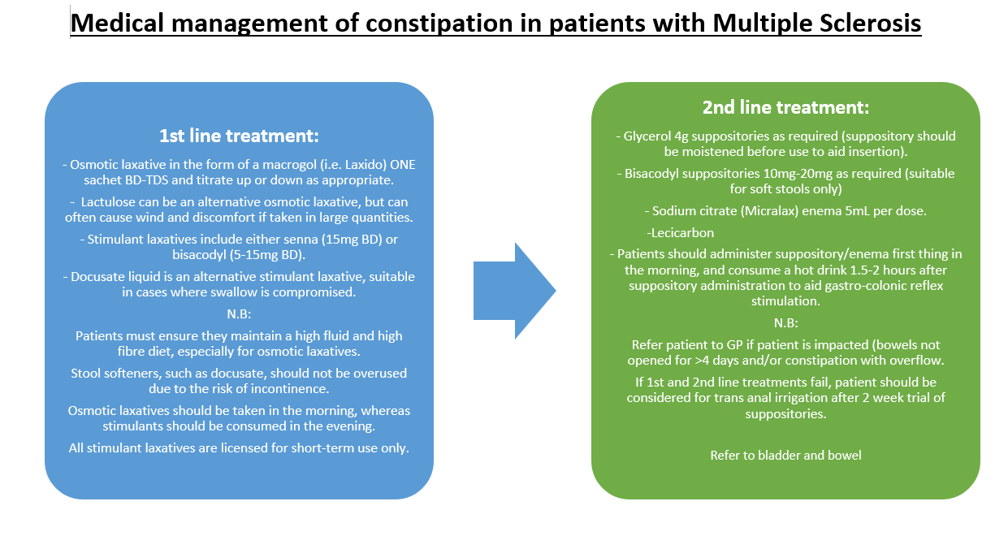
Sponsored by
Page 15
Sepember 2023

Slide 16


Slide 17
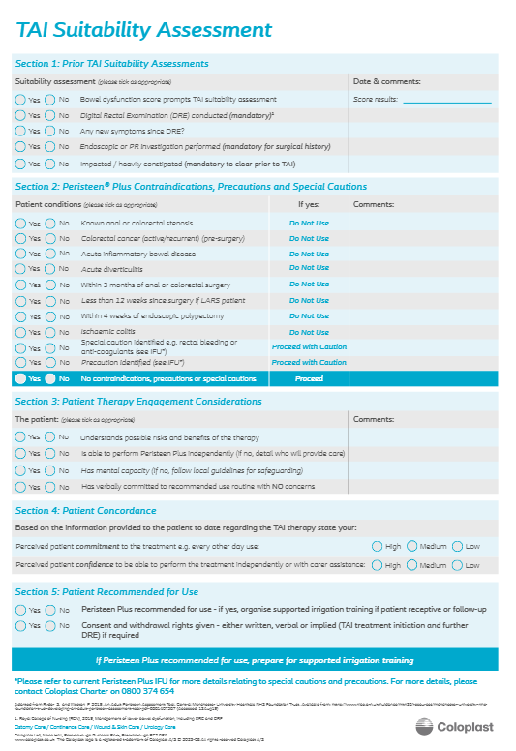
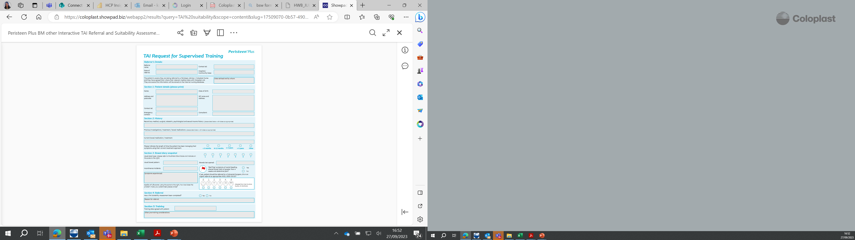
.
Link to electronic forms:
TAI suitability Form
.
Sponsored by
February 2024

