Slide 1

Neurological Pathway 2024
Bladder and Bowel Clinical Lead: Carrie Lincoln
Carrie.lincoln@oxfordhealth.nhs.uk
Notes:
I noticed a gap in service within the transition from the acute sector into the community. Neurological Bladder and Bowel Pathway This pathway has been created for neurological patients to have a clear assessment and treatment pathway for their bladder and bowel dysfunction. This is designed to support patients with a clear referral process, discuss their symptoms and help to diagnosed and treatment what is bothersome for them to ensure they can live well with healthy bladder and bowel function, improving wellbeing and quality of life.

Slide 2
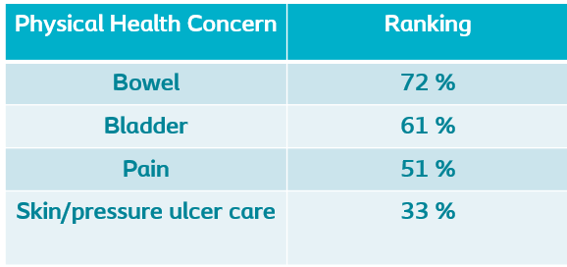
Neurological Bladder and Bowel
Spinal injury Association figures from 536 patients (2022)
Causes
Spinal cord Injury – most
MS – 70-90%
Parkinson’s
Brain injury
Tumour to brain / spinal cord
Inflammatory condition
Stroke/Bleed
Spinal Bifida
CP
Advanced dementia
Carrie.lincoln@oxfordhealth.nhs.uk
Notes:
I noticed a gap in service within the transition from the acute sector into the community. Neurological Bladder and Bowel Pathway This pathway has been created for neurological patients to have a clear assessment and treatment pathway for their bladder and bowel dysfunction. This is designed to support patients with a clear referral process, discuss their symptoms and help to diagnosed and treatment what is bothersome for them to ensure they can live well with healthy bladder and bowel function, improving wellbeing and quality of life.

Slide 3
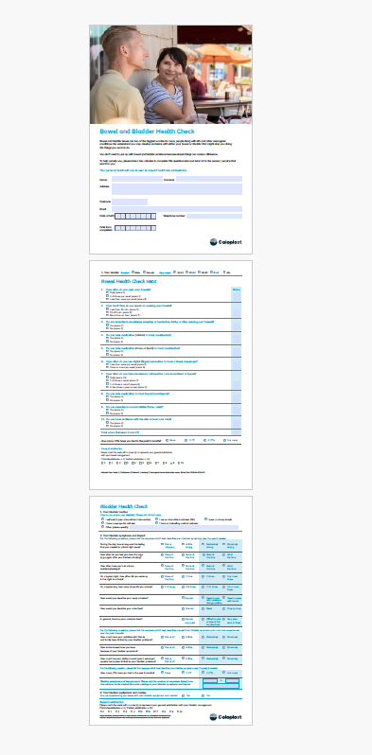
Neuro Questionnaire
This determines how they feel about their bladder and bowel function. We can identify in the blue boxes the issues (and are scored on function) and the patient’s a satisfaction score.
Carrie.lincoln@oxfordhealth.nhs.uk
Notes:
So, firstly we would ask the patient or HCP to complete this form with the patient or patient can do individually

Slide 4
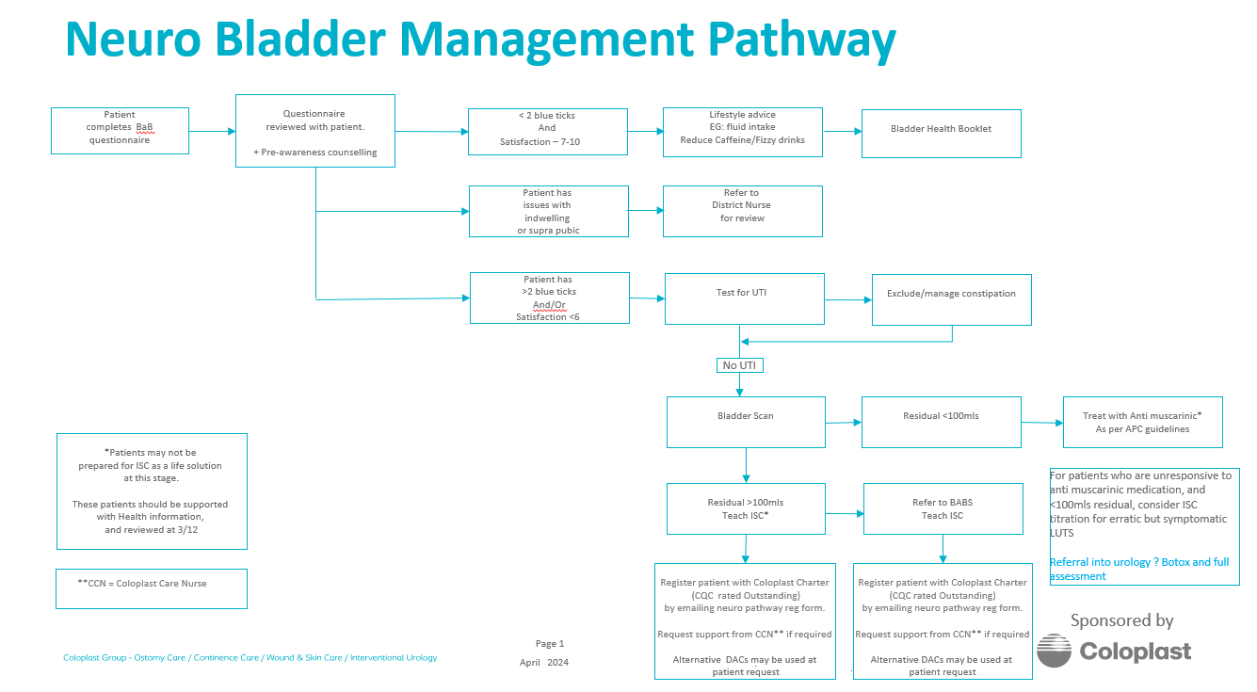
Carrie.lincoln@oxfordhealth.nhs.uk

Slide 5
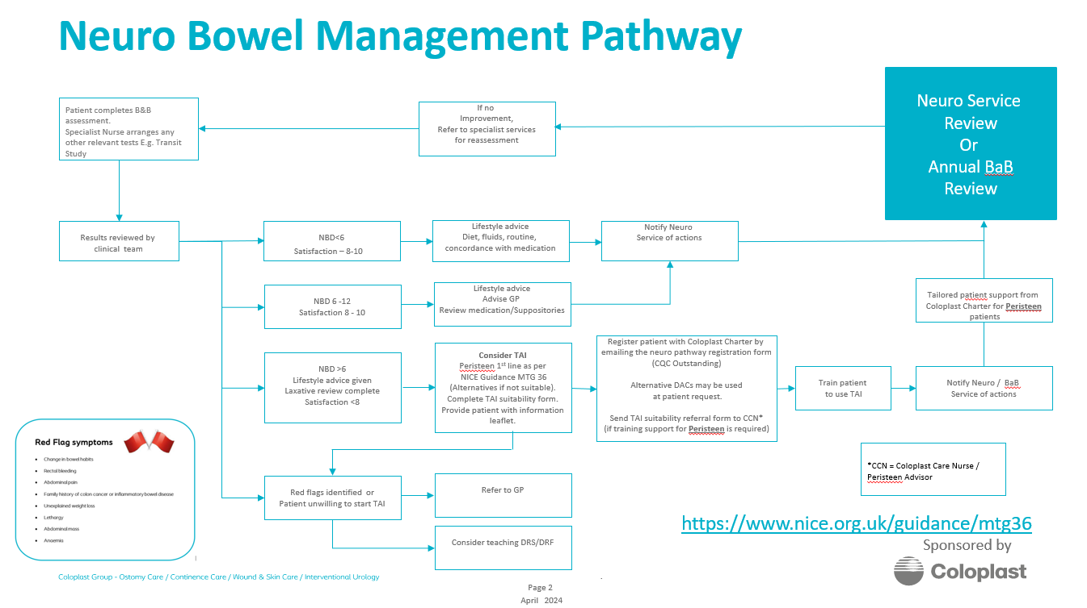
Carrie.lincoln@oxfordhealth.nhs.uk

Slide 6
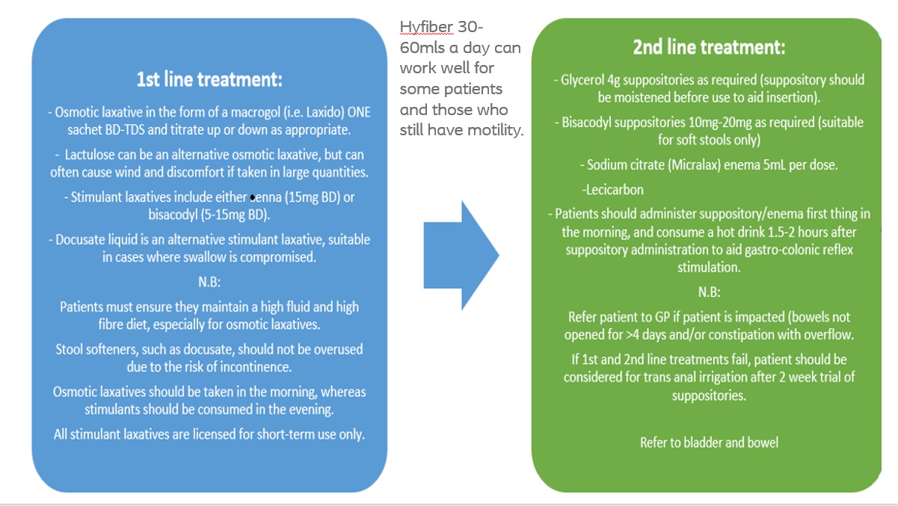

Slide 7
“Following my FND episode in late February 2024, I was discharged under the D2A pathway. Whilst in hospital, I highlighted an issue with my bladder and in-ability to pass urine. Despite numerous conversations with medical teams at JR hospital, nothing was done about this issue. Following the D2A pathway I was given access to a team of community specialists, including an Occupational Therapist and Physio. Lucky for me, the Occupational Therapist listened to the challenges I was experienced with my bladder.”
Here are some key other highlights to my experience with Occupational Therapist (OT) and Bladder & Bowel Service…
Community OT identified my bladder/bowel and prostate issue(s), linking them to my existing FND (Functional Neurological Disorder) – warning of a 6-month delay to be seen F2F
Oxfordshire Adult Bladder and Bowel Service contacted me (based on Community OT referral) and requested for me to track the consumption/excretion of my daily fluids
Following submission of completed ‘Bladder and Bowl Chart Record’ (with 3-days of data recorded), the Oxfordshire Adult Bladder and Bowel Service contacted me within a few days, expressing concerns with my bladder’s ability to retain urine
F2F appointment was scheduled for me to be seen by Oxfordshire Adult Bladder and Bowel Service (within 2 weeks of initial contact), fantastic service from ALL the team in this clinic, totally amazing group of people
A catheter was fitted inside me (early June 2024) in conjunction with Oxfordshire Adult Bladder and Bowel Service and Community District Nursing Team – this is working perfectly (now) after some initial hiccups on fitting
I wanted to incl. is “Truly how remarkable your team is under your leadership”, we (Anne & I) owe you so much for seeing me/us (so soon), the fantastic care shown by you/your team and consideration of my other health challenges that all stem from me being diagnosed with ‘Long Covid’ (in 2020) and FND (in 2022).

Slide 8
If anyone would like to collaborate or trial this pathway in their clinical areas, please do contact me ☺
Carrie.lincoln@oxfordhealth.nhs.uk

Slide 9
Questions?
Carrie.lincoln@oxfordhealth.nhs.uk

