Slide 1

Urinary sheaths
Ade Oyeniyi
Bladder and Bowel Services

Slide 2
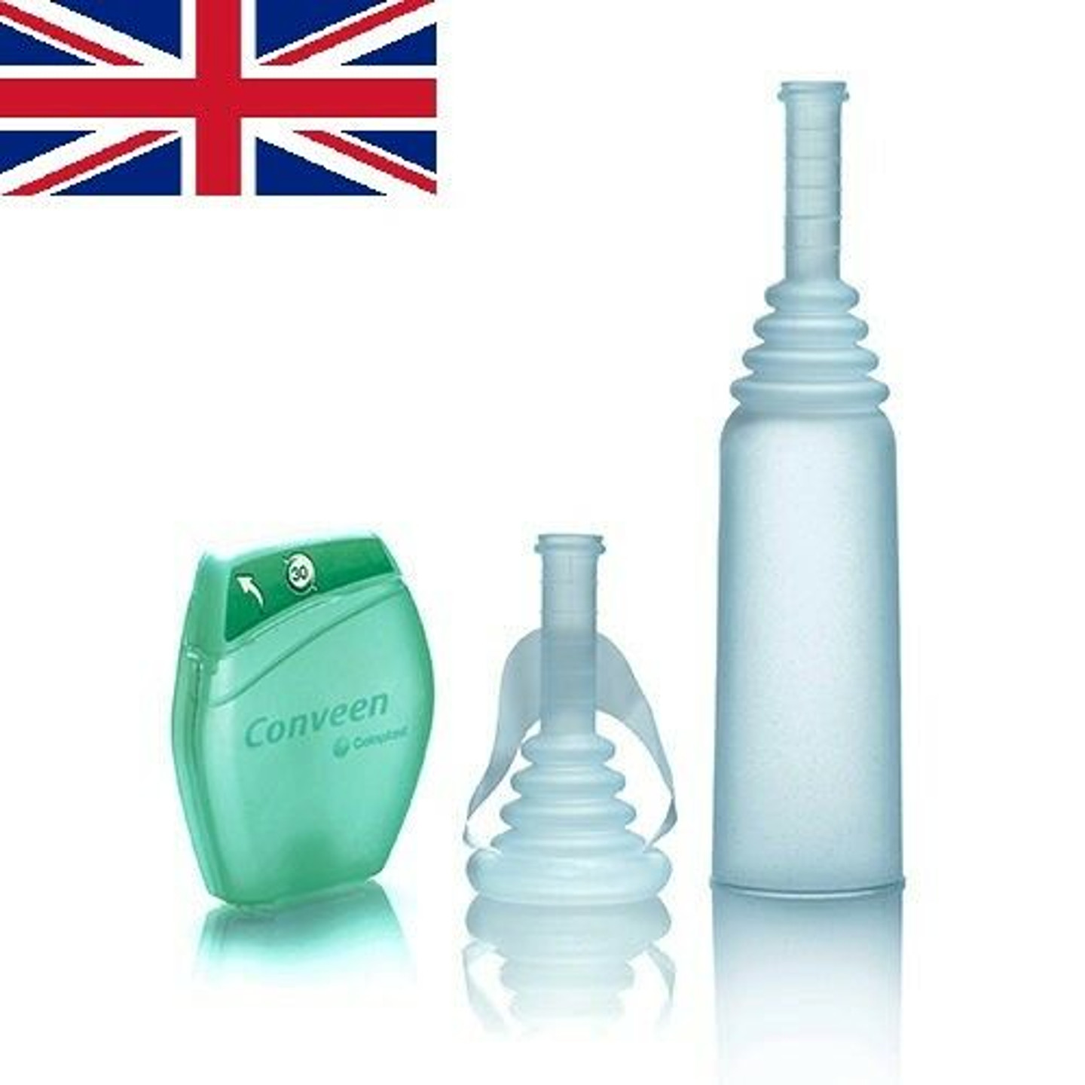

What is urinary sheath?
It is a discreet, reliable alternative to absorbent containment pads. Worn by male patients suffering from urinary incontinence over the penis.

Slide 3
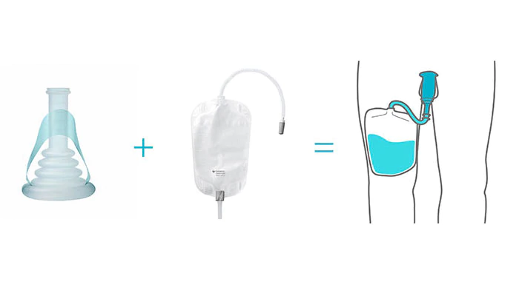
Urinary sheath consists of two products, a sheath worn over the penis connected to a bag worn on the leg.
Content

Slide 4
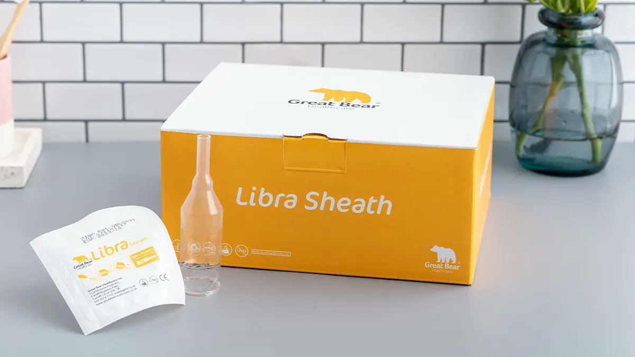
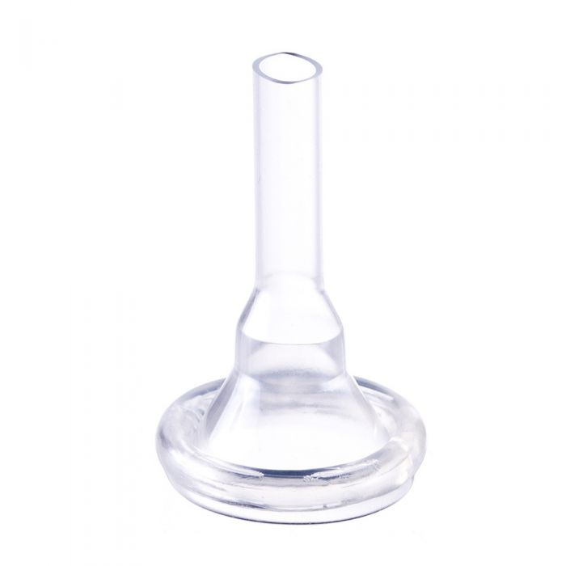
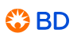
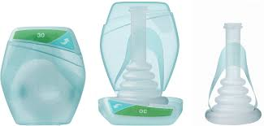
Types of urinary sheath
Libra Sheath
Script-Easy
Conveen

Slide 5
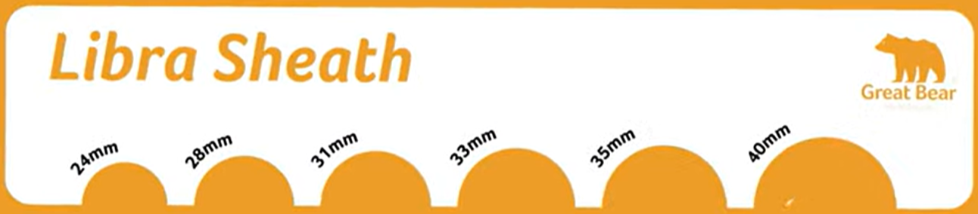

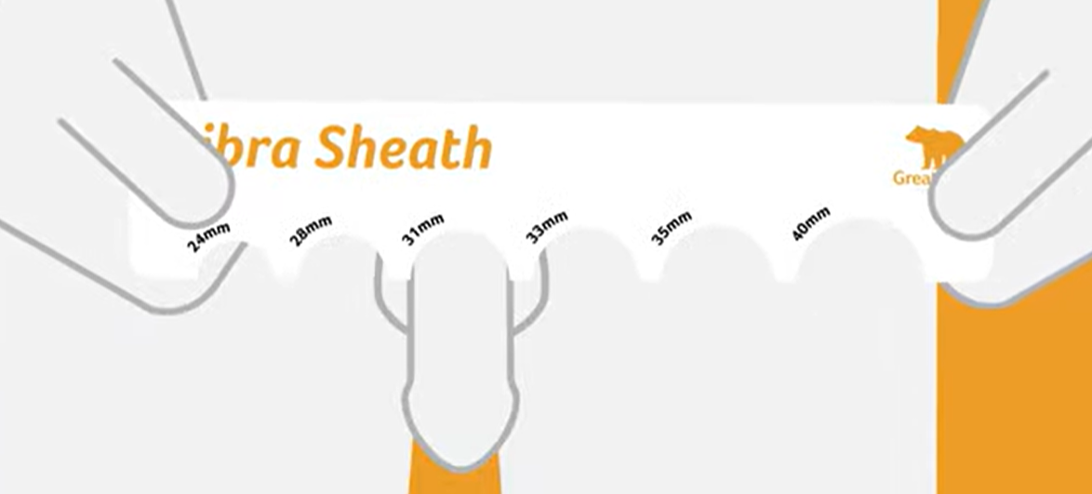
Measuring
The patient should be a comfortable position with their legs slightly parted so that the penis and scrotum are in a natural position.
To measure circumference:
-Measure the penis at the middle of the shaft when it is flaccid(not erect).
-Place the penis in the arcs to determine the best fit.
-If it is between two sizes(both length and circumference), select the smaller size.

Slide 6
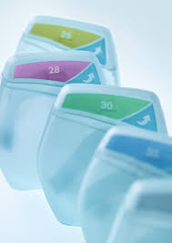
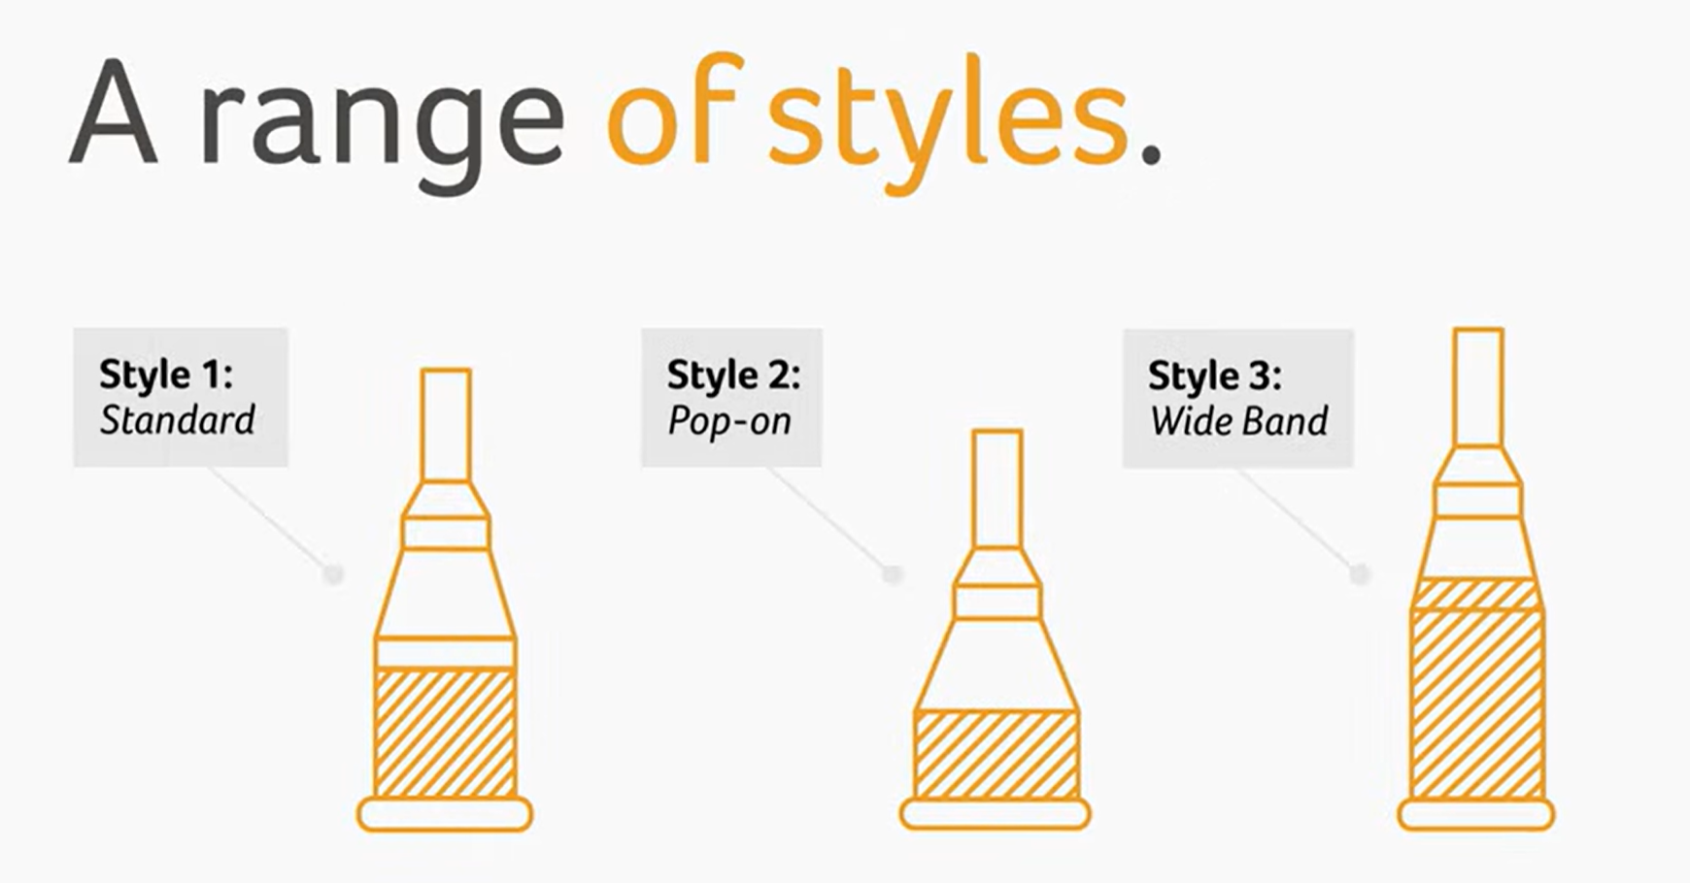
Sizes
Sheath comes in Standard and shorter length.
Sizes are available in 21mm, 25mm, 28mm, 30mm, 35mm and 40mm. Wide fits are available through some providers.

Slide 7
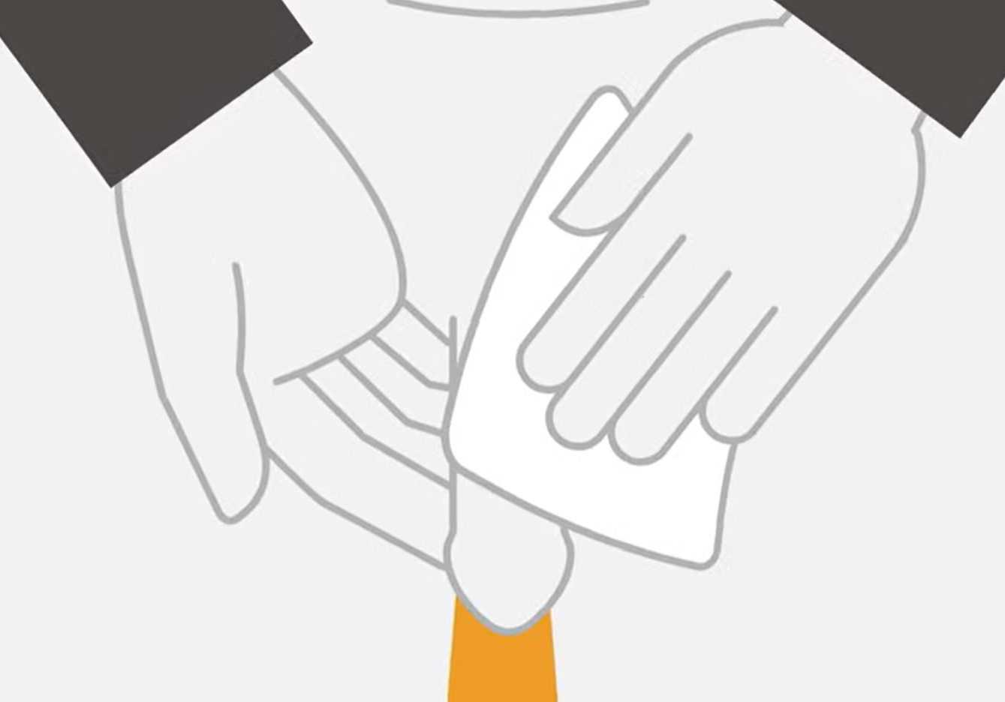
Preparation
Trim the pubic hair if necessary.
Wash the penis with soap and water.
3. Dry the penis thoroughly.

Slide 8
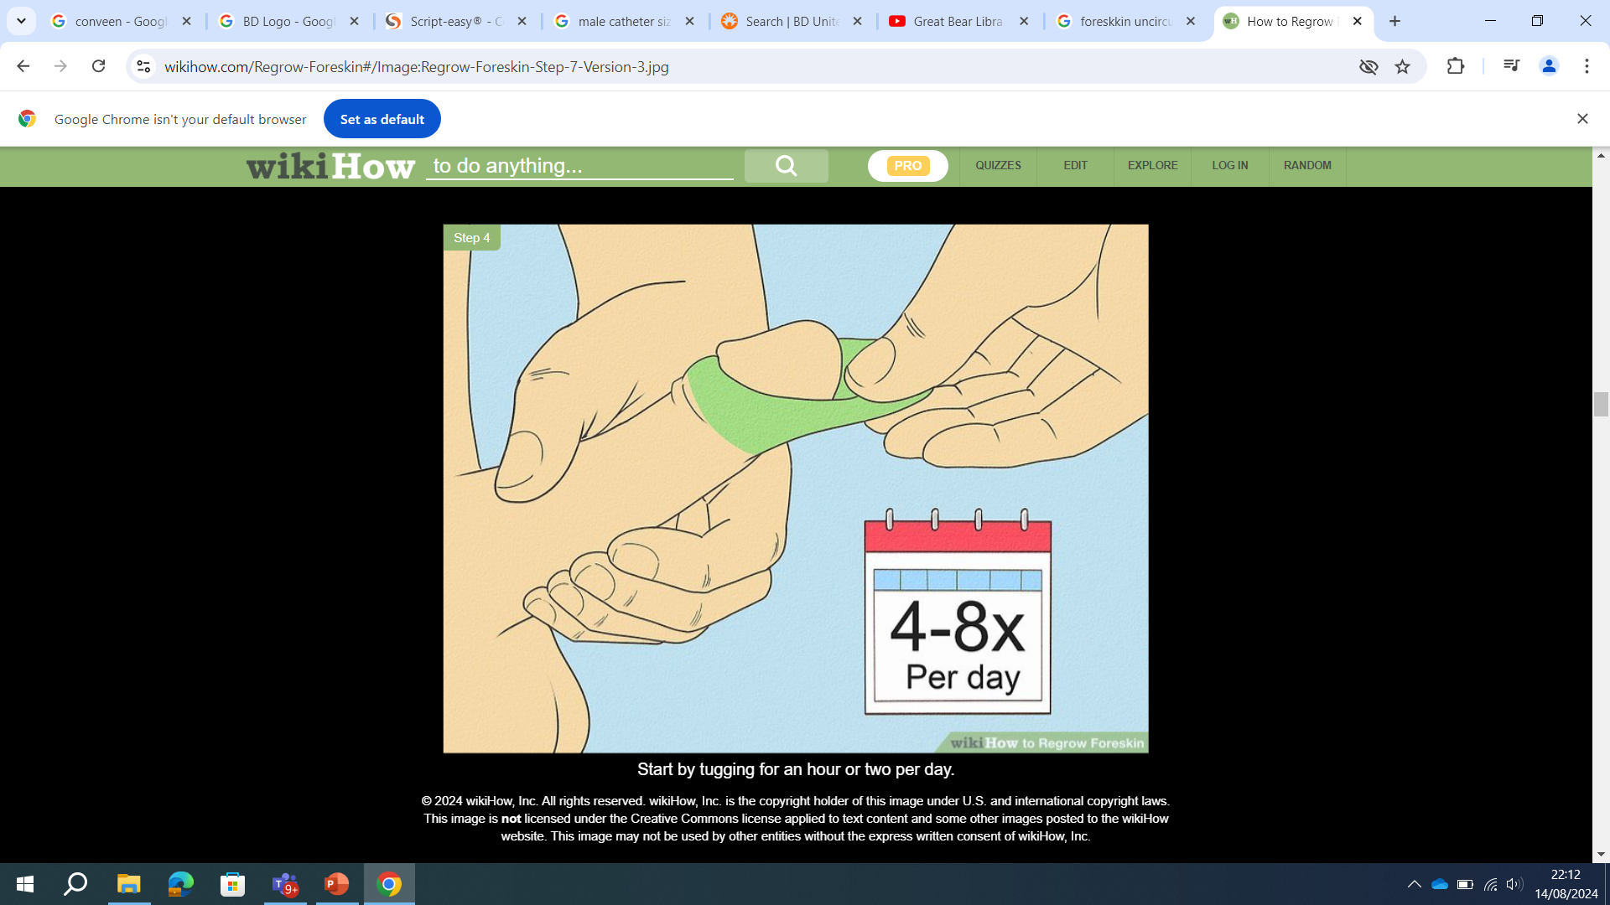
Application
1. When applying the product, leave the foreskin in place over the head of the penis to prevent tangling or pulling of the loose skin.
This applies to uncircumcised men. If circumcised, this instruction does not apply.

Slide 9
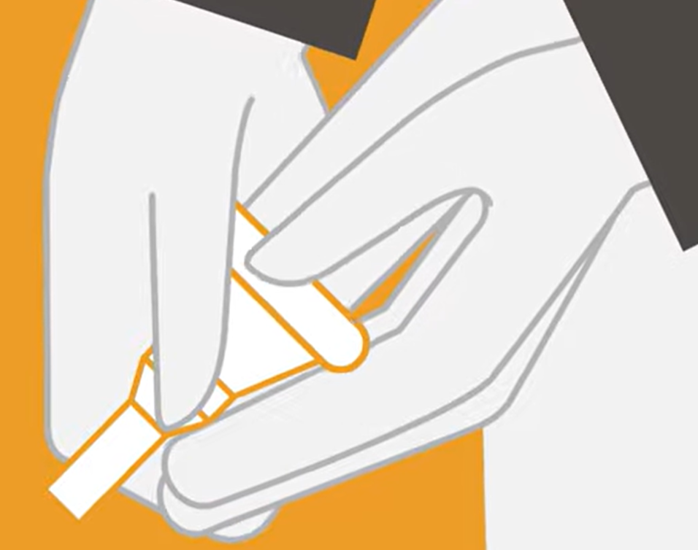
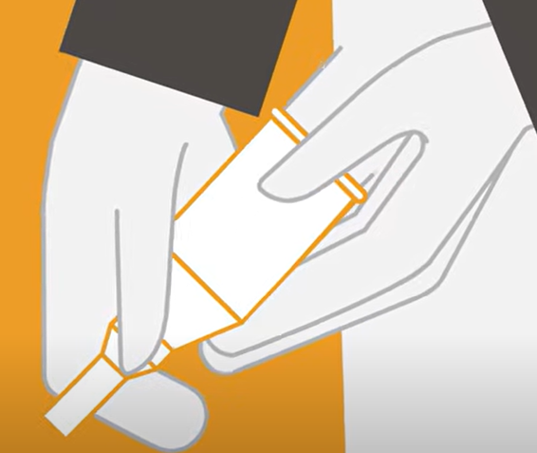
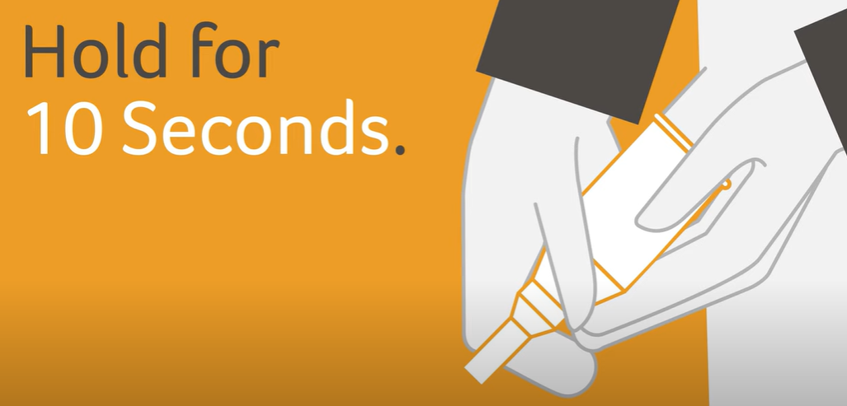
2. Place the rolled sheath over the head of the penis with the narrow end pointing away from the body.
Leave a 1-2cm gap between the tip of the penis and the narrow applet tube to allow the free flow of urine.
Slowly unroll the product to the full length or to the full length of the penis.
3. Hold the sheath in place with one hand and pull the roll out loop.

Slide 10
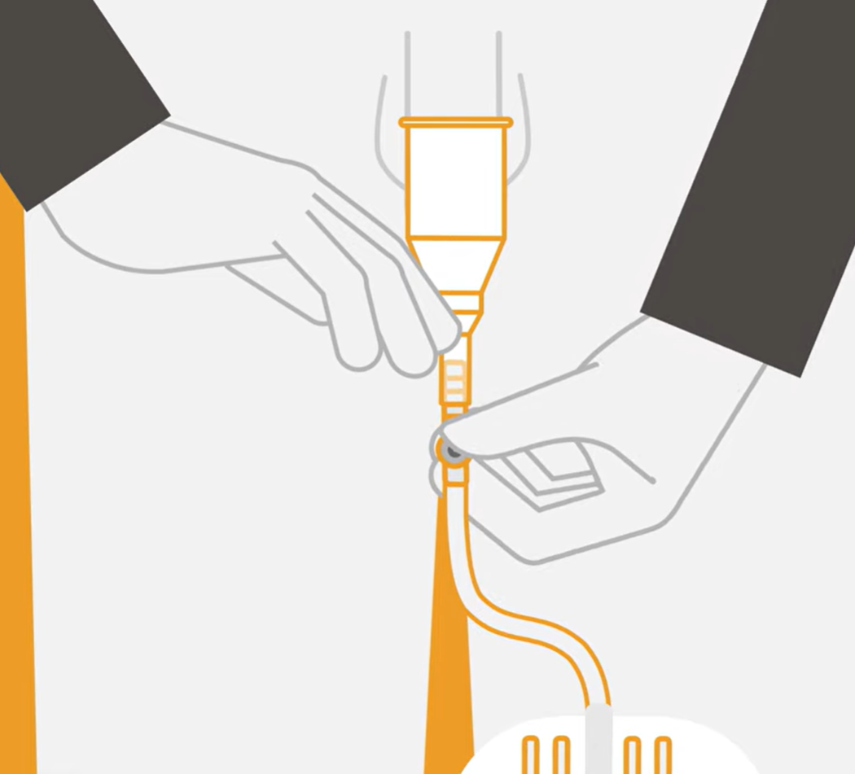
4. Gently squeeze the unrolled sheath around the shaft of the penis to ensure adhesion to the skin and to seal off any wrinkles. No additional adhesive is necessary.
5. Attach the sheath to a urine collection bag.

Slide 11
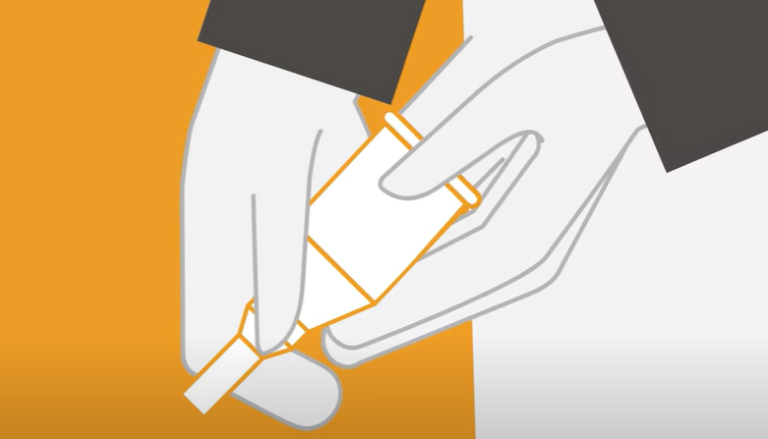
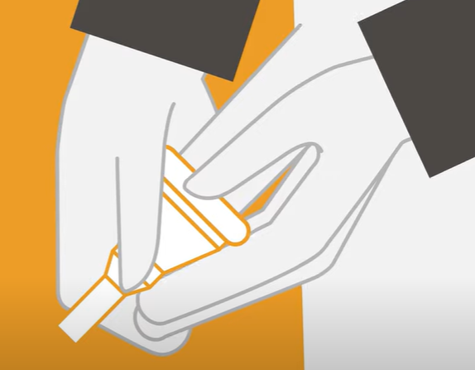
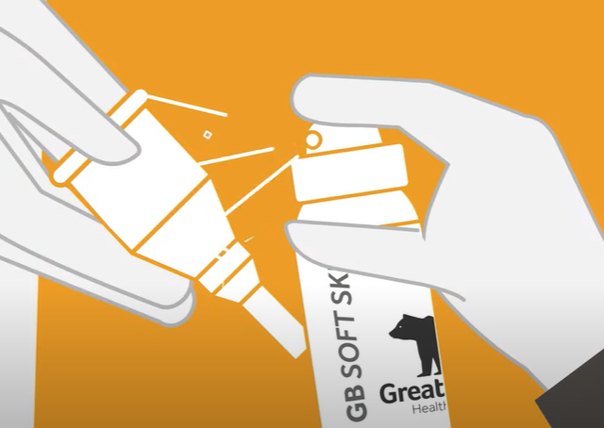

Removal
Disconnect the sheath from the urine collection bag.
Grasp the sheath at the base and roll forwards gently.

Slide 12
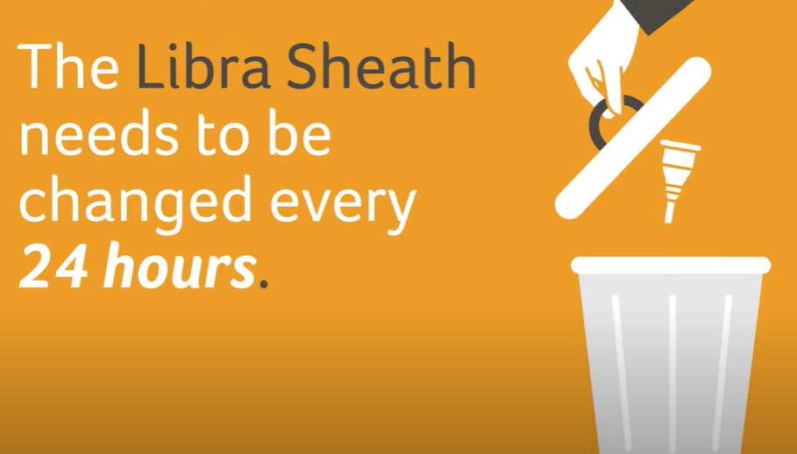
Disposal
The sheath should be worn for no longer than 24hours.
The sheath is intended for single use only and can be disposed of with normal household waste.

Slide 13
Add the services please
Rep details and numbers to contact to trial

